Slide 1

HL7 CQL-Based HQMF Implementation Guide (IG) Discussion
CMS ALLIANCE TO MODERNIZE HEALTHCARE
January 29, 2018
Paul Denning
The MITRE Corporation

Slide 2
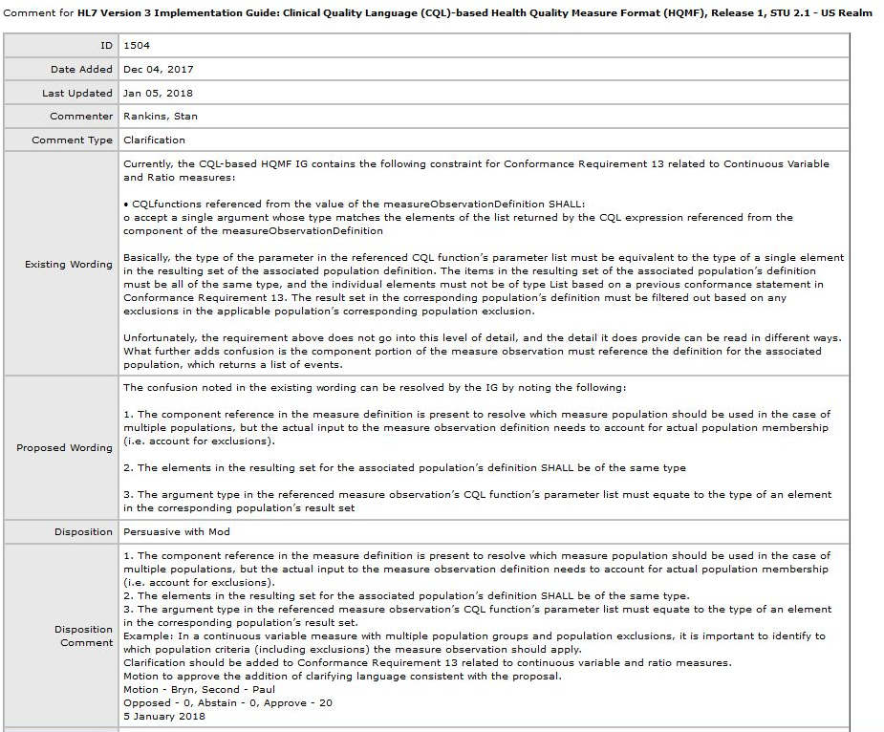
Telligen comment http://www.hl7.org/dstucomments/showdetail_comment.cfm?commentid=1504
2

Slide 3
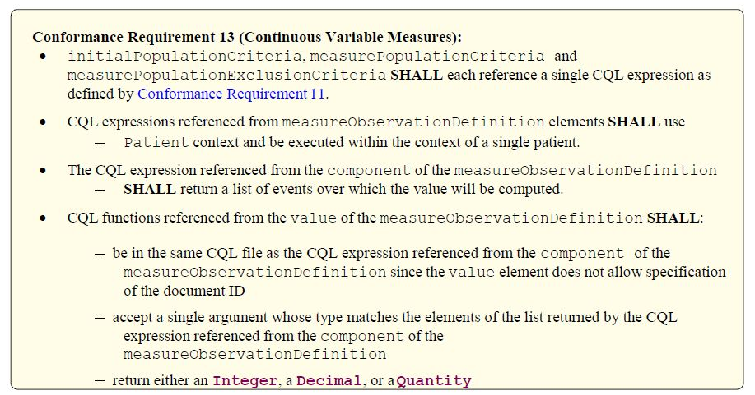
Not accurate: value will be computed over the list of events after exclusions (if any) are removed.
Telligen comment
http://www.hl7.org/dstucomments/showdetail_comment.cfm?commentid=1504
3

Slide 4
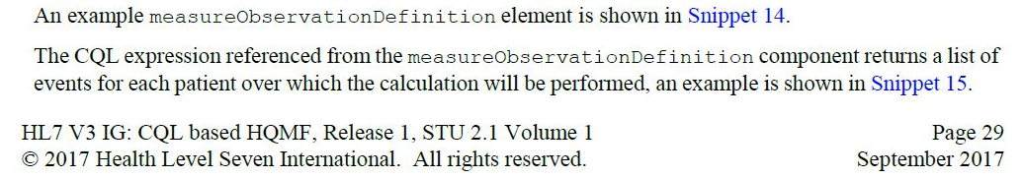
Not accurate: calculation is performed over the list of events after exclusions (if any) are removed.
Disposition of STU comment 1504 should allow change to this section also to clarify calculation
4

Slide 5
Aggregation methodCode explicit in HQMF
<!--Definition for Measure Observation 1--><definition>
<measureObservationDefinition classCode="OBS" moodCode="DEF">
<id extension="SUM Of Measure Observation 1"
root="381B7D83-E720-4E54-A315-0A6ECAC8C484"/>
<code code="AGGREGATE" codeSystem="2.16.840.1.113883.5.4"/>
<value nullFlavor="DER" xsi:type="INT">
<expression value="PD1205.&quot;Measure Observation 1&quot;"/>
</value>
<methodCode>
<item code="SUM" codeSystem="2.16.840.1.113883.5.84"/>
</methodCode>
<component typeCode="COMP">
<criteriaReference classCode="OBS" moodCode="EVN">
<id extension="PD1205.&quot;Measure Population 1&quot;"
root="3775700E-8C1D-4DA6-A289-A7BE17E5111F"/>
</criteriaReference>
</component>
</measureObservationDefinition>
</definition>

Slide 6
Aggregation methodCode not in HQMF
<!--Definition for Measure Observation 1--><definition>
<measureObservationDefinition classCode="OBS" moodCode="DEF">
<id extension="SUM Of Measure Observation 1"
root="381B7D83-E720-4E54-A315-0A6ECAC8C484"/>
<code code="AGGREGATE" codeSystem="2.16.840.1.113883.5.4"/>
<value nullFlavor="DER" xsi:type="INT">
<expression value="PD1205.&quot;Measure Observation 1&quot;"/>
</value>
<methodCode>
<item code="SUM" codeSystem="2.16.840.1.113883.5.84"/>
</methodCode>
<component typeCode="COMP">
<criteriaReference classCode="OBS" moodCode="EVN">
<id extension="PD1205.&quot;Measure Population 1&quot;"
root="3775700E-8C1D-4DA6-A289-A7BE17E5111F"/>
</criteriaReference>
</component>
</measureObservationDefinition>
</definition>
What is default aggregation method if not in HQMF?

Slide 7
Other Clerical Errors

Slide 8
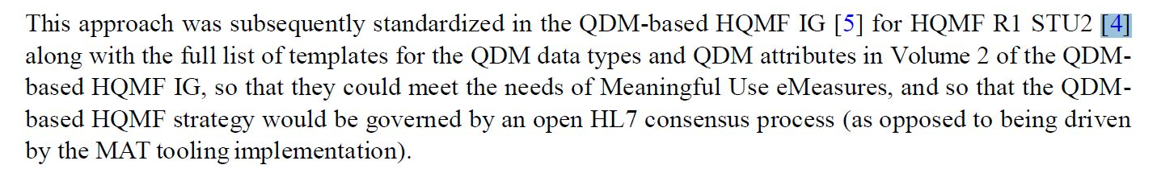
[4] is a reference to the Normative HQMF, not to the earlier R1 STU2
new STU comment to address this clerical error?
8

Slide 9
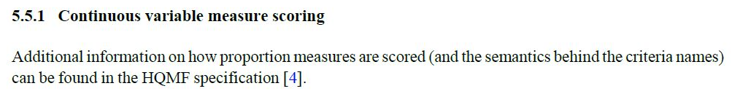
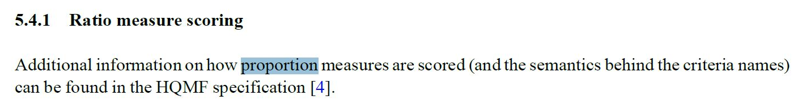
continuous variable
ratio
new STU comment to address this clerical error?
9

