Slide 1
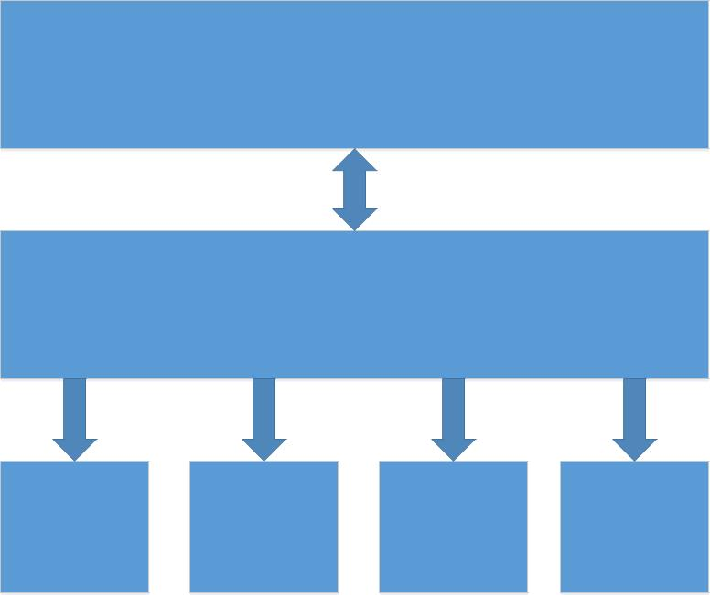
Clinical Quality Language (CQL)
Authors use CQL to produce
libraries containing human-
readable yet precise logic.
ELM XML documents contain
machine-friendly rendering
of the CQL logic. This is the
intended mechanism for
distribution of libraries.
Expression Logical Model (ELM)
Implementation
Java
Script
environments will either
directly execute the ELM, or
perform translation from
ELM to their target
Native
Drools
SQL
environment language.

Slide 2
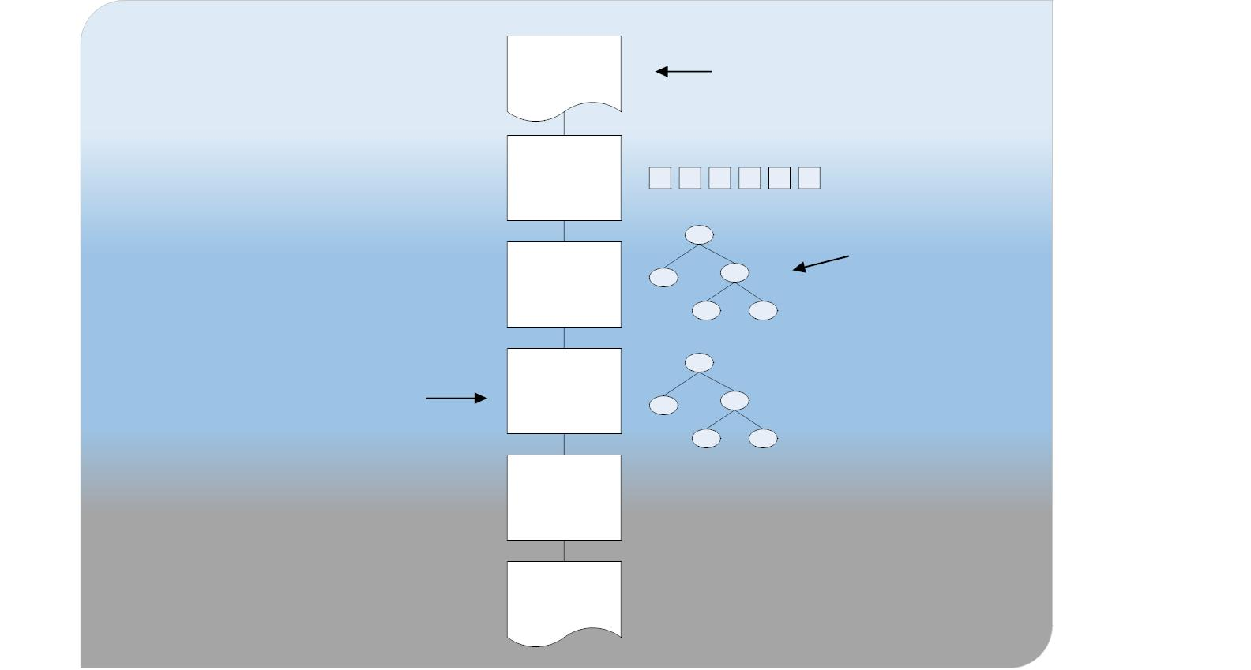
x + y * z;
CQL is defined at
this level
Conceptual Level
Lexical
Analysis
x + y * z ;
+
ELM is
Parsing
x
x
*
defined at this level
y
z
Logical Level
Processing
applications
begin at this
level
+(int, int)
*(int, int)
Semantic
Analysis
+
*
y
z
symbol(z)
Compiling/
Translation
Physical Level
001100...

Slide 3
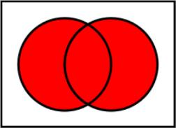
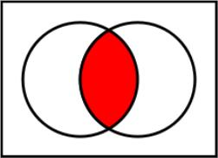
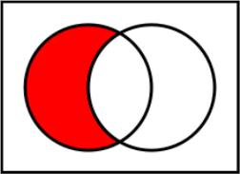
union
intersect
except
union
intersect
except

Slide 4
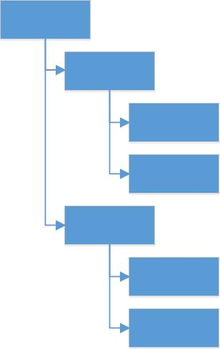
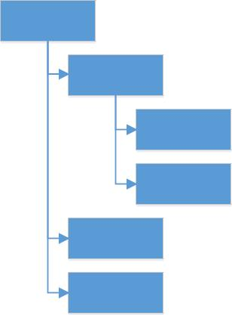
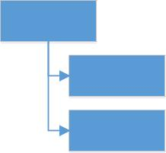
And
If
Equal
Equal
Equal
Add
Literal (2)
Literal (2)
Literal (2)
Literal (2)
Literal (2)
Literal (2)
Literal (1)
Literal (0)
Literal (2)
Literal (2)

Slide 5
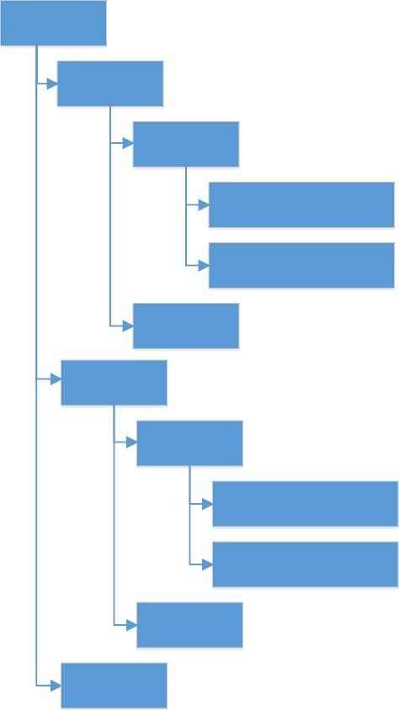
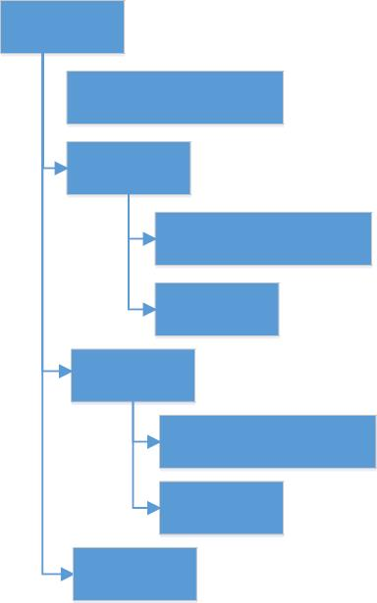
Case
Case
CaseItem
ExpressionRef "A"
CaseItem
Equal
ExpressionRef "A"
Literal 'First'
Literal 'First'
Literal (1)
CaseItem
Literal (1)
CaseItem
Literal 'Second'
Literal (2)
Literal (3)
Equal
ExpressionRef "A"
Literal 'Second'
Literal (2)
Literal (3)

Slide 6
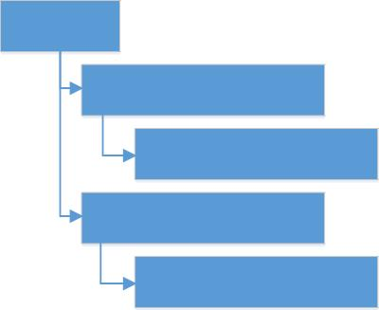
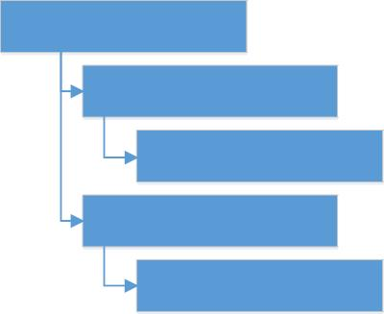
Tuple
Instance "Person"
InstanceElement "Name"
TupleElement "Name"
Literal 'Patrick Henry'
TupleElement "DOB"
Literal '1736-05-29'
Literal 'Patrick Henry'
InstanceElement "DOB"
Literal '1736-05-29'

Slide 7
Operator/Inverse | Diagram | Interpretation
X same as Y Y same as X |  | start of X = start of Y and end of X = end of Y
X before Y Y after X |  | end of X < start of Y
X meets before Y Y meets after X X meets Y |  | successor of end of X = start of Y
X overlaps before Y Y overlaps after X X overlaps Y |  | end of X >= start of Y and start of Y <= end of X
X starts Y |  | start of X = start of Y and end of X <= end of Y
X included in (during) Y Y includes X |  | start of X >= start of Y and end of X <= end of Y
X ends Y |  | start of X >= start of Y and end of X = end of Y
X
Y
X
Y
X
Y
X
Y
X
Y
X
Y
X
Y

