Slide 1
Required
US Core Encounter
US Core Patient
Optional
subject
Choice box
beneficiary
diagnosis.condition*
US Core Condition
Coverage
Endpoint**
focus
location
Da Vinci MessageHeader
event = admit/discharge
US Core Location
endpoint
Sender
US Core Organization
sender
definition
destination.receiver
US Core Practitioner
Recipient
MessageDefinition***
US Core Organization
US Core Practitioner
US Core PractitionerRole
US Core PractitionerRole
Notes:
* This element is not supported by all vendors – rather the condition points the encounter – discuss
** no endpoint element in Practitioner
*** MessageDefinition way to formally define Message

Slide 2
US Core Encounter
focus
Da Vinci MessageHeader
event = admit/discharge

Slide 3
US Core Practitioner
US Core Encounter
participant.individual
location
US Core Location
subject
focus
Choice of
US Core PractitionerRole
US Core Patient
Da Vinci MessageHeader
event = admit/discharge
author
US Core Practitioner
responsible
sender
Choice of
US Core Organization
US Core PractitionerRole
US Core Practitioner

Slide 4
US Core Practitioner
US Core Encounter
US Core Condition
participant.individual
encounter
location
US Core Location
subject
focus
Choice of
US Core PractitionerRole
US Core Patient
Da Vinci MessageHeader
event = admit/discharge
author
US Core Practitioner
beneficiary
responsible
sender
Da Vinci HRex Coverage
Choice of
US Core Organization
US Core PractitionerRole
US Core Practitioner

Slide 5
US Core Practitioner
US Core Encounter
US Core Condition
participant.individual
encounter
location
US Core Location
subject
focus
Choice of
US Core PractitionerRole
US Core Patient
Da Vinci MessageHeader
event = admit/discharge
author
US Core Practitioner
beneficiary
responsible
sender
Da Vinci HRex Coverage
Choice of
US Core Organization
US Core PractitionerRole
US Core Practitioner

Slide 6
Da Vinci MessageHeader
Event or Request Resource
US Core Patient
focus
US Core Patient
Referenced Resources
Referenced Resources
sender
responsible
author
Referencing Resources
Choice of
Required
US Core Organization
US Core Practitioner
US Core PractitionerRole
Use Case Dependent
Choice box

Slide 7
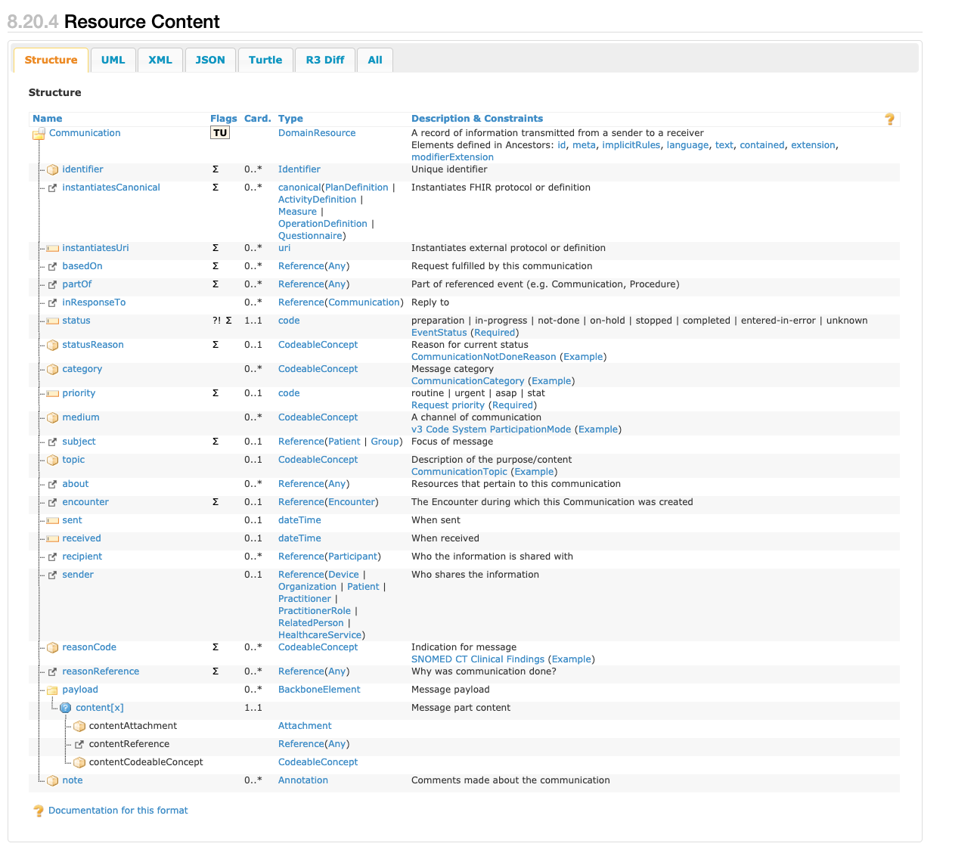
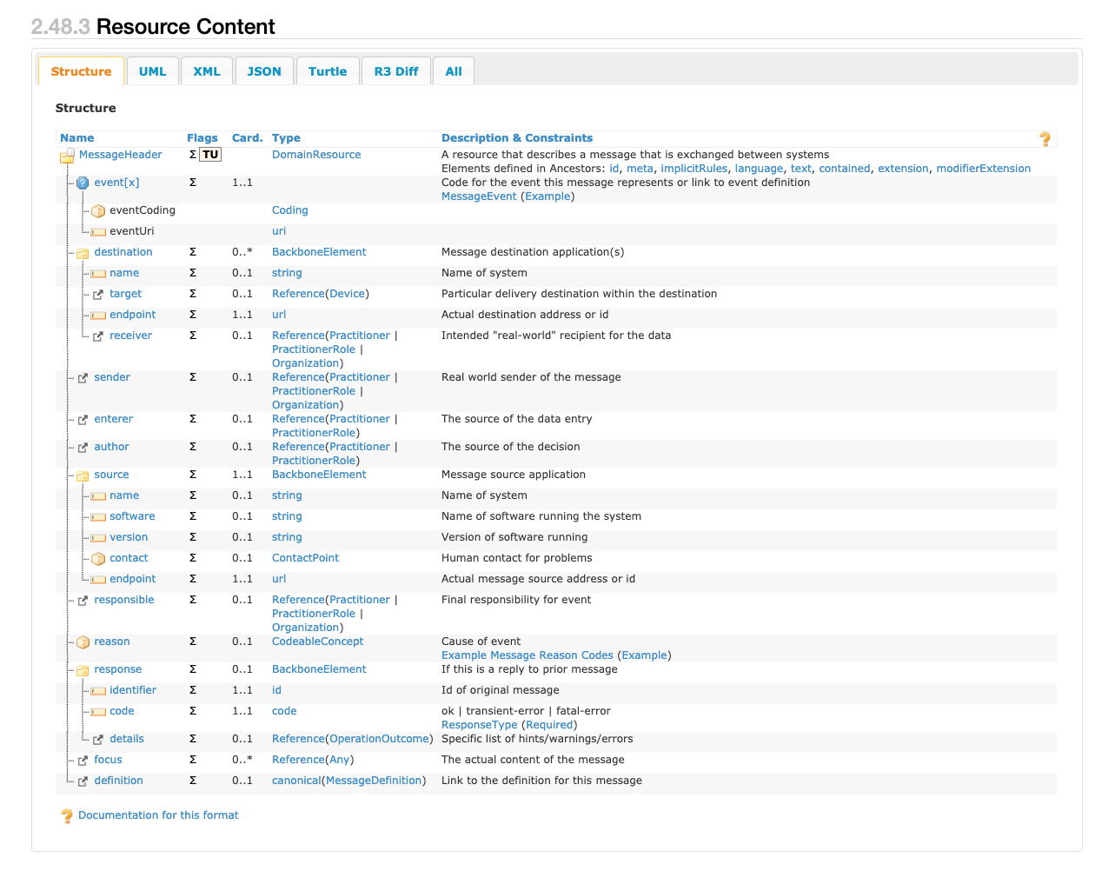
Communication
MessageHeader
?
Nonfocus resource part of message Bundle - includes Patient, Condition, Coverage, and EndPoint and can be defined using MessageDefinition or out of band (e.g. Spreadsheet)

Slide 8
What type of event: e.g., Admission or Discharge
When the message was sent
Source Application
Destination Endpoint
Link to message definition
Bundle
MessageHeader
Who sent this message
US Core Organization (Sender)
Who authorized this event
US Core Practitioner (Author)
Who is responsible for this event (may be the same as Sender)
US Core Organization (Publisher)
What type of encounter
What class of encounter: inpatient, outpatient, etc
Why the encounter occurred
When the encounter occurred
Discharge Disposition
US Core Encounter
Who this event is about
US Core Patient
How is this being paid / Who is the Payer
Da Vinci HRex Coverage
Providers involved in the encounter (may be the same as Author)
US Core Practitioner
Where the encounter occurred
US Core Location
The encounter diagnosis
US Core Condition

