Slide 1
Update on Da Vinci CDEX
September 2021 HL7 WGM
Thursday, September 23
Eric M Haas, DVM, MS

Slide 2




Clinical Data Exchange (CDex)
eg, What are the patient’s active conditions?
Direct Query or Task Based Approach
Task Based Approach
eg, What are the patient’s HbA1C results after 2020-01-01?
eg, Send the patient’s latest History & Physical
1. Payer or External Provider System Initiates Request
2. Provider System Retrieves Data
3. Practitioner Intervention (if required)
4. Provider System
Returns Data

Slide 3
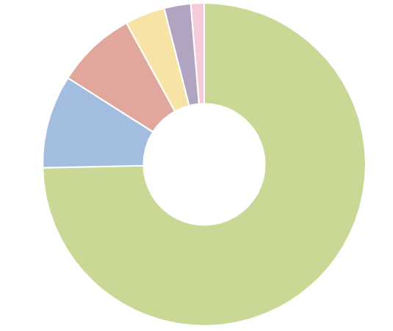
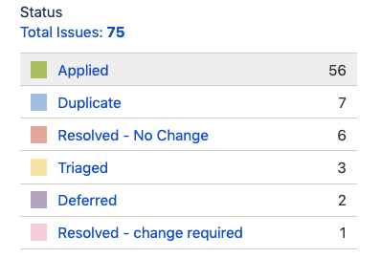
Da Vinci CDEX January 2021 Ballot Progress Report
3 remaining to resolve

Slide 4
Next Steps
Finish Ballot Reconciliation and apply updates to IG
Anticipate resolution of final items and block vote in October
Digital Signature requirements
Purpose of Use
Work Queue hints
Tentative Goal is Publication of Version 1.0.0 by end of October
Notes:
Roadmap for supplemental example guides to flesh out specific use cases.

Slide 5
Future of CDex
New Functionality - Unsolicited Push for Attachments and Preauthorization
Patient demographics, identifier, claim date, amount, etc
the patient’s latest History & Physical
Provider Submits Supporting Information for Claim + Claim Reattachment Data
Payer Processes Claim Data

Slide 6
Next Steps
Include in Publication of Version 1.0.0 as Draft content.
Tentative decision
Test at future Connectathons
January 2022 Ballot for Community Input and Review
Notes:
Roadmap for supplemental example guides to flesh out specific use cases.

Slide 7
Resources
Vanessa Candelora (Project Manager): vanessa.candelora@pocp.com
Eric Haas (Implementation Guide Lead): ehaas@healthedatainc.com
Confluence Page
Conference Calls: Wednesdays at 2pm Eastern
https://global.gotomeeting.com/join/514633709
Join us! All our Welcome!

Slide 8
Questions
For Questions Contact me at: ehaas@healthedatainc.com

