Slide 1
0..1
0..1
Organization
Organization
partOf
partOf
0..1
0..1
partOf
ownedBy
1..1
1..1
administeredBy
Organization
partOf
Network
0..*
InsurancePlan
0..*
Location
coverageArea
0..*
0..*
0..1
Endpoint
participatingOrganization
0..*
0..1
Practitioner
Role
0..*
Organization Affiliation
0..1
Organization
0..*
Healthcare Service
partOf
0..1
0..*
0..*
0..1
organization
0..*
0..*
0..1
Practitioner
Location
Organization
partOf
1

Slide 2
0..1
0..1
Organization
Organization
partOf
partOf
0..1
partOf
ownedBy
1..1
1..1
administeredBy
Network
0..*
InsurancePlan
0..*
Location
0..*
coverageArea
0..*
partOf
0..1
Organization
0..1
0..1
organization
0..1
Practitioner
Role
providedBy
Organization Affiliation
0..1
Organization
0..*
0..1
Healthcare Service
partOf
0..1
0..*
0..*
participatingOrganization
coverageArea
0..*
0..*
0..1
Practitioner
Location
Organization
0..1
0..1
partOf
partOf
managingOrganization
0..1
All profiles except for Practitioner reference Endpoint
Endpoint
2

Slide 3
0..1
Organization
partOf
managingOrganization
0..1
HealthcareService
0..*
Endpoint
0..*
PractitionerRole
0..*
0..*
0..*
0..*
0..*
InsurancePlan
Location
Network
Organization
OrganizationAffiliation
All resources except Practitioner reference Endpoints

Slide 4
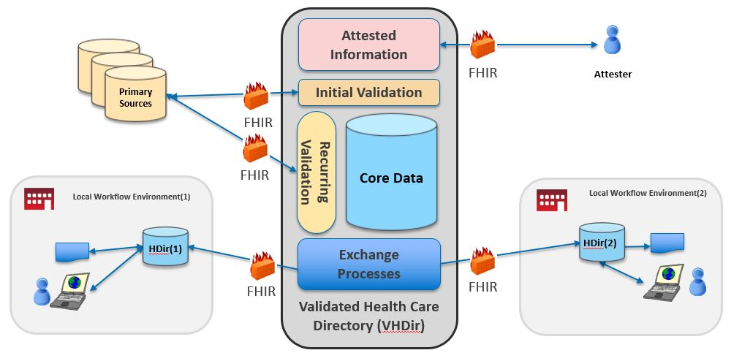
Scope of VhDir Implementation Guide
SearchParameter-organization-coverage-area.json
Scope of Plan-Net Implementation Guide

Slide 5
Network
Acme of Connecticut Preferred Provider
Organization CVS
managingOrganization
providedBy
network
Healthcare Service type: Pharmacy
Location(0) WindsorCT
type: outpharm
Location(1) Other type: outpharm
location
5

Slide 6



Third Party Application
Bulk Data Asynchronous (future)
RESTful GET Synchronous
End User Interface
FHIR API
Provider Directory
Payer

