Slide 1
Network
Organization
0..1
primaryOrganization
0..*
Endpoint
0..*
Organization Affiliation
0..*
Location
0..*
0..1
participatingOrganization
Healthcare Service
Organization

Slide 2
Organization
(payer)
Organization
(payer)
1..1
1..1
ownedBy
administeredBy
InsurancePlan
coverageArea
0..*
Location

Slide 3
Organization
(payer)
providedBy
1..1
HealthCare Service
0..*
Endpoint
0..*
Location

Slide 4
Organization
(payer)
partOf
1..1
Network
0..*
Endpoint
0..*
Location

Slide 5
Network
Location
0..*
0..*
Practitioner
Role
0..*
Healthcare Service
0..1
0..1
0..1
Organization
Practitioner

Slide 6
Organization
0..1
partOf
0..1
Organization
0..*
Endpoint

Slide 7
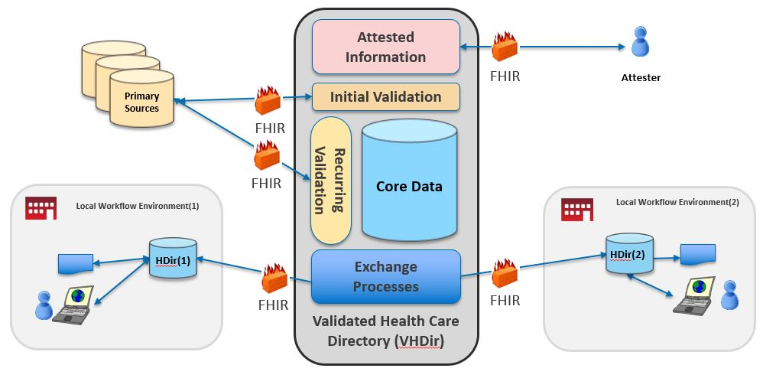
Scope of VhDir Implementation Guide
SearchParameter-organization-coverage-area.json
Scope of Plan-Net Implementation Guide

Slide 8
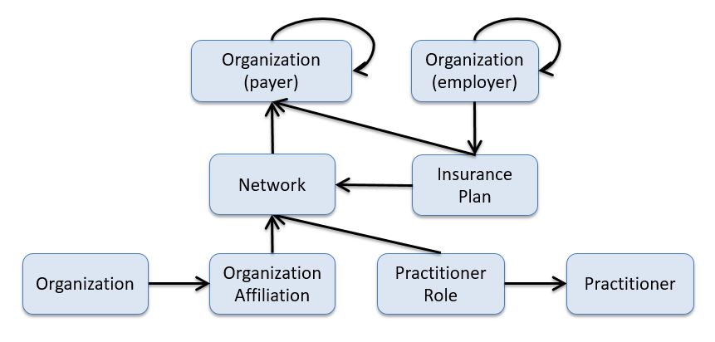

Slide 9
0..1
0..1
Organization
Organization
partOf
partOf
0..1
0..1
partOf
ownedBy
1..1
1..1
administeredBy
Organization
partOf
Network
0..*
InsurancePlan
0..*
Location
coverageArea
0..*
0..*
0..1
Endpoint
participatingOrganization
0..*
0..1
Practitioner
Role
0..*
Organization Affiliation
0..1
Organization
0..*
Healthcare Service
partOf
0..1
0..*
0..*
0..1
organization
0..*
0..1
Practitioner
Location
Organization
partOf
9

Slide 10
0..1
0..1
Organization
Organization
partOf
partOf
0..1
partOf
ownedBy
1..1
1..1
administeredBy
Network
InsurancePlan
0..*
Location
coverageArea
Endpoint
0..*
participatingOrganization
0..1
0..*
Organization Affiliation
0..1
Organization
Healthcare Service
partOf
0..*
0..1
organization
0..*
0..1
Location
Organization
partOf
10

Slide 11
0..1
0..1
Organization
Organization
partOf
partOf
0..1
0..1
partOf
ownedBy
1..1
1..1
administeredBy
Organization
partOf
Network
InsurancePlan
0..*
Location
coverageArea
0..*
0..1
Endpoint
0..*
Practitioner
Role
0..*
Healthcare Service
0..1
0..*
Practitioner
Location
11

