Slide 1
Network
Organization
0..1
primaryOrganization
0..*
Endpoint
0..*
Organization Affiliation
0..*
Location
0..*
0..1
participatingOrganization
Healthcare Service
Organization

Slide 2
Organization
(payer)
Organization
(payer)
1..1
1..1
ownedBy
administeredBy
InsurancePlan
coverageArea
0..*
Location

Slide 3
Organization
(payer)
providedBy
1..1
HealthCare Service
0..*
Endpoint
0..*
Location

Slide 4
Organization
(payer)
partOf
1..1
Network
0..*
Endpoint
0..*
Location

Slide 5
Network
Location
0..*
0..*
Practitioner
Role
0..*
Healthcare Service
0..1
1..1
1..1
Organization
Practitioner

Slide 6
Organization
0..1
partOf
0..1
Organization
0..*
Endpoint

Slide 7
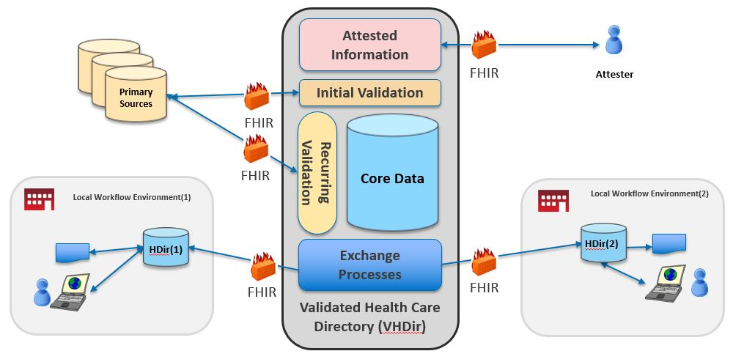
Scope of VhDir Implementation Guide
SearchParameter-organization-coverage-area.json
Scope of Plan-Net Implementation Guide

