Slide 1
IGs
are
awesome

Slide 2
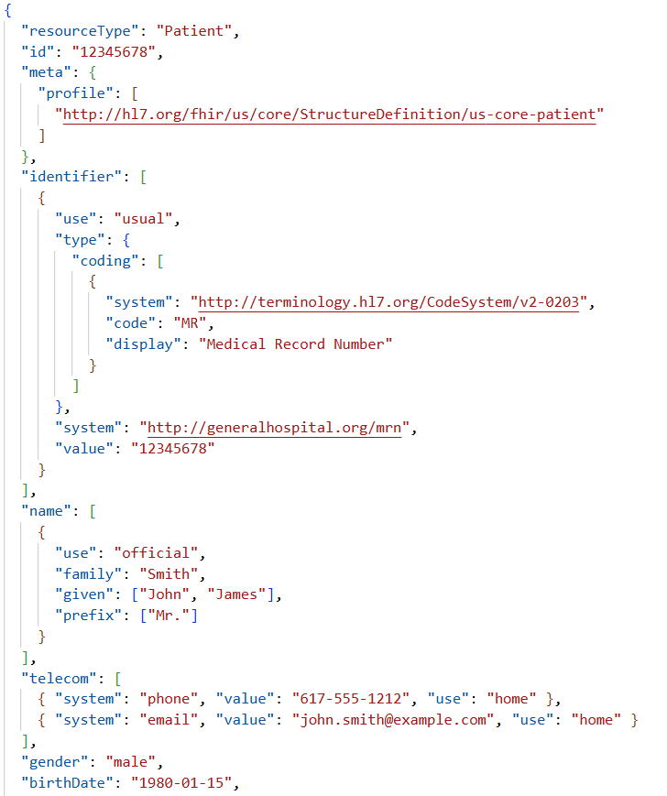
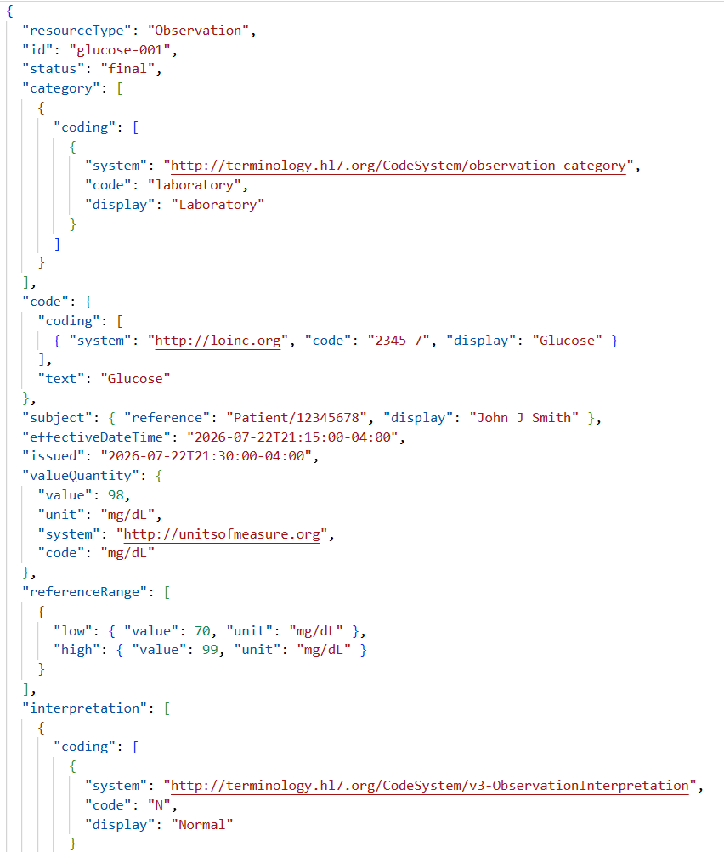
HL7v2 PID (Patient)
HL7v2 OBR (Lab)
MSH|^~\&|EPIC|GENERAL_HOSPITAL|HIE|STATE_HIE|20260722212530||ADT^A01|202607220001|P|2.5.1
EVN|A01|20260722212530|||JSMITH^JOHN
PID|1||12345678^^^GENERAL_HOSPITAL^MR~999887777^^^USSSA^SS||DOE^JOHN^MICHAEL^JR||19800115|M||2106-3|123 MAIN ST^^BOSTON^MA^02108^USA^H~456 OAK AVE^^CAMBRIDGE^MA^02139^USA^P|(617)555-1212^PRN^PH^^1^617^5551212~john.doe@email.com^NET^Internet||ENG|M|CHR|987654321|123456789
PD1|||PRIMARY CARE ASSOCIATES^^^NPI|12345^SMITH^JANE^A^^MD
NK1|1|DOE^JANE|SPO|(617)555-9999^PRN^PH|123 MAIN ST^^BOSTON^MA^02108
NK1|2|DOE^ROBERT|FTH|(617)555-8888^PRN^PH
PV1|1|I|3N^312^1^GENERAL_HOSPITAL^^BED01||||12345^SMITH^JANE^A^^MD|67890^BROWN^SUSAN^^^RN||||||MED||||1234567||||||||||||||||||||GENERAL_HOSPITAL
PV2|||Routine admission||||||||||N
MSH|^~\&|LABSYSTEM|GENERAL_HOSPITAL|EHR|GENERAL_HOSPITAL|20260722213500||ORU^R01|MSG00098765|P|2.5.12PID|1||12345678^^^GENERAL_HOSPITAL^MR||SMITH^JOHN^J||19800115|M|||123 MAIN ST^^BOSTON^MA^02108^USA||(617)555-1212|||M
ORC|RE|ORD123456|FILL987654||CM||||20260722213000|||12345^WILSON^SARAH^^^MD
OBR|1|ORD123456|FILL987654|24323-8^Comprehensive Metabolic Panel^LN||20260722210000|20260722211500||||| |||12345^WILSON^SARAH^^^MD||||||F|||20260722213000||CH
OBX|1|NM|2345-7^Glucose^LN||98|mg/dL|70-99|N|||F
OBX|2|NM|3094-0^Urea Nitrogen (BUN)^LN||14|mg/dL|7-20|N|||F
OBX|3|NM|2160-0^Creatinine^LN||0.92|mg/dL|0.70-1.30|N|||F
OBX|4|NM|2951-2^Sodium^LN||140|mmol/L|135-145|N|||F
OBX|5|NM|2823-3^Potassium^LN||4.2|mmol/L|3.5-5.1|N|||F
OBX|6|NM|2075-0^Chloride^LN||103|mmol/L|98-107|N|||F
OBX|7|NM|2028-9^Carbon Dioxide^LN||25|mmol/L|22-29|N|||F
OBX|8|NM|17861-6^Calcium^LN||9.3|mg/dL|8.6-10.2|N|||F
OBX|9|NM|2885-2^Protein Total^LN||7.1|g/dL|6.4-8.3|N|||F
OBX|10|NM|1751-7^Albumin^LN||4.2|g/dL|3.5-5.2|N|||F
OBX|11|NM|1975-2^Bilirubin Total^LN||0.8|mg/dL|0.2-1.2|N|||F
OBX|12|NM|1742-6^ALT^LN||32|U/L|7-55|N|||F
OBX|13|NM|1920-8^AST^LN||28|U/L|10-40|N|||F
OBX|14|NM|6768-6^Alkaline Phosphatase^LN||88|U/L|40-129|N|||F
“Flattened” PIQI Data Model
PIQI Evaluation Rubric
Data Class: Demographics
Attribute: birthDate "1980-01-15"
Availability
Accuracy
HL7 FHIR Patient Resource
HL7 FHIR Observation Resource
Data Class: LabResult
Attribute: referenceRange { "text": "70-90",
"lowValue": "70",
"highValue": "90" }
Conformity
Plausibility
“Flattened” model will vary by use case and can source data from various standards formats

