Slide 1
Updated FHIR Implementation Guides for Vital Records Workflow
Saul A. Kravitz, MITRE
NVSS Modernization Technical COP Meeting
Wednesday, April 27, 2022

Slide 2
Key Messages
The FHIR Implementation Guides (IGs) supporting the NVSS modernization of death records are complete, stable and documented.
No new IG development is planned, only bug fixes.
Current VRDR STU2 IG is nearing publication-readiness.
Participation in the upcoming testing event is important
Testing is a pathway to certification.
Updated IGs
Expanded testing requirements

Slide 3
Vital Records FHIR Implementation Guides: Why are they changing?
Addressing issues that arose in STU2 ballot (reconciliation)
Avoid future changes and associated costs
Published VRDR STU2 should reflect all known requirements for NCHS and Inter-Jurisdictional Usage.
Full support for IJE elements.
Should change only if requirements change or errors identified

Slide 4
June Testing Event: Important to Participate*
Testing is a pathway to certification.
FHIR Implementation Guides (yes both of them) have changed
Just like recertification of software for MS Windows following upgrade
Data exchange requirements have expanded
62 new fields in test data, including:
Edit bypass fields (e.g., PREG_BYPASS)
All race/ethnicity fields (e.g., RACE15)
Residence address coded city/county, predir/postdir/etc (e.g., PREDIR_R)
Emerging Issues Parameters (e.g., PLACE1_1)
Coded demographic and cause of death data in new ‘True FHIR’ encoding
* Even if your jurisdiction or vendor has tested previously

Slide 5
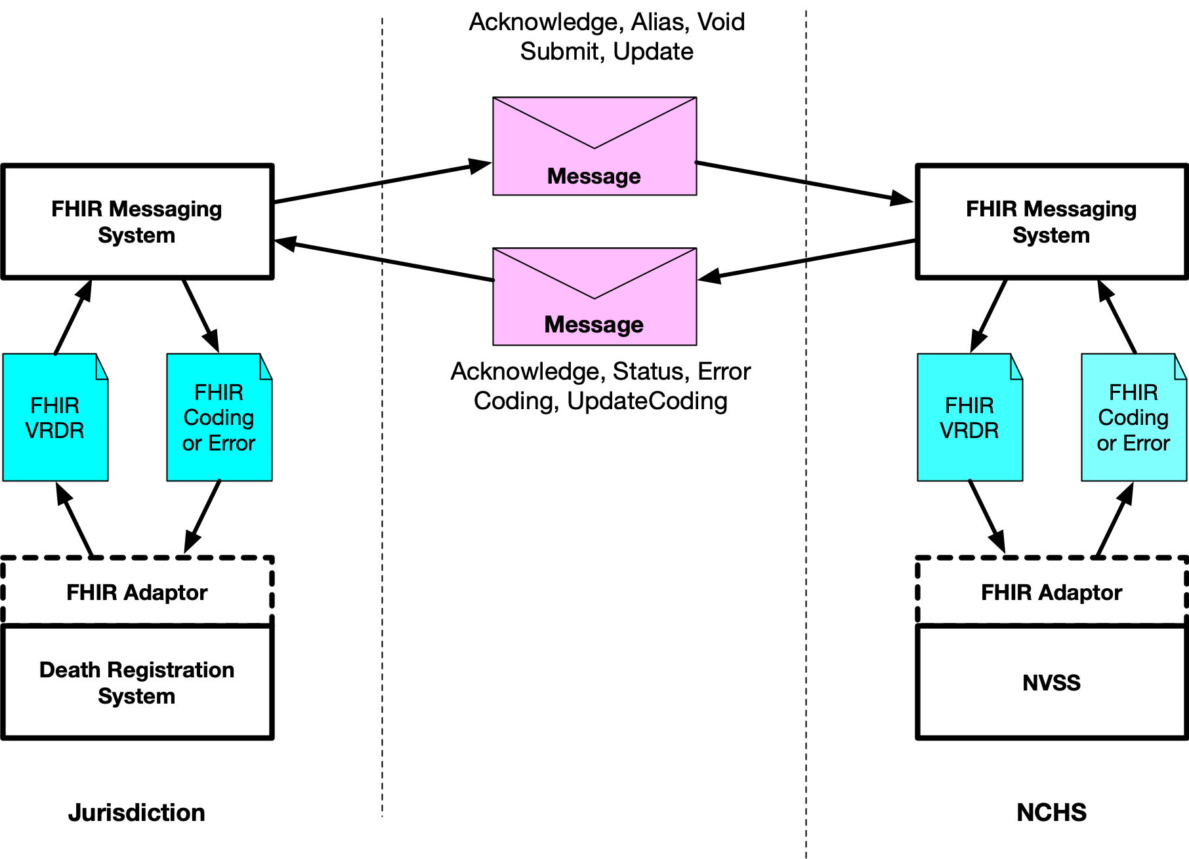
Death Records Architecture: 2 FHIR IGs
HL7 VRDR ID = Content
NCHS Messaging IG = Envelope

Slide 6
Vital Records Death Workflow Supported by Two FHIR IGs
NCHS Vital Records Messaging – v0.9
Messaging framework/envelopes
http://build.fhir.org/ig/HL7/vrdr/
HL7 Vital Records Death Reporting (VRDR) – v1.3
Content of messages
http://build.fhir.org/ig/nightingaleproject/vital_records_fhir_messaging_ig/branches/main/index.html
Now in FHIR IG!
Now complete!

Slide 7
Vital Records Messaging FHIR Implementation Guide: complete*
Now provided as a complete FHIR Implementation guide
Supports all messages in Vital Records Workflow
Submission/Update of Death Records to NCHS
Submission/Update of Coding (Demographic and Cause of Death) to Jurisdictions
Void and Alias of Death Records
Coding Status
Death Record and Coded Content now defined in VRDR
Previously sent as FHIR Parameter-encoded IJE content
* Minor changes still being made

Slide 8
Structure of a Message
Message (Bundle)
Message Header
Defined in Messaging IG (simple)
Parameters
Content of Message
Defined in VRDR IG (complex)

Slide 9
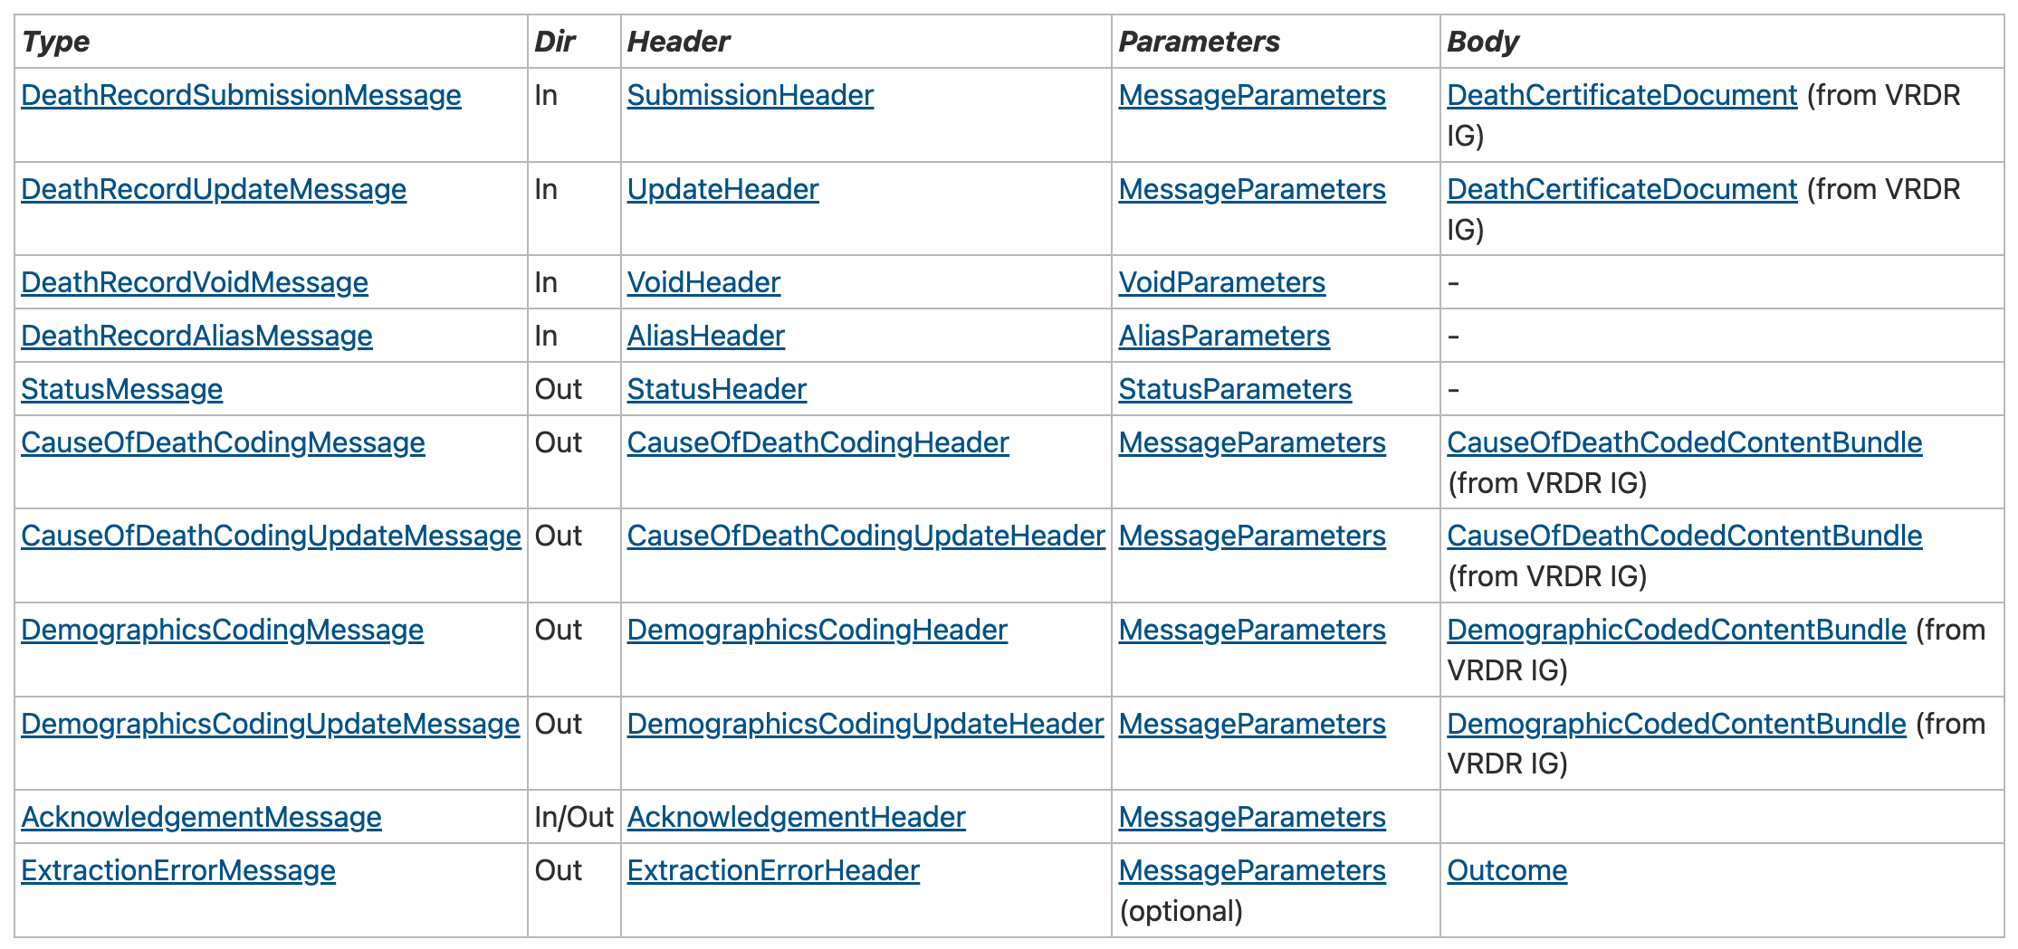
Messaging IG Content
Message Content defined in VRDR

Slide 10
VRDR STU v1.3 FHIR Implementation Guide: complete*
Maps all IJE fields currently in use to FHIR Profiles
Supports all known use cases:
Submission of Death Records to NCHS
TRX and MRE-equivalent Coding Responses to Jurisdictions
Inter-jurisdictional exchange of Full Death Record (a + b)
Provides full documentation of the mapping
Data dictionary IJE field is mapped to FHIR profile/element mapping
Complete value sets included in Implementation Guide
Examples for all profiles and extensions
Plan to start HL7 process after feedback from testing event
* Minor changes still being made

Slide 11
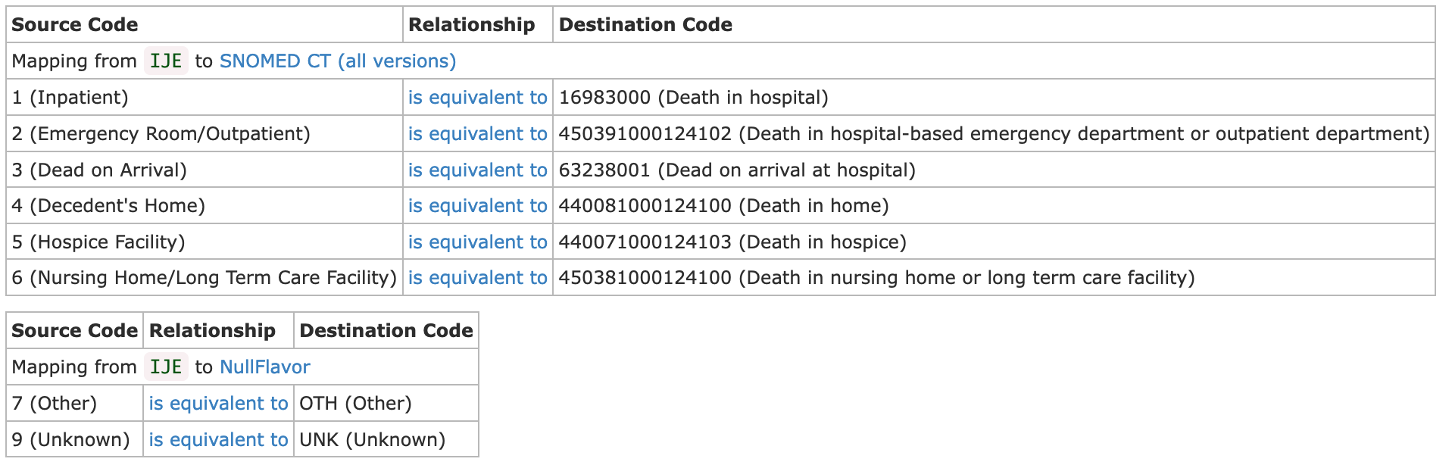
VRDR Changes Since Balloted Version (1)
All value sets included within IG using FHIR-standard codesystems where possible. No dependence on PHINVADs.
Example: PlaceOfDeath Value Set v1.2 (ballot), v1.3 (current)
Concept Maps for mapping IJE coding to FHIR coding included
Example: PlaceOfDeath Concept Map

Slide 12
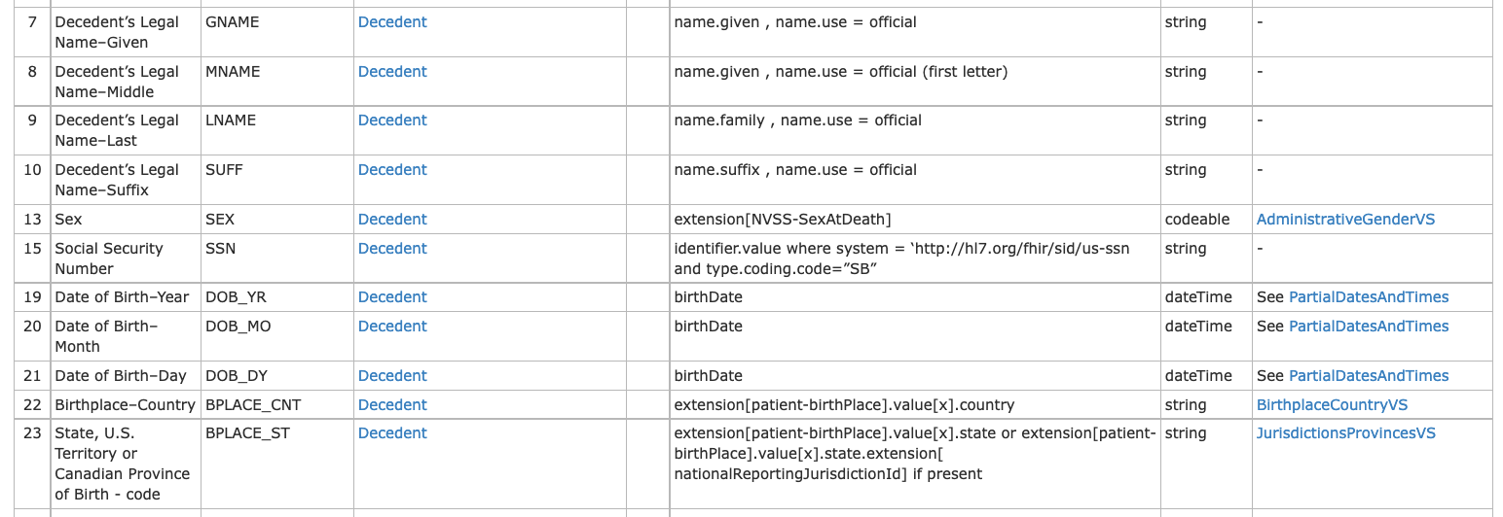
VRDR Changes Since Balloted Version (2) Data Dictionary Shows IJE Field Map to FHIR
http://build.fhir.org/ig/HL7/vrdr/IJE_File_Layouts_Version_2021_FHIR.html

Slide 13
VRDR Changes Since Balloted Version (3)
Consistent encoding of States, Jurisdictions, and Countries
String bound to value set with 2 letter codes
All address components outside of FHIR standard (e.g., county and city codes) added as extensions
Avoid overloading existing fields with new meanings
E.g., SexAtDeath(SEX), Race and Ethnicity(RACE1, RACE1E)
Consistent handling of partial dates and times throughout
Consistent urls for vrdr profiles, extensions, valuesets, and codesystems
Complete examples
Part1 and Part2 Causes of Death mapped to Observations instead of Conditions

Slide 14
Death Record Submission Profiles
Death Record Document (Bundle/Document)
Decedent Demographics
Death Certificate (Composition)
Decedent (Patient)
Death Investigation
Death Certification
Birth Record Identifier
Autopsy Performed
COD Part 1
Mother (Related Person)
Death Date
COD Part 2
Father (RelatedPerson)
Death Location (Location)
COD Pathway (List)
Spouse (RelatedPerson)
Pregnancy Status
Certifier (Practitioner)
Decedent Age
Examiner Contacted
Death Certif. (Procedure)
Education Level
Injury Incident
Manner of Death
Usual Work
Injury Location (Location)
Decedent Disposition
Military Service
Surgery Date
Disp. Method
Emerging Issues
Tobacco Use Contributed
Disp Location (Location)
Race/Ethnicity (Input)
Funeral Home (Organization)
* All profiles are observations, unless noted

Slide 15
Coded Demographic Profiles (MRE Equivalent)
Demographic Coded Content Bundle (Bundle)
Race/Ethnicity
Race/Ethnicity (Coded)
Race/Ethnicity (Input)

Slide 16
Coded Cause of Death (TRX) Profiles
Cause of Death Coded Content Bundle (Bundle)
Death Investigation
Death Certification
Coded Cause of Death
Autopsy Performed
COD Part 1
Activity at Time of Death
Pregnancy Status
COD Part 2
Automated Underlying COD
Injury Incident
COD Pathway (List)
Manual Underlying COD
Surgery Date
Death Certif. (Procedure)
Entity Axis COD
Tobacco Use Contributed
Manner of Death
Place of Injury
Coding Status Values (Parameters)
* All profiles are observations, unless noted

Slide 17
Death Record For Inter-Jurisdictional Exchange: Profiles
Death Record Document (Bundle/Document)
Death Certificate (Composition)
Decedent Demographics
Decedent (Patient)
Death Certification
Coded Cause of Death
Birth Record Identifier
Death Investigation
COD Part 1
Activity at Time of Death
Mother (Related Person)
Autopsy Performed
COD Part 2
Automated Underlying COD
Father (RelatedPerson)
Death Date
COD Pathway (List)
Manual Underlying COD
Spouse (RelatedPerson)
Death Location (Location)
Certifier (Practitioner)
Entity Axis COD
Decedent Age
Pregnancy Status
Death Certif. (Procedure)
Place of Injury
Education Level
Examiner Contacted
Manner of Death
Coding Status Values (Parameters)
Usual Work
Injury Incident
Decedent Disposition
Race/Ethnicity
Military Service
Injury Location (Location)
Disp. Method
Emerging Issues
Race/Ethnicity (Coded)
Surgery Date
Disp Location (Location)
Race/Ethnicity (Input)
Tobacco Use Contributed
Funeral Home (Organization)
* All profiles are observations, unless noted

Slide 18
Mortality Roster Profiles
Mortality Roster Bundle (Bundle)
Decedent Demographics
Death Investigation
Decedent (Patient)
Death Date (Observation)
Mother (Related Person)
Death Location (Location)
Father (RelatedPerson)

Slide 19







Surveillance Profiles
Surveillance Bundle (Bundle)
Decedent Demographics
Death Certificate (Composition)
Decedent (Patient)
Death Investigation
Death Certification
Birth Record Identifier
Autopsy Performed
COD Part 1
Mother (Related Person)
Death Date
COD Part 2
Father (RelatedPerson)
Death Location (Location)
COD Pathway (List)
Spouse (RelatedPerson)
Pregnancy Status
Certifier (Practitioner)
Decedent Age
Examiner Contacted
Death Certif. (Procedure)
Education Level
Injury Incident
Manner of Death
Usual Work
Injury Location (Location)
Decedent Disposition
Military Service
Surgery Date
Disp. Method
Emerging Issues
Tobacco Use Contributed
Disp Location (Location)
Race/Ethnicity (Input)
Funeral Home (Organization)
Dropped
Partial
Alternate needed
Extended
* All profiles are observations, unless noted

Slide 20
Tools Updates
All tools being updated to support new versions of IGs
Tools:
VRDR and VRDR.Messaging dot net libraries
Java Library
Canary including updated test cases

Slide 21
VRDR and VRDR Messaging .NET Libraries​
New release by mid-May
Open Source .NET (C#) code for​
Producing and consuming the Vital Records Death Reporting (VRDR) Health Level 7 (HL7) Fast Healthcare Interoperability Resources (FHIR) standard.​
Producing and consuming FHIR messages for the exchange of VRDR documents.​
Support for converting VRDR FHIR records to and from the Inter-Jurisdictional Exchange (IJE) Mortality format, as well as companion microservice for performing conversions.​
https://github.com/nightingaleproject/vrdr-dotnet

