Slide 1
IGs
are
awesome

Slide 2
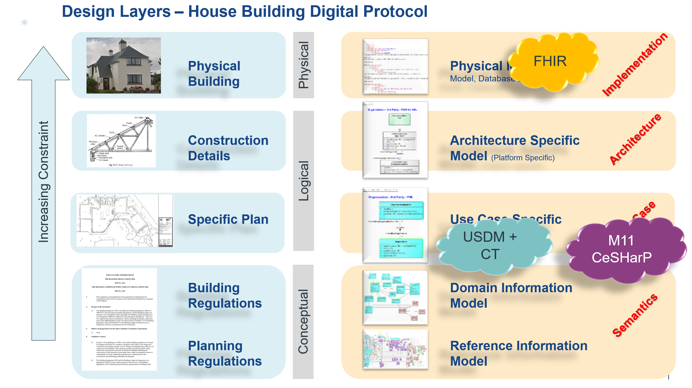

Slide 3
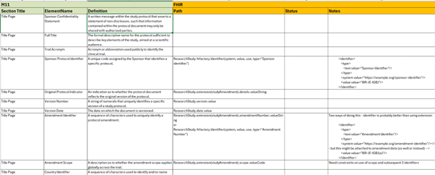

Slide 4
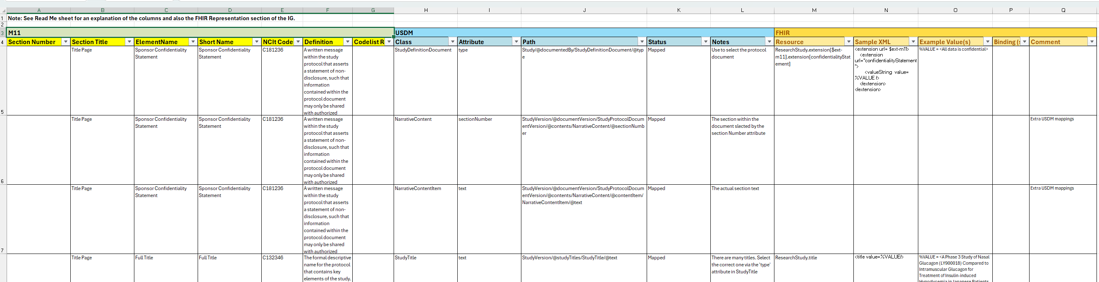
USDM
FHIR
M11

Slide 5
- ResearchStudy
- extended by M11ResearchStudy
- ResearchStudy
- extended by NarrativeElements
- which provides a pointer to M11ResearchStudyNarratives
- ResearchStudy
- extended by ResearchStudyStudyAmendment
- which contains ResearchStudyStudyAmendmentDetails
- and ResearchStudyStudyAmendmentScopeImpact
- Composition
- profiled by ResearchStudyNarratives
- profiled by M11ResearchStudyNarratives
- ResearchStudy
- profiled by M11_ResearchStudyProfile which tightens cardinality of some attributes and binds appropriate terminology
ResearchStudy
M11_ResearchStudyProfile
M11ResearchStudy
SAEReporting
Composition
ConfidentialityStatement
ResearchStudyNarratives
NarrativeElements
M11ResearchStudyNarratives
ResearchStudyStudyAmendment
ResearchStudyStudyAmendmentDetails
ResearchStudyStudyAmendmentScopeImpact

Slide 6
ResearchStudy
StudyDesign
Key:
Extension
Profile from UDP
Profile from EBM
SAEReporting
ConfidentialityStatement
M11_ResearchStudyProfile
Composition
NarrativeElements
M11ResearchStudyNarratives
M11_ProtocolAmendment
ResearchStudyStudyAmendmentDetails
ResearchStudyStudyAmendmentScopeImpact

