Slide 1
IGs
are
awesome

Slide 3
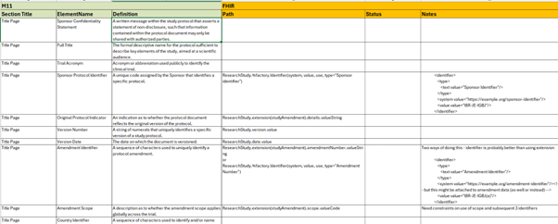

Slide 4
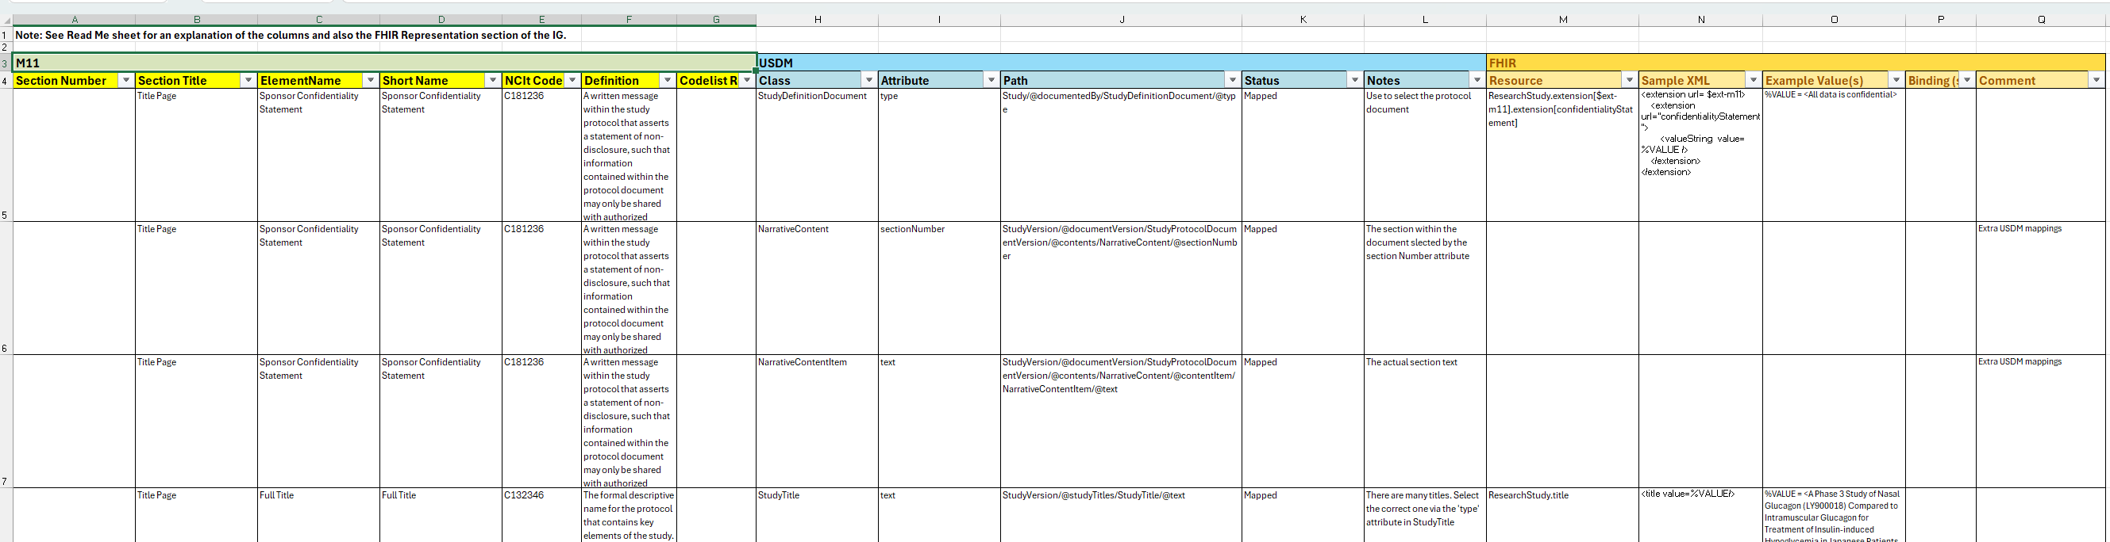
USDM
FHIR
M11

Slide 5
FHIR Representation in UDP
Narrative Form
Structured Form

Slide 6
Narrative Content Representation
ResearchStudy
ResearchStudy has many structured attributes to describe a protocol and it is the correct starting point to use.
BUT It does not have provision to carry narrative text
Composition
Composition is designed to carry narrative content and the content can have sections, sub-sections, sub-sub-sections etc.
ResearchStudy
+ NarrativeElements
We created a NarrativeElements extension to ResearchStudy which is essentially a pointer to a Composition.
Composition
Notes:
What is an extension? What is a profile?

Slide 7
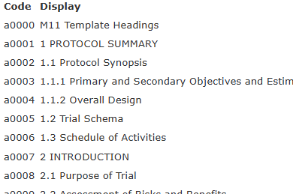
Content Hierarchy and Context (Outline) Representation
To properly reflect the M11 template, the sections and sub-sections in the Composition need to match those in the template.
The template sections can be defined in terminology
Specific narrative instances can then use the codes to specify which parts of the M11 Template they represent
ResearchStudy
+ NarrativeElements a004
In the illustration here ResearchStudy has two NarrativeElements sections attached. One with code a004 which is 1.1.2 Overall Design and one with code a007 which is 2 INTRODUCTION and this would then have all the sub-sections within the INTRODUCTION.
Composition
+ NarrativeElements a007
Composition

Slide 8
Structured Representation
ResearchStudy already has many attributes to describe a protocol but not everything required by M11 is present.
For example M11 requires a field to describe Amendment Scope.
ResearchStudy
+ ResearchStudyStudyAmendment
scope
To accommodate this, we create another extension called ResearchStudyStudyAmendment
and amongst the attributes present in this extension we have one called scope

Slide 9
- ResearchStudy
- extended by M11ResearchStudy
- ResearchStudy
- extended by NarrativeElements
- which provides a pointer to M11ResearchStudyNarratives
- ResearchStudy
- extended by ResearchStudyStudyAmendment
- which contains ResearchStudyStudyAmendmentDetails
- and ResearchStudyStudyAmendmentScopeImpact
- Composition
- profiled by ResearchStudyNarratives
- profiled by M11ResearchStudyNarratives
- ResearchStudy
- profiled by M11_ResearchStudyProfile which tightens cardinality of some attributes and binds appropriate terminology
ResearchStudy
M11_ResearchStudyProfile
M11ResearchStudy
SAEReporting
Composition
ConfidentialityStatement
ResearchStudyNarratives
NarrativeElements
M11ResearchStudyNarratives
ResearchStudyStudyAmendment
ResearchStudyStudyAmendmentDetails
ResearchStudyStudyAmendmentScopeImpact

Slide 10
M11_ResearchStudyProfile (ResearchStudy)
NarrativeElements
M11ResearchStudyNarratives (Composition)
M11_ProtocolAmendment
ResearchStudyStudyAmendmentScopeImpact
ResearchStudyStudyAmendmentDetails
ResearchStudySponsorConfidentialityStatement
Key:
Profile (Base Resource)
Extension

Slide 11
ResearchStudy
StudyDesign
Key:
Extension
Profile from UDP
Profile from EBM
SAEReporting
ConfidentialityStatement
M11_ResearchStudyProfile
Composition
NarrativeElements
M11ResearchStudyNarratives
M11_ProtocolAmendment
ResearchStudyStudyAmendmentDetails
ResearchStudyStudyAmendmentScopeImpact

Slide 12
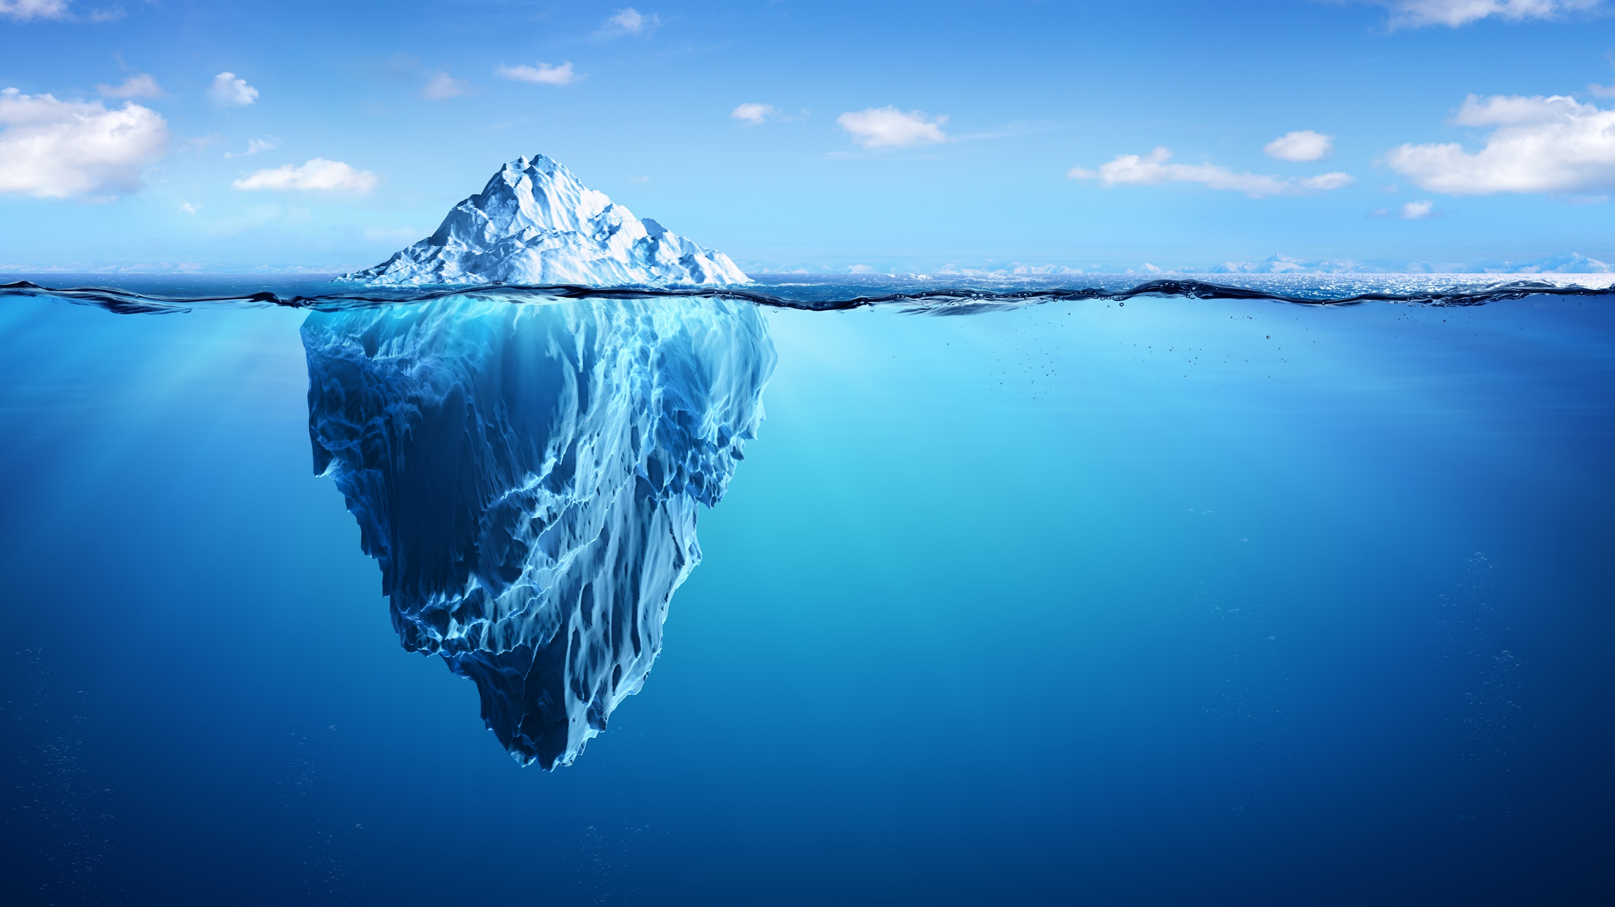
*
Align with evolving regulatory requirements
Secure transfer of sensitive information
Efficient exchange with additional stakeholders
The Power of the Digital Protocol
ICH M11 Aligned Document Transmission
Streamlined Structured Document Creation
Standardized templates for protocols
Automated population of key fields using metadata
Reduced human errors
Real time updates/input
Improved collaboration/version control
Reduced time spent drafting protocols
Efficiencies, Automation, and Analytics
Above the waterline are use cases currently addressed by this Implementation guide.
Below the waterline are an illustration of future use cases for which UDP may develop an implementation guide
EHR Integration
Expedited Recruitment
Site System Integration
Budgeting and Forecasting
Improved Operational Efficiency
Pooled Analysis of Protocols
Notes:
“On the surface” we have enabled FHIR structured protocol exchange between parties. What’s next?
“Below the surface” there are so many more possibilities being pursued across the clinical research ecosystem. Some already in motion, some that can be made a reality or become more efficient with FHIR.
VULCAN is moving into 2026 with exploration of Patient Matching.

Slide 13
Profile
Resource
Extension
Datatype
Terminology

Slide 14
Exemplar Trial Schema Drawing
Hic textus tantummodo
Hic textus tantummodo
Hic textus tantummodo
Hic textus tantummodo
Hic textus tantummodo

Slide 15
Exemplar Schedule of Activities
 |  | Day -1 | Day 0 | Day 1 to n | Day n+1
Pre-assessment |  | x
Signed consent |  | x
Demographics |  |  | x
Clinical Assessment |  |  | x | x
Dose |  |  | x | x
Discharge |  |  |  |  | x

