Slide 1
IGs
are
awesome

Slide 2
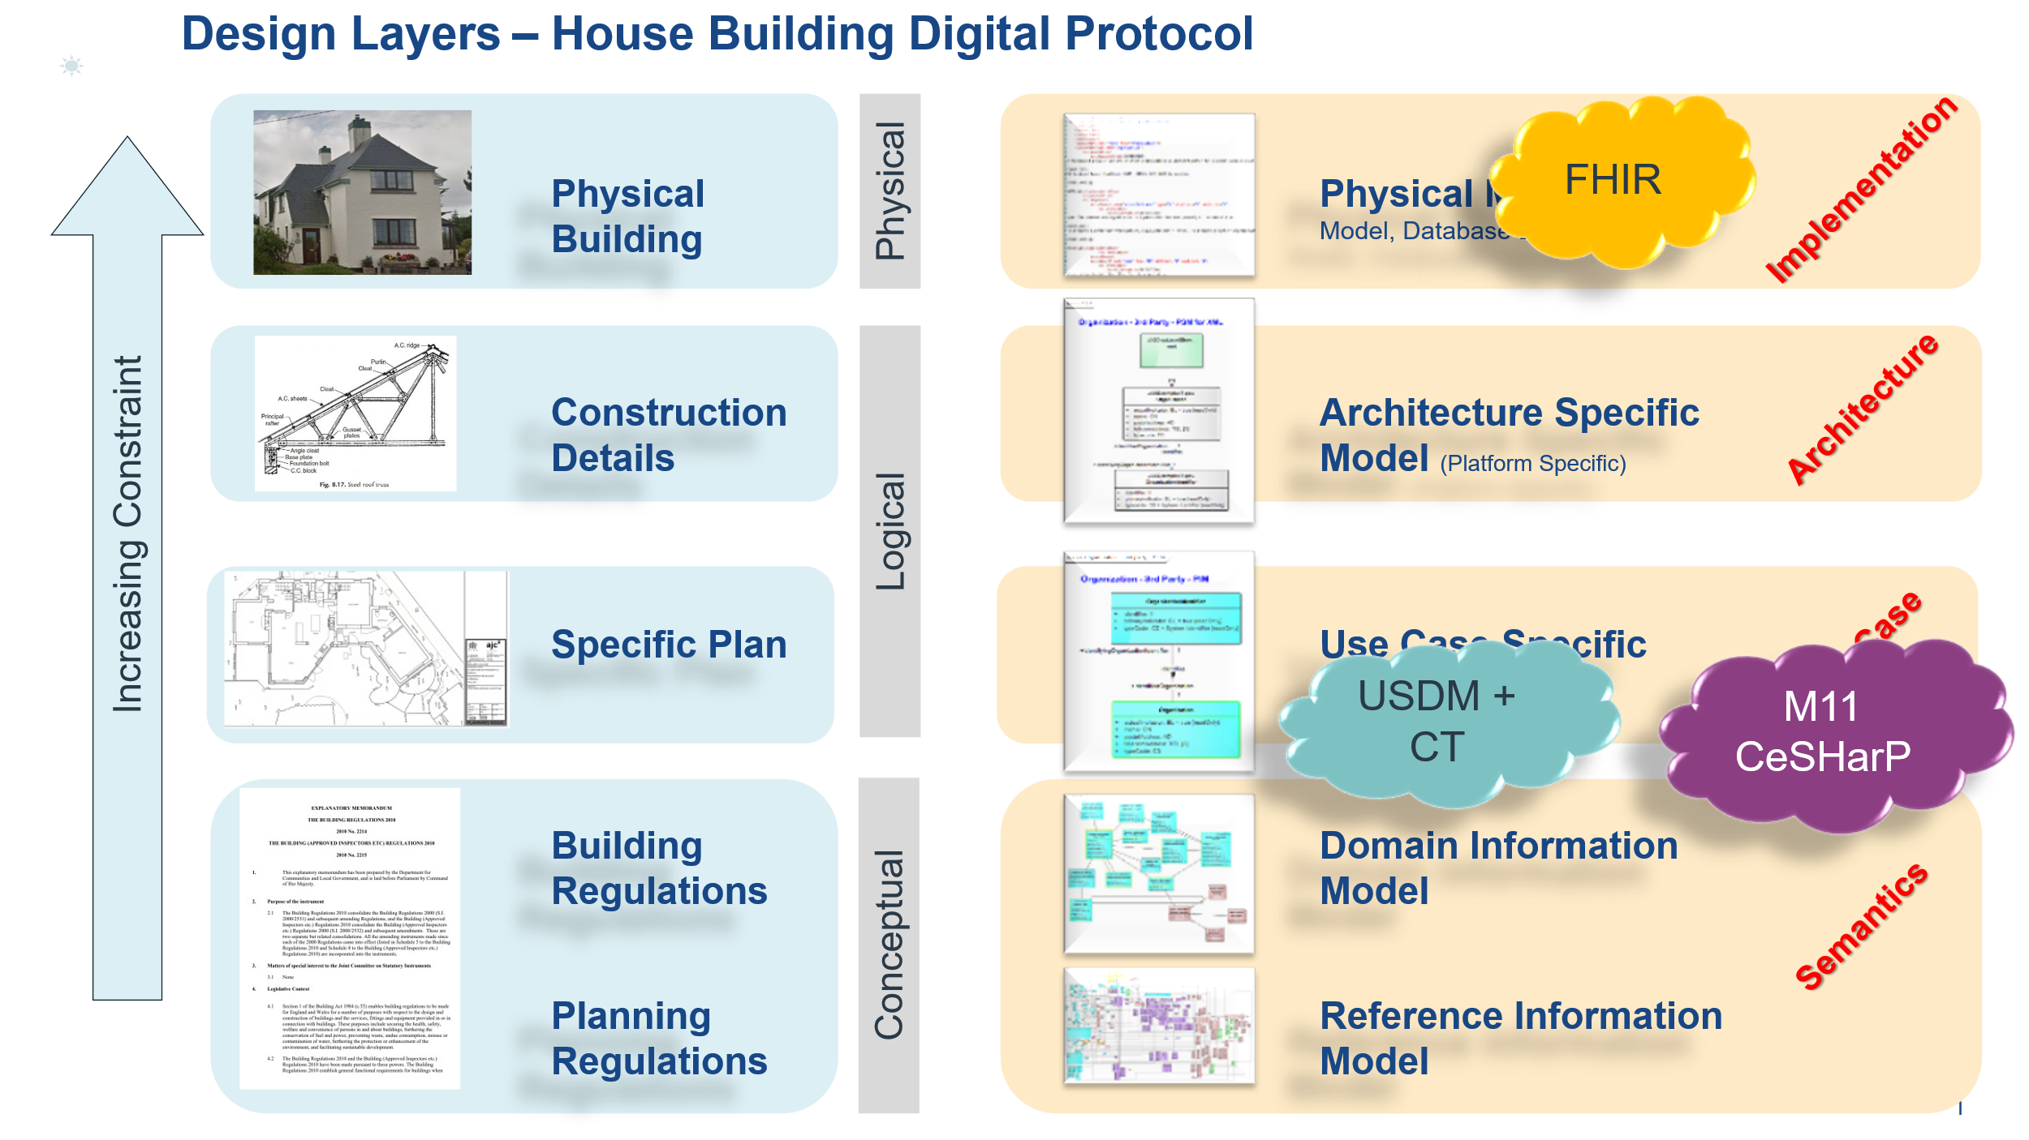

Slide 3
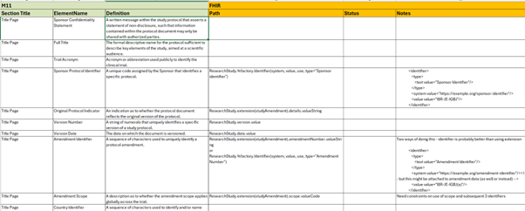

Slide 4
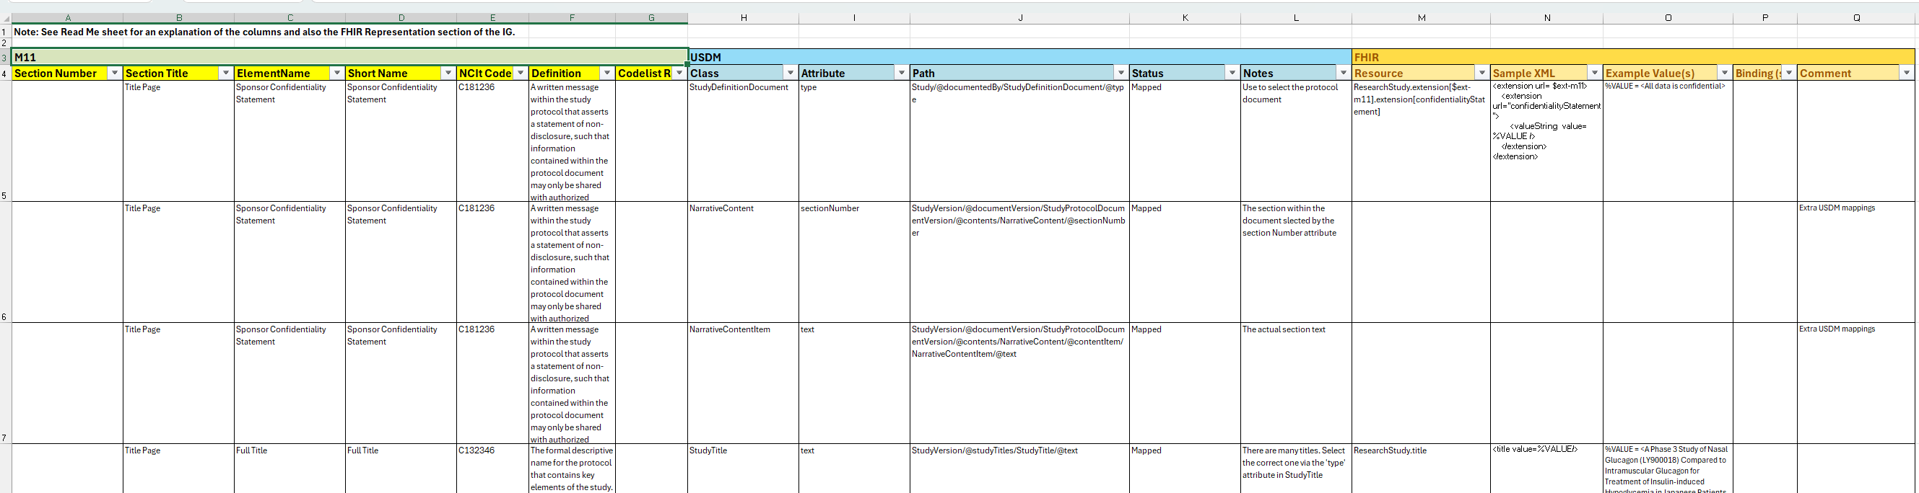
USDM
FHIR
M11

