Slide 1
Thomas Tveit Rosenlund, The Norwegian Directorate of e-health
HL7 FHIR in Norway lessons learned

Slide 2
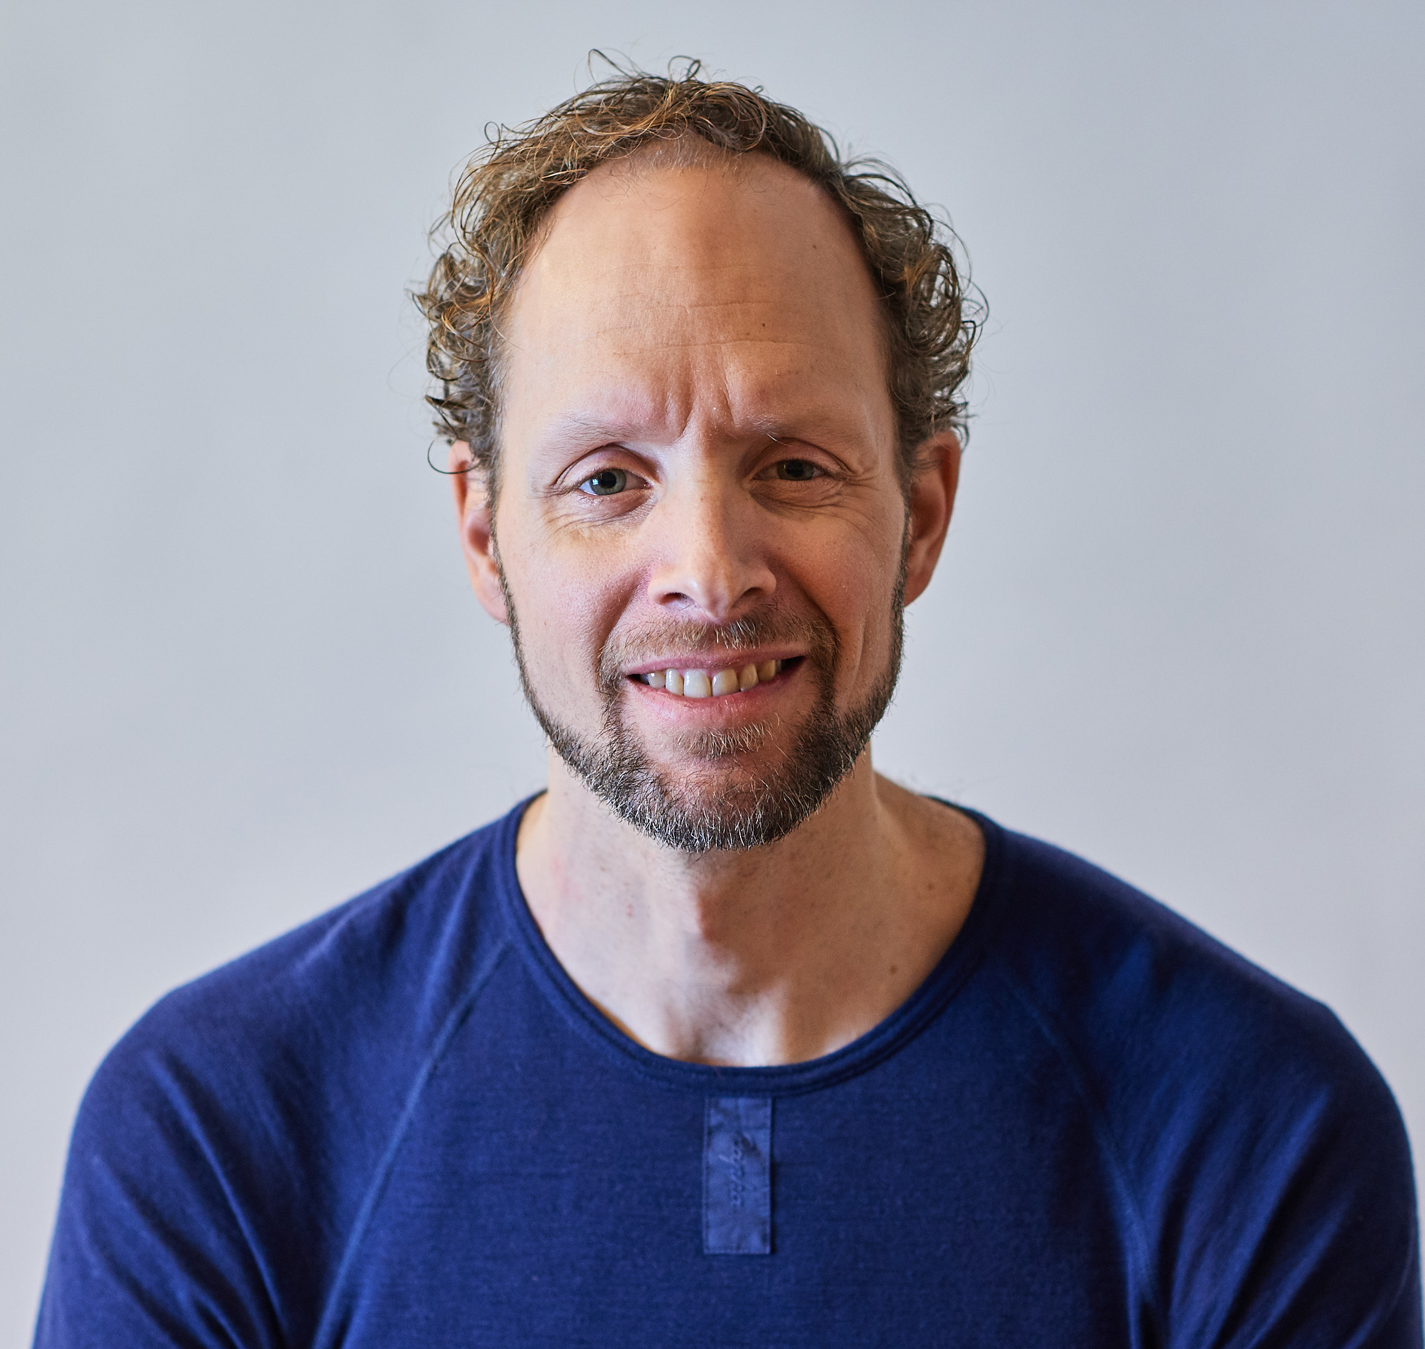
Who am I?
Thomas Tveit Rosenlund
Senior advicer employed at the Norwegian directorate of e-health
Enterprise architect

Slide 3

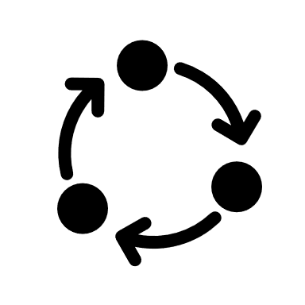



Overview
Strategy for FHIR profiling and governance
Method for development
Guidance for use of FHIR
Standardization
Building the FHIR community
Results

Slide 4
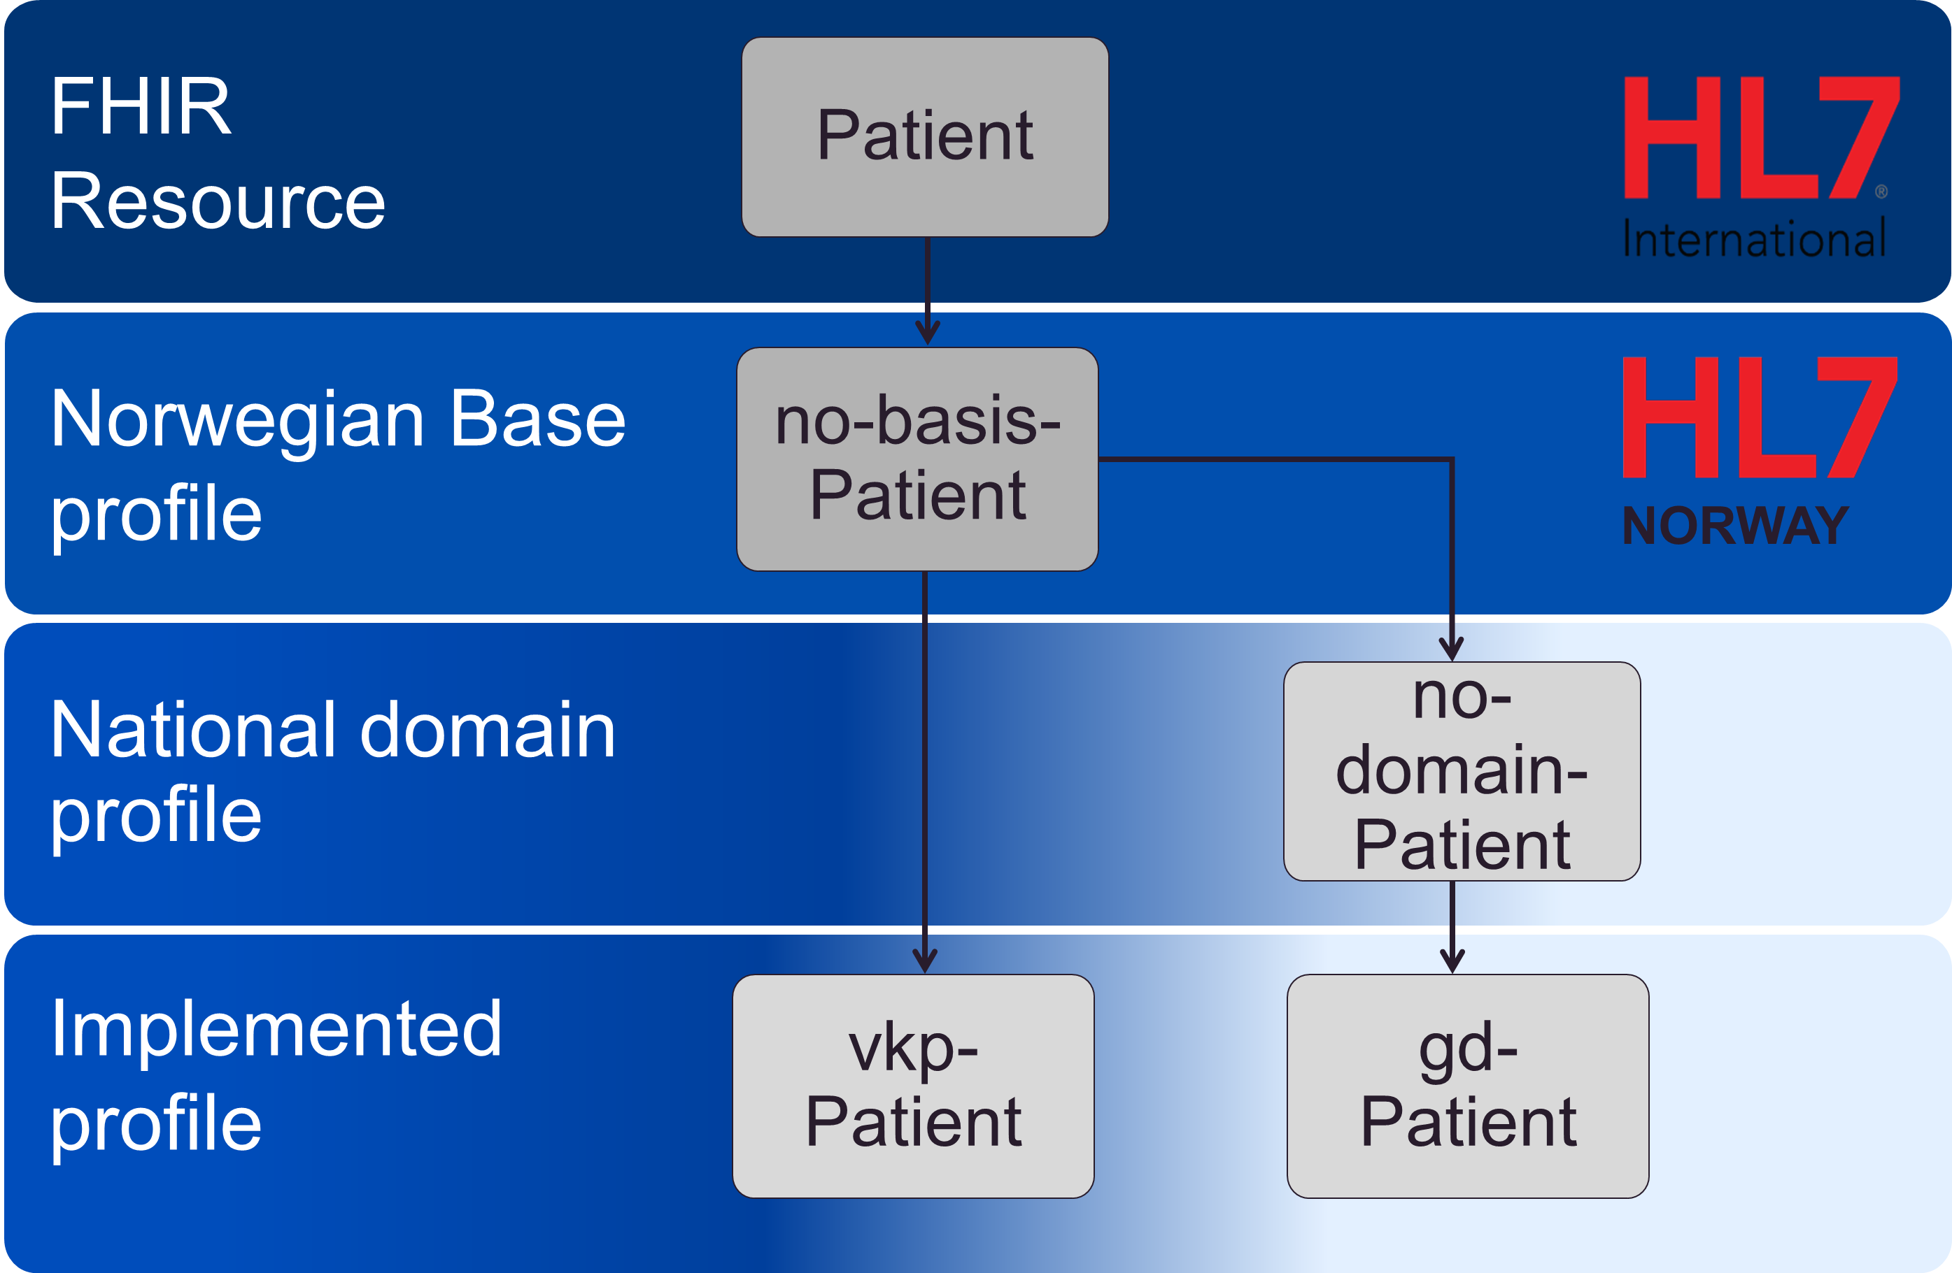
Profiling strategy
Top level view of governance and development for FHIR development in Norway
Everything builds on a collection of base profiles (no-basis)
Domain profiles are developed as needed
Implemented profiles are made by everyone
Notes:
Top-down and bottom-up approach

Slide 5
Norwegian base profiles
Suggestive not implementation rules
Best practice for how to use FHIR in Norway integrated in the base profiles
Identification for person/patients with Norwegian specific identifiers
Coding of HealthcareProfessional qualification and role
Use of RelatedPerson
Identification of Organizations with Norwegian specific identifiers

Slide 6
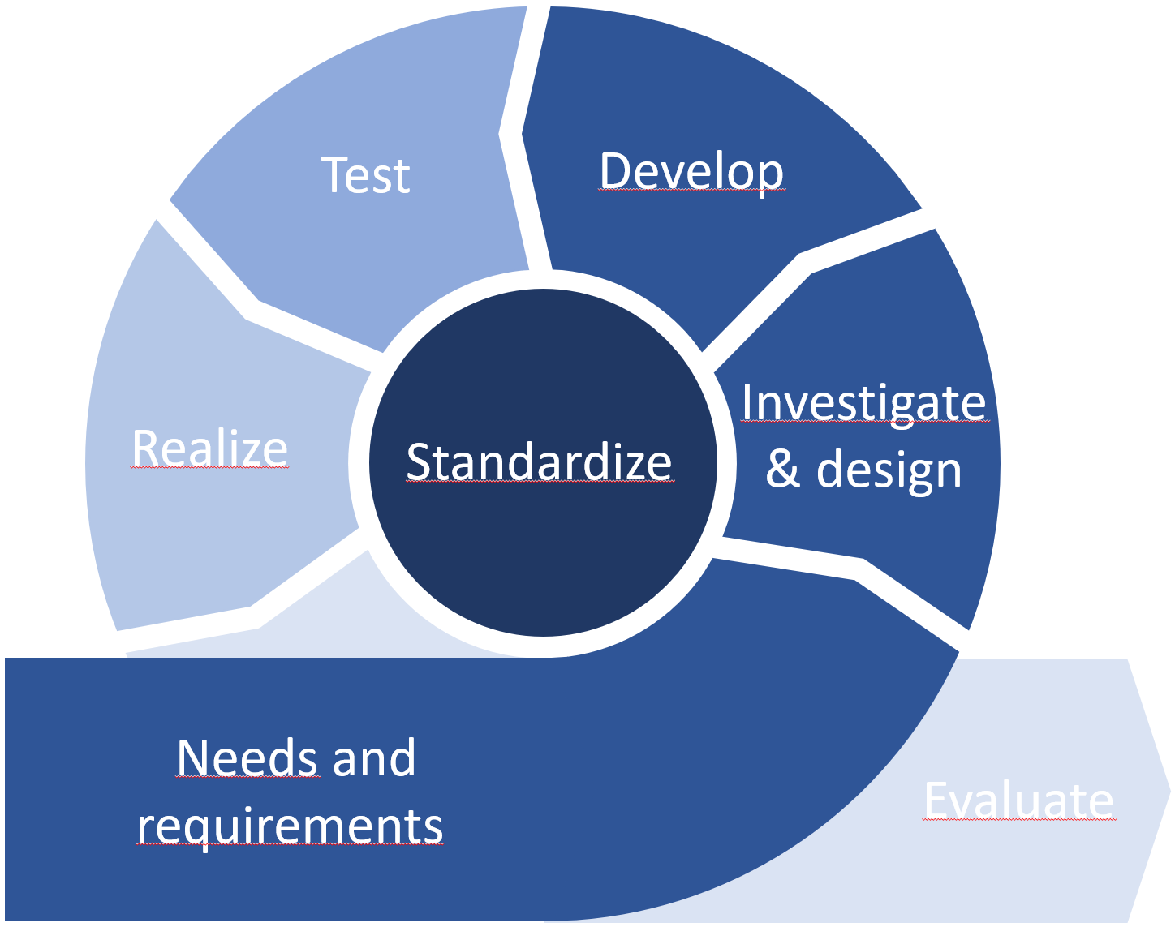
Method no-domain

Slide 7
Test
Develop
Investigate
& design
Realize
Standardize
Needs and
requirements
Evaluate

Slide 8
Utprøve
Utvikle
Utrede
Realisere
Normere
Behov og krav
Evaluere

Slide 9
Contact
During DevDays, you can find / reach me here:
Via Whova App – Speaker’s Gallery
Email
Twitter
..

Slide 10
Q&A

Slide 11
Title for slide
Text to add to slide
Indent item
Another item

