Slide 1
Thomas Tveit Rosenlund, The Norwegian Directorate of e-health
HL7 FHIR in Norway lessons learned

Slide 2
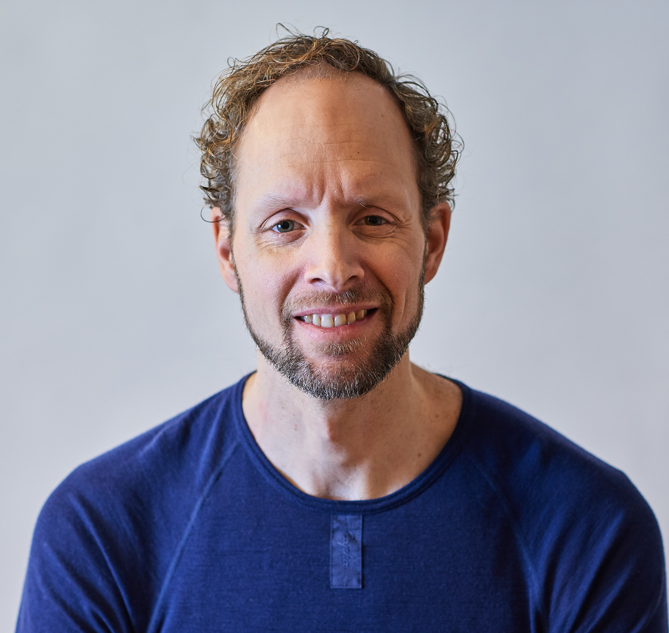
Who am I?
Thomas Tveit Rosenlund
Senior advicer employed at the Norwegian directorate of e-health
Enterprise architect

Slide 3


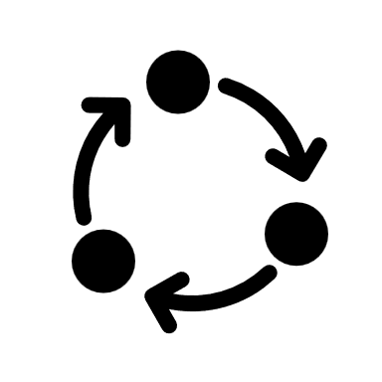




Overview
Strategy for FHIR profiling and governance
Method for development
Guidance for use of FHIR
Building the FHIR community
Standardization
Use FHIR in solutions

Slide 4
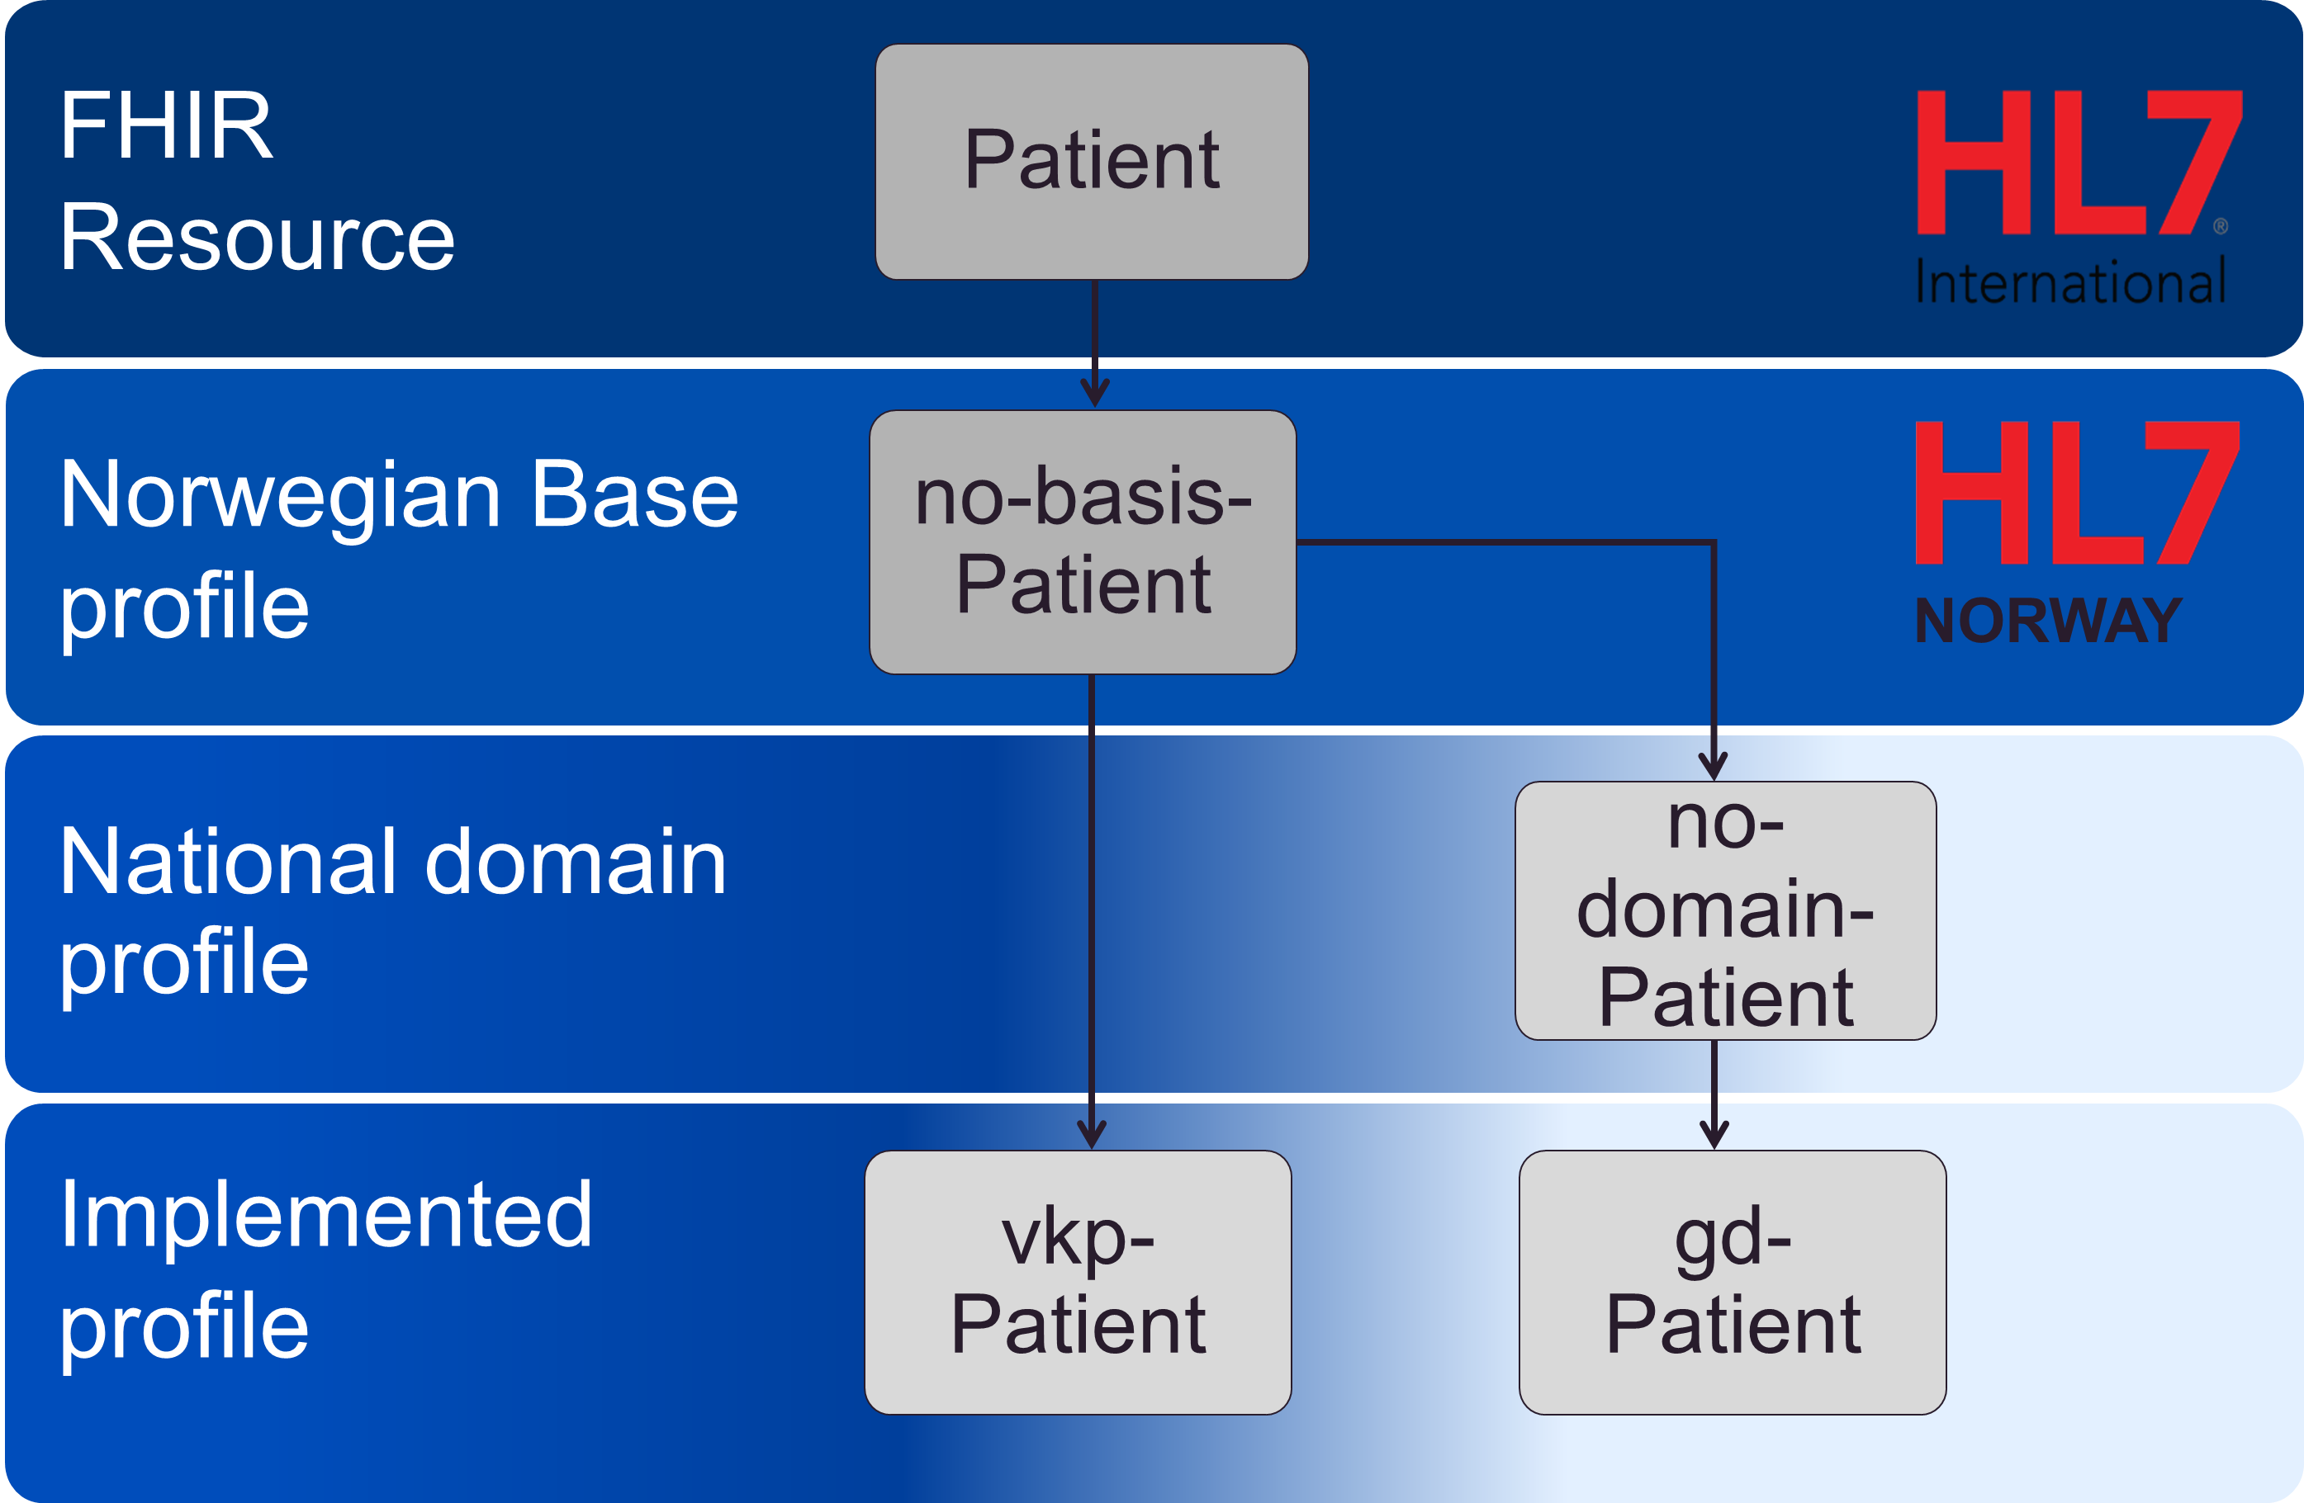
Profiling strategy
Top level view of governance and development for FHIR development in Norway
Everything builds on a collection of base profiles (no-basis)
Domain profiles are developed as needed
Implemented profiles are made by everyone
Notes:
Top-down and bottom-up approach

Slide 5
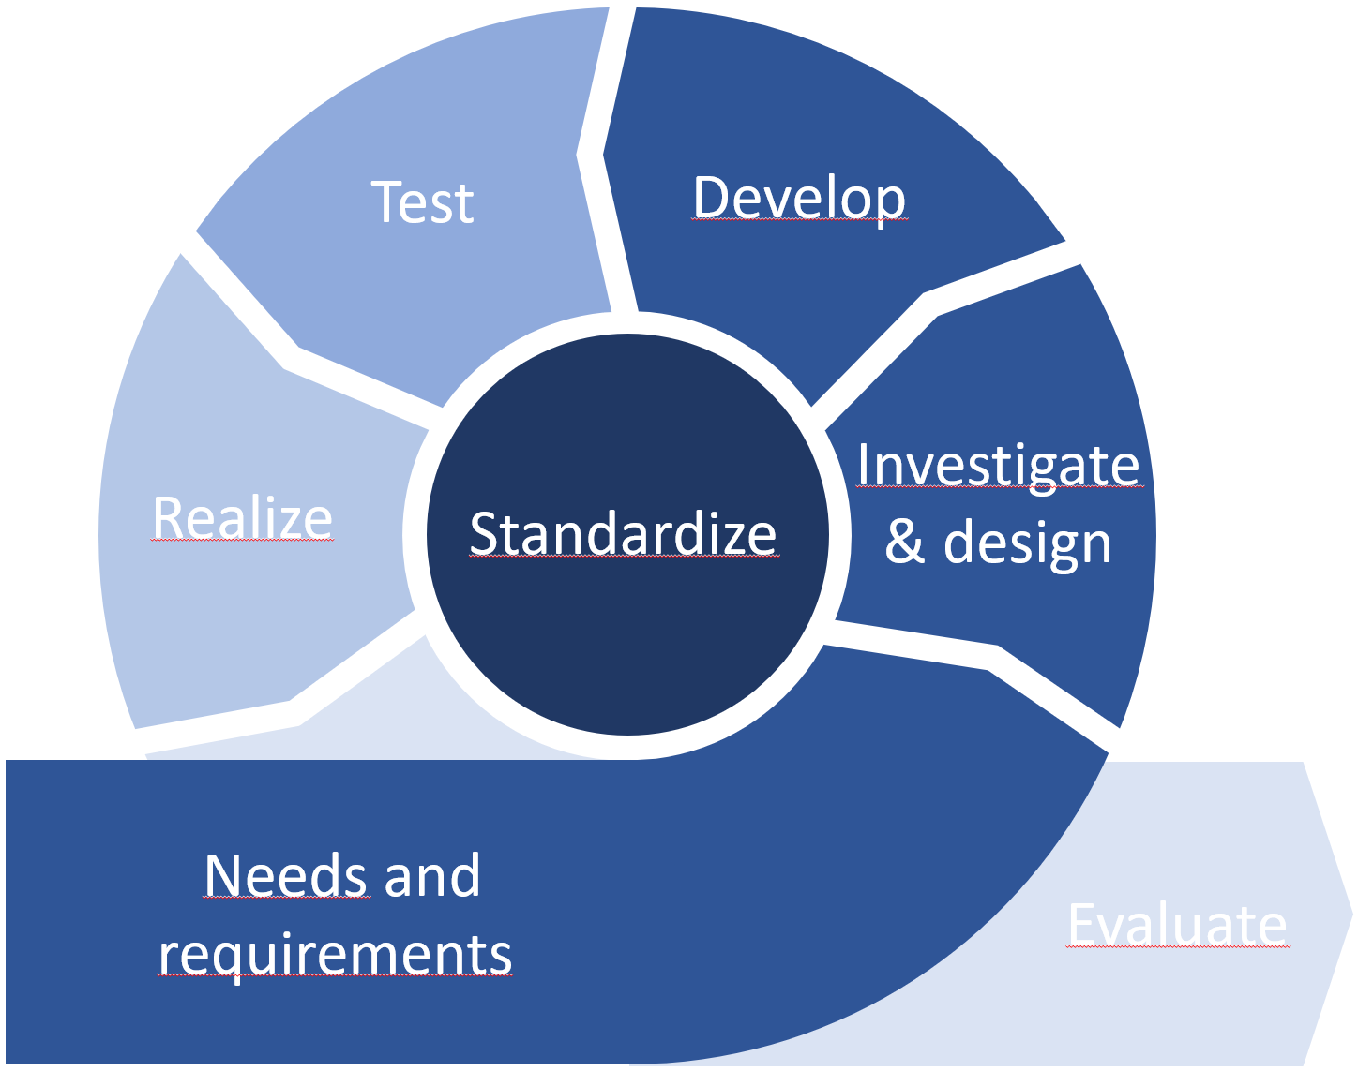
Method no-domain

Slide 6

Building the FHIR community
Mostly organized through HL7 Norway
Workshops base and domain profiling
Courses in FHIR and profiling
The Norwegian FHIR forum (aka «fagforum»)
About six meetins a year
Open disussions and lectures from vendors building solutions

Slide 7
Guideance
Ongoing work of documenting best-practice for using FHIR in the Norwegian realm
Rules for profiling
Pointing to the right places
Coding and terminology
The actual norwegian profiles…

Slide 8
Standardization
Norwegian base profiles
Guideline for standardisering av API using HL7 FHIR
Retningslinje for bruk av SMART on FHIR
In development: Norwegian domain profiles

Slide 9
Norwegian base profiles
Suggestive not implementation rules
Best practice for how to use FHIR in Norway integrated in the base profiles
Identification for person/patients with Norwegian specific identifiers
Coding of HealthcareProfessional qualification and role
Use of RelatedPerson
Identification of Organizations with Norwegian specific identifiers

Slide 10
Using FHIR in solutions

Slide 11
Q&A

Slide 13
Test
Develop
Investigate
& design
Realize
Standardize
Needs and
requirements
Evaluate

Slide 14
Utprøve
Utvikle
Utrede
Realisere
Normere
Behov og krav
Evaluere

