Slide 1
Thomas Tveit Rosenlund, The Norwegian Directorate of e-health
HL7 FHIR in Norway lessons learned

Slide 2

Who am I?
Thomas Tveit Rosenlund
Senior advicer employed at the Norwegian directorate of e-health
Enterprise architect
One of the main authors of national base profiles in Norway

Slide 3


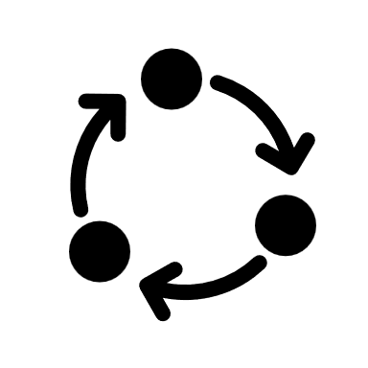




Overview
Strategy for FHIR profiling and governance
Method for development
Guidance for use of FHIR
Building the FHIR community
Standardization
Use FHIR in solutions

Slide 4
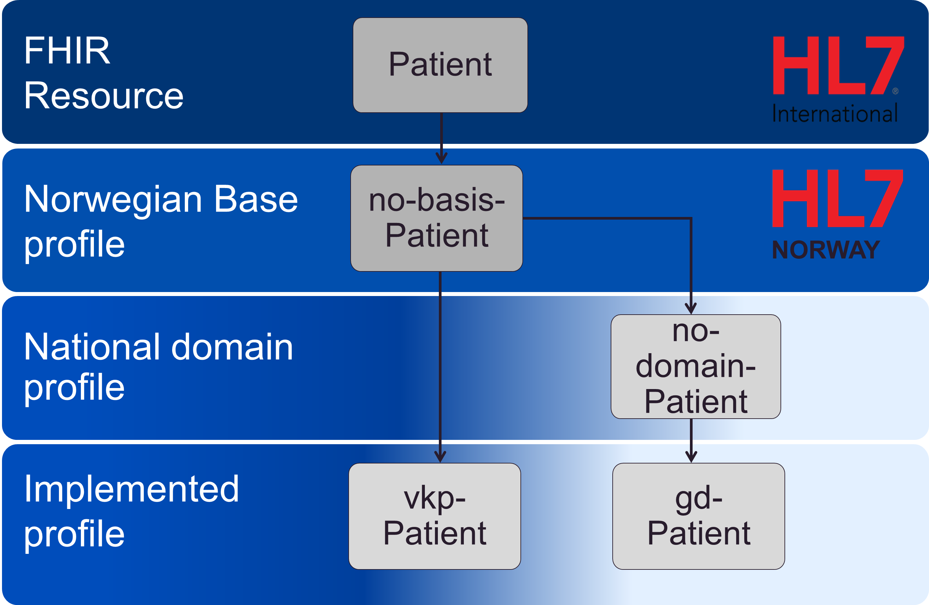
Profiling strategy
Top level view of governance and structure for FHIR implementation in Norway
Everything builds on a small collection of base profiles (no-basis)
Domain profiles (use-case domains) are developed as needed
Implemented profiles
Notes:
Top-down and bottom-up approach
Implemented profiles are made by everyone, and represents the actual implementation of FHIR in products/interfaces.

Slide 5
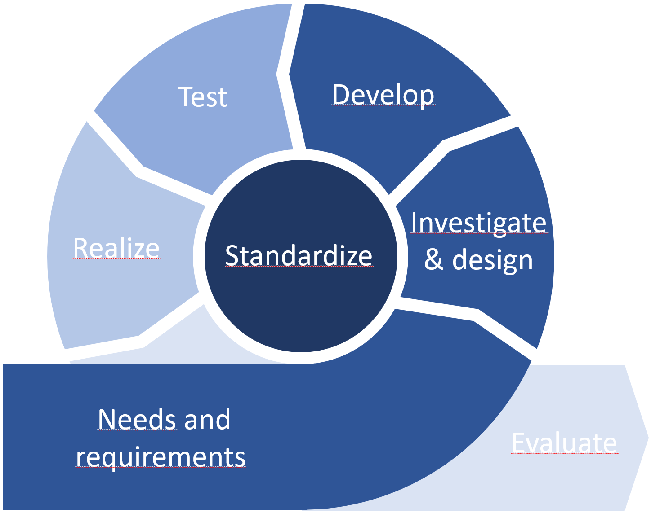
Method no-domain
Agile process for domain profiling
Focus on investigation and re-use of existing solutions
National and international interoperability
No-domain for vital signs is still in development..

Slide 6

Building the FHIR community
Mostly organized through HL7 Norway
Workshops base and domain profiling
Courses in FHIR and profiling
The Norwegian FHIR forum (aka «fagforum»)
About six meetings a year
Open disussions and lectures from vendors building solutions

Slide 7
Guideance
Ongoing work of documenting best-practice for using FHIR in the Norwegian realm
Rules for profiling
Pointing to the right places for research
Best practice for coding and terminology is an ongoing concern
The actual norwegian profiles… (see standardization)

Slide 8
Standardization
Norwegian base profiles
Guideline for standardisering av API using HL7 FHIR
Guideline for use of SMART on FHIR
In development: Norwegian domain profiles

Slide 9
Norwegian base profiles
Suggestive not implementation rules
Best practice for how to use FHIR in Norway is stated in the base profiles
Identification for person/patients with Norwegian specific identifiers
Coding of HealthcareProfessional qualification and role
Use of RelatedPerson
Identification of Organizations with Norwegian specific identifiers
Norwegian adress (including cadastral address)
The Norwegian middlename is not the same as the HL7 specified middlename
Notes:
Cadastral adress is connected to Norwegian property information

Slide 10
Using FHIR in solutions
Several national solutions have developed FHIR API’s
Central medication module (SFM)
The Personal Connected Health and care hub (VKP)
Core medical record (kritisk info kjernejournal)
Helsenorge offers several FHIR API’s (Helsenorge)
Lab results (Pasientens prøvesvar)
Other solutions of notice
Vital signs monitoring (no-domain-vital-signs)
The Norwegian CarePlan is in pilot (DBEP)
Colonoscopy report
Notes:
SFM have now connected about 100 different actors to the modernized infrastructure for medical prespcription.

Slide 11

Great success!
Norwegian base profiles are used by most norwegian FHIR projects (in one way or another).
Effort on building FHIR community by hosting a steady flow of open webinars have been successfull.
The official advice to use FHIR for API data exchange over have been important for adoption of FHIR in Norway.
FHIR FTW

Slide 12


Failure and slow progress
Our greates failure was the effort to publish the Norwegian master person index using FHIR.
The FHIR project was scrapped because of to many extensions and cumbersome use of RelatedPerson structure, wich lead to poor performance.
Norwegian domain profiling is moving very slowly.

Slide 13
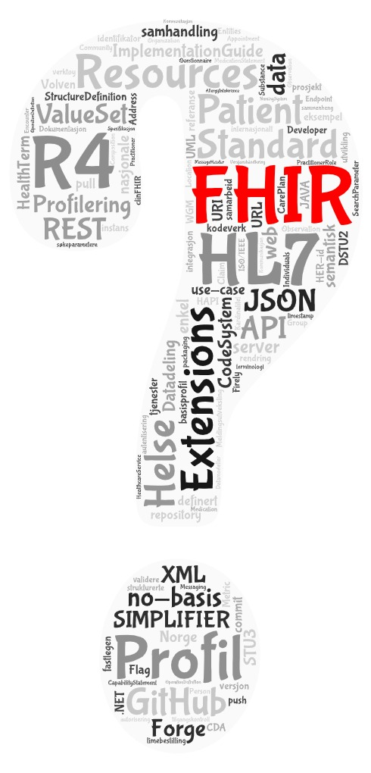
Q&A

Slide 15
Test
Develop
Investigate
& design
Realize
Standardize
Needs and
requirements
Evaluate

Slide 16
Utprøve
Utvikle
Utrede
Realisere
Normere
Behov og krav
Evaluere

