Slide 1
Norwegian FHIR Hackathon
OKT Track Report
EHiN, 2025 November -
FHIR fagforum
HL7 Norge
2025-12-10

Slide 2
The OKT Track
OKT: Oversikt over kommunale tjenester
Overview of municipal health services a patient receives
Designed and maintained by Norsk helsenett
Hackathon track objectives
Test a FHIR implementation of an existing proprietary API
Suggest a FHIR implementation to the service owner
Increase understanding of FHIR and the API content
Notes:
Notes: My notes

Slide 3
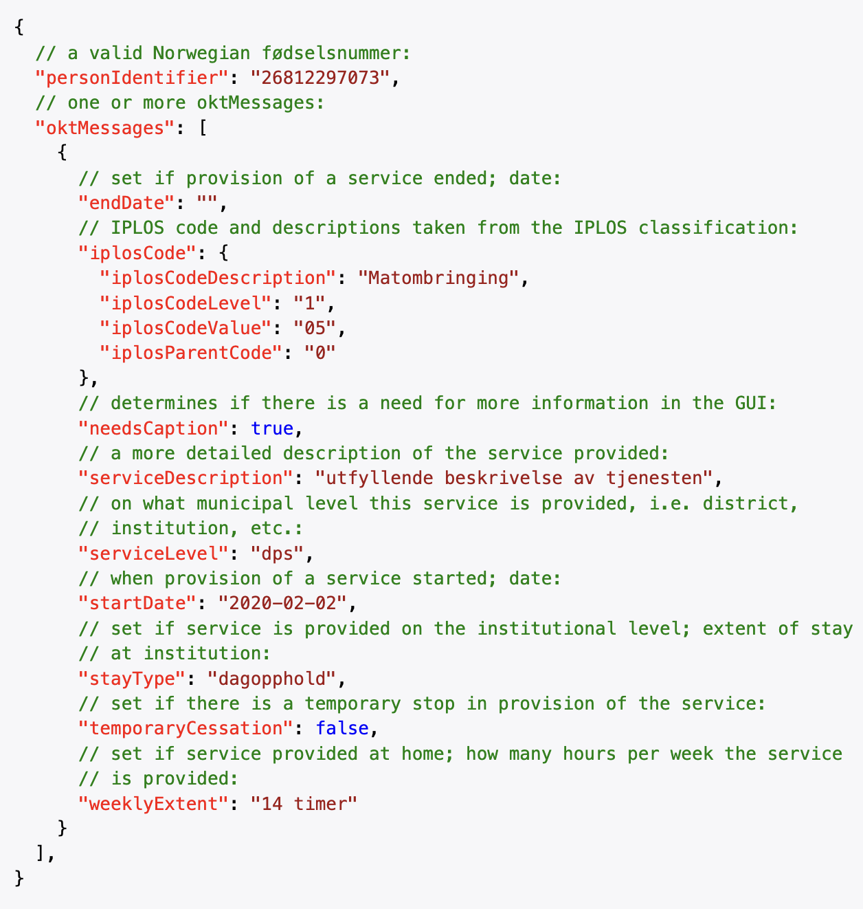
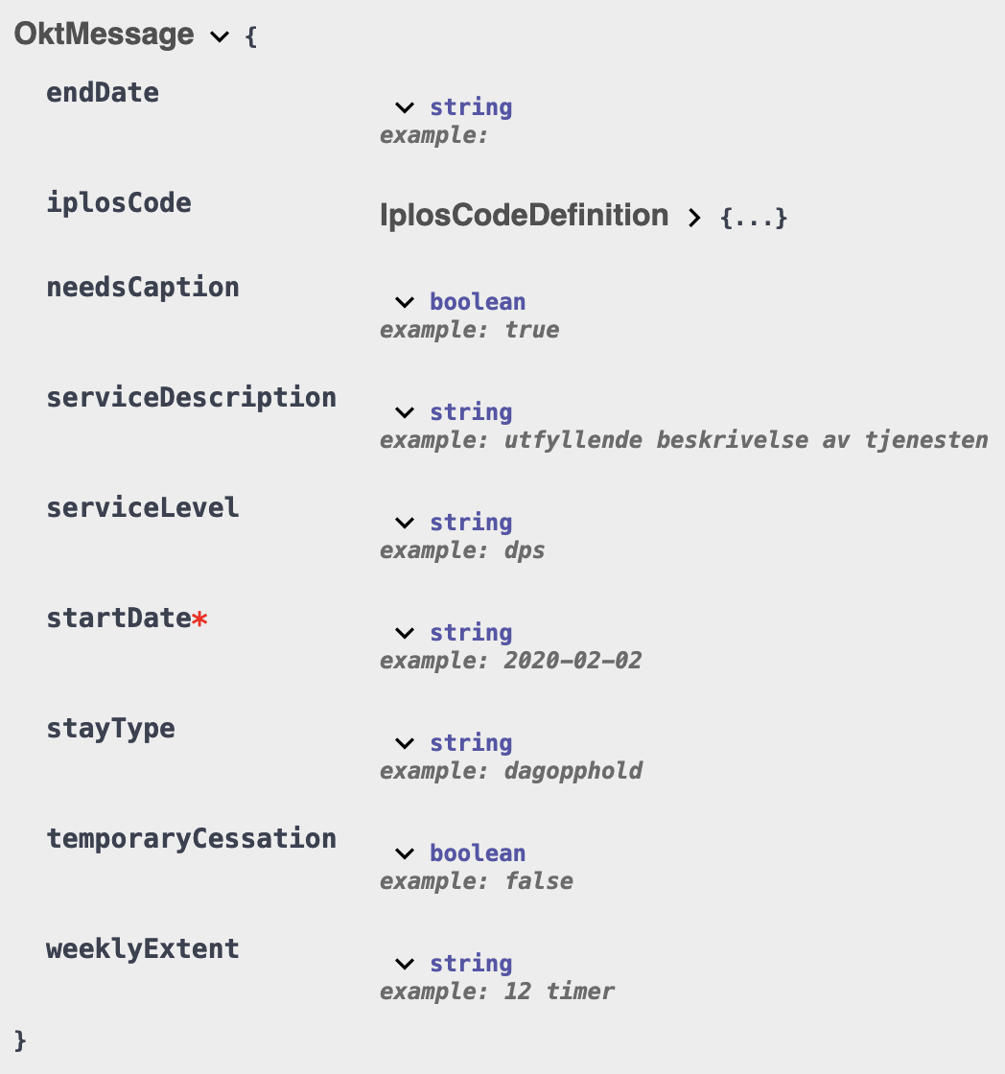
The Proprietary API
Documentation from Norsk helsenett
Default OpenAPI documentation
Examples

Slide 4
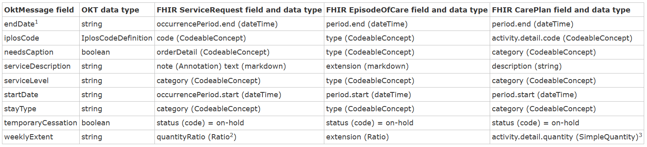
Hackathon Preparations
Draft Implementation Guide
Logical models of the source structure
Selected resource candidates
Suggestions mapping data elements to resources
Several proposals for further discussion

Slide 5
Discussions at the Hackathon
Participants from data provider, consumer, and service owner
Diverse backgrounds, both medical and technical
Lessons learned
Important to scope the discussion:
Mapping the present state or extending functionality
Develop a common understanding of the meaning of concepts in care delivery and the scope of resources

Slide 6
Hackathon Achievements
Narrowing the range of candidates – Selected 2 of the 3 proposed resources for further investigation and testing
Fine-tuning the mappings – Modified some fields to reflect medical content and actual use in the pilot
Common understanding of the content – developed through discussion of the information in the OKT API
Demonstrated how the hackathon model work for co-creating a model with stakeholder involvement
Notes:
Notes: My notes

Slide 7
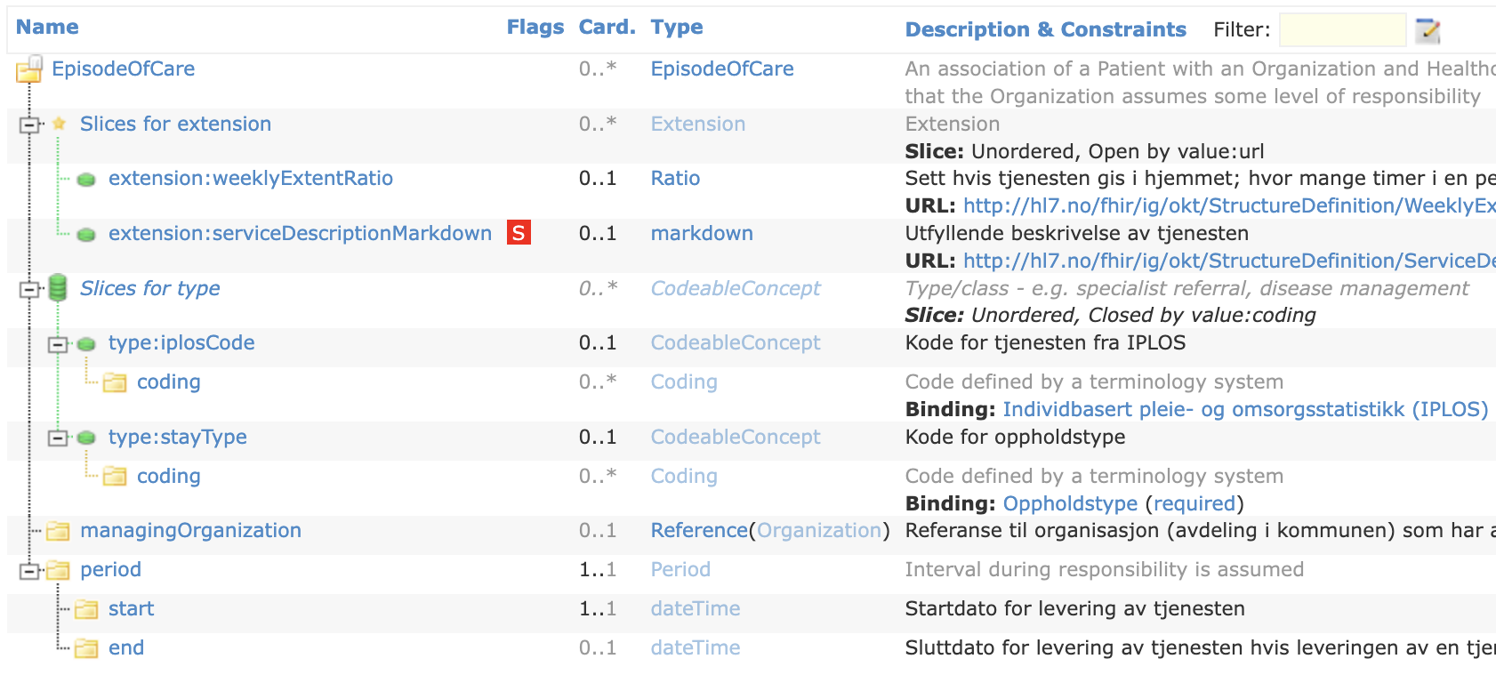
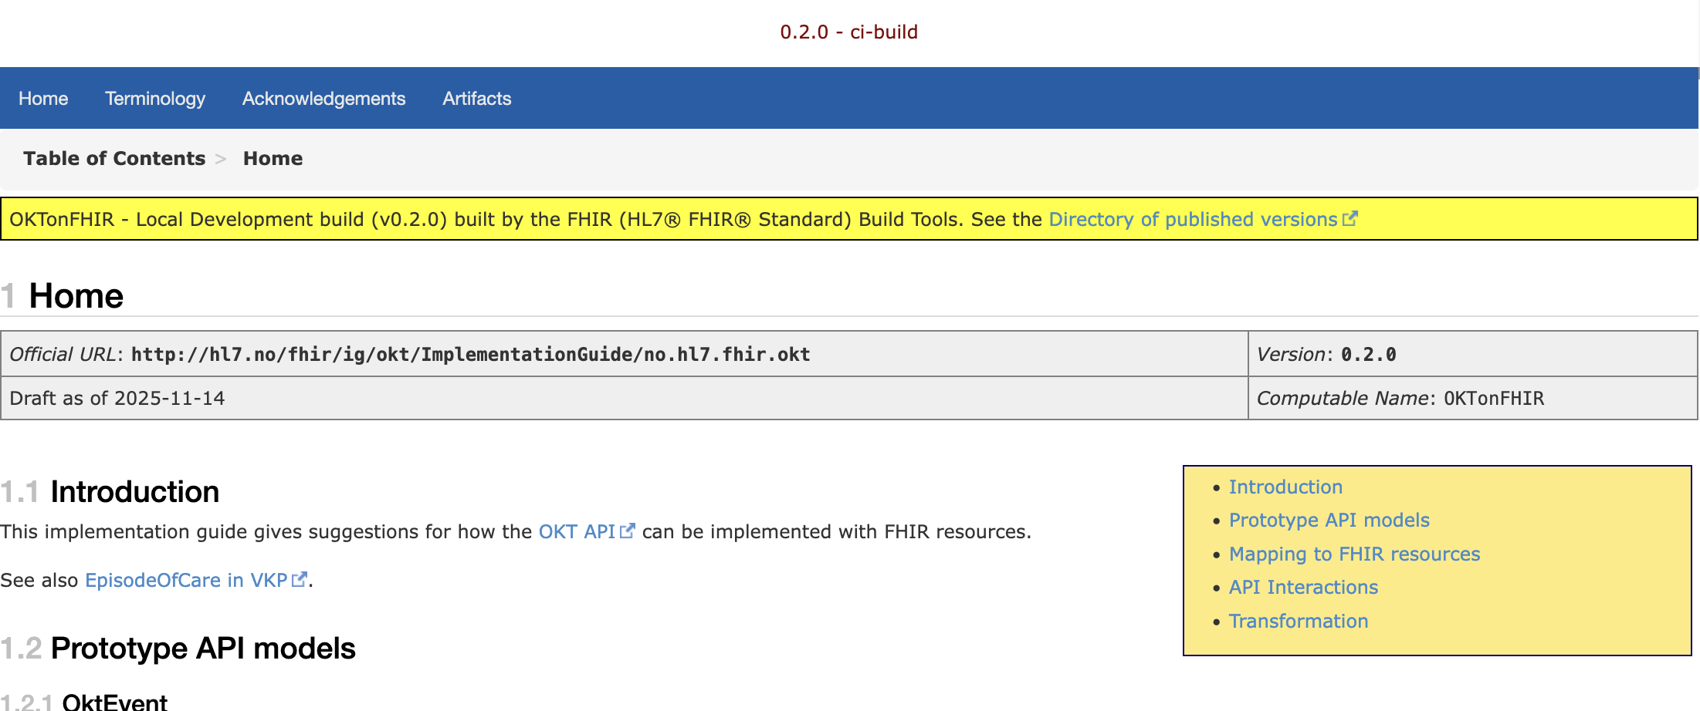
After the Hackathon
Draft Implementation Guide remains available on GitHub:
https://github.com/HL7Norway/FHIR-hackathon-2025-okt-ig
Open to contributions as GitHub Issues and PRs
Continued discussion with hackathon participants and HL7 Norway

Slide 8
Extending the OKT FHIR API
Issues raised during the hackathon:
Add terminology for coded elements
How to ensure that data is updated, last changed vs. last refreshed
Where to store contact information
The process – Follow the steps used for the hackathon:
Identify missing data based on requirements
Extend the logical models
Choose potential FHIR resources
Map data elements
Discuss and validate proposals in hackathons and with TSC in HL7 Norway

Slide 9
Future of the OKT FHIR API
Implementation is the decision of the service owner
The draft Implementation Guide is available for reuse
Forums for discussion can include HL7 Norway and Bedredelt

Slide 10
HL7 Norge | FHIR fagforum | 2025-12-10

