Slide 1

Structuring and enriching electronic package leaflets in Felleskatalogen
FHIR Fagforum
HL7 Norway
2023-03-29
Ádám Z. Kövér
Felleskatalogen AS

Slide 2
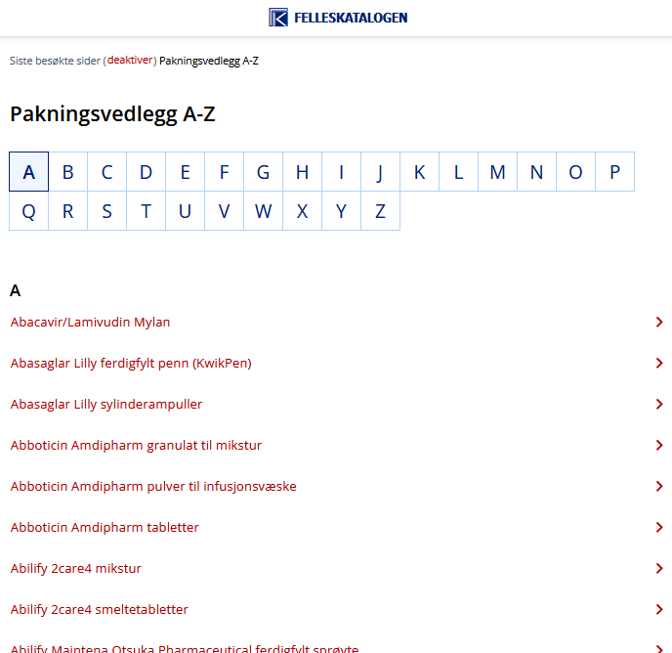


“Les pakningsvedlegg”

Slide 3
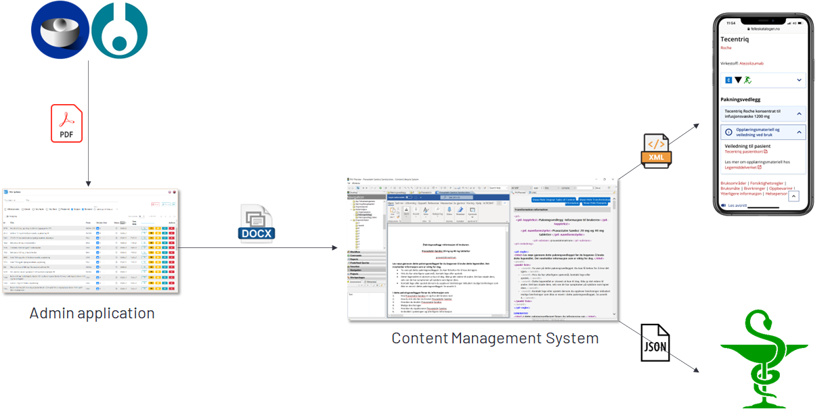
Current workflow with package leaflets

Slide 4
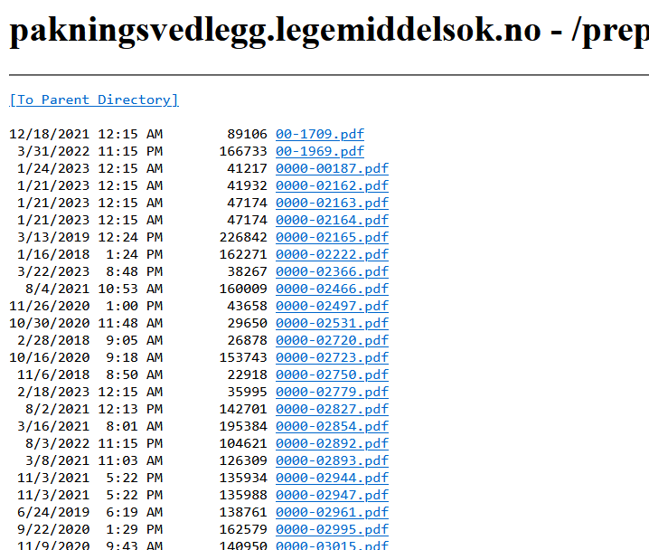
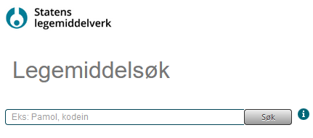
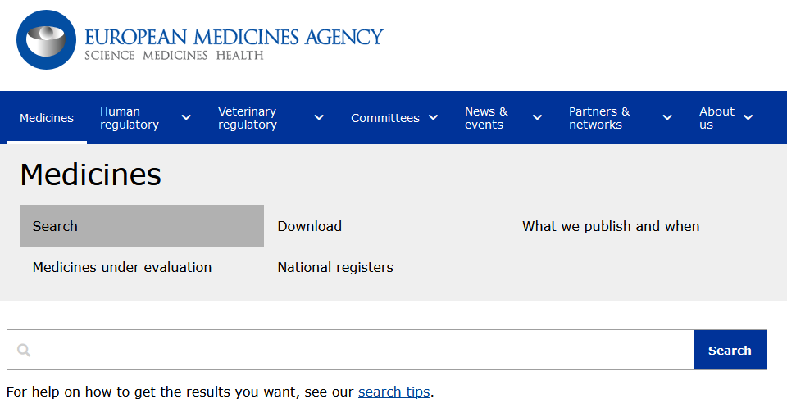
Source material
PDF documents downloaded from:
The Norwegian Medicines Agency
EMA

Slide 5
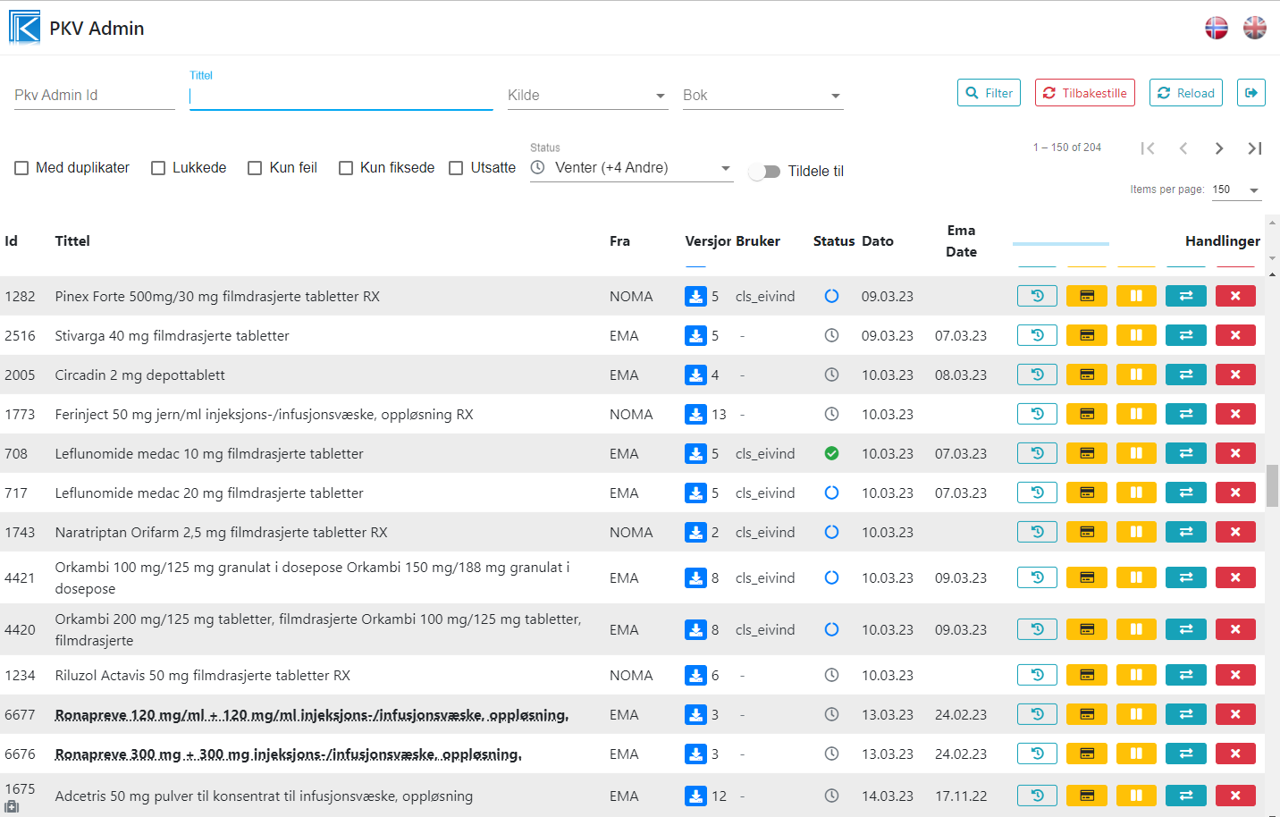
Change detection and automatic conversion
Versioned local cache of PI documents
Changes detected automatically
Review changes between any of the archived versions
Import selected version to CMS for further processing

Slide 6
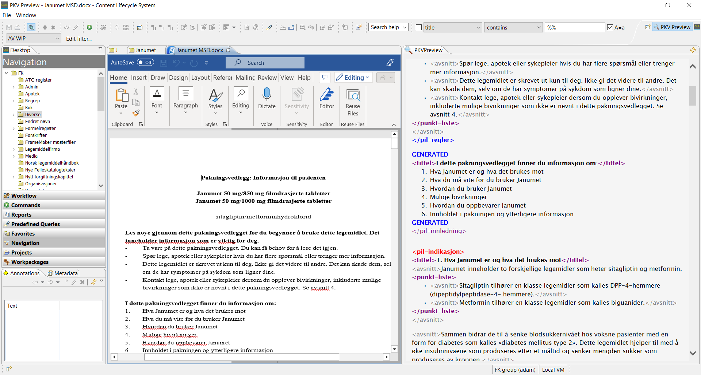
Conversion from Word to XML: Review and comparison
Recognize sections (content patterns)
Convert formatting instructions
Human review

Slide 7
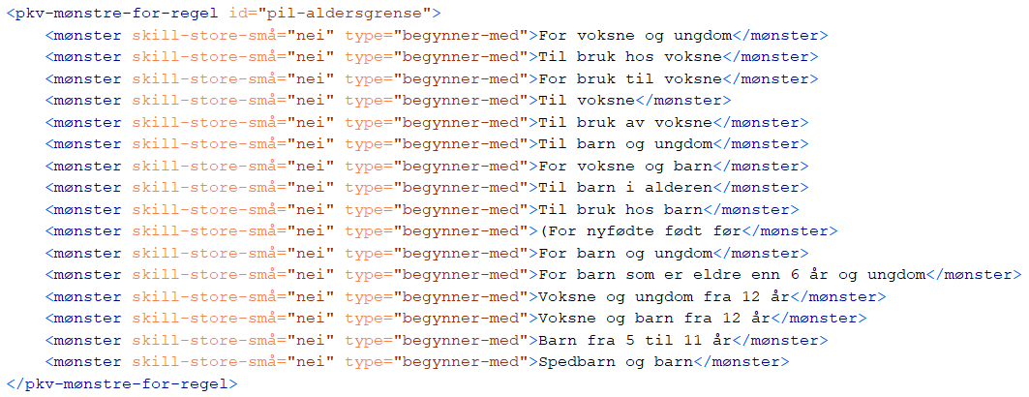
Conversion from Word to XML: Patterns

Slide 8
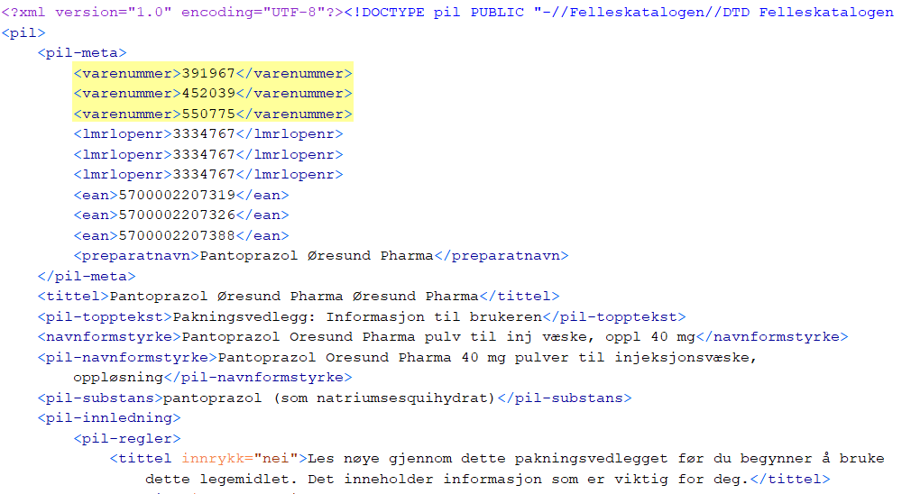
Connection to structured data: Identifiers in metadata

Slide 9
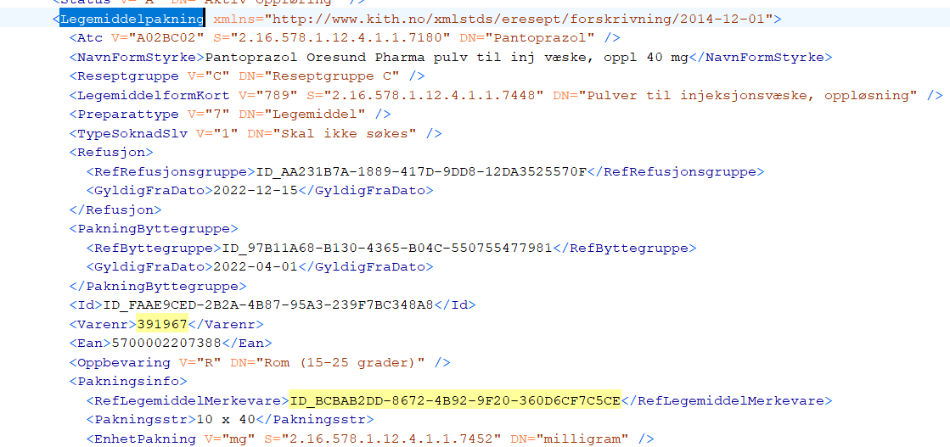
Connection to structured data: FEST

Slide 10
From the CMS to the browser
CMS
Content repository
Web / app
Document structure
Normalized markup
Additional data sources
Metadata
Semantic HTML
Dynamic functions
Structured master data

Slide 11
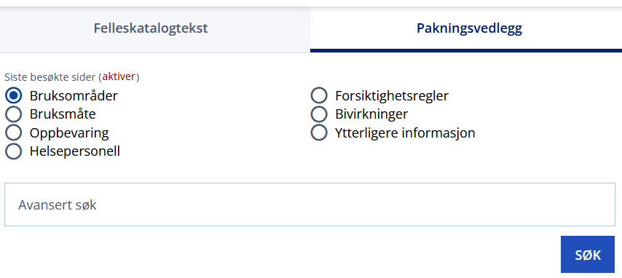
Web: Advanced search
Search in a specific section: needs to identify the section
Level 1 PIL sections

Slide 12
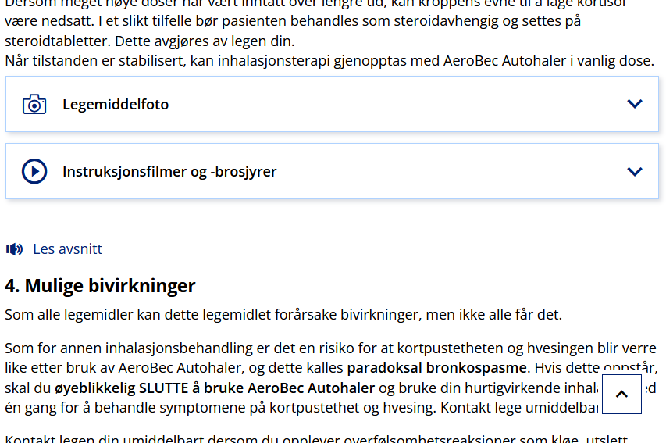
Web: positioning additional content

Slide 13
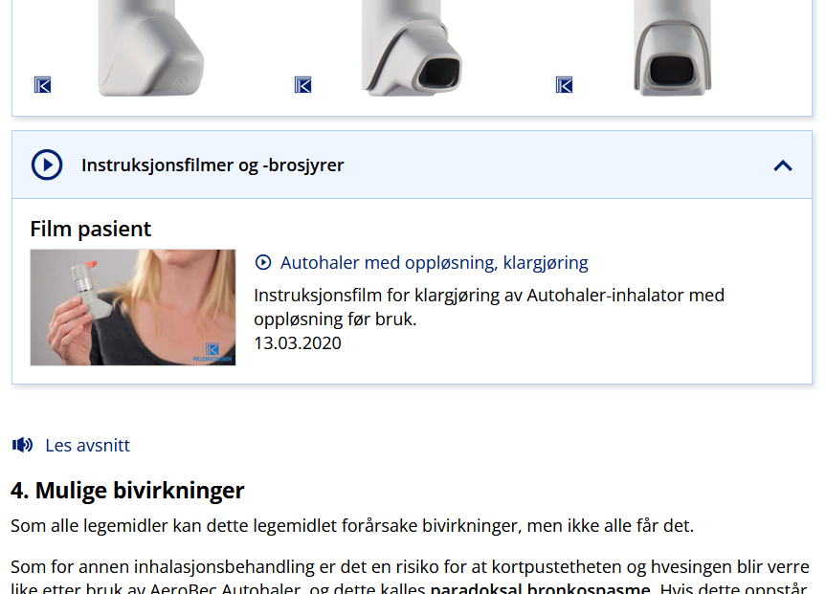
Web: positioning additional content (2)

Slide 14
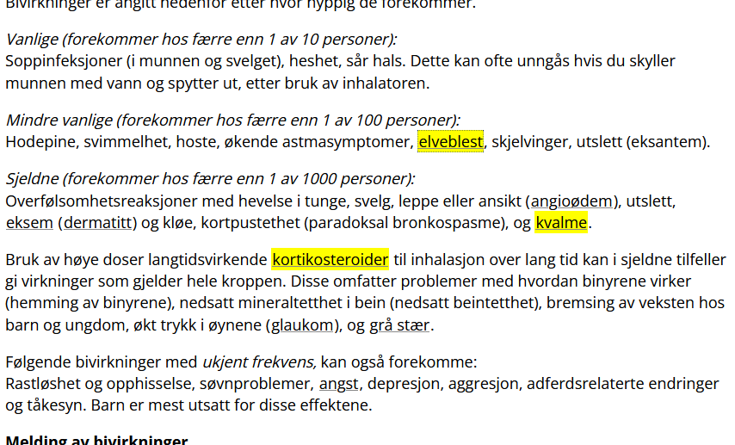
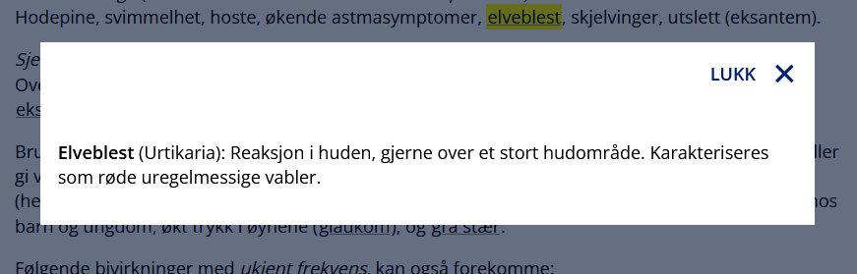
Web: medical dictionary

Slide 15


Felleskatalogen and ePI
Structured document instead of PDF
Connect structured data sources (FEST / SPOR)
Platform for additional features for a richer user experience (Photos and multimedia, dictionary, search / G-lens)

Slide 16
Deliver and prepare to consume ePI
Felleskatalogen XML
Felleskatalogen web / app
FHIR ePI

Slide 17
The QRD template
Defines the PIL content and structure
The ePI composition and Felleskatalogen’s XML capture the same document structure - with potentially different depth
The ePI and Felleskatalogen’s structure should fundamentally be compatible

Slide 18
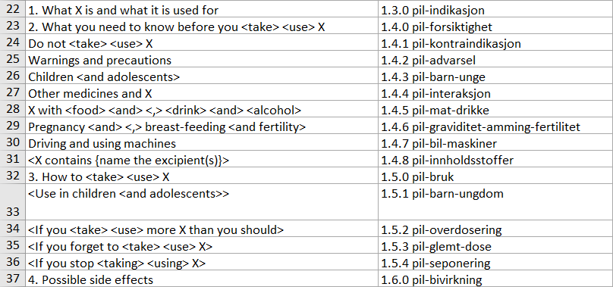
Mapping Felleskatalogen’s XML to ePI sections

Slide 19
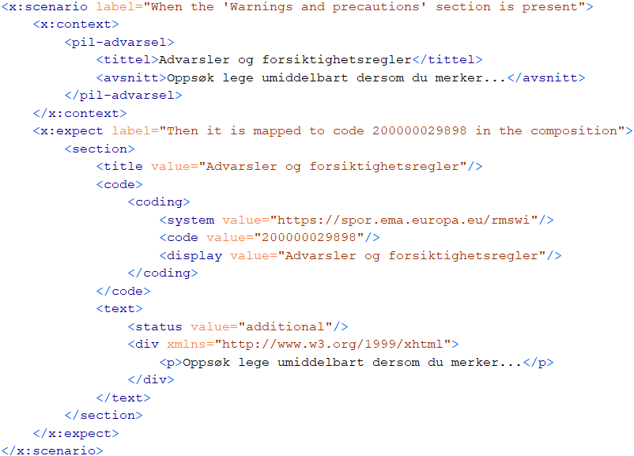
Mapping Felleskatalogen’s XML to ePI sections

Slide 20
Structuring beyond the QRD template
pil-innledning
pil-aldersgrense (“Til bruk hos voksne og ungdom (12-65 år)”)
pil-virkestoff-info
pil-innpakning
pil-viktig-info
pil-notat
pil-bivirkningsovervåkning (additional monitoring)
pil-regler (“Read all of this leaflet carefully”)
pil-innholdsfortegnelse (“What is in this leaflet”)
pil-pasient-info Extended information to patient about administration (about 10% of PILs)

Slide 21
Providing ePI in production
Felleskatalogen has the relevant experience for the one-time conversion needed to migrate from PDF to ePI
The PI documents should be maintained in a structured authoring environment after the conversion
Legacy document management
Felleskatalogen XML
Felleskatalogen web / app
Structured content authoring
FHIR ePI
EMA Portal

