Slide 1
Thomas Tveit Rosenlund, The Norwegian Directorate of e-health
HL7 FHIR in Norway lessons learned

Slide 2

Who am I?
Thomas Tveit Rosenlund
Senior advicer employed at the Norwegian directorate of e-health
Enterprise architect
One of the main authors of national base profiles in Norway

Slide 3


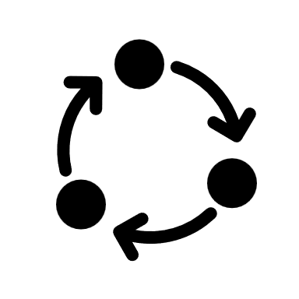




Overview
Strategy for FHIR profiling and governance
Method for profile development
Guidance for use of FHIR and FHIR profiling
Building the FHIR community
Standardization
The use of FHIR in solutions
Successes and failure
Notes:
Standardization of how to use FHIR in Norway.

Slide 4
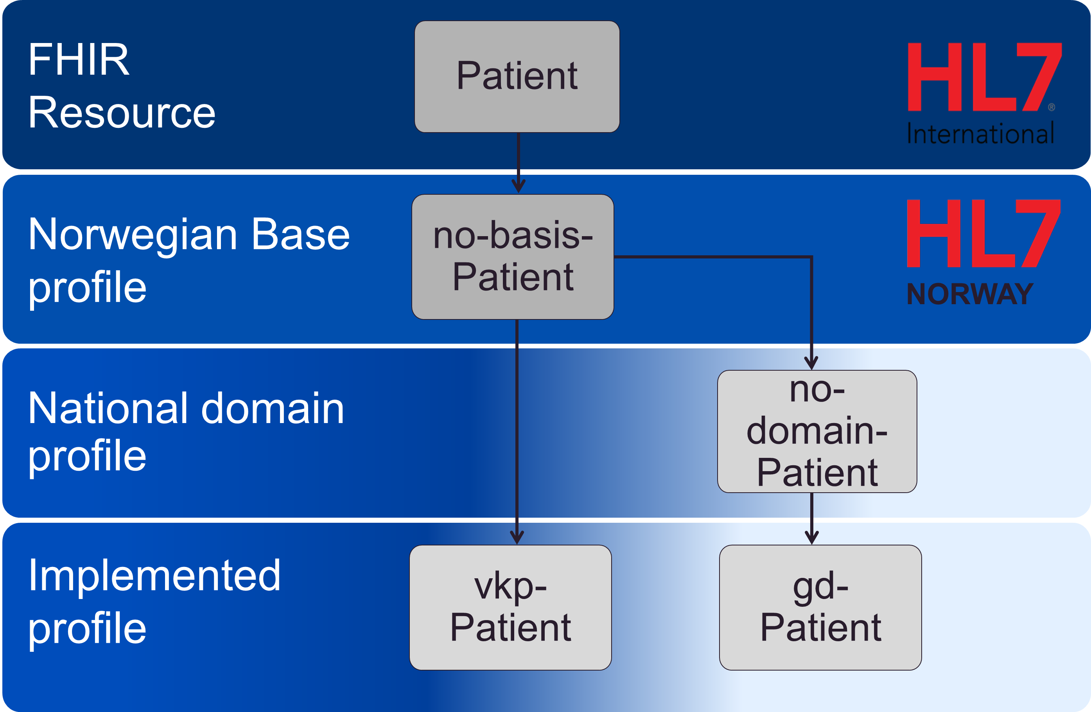
Profiling strategy
Top level view of governance and structure for FHIR implementation in Norway
Everything should build on a small collection of base profiles (no-basis)
Domain profiles (use-case domains) are developed as needed
Implemented profiles
Notes:
Early on we started by defining the Norwegian profiling strategy, also known as the profiling hierarcy.
The strategy is a top level view of the governance of different sets of profiles and show how FHIR implementation can use higher level base and domain profiles.
It is based on a top-down and bottom-up approach where we believe that FHIR is developed when we build actual solutions that uses FHIR for interoperability, however we want to document the common rules that most implementers needs in base and domain profiles.
Base profiles states the most important common rules for how to use FHIR in Norway, that should be relevant to most solutions regardless of use-case.
Domain profiles are developed as needed and states the same as base profiles, should build on base profiles, but are related to some high level use case, like exchaning vital signs in Norway.
Implemented profiles are made by everyone, and represents how FHIR is used in actual implementation in products/interfaces, most should relate to domain or base profiles if relevant profiles exists.

Slide 5
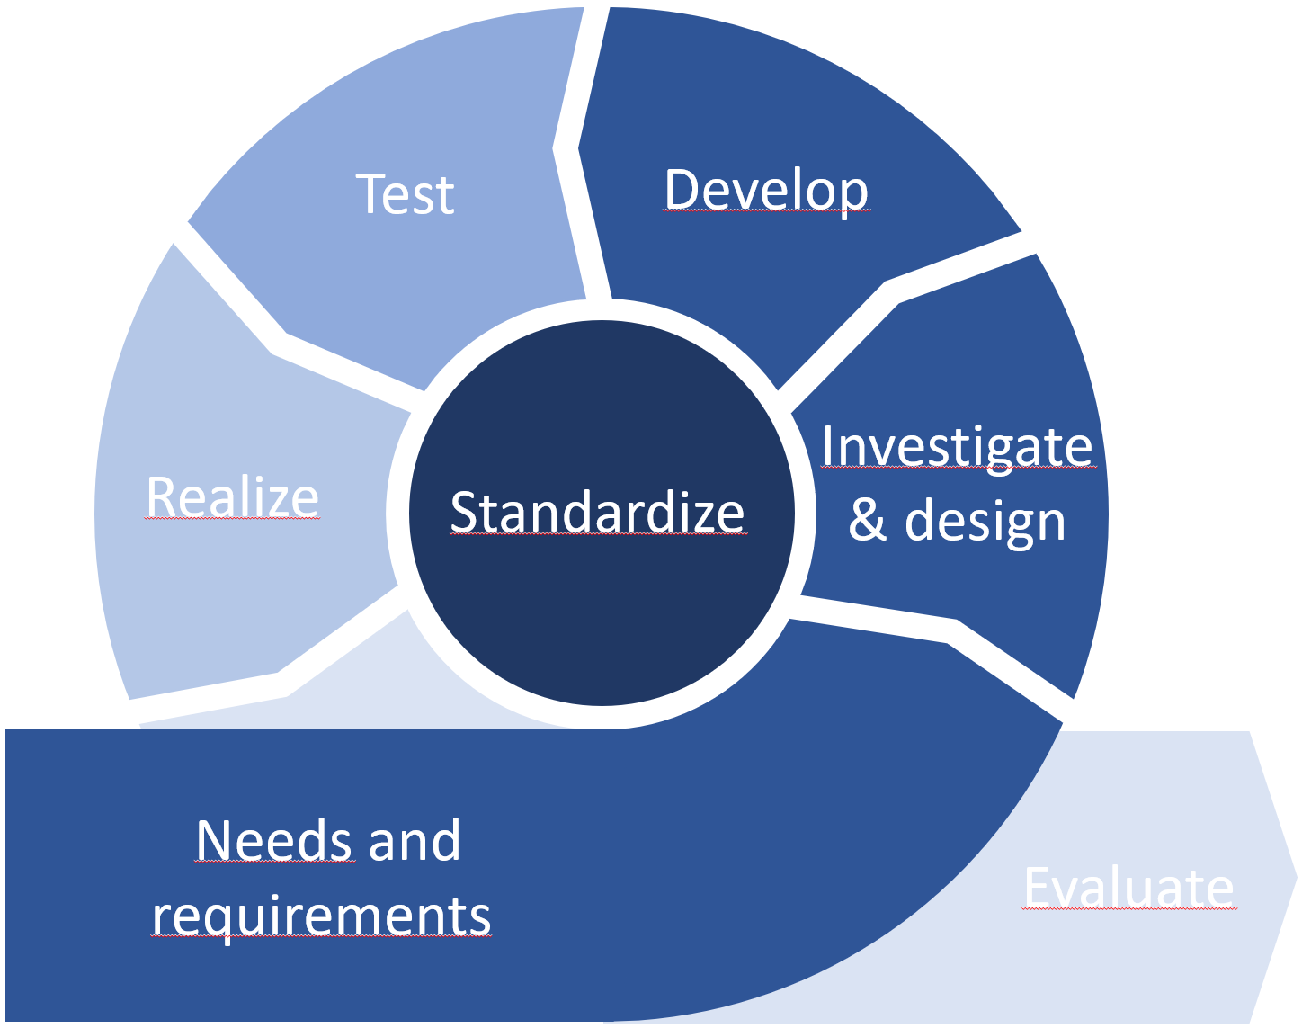
Method no-domain
Agile process for domain profiling
Focus on investigation and re-use of existing solutions
National and international interoperability
No-domain for vital signs is still in development..

Slide 6

Building the FHIR community
Mostly organized through HL7 Norway
Workshops base and domain profiling
Courses in FHIR and profiling
The Norwegian FHIR forum (aka «fagforum»)
About six meetings a year
Open disussions and speakers from vendors building solutions
Notes:
FHIR fagforum also shares information from research projects that is using FHIR like Gravitate health and CAPABLE programs.

Slide 7
Guideance
Ongoing work of documenting best-practice for using FHIR in the Norwegian realm
Rules and method for profiling
Existing profiles and projects
Pointing to the right places for research
Best practice for coding and terminology is an ongoing concern
The actual norwegian profiles… (see standardization)
Notes:
General guideance on how to use FHIR in the Norwegian realm.

Slide 8
Standardization and recommendations
Norwegian base profiles
Recommendation for using HL7 FHIR for data sharing
Recommendation for using SMART on FHIR for app integrations in heathcare applications
In development: Norwegian domain profiles
Notes:
Normative standardization of how to use HL7 FHIr in Norway that is documented in the base profiles.
In addition the authorities, that is the Norwegian directorate of e-health have published two recommendations of using FHIR technology.
Interoperability throug API’s
Using Smart on FHIR for app integrations in healthcare applications

Slide 9
Norwegian base profiles
Suggests how to use HL7 FHIR in the norwegian realm and show how to specify this in a profile that can be re-used by implementers.
No-basis contains no mandatory conformance requirements, meaning almost any implementation can use no-basis as a base for re-profiling
Best practice for how to use FHIR in Norway is stated in the base profiles
Identification for person/patients with Norwegian specific identifiers
Coding of HealthcareProfessional qualification and role
Use of RelatedPerson
Identification of Organizations with Norwegian specific identifiers
Norwegian adress (including cadastral address)
The Norwegian middlename is not the same as the HL7 specified middlename
Notes:
The base profile suggest methods of how to use HL7 FHIR in the Norwegian realm and sho example of how to implement this as a HL7 FHIr profile. The base profile can be used by implementers as a base for the implementation of actual implemented profiles used by actual solutions.
This is an important principle and is stated as such in the no-basis principles.
Suggestions for useful extension, like how to add a Norwegian Cadastral adress in the FHIR Address datatype, this is added using a voluntarily property information extension.

Slide 10
Using FHIR in solutions
Several national solutions have developed FHIR API’s
Central medication module (SFM)
The Personal Connected Health and care hub (VKP)
Core medical record (kritisk info kjernejournal)
Helsenorge offers several FHIR API’s (Helsenorge)
Lab results service (Pasientens prøvesvar)
Other solutions of notice
Vital signs monitoring (no-domain-vital-signs)
Digital CarePlan using core medical record is in pilot (DBEP)
Notes:
SFM have now connected about 100 different actors to the modernized infrastructure for medical prespcription.

Slide 11

Great success!
Norwegian base profiles are used by most norwegian FHIR projects (in one way or another).
Effort on building FHIR community by hosting a steady flow of open webinars have been successfull
The official recomendation to use FHIR for data sharing have been important for adoption of FHIR in Norway.
FHIR FTW
Notes:
The flexiblity of the base profiles are important for their success. The lax suggestive nature of those profiles means that almost any implementation can re-profiles the base and build on them.
FHIR fagforum both builds avareness, shares implementations experiences, builds FHIR knowledge and is a goto meeting place for the Norwegian FHIR community.
There are no sanctions for not following the official recommendation for use of FHIR for API’s but the fact that it is there and can be referenced is of great value for rising avareness of FHIR for interoperability.

Slide 12


Failure and slow progress
Our greatest failure was the effort to publish the Norwegian master person index using FHIR.
The FHIR project was scrapped because of to many extensions and cumbersome use of RelatedPerson structure, wich lead to poor performance.
Norwegian domain profiling is moving very slowly.
Mainly because of the difficulty relating the LOINC magic value to actual SNOMED terminology that clinicians want to use
Notes:
The way we used RelatedPerson resources led to a great number of resources on the server, and athough it was a flexible model it did not scale well.
Norwegian domain profiling and relating the mandatory SNOMED CT terminology to the LOINC magic value have been time consuming for vital-signs.
Also the level of detail that norwegian clinicians think is necessary when exchanging the vital signs

Slide 13
Contact
Email: thomasrosenlund@gmail.com
Direct messaging on chat.fhir.org
https://www.linkedin.com/in/thomas-tveit-rosenlund/

Slide 14
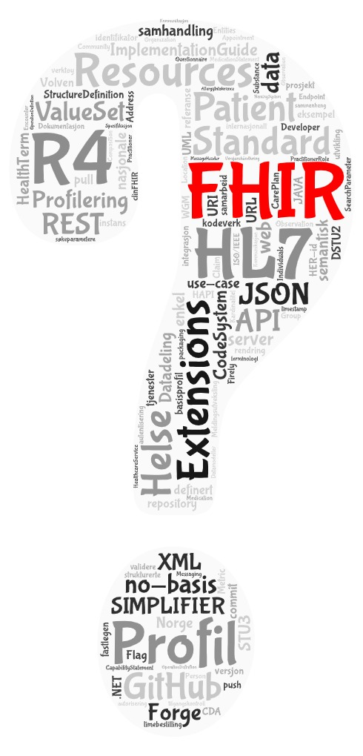
Q&A

Slide 16
Test
Develop
Investigate
& design
Realize
Standardize
Needs and
requirements
Evaluate

Slide 17
Utprøve
Utvikle
Utrede
Realisere
Normere
Behov og krav
Evaluere

