Slide 1
Thomas Tveit Rosenlund, The Norwegian Directorate of e-health
HL7 FHIR in Norway lessons learned

Slide 2
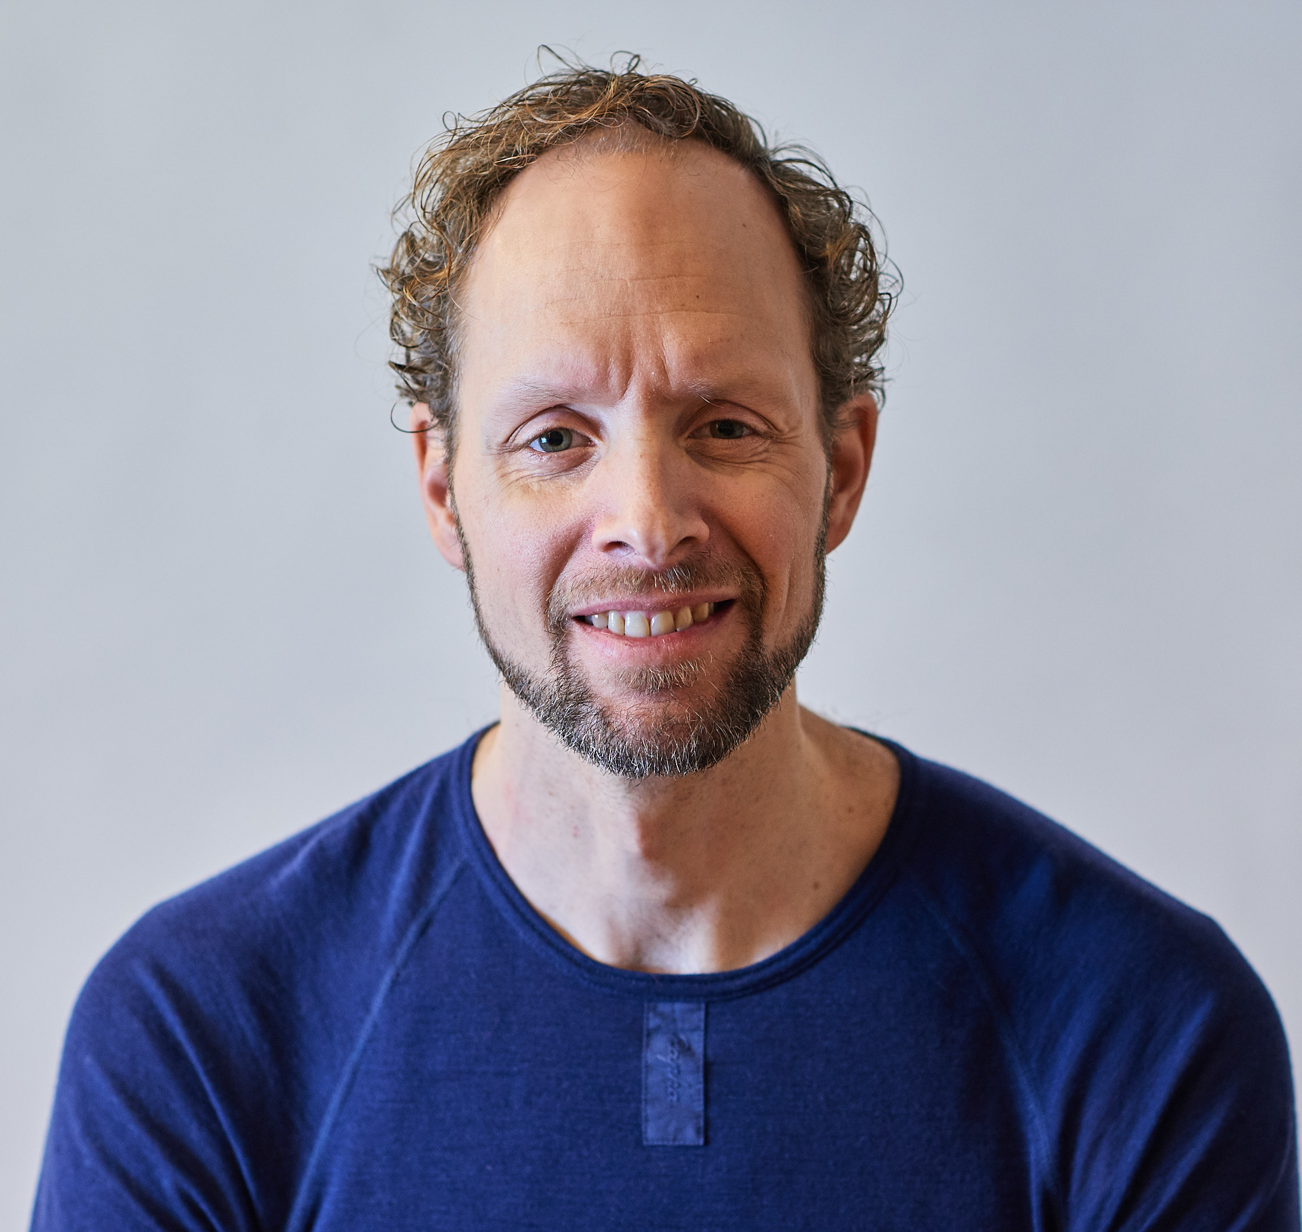
Who am I?
Thomas Tveit Rosenlund
Senior advicer employed at the Norwegian directorate of e-health
Enterprise architect

Slide 3
Overview
Guidance for use of FHIR
Strategy for FHIR profiling and governance
Method for development
Standardization
Cooperation and sharing
Results

Slide 4
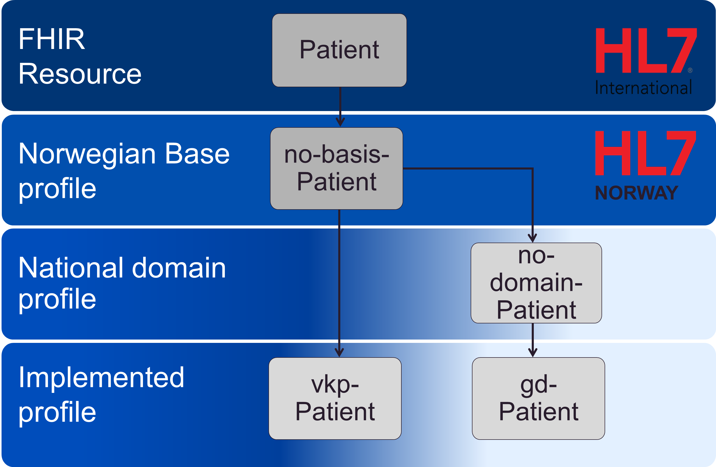
Profiling strategy
Top level view of governance and development for FHIR development in Norway
Everything builds on a collection of base profiles (no-basis)
Domain profiles are developed as needed
Implemented profiles are made by everyone

Slide 5
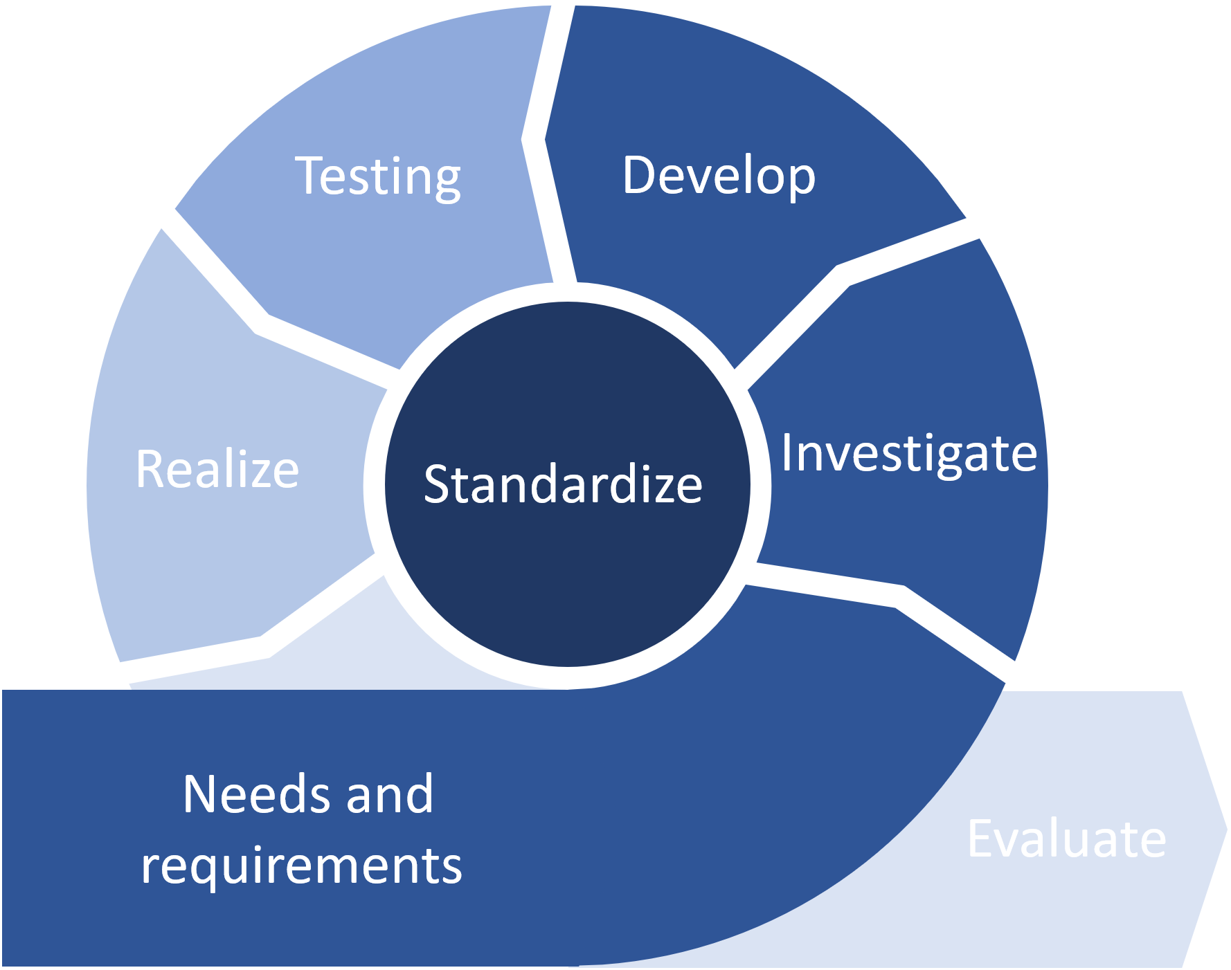
Method

Slide 6
Testing
Develop
Realize
Investigate
Standardize
Needs and
requirements
Evaluate

Slide 7
Utprøve
Utvikle
Utrede
Realisere
Normere
Behov og krav
Evaluere

Slide 8
Contact
During DevDays, you can find / reach me here:
Via Whova App – Speaker’s Gallery
Email
Twitter
..

Slide 9
Q&A

Slide 10
Title for slide
Text to add to slide
Indent item
Another item

