Slide 1
Cylleneus
next-gen corpus search for ancient languages

Slide 2
Next-gen search engine for ancient languages
a full-featured and easily extensible open-source search engine library written in Python
enables texts to be searched on the basis of their semantic as well as morphosyntactic properties
takes advantage of rich data from the Sanskrit, Greek, and Latin WordNets
easily integrates with all corpus types, from plain-text corpora to treebanks

Slide 3
texts can be searched by the meanings of words as well as by the kinds of grammatical constructions they occur in

Slide 4
Intelligent Draws on the rich lexical and semantic information of the Sanskrit, Greek, and Latin WordNets
Polyglot Using the MultiWordNet, meanings can be specified in English, Italian, Spanish, or French
Flexible Find words, or filter the results of other queries, based on morphological properties – including for plain-text corpora
Fast Once a corpus is indexed, searching is nearly instantaneous for most query types
Advanced Query types can be combined into complex contextual or phrasal search patterns
Extensible Indexing pipelines can be created for any corpus type with different annotation schemas (or none!)

Slide 5
‘First-gen’ search tools
large collections of Latin and Greek texts
word-form searches
wildcard queries
lemma queries
special cases: e.g.,
Tesserae Project, intertextual searches between texts and even across languages
Pede Certo, metrical pattern searches
syntactic properties and relations

Slide 6
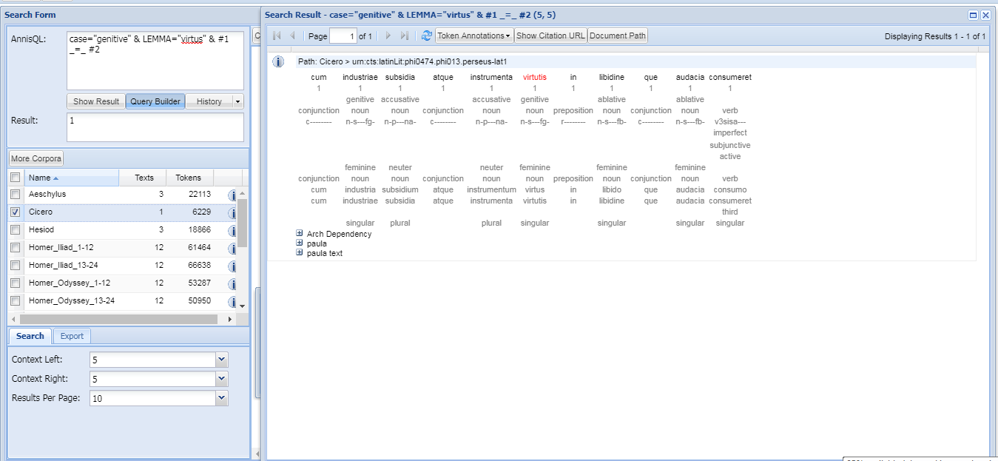
Ancient Greek and Latin
Dependency Treebank

Slide 7
A problem of metaphor research
flagrabat ingens bellum ‘a huge war was burning’ (Tac. Hist. 2.86)
adolere, (ad)uro, aestuare, ardere, fervere, incendere, torrere . . .
bellum, certatus, certamen, colluctatio, concertatio, conflictus, congressio, congressus, dimicatio, proelium, pugna, Mars . . .

Slide 8
WordNet data structures
Lemmas
Headword
Part of speech
Morphological description
Sense attributions
Synsets
Part of speech
Unique offset identification number
Gloss
Relations
Lexical (derivation, parasynthesis, composition . . .)
Semfields
Broad semantic domains including multiple synsets
Semantic (antonymy, hypernymy, hyponymy . . . )

Slide 9
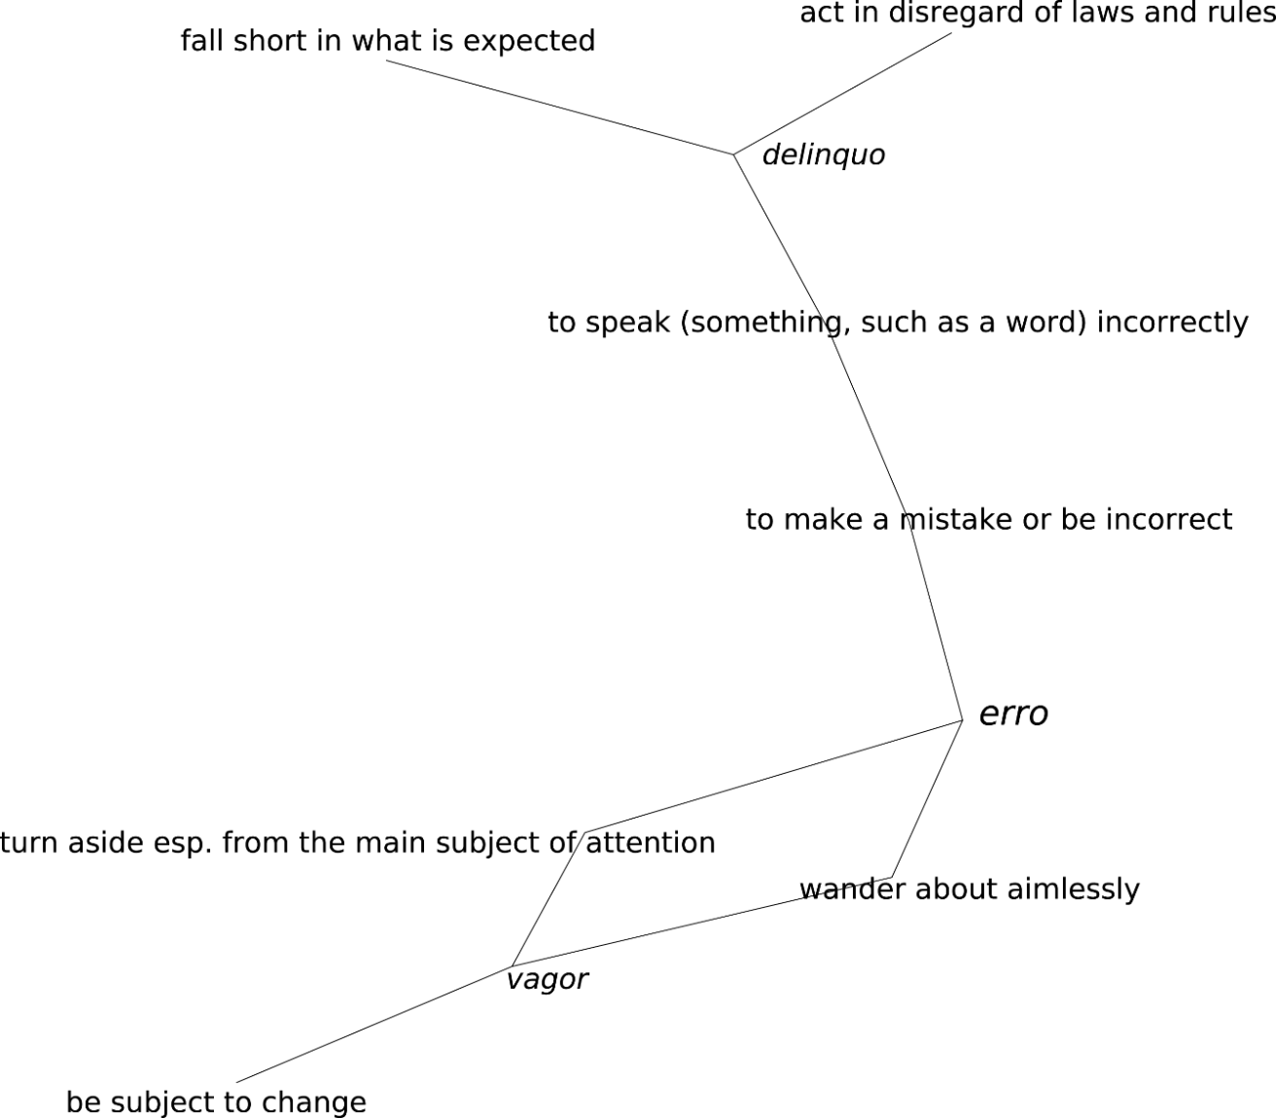
Semantic network of
Latin erro

Slide 10

Ancient Language WordNets
Sanskrit about 235,000 lemmas https://sanskritwordnet.unipv.it
Greek about 112,000 lemmas https://greekwordnet.chs.harvard.edu
Latin about 70,000 lemmas https://latinwordnet.exeter.ac.uk

Slide 11
Ancient Language WordNets
Discrimination between literal, metonymic, and metaphor sense of words
Etymological information
Metaphorical and metonymic mappings that capture supra-lexical relations between concepts
Diachronic and generic tagging, at the level of sense attribution
RESTful API for programmatic access

Slide 12
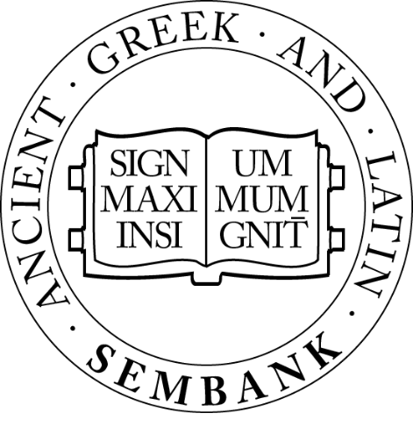
Ancient Greek and Latin Sembank
Cat. Agr. pr.1
est interdum praestare mercaturis rem quaerere
(v#01246259) ‘value more highly’
(v#01513874) ‘come into possession of’ (r#00020741) 'on certain occasions’ (n#09639711) 'the most common medium of exchange’
(v#01775163) 'have an existence, be extant’ (n#00707408) 'the commercial of goods and services'

Slide 13
Permissible query types and specification
Forms, wildcards ‘animos’ contum*
Lemmas <animus>
Meanings [en?courage] [it?guerra]
Semfields {611}
Morphology :ACC.PL.
. . . as a filter [en?courage]|ABL.SG.
Contextual & sequential queries “ . . . ”
Lexical & semantic relations </::bellum> [!::en?courage]
Morphosyntax /ablative absolute/

Slide 14
The indexing pipeline
Schema class
specifies searchable fields in documents
Tokenizer class
tokenizes the raw text forms
Lemma Filter lemmatizes the text via the WordNet
Synset Filter
assigns meanings from the WordNet
Morphology Filter assigns morphological tags
Syntax Filter
assigns syntactic annotations
Other Filters
index any additional annotations
‘fetch’ function to read source files

Slide 15
Works with any structured or plaintext corpus
Ready-made indexing infrastructure is provided for many corpus formats
Perseus Digital Library (in JSON or TEI XML format)
LASLA
PROIEL
AGLDT
CAMENA
DigilibLT
Digital Corpus of Sanskrit
ATLAS
Diorisis
The Latin Library
Perseids Project translation alignments
Searches can be performed over ‘collections’ which may include documents from different corpora

Slide 16
Some research use cases
Metaphor research, by enabling efficient searching of relations between whole semantic fields
Intertextual research, by finding lexically and even semantically similar expressions
Translation research, by abstracting away from the specific lexicalization of concepts
Permits exploration of ancient literature even without expert linguistic knowledge

Slide 17

https://mybinder.org/v2/gh/cylleneus/cylleneus/master?filepath=notebooks/quick_search.ipynb

