Slide 1

The Vindolanda tablets online
Dimitar Iliev
St. Kliment Ohridski University of Sofia

Slide 2

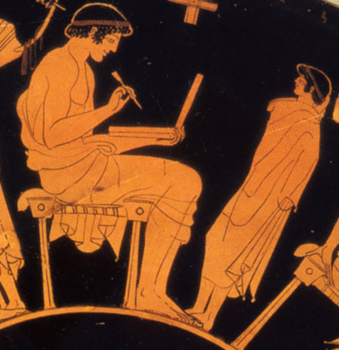
Graeco-Roman tablets
two types
- wax on wood
- ink on wood
notes, letters, contracts

Slide 3
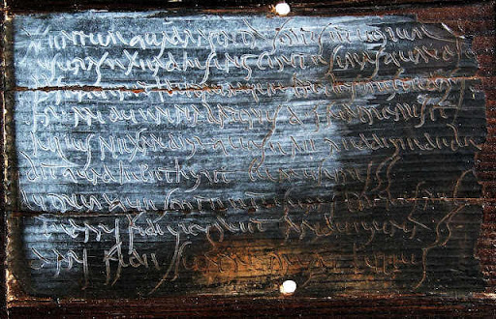
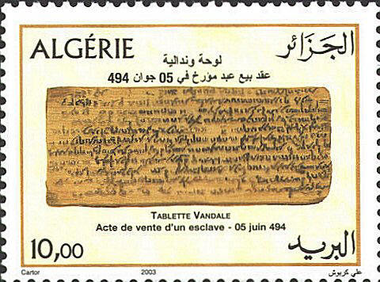
Notable collections
Vindolanda tablets
Bloomberg tablets
Albertini tablets
Alburnus Maior tablets

Slide 4
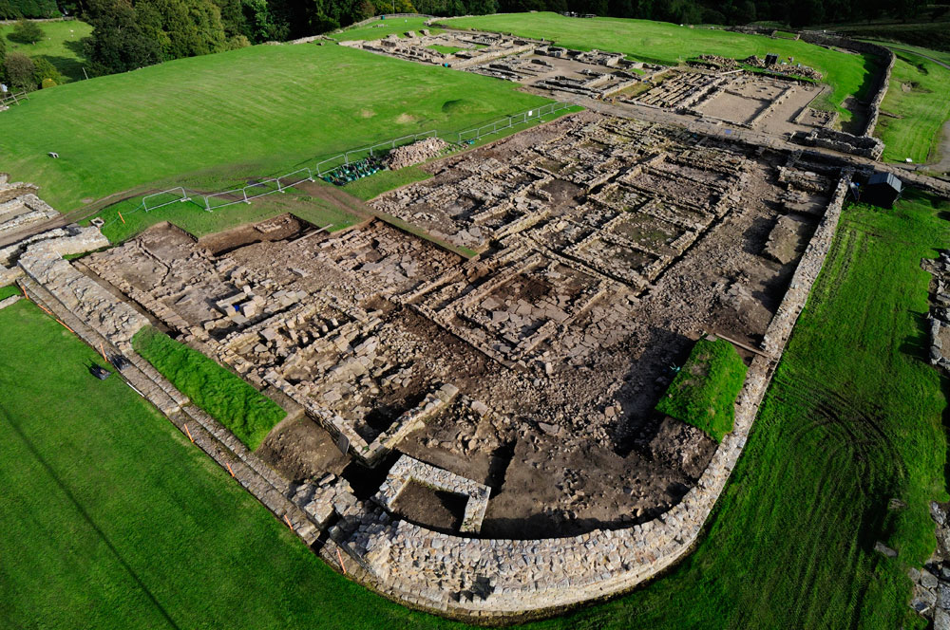
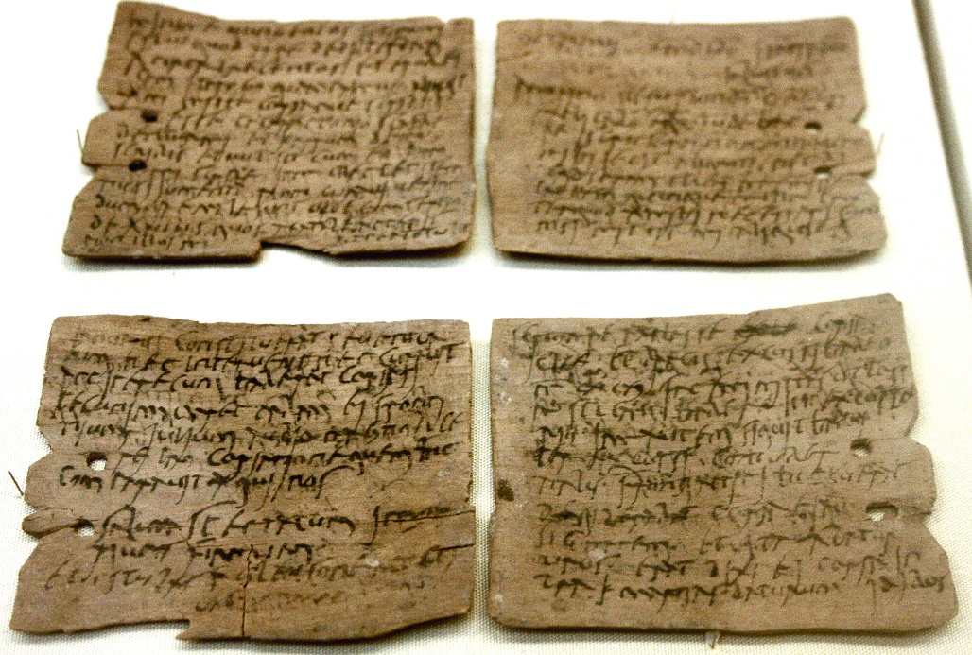
The Vindolanda tablets
850 pieces
black ink on birch wood
diptychs
letters
published in 3 printed volumes

