Slide 1
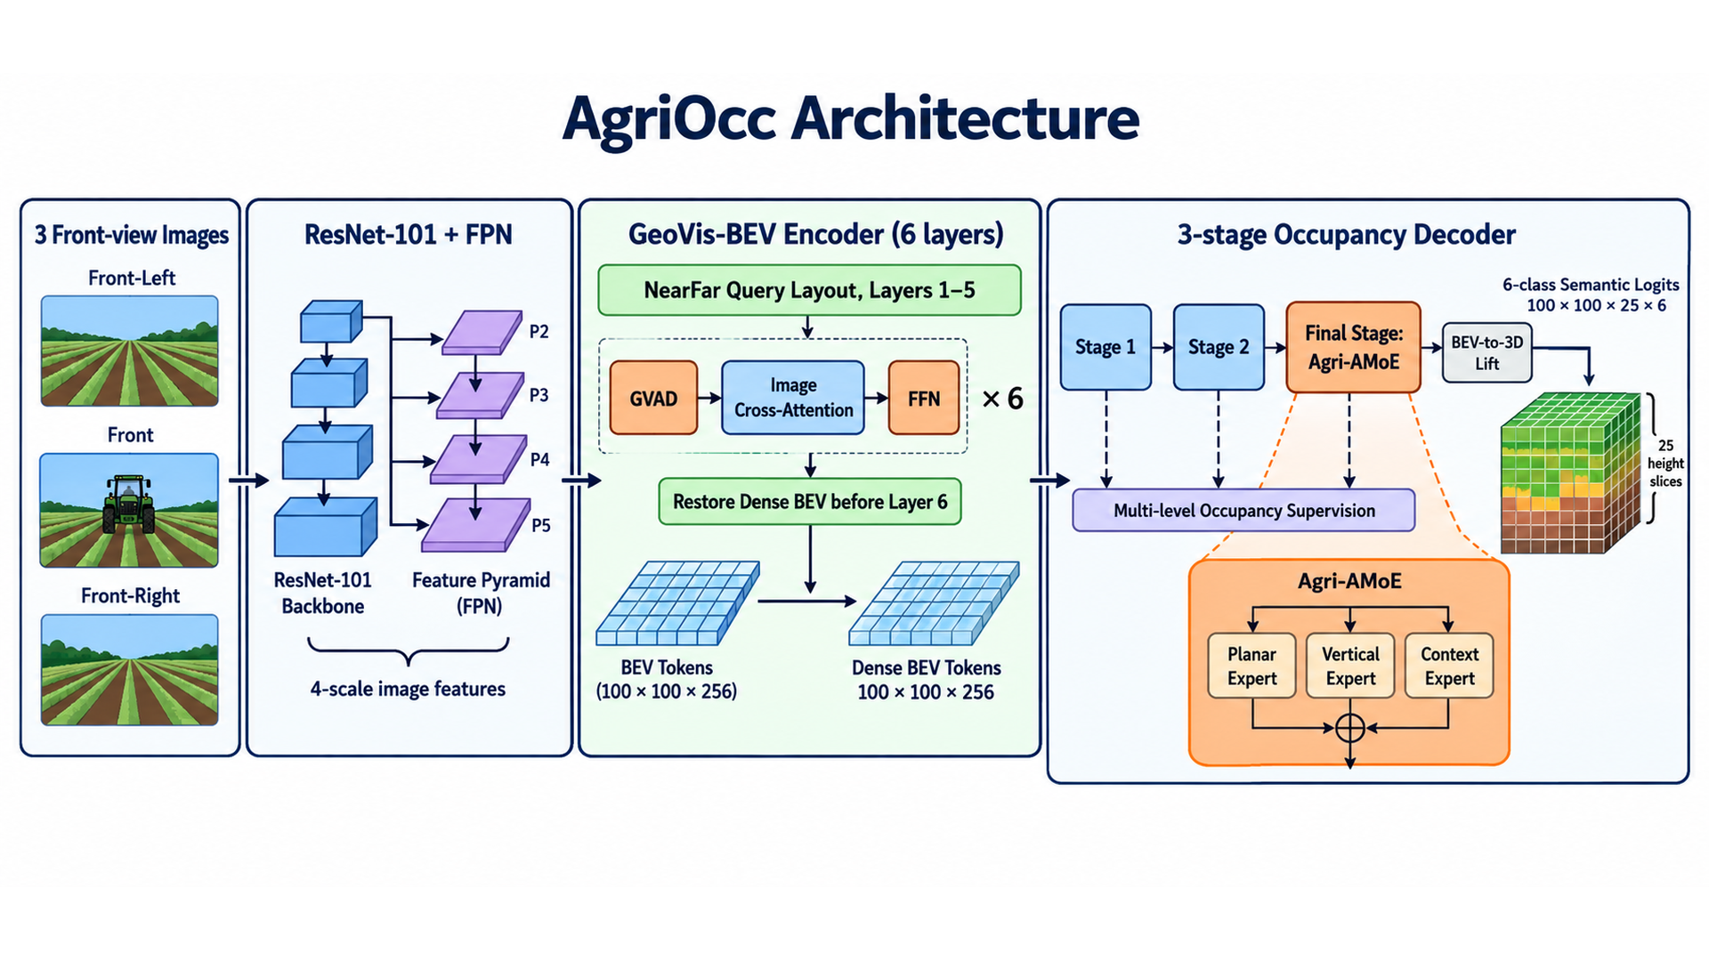
AgriOcc Architecture
3 Front-view Images
ResNet-101 + FPN
GeoVis-BEV Encoder (6 layers)
3-stage Occupancy Decoder
Front-Left
NearFar Query Layout, Layers 1–5
P2
GVAD
Image
Cross-Attention
FFN
Stage 1
Stage 2
Final Stage:
Agri-AMoE
BEV-to-3D
Lift
× 6
P3
Front
Restore Dense BEV before Layer 6
P4
Multi-level Occupancy Supervision
6-class
Semantic Logits
100 × 100 × 25 × 6
P5
Agri-AMoE
Front-Right
Planar
Expert
Vertical
Expert
Context
Expert
4-scale image features
BEV Tokens
100 × 100 × 256
Dense BEV Tokens
100 × 100 × 256

Slide 2
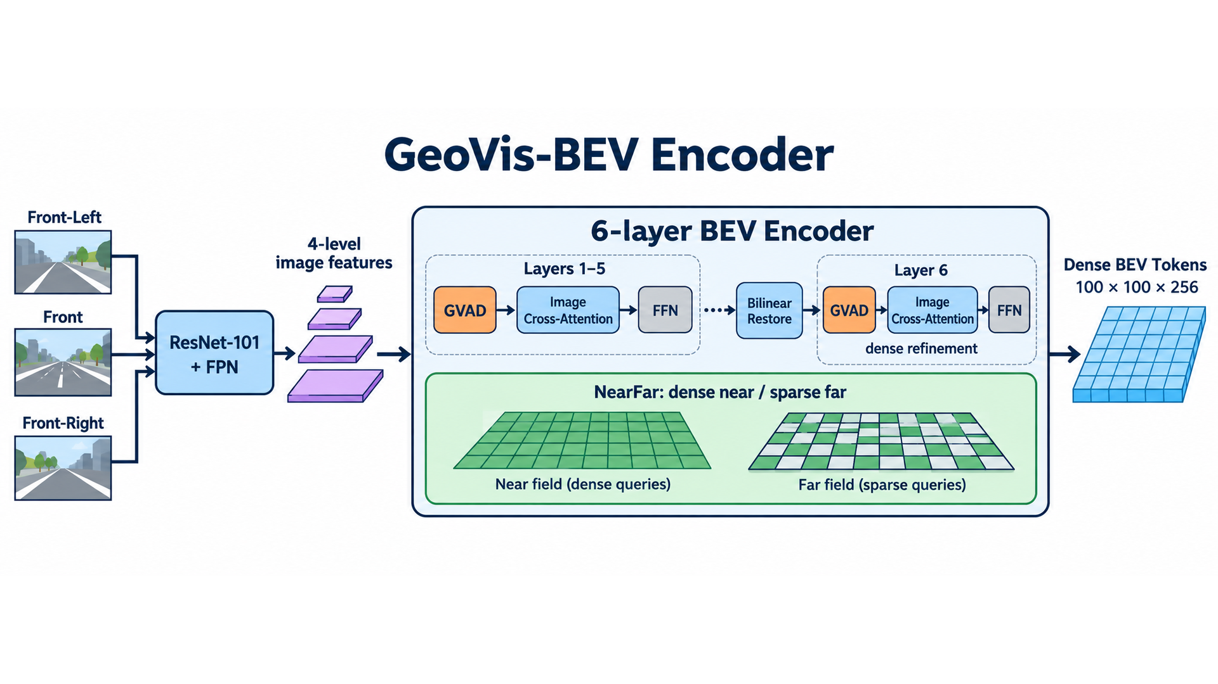
GeoVis-BEV Encoder
Multi-view Image Features
ResNet-101 + FPN
GeoVis-BEV Encoder (6 layers)
Dense BEV Output
Front-Left
P2
NearFar Query Layout: Layers 1–5
P3
Layer 1
GVAD
Image Cross-Attention
FFN
Front
P4
Layer 2
GVAD
Image Cross-Attention
FFN
Layer 3
GVAD
Image Cross-Attention
FFN
P5
Layer 4
GVAD
Image Cross-Attention
FFN
Dense BEV Tokens
100 × 100 × 256
Front-Right
Layer 5
GVAD
Image Cross-Attention
FFN
Bilinear Restore to Dense BEV Grid
Layer 6
GVAD
Image Cross-Attention
FFN

Slide 3
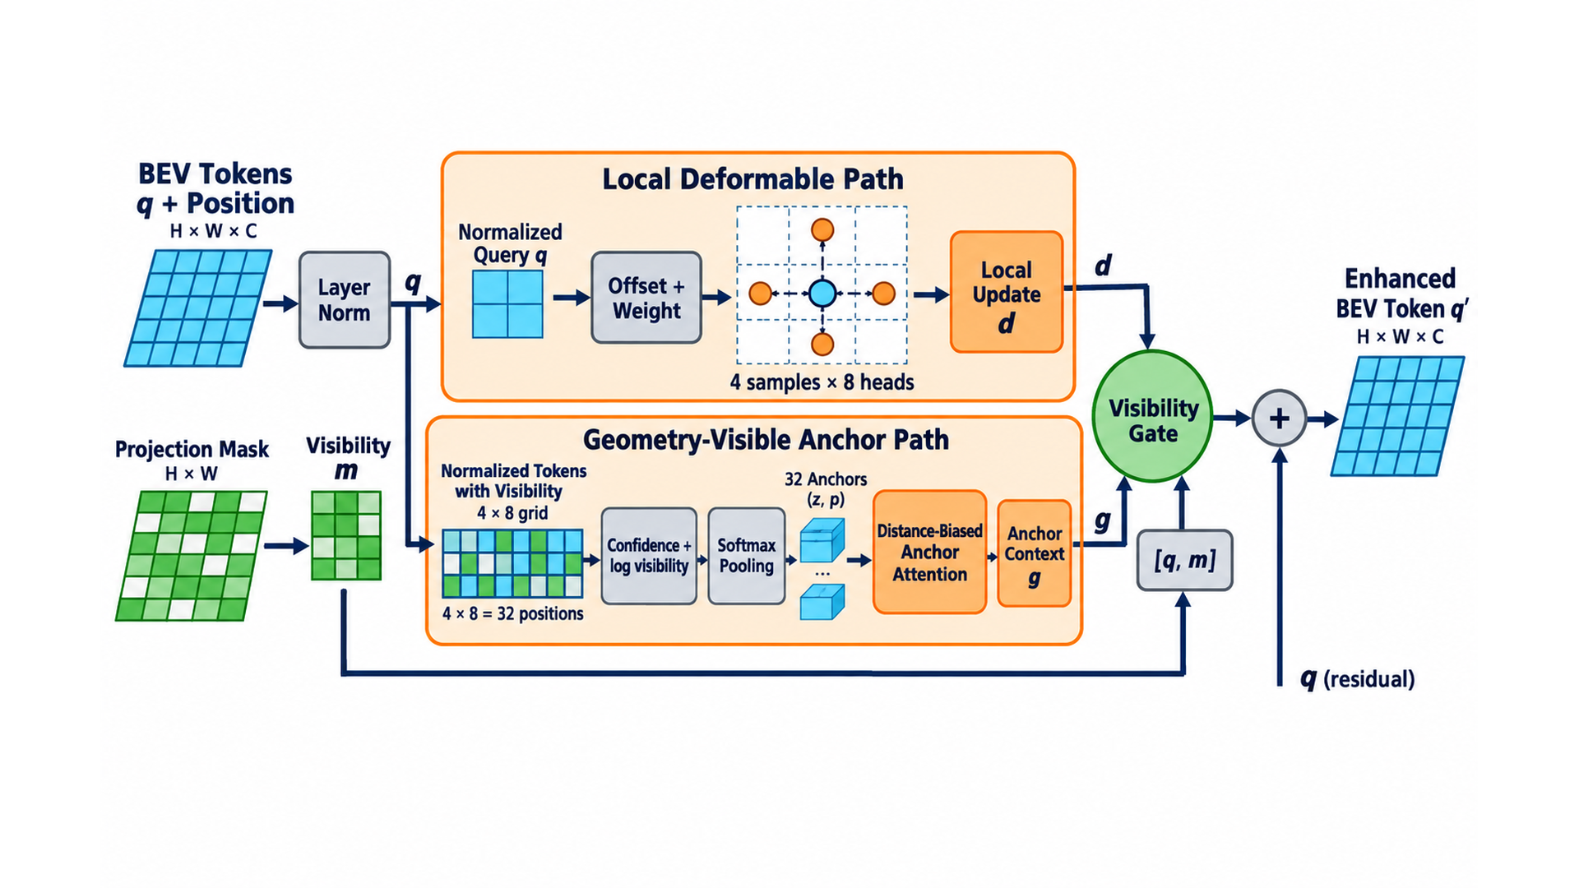
Geometry-visible Anchor Deformable Attention (GVAD)
Geometry-visible Anchor Path
Camera Projection
Mask
Visibility
m
4 × 8 BEV
Anchor Grid
Confidence +
log Visibility
Local Deformable Path
BEV Query
q + position
32 Visible
Anchors
Distance-biased
Attention
Visibility Gate
σ(fg[q,m])
Residual
Fusion
Offset & Weight
Prediction
4 sampling
points × 8 heads
Local
Update d
Anchor
Context g
Enhanced
BEV Token q′

Slide 4
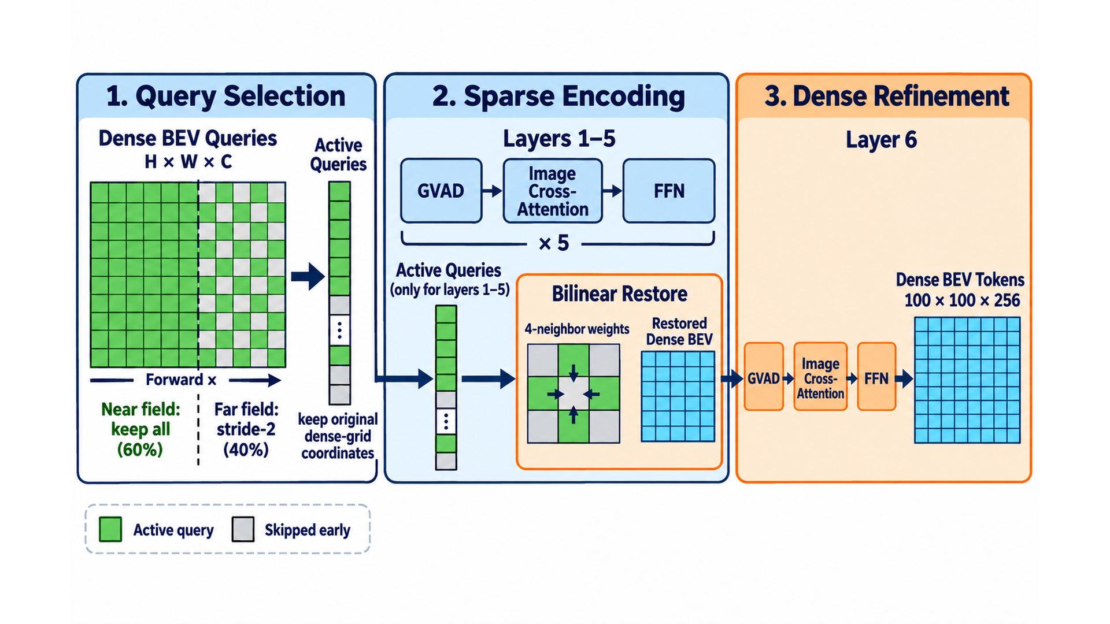
NearFar BEV Query Layout
1. Query Selection
2. Sparse Encoding
3. Restore Dense BEV
Final Dense Refinement
Layer 1: GVAD → Cross-Attn → FFN
4 Neighboring
Active Tokens
Layer 6: GVAD → Image Cross-Attn → FFN
Layer 2: GVAD → Cross-Attn → FFN
Bilinear
Interpolation
Layer 3: GVAD → Cross-Attn → FFN
Near 60%: retain all tokens
Layer 4: GVAD → Cross-Attn → FFN
Far 40%: stride-2 sampling
Layer 5: GVAD → Cross-Attn → FFN
Dense BEV Tokens
100 × 100 × 256
Keep original dense
BEV coordinates
Active Tokens Only

Slide 5
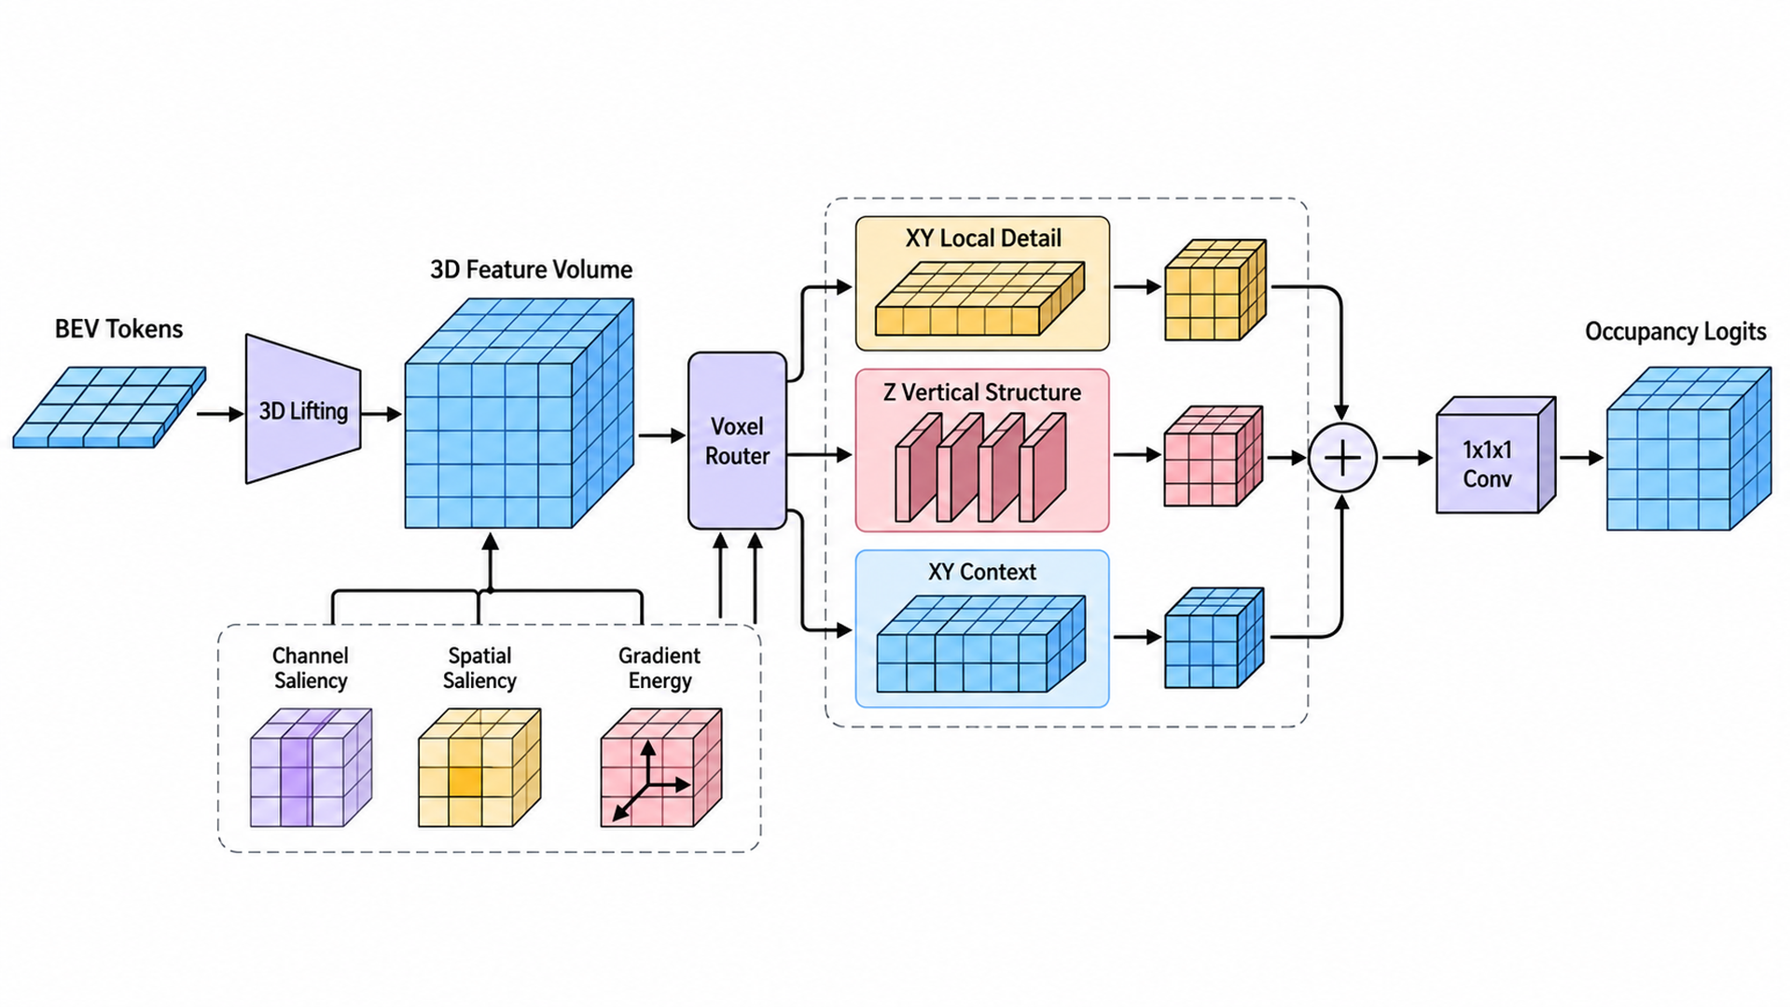
Agri-AMoE 3D Occupancy Decoder
3D Feature Volume
Feature-guided Router
Three Anisotropic Experts
Channel Saliency
Planar Detail
1 × 3 × 3
Final BEV
Tokens
BEV-to-3D
Lift
Spatial Saliency
Residual Mix
+ 1×1×1 Classifier
Vertical Structure
3 × 1 × 1
x/y/z Gradient
Energy
Cₐ = 96, Z = 25
Planar Context
Dilation 2
6-class
Semantic Logits
Voxel-wise
Softmax Router

