Slide 1
Aspect-based Sentiment Classification
With Aspect-specific Graph Convolutional Networks
EMNLP 2019
Beijing Institute of Technology Beijing
Dawei Song

Slide 2
1 Introduction
1.1 Task
positive
negative
“From the speed to the multi-touch gestures this operating system beats Windows easily.”
1.2 Limitation
Limitation 1: The current attention mechanism may lead to a given aspect mistakenly attending to syntactically unrelated context words as descriptors.
True: Its size is ideal and the weight is acceptable.
False: Its size is ideal and the weight is acceptable.
Method : He et al. (2018) imposed some syntactical constraints on attention weights.
(the effect of syntactical structure was not fully exploited.)
Limitation 2: An aspect is usually determined by key phrases. The CNN-based models can only perceive multi-word features as consecutive words.
True: The staff should be a bit more friendly.
(negative)
False: The staff should be a bit more friendly.
(positive)
Method : RNNs?

Slide 3
1 Introduction
1.3 Contribution
Contribution 1: We propose to exploit syntactical dependency structures within a sentence and resolve the long-range multi-word dependency issue for aspect-based sentiment classification.
Contribution 2: We propose a novel Aspect-specific GCN model
Contribution 3: experiment results verify the importance of leveraging syntactical information and long-range word dependencies

Slide 4
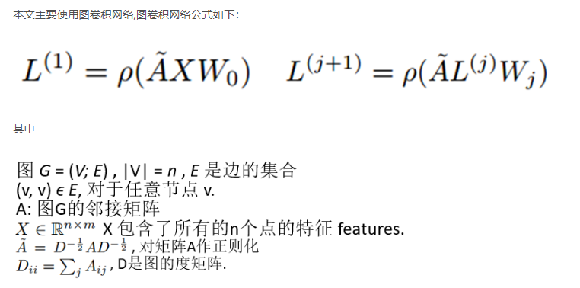
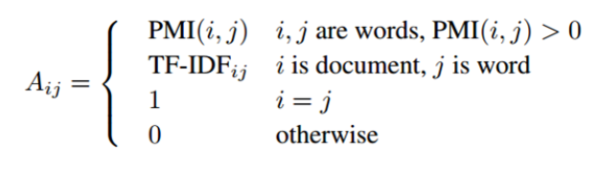

2 GCN相关论文（主要是构图方法）
2.1 Graph Convolutional Networks for Text Classification
归一化操作，防止过大的度对结果产生不利影响
本文使用一个简单的二层图卷积网络，结构如下：

Slide 5
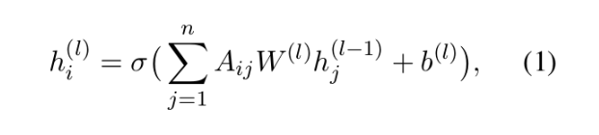



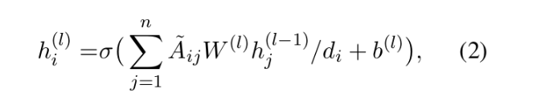

2 GCN相关论文（主要是构图方法）
2.2 Graph Convolution over Pruned Dependency Trees Improves Relation Extraction
本文使用句法树进行构图：
表示邻接矩阵
表示第l层第i个节点的输入向量
然而，在等式(1)中片面地应用图卷积运算，可能会导致节点表示的结果大不相同，因为节点的度变化很大。
因此他们进行了归一化操作
表示邻接矩阵+单位矩阵
表示度

Slide 6
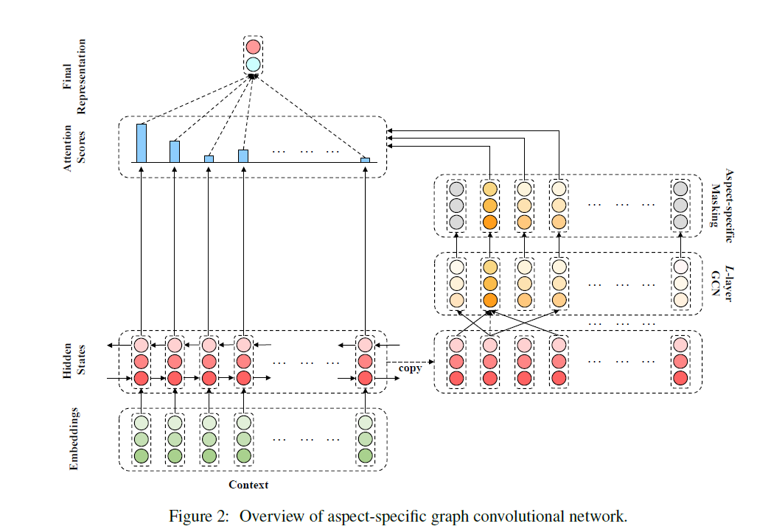



3 Aspect-specific Graph Convolutional Network
3.1 Embedding and Bidirectional LSTM
Given a n-word sentence
aspect
Embedding matrix
Bidirectional LSTM
aspect
3.2 Obtaining Aspect-oriented Features
Multi-layer graph convolution
Aspect-specific masking

Slide 7
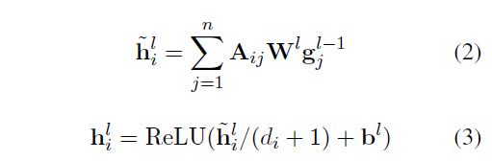


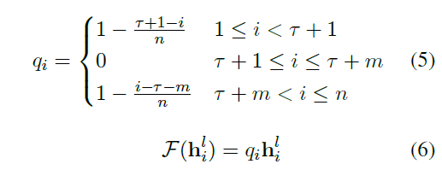

3 Aspect-specific Graph Convolutional Network
3.3 Graph Convolution over Dependency Trees
Un-directional : ASGCN-DG
Directional: ASGCN-DT
is a function assigning position weights

Slide 8
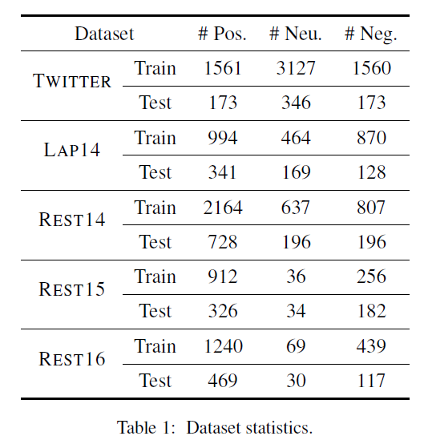
4 Experiments
4.1 Datasets and Experimental Settings
300-dimensional pretrained GloVe vectors
hidden state :300
Adam: 0.001
L2-regularization is 0.00001
batch size is 32.
Layer_gcn: 2
results : averaging 3 runs with random initialization

Slide 9
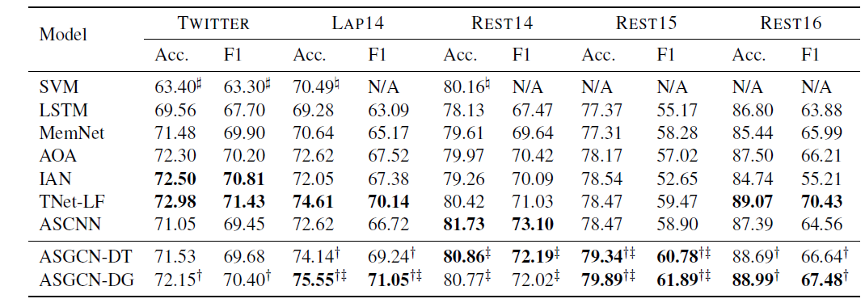
4 Experiments
4.2 Models for Comparison
directional
Un-directional
Effectiveness of ASGCN-DG
ASGCN-DG performs better than ASGCN-DT (reason)
3. ASGCN-DG outperforms ASCNN on all datasets except REST14, illustrating ASGCN is better at capturing long-range word dependencies (reason)

Slide 10
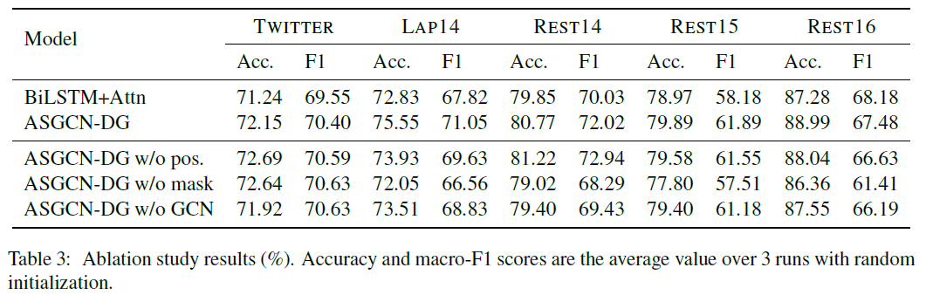
4 Experiments
4.3 Ablation Study

Slide 11
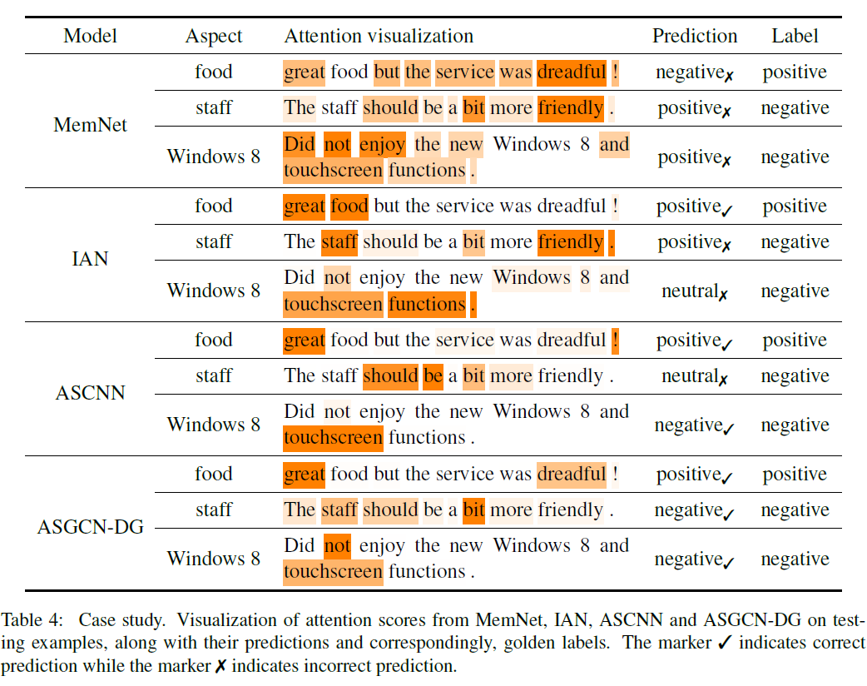
4 Experiments
4.4 Case Study

Slide 12
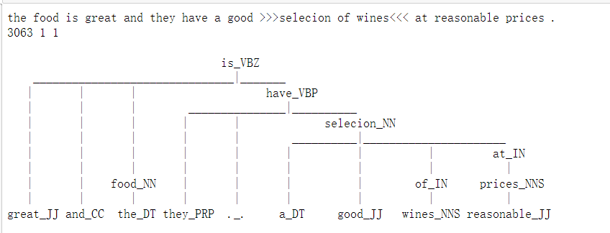
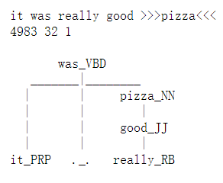
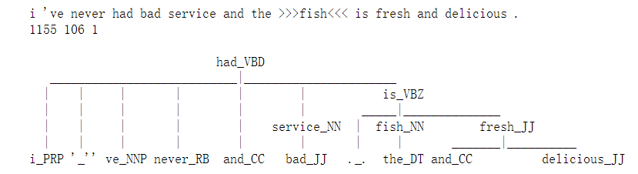
间接能解决的
6 My Thoughts
Single-word
直接能解决的
不能解决的

Slide 13
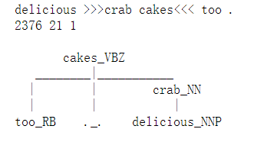
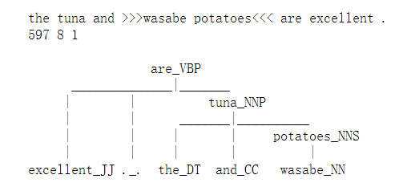
6 My Thoughts
Multi-word
不能解决的
能解决的
间接能解决的

Slide 14
7 My result
nn_0 | nn_1 | rb_0 | rb_1 | REST14
 |  |  |  | acc | f1
- | - | - | - | 0.8101 | .0.7250
1 | 1 | 1 | 4 | 0.8153 | 0.7353
1 | 1 | 2 | 4 | 0.8161 | 0.7345
1 | 4 | 1 | 1 | 0.8158 | 0.7346
nn_0 | nn_1 | rb_0 | rb_1 | Twitter
 |  |  |  | acc | f1
- | - | - | - | 0.7225 | 0.7008
1 | 2 | 2 | 1 | 0.7278 | 0.7089
2 | 2 | 2 | 1 | 0.7317 | 0.7118
2 | 3 | 1 | 1 | 0.7274 | 0.7112
2 | 4 | 1 | 2 | 0.7278 | 0.7140
nn_0 | nn_1 | rb_0 | rb_1
- | - | - | -
1 | 2 | 1 | 3
1 | 2 | 2 | 2
1 | 3 | 1 | 3
1 | 4 | 1 | 1
2 | 3 | 1 | 4
LAP14
acc | f1
0.7550 | 0.7146
0.7665 | 0.7244
0.7612 | 0.7197
0.7607 | 0.7198
0.7685 | 0.7265
0.7628 | 0.7243
nn_0 | nn_1 | rb_0 | rb_1 | REST15
 |  |  |  | acc | f1
- | - | - | - | 0.7989 | 0.6265
1 | 1 | 1 | 1 | 0.7995 | 0.6337
1 | 2 | 1 | 4 | 0.8020 | 0.6480
1 | 2 | 2 | 1 | 0.7958 | 0.6352
1 | 4 | 2 | 4 | 0.7989 | 0.6383

Slide 15
7 My result
nn_0 | nn_1 | rb_0 | rb_1 | REST16
 |  |  |  | acc | f1
- | - | - | - | 0.8837 | 0.6818
1 | 1 | 2 | 1 | 0.8858 | 0.6993
1 | 2 | 1 | 3 | 0.8837 | 0.6977
1 | 2 | 2 | 2 | 0.8842 | 0.7015
1 | 3 | 1 | 2 | 0.8853 | 0.7062
1 | 4 | 1 | 4 | 0.8939 | 0.7100

Slide 16
7 My result
nn_0 | nn_1 | rb_0 | rb_1 | REST16
 |  |  |  | acc | f1
- | - | - | - | 0.8837 | 0.6818
1 | 1 | 2 | 1 | 0.8858 | 0.6993
1 | 2 | 1 | 3 | 0.8837 | 0.6977
1 | 2 | 2 | 2 | 0.8842 | 0.7015
1 | 3 | 1 | 2 | 0.8853 | 0.7062
1 | 4 | 1 | 4 | 0.8939 | 0.7100

