Slide 1

A logic-Driven Framework for Consistency of Neural Models
Paper reading
EMNLP 2019
Made by Yuhan Liu, HLT-HITSZ, 2019-11-1

Slide 2
Why we proposes this framework
1. We could see progressively improving performances from different models on benchmarks such as GLUE. But, are models really becoming better?
2. Reasoning about language requires that a system has the ability not only to draw correct inferences about textual inputs, but also to be consistent its beliefs across various inputs
Here is an example of consistency illustration(we focus on NLI task):
P : John is on a train to Berlin. H : John is traveling to Berlin. Z : John is having lunch in Berlin.
P entails H and H contradicts Z , Using these two facts, we can infer that P contradicts Z.

Slide 3
Why we proposes this framework
Here is an example of consistency illustration(we focus on NLI task):
P : John is on a train to Berlin. H : John is traveling to Berlin. Z : John is having lunch in Berlin.
P entails H and H contradicts Z , Using these two facts, we can infer that P contradicts Z.
3. In other words, these three decisions are not independent of each other. Any model for textual inference should not violate this invariant defined over any three sentences.
4. Neither are today’s models trained to be consistent in this fashion, nor is consistency evaluated.
5. Even state-of-the-art models can be highly inconsistent in their predictions

Slide 4
Contribution
We define a mechanism to measure model inconsistency with respect to declaratively specified invariants.
We present a framework that compiles knowledge stated in first-order logic to loss functions that mitigate inconsistency.
We show that our learning framework can reduce prediction inconsistencies even with small amount of annotated examples without sacrificing predictive accuracy

Slide 5
What is first order logic
命题逻辑（Propositional Logic）
形如 ¬P，P∧Q，P∨Q，P → Q ，P↔Q的语句，值为True或者False
推理规则较简单，往往通过（1.真值表 2.为数不多的推理规则）
缺点，不能或者很难表示复杂的语句，不能记录推理过程中的变化
不像命题逻辑只处理简单的陈述命题，一阶逻辑还额外包含了断言和量化。断言是一个会传回真或伪的函数, 例如：
HIT is a Chinese university.
Thu is a Chinese university.
则有断言: Is_Chinese_university(a).
Is_Chinese_university为一个语法实体，决定哪些符号的组合是一阶逻辑内的合法表示式

Slide 6
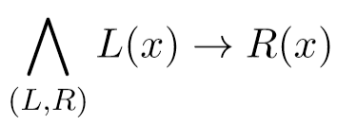
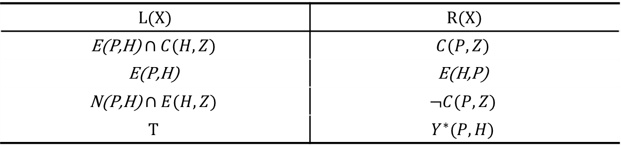
Measure and mitigate (in)consistency
We could write constraints about a collection of examples(perhaps labeled) as a conjunction of statements in logic:
L and R are Boolean formulas
We could consider L and R as antecedents and consequents constructed from model predictions on examples
L(X) | R(X)
$$\text{E}\text{(}\text{P}\text{,}\text{H}\text{)}∩C(H,Z)$$ | $$C(P,Z)$$
$$\text{E}\text{(}\text{P}\text{,}\text{H}\text{)}$$ | $$\text{E}\text{(}\text{H}\text{,}\text{P}\text{)}$$
$$\text{N}\text{(}\text{P}\text{,}\text{H}\text{)}∩E(H,Z)$$ | $$¬C(P,Z)$$
$$T$$ | $$Y^{∗}(P,H)$$

Slide 7
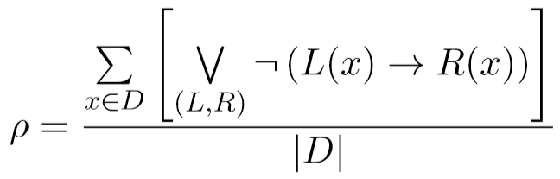
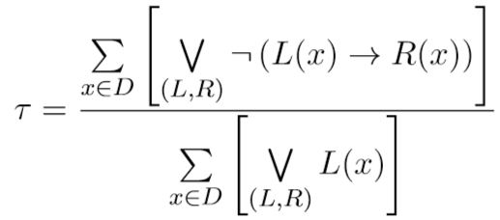
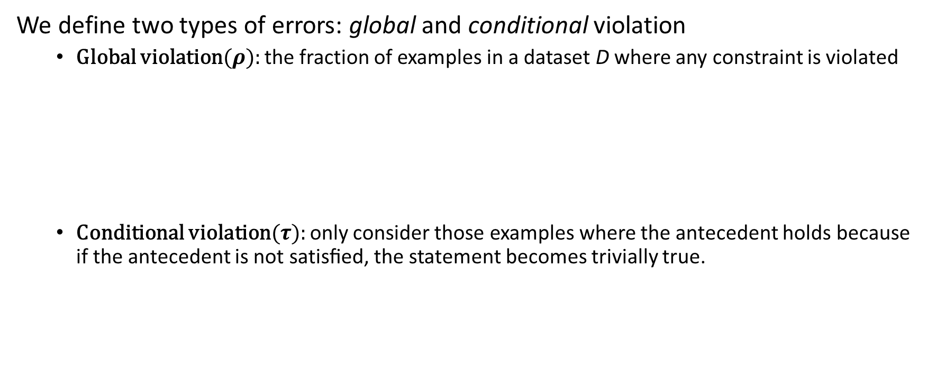
Measure and mitigate (in)consistency
An evaluation metric should:
Quantify the inconsistency of predictions
Generalize classification error
We define two types of errors: global and conditional violation
Global violation($ρ$): the fraction of examples in a dataset D where any constraint is violated
Conditional violation($τ$): only consider those examples where the antecedent holds because if the antecedent is not satisﬁed, the statement becomes trivially true.

Slide 8
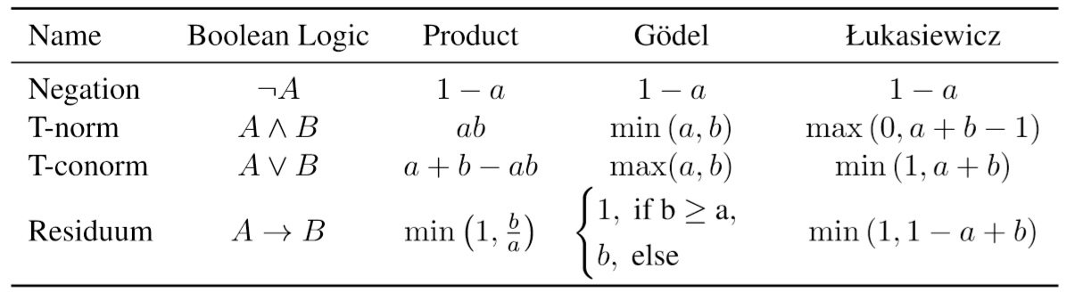
Minimizing inconsistency losses
How to convert discrete declarative constraints into the standard loss-driven learning paradigm is a challenge
To solve this, we could using t-norms to deterministically compile rules into differentiable loss functions.
We treat predicted label probabilities as soft surrogates for Boolean decisions.

Slide 9


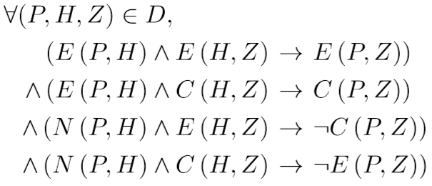
Minimizing inconsistency losses
To minimizing losses, we focus on three kind of consistency requirements:
Annotation Consistency
Symmetry Consistency
Transitivity Consistency

Slide 10
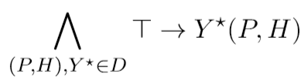
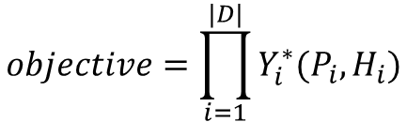
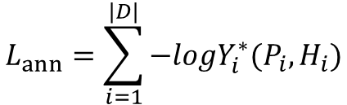
Minimizing inconsistency losses
Derivation details:
For annotation consistency, we can write the universal quantifier as a conjunctions:
Which means we should maximize the probabilities
$$objective=\prod_{i=1}^{|D|}{Y_{i}^{∗}(P_{i}, H_{i})}$$
In other words, minimizing the negative log space
$$L_{ann}=\sum_{i=1}^{|D|}{{−logY}_{i}^{∗}(P_{i}, H_{i})}$$

Slide 11
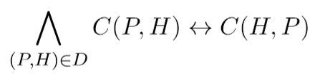
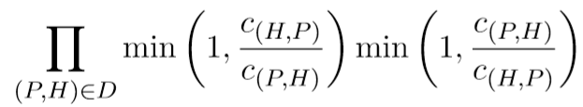
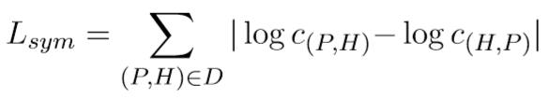
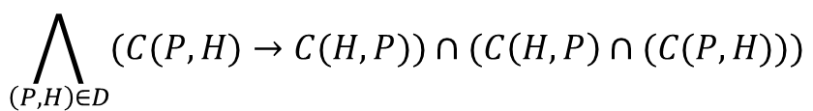
Minimizing inconsistency losses
Derivation details:
For symmetry consistency:
$$\bigwedge_{\left(P,H\right)∈D}{(C(P,H)→C(H,P))∩(C\left(H,P\right)∩(C(P,H)))}$$
Which means we should maximize the probabilities
In other words, minimizing the negative log space

Slide 12
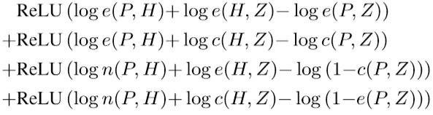
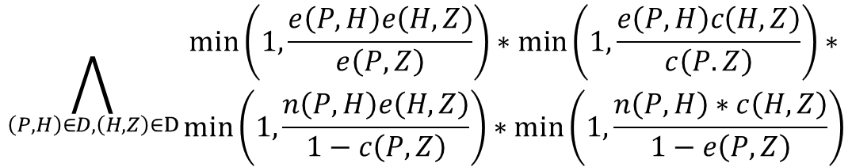
Minimizing inconsistency losses
Derivation details:
$$−log\min\left(1, \frac{e\left(P,H\right)e\left(H,Z\right)}{e\left(P,Z\right)}\right)=max(0, loge\left(P,H\right)+loge\left(H,Z\right)−loge(P,Z))$$
For symmetry consistency:
$$\bigwedge_{\left(P,H\right)∈D,\left(H,Z\right)∈D}{\begin{aligned}\min\left(1, \frac{e\left(P,H\right)e\left(H,Z\right)}{e\left(P,Z\right)}\right)∗\min\left(1,\frac{e\left(P,H\right)c\left(H,Z\right)}{c\left(P.Z\right)}\right)∗ \\ \min\left(1,\frac{n\left(P,H\right)e\left(H,Z\right)}{1−c\left(P,Z\right)}\right)∗\min\left(1,\frac{n\left(P,H\right)∗c\left(H,Z\right)}{1−e\left(P,Z\right)}\right)\end{aligned}}$$
minimizing the negative log space

Slide 13

Minimizing inconsistency losses
So the final goal of learning is to minimize:
Here, the λ’s are hyperparameters to control the inﬂuence of each loss term

Slide 14
Datasets
We use both of the SNLI and MultiNLI to train our models. Besides, we construct both labeled and unlabeled datasets to consistency detection:
Mirrored Instances (M)
Given a labeled example, we construct its mirrored version by swapping the premise and the hypothesis
Unlabeled Instance Triples (T)
we sample 100k sentence triples from MS COCO captions: sentences (P; H; Z) gives the pairs (P; H), (H; Z) and (P; Z)
Unlabeled Instance Pairs (U)
For each sentence triple in the dataset T, we take the first example (P; H) and construct mirrored examples

Slide 15
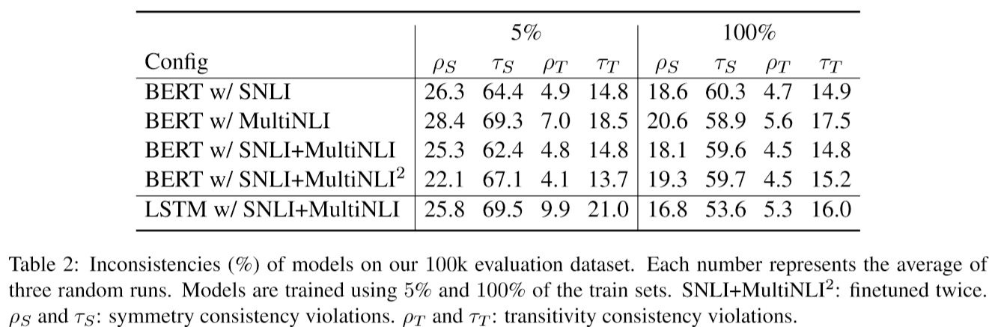
Experiments
Exploring inconsistency of neural models
Inconsistencies have no relation with types of datasets
Stronger representations does not necessarily mean more consistent models
finetuning twice does not improve much over models finetuned once
transitivity consistency violations does not reduce as much as symmetry consistency violations

Slide 16
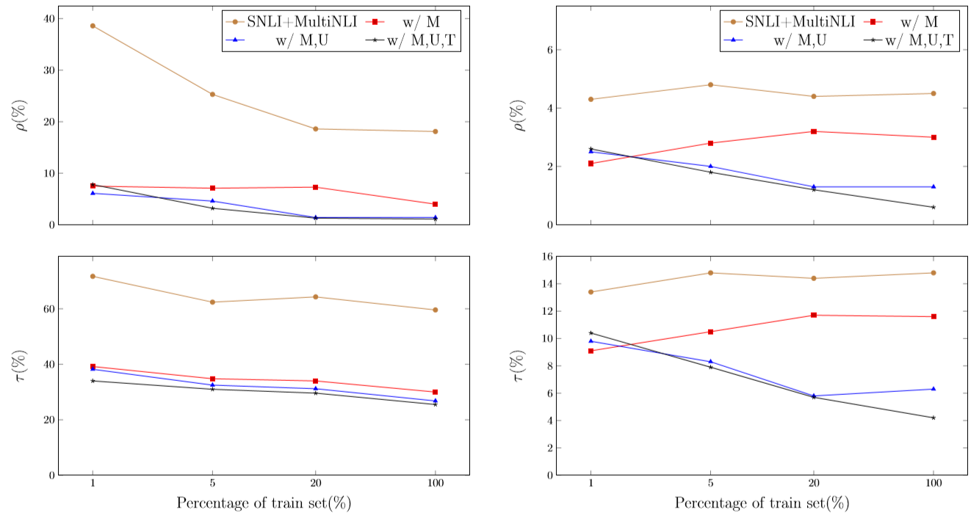
Experiments
study the effect of symmetry and transitivity consistency losses in turn using the BERT models
This suggests that label supervision does not explicitly encode the notion of consistency

Slide 17
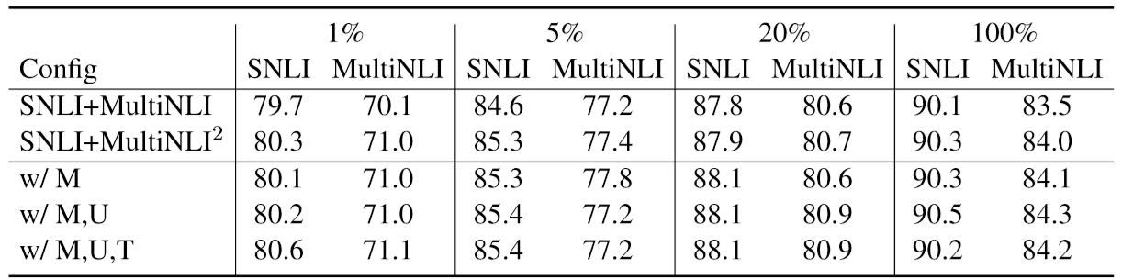
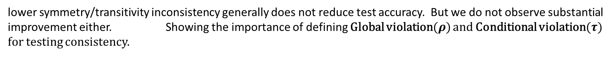
Experiments
Exploring the interaction of losses
lower symmetry/transitivity inconsistency generally does not reduce test accuracy. But we do not observe substantial improvement either. Showing the importance of defining Global violation($ρ$) and Conditional violation($τ$) for testing consistency.

Slide 18
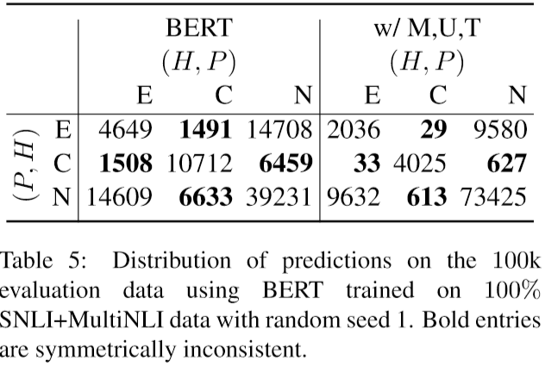
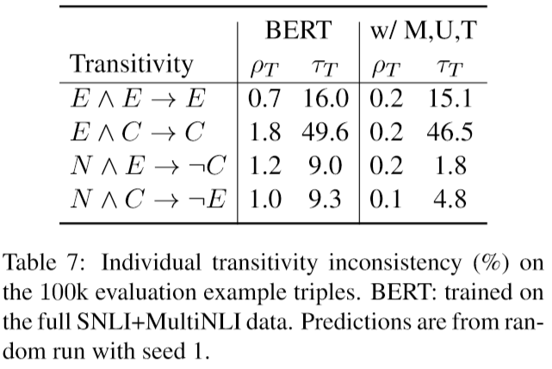
Experiments
Distribution of Predictions
the number of constraint-violating(off-diagonal) predictions signiﬁcantly dropped
Clearly our framework mitigated the violation rates on all four statements.
Neutral nearly doubled. This meets our expectation.
because the example pairs are constructed randomly
sampled from the same topic

Slide 19
Conclusion
We proposed a framework to measure and mitigate model inconsistencies
We construct logic rules into loss functions for model training
We show models can be highly accurate and consistent at the same time with our framework

Slide 20
QA

