Slide 1
Incorporating Syntactic and Semantic Information in Word Embeddings using Graph Convolutional Networks (ACL 2019)
Yiping Yin

Slide 2
overview
Review of Word Embeddings
Review of Graph Convolutional Networks
Motivation
synGCN
semGCN
Experiments
Discussion

Slide 3
Word Embeddings
CBOW & Skip-gram
Co-occurrence matrix
Syntax-based embeddings
Incorporating semantic knowledge sources
Graph convolutional networks

Slide 4



Review of Graph Convolutional Networks
i. Definations:
convolutional, because filter parameters are typically shared over all locations in the graph.
G=(V, E)
Z = f(X, A)
H^{(l+1)} = f(H^{(l)}, A) , H⁽⁰⁾=X, H^{(L)}=Z
ii. Fomulations
A_hat = A + I; D_hat is the degree matrix of A_hat.

Slide 5
Motivation
Most existing word embedding methods utilize sequential context of a word to learn its embedding. (add co-occurrence statistics)
Some attempts that utilizing syntactic context of a word result in an explosion of the vocabulary size.
For instance,
Scientists discover water on Mars.
Vocabulary : {scientists, discover, water, on, Mars, scientists_subj, water_obj, mars_nmod,…}

Slide 6
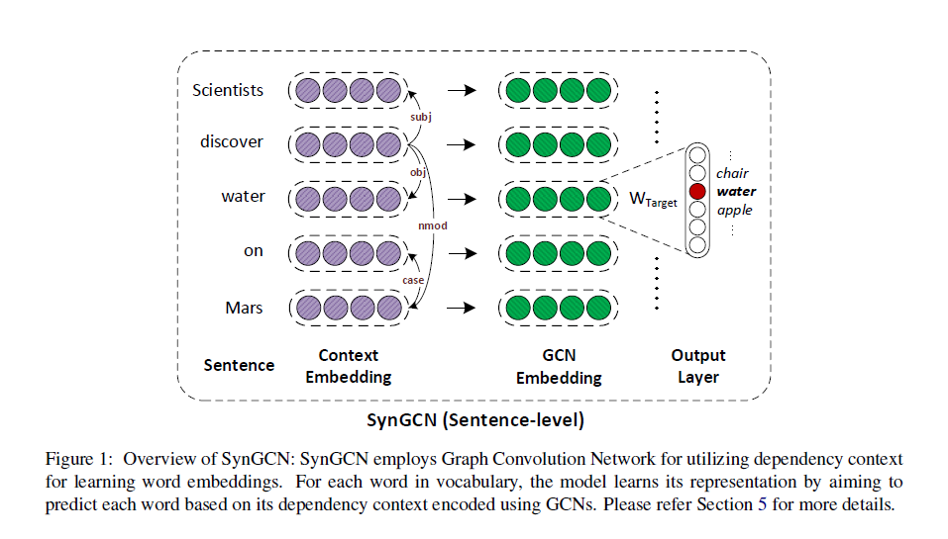
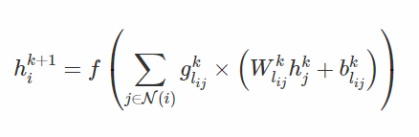
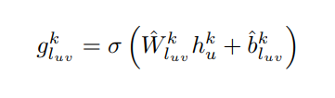
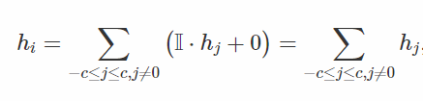
synGCN
Window size influences the quality of word embedding –> edge-wise gating
Sentence-level
S = (w₁, w₂, …, w_{n})
Dependency parse graph
G_{s} = (V_{s}, E_{s}) – CoreNLP parser
V_{s} = {w₁, w₂, …, w_{n}}
E_{s} = {(w_{i} , w_{j} , l_{ij})}
A generalizatiojn of CBOW

Slide 7
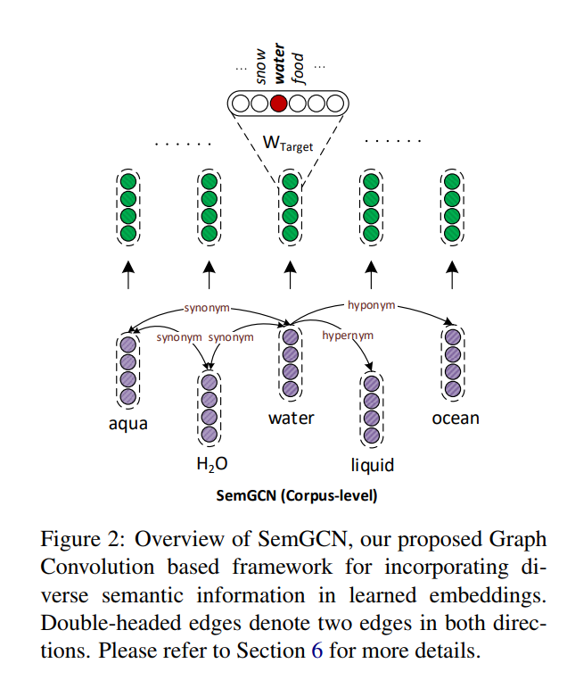
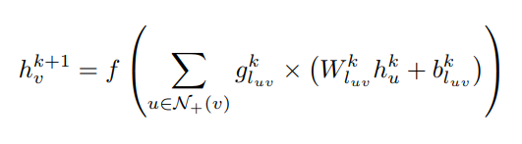
semGCN
Be capable of incorporating both symmetric as well as asymmetric information.
corpus-level
S = (w₁, w₂, …, w_{n})
G_{s} = (V_{s}, E_{s})
V_{s} = {w₁, w₂, …, w_{n}}
E_{s} = {(w_{i} , w_{j} , l_{ij})}

Slide 8
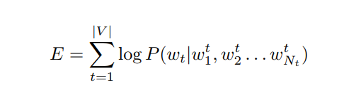
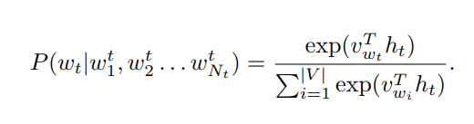
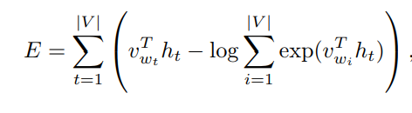
Objective
Why not joint synGCN and semGCN model ?
Syntactic information is much greater than the semantic information. So the latter is not effectively utilized.

Slide 9
Experiments
Wikipedia corpus
<num_words> <num_dep_rels> tok1 tok2 tok3 ... tokn dep_e1 dep_e2 .... dep_em
dep_en : source_token|destination_token|dep_rel_label
Average sentence length: nearly 20 words
# vocabulary size: 150000
# sentences: 57 million
# tokens: 1.1 billion
Syntactic dependencies: 1 billion

Slide 10
Experiments
Baselines:
synGCN & Word2vec
GloVe
Deps
EXT
semGCN & Retro-fit
Counter-fit
JointReps
Evaluation method:
Intrinsic tasks: word similarity
Word analogy
spearman correlation
Concept categorization
cluster purity
Extrinsic tasks: question answering
Part-of-speech
Co-reference resolution

Slide 11
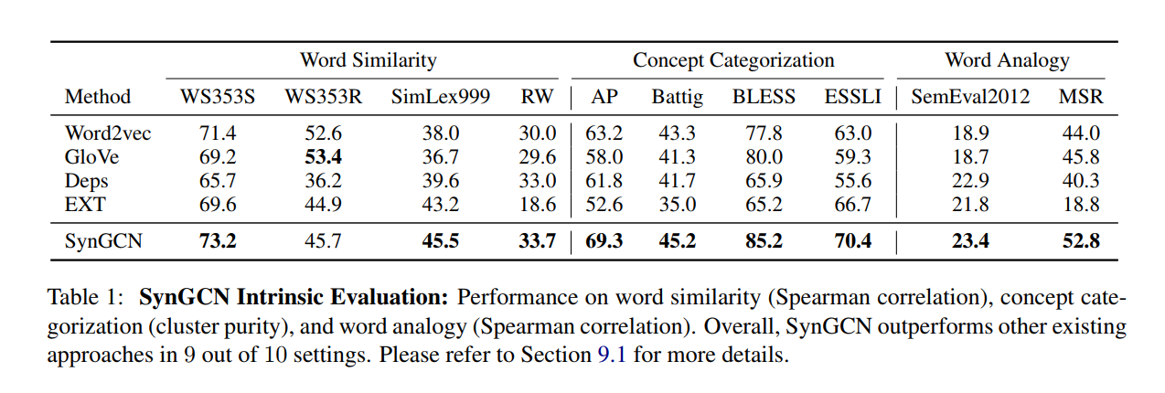
Experiments – synGCN
9 out of 10

Slide 12
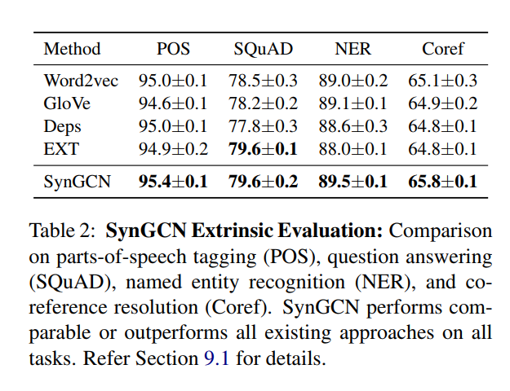
Experiments – synGCN

Slide 13
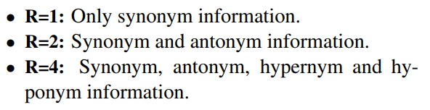
Experiments – semGCN
M(X, R)
X is initialization embeddings; R is the types of semantic information.
For instance, counter_fit (GloVe, 2)

Slide 14
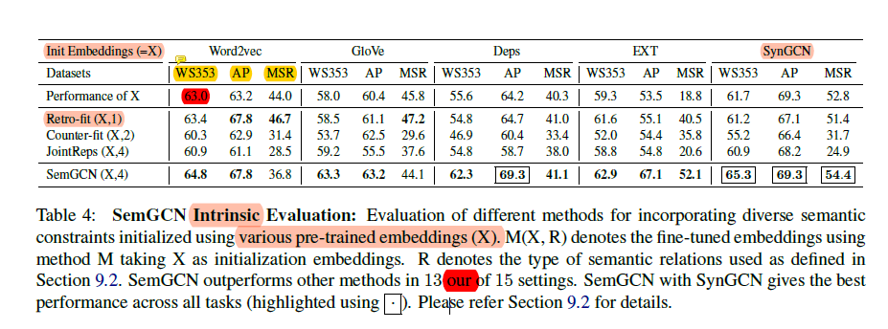
Experiments – semGCN
13out of 15

Slide 15
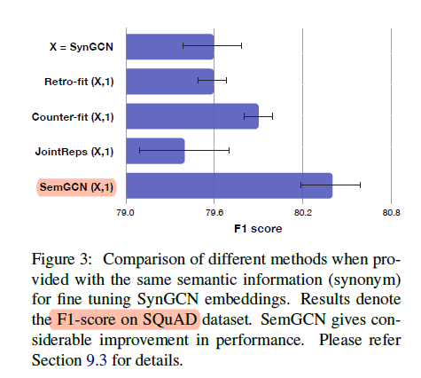
Experiments – semGCN
Same semantic information – synonyms from PPDB

Slide 16
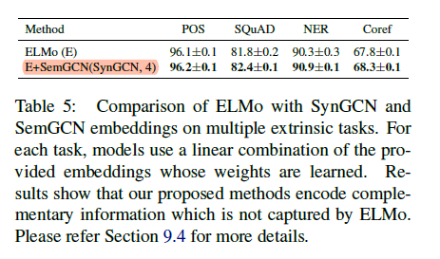
Experiments – semGCN + ELMo

Slide 17
Discussion
Why use First-order GCN rather than more advanced GCN?
Superior performance at question answering task. –> CCKS
Bert.
Application.
http://github.com/malllabiisc/WordGCN.

