Slide 1

论辩挖掘研究简述
报告人： 鲍建竹

Slide 2
01
任务介绍及传统方法
概要
02
研究方向

Slide 3
任务介绍
论辩挖掘
Ever since researchers at the Roslin Institute in Edinburgh cloned an adult sheep, there has been an ongoing debate about whether cloning technology is morally and ethically right or not. As far as I’m concerned, [cloning is an important technology for humankind]_{MajorClaim1} since [it would be very useful for developing novel cures]_{Claim1}.
First, [cloning will be beneﬁcial for many people who are in need of organ transplants]_{Claim2}. [Cloned organs will match perfectly to the blood group and tissue of patients]_{Premise1} since [they can be raised from cloned stem cells of the patient]_{Premise2}. In addition, [it shortens the healing process]_{Premise3}. Usually, [it is very rare to ﬁnd an appropriate organ donor]_{Premise4} and [by using cloning in order to raise required organs the waiting time can be shortened tremendously]_{Premise5}.

Slide 4
任务介绍
三个子任务
(1) Component identiﬁcation（论辩部件检测）
(2) Component classiﬁcation（论辩部件分类）
(3) Component relationship classiﬁcation/Structure identiﬁcation （论辩关系分类）

Slide 5
任务1：论辩边界检测
任务1
Ever since researchers at the Roslin Institute in Edinburgh cloned an adult sheep, there has been an ongoing debate about whether cloning technology is morally and ethically right or not. As far as I’m concerned, [cloning is an important technology for humankind]_{MajorClaim1} since [it would be very useful for developing novel cures]_{Claim1}.
First, [cloning will be beneﬁcial for many people who are in need of organ transplants]_{Claim2}. [Cloned organs will match perfectly to the blood group and tissue of patients]_{Premise1} since [they can be raised from cloned stem cells of the patient]_{Premise2}. In addition, [it shortens the healing process]_{Premise3}. Usually, [it is very rare to ﬁnd an appropriate organ donor]_{Premise4} and [by using cloning in order to raise required organs the waiting time can be shortened tremendously]_{Premise5}.

Slide 6
任务1：论辩边界检测
方法
(1) 子句级别，二分类问题。
(2) 使用篇章标记确定边界。
(3) 第一步，子句级别二分类。 第二步, 使用CRF对每个包含论辩的子句确定具体边界。

Slide 7
任务2：论辩部件分类
任务2
Major Claim: Represents the author’s standpoint on the topic.
Claim/Conclusion: A controversial statement and the central component of an argument.
Premise: Reasons for justifying (or refuting) the claim.

Slide 8
任务2：论辩部件分类
任务2
Ever since researchers at the Roslin Institute in Edinburgh cloned an adult sheep, there has been an ongoing debate about whether cloning technology is morally and ethically right or not. As far as I’m concerned, [cloning is an important technology for humankind]_{MajorClaim1} since [it would be very useful for developing novel cures]_{Claim1}.
First, [cloning will be beneﬁcial for many people who are in need of organ transplants]_{Claim2}. [Cloned organs will match perfectly to the blood group and tissue of patients]_{Premise1} since [they can be raised from cloned stem cells of the patient]_{Premise2}. In addition, [it shortens the healing process]_{Premise3}. Usually, [it is very rare to ﬁnd an appropriate organ donor]_{Premise4} and [by using cloning in order to raise required organs the waiting time can be shortened tremendously]_{Premise5}.

Slide 9
任务2：论辩部件分类
方法
(1) 二分类或者三分类问题，使用structural, lexical, syntactic, indicator等特征。
(2) ner

Slide 10
任务3：论辩关系分类
任务3
对所有论辩部件之间的关系进行分类。
Support
Attack
进而得到整个论辩的结构，所以又叫论辩结构检测。

Slide 11
任务3：论辩关系分类
任务3
Ever since researchers at the Roslin Institute in Edinburgh cloned an adult sheep, there has been an ongoing debate about whether cloning technology is morally and ethically right or not. As far as I’m concerned, [cloning is an important technology for humankind]_{MajorClaim1} since [it would be very useful for developing novel cures]_{Claim1}.
First, [cloning will be beneﬁcial for many people who are in need of organ transplants]_{Claim2}. [Cloned organs will match perfectly to the blood group and tissue of patients]_{Premise1} since [they can be raised from cloned stem cells of the patient]_{Premise2}. In addition, [it shortens the healing process]_{Premise3}. Usually, [it is very rare to ﬁnd an appropriate organ donor]_{Premise4} and [by using cloning in order to raise required organs the waiting time can be shortened tremendously]_{Premise5}.

Slide 12
任务3：论辩关系分类
论辩结构
MajorClaim1
Claim1
Claim2
Premise1
Premise3
Premise2
Premise4
Premise5

Slide 13
任务3：论辩关系分类
方法
(1) 将论辩部件之间的关系分为两类，support or not-linked，使用SVM根据structural, lexical, syntactic, and indicator 等特征来进行分类.
(2) 使用整数线性规划（Integer Linear Programming），在对论辩部件分类的同时对部件关系进行分类。

Slide 14
多任务学习
序列标注
Neural End-to-End Learning for Computational Argumentation Mining，ACL 2017
(1) AM as Sequence Tagging，将多个任务都转化为序列标注问题，label放在一起，同时进行标注。
(2) LSTM-ER，联合学习，但是将部件分类和关系分类两个任务区别开。

Slide 15
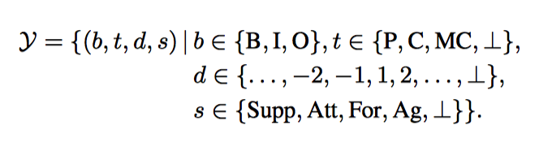
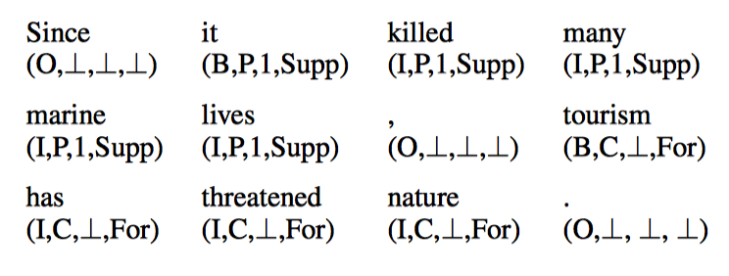
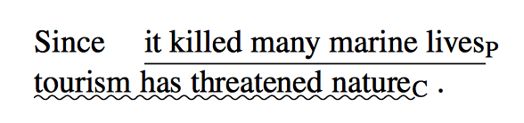
序列标注任务
AM as Sequence Tagging

Slide 16
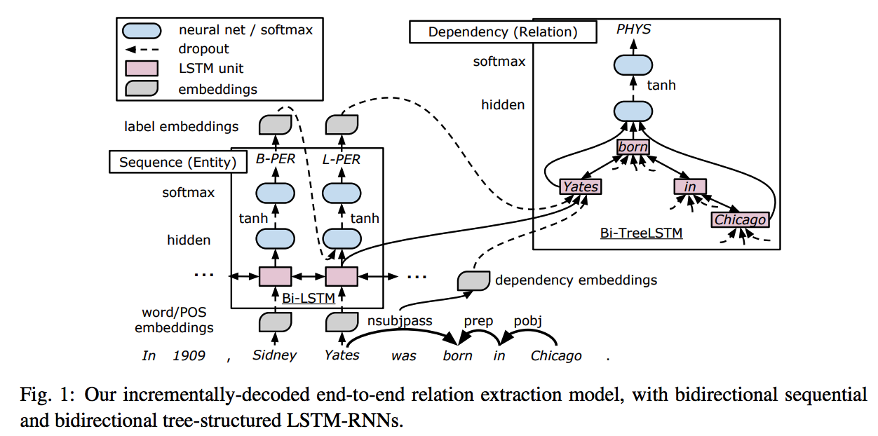
序列标注任务
LSTM-ER
End-to-End Relation Extraction using LSTMs on Sequences and Tree Structures

Slide 17
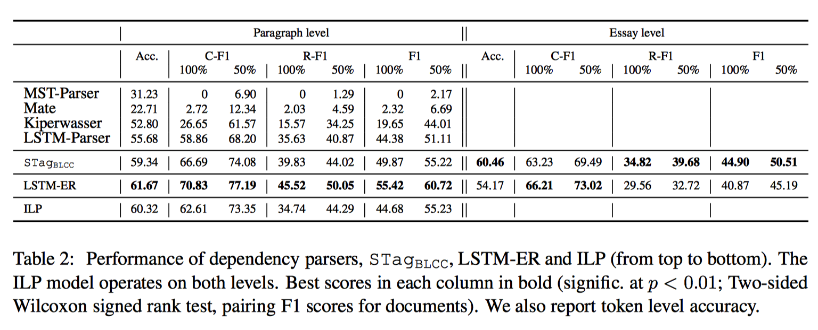
多任务学习
序列标注
Neural End-to-End Learning for Computational Argumentation Mining，ACL 2017

Slide 18
多任务学习
Pointer Network
Here’s My Point: Joint Pointer Architecture for Argument Mining
能够同时预测论辩部件的类别及其之间有无联系的多任务学习模型。

Slide 19
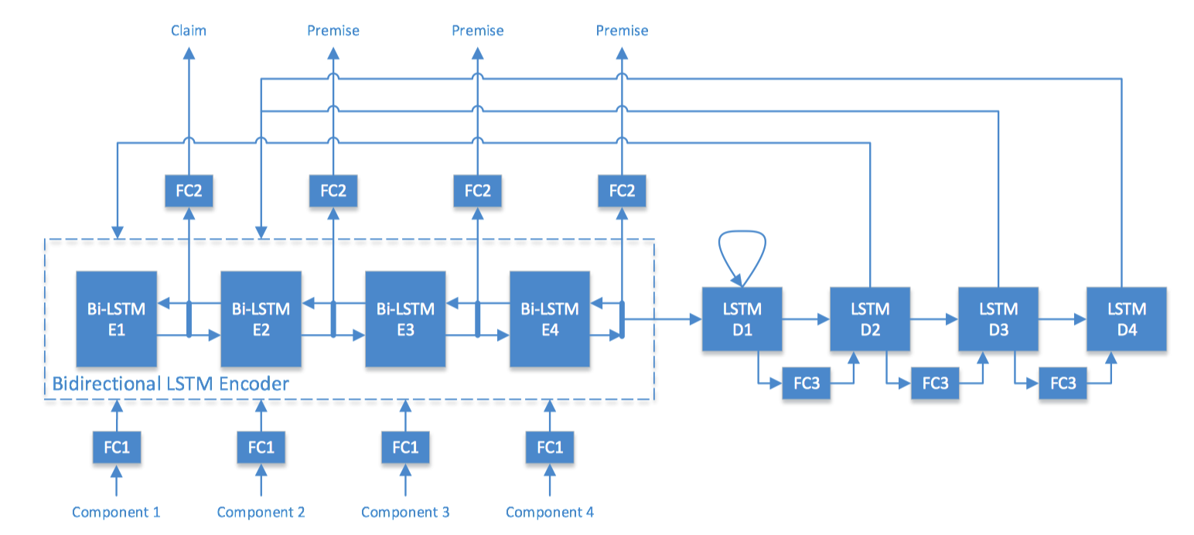
多任务学习
Pointer Network

Slide 20
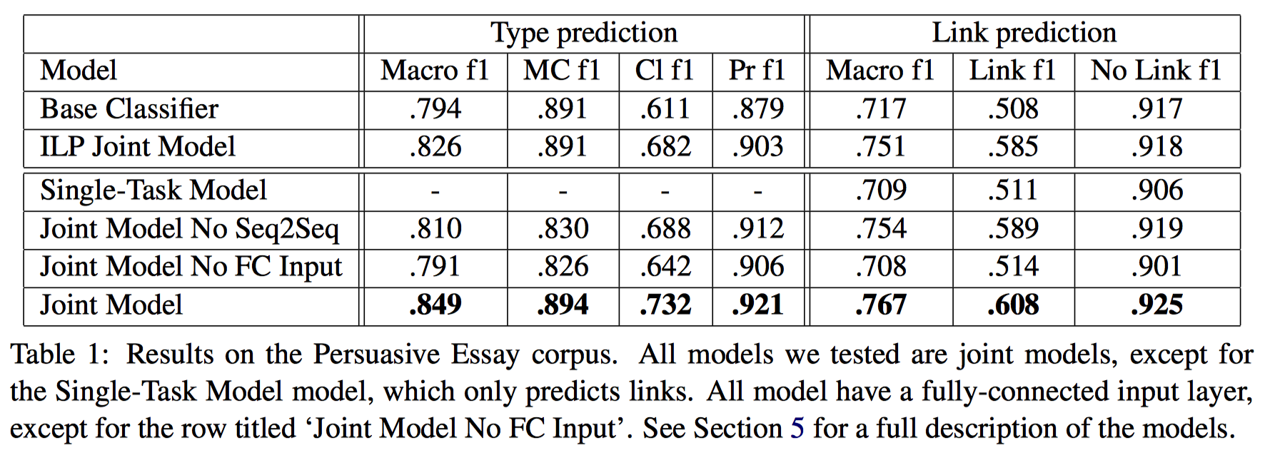
多任务学习
Pointer Network

Slide 21
BERT
BERT
Classiﬁcation and Clustering of Arguments with Contextualized Word Embeddings，ACL 2019
首次用BERT、ELMo等来对论辩文本进行分类。
Classiﬁcation
Clustering

Slide 22
BERT
Classiﬁcation
Classiﬁcation and Clustering of Arguments with Contextualized Word Embeddings，ACL 2019
子句级
使用的数据集带有Topic信息，每句话都有topic标签
pro/con
分类子句对相应topic是支持还是反对
方法：将topic和sentence用[SEP]连接起来，进行分类。

Slide 23
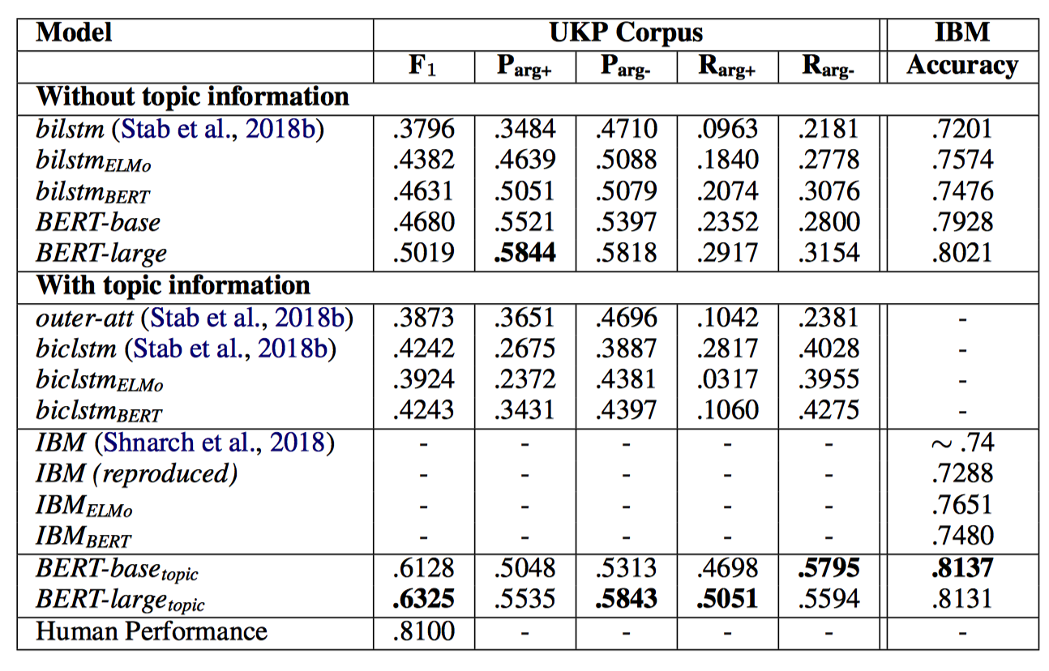
BERT
Classiﬁcation

Slide 24
BERT
Clustering
Classiﬁcation and Clustering of Arguments with Contextualized Word Embeddings，ACL 2019
对每个topic下的子句进行聚类
描述同一个方面的子句聚为一类
使用多种不同特征，如Tf-Idf、GloVe、ELMo等
Agglomerative clustering （层次聚类算法）

Slide 25
BERT
Clustering
Classiﬁcation and Clustering of Arguments with Contextualized Word Embeddings，ACL 2019
对每个topic下的子句进行聚类
描述同一个方面的子句聚为一类
使用多种不同特征，如Tf-Idf、GloVe、ELMo等
Agglomerative clustering （层次聚类算法）
除此之外，还使用bert作为监督学习任务微调，预测两句话是否为一类。

Slide 26
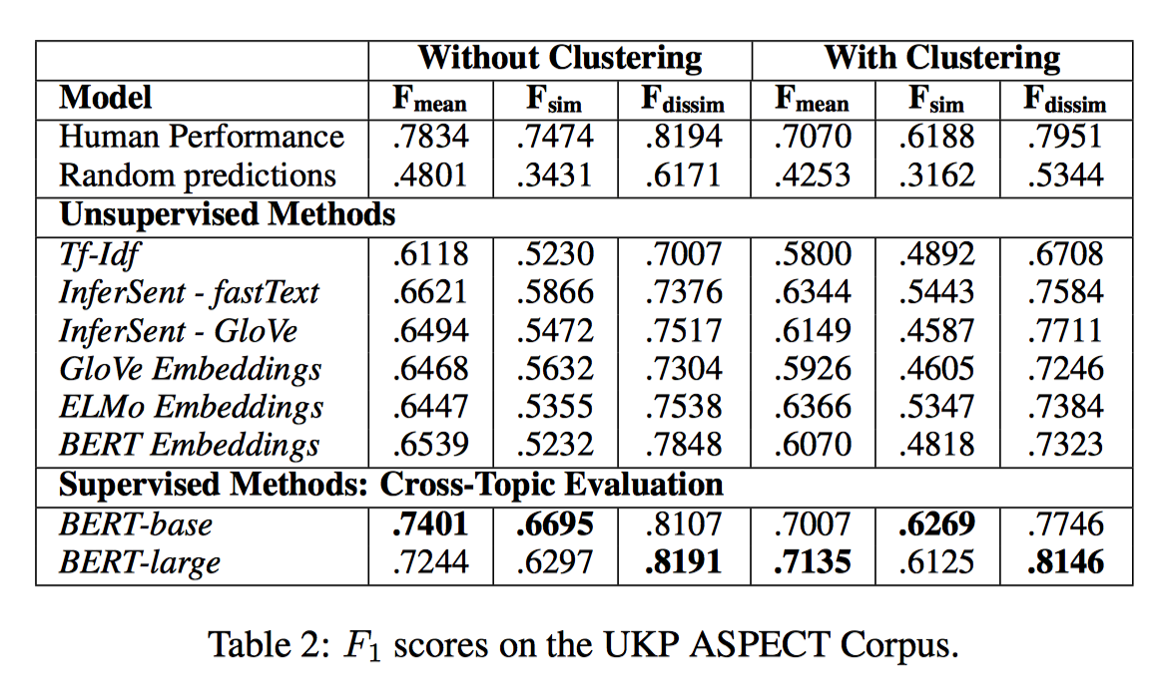
BERT
Clustering

Slide 27
Decompositional
Decompositional Argument Mining: A General Purpose Approach for Argument Graph Construction， ACL 2019
将每个论辩部件再细分为四个组件，通过组件之间的关系来确定论辩部件之间的关系。
四个组件：
target concepts (C),
aspects (A),
opinions on aspects (OA)
opinions on target concepts (OC).
[Camping]_{c} [is a great way]_{oc} to [bring]_{oa} [families]_{a} [together]_{oa.}

Slide 28
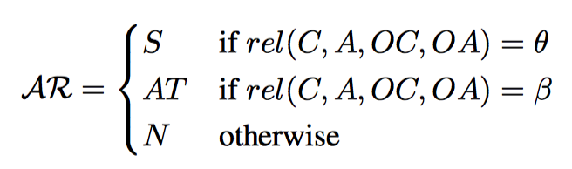
Decompositional
[Camping]_{c} [is a great way]_{oc} to [bring]_{oa} [families]_{a} [together]_{oa.}
target concepts (C),
aspects (A),
opinions on aspects (OA)
opinions on target concepts (OC).

Slide 29
Decompositional
识别C, A, OC, OA，使用NER
识别OC和OA之间的关系，是支持还是冲突。
计算C, A之间的相似度。
利用C和A之间的相似度, OC和OA之间的联系，训练分类器分类两个组件之间的联系。

Slide 30
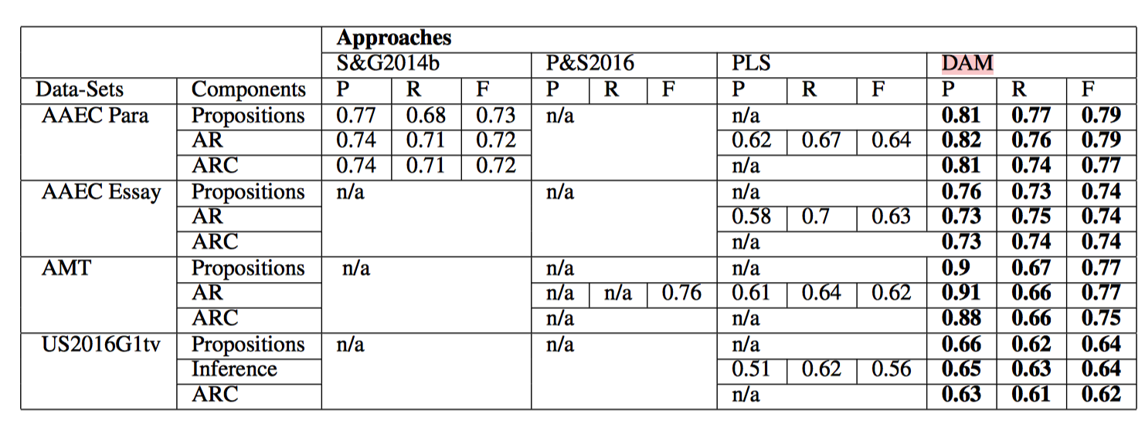
Decompositional

Slide 31
研究方向
多任务学习
尝试用BERT做部件关系识别

Slide 32
THANKS

