Slide 1

Do you know that Florence is packed with visitors? Evaluating state-of-the-art models of speaker commitment
ACL 2019 best short paper

Slide 2
Introduction – speaker commitment
Do you know that Florence is packed with visitors?
Do you think that Florence is packed with visitors?
Prediction of speaker commitment is the task of determining to what extent the speaker is committed to an event in a sentence as actual, nonactual, or uncertain.

Slide 3
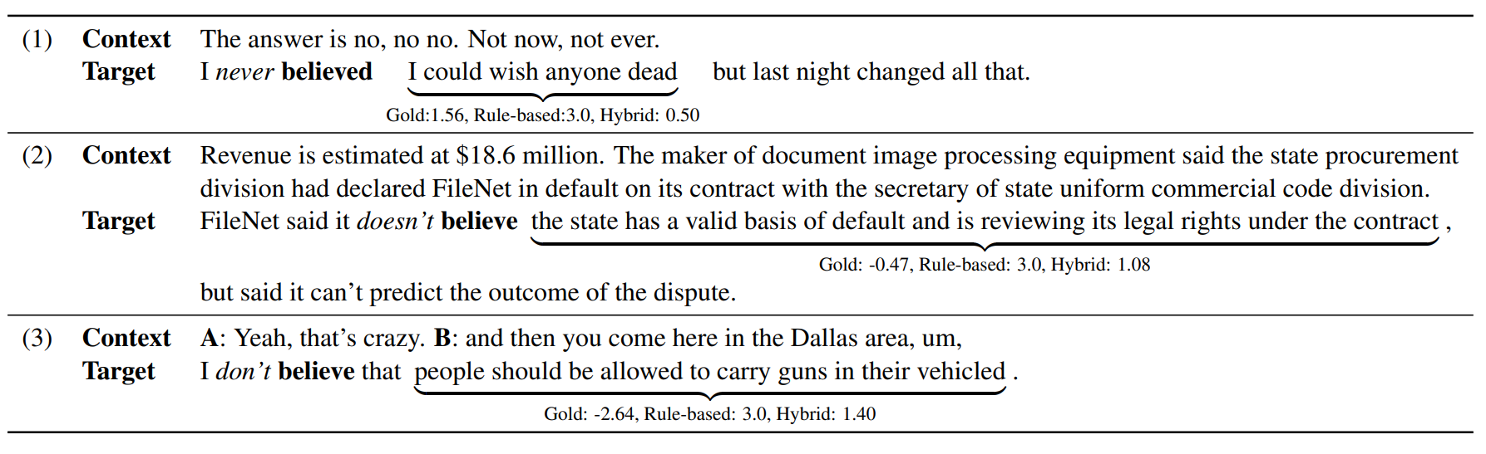
Introduction – speaker commitment

Slide 4
The Commitmentbank corpus
The CommitmentBank consists of 1,200 naturally occurring items involving clause-embedding verbs under four entailment-canceling environments (negations, modals, questions, conditionals).
Each item consists of up to two context sentences and one target sentence.
Genre：news fiction dialog
gold score:
get from at least eight native English speakers
Participants judged whether or not the speaker is certain that the content of the complement in the target sentence is true, using a Likert scale labeled at 3 points:
+3: certainly true 0:not certain -3:centainly false
mean annotations of each item as gold score of speaker commitment

Slide 5
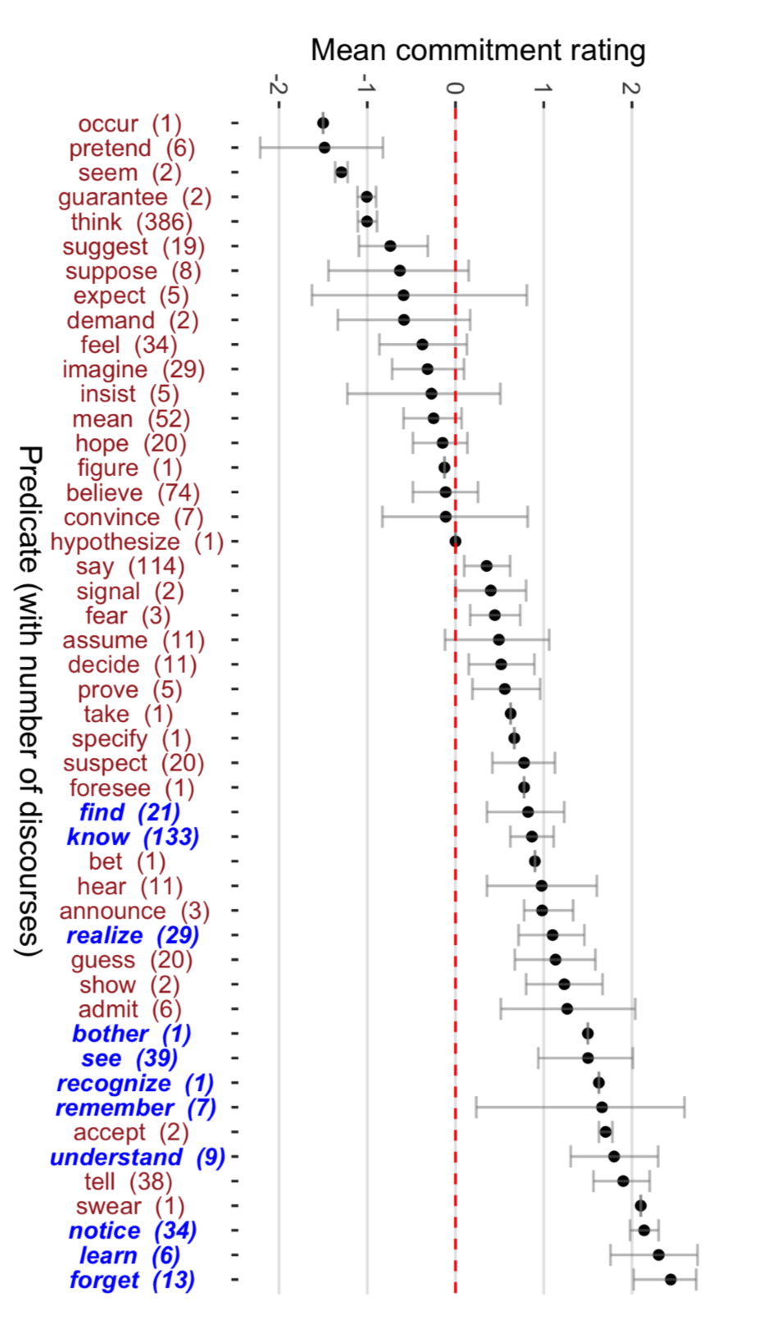
Mean commitment scores in all of the CommitmentBank. Italicized verbs are factive, plain nonfactive.

Slide 6
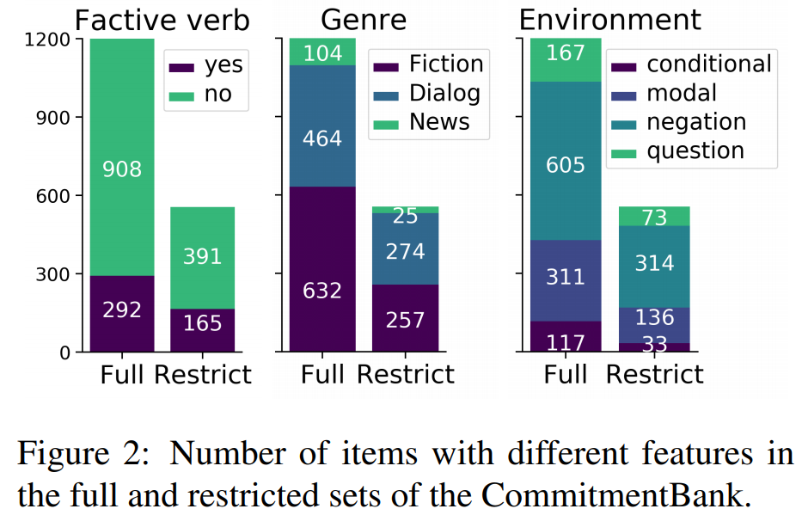
Restricted set
divide the range of integer ratings [−3, 3] into three sub-ranges:
[1,3] 0 [-3,-1]
gives 556 items, with 37 clause-embedding verbs
The full CommitmentBank has a Krippendorff’s α of 0.53, while α is 0.74 on the restricted set.

Slide 7
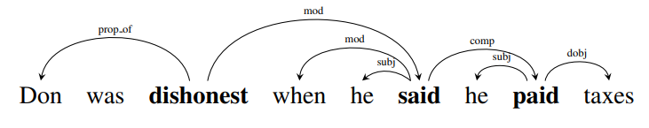
Models
rule-based model (Stanovsky et al., 2017)
-TruthTeller -PropS
extend TruthTeller’s lexicon by roughly 40%
integrate PropS with TruthTeller
take features： TruthTeller annotations of the target predicate
its PropS head and its children

Slide 8
TruthTeller
A novel algorithm and system that identifies the truth value of each predicate in a given sentence. It annotates nodes in the text’s dependency parse-tree via a combination of pattern-based annotation rules and a recursive algorithm based on natural logic.
4 annotation types：
-Predicate Implication Signature：
Ed refused to pay entails that Ed didn't pay.
-Negation and Uncertainty：
might, probably no, never
-Clause-Truth：indicates whether the entire clause headed by the predicate is entailed by the complete sentence
-Predicate Truth：indicates whether the predicate itself is entailed by the sentence

Slide 9
PROPS(Proposition Structure)
An automatic converter which takes as input Stanford dependency trees, and outputs proposition structures with the notation.
five desired structural principles:
-Masking non-core syntactic detail:
remove auxiliary words group within a single node
-Representing propositions in a uniform manner
uniformly access a wide range of propositions, headed by different types of predicates
-Canonicalizing and differentiating syntactic constructions
unify differentiate
- Marking proposition boundaries:
Clearly marking the minimal span of a standalone proposition and its elements
-Propagating Relations:
infer every relation through parse tree traversal

Slide 10
Models
neural-based model (Rudinger et al., 2018)
linear biLSTM
dependency tree biLSTM
hybrid
dataset: FactBank UW MEANTIME UDS
All four datasets have annotations biased towards +3

Slide 11
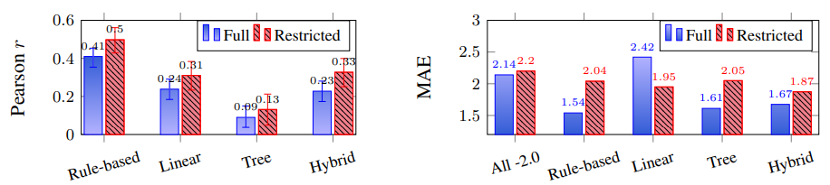
Evaluation & Analysis
The rule-based model outperforms the biLSTM models on the full set, but overall both SoA models do not perform very well on the CommitmentBank.

Slide 12
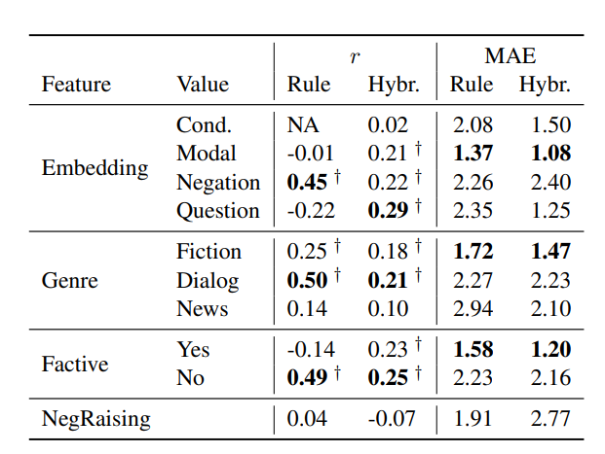
Evaluation & Analysis

Slide 13
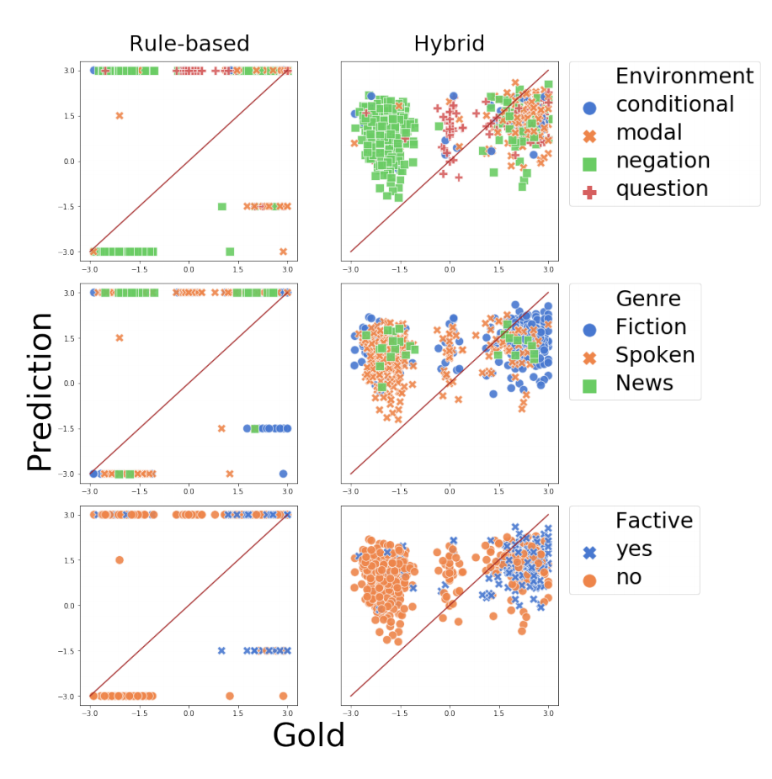
Evaluation & Analysis

Slide 14
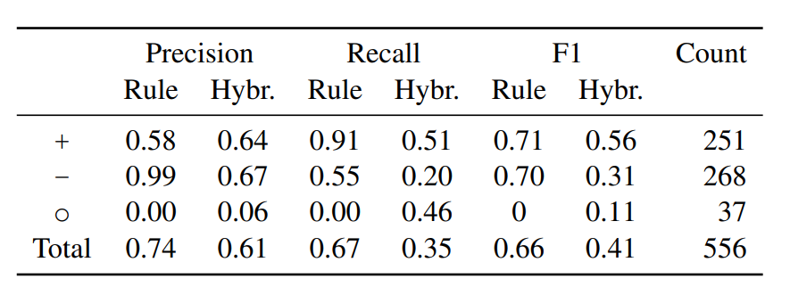
Evaluation & Analysis
classfication
highest mean -> +
certainly true
lowest mean -> -
certainly false
the remaining -> o
not certain

Slide 15
Conclusion
The models perform better on sentences with negation, and with nonfactive embedding verbs. However, they are not able to generalize to other linguistic environments such as conditional, modal, and neg-raising
The rulebased model, outperforming the biLSTM models on the full CommitmentBank, shows that a linguistically-informed model scales more successfully to challenging naturalistic data.
In the long run, to perform robust language understanding, models will need to incorporate more linguistic foreknowledge and be able to generalize to a wider range of linguistic constructions.

