Slide 1

Bridging the Gap between Training and Inference for Neural Machine Translation
ACL 2019 Best long paper

Slide 2











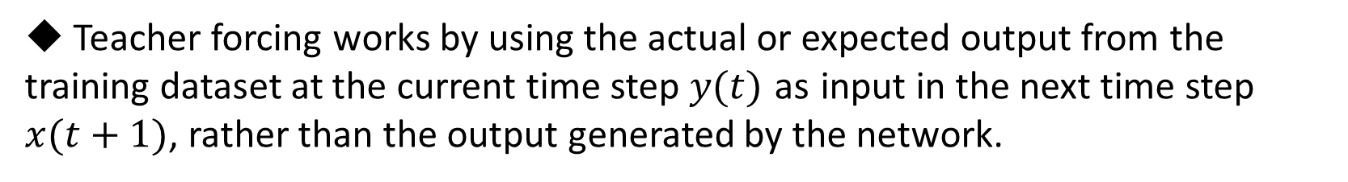




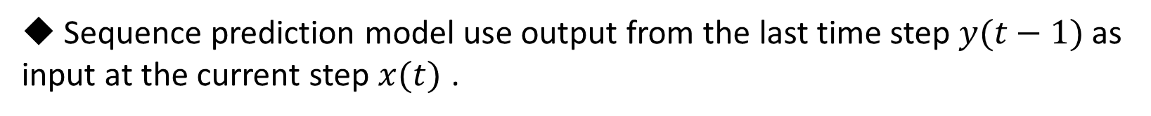



Introduction – Teacher forcing
Sequence prediction model use output from the last time step $y(t−1)$ as input at the current step $x(t)$ .
Teacher forcing works by using the actual or expected output from the training dataset at the current time step $y(t)$ as input in the next time step $x(t+1)$, rather than the output generated by the network.
$${ y}_{1}^{′}$$
$${ y}_{2}^{′}$$
$${ y}_{3}^{′}$$
$${ h}_{1}$$
$${ h}_{2}$$
$${ h}_{3}$$
$${ h}_{4}$$
$${ h}_{1}^{′}$$
$${ h}_{2}^{′}$$
$${ h}_{3}^{′}$$
$${ h}_{0}$$
$$c$$
$${ x}_{1}$$
$${ x}_{2}$$
$${ x}_{3}$$
$${ x}_{4}$$
BOS
$${ y}_{1}$$
$${ y}_{2}$$

Slide 3
Introduction – Exposure Bias
At training time, model predicts with the ground truth words as context while at inference it has to generate the entire sequence from scratch.
This process is very brittle because the model was trained on a different distribution of inputs, namely, words drawn from the data distribution, as opposed to words drawn from the model distribution.

Slide 4
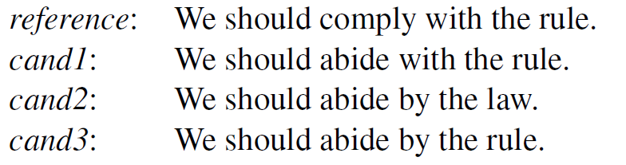
Introduction – Overcorrection
Word-level training requires strict matching between the generated sequence and the ground truth sequence which leads to overcorrection over difference but reasonable translations.

Slide 5
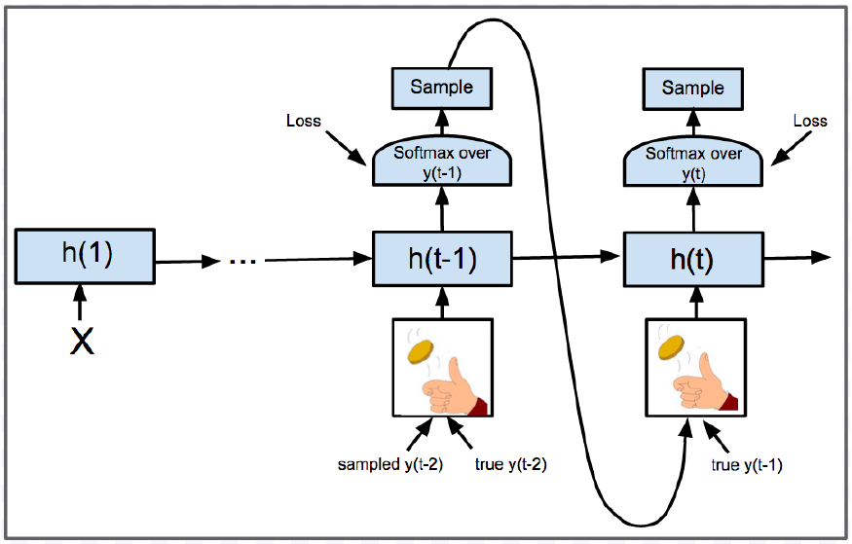
Method
Select oracle words from the predicted words and then samples as context from the oracle words and ground truth words.
At the beginning of training, the model selects as context ground truth words at a greater probability, as the model converges gradually, oracle words are chosen as context more often.

Slide 6
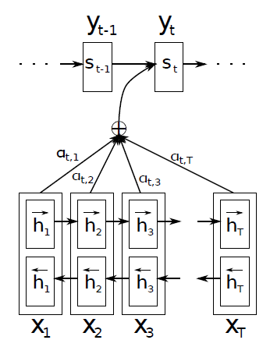
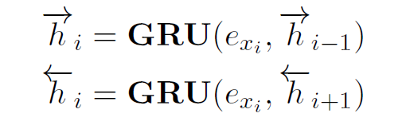
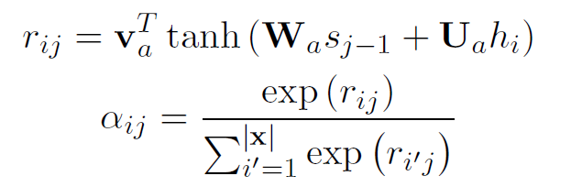
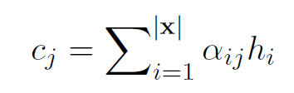
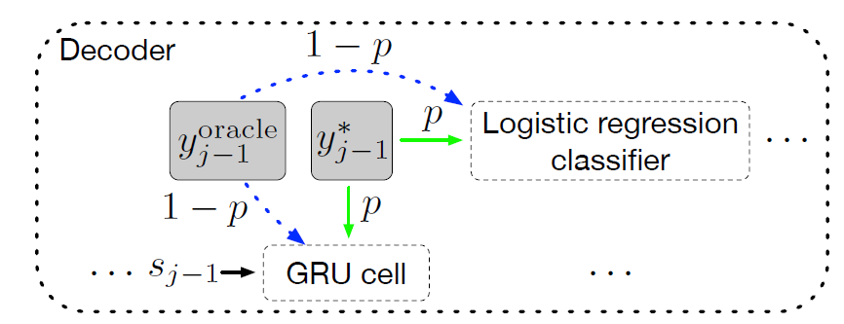

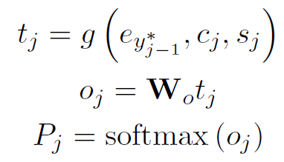
RNN-based NMT Model
Encoder
Decoder
6

Slide 7
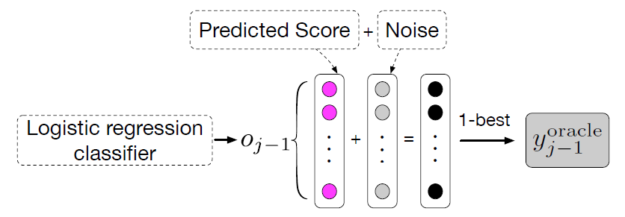
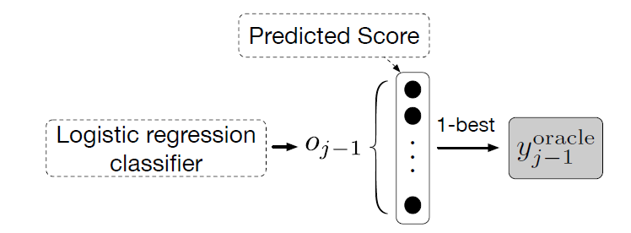
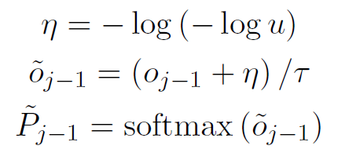
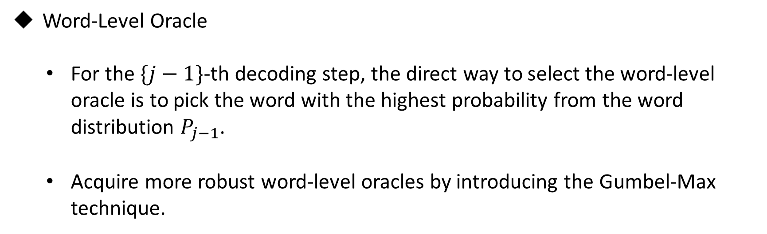
Oracle Word Selection
Word-Level Oracle
For the $\{j−1\}$-th decoding step, the direct way to select the word-level oracle is to pick the word with the highest probability from the word distribution $P_{j−1}$.
Acquire more robust word-level oracles by introducing the Gumbel-Max technique.

Slide 8
Oracle Word Selection
Sentence-Level Oracle
Perform beam search for all sentences in each batch, Gumble noise can also be used for each word generation.
Evaluation each translation by calculating its BLEU score with the ground truth sequence, and use the translation with the highest BLEU score as the oracle sentence

Slide 9
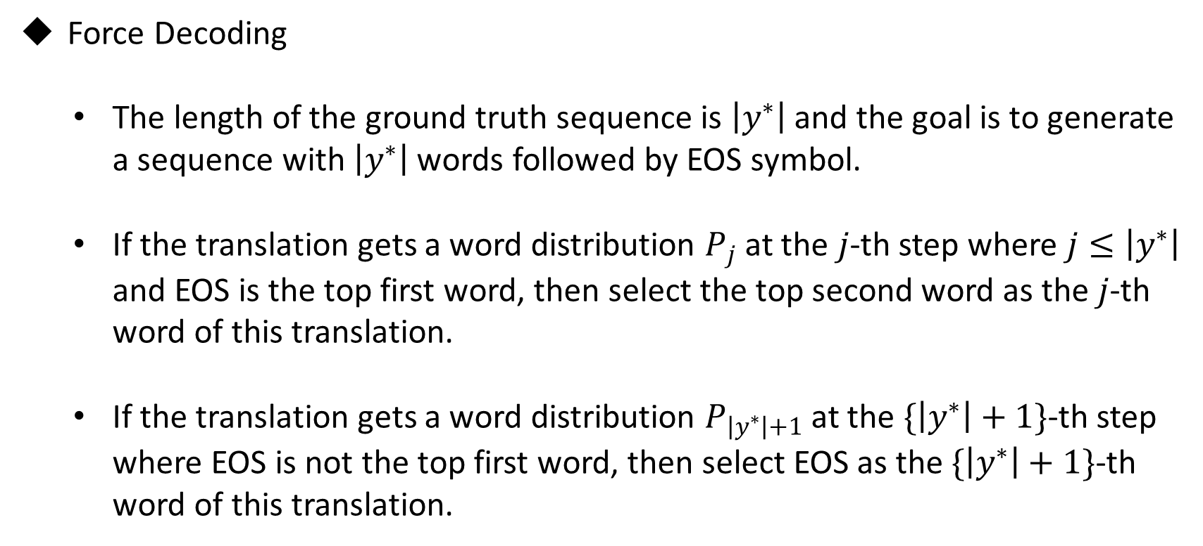
Oracle Word Selection
Force Decoding
The length of the ground truth sequence is $\left|y^{∗}\right|$ and the goal is to generate a sequence with $\left|y^{∗}\right|$ words followed by EOS symbol.
If the translation gets a word distribution $P_{j}$ at the $j$-th step where $j≤\left|y^{∗}\right|$ and EOS is the top first word, then select the top second word as the $j$-th word of this translation.
If the translation gets a word distribution $P_{\left|y^{∗}\right|+1}$ at the $\{\left|y^{∗}\right|+1\}$-th step where EOS is not the top first word, then select EOS as the $\{\left|y^{∗}\right|+1\}$-th word of this translation.

Slide 10
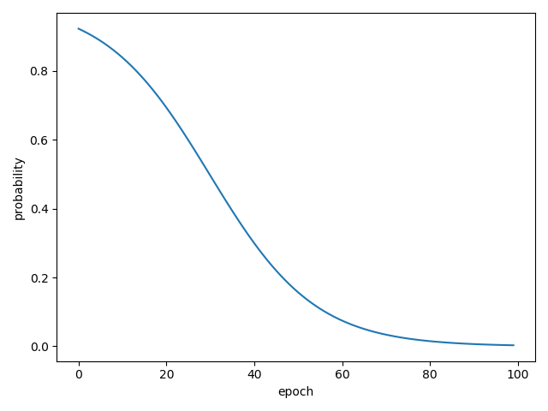
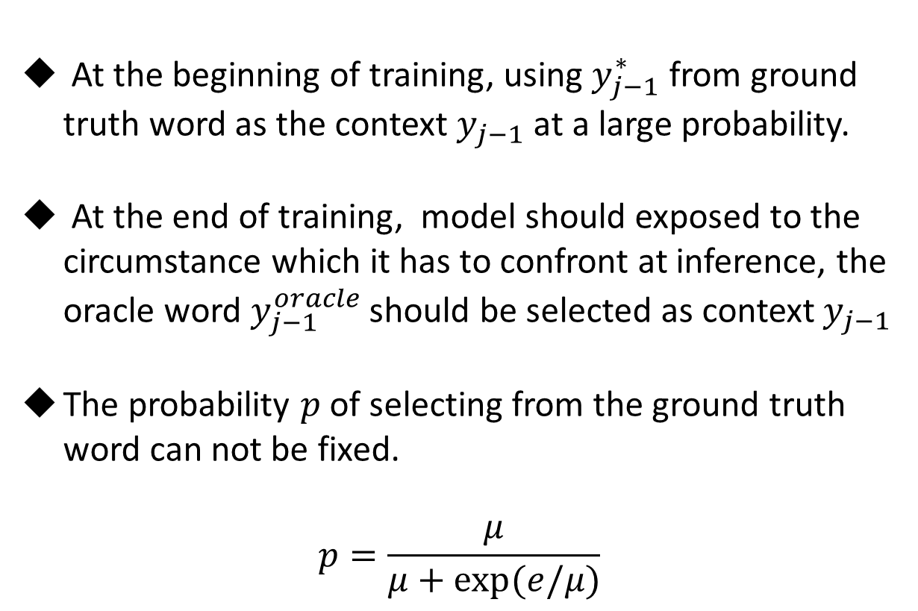
Sampling with Decay
At the beginning of training, using $y_{j−1}^{∗}$ from ground truth word as the context $y_{j−1}$ at a large probability.
At the end of training, model should exposed to the circumstance which it has to confront at inference, the oracle word $y_{j−1}^{oracle}$ should be selected as context $y_{j−1}$
The probability $p$ of selecting from the ground truth word can not be fixed.
$$p=\frac{μ}{μ+exp⁡(e/μ)}$$

Slide 11

Training
Objective is to maximize the probability of the ground truth sequence based on MLE.

Slide 12

Experiment – Dataset
NIST Chinese$→$English
WMT’14 English$→$German
Train set | Validation set | Test set
1.25M | 878 | NIST 2003 (MT03) | NIST 2004 (MT04) | NIST 2005 (MT05) | NIST 2006 (MT06)
 |  | 919 | 1788 | 1082 | 1664
Train set | Validation set | Test set
4.5M | 3003 | 2737

Slide 13

Experiment – Hyper-parameter
NIST Chinese$→$English
WMT’14 English$→$German
The mini-batch SGD is employed and the learning rate is adjusted by adadelta optimizer with $ρ$=0.95 and $ε$ = 1e-6
Zh Vocab size | En Vocab size | Sentence len | Embedding size | Hidden size | Beam size | Batch size | Dropout
30K | 30K | 50 | 512 | 512 | 10 | 80 | 0.5
En Vocab size | De Vocab size | Sentence len | Embedding size | Hidden size | Beam size | Batch size | Dropout
39418 | 40274 | 128 | 512 | 512 | 10 | 80 | 0.5

Slide 14
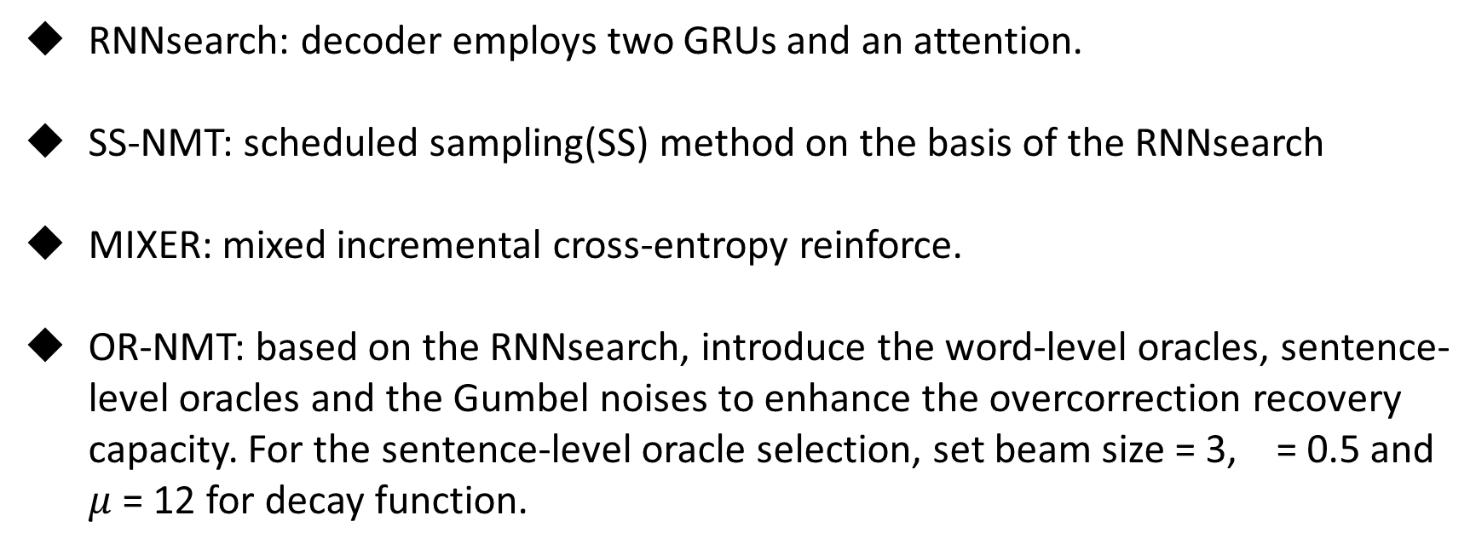
Experiment – Baseline
RNNsearch: decoder employs two GRUs and an attention.
SS-NMT: scheduled sampling(SS) method on the basis of the RNNsearch
MIXER: mixed incremental cross-entropy reinforce.
OR-NMT: based on the RNNsearch, introduce the word-level oracles, sentence-level oracles and the Gumbel noises to enhance the overcorrection recovery capacity. For the sentence-level oracle selection, set beam size = 3, = 0.5 and $μ$ = 12 for decay function.

Slide 15
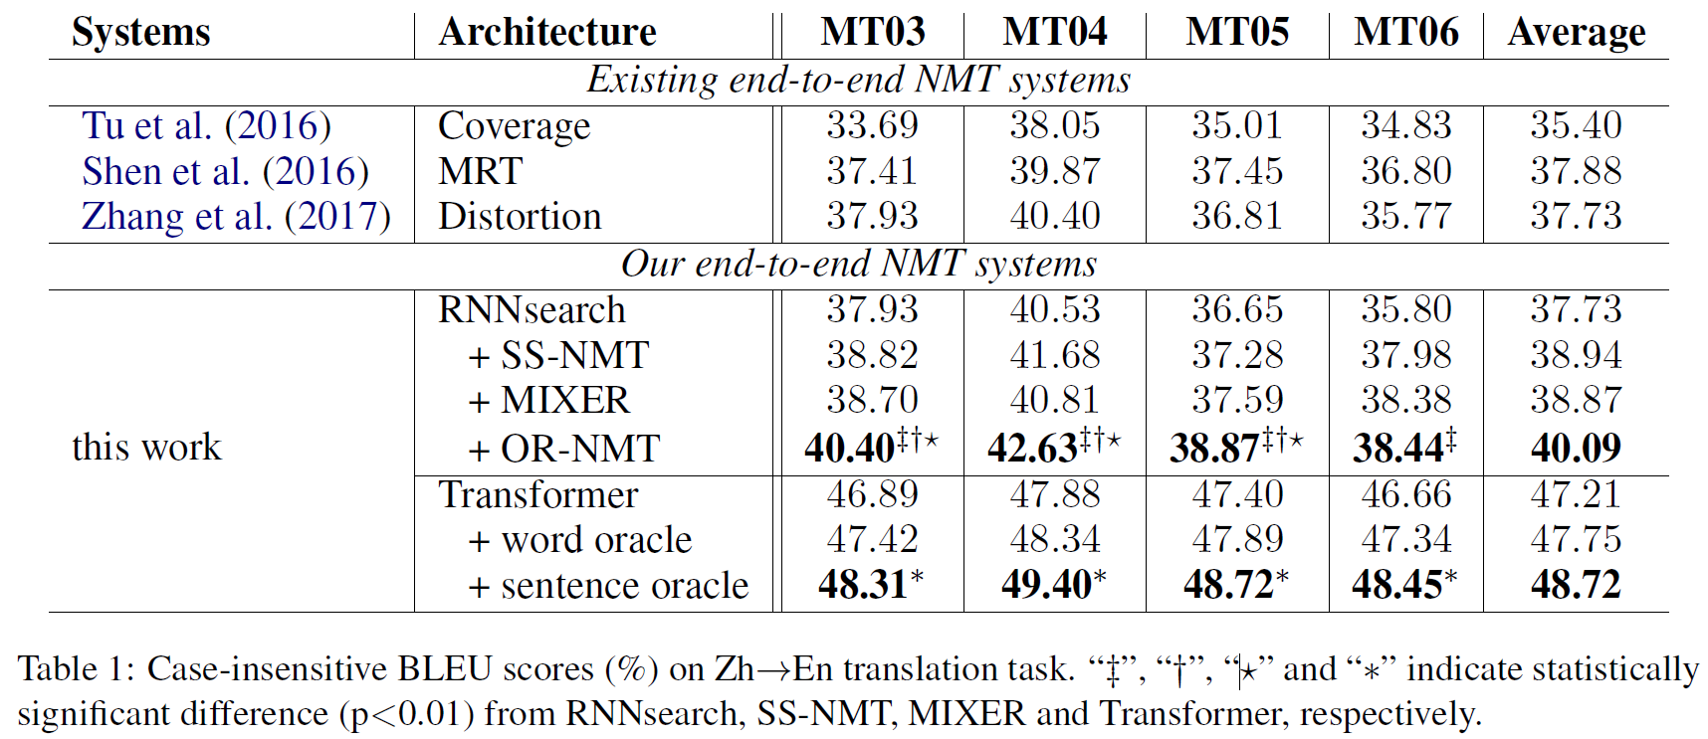
Experiment – Results

Slide 16
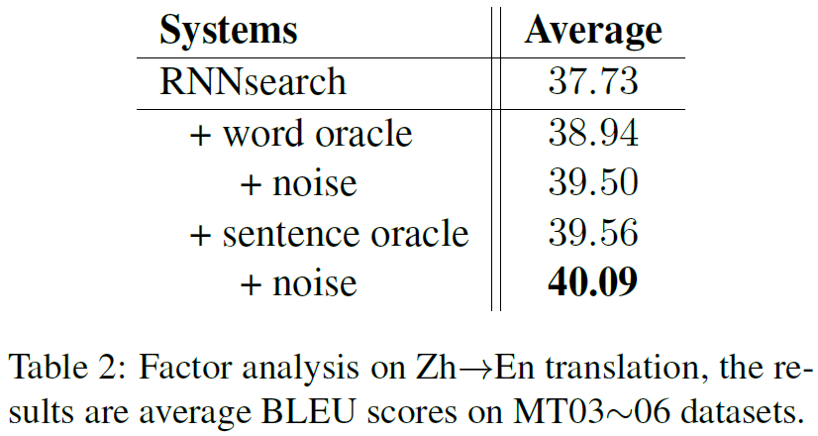
Experiment – Factor Analysis
To investigate the influence of utilizing word-level oracle, the sentence-level oracle and incorporating the Gumbel noise for oracle selection.

Slide 17
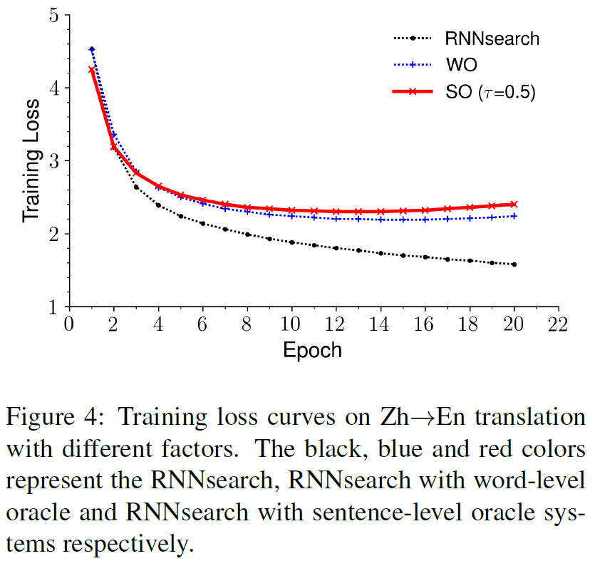
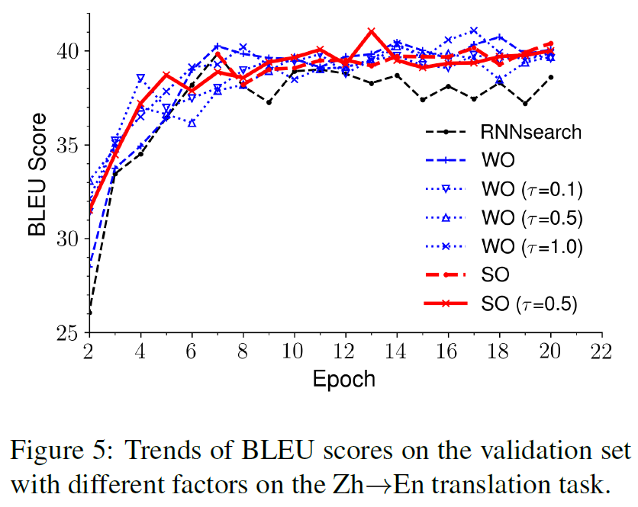
Experiment – About Convergence

Slide 18
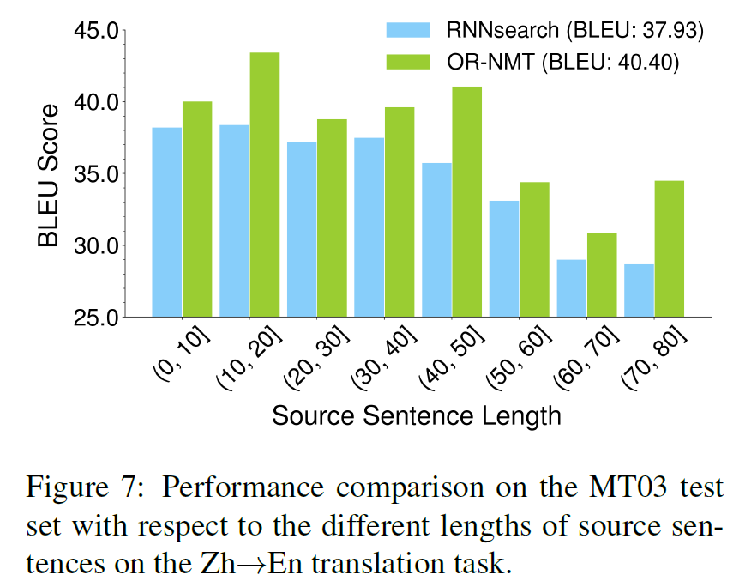
Experiment – About Length
The cross-entropy loss requires that the predicted sequence is exactly the same as the ground truth sequence, which is more difficult to achieve for long sentence, while sentence-level oracle can help recover from this kind of overcorrection.

Slide 19
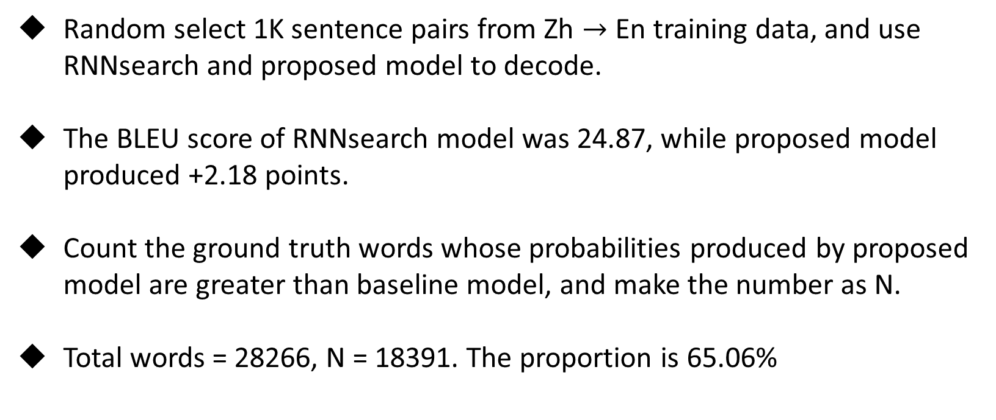
Experiment – Effect on Exposure Bias
Random select 1K sentence pairs from Zh $→$ En training data, and use RNNsearch and proposed model to decode.
The BLEU score of RNNsearch model was 24.87, while proposed model produced +2.18 points.
Count the ground truth words whose probabilities produced by proposed model are greater than baseline model, and make the number as N.
Total words = 28266, N = 18391. The proportion is 65.06%

Slide 20
Summary
To mitigate the discrepancy between training and inference, when predicting one word, feed as context either the ground truth word or the previous predicted word with a sampling scheme.
Compared to word-level oracle, sentence-level oracle can further equip the model with the ability of overcorrection recovery.

