Slide 1
Bias in Facial Recognition
By : Laiza

Slide 2
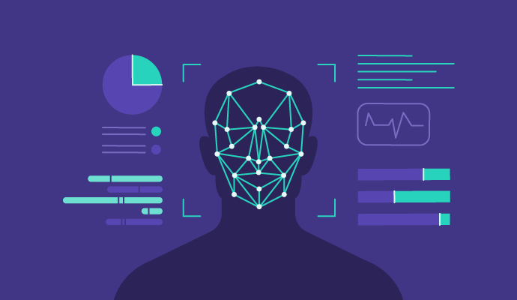
Facial recognition
Facial recognition is the use of technology and biometrics to identify human faces; mainly through AI. This is similar to a fingerprint and DNA is a way to identify you.
Facial recognition software is often used to compare one face to faces in databases to see if they match.

Slide 3
The Controversies
The main issues addressed in “Coded Bias” was the use of facial recognition technology by big corporations and governments even though there’s immense bias within the data sets.
Facial recognition was more accurate in identifying white males than any other.
Those who have more money have more control over it than those who don’t have any money or power.
It also takes away from people’s privacy and rights if they have not already given permission.

Slide 4
Some Perspective
While facial recognition has it’s benefits for both the users and the providers, there should be more caution to it’s uses.
It was quite scary to see law enforcement immediately believe in the facial recognition software than to make sure that the pedestrian had actually 100% matched with what the AI had said.
Big corporations and even governments easily trust AI when they don’t know much about it.
Regulations are implanted now to regulate the use of facial recognition.
Facial recognition has helped with preventing identify fraud and having an easier method of verification.

