Slide 1
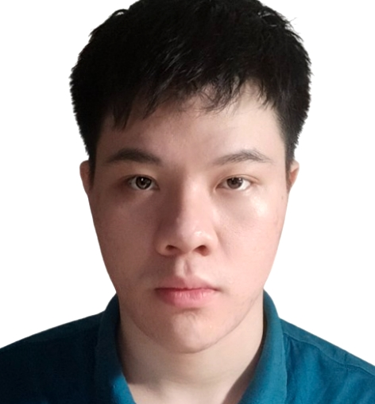
Linh Hong Nguyen
An Embedded Software Engineer with entry-level experience specializing in software development, microcontrollers, hardware design, and firmware.
Adept at identifying opportunities to enhance hardware and software performance for large-scale technology implementations.
Have good at preparing test data and developing automation test scripts by using automation tools. Also have good soft skills such as English communication skill, analytical and solving problem skill.
Able to learn and apply new technologies quickly, with high team-work spirit.
Major achievements
Functional expertise
A Van Nguyen
QC for UDS Migration project Manual and Automation tester. Using Botsina framework for create & develop test script. Writing and executing testcase. Finding and reporting bugs.
QC for Strut Testing project and Cloud Based IoT System project Automation tester. Using Botsina, Selenium, Cucumber framework for create & develop test script.
QC for Satellite Broadcasting Agile Project Automation tester. Using USAFe framework for create and develop test script.
QC Team Leader for Satellite Broadcasting Project Manage resources, Estimate working efforts, duration and progress in the project, Set working plan and track working progress for the whole team, Make reports sent to manager and customer, Perform regression test and new feature test (manual testing), Support team members to troubleshoot issues and execute test cases
QC Engineer for Set-top-box Testing Project Read and analyze related specifications of new features, Execute test cases, Find and report bugs, Estimate and design new test cases for new features, Edit and create new test scripts using Bash-shell, Pika.
OS: Linux, Windows.
Development IDEs : Eclipse, Visual Studio.
Database: SQL Server, MySQL.
Program Language: Python, Java, Botsina, Gherkin keywords.
Framework: USAFe, Botsina, Selenium, Cucumber.
SCM: Git, SVN.
Software development Process: Waterfall, Scrum/ Agile.
Embedded Systems Engineer
Education / Certifications
Ho Chi Minh City University of Science, Bachelor of Information Technology.

