Slide 1

Expert elicitation - Cotopaxi
27-Oct-2026

Slide 2
Experts' weights
Expert elicitation 27-Oct-2026

Slide 3
Experts' weights
Expert elicitation 27-Oct-2026
Equal weight = 5.88
For Cookes' method, below threshold weight does not mean zero score. It simply means that this expert's knowledge was already contributed by other experts and adding this expert would not change significantly the results.
Expert ID | Cooke
Exp1 | 21.26
Exp2 | 1.68
Exp3 | Below threshold
Exp4 | 20.31
Exp5 | 8.13
Exp6 | 11.32
Exp7 | Below threshold
Exp8 | 2.86
Exp9 | Below threshold
Exp10 | 18.97
Exp11 | 5.95
Exp12 | 4.23
Exp13 | Below threshold
Exp14 | Below threshold
Exp15 | Below threshold
Exp16 | Below threshold
Exp17 | 5.30

Slide 4
Seed Answers
Expert elicitation 27-Oct-2026

Slide 5
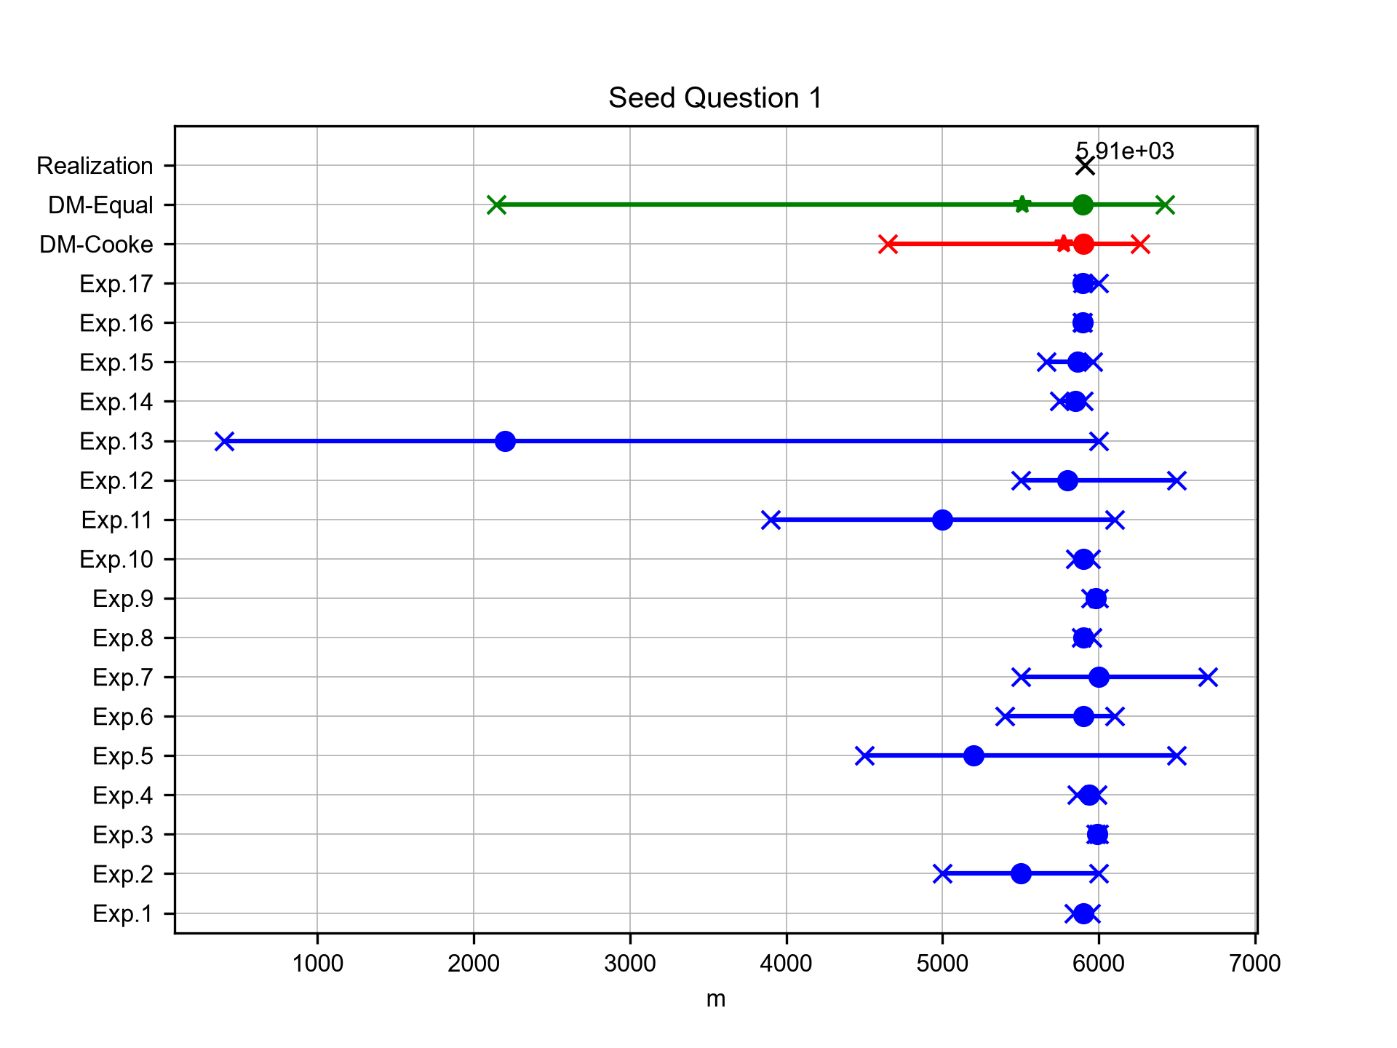
Elevation of Cotopaxi
Expert elicitation 27-Oct-2026
What is the elevation (in m a.s.l.) of the Cotopaxi volcano? (Data source: GVP database [2018])

Slide 6
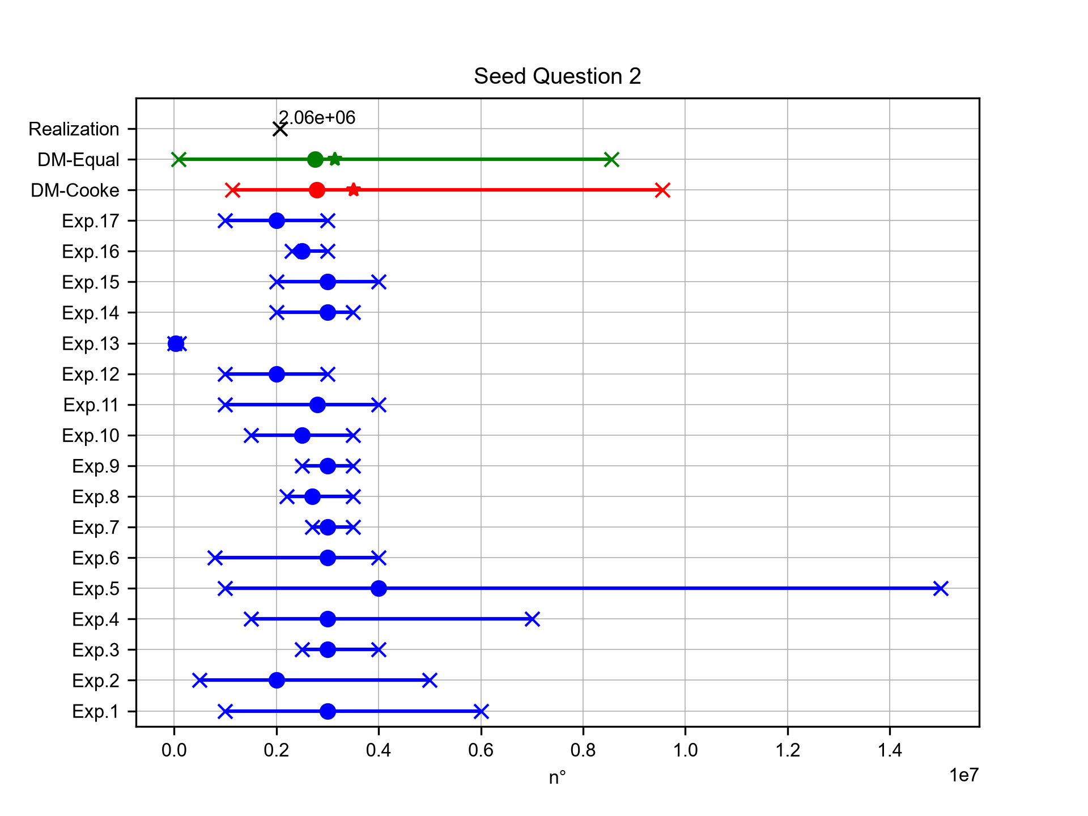
People living close to Guagua Pichincha
Expert elicitation 27-Oct-2026
According to the GVP database [2018], how many people live within a radius of 30 km from the crater of the Guagua Pichincha volcano?

Slide 7
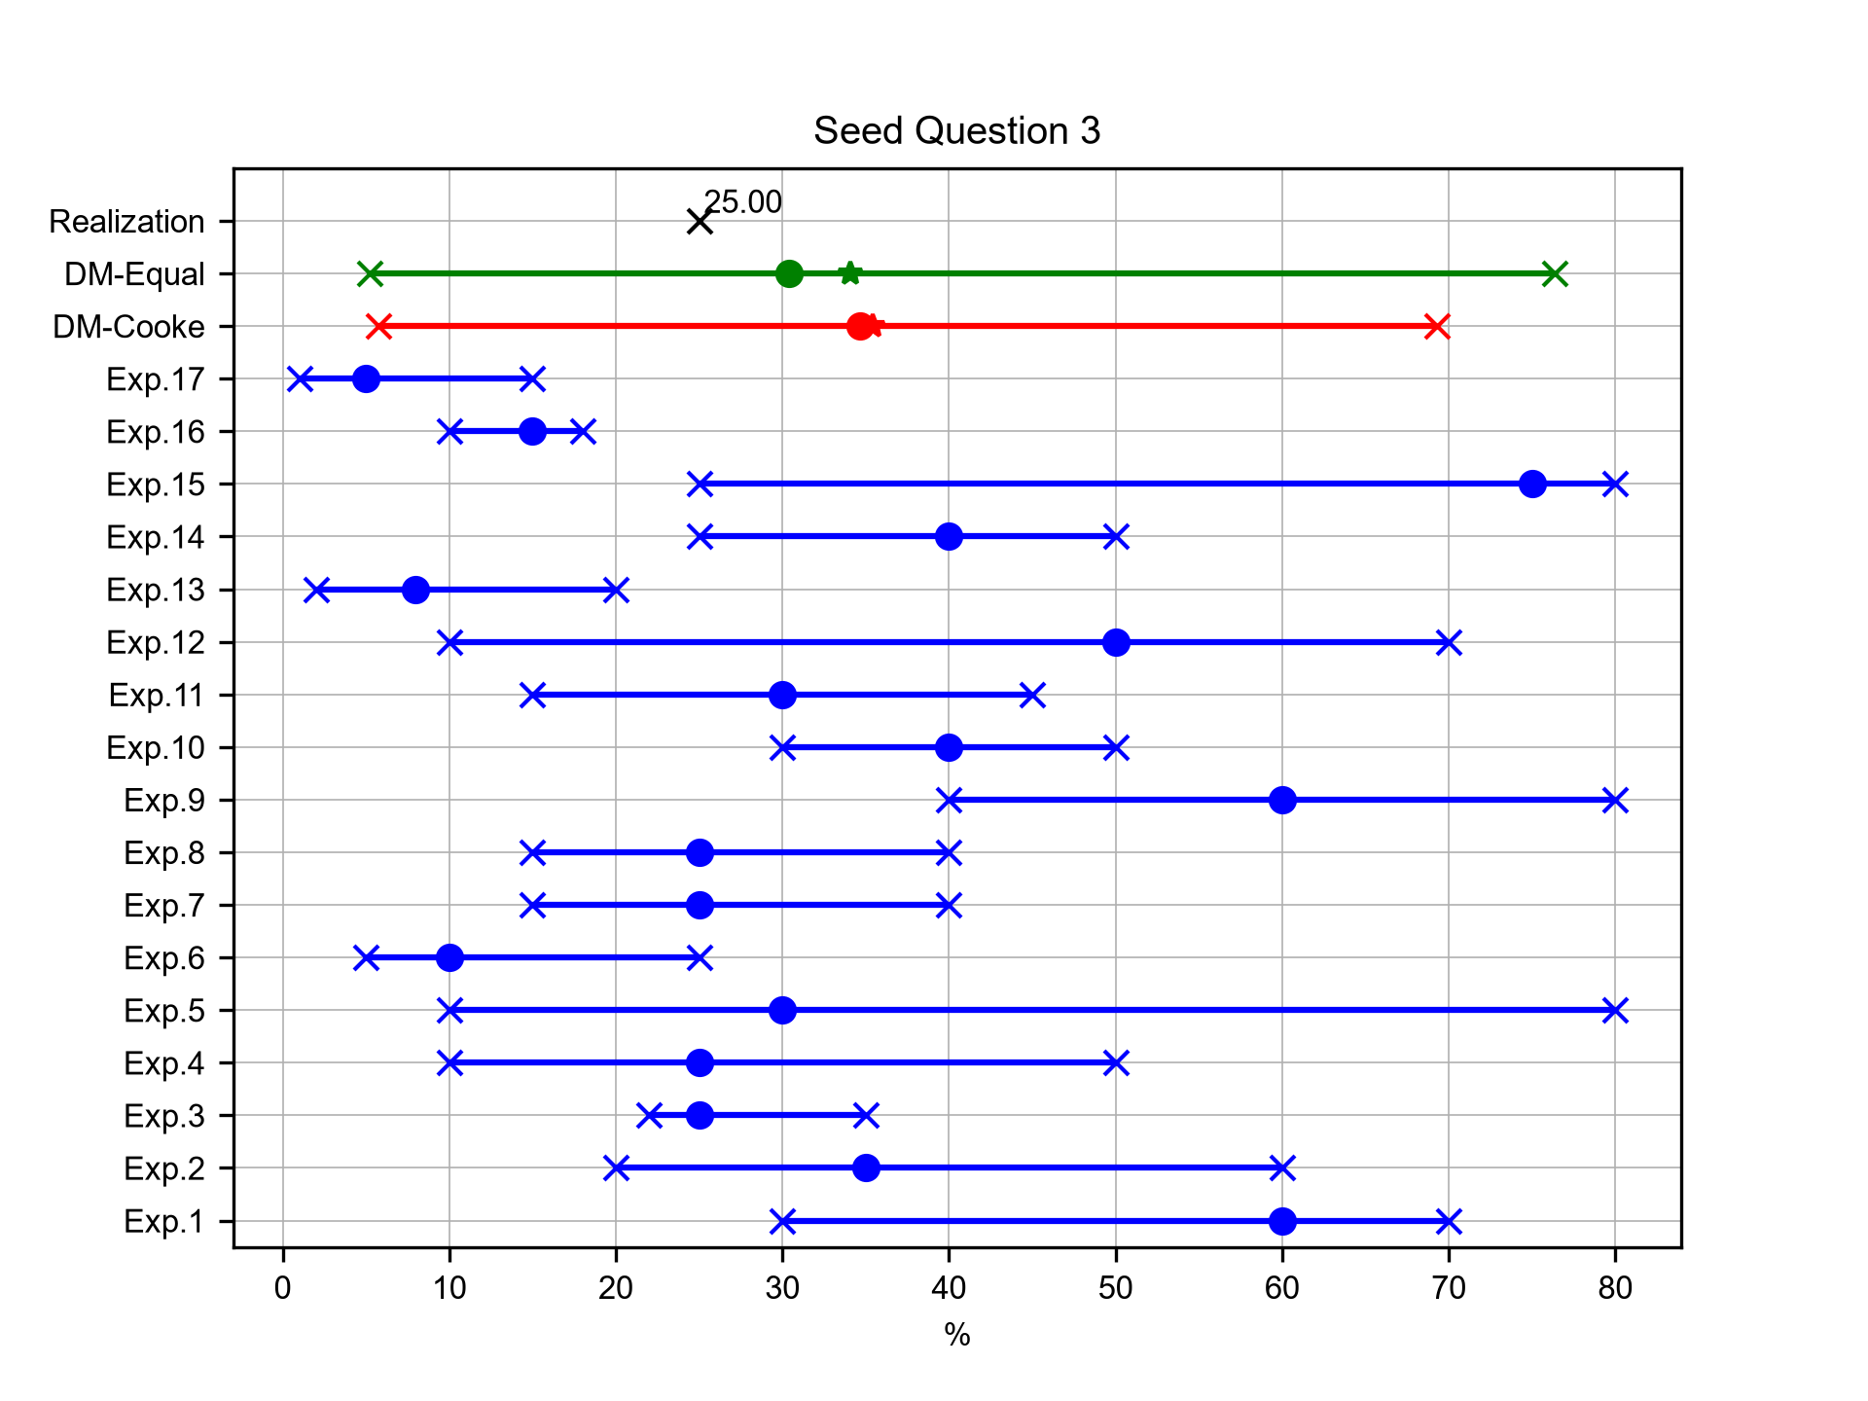
Percentage of VEI4+ eruptions at Cotopaxi
Expert elicitation 27-Oct-2026
Given your knowledge of the frequency of activity over the past ~4 ka at Cotopaxi volcano and based on the total number of eruptions (76) for which a VEI index has been estimated, what percentage were VEI 4 or higher eruptions? (Data source: GVP database [2018])

Slide 8
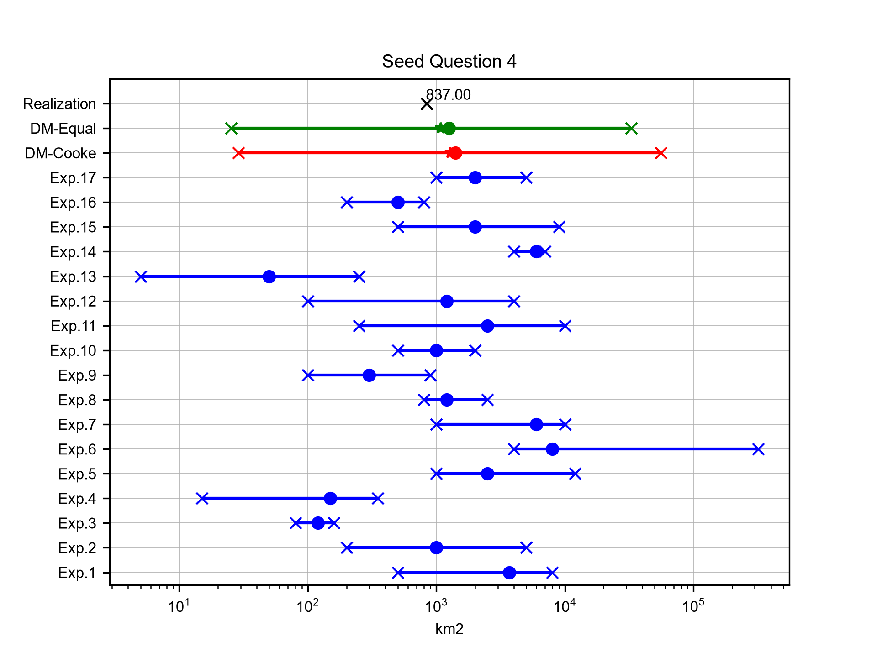
Mean area of 10 cm isopach for Plinian eruptions at Cotopaxi
Expert elicitation 27-Oct-2026
Robin et al. [2008] derived from field data the isopach maps of the fallout deposits from the three Plinian eruptions (1660 AD, 970 AD and 70 AD) at Guagua Pichincha volcano. What is the mean surface area (in km2) enclosed by the 10 cm isopach lines of the fallout deposits? (e.g., the three surface areas of the corresponding 10 cm isopach for the three eruptions are, respectively, 2000, 300 and 10000 km2, the mean value is therefore 4100 km2)

Slide 9
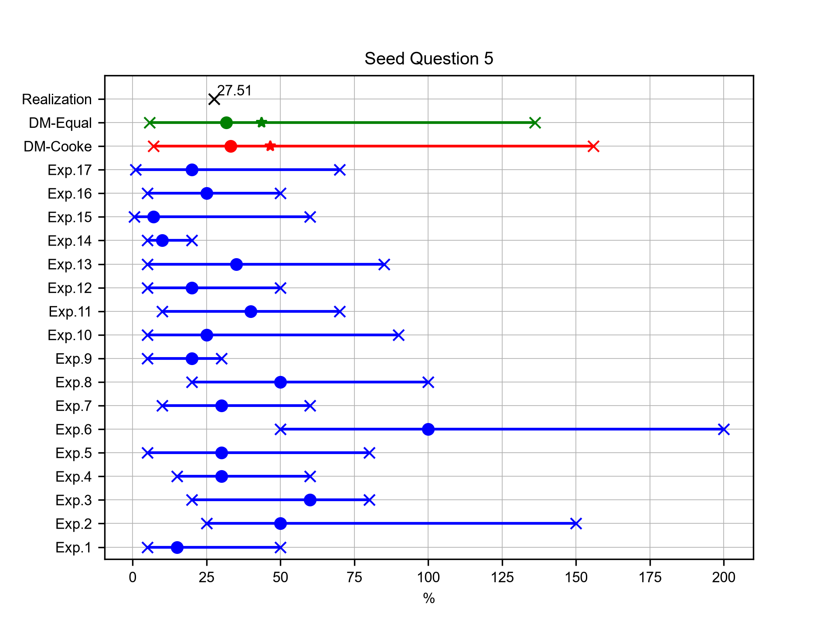
Mean relative uncertainty of eruption duration for Layers 3-5 at Cotopaxi
Expert elicitation 27-Oct-2026
Biass and Bonadonna (2011) quantified the uncertainty associated with the estimation of eruption durations for past eruptions: they applied different methodologies (empirical and analytical) for calculating total mass and MFR, and they quantified the propagation of uncertainty up to the final estimation of eruption duration (total mass/MFR). In this way, they calculated such parameters for the Plinian eruptions of Layer 3 and Layer 5 of Cotopaxi volcano. What is the mean relative uncertainty (in %) with respect to the calculations of eruption duration for Layers 3 and 5 made by Biass and Bonadonna (2011)? (example: two estimations have values of 500±5 minutes and 350±150 minutes; the two relative uncertainties are [5/500]*100=1% and [150/350]*100=42.8% and the mean is 21.9%)

Slide 10
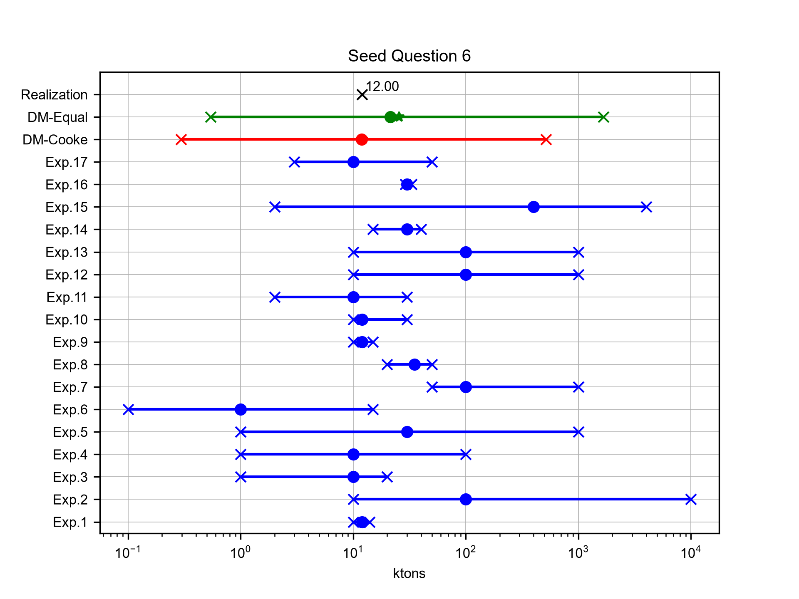
Total SO2 production from Tungurahua at 14/07/2006
Expert elicitation 27-Oct-2026
Carn et al. [2008] measured the daily emission of SO2 from active volcanoes in Ecuador between September 2004 and September 2006 from the Ozone Monitoring Instrument (OMI) on NASA's EOS/Aura satellite. How much was the total SO2 production (in ktons) of the 14/07/2006 eruptive event of Tungurahua (duration 1 day)?

Slide 11
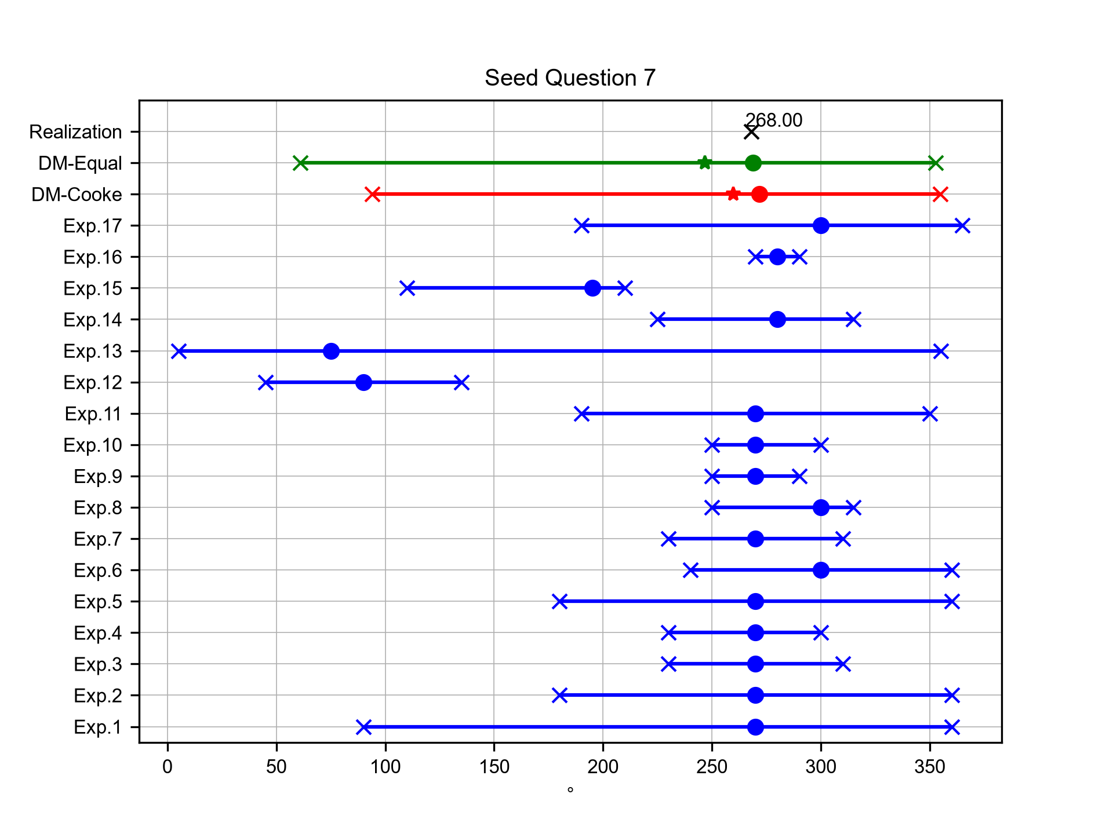
Mean elongation direction of fallout deposits for Plinian eruption at Cotopaxi
Expert elicitation 27-Oct-2026
What is the mean direction (in degrees from N) of the axis of main elongation of the isopachs (i.e. the downwind range) of the F2, F4, Layer 3 and Layer 5 plinian fall deposits at Cotopaxi volcano, described in Hall and Mothes [2008] and Barberi et al. [1995]?

Slide 12
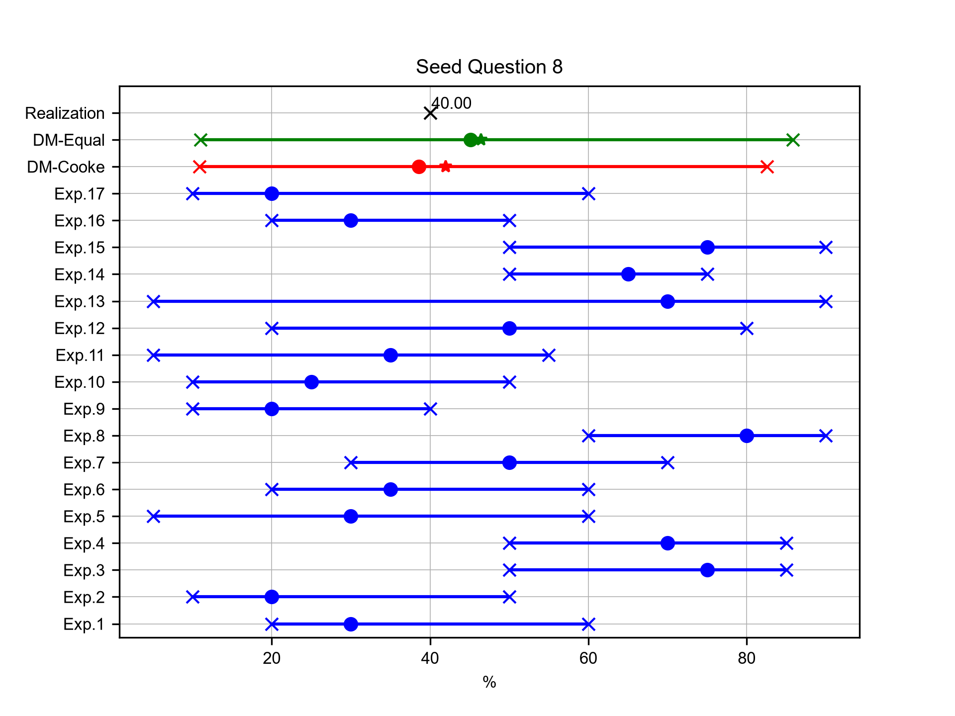
Volumetric percentage of andesites at Cotopaxi (last 0.5 Ma)
Expert elicitation 27-Oct-2026
With respect to the calculations of Hall and Mothes [2008], what is the percentage (volumetrically) of volcanic products of andesitic composition with respect to the total amount of material erupted over the past 0.5 Ma at Cotopaxi volcano?

Slide 13
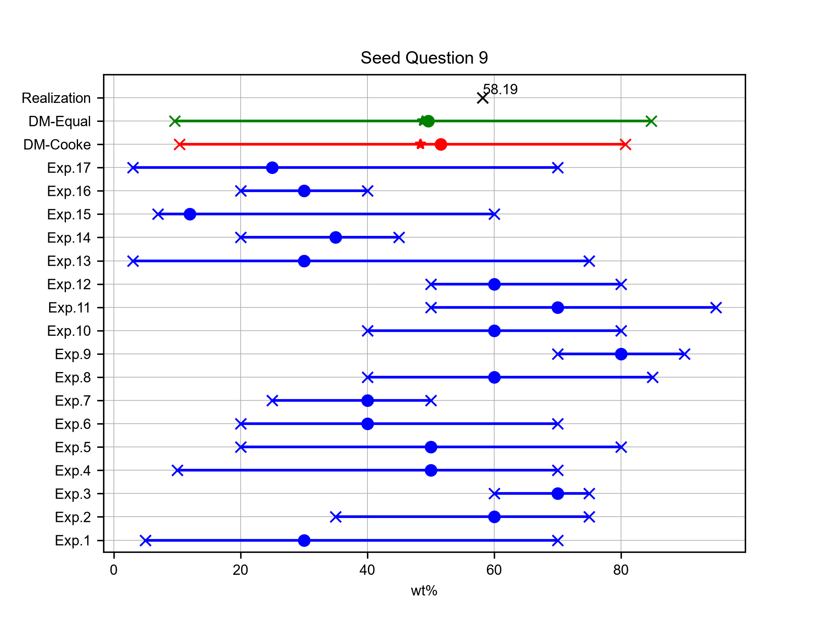
Average amount of ash in BF2 layer of Pululagua
Expert elicitation 27-Oct-2026
Volentik et al. [2010] calculated the Total Grain Size Distribution for the climactic phase of the 2450 BP Plinian eruption of Pululagua volcano (BF2 layer) using different techniques and datasets. According to their calculations, what is the average amount (in wt%) of ash (D < 2mm) in this layer?

Slide 14
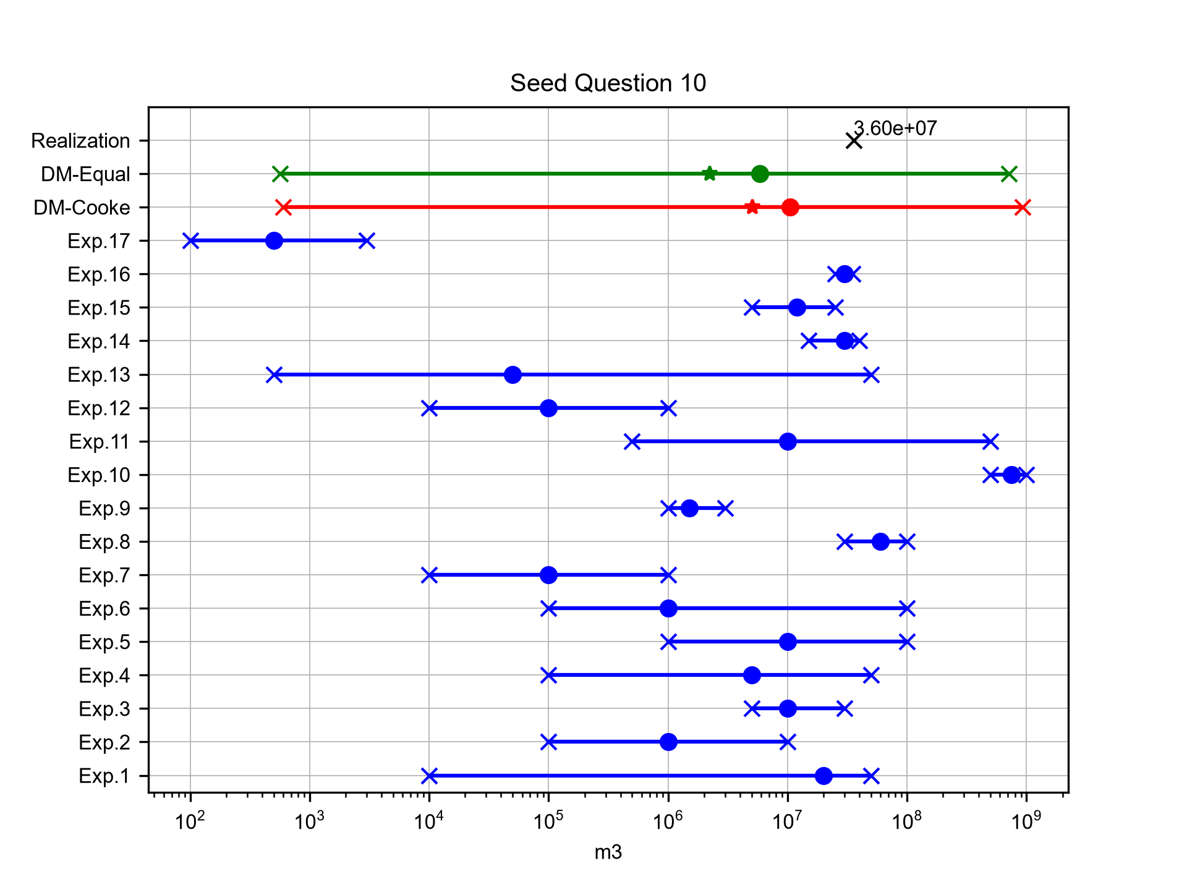
Total volume of lava flow deposits of the 2002 eruption of Reventador
Expert elicitation 27-Oct-2026
The complex sub-Plinian to Plinian 2002 eruption of El Reventador produced different types of volcanic deposits (tephra fall, PDC and lava flows). What is the total volume (in m3) of lava flow deposits? (Sources: Johnson et al. [2006]; Ridolfi et al. [2008])

Slide 15
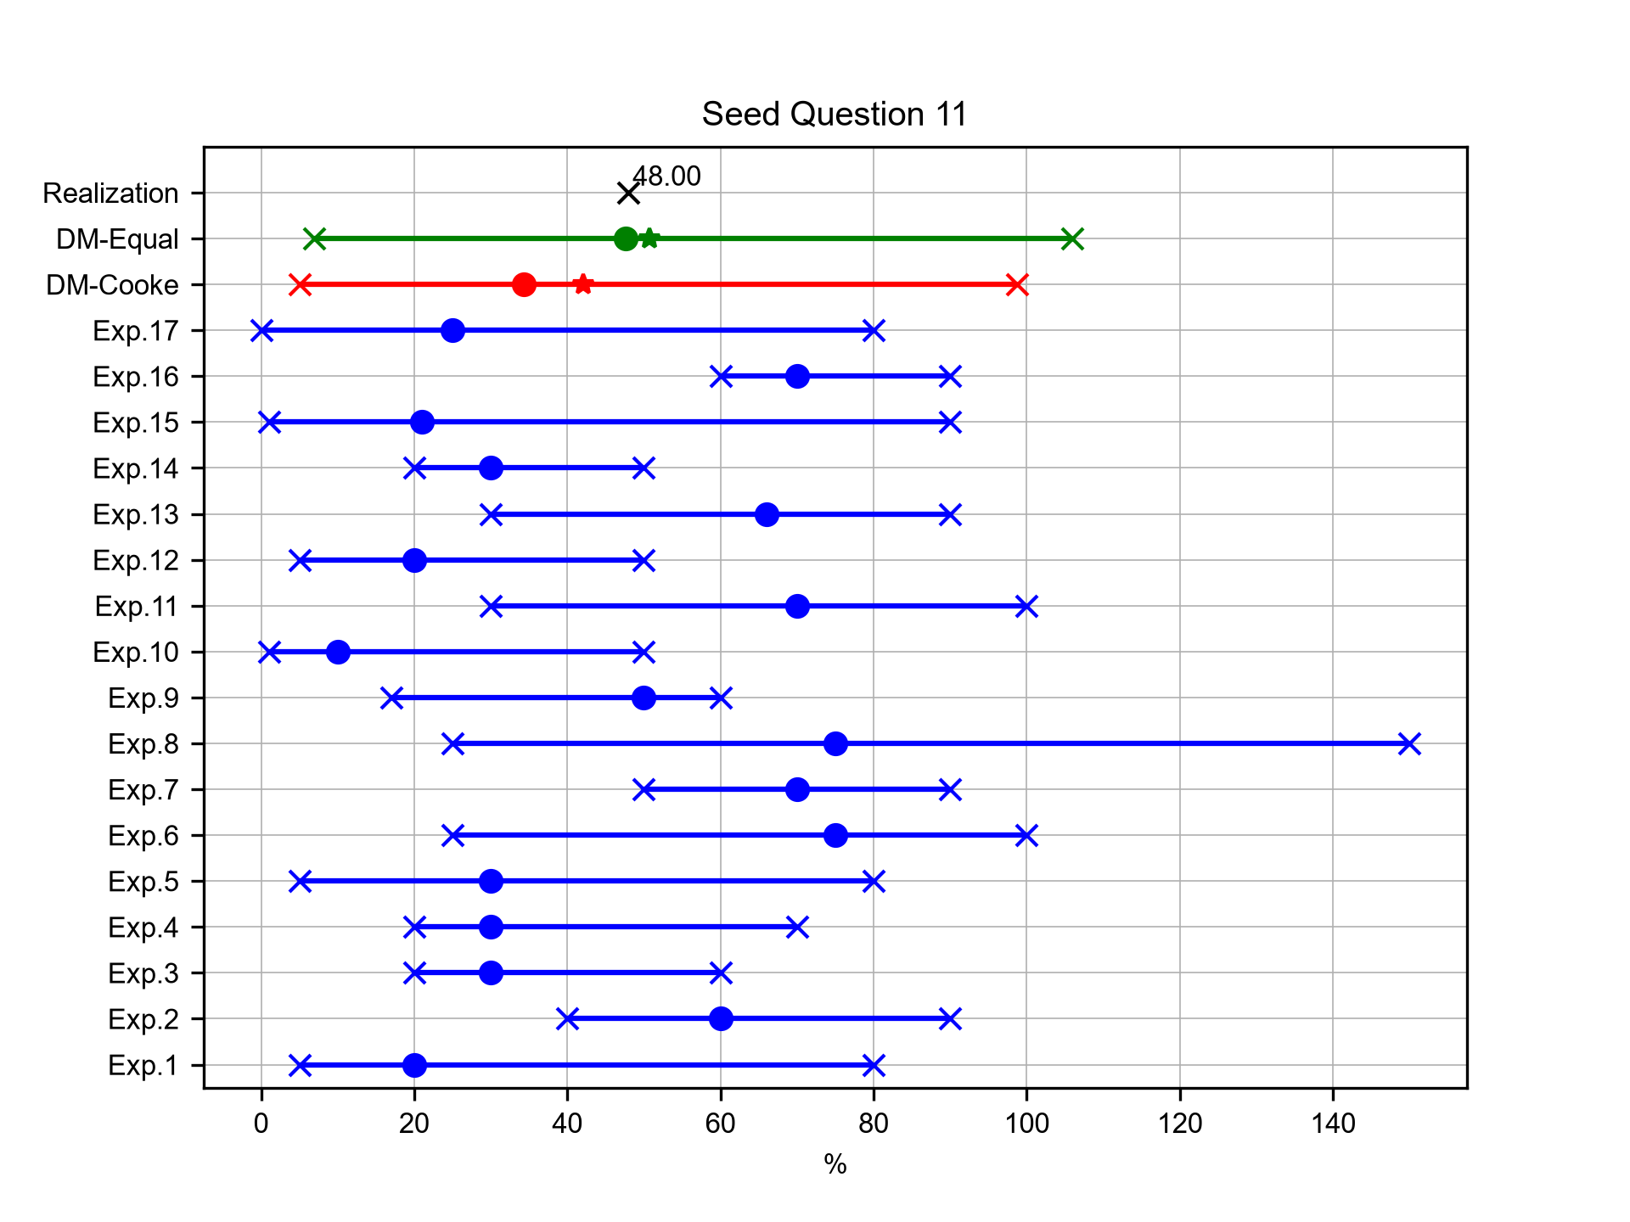
Mean difference between min-max estimation of Terminal Fall Velocity
Expert elicitation 27-Oct-2026
Terminal Fall Velocity (TFV) is a parameter that strongly controls particle sedimentation, and various models for calculating this parameter have been proposed. Alfano et al. [2011] compared alternative existing models and different morphological characterizations of particles for the calculation of TFV of tephra particles from various eruptions. According to their results, what is the mean difference (in %) between the maximum and the minimum estimates of TFV for the grain size φ = -1 (2 mm) for tephra particles of Fontana Lapilli deposit from the basaltic Plinian eruption of Masaya volcano (Nicaragua)?

Slide 16
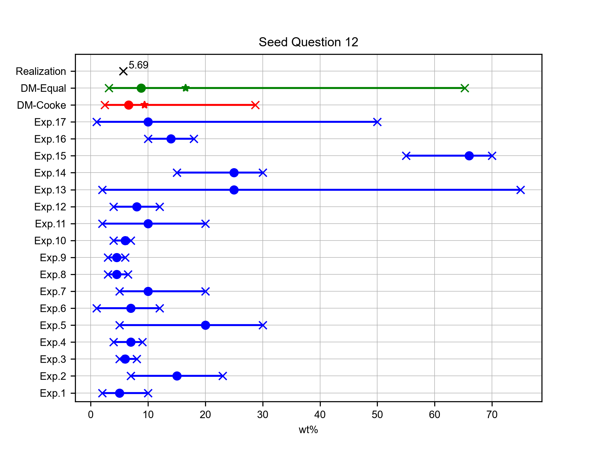
Mean wt% of Na2O+K2O of Guagua Pichincha products (last 55 ka years)
Expert elicitation 27-Oct-2026
What is the mean content (in weight %) of Na2O+K2O of the volcanic products of the Guagua Pichincha volcano from the last 55 ka years, as reported in Chiaradia et al. [2009]

Slide 17
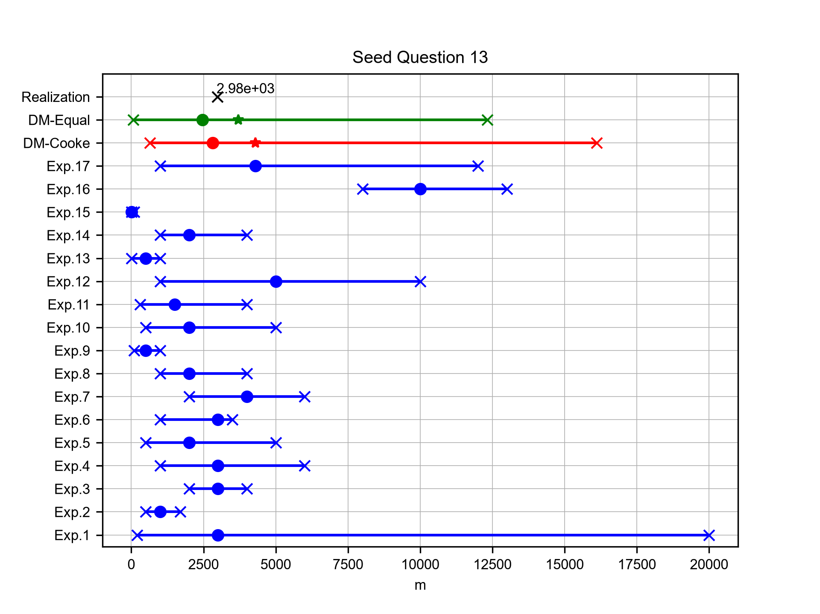
Mean difference between min-max estimation of plume heights for the August 2006 eruption at Tungurahua
Expert elicitation 27-Oct-2026
For the calculation of volcanic plume heights without using field deposit data, several techniques are presently available. Among them, Steffke et al. [2010] used the velocity determination and plume top temperature (PTT) models to calculate the plume heights (above vent level) of the most recent eruptions at Tungurahua volcano. What is the mean difference (in m) between the minimum and the maximum estimation of plume heights (above vent level) for the whole August 2006 eruption (25 measurements every 30 min; period 16/08/2006 20:15 – 17/08/2006 11:15)?

Slide 18
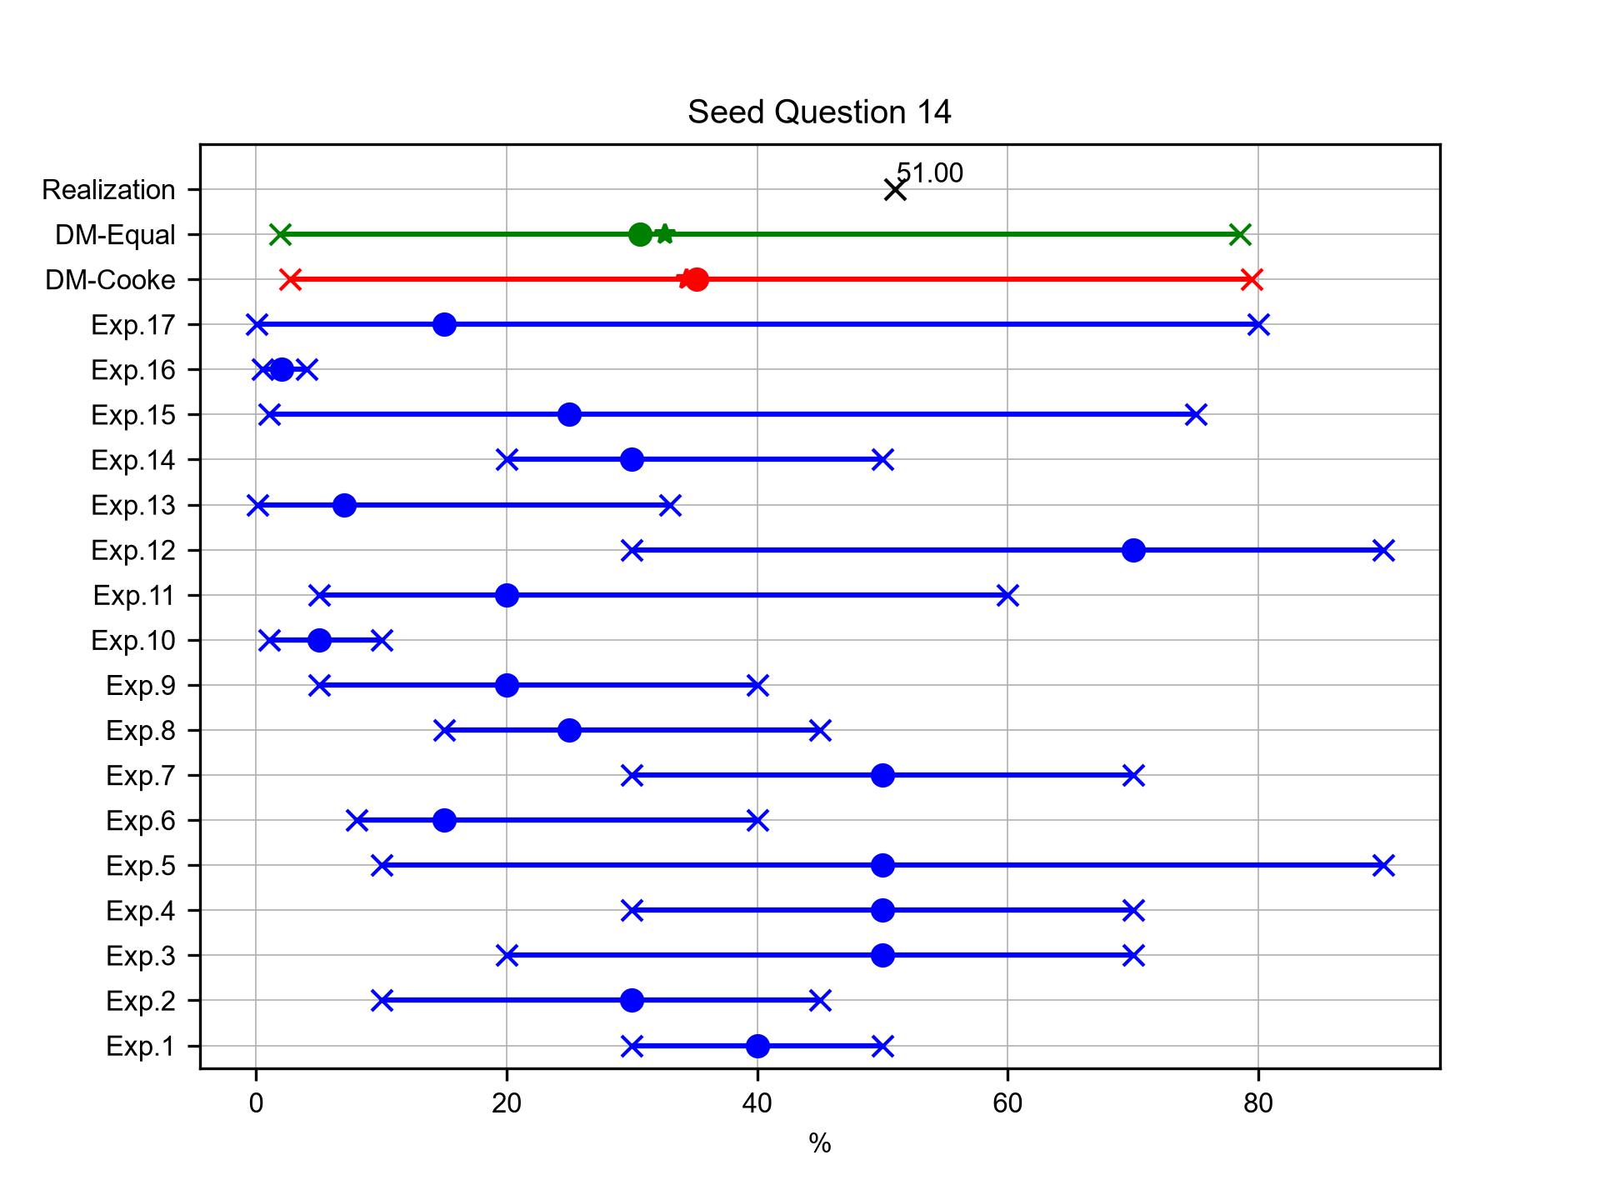
Mean value of porosity for 1999 eruption of Guagua Pichincha
Expert elicitation 27-Oct-2026
Wright et al. [2007] measured the values of connected porosity (i.e. the volumetric part of the sample through which gases and/or liquids can freely flow) for 9 breadcrust bombs from the 1999 vulcanian eruption of Guagua Pichincha volcano. What is the mean value of connected porosity (in %) of the samples studied?

Slide 19
Target Answers
Expert elicitation 27-Oct-2026

Slide 20
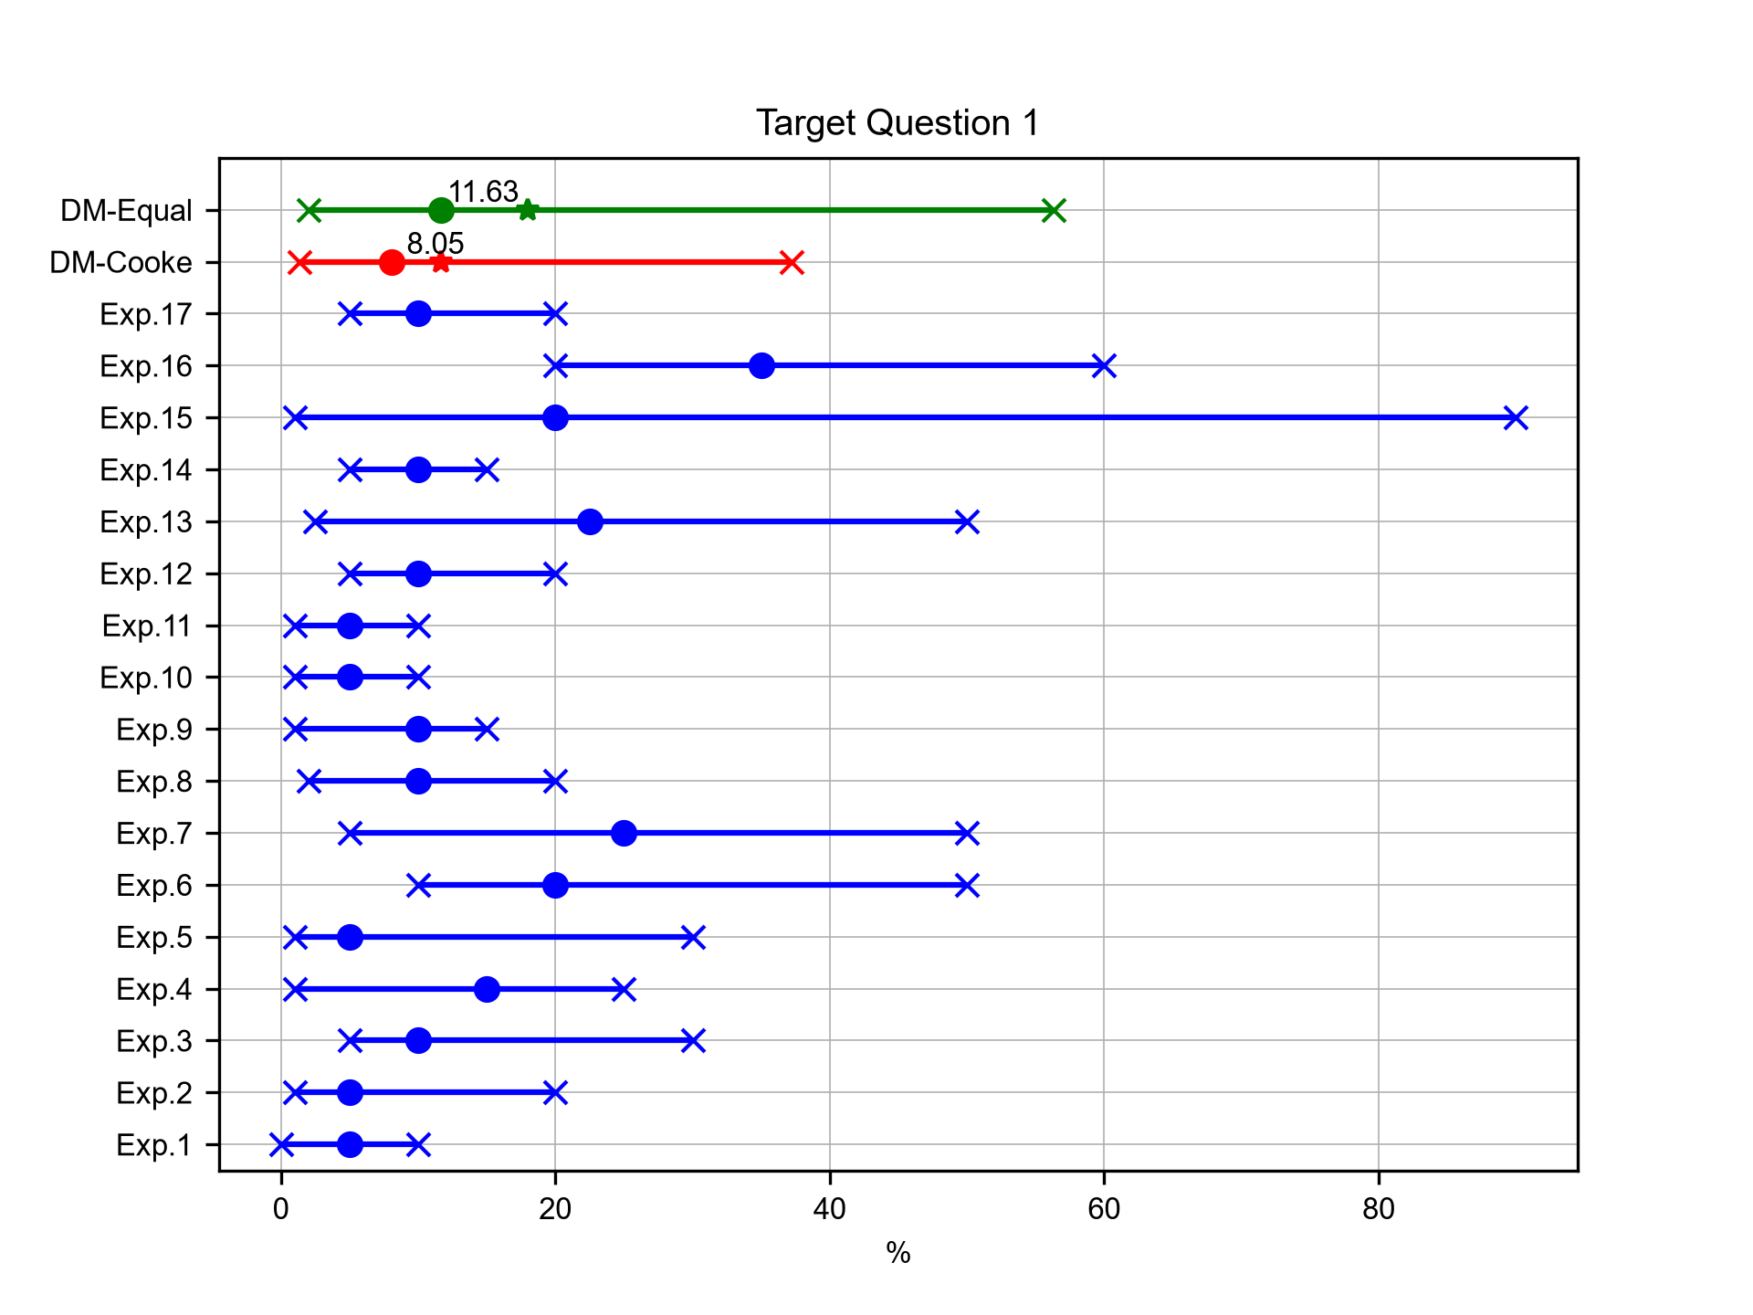
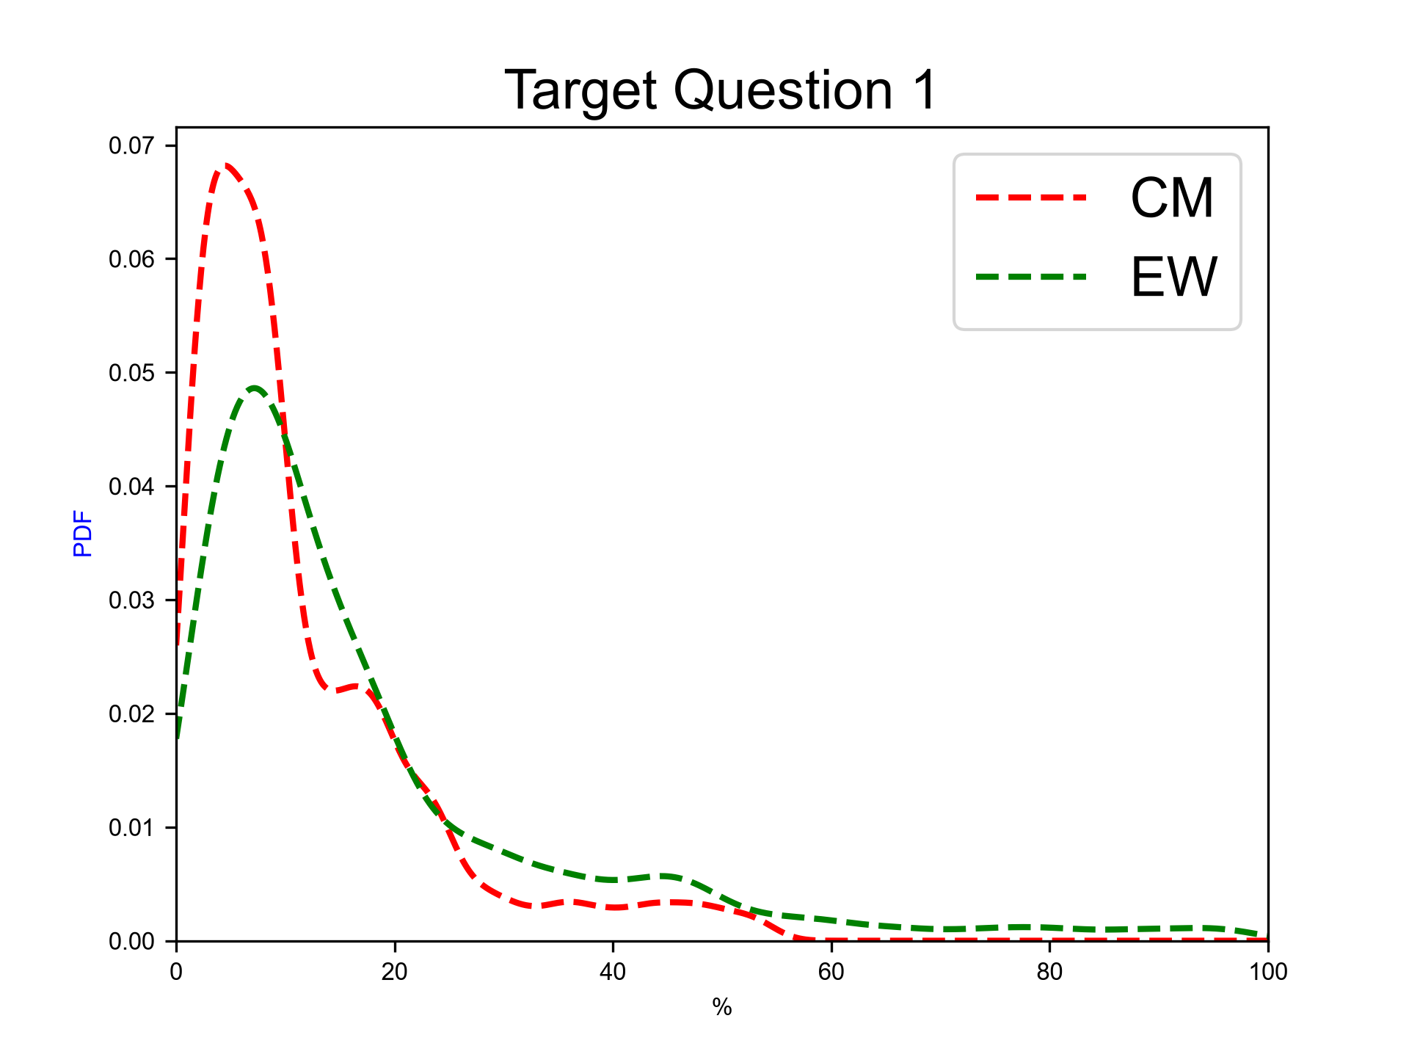
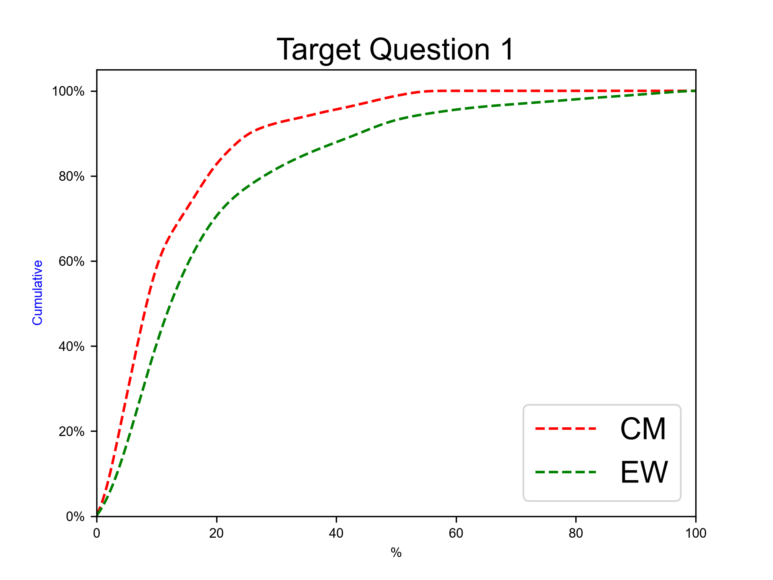
Next eruption, rhyolitic magma
Expert elicitation 27-Oct-2026
Given the present state of Cotopaxi volcano and your knowledge of its past eruptive chronology, how much probability do you assign to the possibility that, for the next eruption at Cotopaxi, the magma involved would be totally or predominantly of rhyolitic composition?
N.B. The sum of 50%iles for questions 1-2 have to sum to 100.0.

Slide 21
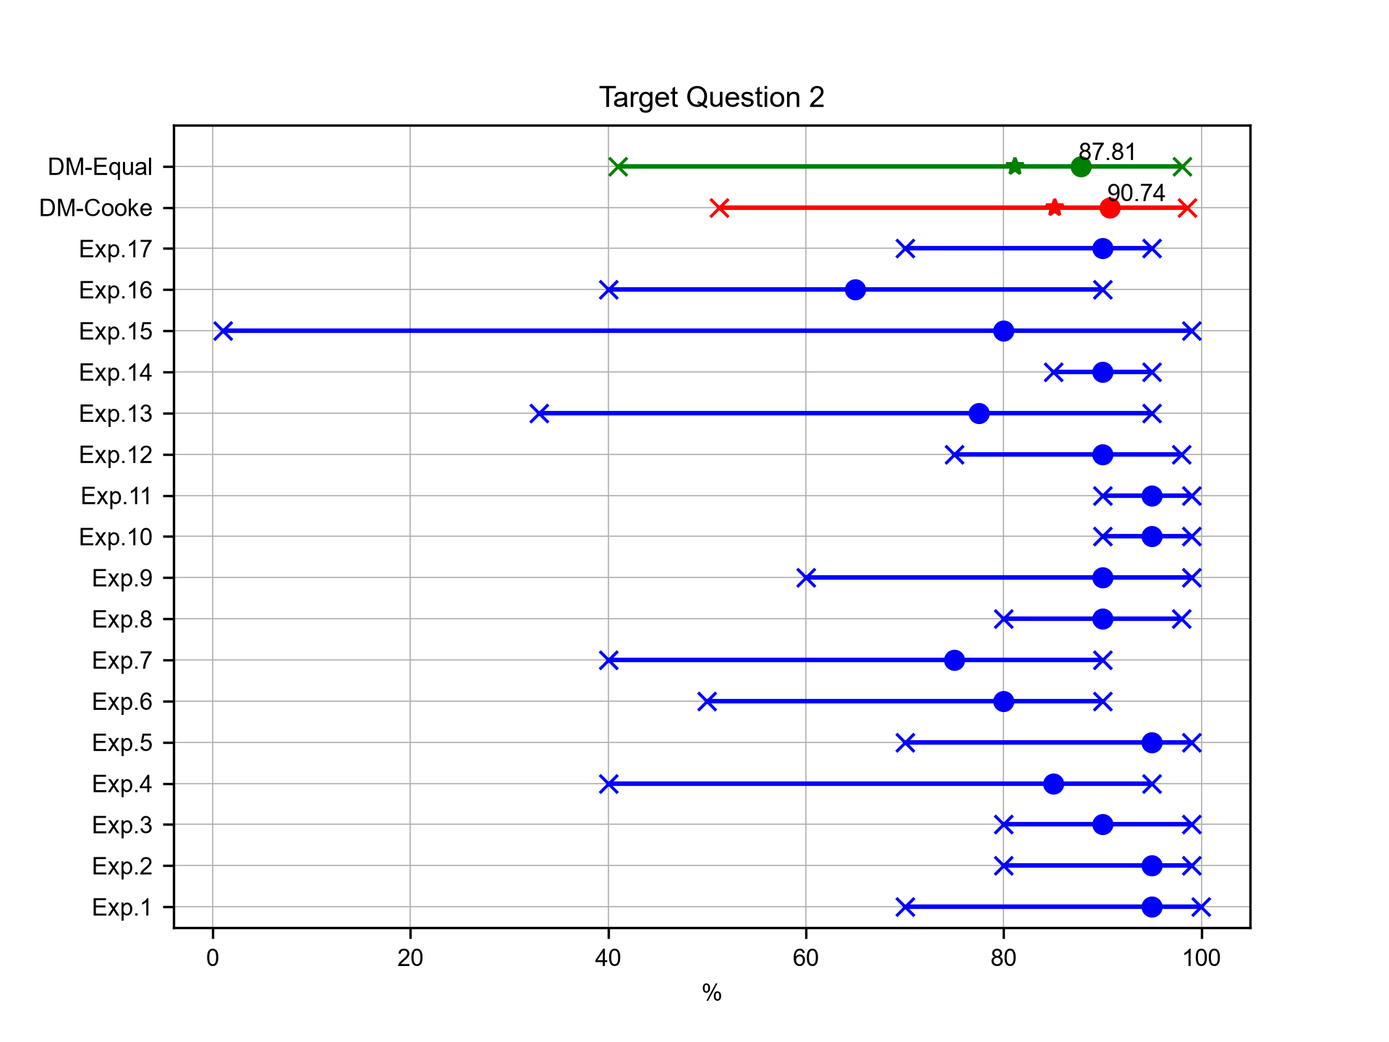
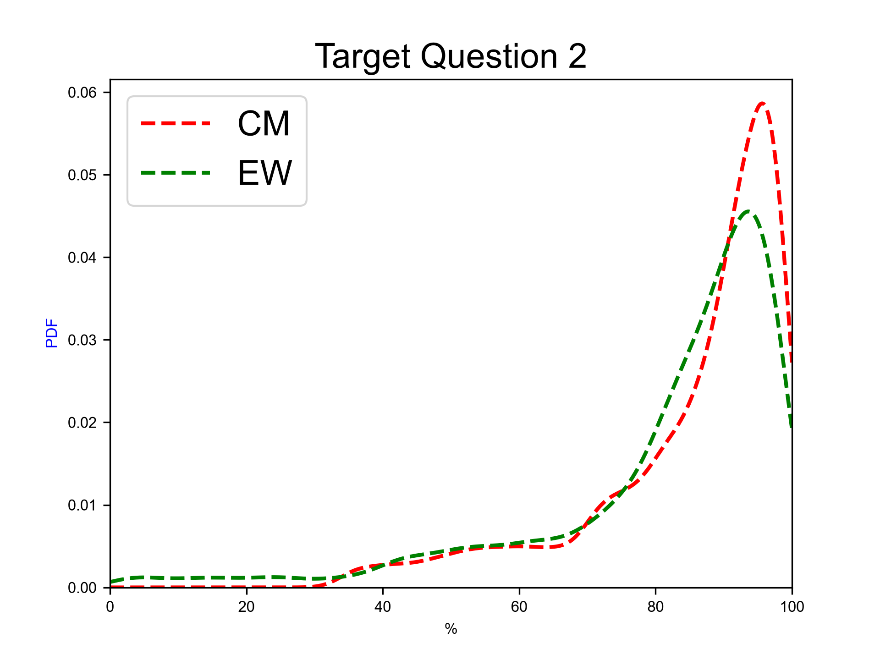
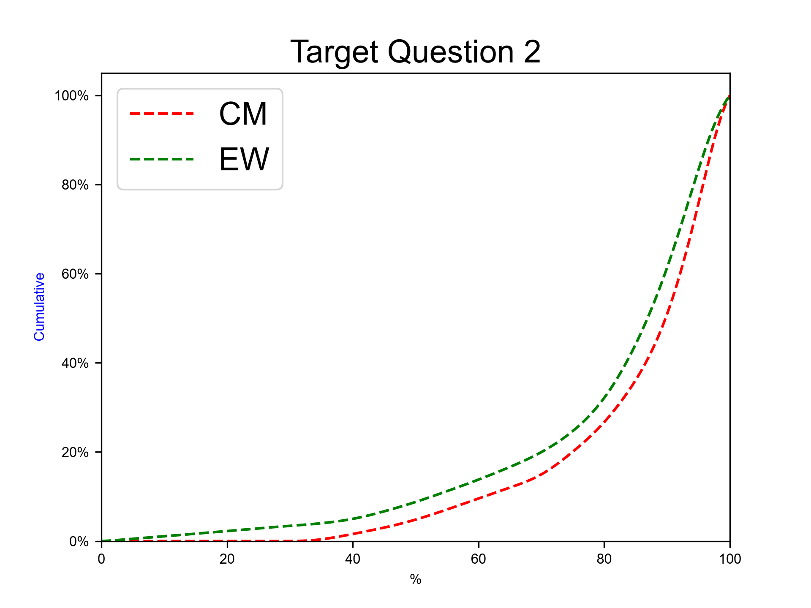
Next eruption, andesitic magma
Expert elicitation 27-Oct-2026
Given the present state of Cotopaxi volcano and your knowledge of its past eruptive chronology, how much probability do you assign to the possibility that, for the next eruption at Cotopaxi, the magma involved would be totally or predominantly of andesitic composition?
N.B. The sum of 50%iles for questions 1-2 have to sum to 100.0.

Slide 22
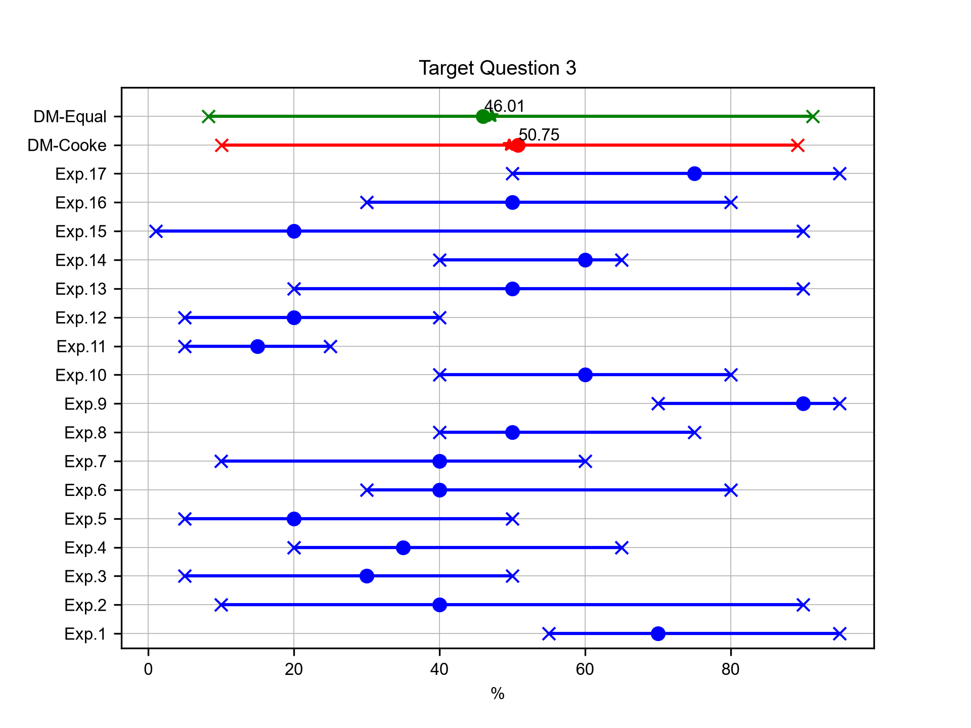
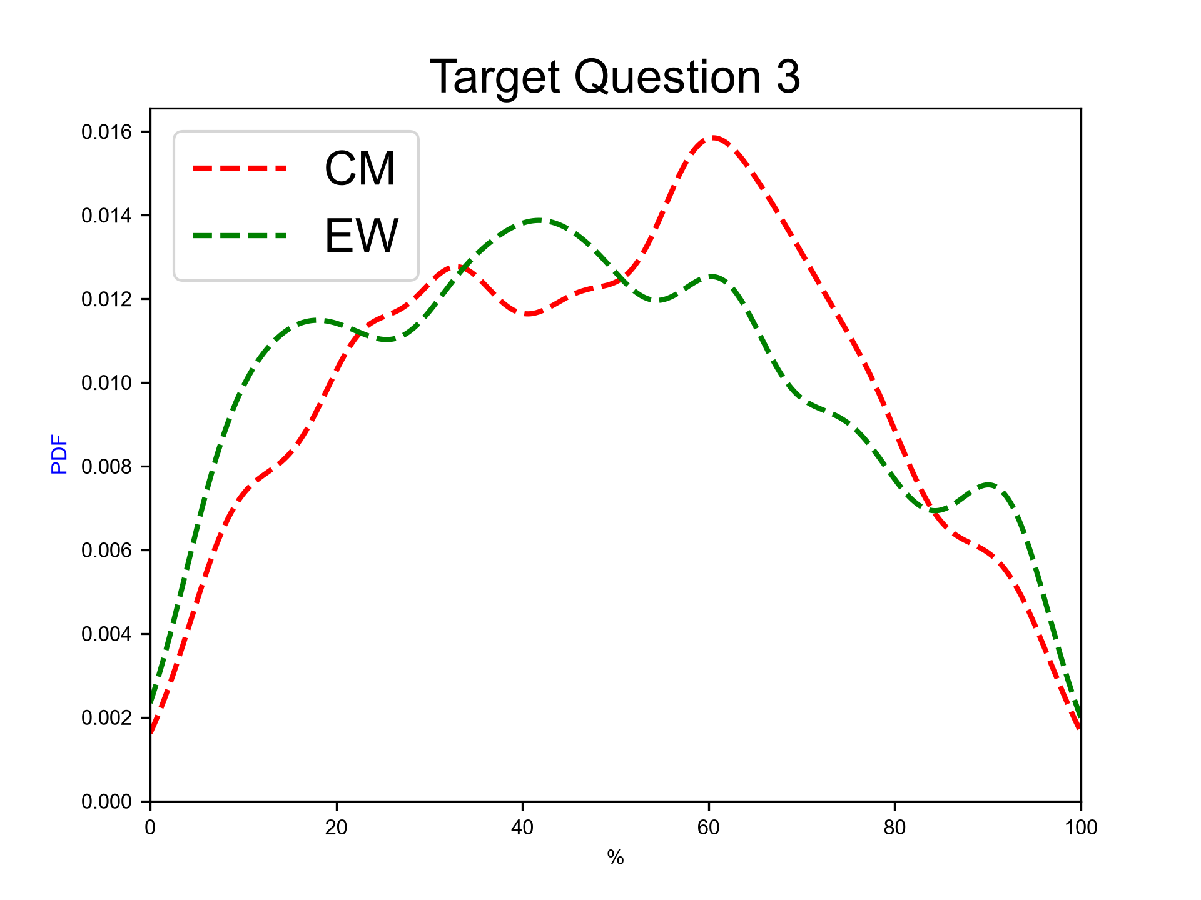
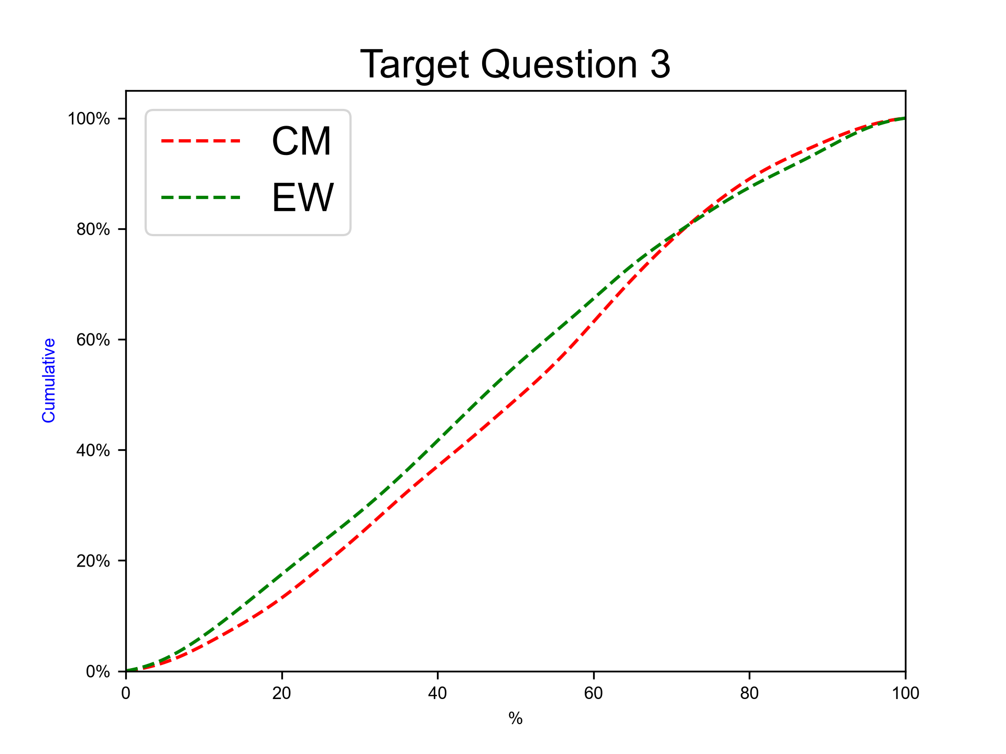
Next eruption, rhyolitic magma, SubPlinian eruption
Expert elicitation 27-Oct-2026
Given the present state of Cotopaxi volcano and your knowledge of its past eruptive chronology, how much probability do you assign to the possibility that at Cotopaxi, in case that the next eruption would involve totally or predominantly rhyolitic magma, the eruption would be SubPlinian (VEI 3-4)?
N.B. The sum of 50%iles for questions 3-5 have to sum to 100.0.

Slide 23
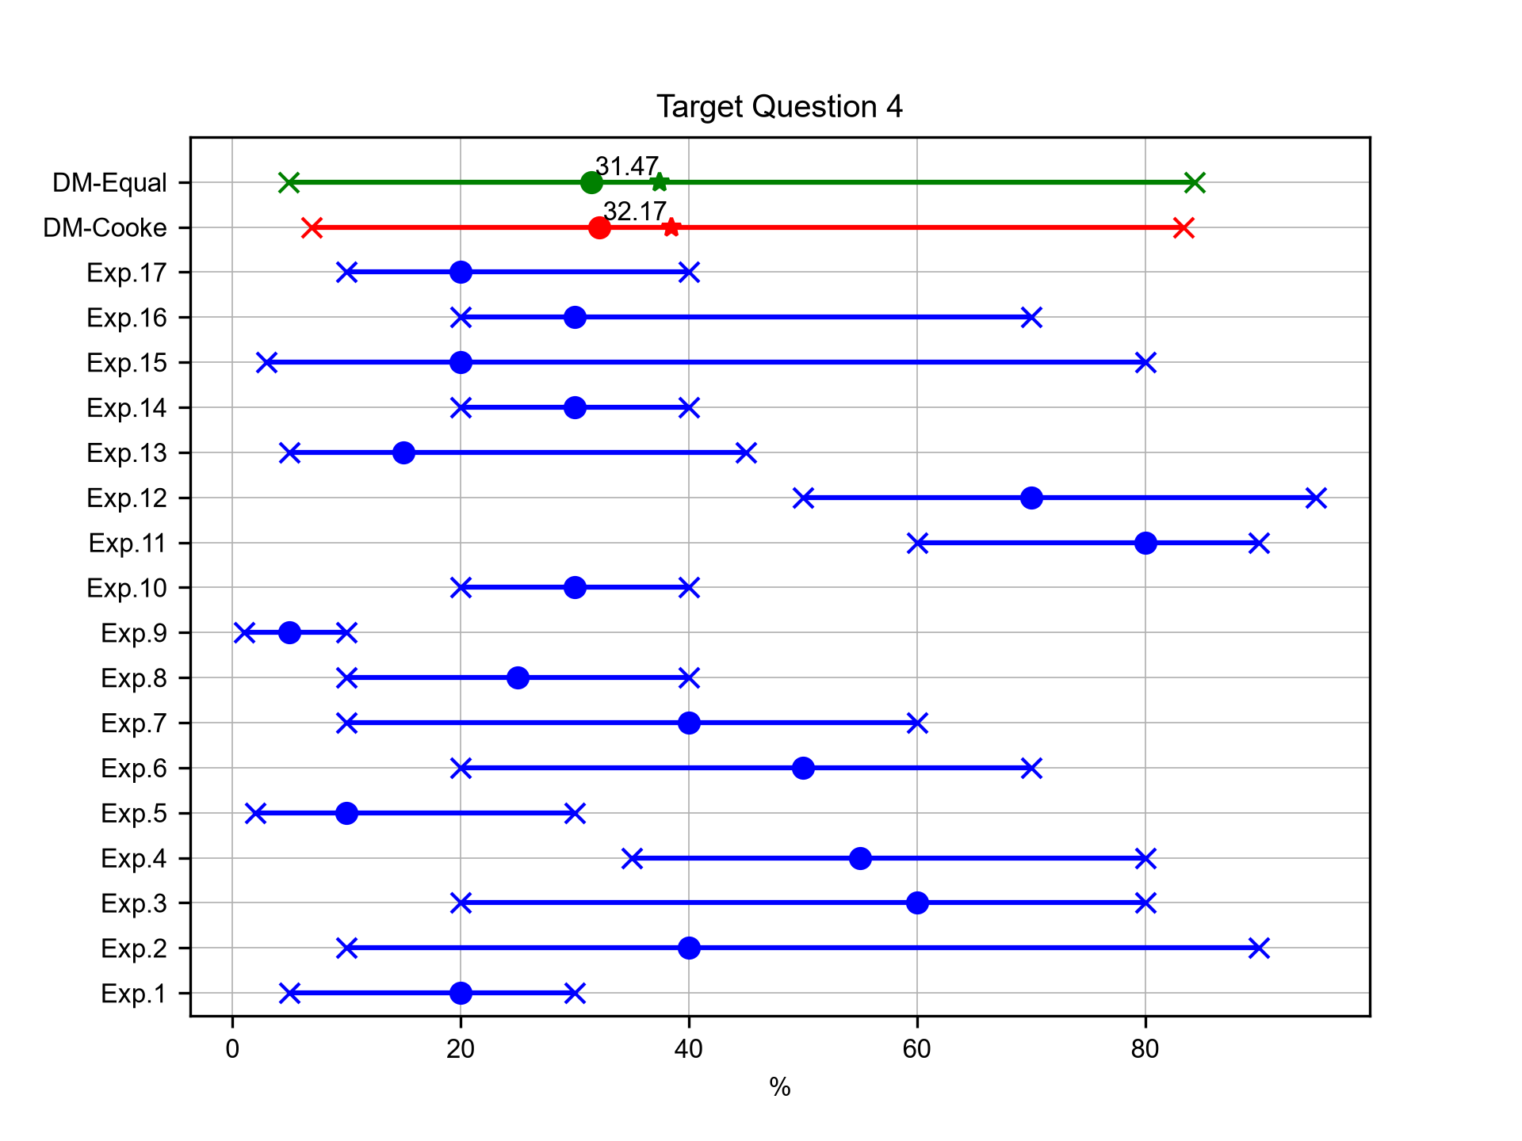
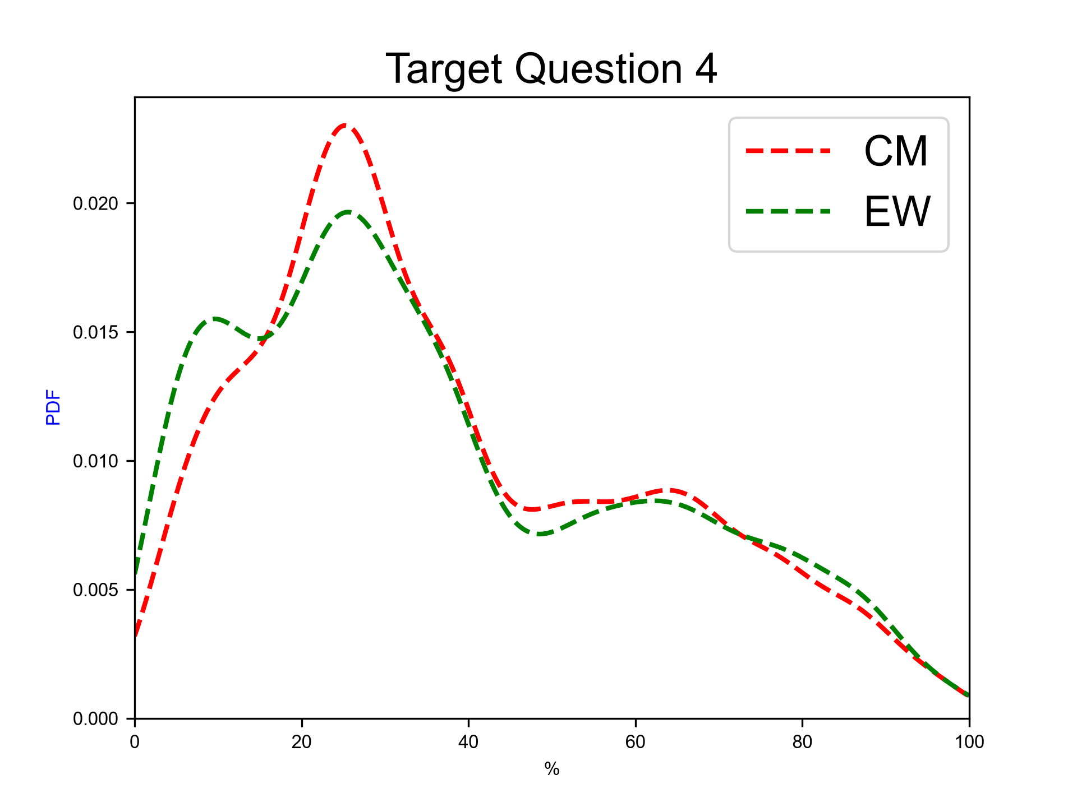
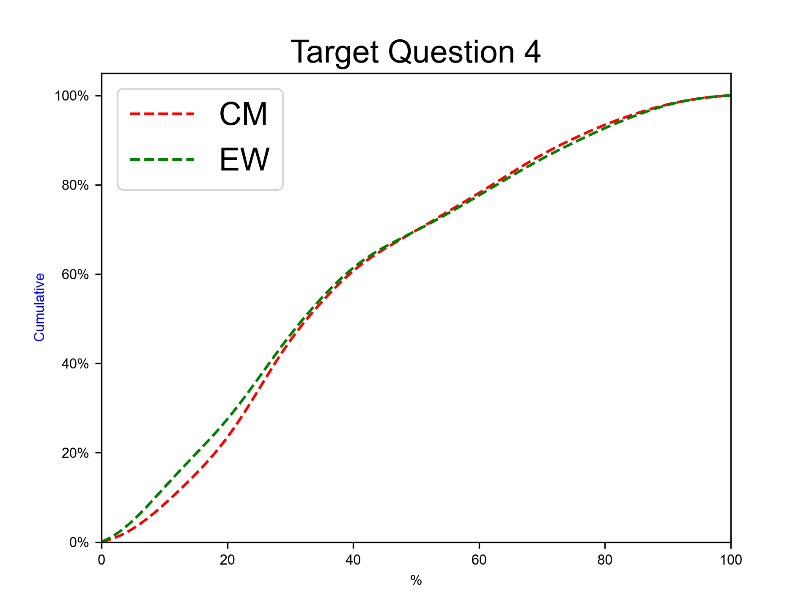
Next eruption, rhyolitic magma, Plinian eruption
Expert elicitation 27-Oct-2026
Given the present state of Cotopaxi volcano and your knowledge of its past eruptive chronology, how much probability do you assign to the possibility that at Cotopaxi, in case that the next eruption would involve totally or predominantly rhyolitic magma, the eruption would be similar to the F-2/F-4 ones (Plinian, VEI 4-5)?
N.B. The sum of 50%iles for questions 3-5 have to sum to 100.0.

Slide 24
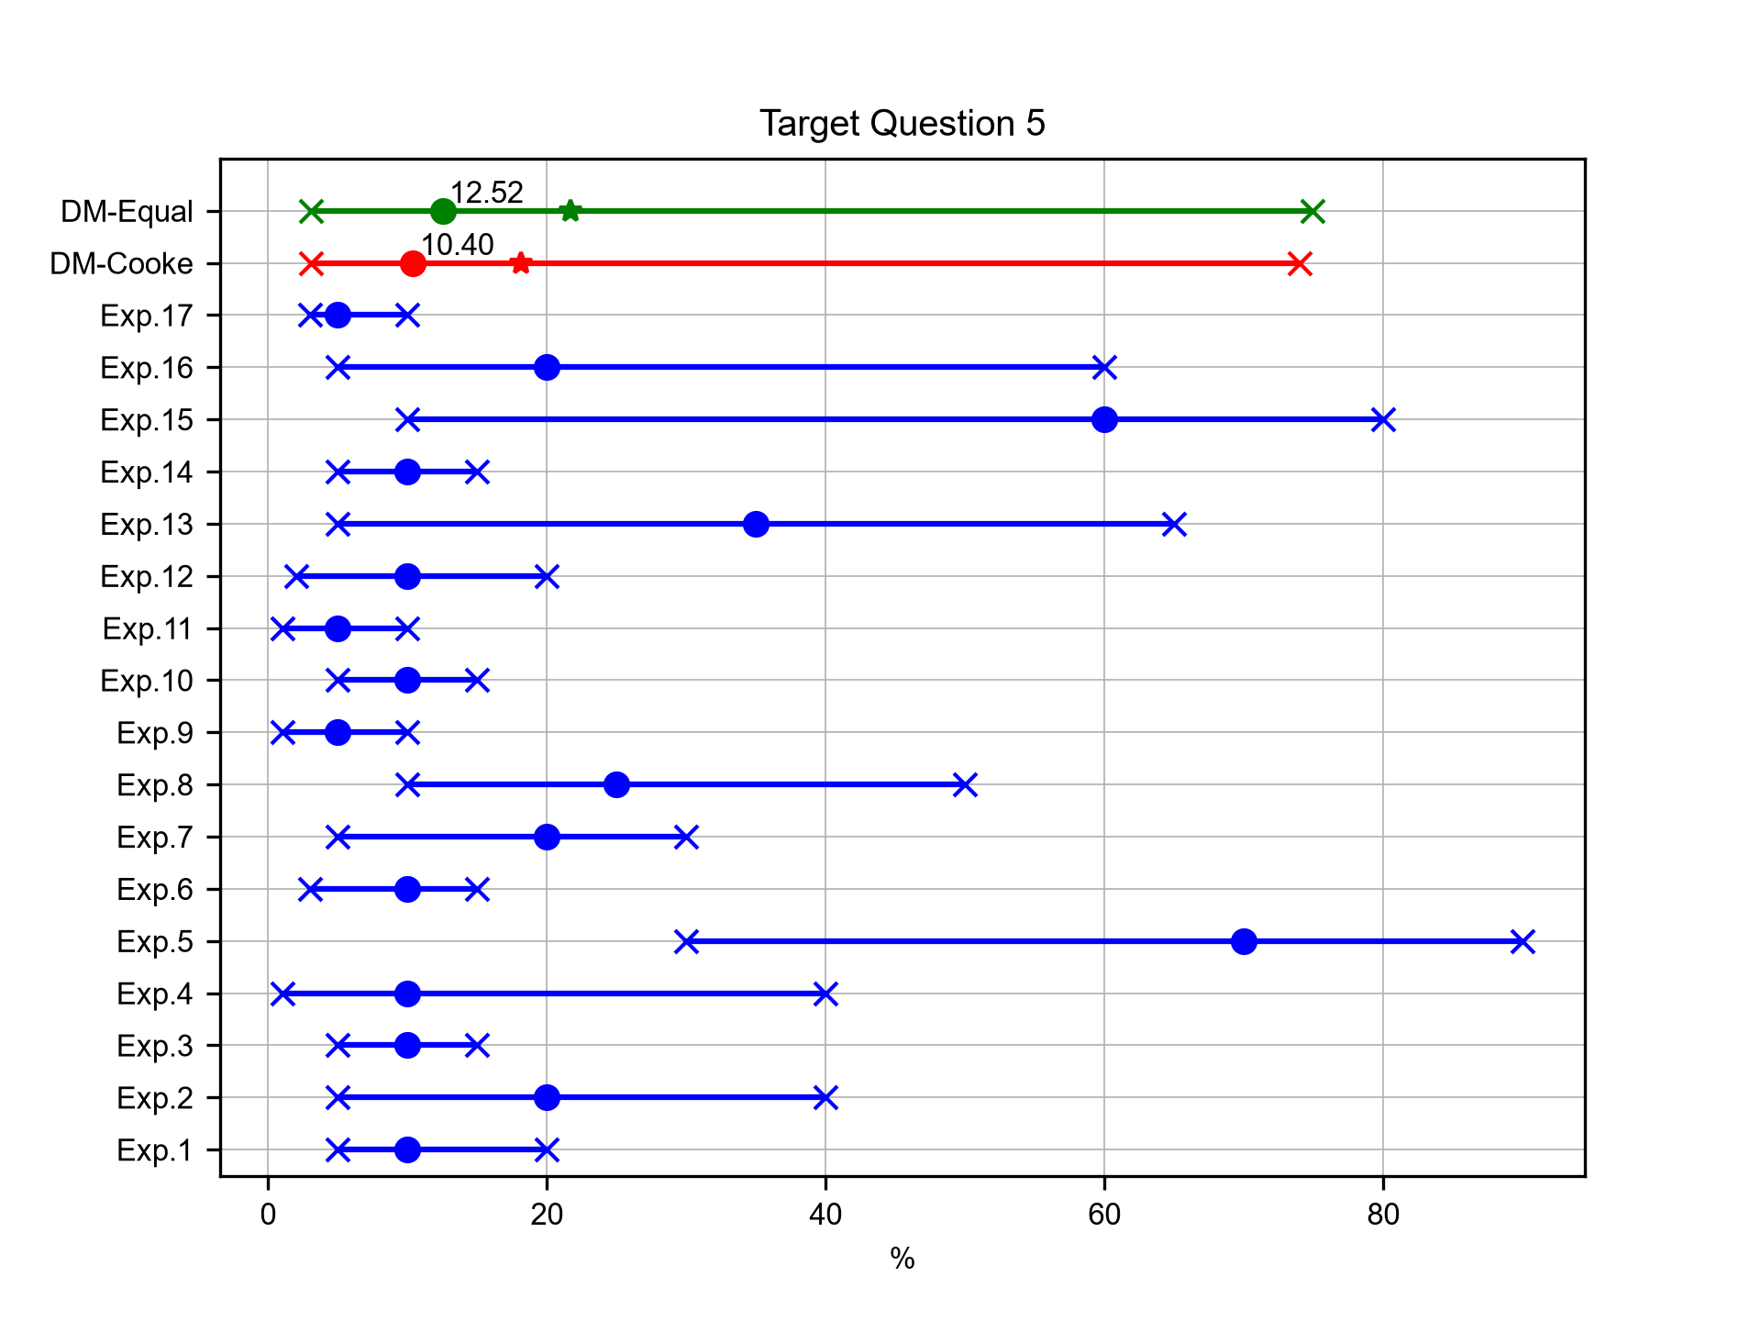
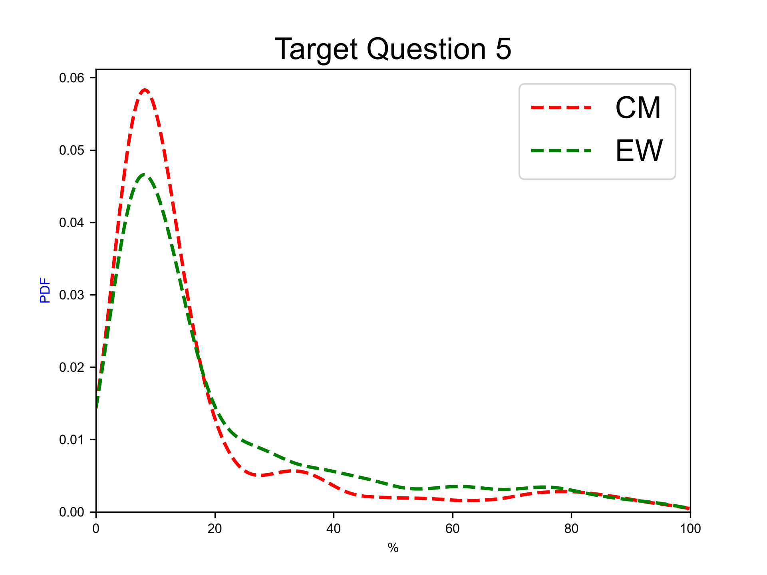
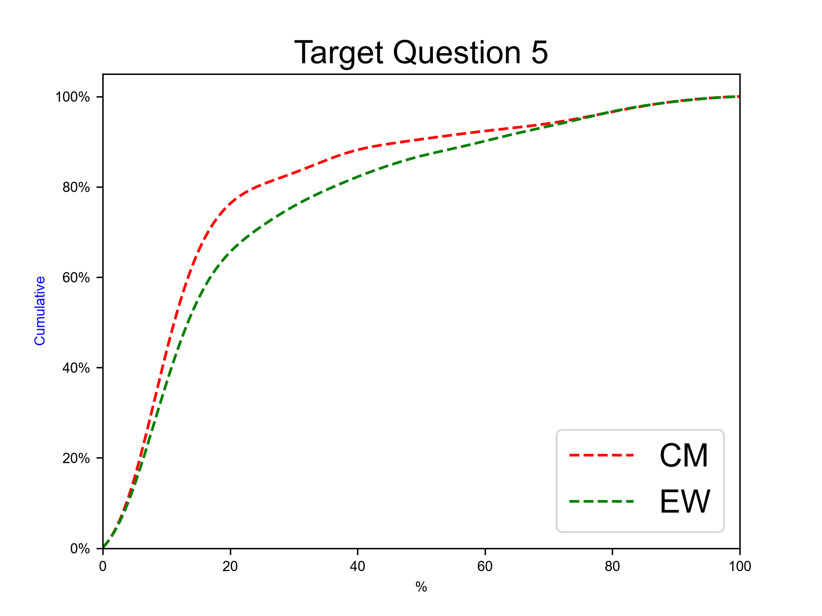
Next eruption, rhyolitic magma, other eruption type
Expert elicitation 27-Oct-2026
Given the present state of Cotopaxi volcano and your knowledge of its past eruptive chronology, how much probability do you assign to the possibility that at Cotopaxi, in case that the next eruption would involve totally or predominantly rhyolitic magma, the eruption would be of different type with respect to the previous ones?
N.B. The sum of 50%iles for questions 3-5 have to sum to 100.0.

Slide 25
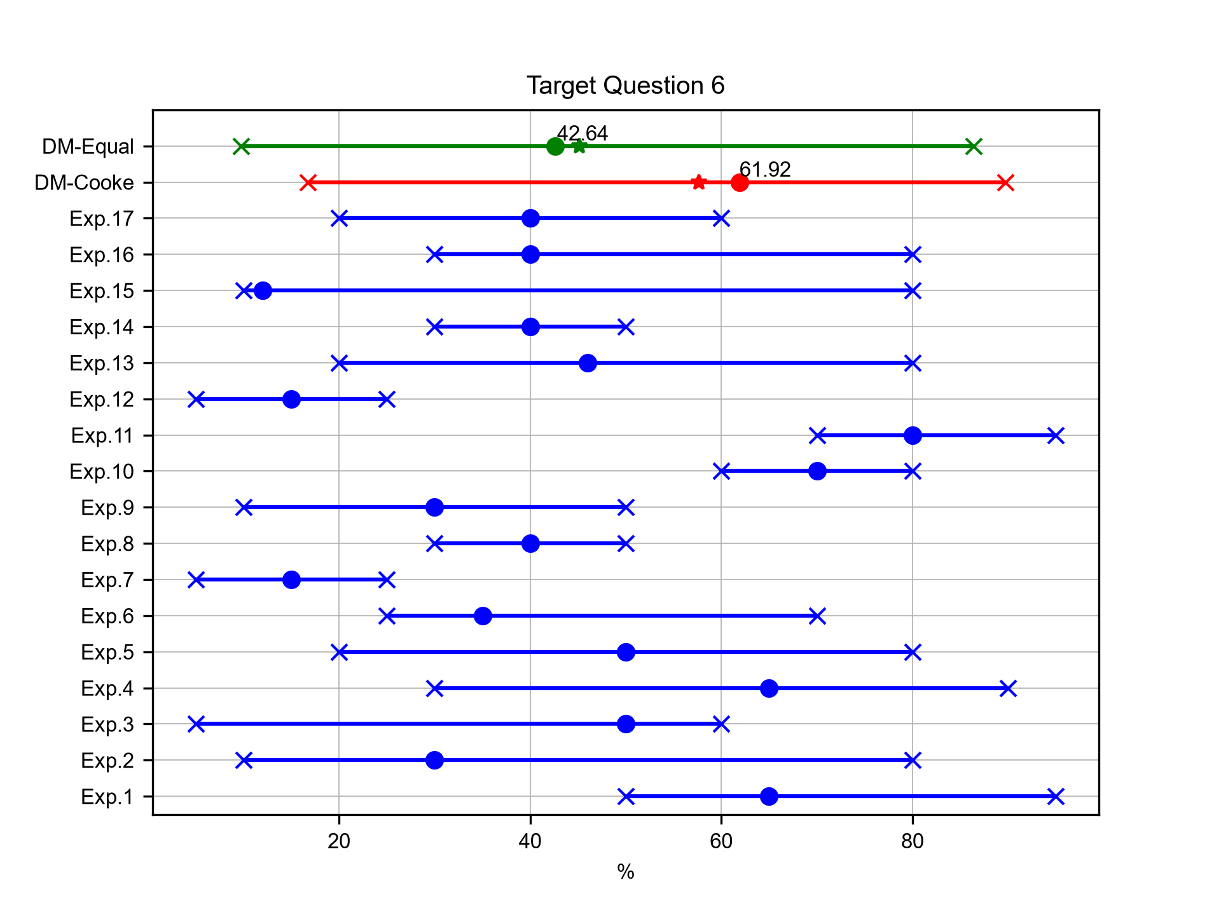
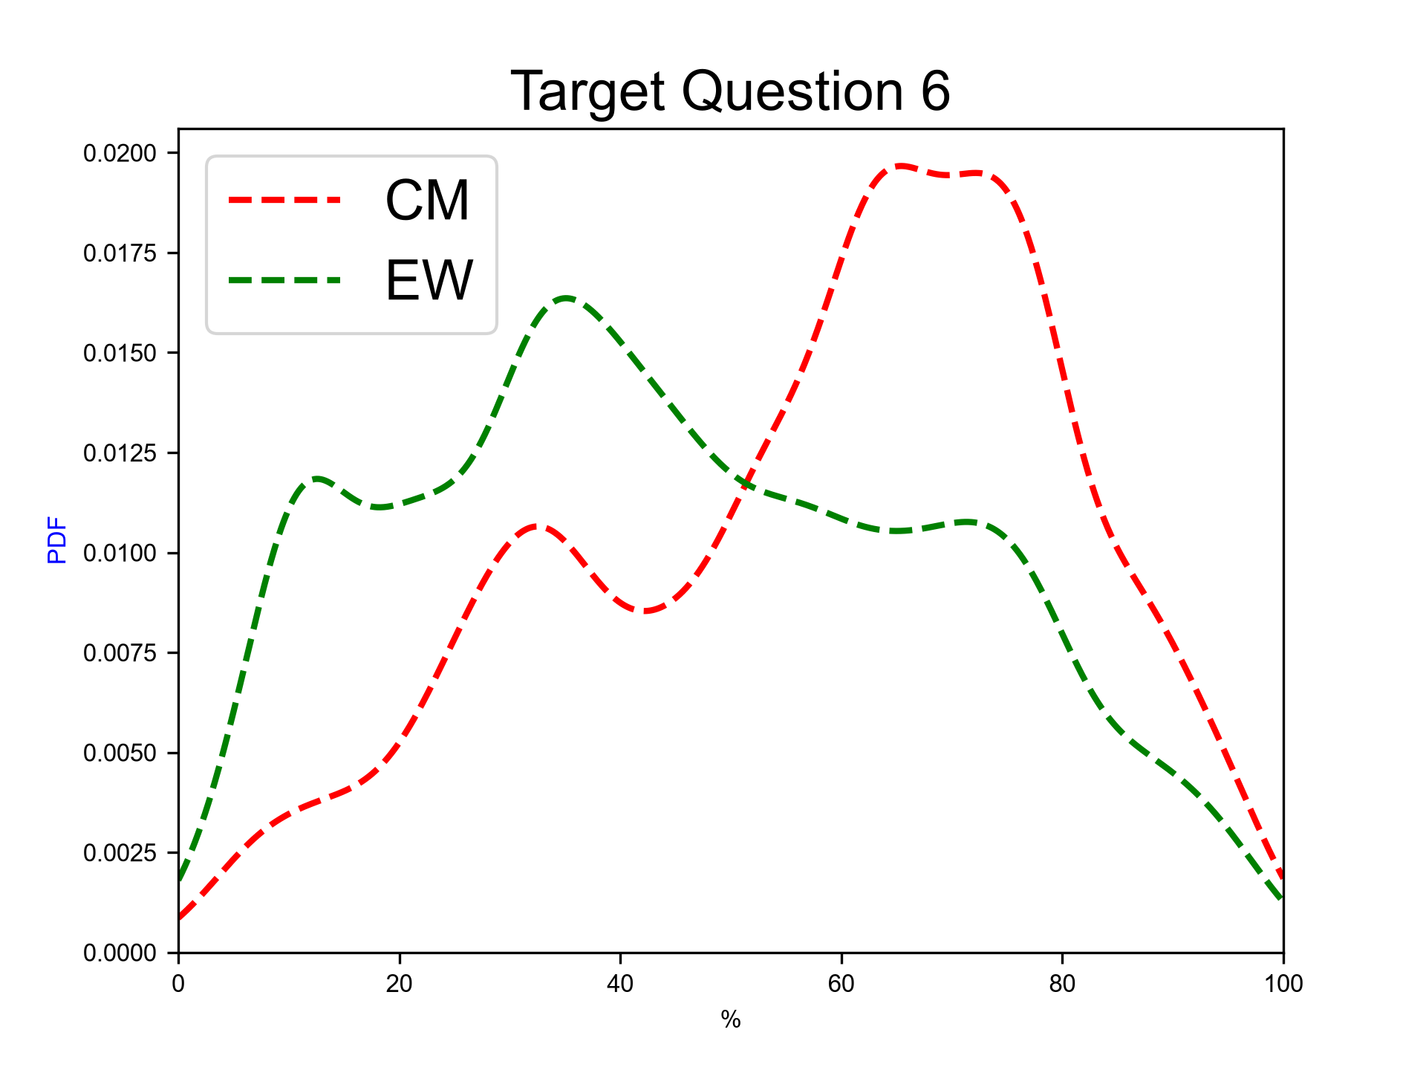
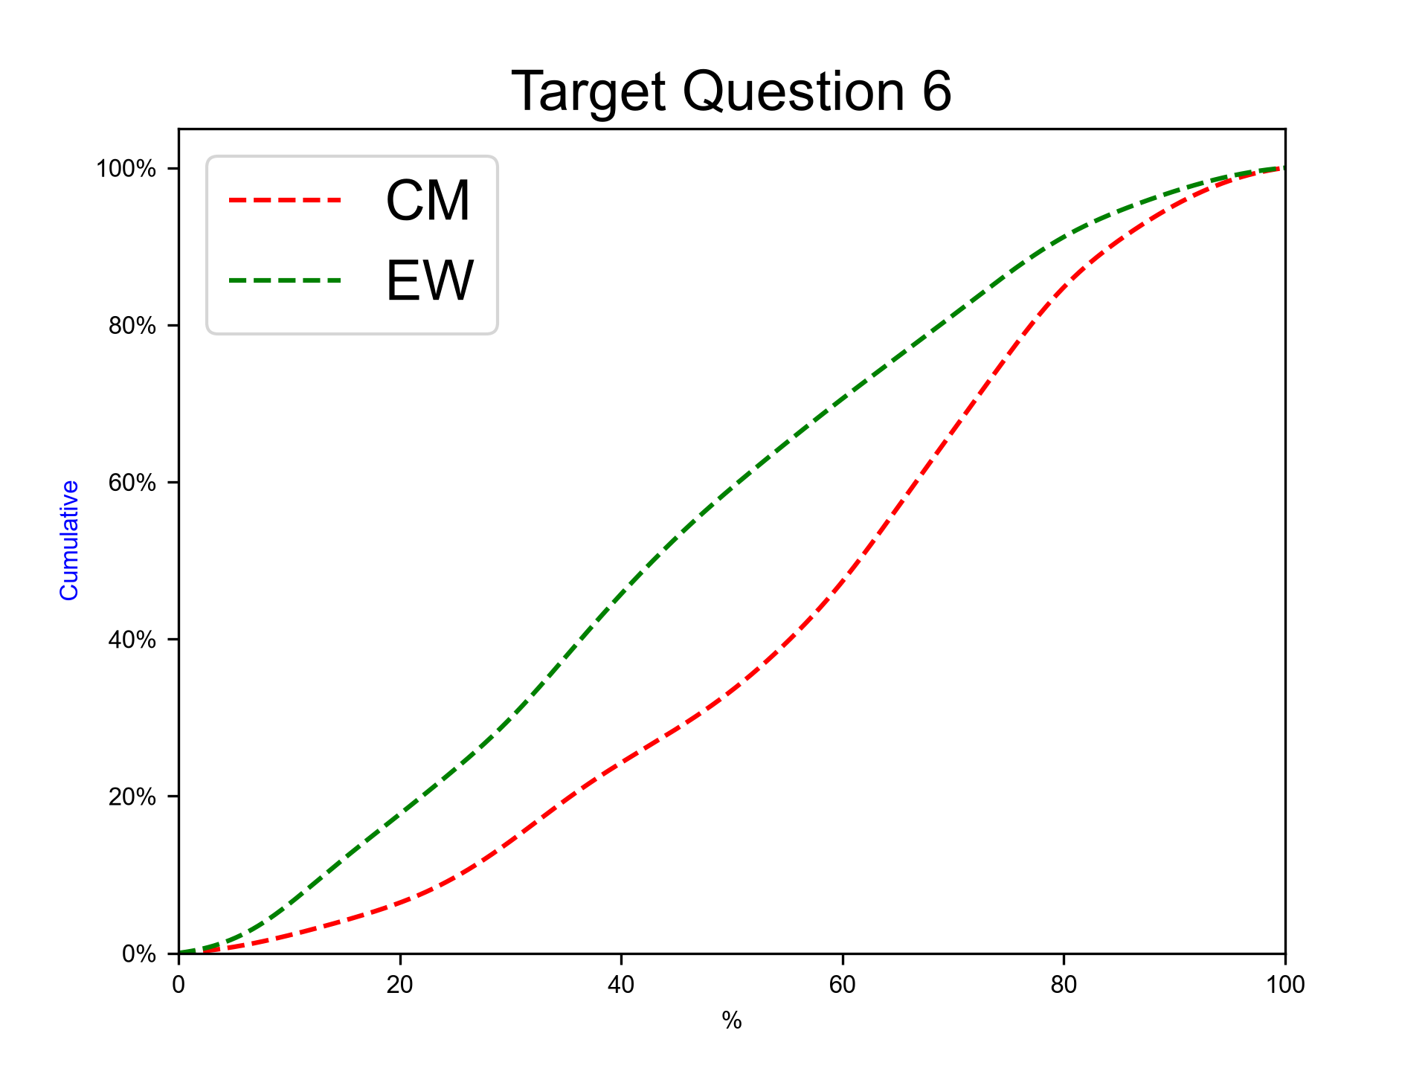
Next eruption, andesitic magma, Hydrovolcanic/Continuos ash emission eruption
Expert elicitation 27-Oct-2026
Given the present state of Cotopaxi volcano and your knowledge of its past eruptive chronology, how much probability do you assign to the possibility that at Cotopaxi, in case that the next eruption would involve totally or predominantly andesitic magma, the eruption would be similar to the AD 2015 one (Hydrovolcanic to long-lasting ash emission, VEI 1-2)?
N.B. The sum of 50%iles for questions 6-10 have to sum to 100.0.

Slide 26
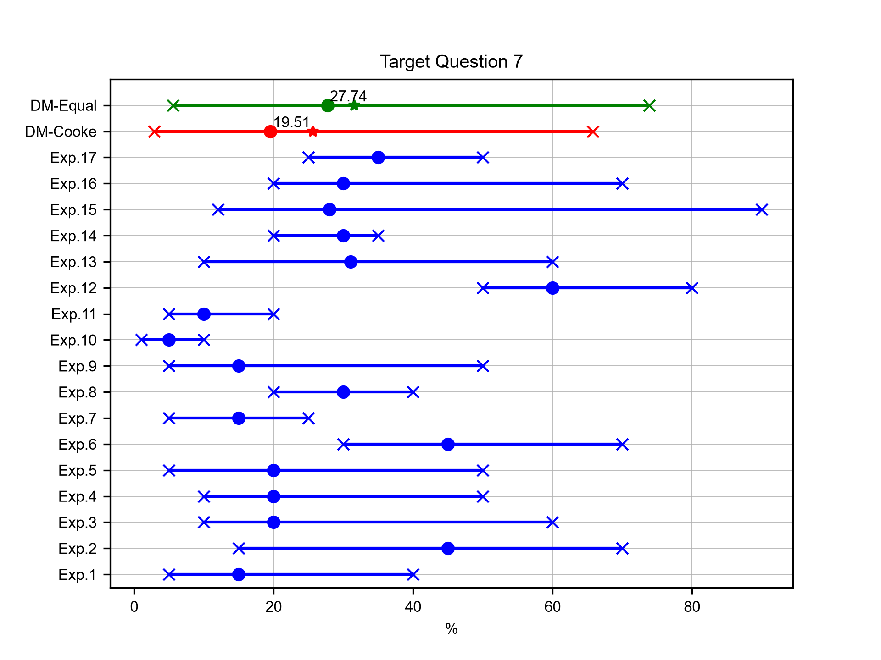
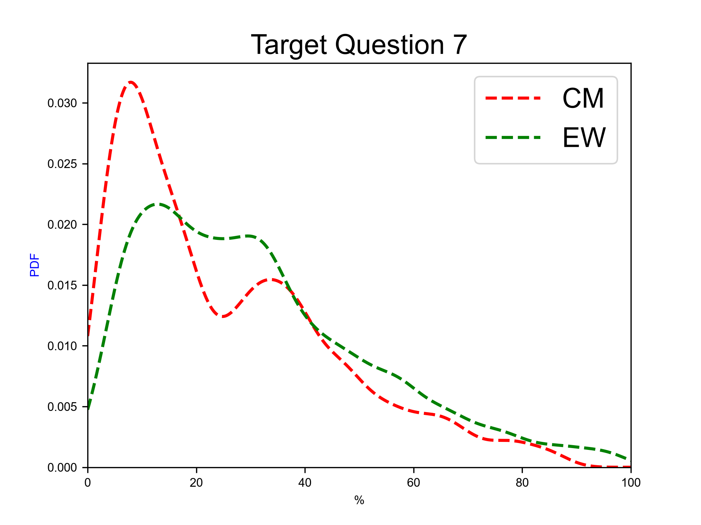
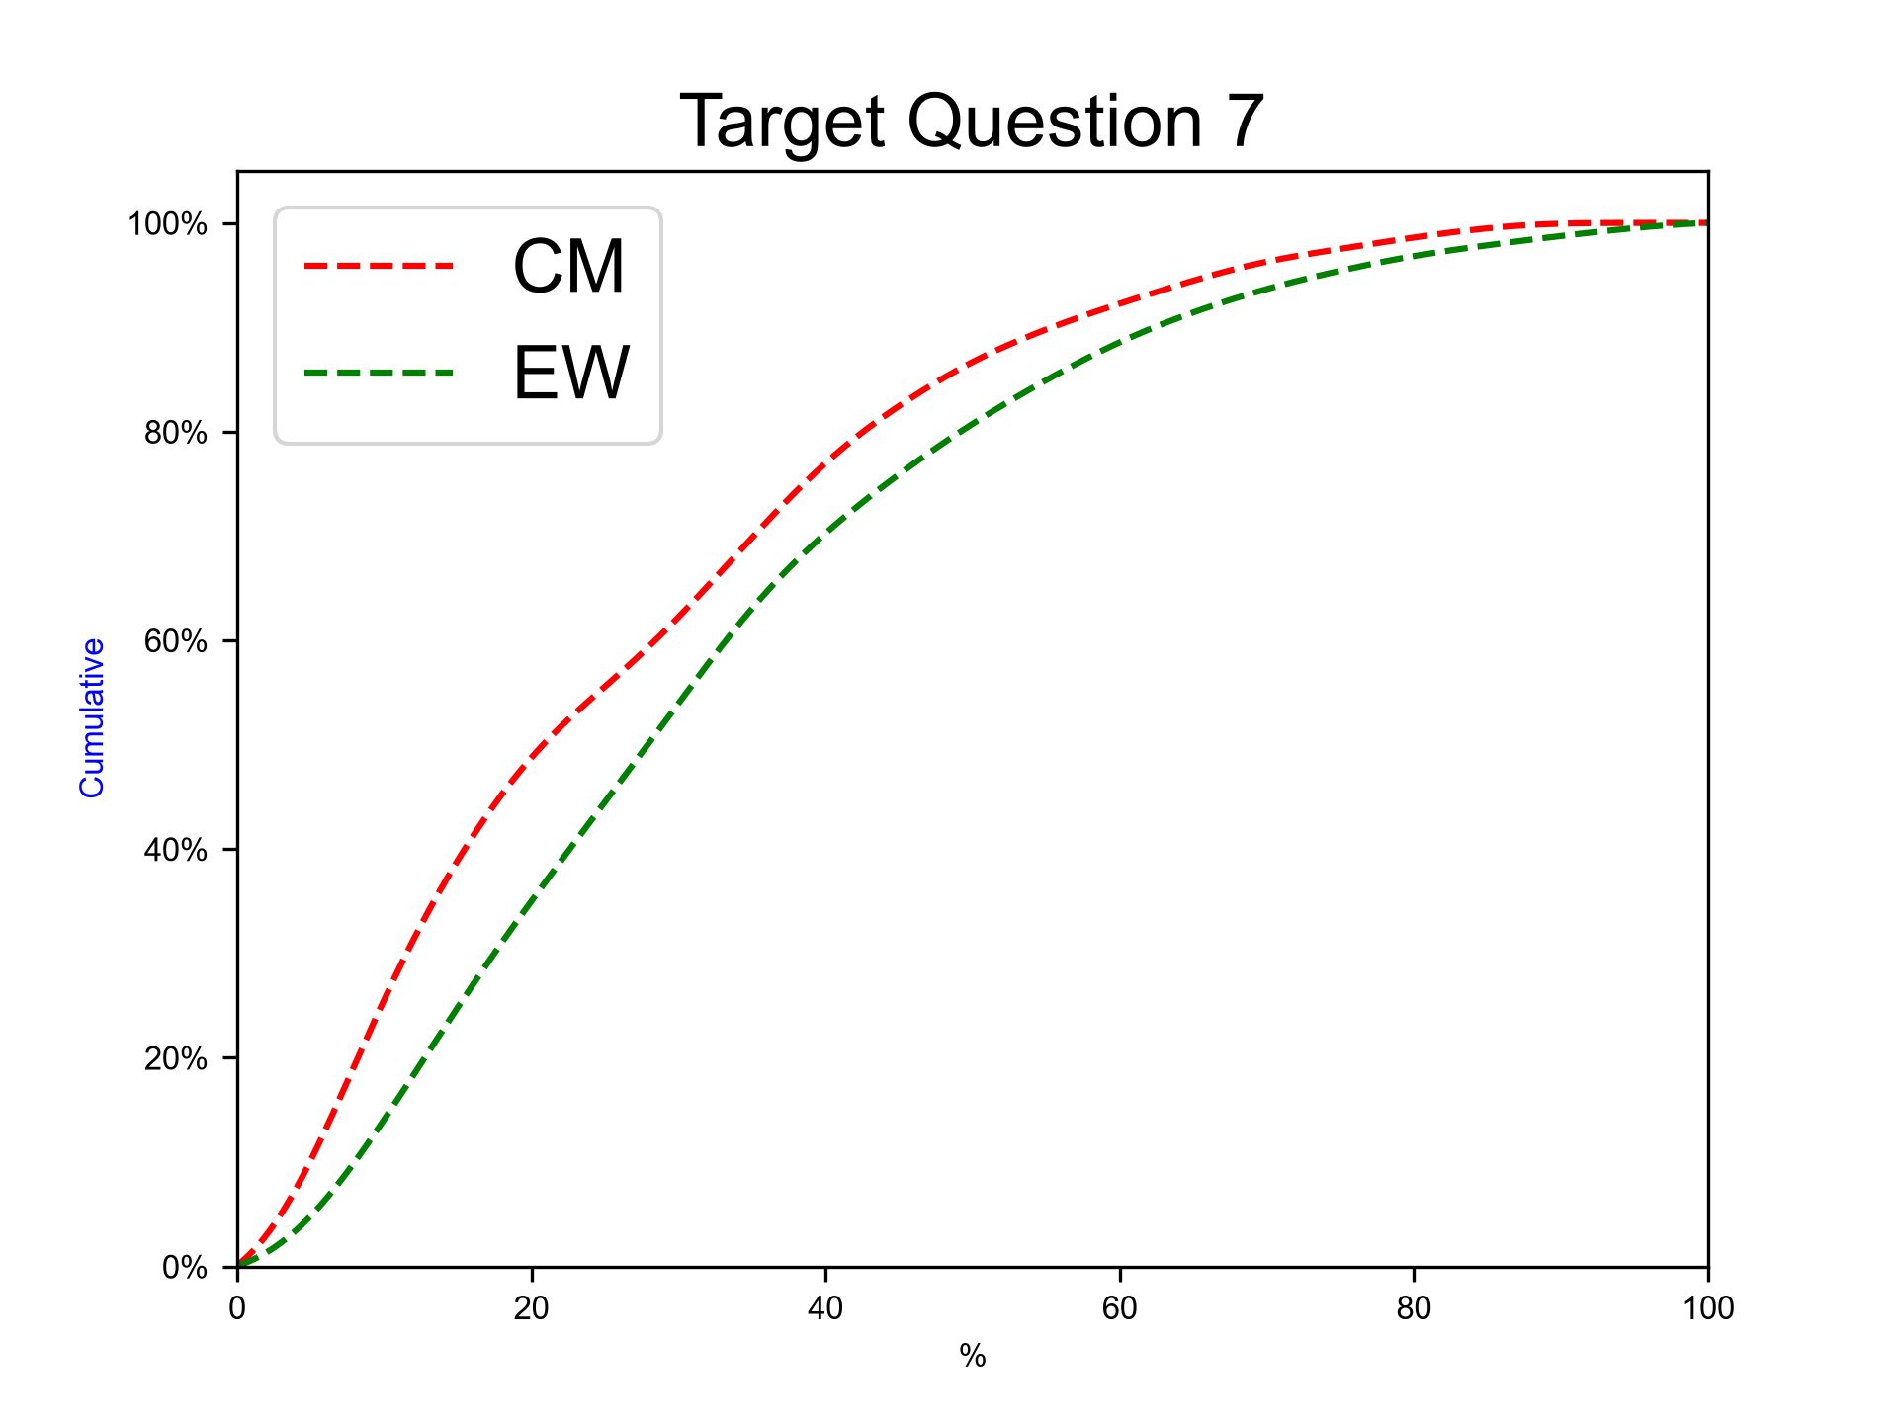
Next eruption, andesitic magma, Violent Strombolian eruption
Expert elicitation 27-Oct-2026
Given the present state of Cotopaxi volcano and your knowledge of its past eruptive chronology, how much probability do you assign to the possibility that at Cotopaxi, in case that the next eruption would involve totally or predominantly andesitic magma, the eruption would be similar to the ones in the XIX century (Violent Strombolian, VEI 2-3)?
N.B. The sum of 50%iles for questions 6-10 have to sum to 100.0.

Slide 27
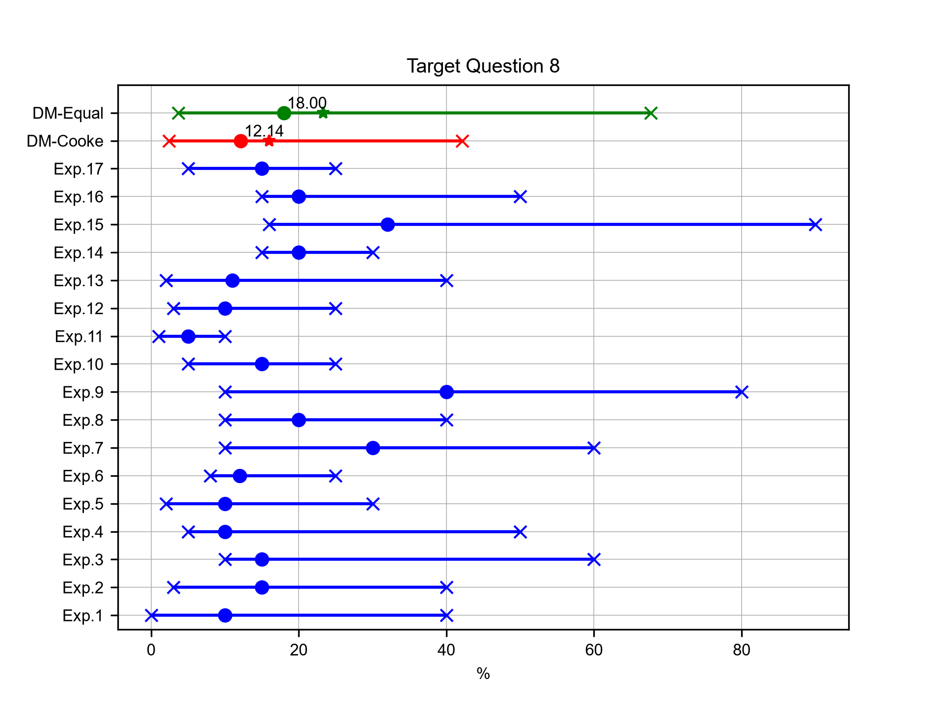
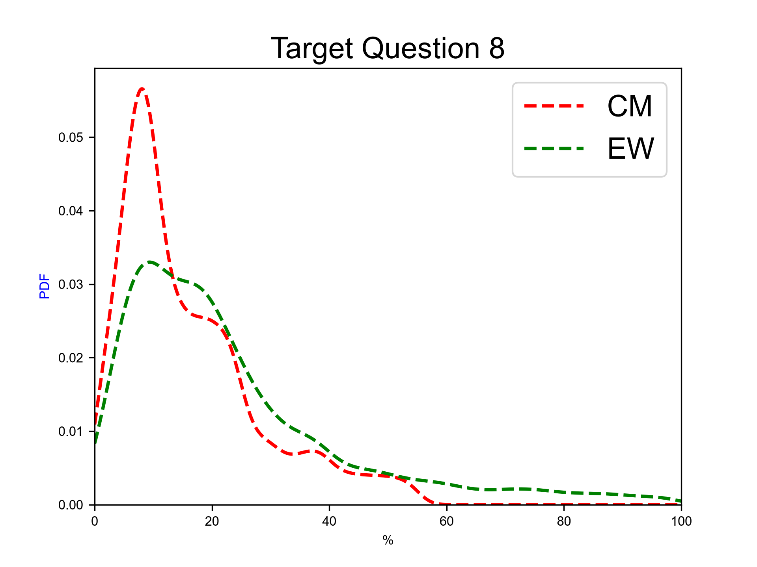
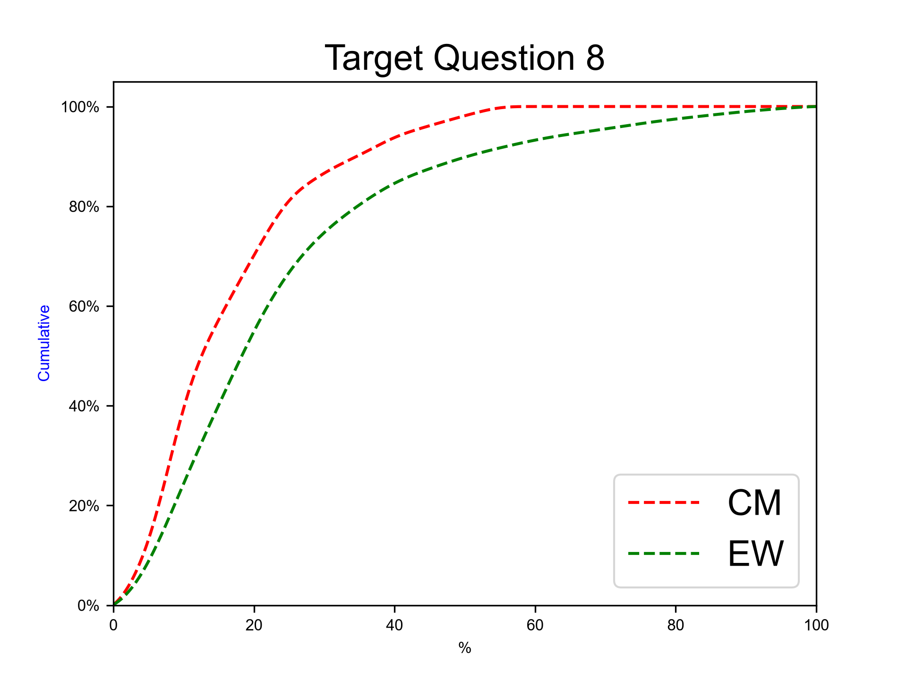
Next eruption, andesitic magma, SubPlinian eruption
Expert elicitation 27-Oct-2026
Given the present state of Cotopaxi volcano and your knowledge of its past eruptive chronology, how much probability do you assign to the possibility that at Cotopaxi, in case that the next eruption would involve totally or predominantly andesitic magma, the eruption would be similar to the AD 1877 one (SubPlinian, VEI 3-4)?
N.B. The sum of 50%iles for questions 6-10 have to sum to 100.0.

Slide 28
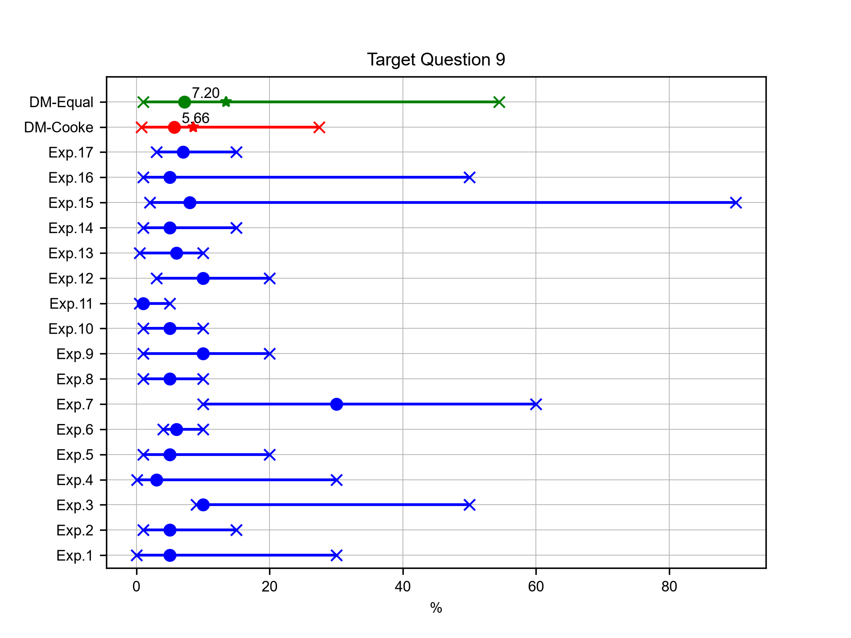
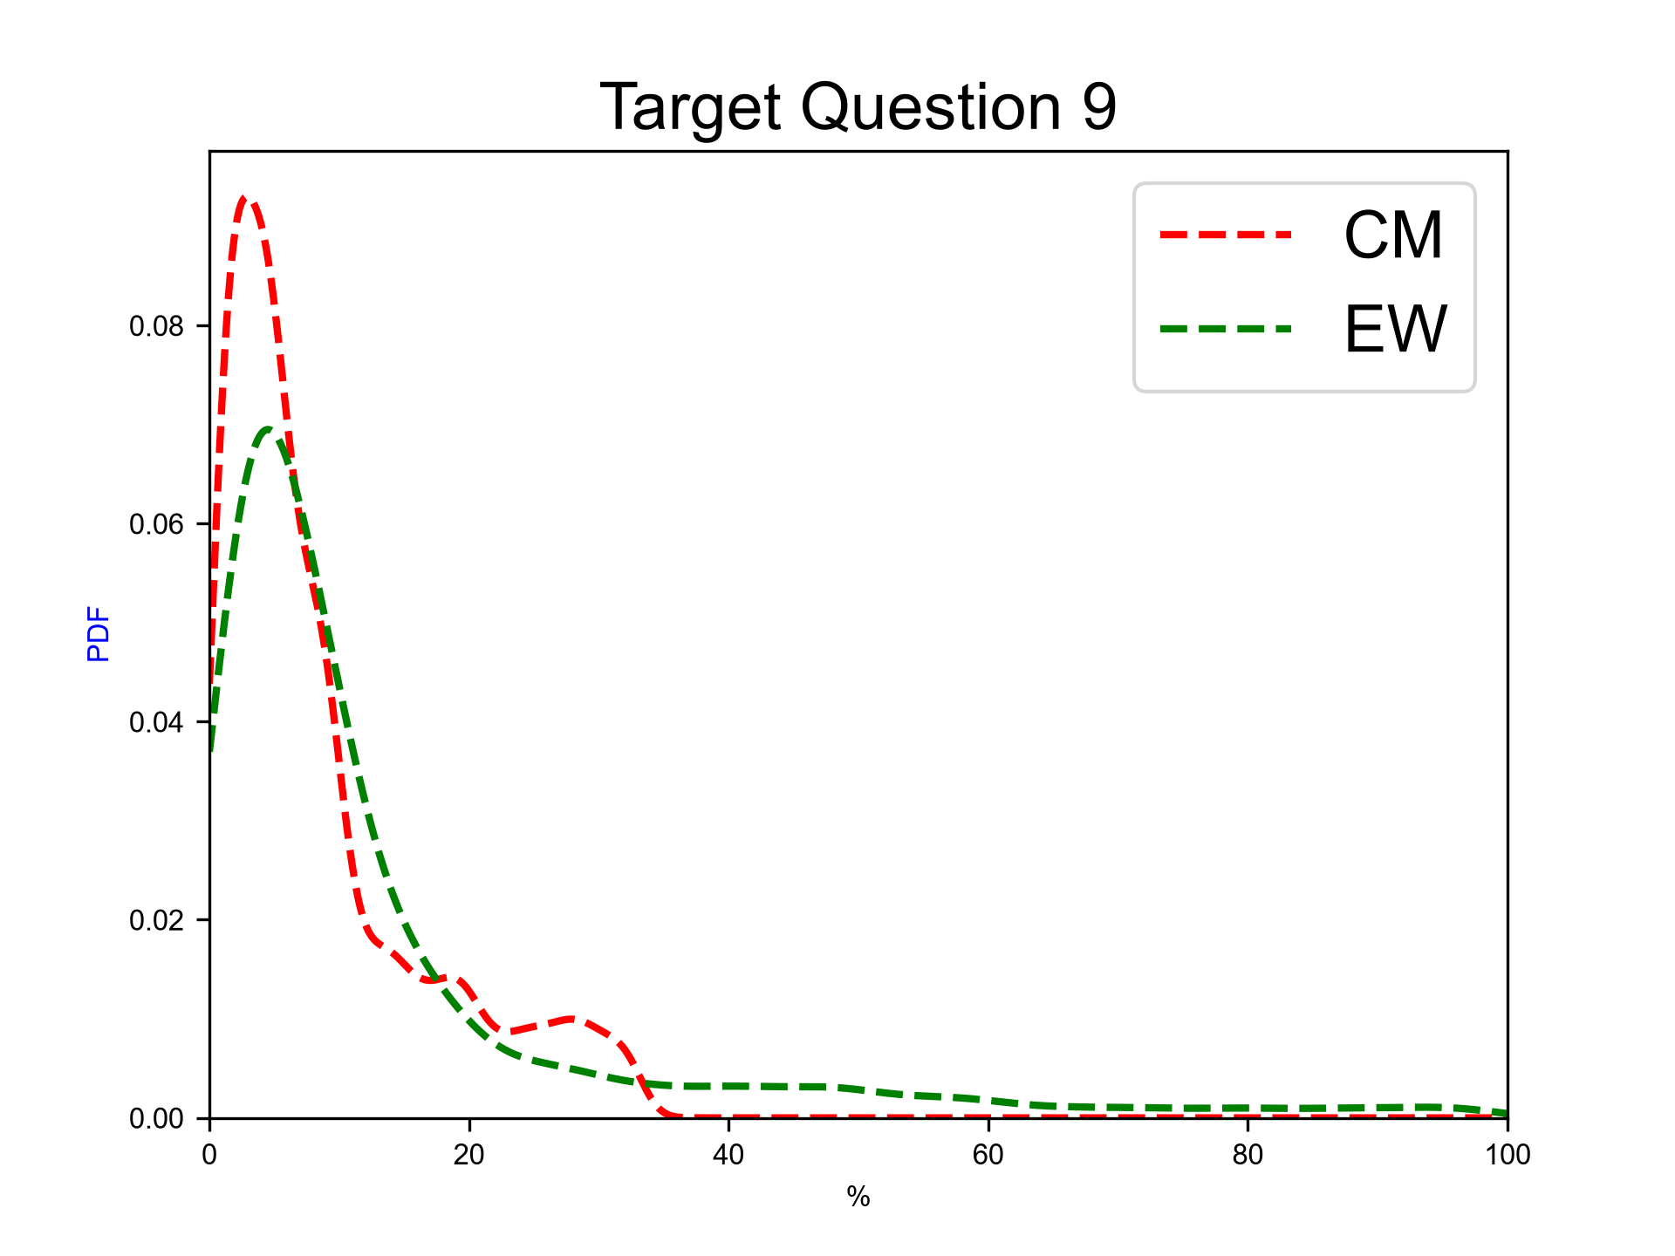
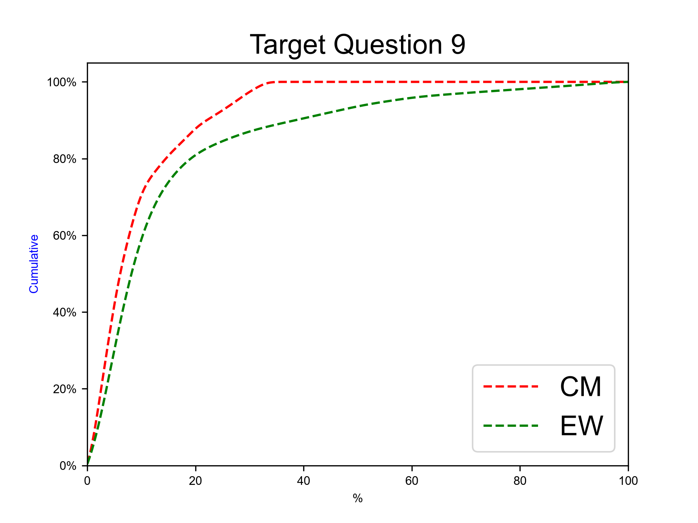
Next eruption, andesitic magma, Plinian eruption
Expert elicitation 27-Oct-2026
Given the present state of Cotopaxi volcano and your knowledge of its past eruptive chronology, how much probability do you assign to the possibility that at Cotopaxi, in case that the next eruption would involve totally or predominantly andesitic magma, the eruption would be similar to the Layers 3/5 ones (Plinian, VEI 4-5)?
N.B. The sum of 50%iles for questions 6-10 have to sum to 100.0.

Slide 29
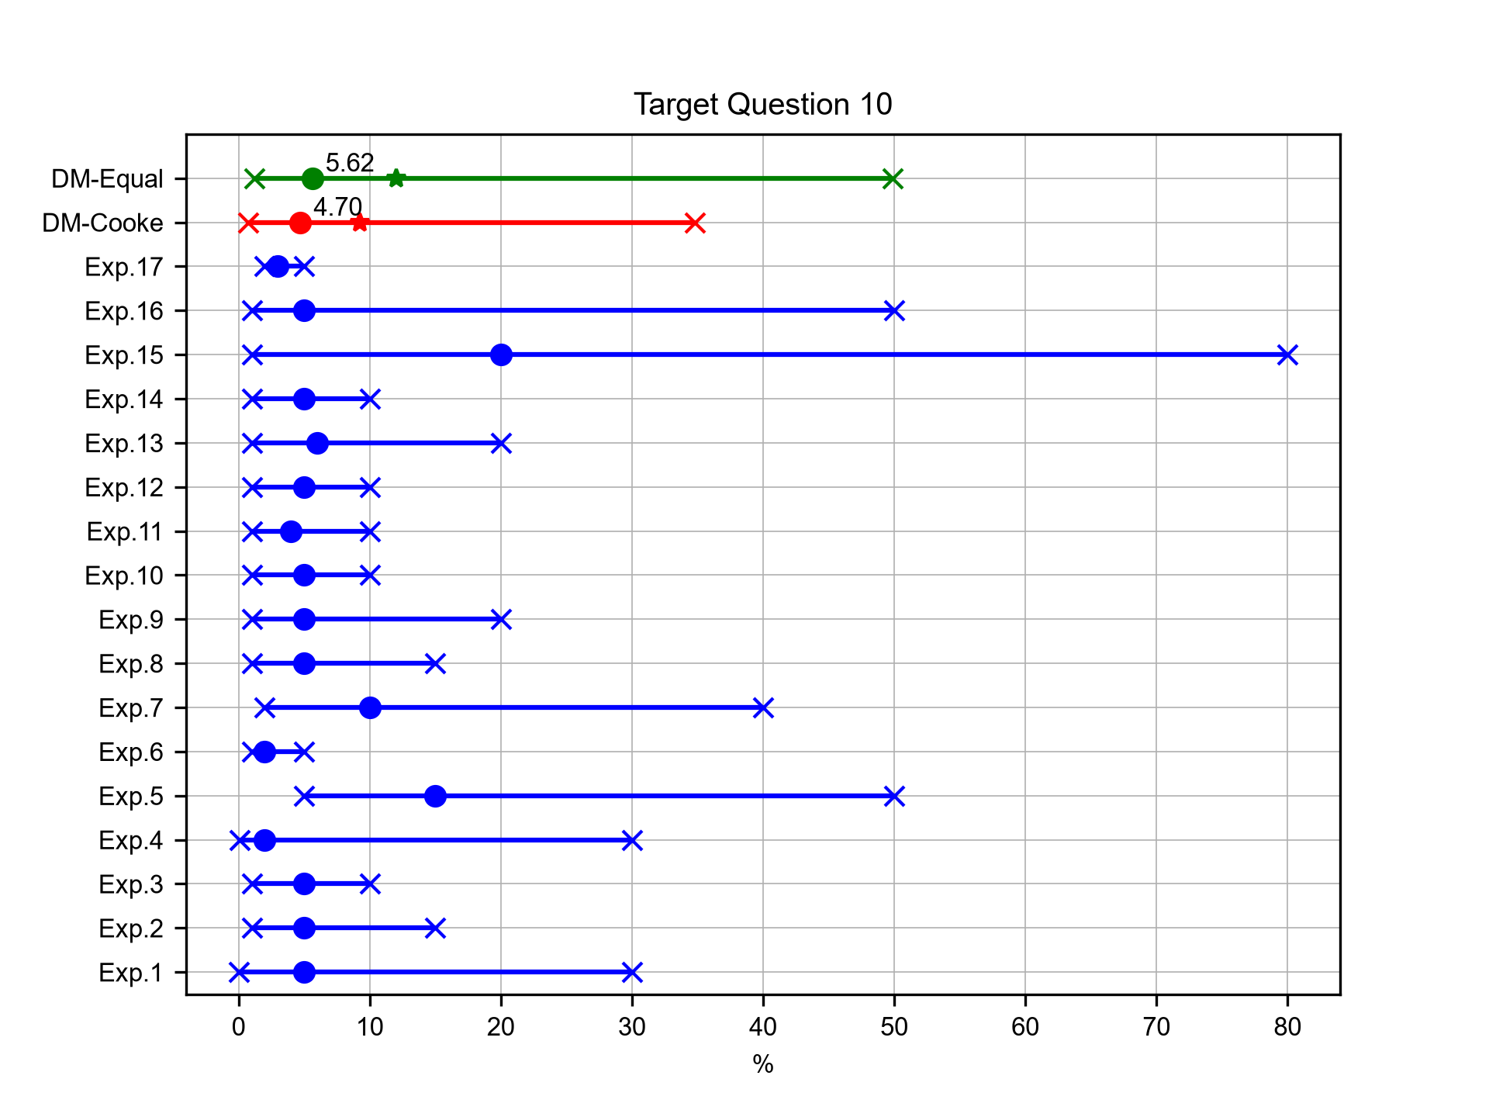
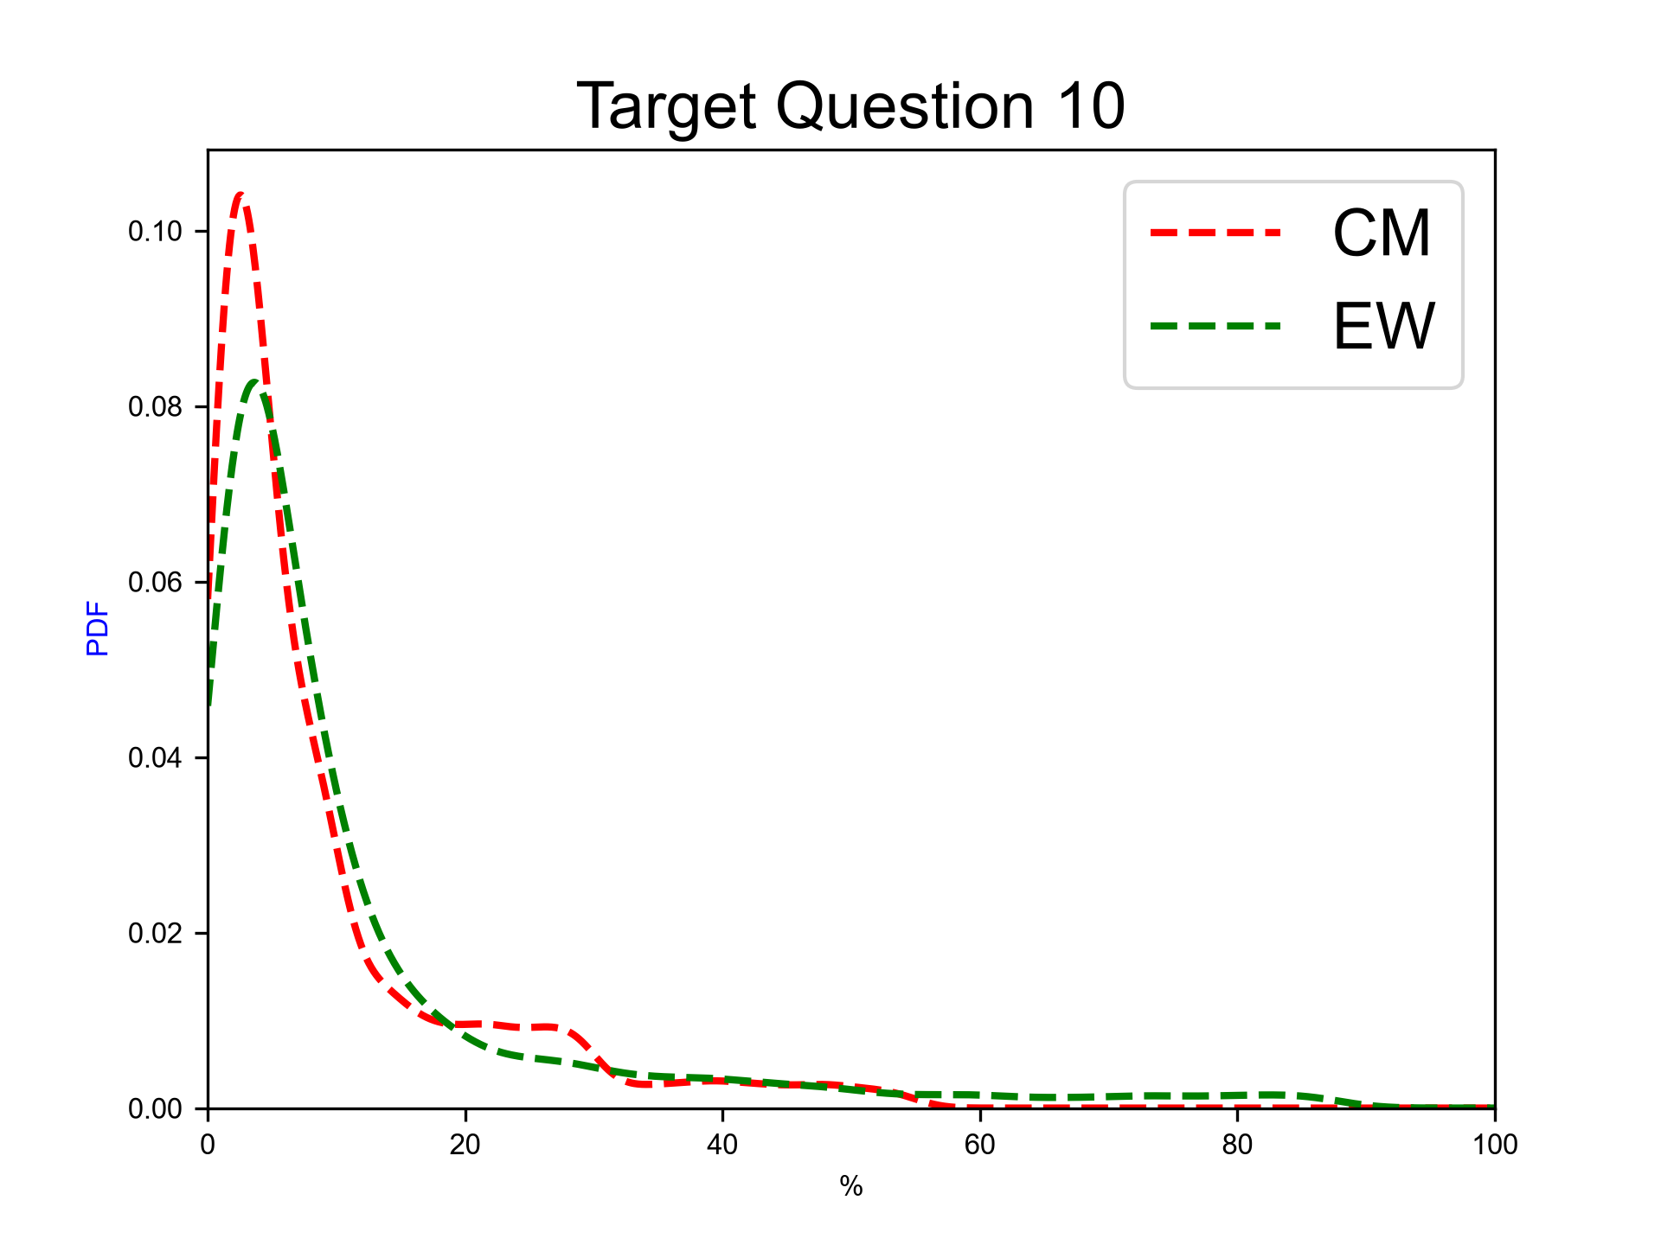
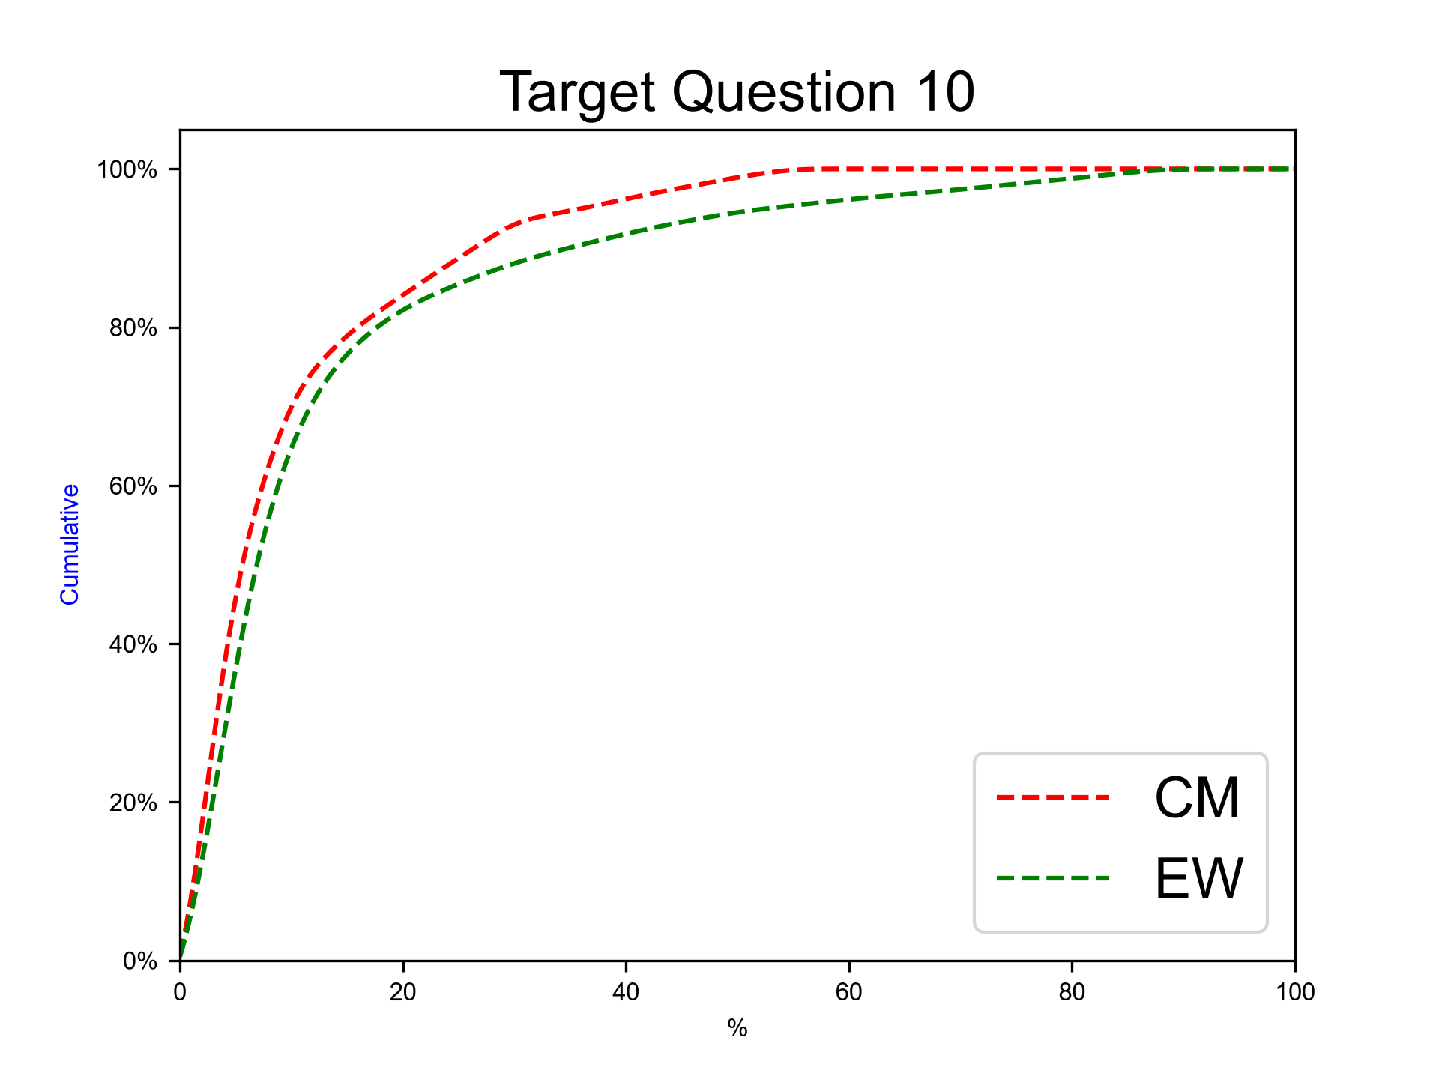
Next eruption, andesitic magma, other eruption type
Expert elicitation 27-Oct-2026
Given the present state of Cotopaxi volcano and your knowledge of its past eruptive chronology, how much probability do you assign to the possibility that at Cotopaxi, in case that the next eruption would involve totally or predominantly andesitic magma, the eruption would be of different type with respect to the previous ones?
N.B. The sum of 50%iles for questions 6-10 have to sum to 100.0.

Slide 30
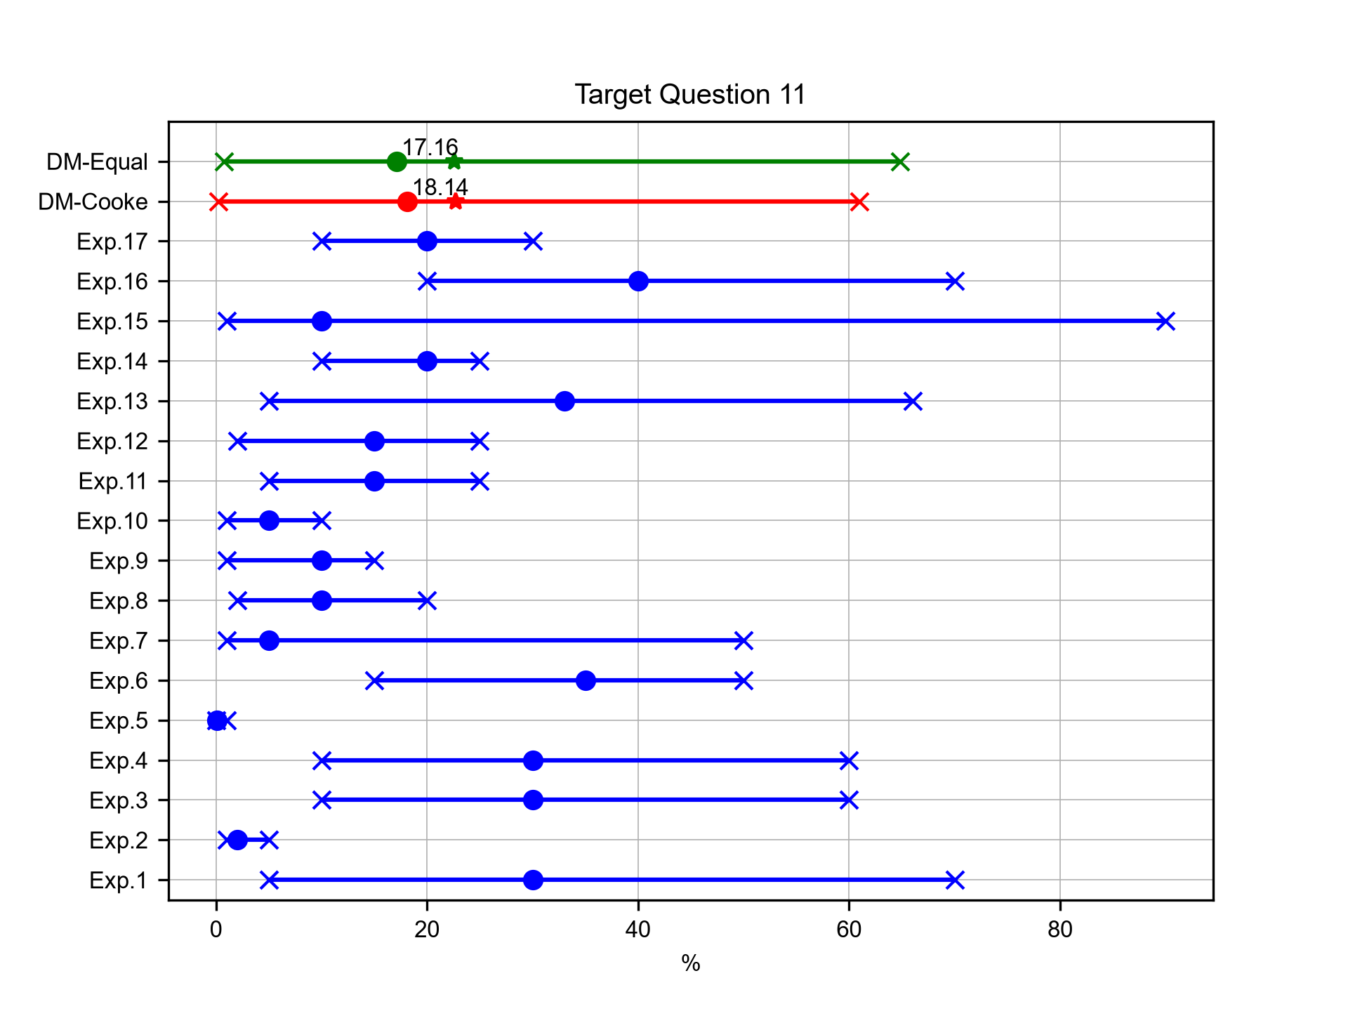
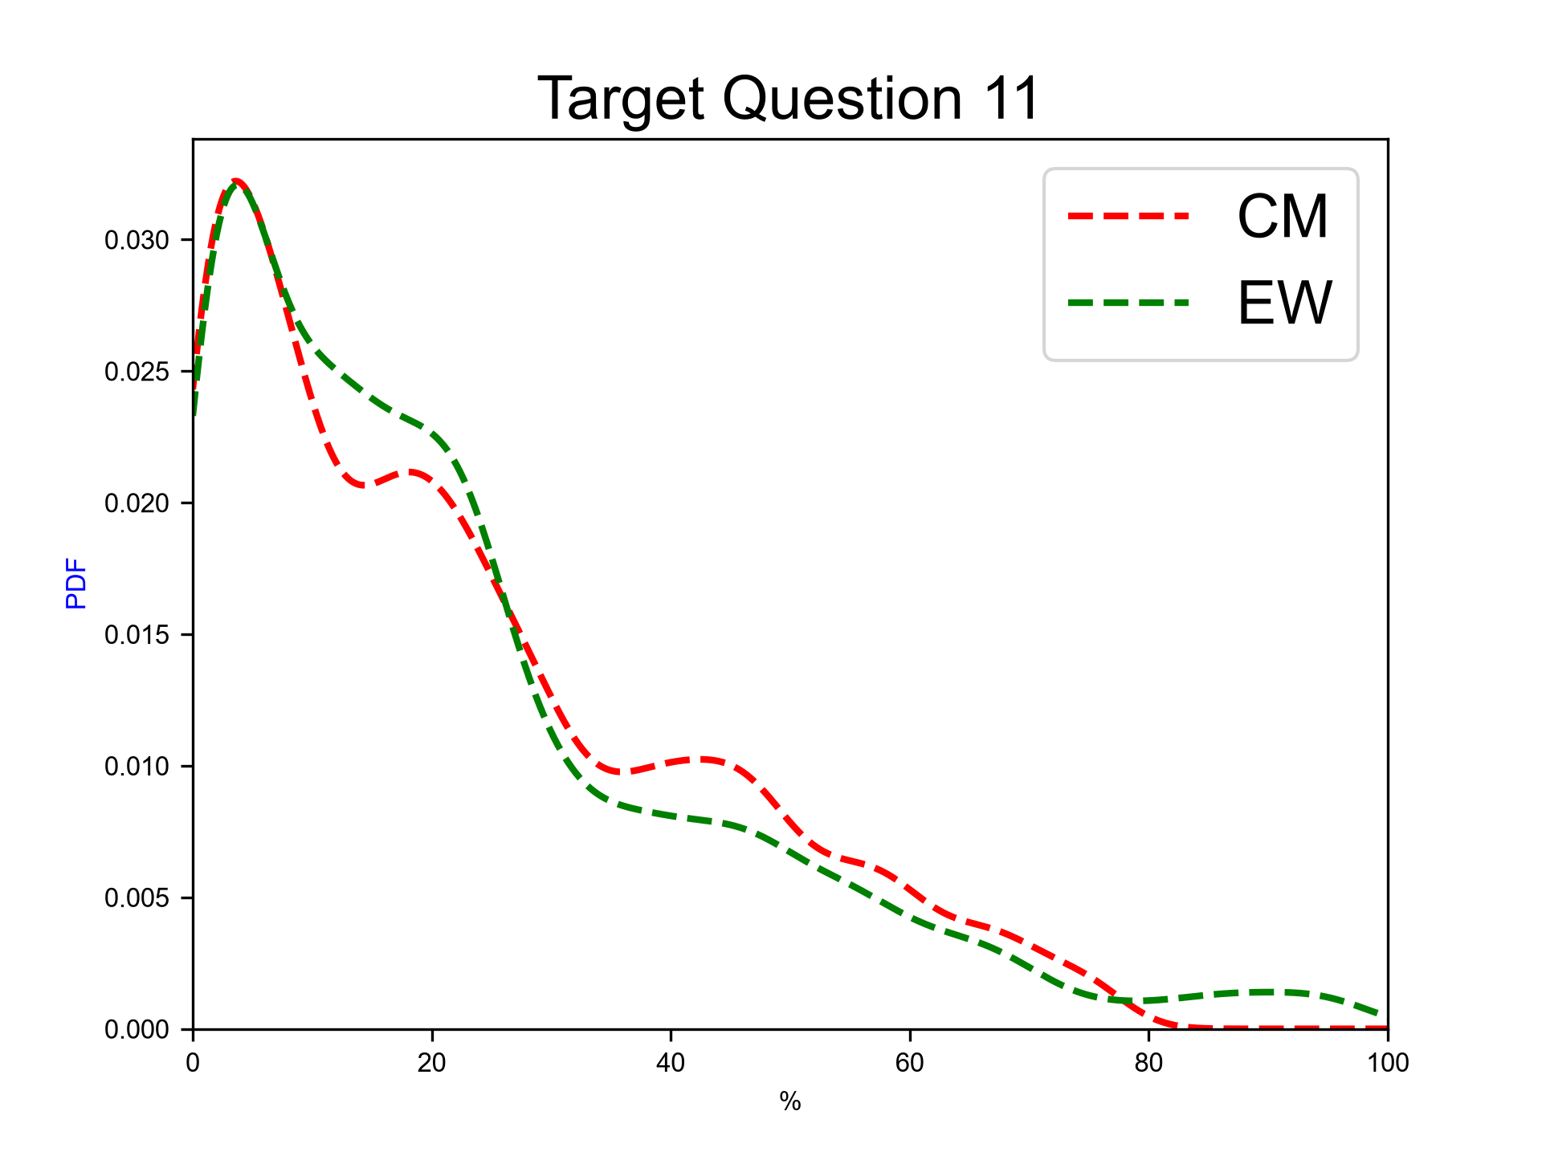
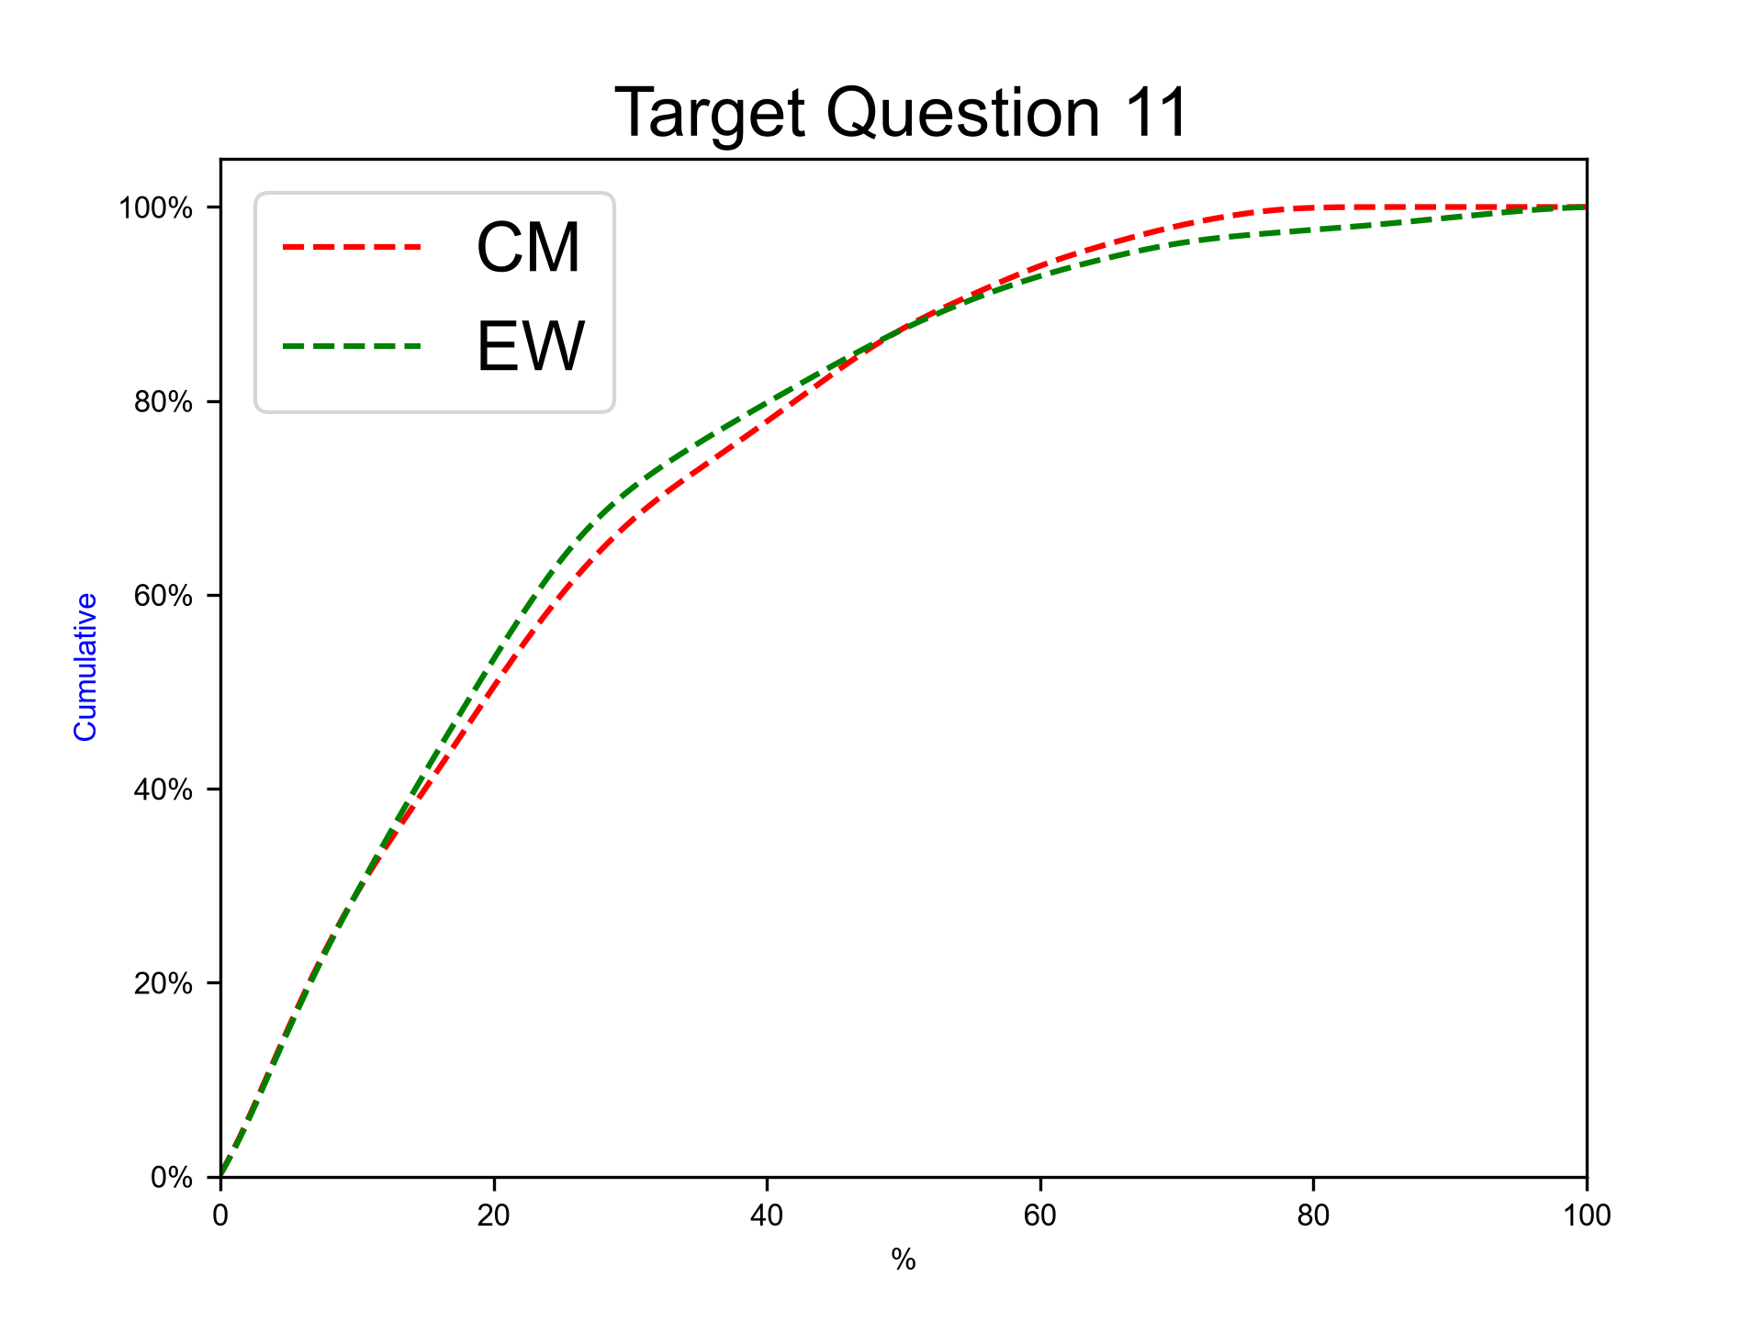
Next 100 years, rhyolitic magma
Expert elicitation 27-Oct-2026
Given the present state of Cotopaxi volcano and your knowledge of its past eruptive chronology, how much probability do you assign to the possibility that, for the next 100 years at Cotopaxi, there will be at least 1 eruption involving magma totally or predominantly of rhyolitic composition?

Slide 31
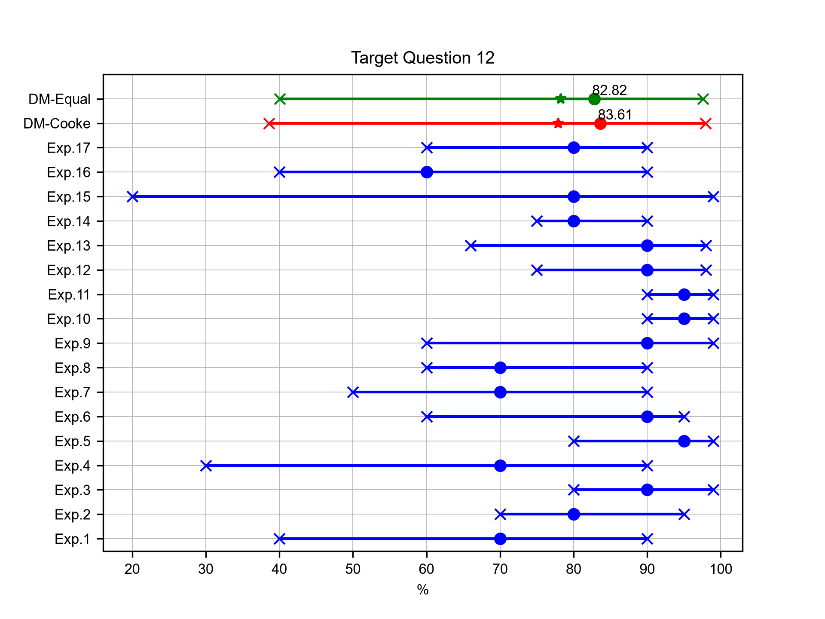
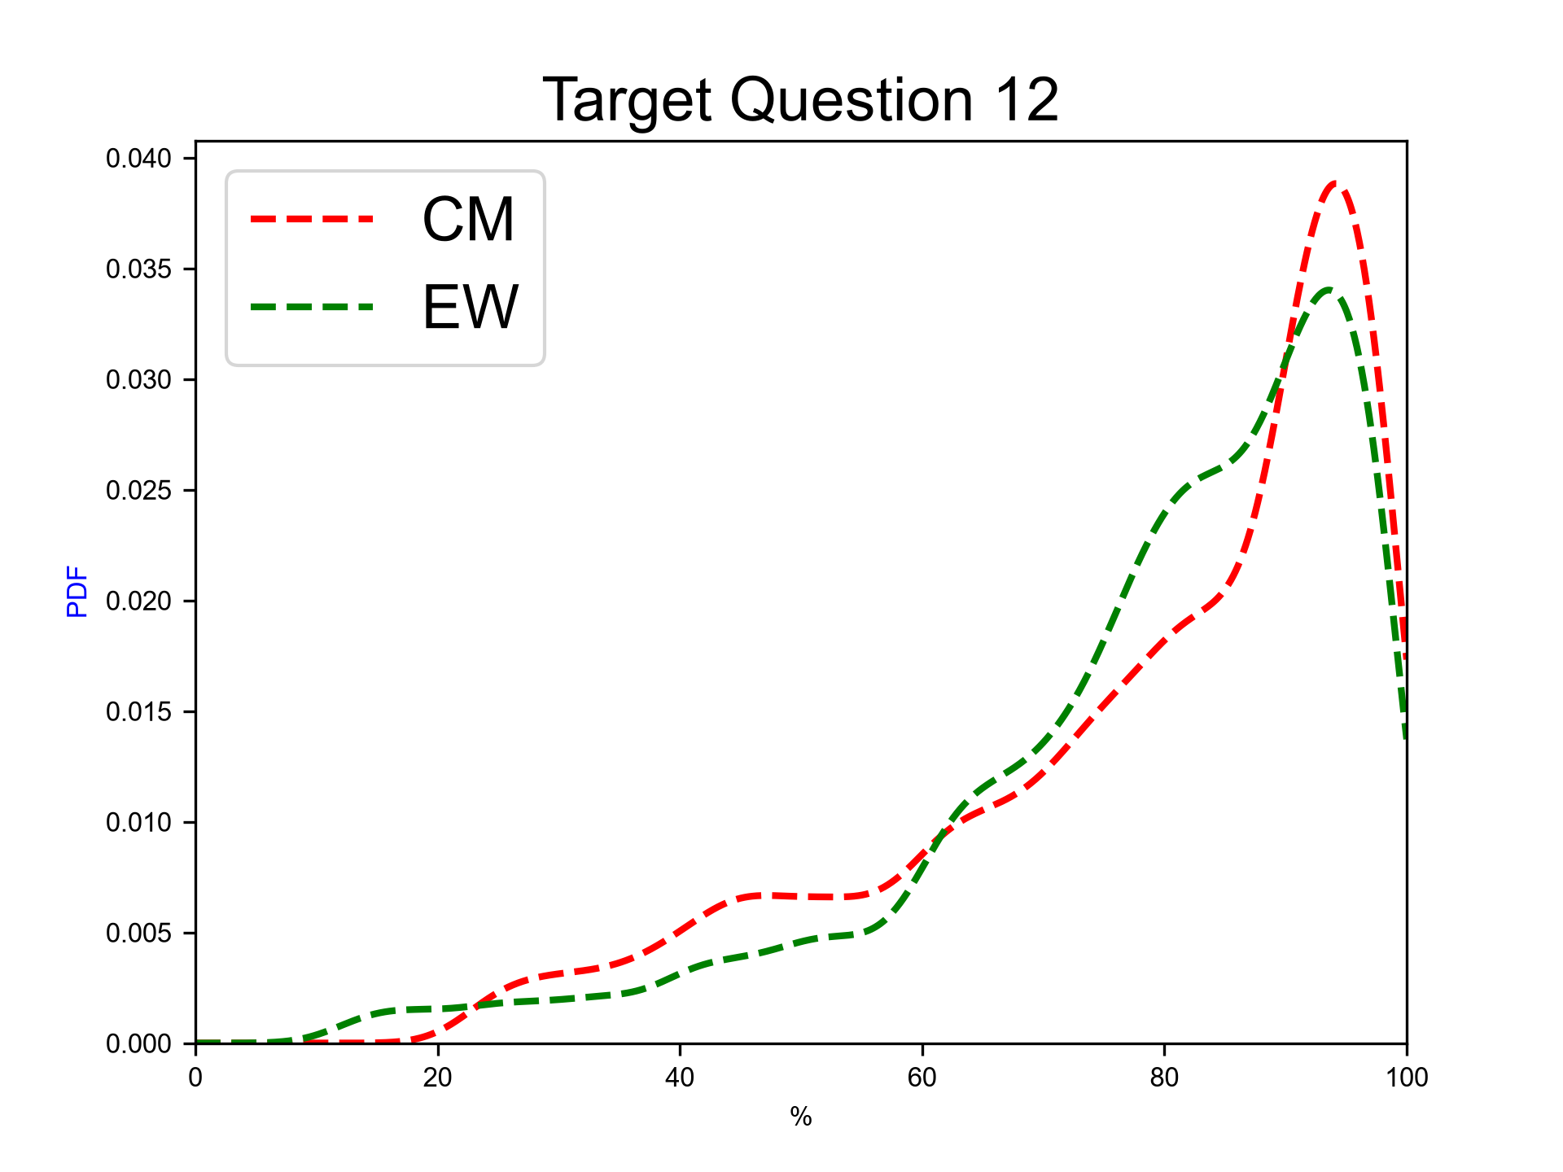
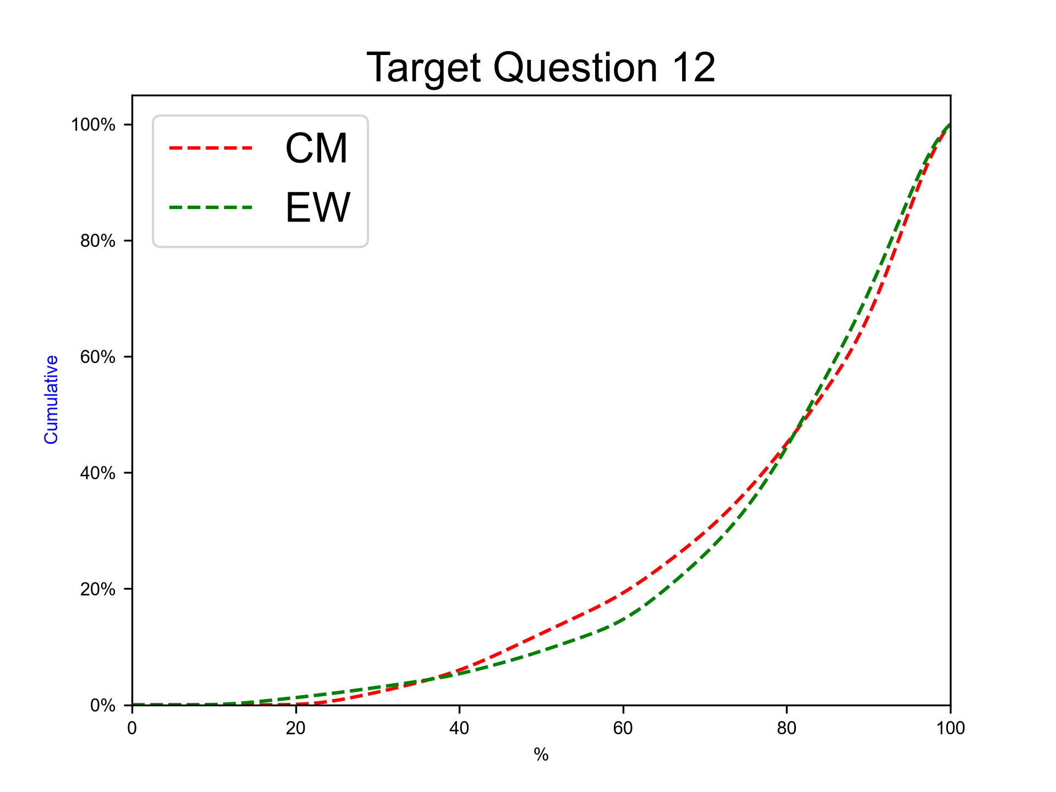
Next 100 years, andesitic magma
Expert elicitation 27-Oct-2026
Given the present state of Cotopaxi volcano and your knowledge of its past eruptive chronology, how much probability do you assign to the possibility that, for the next 100 years at Cotopaxi, there will be at least 1 eruption involving magma totally or predominantly of andesitic composition?

Slide 32



Next 100 years, rhyolitic magma, SubPlinian eruption
Expert elicitation 27-Oct-2026
Given the present state of Cotopaxi volcano and your knowledge of its past eruptive chronology, how much probability do you assign to the possibility that, for the next 100 years at Cotopaxi, in case totally or predominantly rhyolitic magma would be involved, there will be at least 1 SubPlinian eruption (VEI 3-4)?

Slide 33



Next 100 years, rhyolitic magma, Plinian eruption
Expert elicitation 27-Oct-2026
Given the present state of Cotopaxi volcano and your knowledge of its past eruptive chronology, how much probability do you assign to the possibility that, for the next 100 years at Cotopaxi, in case totally or predominantly rhyolitic magma would be involved, there will be at least 1 eruption similar to the F-2/F-4 ones (Plinian, VEI 4-5)?

Slide 34



Next 100 years, rhyolitic magma, other eruption type
Expert elicitation 27-Oct-2026
Given the present state of Cotopaxi volcano and your knowledge of its past eruptive chronology, how much probability do you assign to the possibility that, for the next 100 years at Cotopaxi, in case totally or predominantly rhyolitic magma would be involved, there will be at least 1 eruption of different type with respect to the previous ones?

Slide 35

Next 100 years, andesitic magma, Hydrovolcanic/Continuos ash emission eruption
Expert elicitation 27-Oct-2026
Given the present state of Cotopaxi volcano and your knowledge of its past eruptive chronology, how much probability do you assign to the possibility that, for the next 100 years at Cotopaxi, in case totally or predominantly andesitic magma would be involved, there will be at least 1 eruption similar to the AD 2015 one (Hydrovolcanic to long-lasting ash emission, VEI 1-2)?

Slide 36
Next 100 years, andesitic magma, Violent Strombolian eruption
Expert elicitation 27-Oct-2026
Given the present state of Cotopaxi volcano and your knowledge of its past eruptive chronology, how much probability do you assign to the possibility that, for the next 100 years at Cotopaxi, in case totally or predominantly andesitic magma would be involved, there will be at least 1 eruption similar to the ones in the XIX century (Violent Strombolian, VEI 2-3)?

Slide 37
Next 100 years, andesitic magma, SubPlinian eruption
Expert elicitation 27-Oct-2026
Given the present state of Cotopaxi volcano and your knowledge of its past eruptive chronology, how much probability do you assign to the possibility that, for the next 100 years at Cotopaxi, in case totally or predominantly andesitic magma would be involved, there will be at least 1 eruption similar to the AD 1877 one (SubPlinian, VEI 3-4)?

Slide 38
Next 100 years, andesitic magma, Plinian eruption
Expert elicitation 27-Oct-2026
Given the present state of Cotopaxi volcano and your knowledge of its past eruptive chronology, how much probability do you assign to the possibility that, for the next 100 years at Cotopaxi, in case totally or predominantly andesitic magma would be involved, there will be at least 1 eruption similar to the Layers 3/5 ones (Plinian, VEI 4-5)?

Slide 39
Next 100 years, andesitic magma, other eruption type
Expert elicitation 27-Oct-2026
Given the present state of Cotopaxi volcano and your knowledge of its past eruptive chronology, how much probability do you assign to the possibility that, for the next 100 years at Cotopaxi, in case totally or predominantly andesitic magma would be involved, there will be at least 1 eruption of different type with respect to the previous ones?

Slide 40
SubPlinian rhyolitic, duration
Expert elicitation 27-Oct-2026
SubPlinian eruptions – rhyolitic magma: what is the mean duration of this kind of eruption?

Slide 41
SubPlinian rhyolitic, total mass fallout
Expert elicitation 27-Oct-2026
SubPlinian eruptions – rhyolitic magma: what is the total amount of mass of the tephra fallout deposits associated to this kind of eruption?

Slide 42
SubPlinian rhyolitic, average plume height
Expert elicitation 27-Oct-2026
SubPlinian eruptions – rhyolitic magma: what is the average plume height of this kind of eruption?

Slide 43
Plinian rhyolitic, duration
Expert elicitation 27-Oct-2026
Plinian eruptions – rhyolitic magma: what is the mean duration of this kind of eruption?

Slide 44
Plinian rhyolitic, total mass fallout
Expert elicitation 27-Oct-2026
Plinian eruptions – rhyolitic magma: what is the total amount of mass of the tephra fallout deposits associated to this kind of eruption?

Slide 45
Plinian rhyolitic, average plume height
Expert elicitation 27-Oct-2026
Plinian eruptions – rhyolitic magma: what is the average plume height of this kind of eruption?

Slide 46
Hydrovolcanic/Continuos ash emission andesitic, duration
Expert elicitation 27-Oct-2026
Hydrovolcanic to long-lasting ash emission eruptions – andesitic magma: what is the mean duration of this kind of eruption?

Slide 47
Hydrovolcanic/Continuos ash emission andesitic, total mass fallout
Expert elicitation 27-Oct-2026
Hydrovolcanic to long-lasting ash emission eruptions – andesitic magma: what is the total amount of mass of the tephra fallout deposits associated to this kind of eruption?

Slide 48
Hydrovolcanic/Continuos ash emission andesitic, average plume height
Expert elicitation 27-Oct-2026
Hydrovolcanic to long-lasting ash emission eruptions – andesitic magma: what is the average plume height of this kind of eruption?

Slide 49
Violent Strombolian andesitic, duration
Expert elicitation 27-Oct-2026
Violent Strombolian eruptions – andesitic magma: what is the mean duration of this kind of eruption?

Slide 50
Violent Strombolian andesitic, total mass fallout
Expert elicitation 27-Oct-2026
Violent Strombolian eruptions – andesitic magma: what is the total amount of mass of the tephra fallout deposits associated to this kind of eruption?

Slide 51
Violent Strombolian andesitic, average plume height
Expert elicitation 27-Oct-2026
Violent Strombolian eruptions – andesitic magma: what is the average plume height of this kind of eruption?

Slide 52
SubPlinian andesitic, duration
Expert elicitation 27-Oct-2026
Subplinian eruptions – andesitic magma: what is the mean duration of this kind of eruption?

Slide 53
SubPlinian andesitic, total mass fallout
Expert elicitation 27-Oct-2026
Subplinian eruptions – andesitic magma: what is the total amount of mass of the tephra fallout deposits associated to this kind of eruption?

Slide 54
SubPlinian andesitic, average plume height
Expert elicitation 27-Oct-2026
Subplinian eruptions – andesitic magma: what is the average plume height of this kind of eruption?

Slide 55
Plinian andesitic, duration
Expert elicitation 27-Oct-2026
Plinian eruptions – andesitic magma: what is the mean duration of this kind of eruption?

Slide 56
Plinian andesitic, total mass fallout
Expert elicitation 27-Oct-2026
Plinian eruptions – andesitic magma: what is the total amount of mass of the tephra fallout deposits associated to this kind of eruption?

Slide 57
Plinian andesitic, average plume height
Expert elicitation 27-Oct-2026
Plinian eruptions – andesitic magma: what is the average plume height of this kind of eruption?

Slide 58
Target Percentiles
Expert elicitation 27-Oct-2026

Slide 59
Percentiles of target questions
Expert elicitation 27-Oct-2026
 | Q05 (EW) | Q50 (EW) | Q95 (EW) | Qmean (EW) | Q05 (Cooke) | Q50 (Cooke) | Q95 (Cooke) | Qmean (Cooke)
TQ 1 | 2.01 | 11.63 | 56.28 | 17.96 | 1.36 | 8.05 | 37.22 | 11.65
TQ 2 | 40.99 | 87.81 | 98.04 | 81.12 | 51.23 | 90.74 | 98.59 | 85.18
TQ 3 | 8.28 | 46.01 | 91.27 | 47.26 | 10.09 | 50.75 | 89.19 | 49.59
TQ 4 | 4.91 | 31.47 | 84.36 | 37.47 | 6.92 | 32.17 | 83.39 | 38.48
TQ 5 | 3.04 | 12.52 | 74.93 | 21.67 | 3.05 | 10.40 | 73.98 | 18.11
TQ 6 | 9.76 | 42.64 | 86.40 | 45.12 | 16.74 | 61.92 | 89.73 | 57.67
TQ 7 | 5.57 | 27.74 | 73.83 | 31.56 | 2.87 | 19.51 | 65.74 | 25.61
TQ 8 | 3.68 | 18.00 | 67.70 | 23.30 | 2.42 | 12.14 | 42.11 | 15.97
TQ 9 | 1.03 | 7.20 | 54.43 | 13.49 | 0.75 | 5.66 | 27.42 | 8.55
TQ 10 | 1.23 | 5.62 | 49.90 | 12.02 | 0.75 | 4.70 | 34.80 | 9.28
TQ 11 | 0.73 | 17.16 | 64.83 | 22.60 | 0.20 | 18.14 | 61.00 | 22.68
TQ 12 | 40.07 | 82.82 | 97.58 | 78.26 | 38.59 | 83.61 | 97.95 | 77.88
TQ 13 | 4.91 | 50.33 | 91.35 | 49.88 | 11.67 | 49.23 | 85.08 | 48.93
TQ 14 | 2.82 | 39.70 | 87.20 | 42.25 | 7.42 | 44.70 | 88.53 | 47.65
TQ 15 | 1.68 | 11.85 | 74.59 | 19.97 | 1.51 | 10.03 | 67.77 | 16.56
TQ 16 | 13.04 | 60.61 | 93.36 | 57.59 | 18.72 | 75.36 | 93.67 | 66.68
TQ 17 | 11.69 | 51.92 | 90.27 | 49.76 | 12.67 | 61.85 | 93.18 | 58.34
TQ 18 | 5.28 | 30.18 | 81.01 | 34.95 | 7.16 | 39.54 | 84.97 | 41.16

Slide 60
Percentiles of target questions
Expert elicitation 27-Oct-2026
 | Q05 (EW) | Q50 (EW) | Q95 (EW) | Qmean (EW) | Q05 (Cooke) | Q50 (Cooke) | Q95 (Cooke) | Qmean (Cooke)
TQ 19 | 1.35 | 14.75 | 58.41 | 19.96 | 2.38 | 19.56 | 46.00 | 21.18
TQ 20 | 1.26 | 10.49 | 54.98 | 16.84 | 1.62 | 8.90 | 42.33 | 13.15
TQ 21 | 9.24E+00 | 1.92E+02 | 4.16E+03 | 1.71E+02 | 1.64E+01 | 1.53E+02 | 6.09E+03 | 1.93E+02
TQ 22 | 7.94E+05 | 3.37E+10 | 7.63E+11 | 1.29E+10 | 3.08E+09 | 5.13E+10 | 7.51E+11 | 5.12E+10
TQ 23 | 1.66E+03 | 1.67E+04 | 2.78E+04 | 1.36E+04 | 6.58E+03 | 1.59E+04 | 2.53E+04 | 1.47E+04
TQ 24 | 1.49E+01 | 3.35E+02 | 9.76E+03 | 2.94E+02 | 2.90E+01 | 3.51E+02 | 1.26E+04 | 3.75E+02
TQ 25 | 5.77E+05 | 4.70E+11 | 3.02E+13 | 1.57E+11 | 2.64E+10 | 4.19E+11 | 6.45E+12 | 4.36E+11
TQ 26 | 5.32E+03 | 2.63E+04 | 4.11E+04 | 2.21E+04 | 1.11E+04 | 2.45E+04 | 3.93E+04 | 2.33E+04
TQ 27 | 3.20E+01 | 4.48E+04 | 8.22E+05 | 1.75E+04 | 2.84E+02 | 4.30E+04 | 1.09E+06 | 3.31E+04
TQ 28 | 1.68E+04 | 8.14E+08 | 6.36E+10 | 2.01E+08 | 1.58E+05 | 8.61E+08 | 1.10E+11 | 4.78E+08
TQ 29 | 2.19E+02 | 3.01E+03 | 1.30E+04 | 2.68E+03 | 3.25E+02 | 3.95E+03 | 1.37E+04 | 3.29E+03
TQ 30 | 6.27E+00 | 4.56E+01 | 4.06E+03 | 7.33E+01 | 6.57E+00 | 4.36E+01 | 3.93E+03 | 6.65E+01
TQ 31 | 4.73E+06 | 9.32E+08 | 5.42E+10 | 8.37E+08 | 1.79E+07 | 5.88E+09 | 7.90E+10 | 3.55E+09
TQ 32 | 1.49E+03 | 9.57E+03 | 2.73E+04 | 8.15E+03 | 1.73E+03 | 8.34E+03 | 1.71E+04 | 7.30E+03
TQ 33 | 8.47E+00 | 5.82E+01 | 4.93E+03 | 8.09E+01 | 9.32E+00 | 7.80E+01 | 9.51E+03 | 1.19E+02
TQ 34 | 3.99E+07 | 1.83E+10 | 3.08E+11 | 1.04E+10 | 1.31E+09 | 3.26E+10 | 3.96E+11 | 2.75E+10
TQ 35 | 7.30E+03 | 1.92E+04 | 2.79E+04 | 1.74E+04 | 6.78E+03 | 1.81E+04 | 2.53E+04 | 1.63E+04
TQ 36 | 1.26E+01 | 1.55E+02 | 1.32E+04 | 1.88E+02 | 1.20E+01 | 1.73E+02 | 1.88E+04 | 2.34E+02

Slide 61
Percentiles of target questions
Expert elicitation 27-Oct-2026
 | Q05 (EW) | Q50 (EW) | Q95 (EW) | Qmean (EW) | Q05 (Cooke) | Q50 (Cooke) | Q95 (Cooke) | Qmean (Cooke)
TQ 37 | 4.06E+07 | 2.75E+11 | 9.83E+12 | 1.69E+11 | 1.40E+10 | 2.48E+11 | 2.90E+12 | 2.47E+11
TQ 38 | 1.32E+04 | 2.59E+04 | 3.67E+04 | 2.47E+04 | 1.30E+04 | 2.54E+04 | 3.49E+04 | 2.42E+04

Slide 62
Index plots
Expert elicitation 27-Oct-2026

Slide 63
Target questions Group 1
Expert elicitation 27-Oct-2026
TQ1. Next eruption, rhyolitic magma.
TQ2. Next eruption, andesitic magma.
TQ3. Next eruption, rhyolitic magma, SubPlinian eruption.
TQ4. Next eruption, rhyolitic magma, Plinian eruption.
Intervals show mean and standard error of the index.

Slide 64
Target questions Group 2
Expert elicitation 27-Oct-2026
TQ5. Next eruption, rhyolitic magma, other eruption type.
TQ6. Next eruption, andesitic magma, Hydrovolcanic/Continuos ash emission eruption.
TQ7. Next eruption, andesitic magma, Violent Strombolian eruption.
TQ8. Next eruption, andesitic magma, SubPlinian eruption.
Intervals show mean and standard error of the index.

Slide 65
Trend plots
Expert elicitation 27-Oct-2026

Slide 66
Target questions Group 1
Expert elicitation 27-Oct-2026
TQ6. Next eruption, andesitic magma, Hydrovolcanic/Continuos ash emission eruption.
TQ7. Next eruption, andesitic magma, Violent Strombolian eruption.
TQ8. Next eruption, andesitic magma, SubPlinian eruption.
TQ9. Next eruption, andesitic magma, Plinian eruption.
TQ10. Next eruption, andesitic magma, other eruption type.

Slide 67
Violin plots
Expert elicitation 27-Oct-2026

Slide 68
Target questions Group 1
Expert elicitation 27-Oct-2026
TQ6. Next eruption, andesitic magma, Hydrovolcanic/Continuos ash emission eruption.
TQ7. Next eruption, andesitic magma, Violent Strombolian eruption.
TQ8. Next eruption, andesitic magma, SubPlinian eruption.
TQ9. Next eruption, andesitic magma, Plinian eruption.
TQ10. Next eruption, andesitic magma, other eruption type.

Slide 69
Pie charts
Expert elicitation 27-Oct-2026

Slide 70
Target questions Group 1
Expert elicitation 27-Oct-2026
TQ3. Next eruption, rhyolitic magma, SubPlinian eruption.
TQ4. Next eruption, rhyolitic magma, Plinian eruption.
TQ5. Next eruption, rhyolitic magma, other eruption type.

Slide 71
Target questions Group 2
Expert elicitation 27-Oct-2026
TQ6. Next eruption, andesitic magma, Hydrovolcanic/Continuos ash emission eruption.
TQ7. Next eruption, andesitic magma, Violent Strombolian eruption.
TQ8. Next eruption, andesitic magma, SubPlinian eruption.
TQ9. Next eruption, andesitic magma, Plinian eruption.
TQ10. Next eruption, andesitic magma, other eruption type.

Slide 72
Target Barplots
Expert elicitation 27-Oct-2026

Slide 73
Next eruption, rhyolitic magma
Expert elicitation 27-Oct-2026
Given the present state of Cotopaxi volcano and your knowledge of its past eruptive chronology, how much probability do you assign to the possibility that, for the next eruption at Cotopaxi, the magma involved would be totally or predominantly of rhyolitic composition?
 | Q05 | Q50 | Q95 | Qmean
Cooke | 1.36E+00 | 8.05E+00 | 3.72E+01 | 1.16E+01
EW | 2.01E+00 | 1.16E+01 | 5.63E+01 | 1.80E+01

Slide 74
Next eruption, andesitic magma
Expert elicitation 27-Oct-2026
Given the present state of Cotopaxi volcano and your knowledge of its past eruptive chronology, how much probability do you assign to the possibility that, for the next eruption at Cotopaxi, the magma involved would be totally or predominantly of andesitic composition?
 | Q05 | Q50 | Q95 | Qmean
Cooke | 5.12E+01 | 9.07E+01 | 9.86E+01 | 8.52E+01
EW | 4.10E+01 | 8.78E+01 | 9.80E+01 | 8.11E+01

Slide 75
Next eruption, rhyolitic magma, SubPlinian eruption
Expert elicitation 27-Oct-2026
Given the present state of Cotopaxi volcano and your knowledge of its past eruptive chronology, how much probability do you assign to the possibility that at Cotopaxi, in case that the next eruption would involve totally or predominantly rhyolitic magma, the eruption would be SubPlinian (VEI 3-4)?
 | Q05 | Q50 | Q95 | Qmean
Cooke | 1.01E+01 | 5.08E+01 | 8.92E+01 | 4.96E+01
EW | 8.28E+00 | 4.60E+01 | 9.13E+01 | 4.73E+01

Slide 76
Next eruption, rhyolitic magma, Plinian eruption
Expert elicitation 27-Oct-2026
Given the present state of Cotopaxi volcano and your knowledge of its past eruptive chronology, how much probability do you assign to the possibility that at Cotopaxi, in case that the next eruption would involve totally or predominantly rhyolitic magma, the eruption would be similar to the F-2/F-4 ones (Plinian, VEI 4-5)?
 | Q05 | Q50 | Q95 | Qmean
Cooke | 6.92E+00 | 3.22E+01 | 8.34E+01 | 3.85E+01
EW | 4.91E+00 | 3.15E+01 | 8.44E+01 | 3.75E+01

Slide 77
Next eruption, rhyolitic magma, other eruption type
Expert elicitation 27-Oct-2026
Given the present state of Cotopaxi volcano and your knowledge of its past eruptive chronology, how much probability do you assign to the possibility that at Cotopaxi, in case that the next eruption would involve totally or predominantly rhyolitic magma, the eruption would be of different type with respect to the previous ones?
 | Q05 | Q50 | Q95 | Qmean
Cooke | 3.05E+00 | 1.04E+01 | 7.40E+01 | 1.81E+01
EW | 3.04E+00 | 1.25E+01 | 7.49E+01 | 2.17E+01

Slide 78
Next eruption, andesitic magma, Hydrovolcanic/Continuos ash emission eruption
Expert elicitation 27-Oct-2026
Given the present state of Cotopaxi volcano and your knowledge of its past eruptive chronology, how much probability do you assign to the possibility that at Cotopaxi, in case that the next eruption would involve totally or predominantly andesitic magma, the eruption would be similar to the AD 2015 one (Hydrovolcanic to long-lasting ash emission, VEI 1-2)?
 | Q05 | Q50 | Q95 | Qmean
Cooke | 1.67E+01 | 6.19E+01 | 8.97E+01 | 5.77E+01
EW | 9.76E+00 | 4.26E+01 | 8.64E+01 | 4.51E+01

Slide 79
Next eruption, andesitic magma, Violent Strombolian eruption
Expert elicitation 27-Oct-2026
Given the present state of Cotopaxi volcano and your knowledge of its past eruptive chronology, how much probability do you assign to the possibility that at Cotopaxi, in case that the next eruption would involve totally or predominantly andesitic magma, the eruption would be similar to the ones in the XIX century (Violent Strombolian, VEI 2-3)?
 | Q05 | Q50 | Q95 | Qmean
Cooke | 2.87E+00 | 1.95E+01 | 6.57E+01 | 2.56E+01
EW | 5.57E+00 | 2.77E+01 | 7.38E+01 | 3.16E+01

Slide 80
Next eruption, andesitic magma, SubPlinian eruption
Expert elicitation 27-Oct-2026
Given the present state of Cotopaxi volcano and your knowledge of its past eruptive chronology, how much probability do you assign to the possibility that at Cotopaxi, in case that the next eruption would involve totally or predominantly andesitic magma, the eruption would be similar to the AD 1877 one (SubPlinian, VEI 3-4)?
 | Q05 | Q50 | Q95 | Qmean
Cooke | 2.42E+00 | 1.21E+01 | 4.21E+01 | 1.60E+01
EW | 3.68E+00 | 1.80E+01 | 6.77E+01 | 2.33E+01

Slide 81
Next eruption, andesitic magma, Plinian eruption
Expert elicitation 27-Oct-2026
Given the present state of Cotopaxi volcano and your knowledge of its past eruptive chronology, how much probability do you assign to the possibility that at Cotopaxi, in case that the next eruption would involve totally or predominantly andesitic magma, the eruption would be similar to the Layers 3/5 ones (Plinian, VEI 4-5)?
 | Q05 | Q50 | Q95 | Qmean
Cooke | 7.50E-01 | 5.66E+00 | 2.74E+01 | 8.55E+00
EW | 1.03E+00 | 7.20E+00 | 5.44E+01 | 1.35E+01

Slide 82
Next eruption, andesitic magma, other eruption type
Expert elicitation 27-Oct-2026
Given the present state of Cotopaxi volcano and your knowledge of its past eruptive chronology, how much probability do you assign to the possibility that at Cotopaxi, in case that the next eruption would involve totally or predominantly andesitic magma, the eruption would be of different type with respect to the previous ones?
 | Q05 | Q50 | Q95 | Qmean
Cooke | 7.48E-01 | 4.70E+00 | 3.48E+01 | 9.28E+00
EW | 1.23E+00 | 5.62E+00 | 4.99E+01 | 1.20E+01

Slide 83
Next 100 years, rhyolitic magma
Expert elicitation 27-Oct-2026
Given the present state of Cotopaxi volcano and your knowledge of its past eruptive chronology, how much probability do you assign to the possibility that, for the next 100 years at Cotopaxi, there will be at least 1 eruption involving magma totally or predominantly of rhyolitic composition?
 | Q05 | Q50 | Q95 | Qmean
Cooke | 2.00E-01 | 1.81E+01 | 6.10E+01 | 2.27E+01
EW | 7.33E-01 | 1.72E+01 | 6.48E+01 | 2.26E+01

Slide 84
Next 100 years, andesitic magma
Expert elicitation 27-Oct-2026
Given the present state of Cotopaxi volcano and your knowledge of its past eruptive chronology, how much probability do you assign to the possibility that, for the next 100 years at Cotopaxi, there will be at least 1 eruption involving magma totally or predominantly of andesitic composition?
 | Q05 | Q50 | Q95 | Qmean
Cooke | 3.86E+01 | 8.36E+01 | 9.80E+01 | 7.79E+01
EW | 4.01E+01 | 8.28E+01 | 9.76E+01 | 7.83E+01

Slide 85
Next 100 years, rhyolitic magma, SubPlinian eruption
Expert elicitation 27-Oct-2026
Given the present state of Cotopaxi volcano and your knowledge of its past eruptive chronology, how much probability do you assign to the possibility that, for the next 100 years at Cotopaxi, in case totally or predominantly rhyolitic magma would be involved, there will be at least 1 SubPlinian eruption (VEI 3-4)?
 | Q05 | Q50 | Q95 | Qmean
Cooke | 1.17E+01 | 4.92E+01 | 8.51E+01 | 4.89E+01
EW | 4.91E+00 | 5.03E+01 | 9.14E+01 | 4.99E+01

Slide 86
Next 100 years, rhyolitic magma, Plinian eruption
Expert elicitation 27-Oct-2026
Given the present state of Cotopaxi volcano and your knowledge of its past eruptive chronology, how much probability do you assign to the possibility that, for the next 100 years at Cotopaxi, in case totally or predominantly rhyolitic magma would be involved, there will be at least 1 eruption similar to the F-2/F-4 ones (Plinian, VEI 4-5)?
 | Q05 | Q50 | Q95 | Qmean
Cooke | 7.42E+00 | 4.47E+01 | 8.85E+01 | 4.77E+01
EW | 2.82E+00 | 3.97E+01 | 8.72E+01 | 4.23E+01

Slide 87
Next 100 years, rhyolitic magma, other eruption type
Expert elicitation 27-Oct-2026
Given the present state of Cotopaxi volcano and your knowledge of its past eruptive chronology, how much probability do you assign to the possibility that, for the next 100 years at Cotopaxi, in case totally or predominantly rhyolitic magma would be involved, there will be at least 1 eruption of different type with respect to the previous ones?
 | Q05 | Q50 | Q95 | Qmean
Cooke | 1.51E+00 | 1.00E+01 | 6.78E+01 | 1.66E+01
EW | 1.68E+00 | 1.19E+01 | 7.46E+01 | 2.00E+01

Slide 88
Next 100 years, andesitic magma, Hydrovolcanic/Continuos ash emission eruption
Expert elicitation 27-Oct-2026
Given the present state of Cotopaxi volcano and your knowledge of its past eruptive chronology, how much probability do you assign to the possibility that, for the next 100 years at Cotopaxi, in case totally or predominantly andesitic magma would be involved, there will be at least 1 eruption similar to the AD 2015 one (Hydrovolcanic to long-lasting ash emission, VEI 1-2)?
 | Q05 | Q50 | Q95 | Qmean
Cooke | 1.87E+01 | 7.54E+01 | 9.37E+01 | 6.67E+01
EW | 1.30E+01 | 6.06E+01 | 9.34E+01 | 5.76E+01

Slide 89
Next 100 years, andesitic magma, Violent Strombolian eruption
Expert elicitation 27-Oct-2026
Given the present state of Cotopaxi volcano and your knowledge of its past eruptive chronology, how much probability do you assign to the possibility that, for the next 100 years at Cotopaxi, in case totally or predominantly andesitic magma would be involved, there will be at least 1 eruption similar to the ones in the XIX century (Violent Strombolian, VEI 2-3)?
 | Q05 | Q50 | Q95 | Qmean
Cooke | 1.27E+01 | 6.18E+01 | 9.32E+01 | 5.83E+01
EW | 1.17E+01 | 5.19E+01 | 9.03E+01 | 4.98E+01

Slide 90
Next 100 years, andesitic magma, SubPlinian eruption
Expert elicitation 27-Oct-2026
Given the present state of Cotopaxi volcano and your knowledge of its past eruptive chronology, how much probability do you assign to the possibility that, for the next 100 years at Cotopaxi, in case totally or predominantly andesitic magma would be involved, there will be at least 1 eruption similar to the AD 1877 one (SubPlinian, VEI 3-4)?
 | Q05 | Q50 | Q95 | Qmean
Cooke | 7.16E+00 | 3.95E+01 | 8.50E+01 | 4.12E+01
EW | 5.28E+00 | 3.02E+01 | 8.10E+01 | 3.49E+01

Slide 91
Next 100 years, andesitic magma, Plinian eruption
Expert elicitation 27-Oct-2026
Given the present state of Cotopaxi volcano and your knowledge of its past eruptive chronology, how much probability do you assign to the possibility that, for the next 100 years at Cotopaxi, in case totally or predominantly andesitic magma would be involved, there will be at least 1 eruption similar to the Layers 3/5 ones (Plinian, VEI 4-5)?
 | Q05 | Q50 | Q95 | Qmean
Cooke | 2.38E+00 | 1.96E+01 | 4.60E+01 | 2.12E+01
EW | 1.35E+00 | 1.47E+01 | 5.84E+01 | 2.00E+01

Slide 92
Next 100 years, andesitic magma, other eruption type
Expert elicitation 27-Oct-2026
Given the present state of Cotopaxi volcano and your knowledge of its past eruptive chronology, how much probability do you assign to the possibility that, for the next 100 years at Cotopaxi, in case totally or predominantly andesitic magma would be involved, there will be at least 1 eruption of different type with respect to the previous ones?
 | Q05 | Q50 | Q95 | Qmean
Cooke | 1.62E+00 | 8.90E+00 | 4.23E+01 | 1.32E+01
EW | 1.26E+00 | 1.05E+01 | 5.50E+01 | 1.68E+01

Slide 93
SubPlinian rhyolitic, duration
Expert elicitation 27-Oct-2026
SubPlinian eruptions – rhyolitic magma: what is the mean duration of this kind of eruption?
 | Q05 | Q50 | Q95 | Qmean
Cooke | 1.64E+01 | 1.53E+02 | 6.09E+03 | 1.93E+02
EW | 9.24E+00 | 1.92E+02 | 4.16E+03 | 1.71E+02

Slide 94
SubPlinian rhyolitic, total mass fallout
Expert elicitation 27-Oct-2026
SubPlinian eruptions – rhyolitic magma: what is the total amount of mass of the tephra fallout deposits associated to this kind of eruption?
 | Q05 | Q50 | Q95 | Qmean
Cooke | 3.08E+09 | 5.13E+10 | 7.51E+11 | 5.12E+10
EW | 7.94E+05 | 3.37E+10 | 7.63E+11 | 1.29E+10

Slide 95
SubPlinian rhyolitic, average plume height
Expert elicitation 27-Oct-2026
SubPlinian eruptions – rhyolitic magma: what is the average plume height of this kind of eruption?
 | Q05 | Q50 | Q95 | Qmean
Cooke | 6.58E+03 | 1.59E+04 | 2.53E+04 | 1.47E+04
EW | 1.66E+03 | 1.67E+04 | 2.78E+04 | 1.36E+04

Slide 96
Plinian rhyolitic, duration
Expert elicitation 27-Oct-2026
Plinian eruptions – rhyolitic magma: what is the mean duration of this kind of eruption?
 | Q05 | Q50 | Q95 | Qmean
Cooke | 2.90E+01 | 3.51E+02 | 1.26E+04 | 3.75E+02
EW | 1.49E+01 | 3.35E+02 | 9.76E+03 | 2.94E+02

Slide 97
Plinian rhyolitic, total mass fallout
Expert elicitation 27-Oct-2026
Plinian eruptions – rhyolitic magma: what is the total amount of mass of the tephra fallout deposits associated to this kind of eruption?
 | Q05 | Q50 | Q95 | Qmean
Cooke | 2.64E+10 | 4.19E+11 | 6.45E+12 | 4.36E+11
EW | 5.77E+05 | 4.70E+11 | 3.02E+13 | 1.57E+11

Slide 98
Plinian rhyolitic, average plume height
Expert elicitation 27-Oct-2026
Plinian eruptions – rhyolitic magma: what is the average plume height of this kind of eruption?
 | Q05 | Q50 | Q95 | Qmean
Cooke | 1.11E+04 | 2.45E+04 | 3.93E+04 | 2.33E+04
EW | 5.32E+03 | 2.63E+04 | 4.11E+04 | 2.21E+04

Slide 99
Hydrovolcanic/Continuos ash emission andesitic, duration
Expert elicitation 27-Oct-2026
Hydrovolcanic to long-lasting ash emission eruptions – andesitic magma: what is the mean duration of this kind of eruption?
 | Q05 | Q50 | Q95 | Qmean
Cooke | 2.84E+02 | 4.30E+04 | 1.09E+06 | 3.31E+04
EW | 3.20E+01 | 4.48E+04 | 8.22E+05 | 1.75E+04

Slide 100
Hydrovolcanic/Continuos ash emission andesitic, total mass fallout
Expert elicitation 27-Oct-2026
Hydrovolcanic to long-lasting ash emission eruptions – andesitic magma: what is the total amount of mass of the tephra fallout deposits associated to this kind of eruption?
 | Q05 | Q50 | Q95 | Qmean
Cooke | 1.58E+05 | 8.61E+08 | 1.10E+11 | 4.78E+08
EW | 1.68E+04 | 8.14E+08 | 6.36E+10 | 2.01E+08

Slide 101
Hydrovolcanic/Continuos ash emission andesitic, average plume height
Expert elicitation 27-Oct-2026
Hydrovolcanic to long-lasting ash emission eruptions – andesitic magma: what is the average plume height of this kind of eruption?
 | Q05 | Q50 | Q95 | Qmean
Cooke | 3.25E+02 | 3.95E+03 | 1.37E+04 | 3.29E+03
EW | 2.19E+02 | 3.01E+03 | 1.30E+04 | 2.68E+03

Slide 102
Violent Strombolian andesitic, duration
Expert elicitation 27-Oct-2026
Violent Strombolian eruptions – andesitic magma: what is the mean duration of this kind of eruption?
 | Q05 | Q50 | Q95 | Qmean
Cooke | 6.57E+00 | 4.36E+01 | 3.93E+03 | 6.65E+01
EW | 6.27E+00 | 4.56E+01 | 4.06E+03 | 7.33E+01

Slide 103
Violent Strombolian andesitic, total mass fallout
Expert elicitation 27-Oct-2026
Violent Strombolian eruptions – andesitic magma: what is the total amount of mass of the tephra fallout deposits associated to this kind of eruption?
 | Q05 | Q50 | Q95 | Qmean
Cooke | 1.79E+07 | 5.88E+09 | 7.90E+10 | 3.55E+09
EW | 4.73E+06 | 9.32E+08 | 5.42E+10 | 8.37E+08

Slide 104
Violent Strombolian andesitic, average plume height
Expert elicitation 27-Oct-2026
Violent Strombolian eruptions – andesitic magma: what is the average plume height of this kind of eruption?
 | Q05 | Q50 | Q95 | Qmean
Cooke | 1.73E+03 | 8.34E+03 | 1.71E+04 | 7.30E+03
EW | 1.49E+03 | 9.57E+03 | 2.73E+04 | 8.15E+03

Slide 105
SubPlinian andesitic, duration
Expert elicitation 27-Oct-2026
Subplinian eruptions – andesitic magma: what is the mean duration of this kind of eruption?
 | Q05 | Q50 | Q95 | Qmean
Cooke | 9.32E+00 | 7.80E+01 | 9.51E+03 | 1.19E+02
EW | 8.47E+00 | 5.82E+01 | 4.93E+03 | 8.09E+01

Slide 106
SubPlinian andesitic, total mass fallout
Expert elicitation 27-Oct-2026
Subplinian eruptions – andesitic magma: what is the total amount of mass of the tephra fallout deposits associated to this kind of eruption?
 | Q05 | Q50 | Q95 | Qmean
Cooke | 1.31E+09 | 3.26E+10 | 3.96E+11 | 2.75E+10
EW | 3.99E+07 | 1.83E+10 | 3.08E+11 | 1.04E+10

Slide 107
SubPlinian andesitic, average plume height
Expert elicitation 27-Oct-2026
Subplinian eruptions – andesitic magma: what is the average plume height of this kind of eruption?
 | Q05 | Q50 | Q95 | Qmean
Cooke | 6.78E+03 | 1.81E+04 | 2.53E+04 | 1.63E+04
EW | 7.30E+03 | 1.92E+04 | 2.79E+04 | 1.74E+04

Slide 108
Plinian andesitic, duration
Expert elicitation 27-Oct-2026
Plinian eruptions – andesitic magma: what is the mean duration of this kind of eruption?
 | Q05 | Q50 | Q95 | Qmean
Cooke | 1.20E+01 | 1.73E+02 | 1.88E+04 | 2.34E+02
EW | 1.26E+01 | 1.55E+02 | 1.32E+04 | 1.88E+02

Slide 109
Plinian andesitic, total mass fallout
Expert elicitation 27-Oct-2026
Plinian eruptions – andesitic magma: what is the total amount of mass of the tephra fallout deposits associated to this kind of eruption?
 | Q05 | Q50 | Q95 | Qmean
Cooke | 1.40E+10 | 2.48E+11 | 2.90E+12 | 2.47E+11
EW | 4.06E+07 | 2.75E+11 | 9.83E+12 | 1.69E+11

Slide 110
Plinian andesitic, average plume height
Expert elicitation 27-Oct-2026
Plinian eruptions – andesitic magma: what is the average plume height of this kind of eruption?
 | Q05 | Q50 | Q95 | Qmean
Cooke | 1.30E+04 | 2.54E+04 | 3.49E+04 | 2.42E+04
EW | 1.32E+04 | 2.59E+04 | 3.67E+04 | 2.47E+04

