Slide 1

Expert elicitation - TOPAZ2_test_oct26_16exp
02-Nov-2026

Slide 2
Experts' weights
Expert elicitation 02-Nov-2026

Slide 3
Experts' weights
Expert elicitation 02-Nov-2026
Equal weight = 6.25
For Cookes' method, below threshold weight does not mean zero score. It simply means that this expert's knowledge was already contributed by other experts and adding this expert would not change significantly the results.
Expert ID | Cooke
Exp1 | Below threshold
Exp2 | Below threshold
Exp3 | 14.67
Exp4 | 6.46
Exp5 | 7.08
Exp6 | 6.46
Exp7 | Below threshold
Exp8 | Below threshold
Exp9 | Below threshold
Exp10 | 2.73
Exp11 | 4.53
Exp12 | 7.09
Exp13 | 8.63
Exp14 | 19.76
Exp15 | 14.67
Exp16 | 7.91

Slide 4
Seed Answers
Expert elicitation 02-Nov-2026

Slide 5
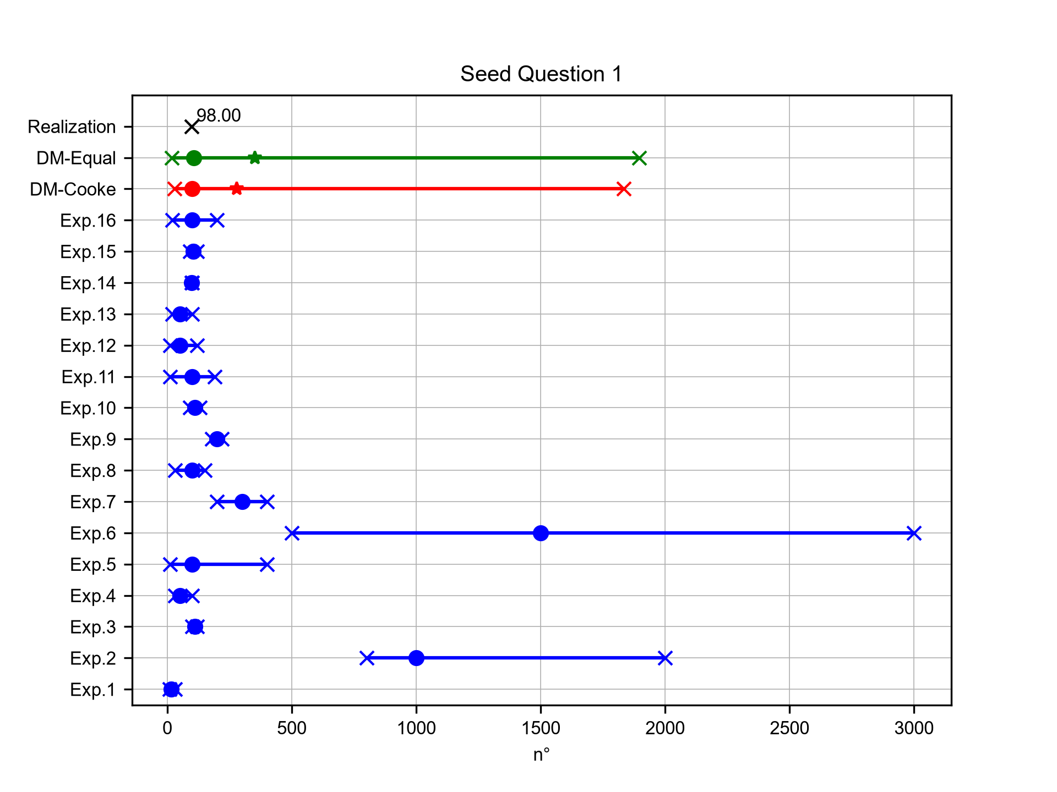
Major active faults in Japan
Expert elicitation 02-Nov-2026
In its 1997 report, The Promotion of Earthquake Research: Basic Comprehensive Policy for the Promotion of Earthquake Observation, Measurement, Surveys and Research, the Japanese Government defined “major active faults” by total length of 20 km or longer and displacement rate 0.1 m/ka or greater, i.e., faults capable of generating events M7 or greater. How many major active faults were identified?

Slide 6
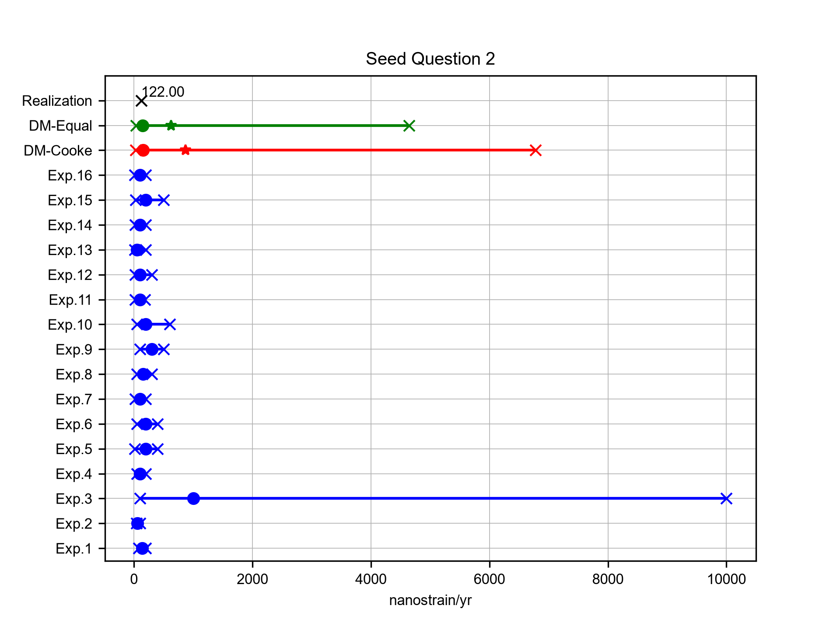
NE Japan regional strain rate
Expert elicitation 02-Nov-2026
Historical and modern geodetic observations spanning 1894-2009 were analysed to assess the steadiness of strain rates across northeast Japan over a century; upper and lower rate estimates were given. Based on those two rates, what would be the average maximum shear strain rate estimated for the interseismic period (1894-2009), in nanostrain/yr? [Source: Nishimura, Munekane & Yarai, (2011)]

Slide 7
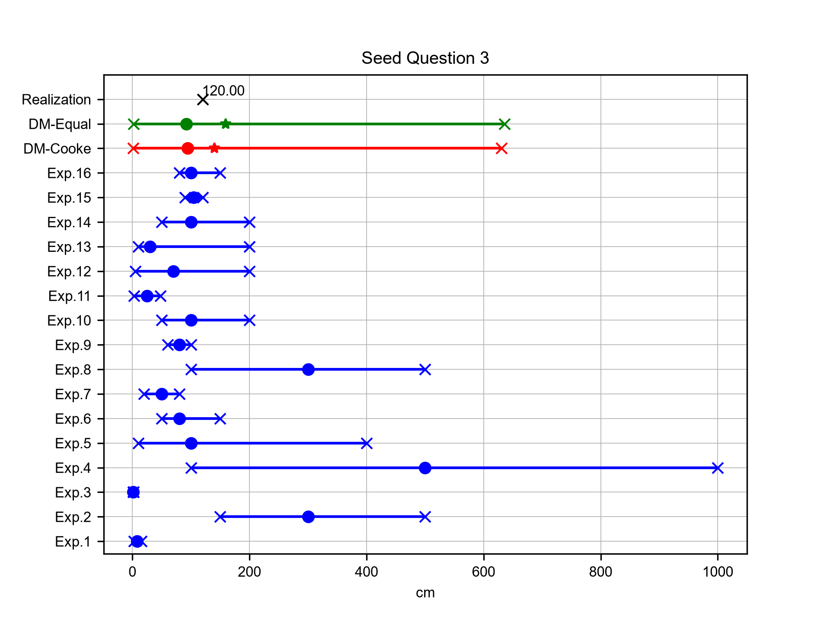
2011 Tohoku earthquake coseismic subsidence
Expert elicitation 02-Nov-2026
What was the maximum magnitude of coseismic subsidence recorded by the GNSS/GEONET network along the Pacific coast during the 2011 Tohoku-oki earthquake, in cm? [Source: Nishimura, Munekane & Yarai, 2011]

Slide 8
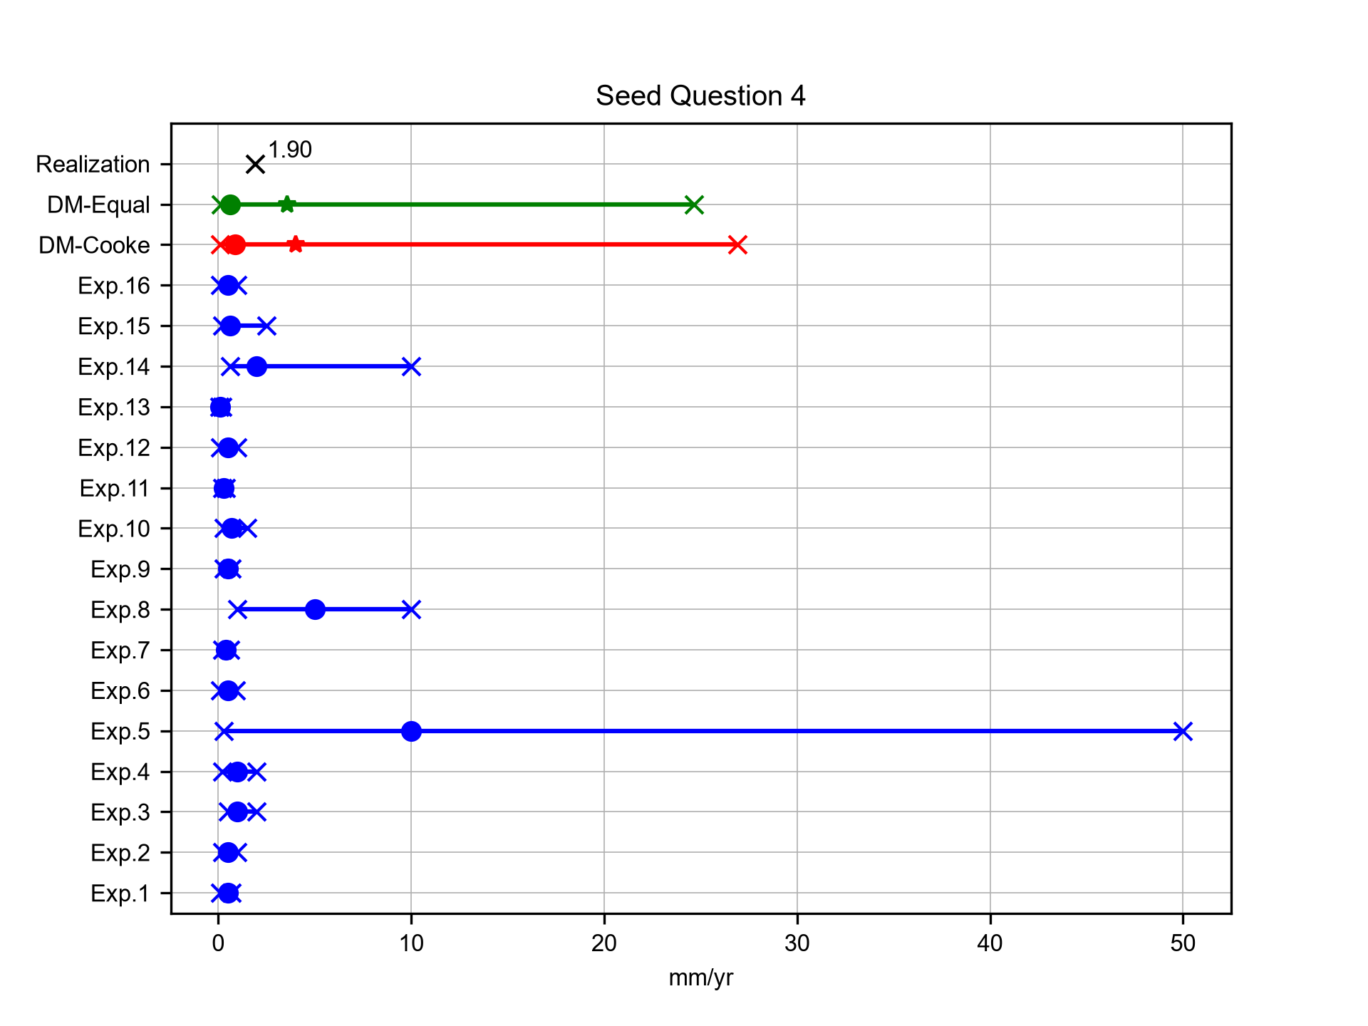
Slip rate revision
Expert elicitation 02-Nov-2026
Previous geologic studies suggest an upper Late-Quaternary slip rate of 0.3 mm/yr for the southern Eastern Fault Zone of Yokote Basin (EFZYB) in the Ou Backbone Range. What is the revised upper slip rate for the southern EFZYB estimated from recent borehole and seismic reflection studies of the Higashi Chokai-san fault, in mm/yr? [Source: Shyu et al., 2024]

Slide 9
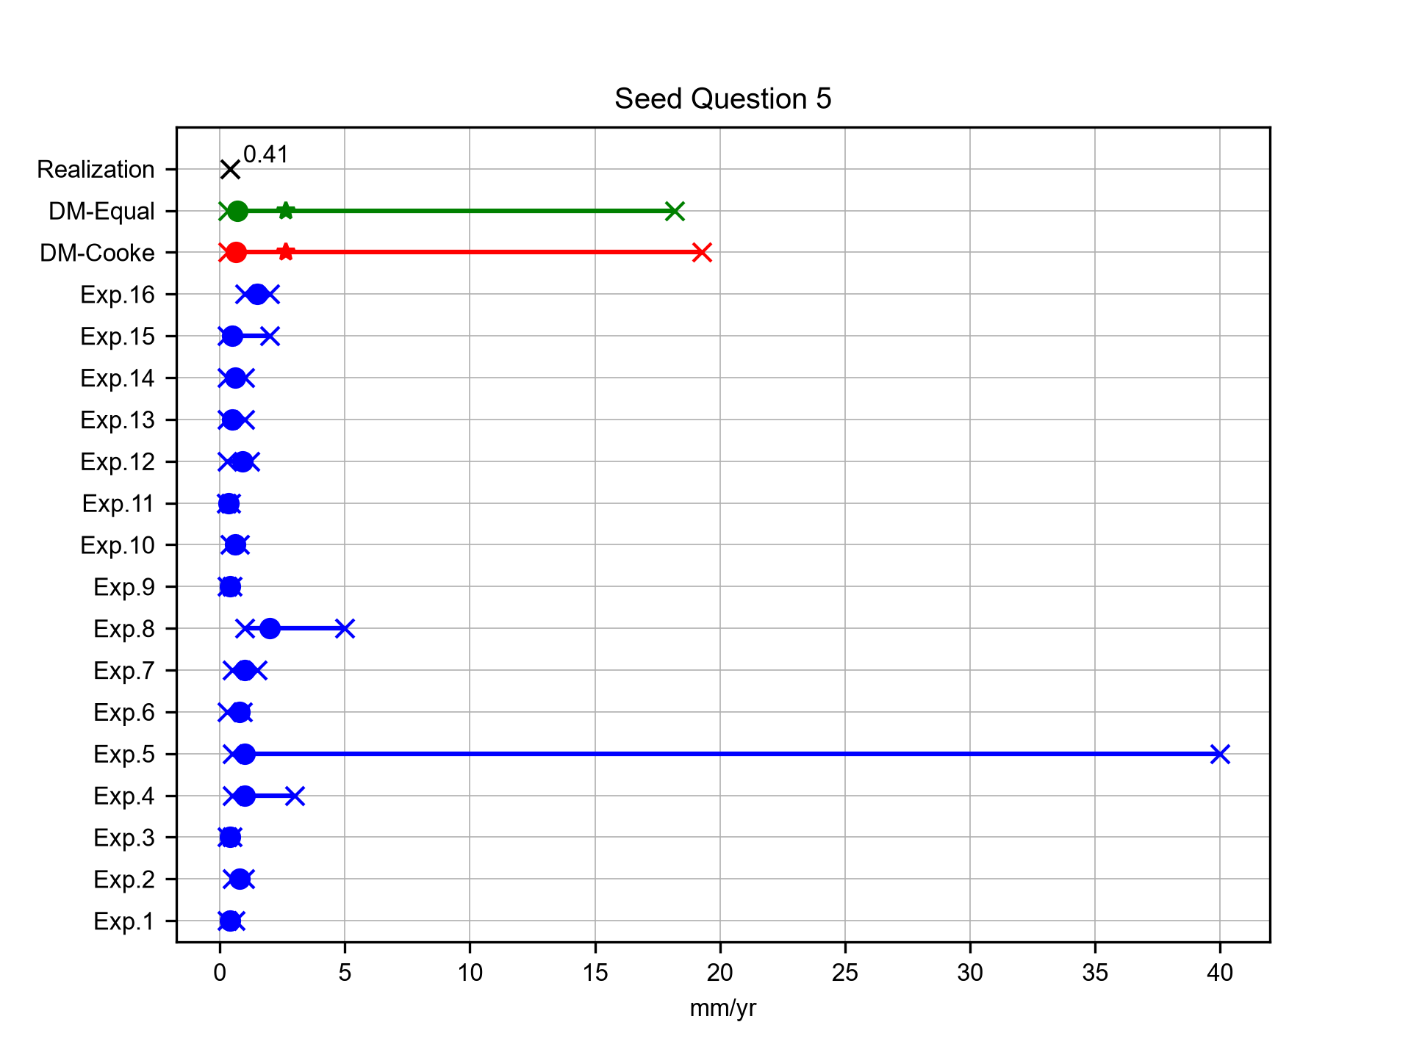
Uplift rate – upper endpoint
Expert elicitation 02-Nov-2026
For the Shizunai area on the Hidaka coast of southern Hokkaido, a range of long-term late-Quaternary uplift rates was estimated from adjusted relative sea-level elevations of MIS 5e marine terraces (130–116 ka), with peak sea level at approximately 124 ka. The lower endpoint of the reported range is 0.25 mm/yr. What is the corresponding upper endpoint, in mm/yr? [Nakanishi & Ashi, 2022]

Slide 10
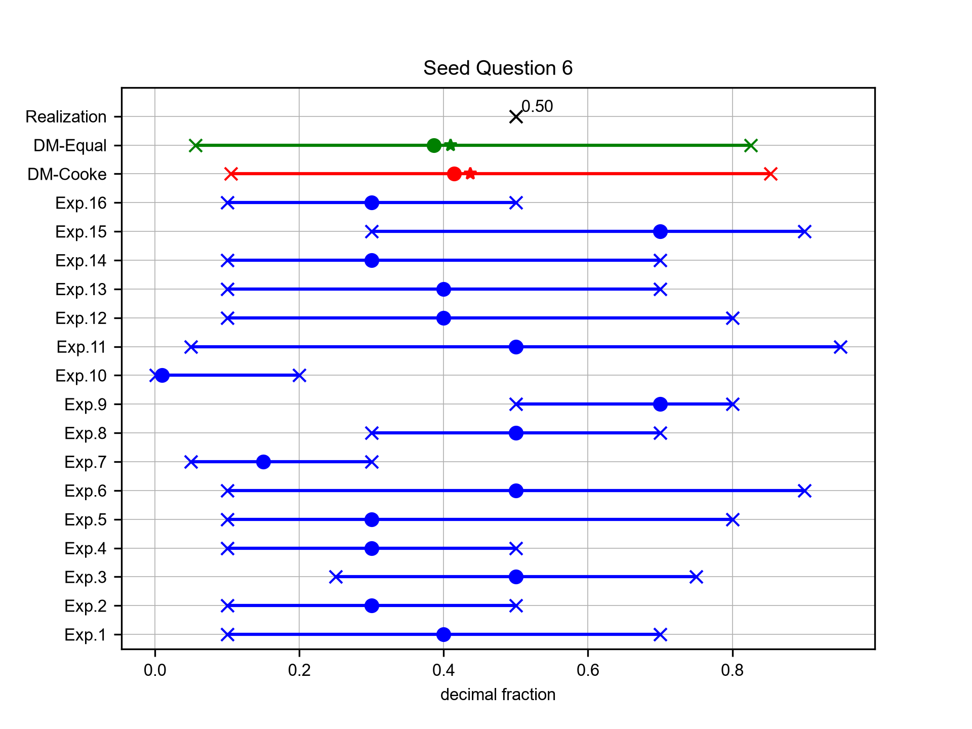
Deformation budget fraction
Expert elicitation 02-Nov-2026
According to Kato et al. (2004), using the long-term whole-system shortening estimate adopted from Ito (2002) and the Amurian–Okhotsk convergence rate from the plate-motion model used in that study, what fraction of regional plate convergence was inferred to be accommodated by shortening across the entire Hidaka thrust system in central Hokkaido? Express your quantiles as decimal fractions.

Slide 11
Target Answers
Expert elicitation 02-Nov-2026

Slide 12
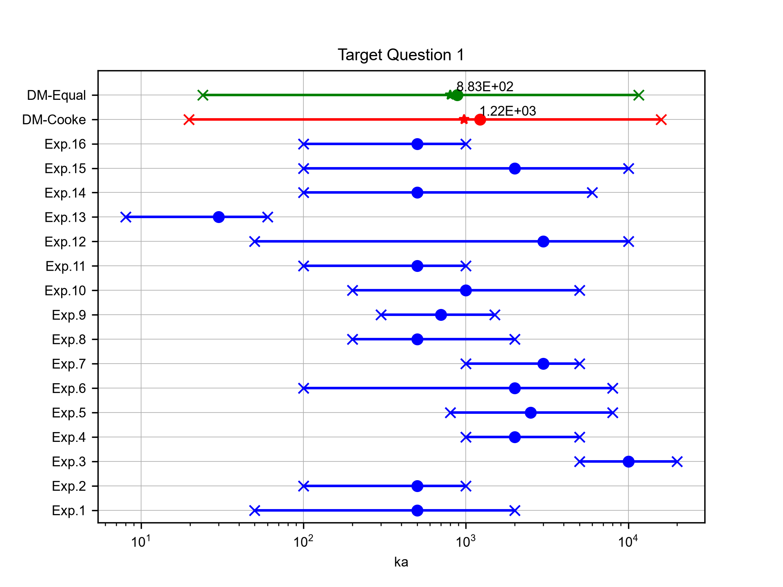
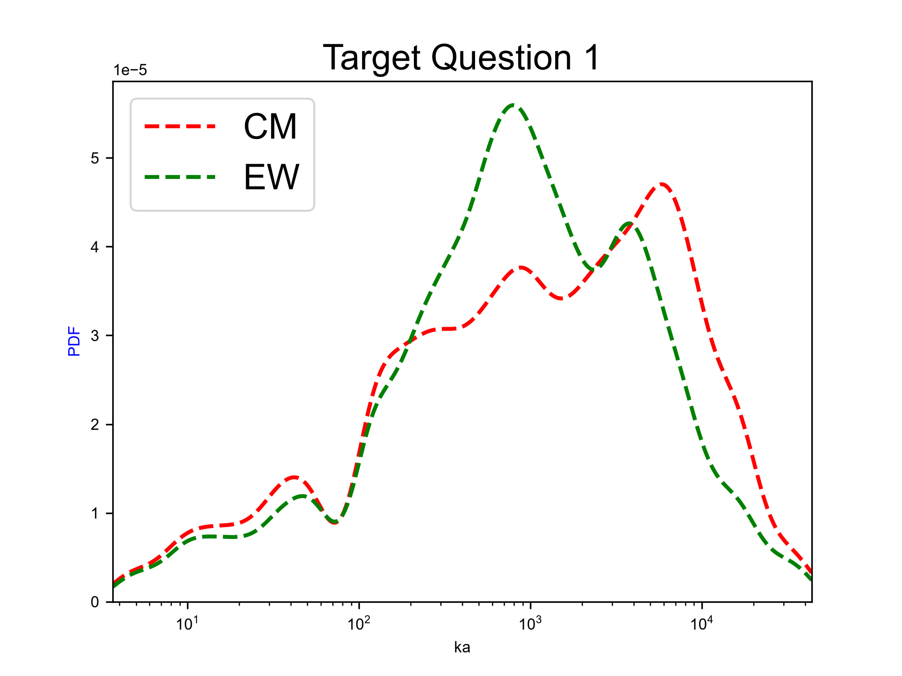
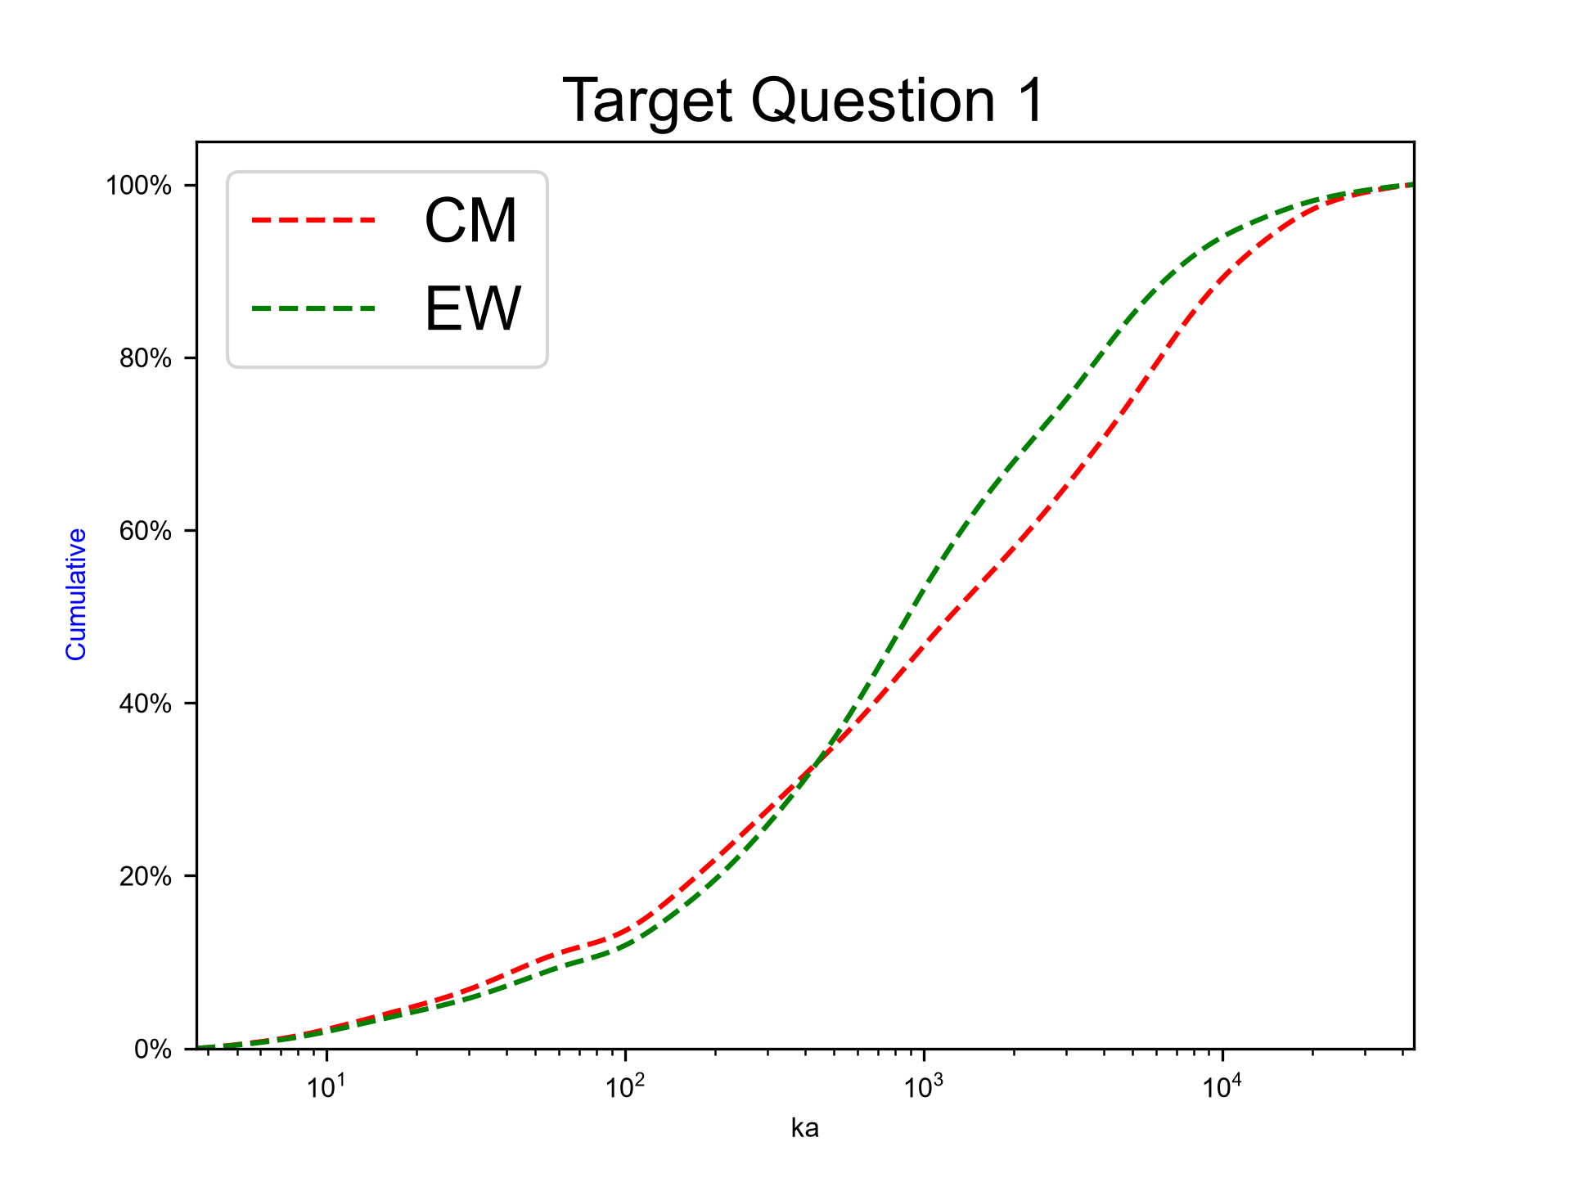
Persistence of the southwestern Hokkaido tectonic regime
Expert elicitation 02-Nov-2026
Consider the time, in thousands of years, that the present tectonic regime will continue to persist from now, in the southwestern Hokkaido RES (Regional Evolution Scenario) area. During this expected remaining lifetime, no significant change develops -- in terms of any substantive and sustained reorganization of the regime -- such that tectonic hazard calculations with current parameters would cease to be valid. For example, such a reorganization may involve one or more of the following changes: (i) a sustained, significant change in the rate or direction of the specified relative plate motion; (ii) a sustained redistribution or significant re-scaling of deformation among the principal tectonic structures or zones; or (iii) a substantive change in the geometry or location of controlling features of the regional tectonic regime (such as a marked alteration of local dominant faulting style or orientation). However, transient earthquake-cycle, post-seismic or other short-term geodetic changes (e.g., < ~1 kyr) are not considered to represent sustained tectonic reorganisation in respect of tectonic regime persistence. Please provide your 5th-, 50th- and 95th-percentile judgments for the future duration of the SW Hokkaido tectonic regime, expressed in units of ka (thousands of years).

Slide 13
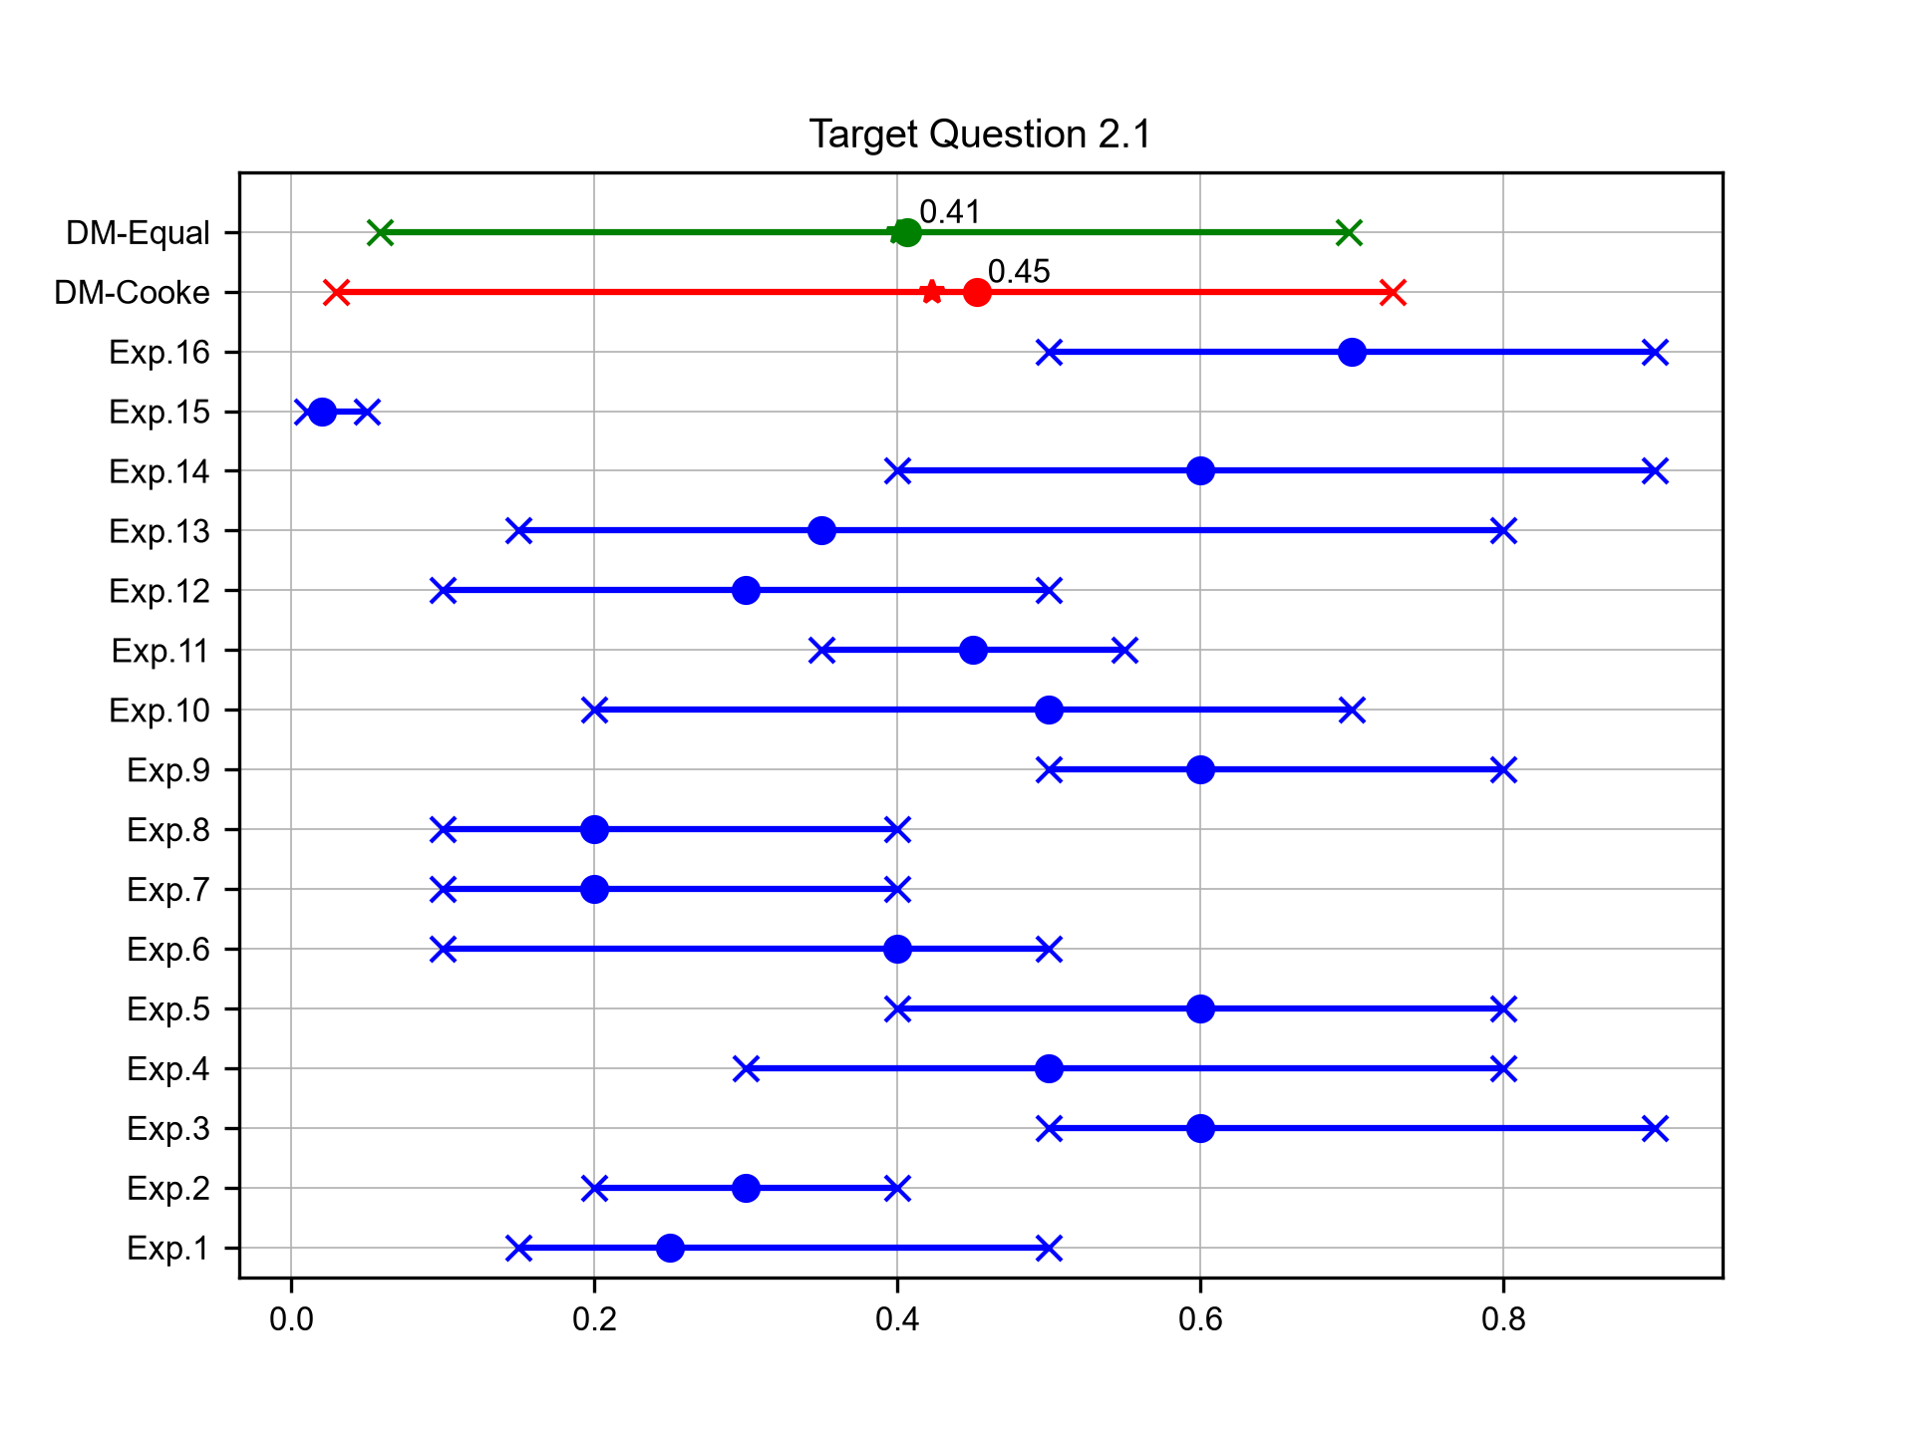
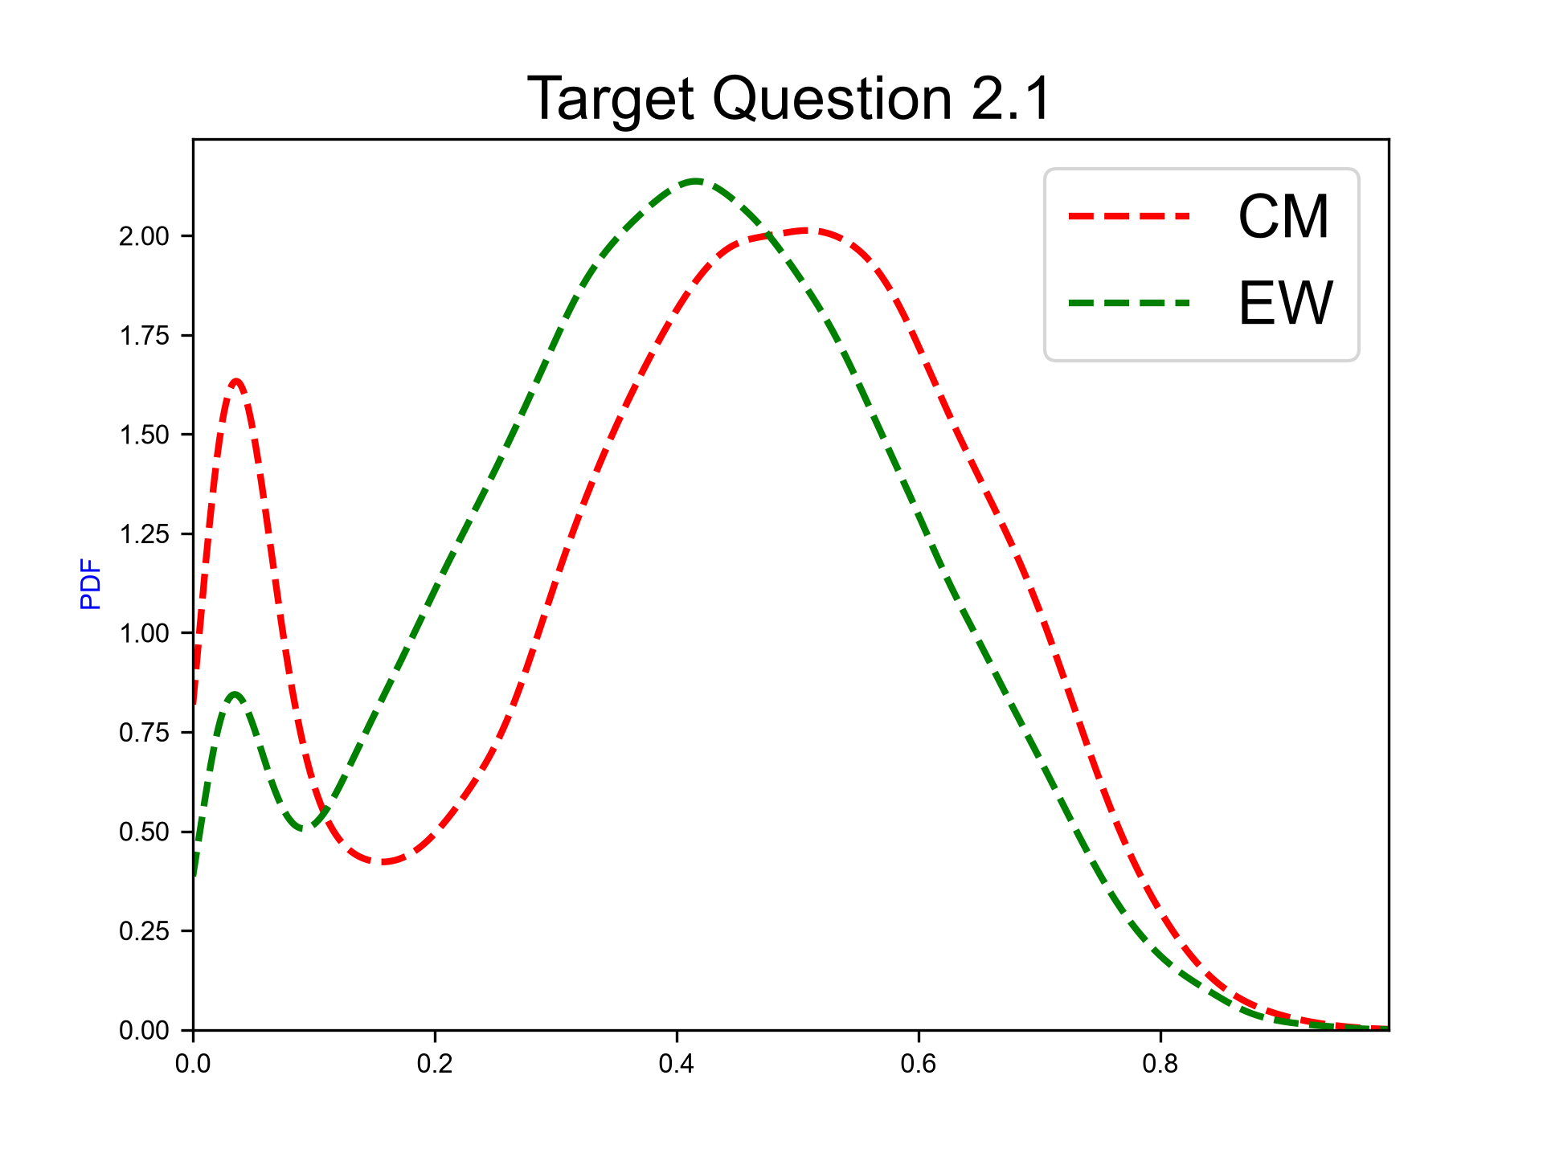
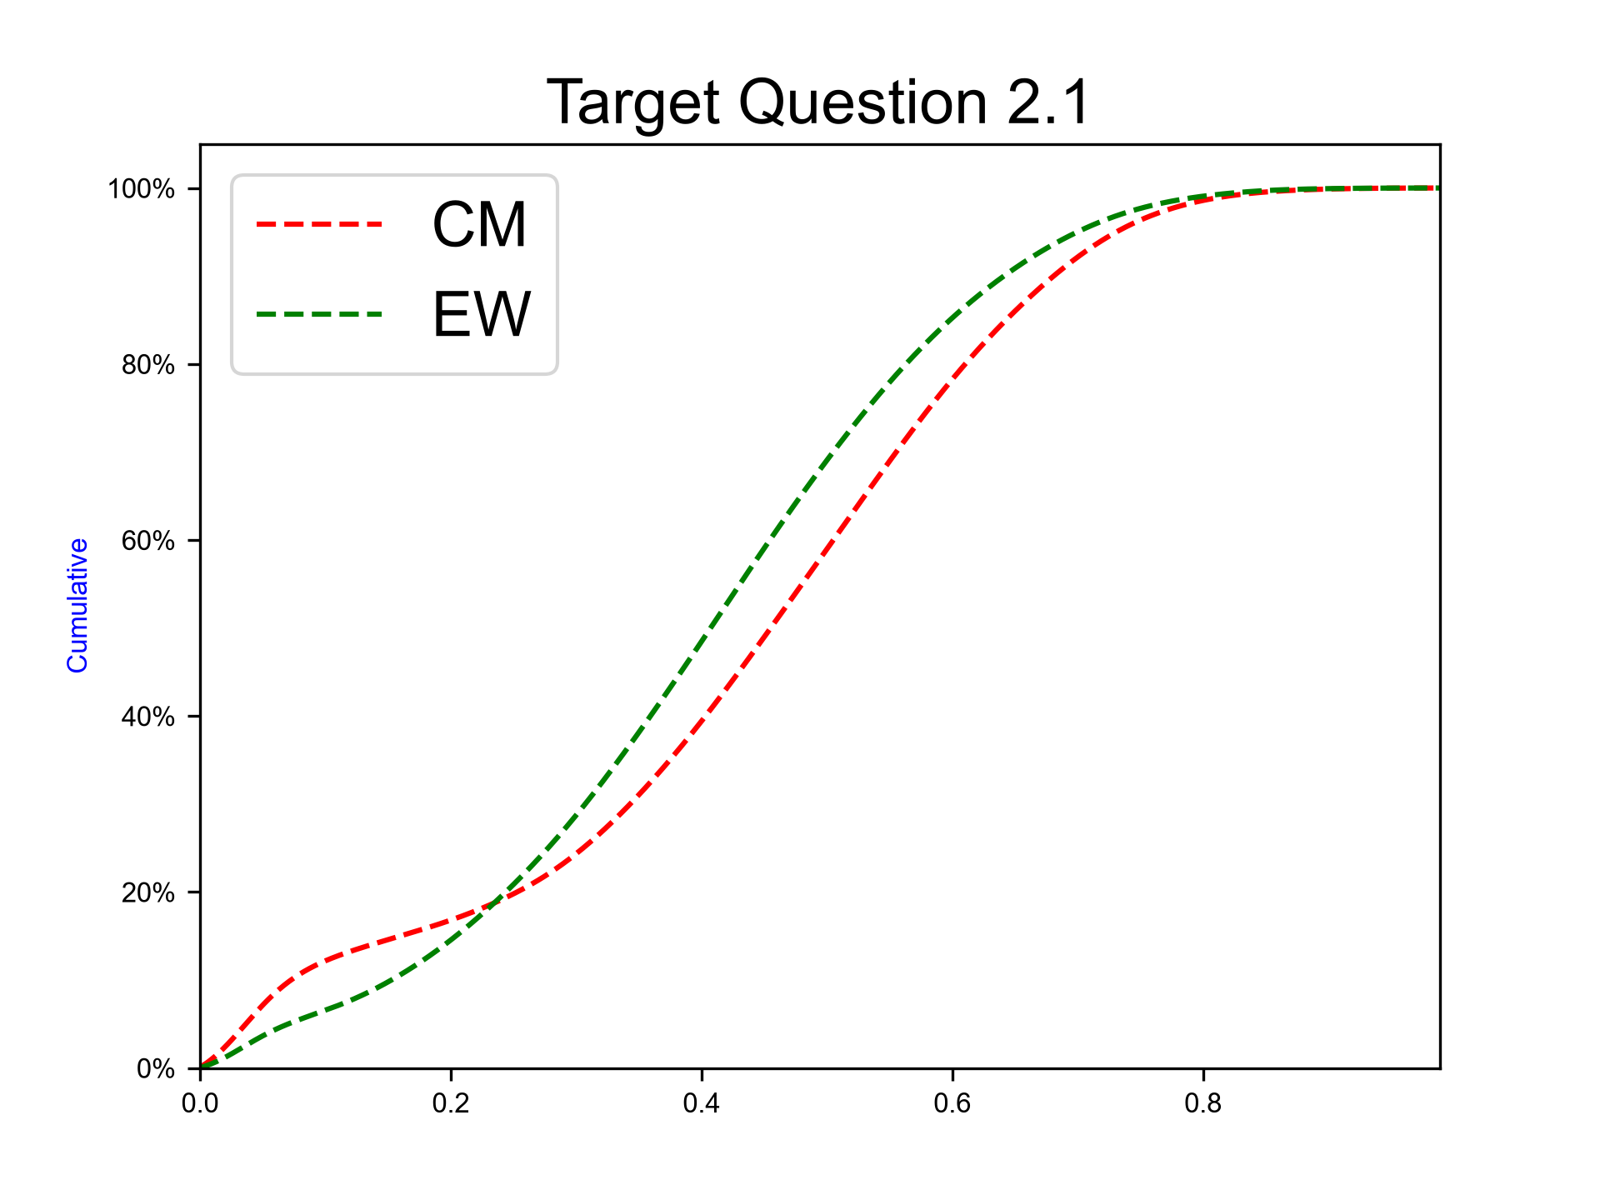
Uplift mechanisms in SW Hokkaido – One or more hidden active faults within 5 km of the uplift area
Expert elicitation 02-Nov-2026
Modest regional uplift at rates of up to 0.5 m per thousand years, indicated by the elevation of former interglacial shorelines (MIS 5 – 7), occurs along the southwest coast in SW Hokkaido (Amano et al., 2018; Nuclear Power Plant Environmental Improvement Organisation, 2024). This uplift is distant from currently mapped active faults (> 10-30 km distant) and active volcanoes (> 30-65 km). On timescales of hundreds of thousands of years, the cumulative effect of uplift and erosion could result in significant changes to groundwater flow and the oxidizing/reducing environment around a repository as the overburden thins and the repository moves into a shallower environment. For example, a hidden active fault could entail metre-scale cumulative displacement in around 10,000 years, for overall uplift of 50 metres in about 100ka. Two other uplift mechanisms are possible continuous processes at the timescale of many earthquake cycles, e.g., magma intrusion or isostatic adjustment, each with potential for long-term cumulative uplift effects. Our goal is to characterize our current knowledge of this scenario by pooling your judgments on the contributions to uplift by these processes to generate a synthesis assessment which incorporates epistemic uncertainties (see illustrative example plot). Three probable situations are identified below that could contribute to long-term uplift along the southwest coast in SW Hokkaido. Please ascribe your median weights for the relative contributions of each mechanism and your 5th and 95th percentiles for each weight, all values must be within the relative weight interval [0..1]. Notes: Please note that your three median fractional weights should sum to 1.0 (strictly, the means sum to 1.0). Your marginal 5th and 95th percentiles are not simultaneous realizations of the process but a way of expressing your uncertainty around your median weight; these marginal percentile weights will not sum to 1.0, but each value must lie within interval [0..1].
N.B. The sum of 50%iles for questions 2-4 have to sum to 1.

Slide 14
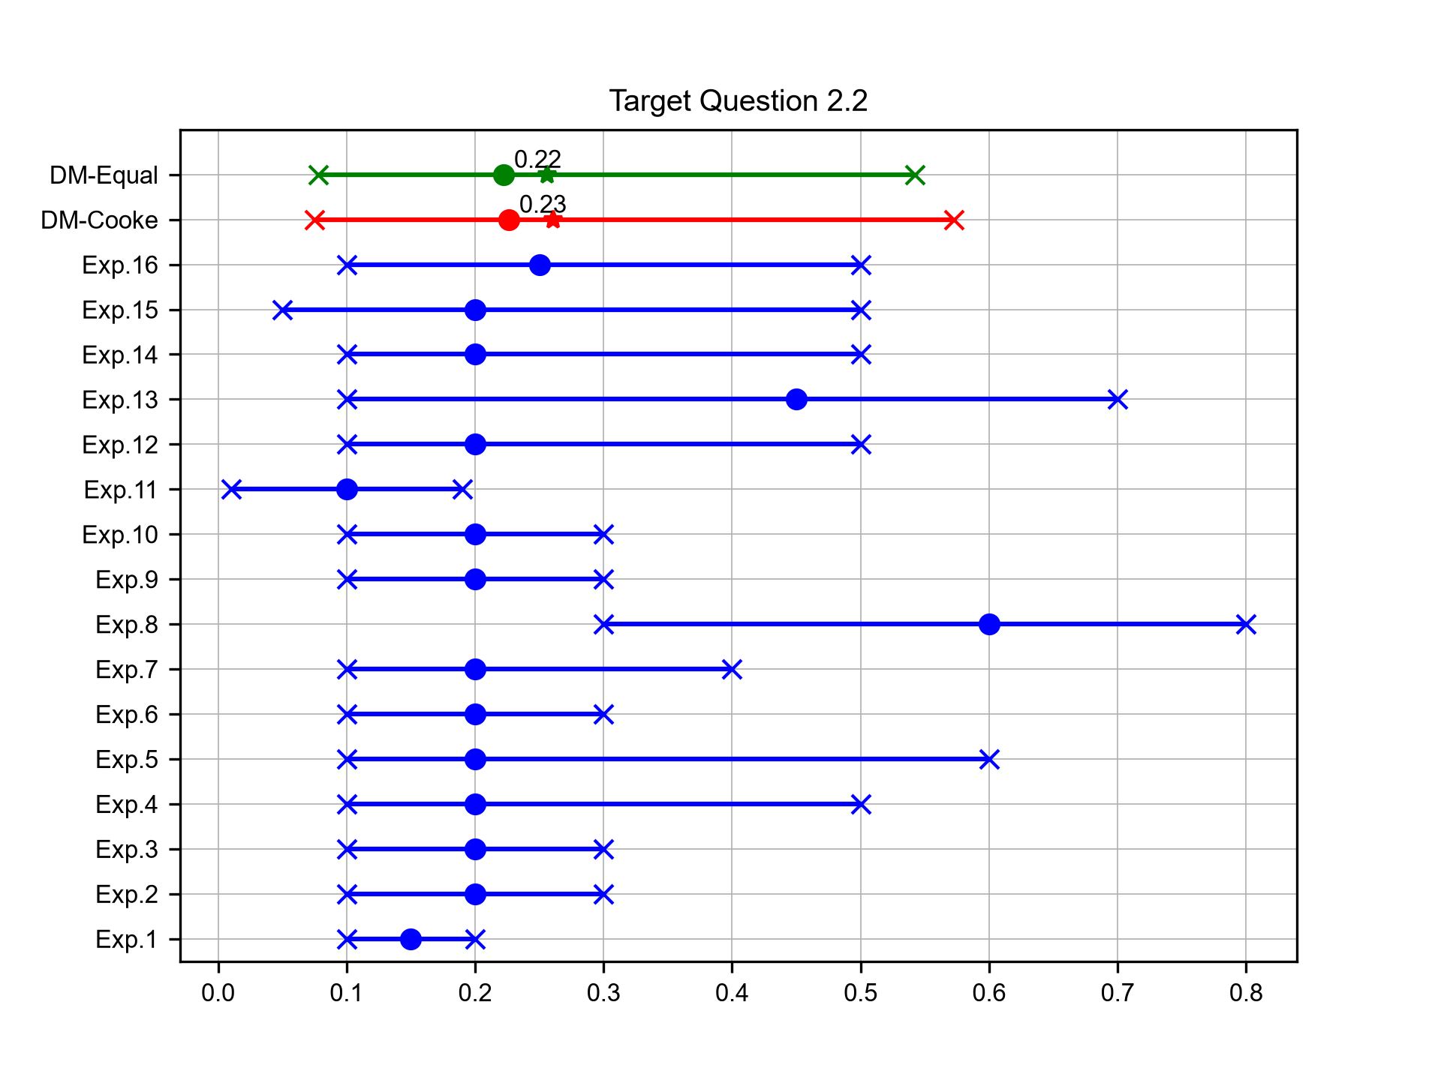
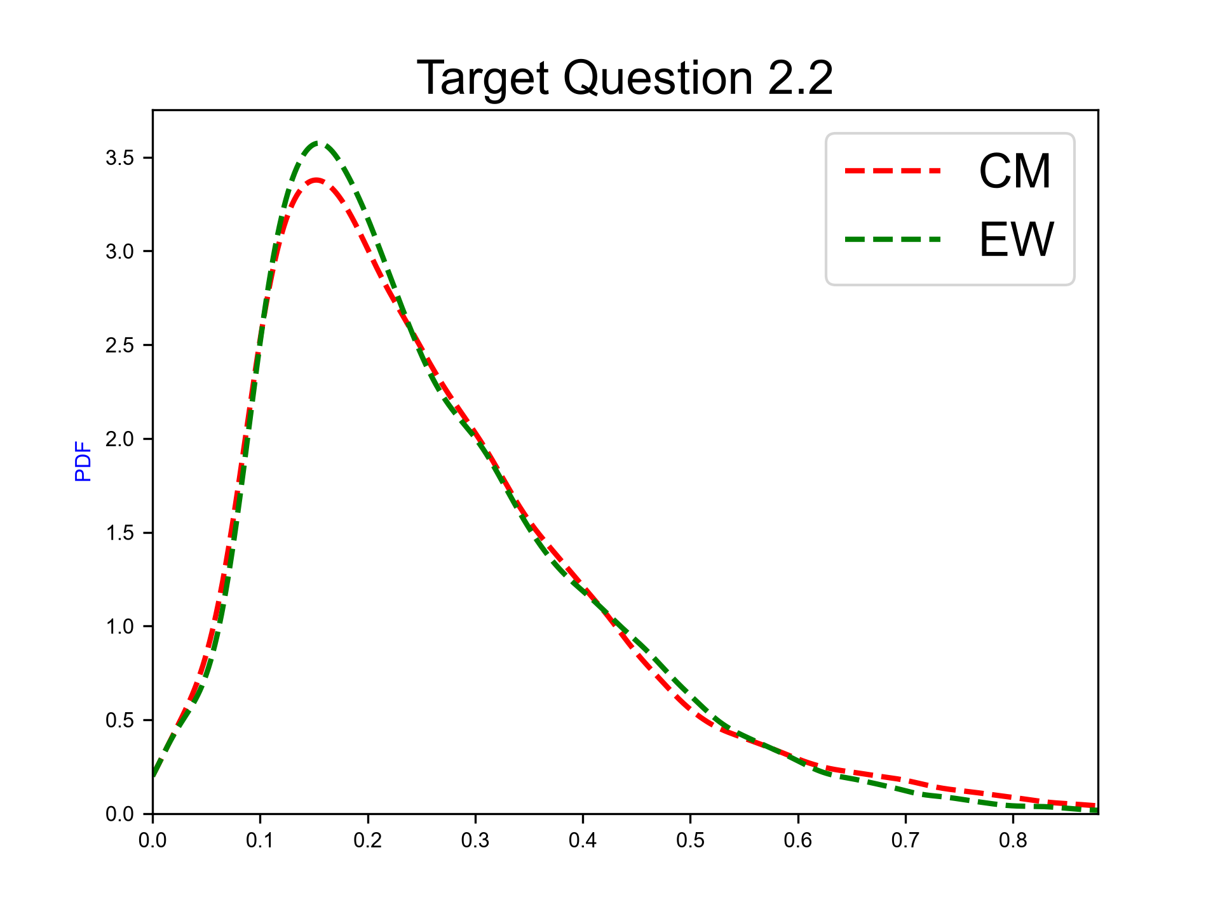
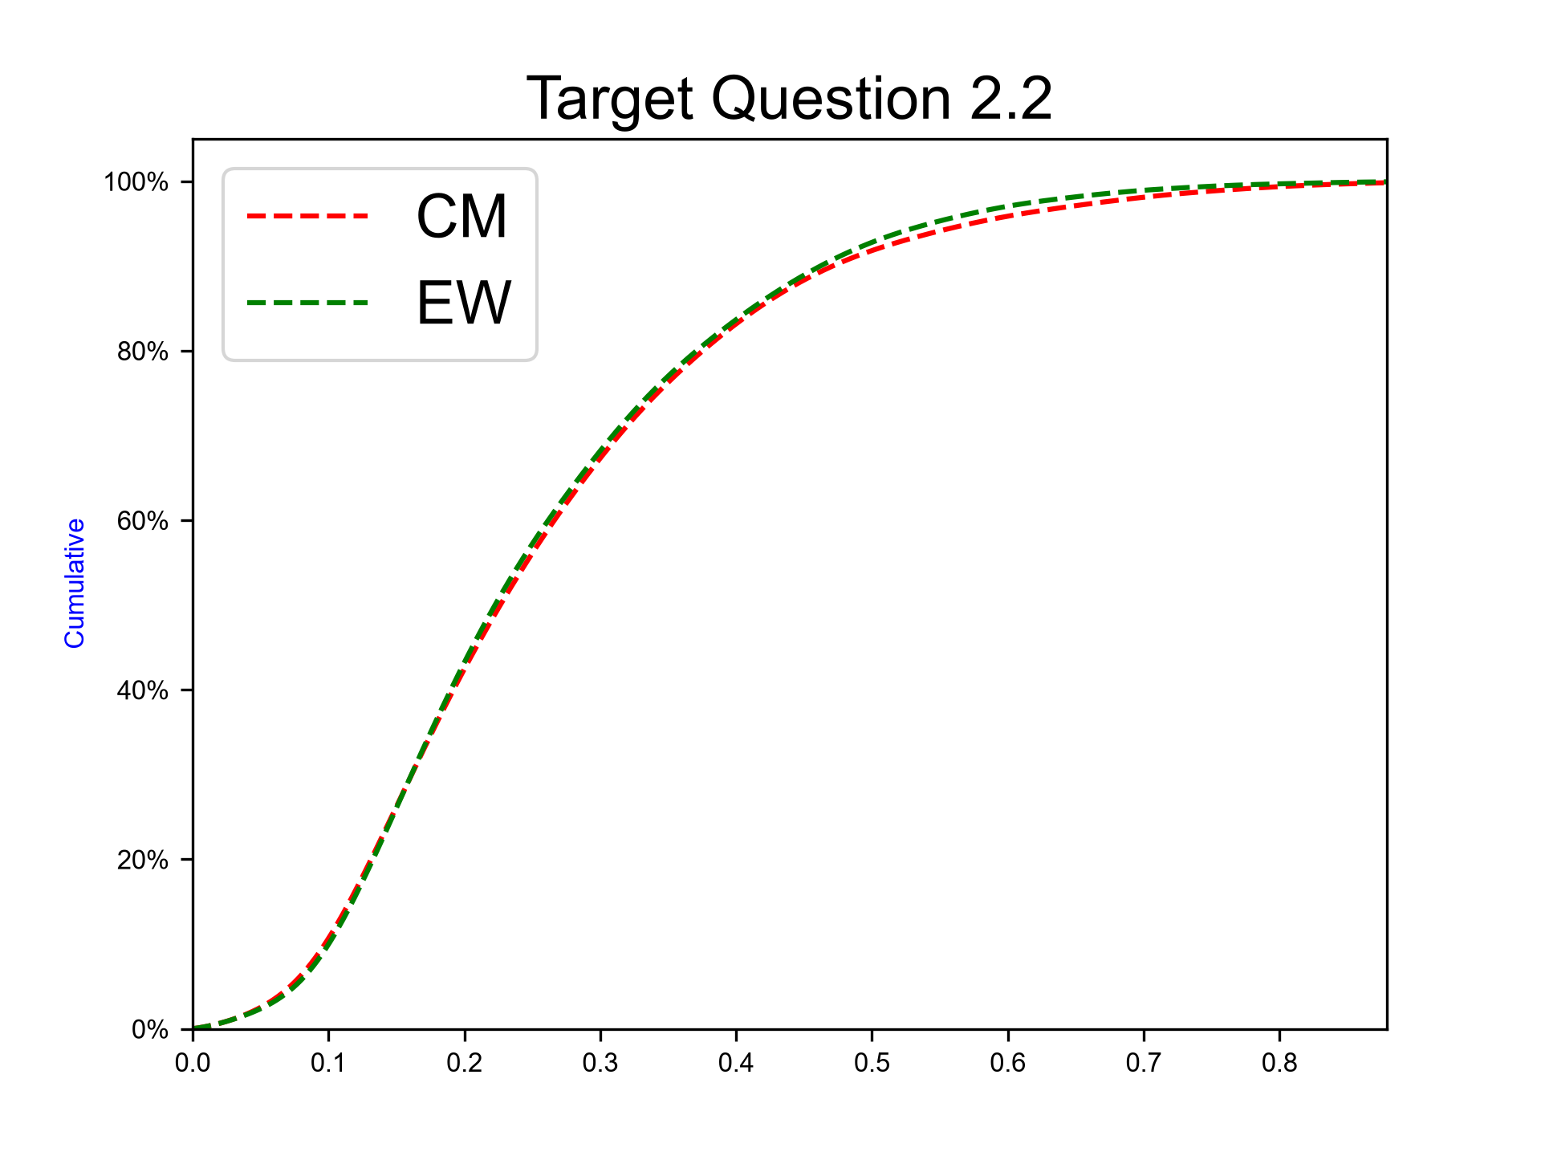
Uplift mechanisms in SW Hokkaido – Magma intrusion < 15 km from the area of uplift
Expert elicitation 02-Nov-2026
Please ascribe your median weights for the relative contributions of each mechanism and your 5th and 95th percentiles for each weight, all values must be within the relative weight interval [0..1]. Notes: Please note that your three median fractional weights should sum to 1.0 (strictly, the means sum to 1.0). Your marginal 5th and 95th percentiles are not simultaneous realizations of the process but a way of expressing your uncertainty around your median weight; these marginal percentile weights will not sum to 1.0, but each value must lie within interval [0..1].
N.B. The sum of 50%iles for questions 2-4 have to sum to 1.

Slide 15
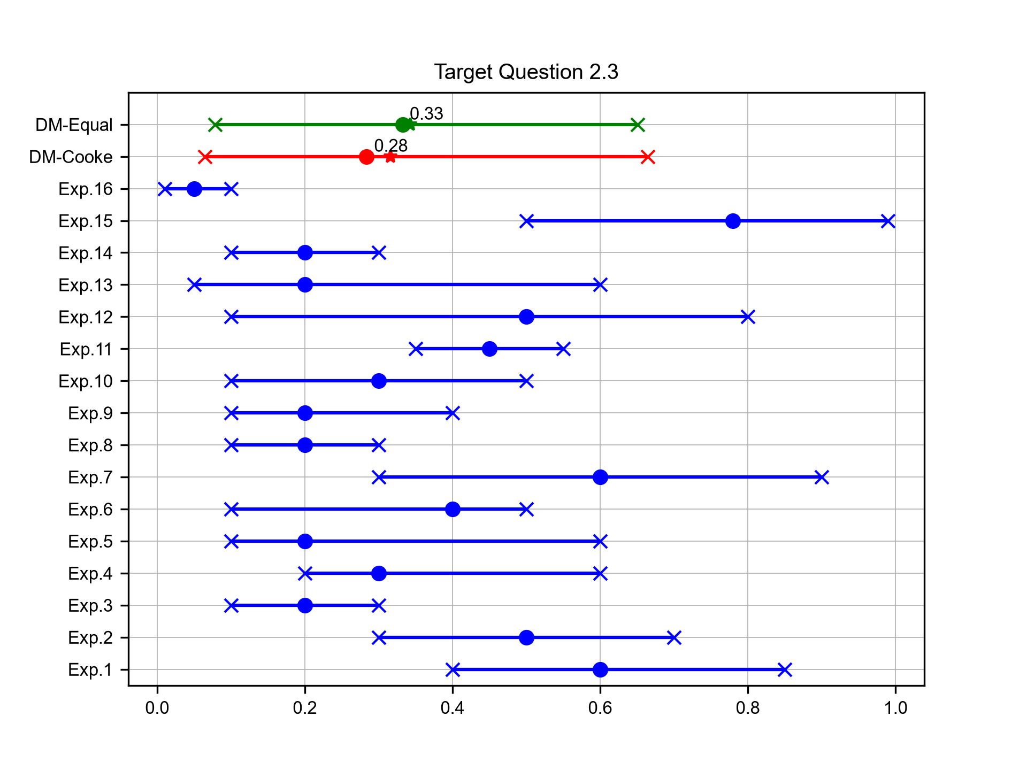
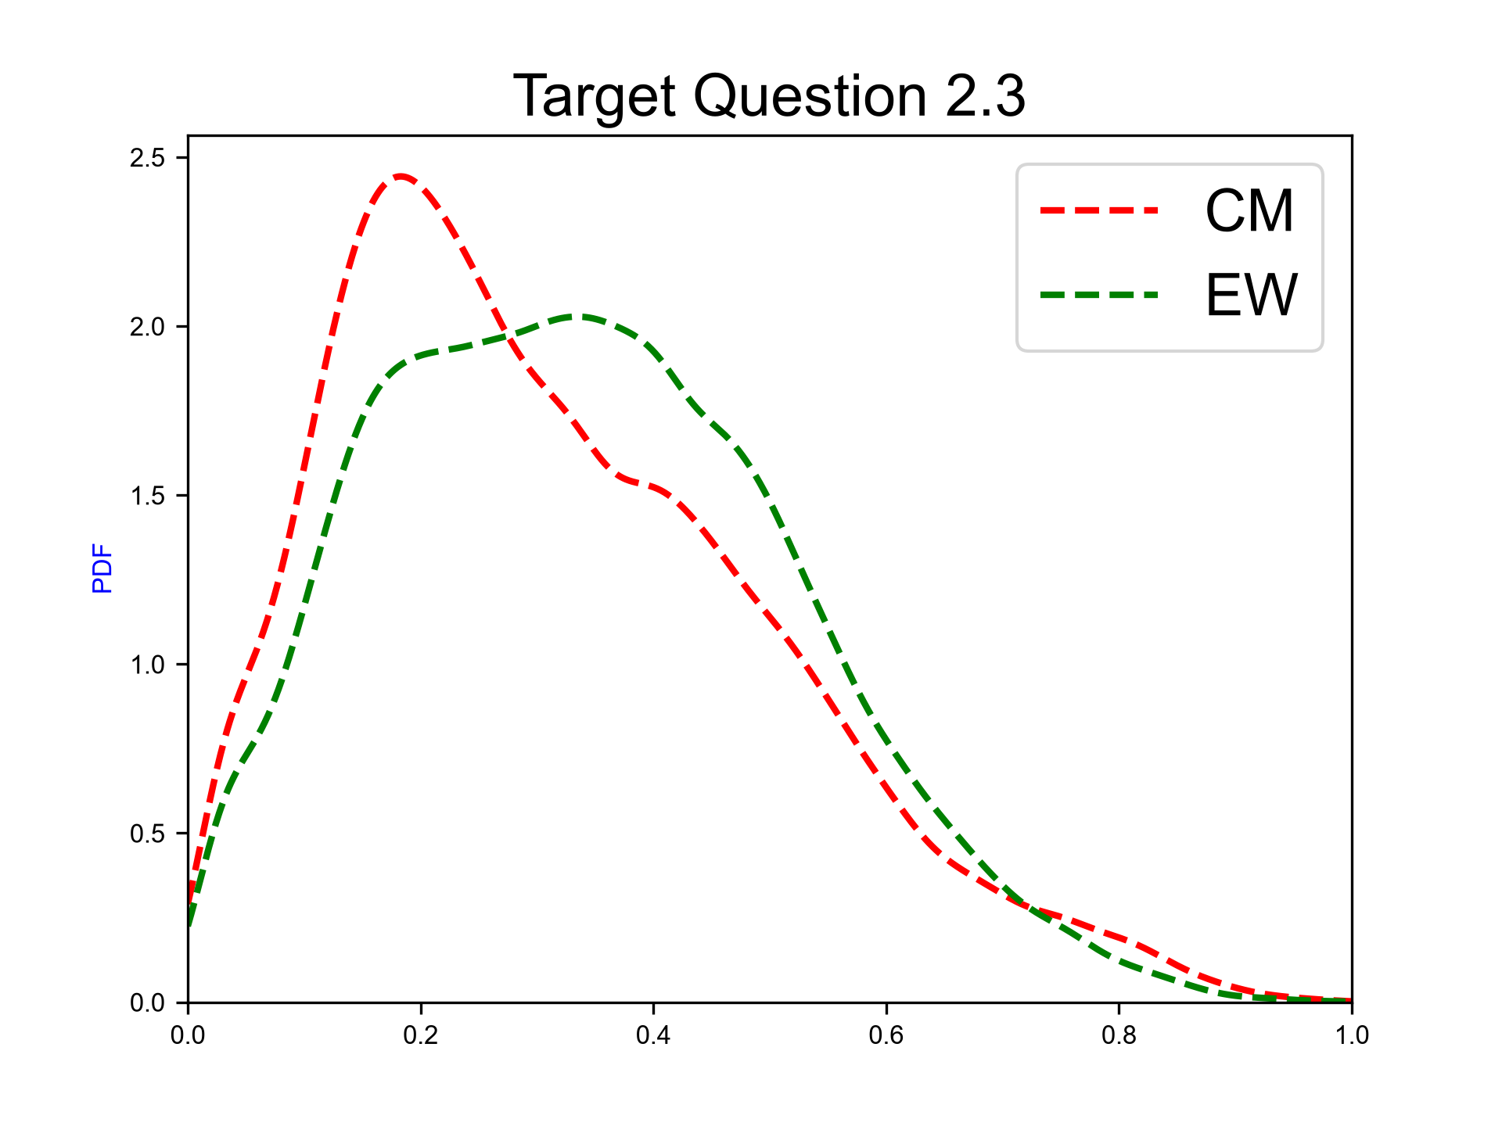
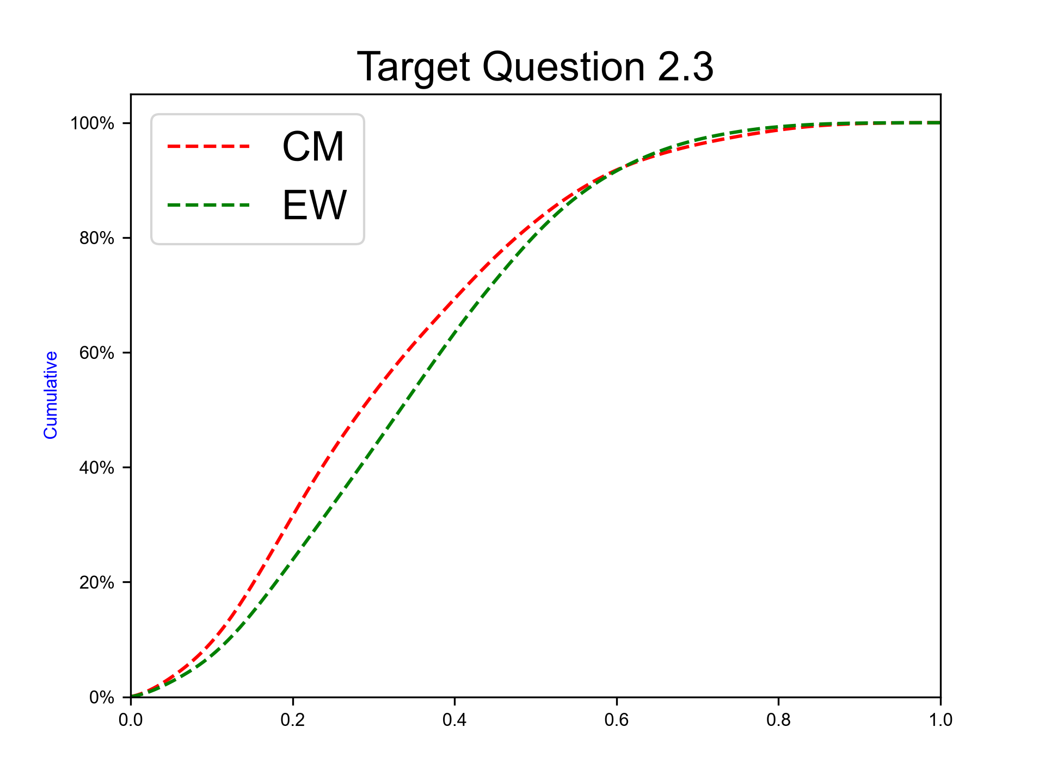
Uplift mechanisms in SW Hokkaido – Local isostatic response to sediment loading offshore
Expert elicitation 02-Nov-2026
Please ascribe your median weights for the relative contributions of each mechanism and your 5th and 95th percentiles for each weight, all values must be within the relative weight interval [0..1]. Notes: Please note that your three median fractional weights should sum to 1.0 (strictly, the means sum to 1.0). Your marginal 5th and 95th percentiles are not simultaneous realizations of the process but a way of expressing your uncertainty around your median weight; these marginal percentile weights will not sum to 1.0, but each value must lie within interval [0..1].
N.B. The sum of 50%iles for questions 2-4 have to sum to 1.

Slide 16
Target Percentiles
Expert elicitation 02-Nov-2026

Slide 17
Percentiles of target questions
Expert elicitation 02-Nov-2026
 | Q05 (EW) | Q50 (EW) | Q95 (EW) | Qmean (EW) | Q05 (Cooke) | Q50 (Cooke) | Q95 (Cooke) | Qmean (Cooke)
TQ 1 | 2.39E+01 | 8.83E+02 | 1.16E+04 | 7.99E+02 | 1.96E+01 | 1.22E+03 | 1.59E+04 | 9.74E+02
TQ 2.1 | 5.84E-02 | 4.07E-01 | 6.98E-01 | 4.01E-01 | 2.96E-02 | 4.52E-01 | 7.27E-01 | 4.23E-01
TQ 2.2 | 7.79E-02 | 2.22E-01 | 5.42E-01 | 2.56E-01 | 7.49E-02 | 2.26E-01 | 5.73E-01 | 2.61E-01
TQ 2.3 | 7.87E-02 | 3.32E-01 | 6.51E-01 | 3.43E-01 | 6.46E-02 | 2.84E-01 | 6.64E-01 | 3.16E-01

Slide 18
Trend plots
Expert elicitation 02-Nov-2026

Slide 19
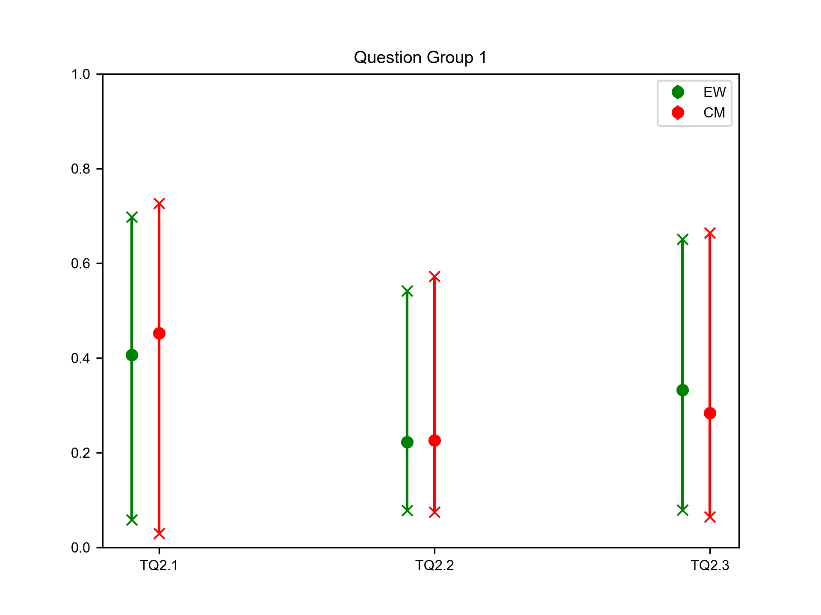
Target questions Group 1
Expert elicitation 02-Nov-2026
TQ2.1. Uplift mechanisms in SW Hokkaido – One or more hidden active faults within 5 km of the uplift area.
TQ2.2. Uplift mechanisms in SW Hokkaido – Magma intrusion < 15 km from the area of uplift.
TQ2.3. Uplift mechanisms in SW Hokkaido – Local isostatic response to sediment loading offshore.

Slide 20
Pie charts
Expert elicitation 02-Nov-2026

Slide 21
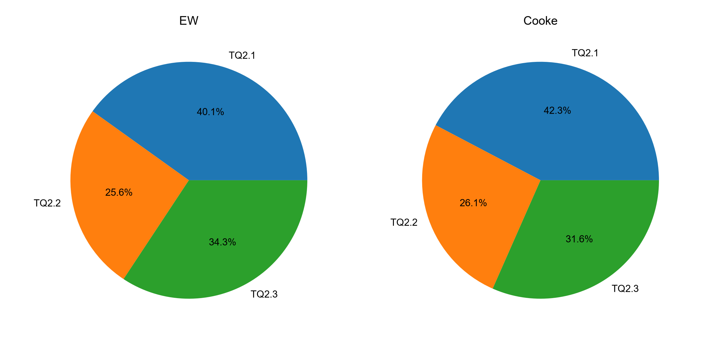
Target questions Group 1
Expert elicitation 02-Nov-2026
TQ2.1. Uplift mechanisms in SW Hokkaido – One or more hidden active faults within 5 km of the uplift area.
TQ2.2. Uplift mechanisms in SW Hokkaido – Magma intrusion < 15 km from the area of uplift.
TQ2.3. Uplift mechanisms in SW Hokkaido – Local isostatic response to sediment loading offshore.

Slide 22
Target Barplots
Expert elicitation 02-Nov-2026

Slide 23
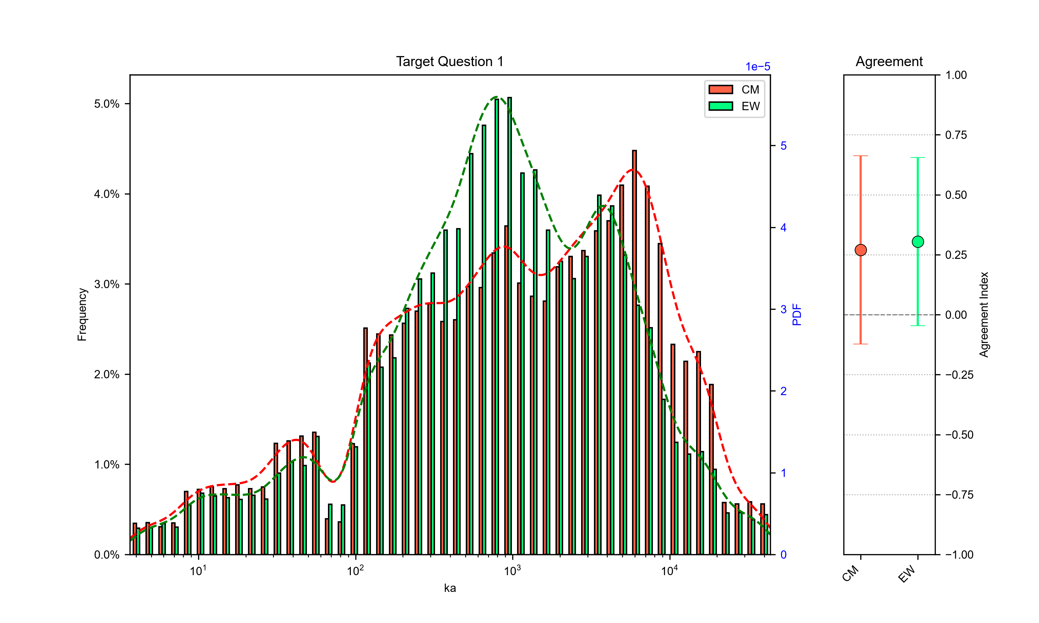
Persistence of the southwestern Hokkaido tectonic regime
Expert elicitation 02-Nov-2026
Consider the time, in thousands of years, that the present tectonic regime will continue to persist from now, in the southwestern Hokkaido RES (Regional Evolution Scenario) area. During this expected remaining lifetime, no significant change develops -- in terms of any substantive and sustained reorganization of the regime -- such that tectonic hazard calculations with current parameters would cease to be valid. For example, such a reorganization may involve one or more of the following changes: (i) a sustained, significant change in the rate or direction of the specified relative plate motion; (ii) a sustained redistribution or significant re-scaling of deformation among the principal tectonic structures or zones; or (iii) a substantive change in the geometry or location of controlling features of the regional tectonic regime (such as a marked alteration of local dominant faulting style or orientation). However, transient earthquake-cycle, post-seismic or other short-term geodetic changes (e.g., < ~1 kyr) are not considered to represent sustained tectonic reorganisation in respect of tectonic regime persistence. Please provide your 5th-, 50th- and 95th-percentile judgments for the future duration of the SW Hokkaido tectonic regime, expressed in units of ka (thousands of years).
 | Q05 | Q50 | Q95 | Qmean
Cooke | 1.96E+01 | 1.22E+03 | 1.59E+04 | 9.74E+02
EW | 2.39E+01 | 8.83E+02 | 1.16E+04 | 7.99E+02

Slide 24
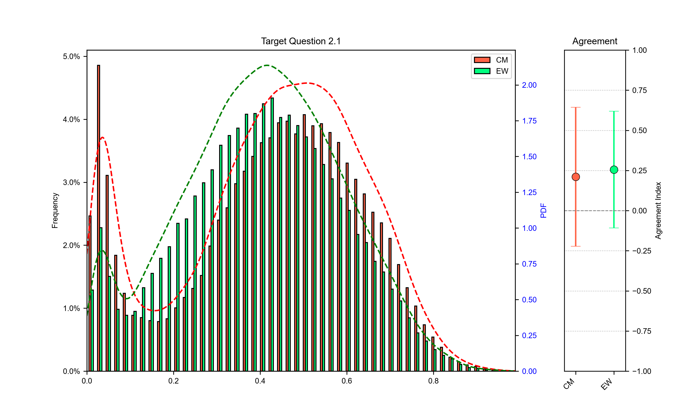
Uplift mechanisms in SW Hokkaido – One or more hidden active faults within 5 km of the uplift area
Expert elicitation 02-Nov-2026
Modest regional uplift at rates of up to 0.5 m per thousand years, indicated by the elevation of former interglacial shorelines (MIS 5 – 7), occurs along the southwest coast in SW Hokkaido (Amano et al., 2018; Nuclear Power Plant Environmental Improvement Organisation, 2024). This uplift is distant from currently mapped active faults (> 10-30 km distant) and active volcanoes (> 30-65 km). On timescales of hundreds of thousands of years, the cumulative effect of uplift and erosion could result in significant changes to groundwater flow and the oxidizing/reducing environment around a repository as the overburden thins and the repository moves into a shallower environment. For example, a hidden active fault could entail metre-scale cumulative displacement in around 10,000 years, for overall uplift of 50 metres in about 100ka. Two other uplift mechanisms are possible continuous processes at the timescale of many earthquake cycles, e.g., magma intrusion or isostatic adjustment, each with potential for long-term cumulative uplift effects. Our goal is to characterize our current knowledge of this scenario by pooling your judgments on the contributions to uplift by these processes to generate a synthesis assessment which incorporates epistemic uncertainties (see illustrative example plot). Three probable situations are identified below that could contribute to long-term uplift along the southwest coast in SW Hokkaido. Please ascribe your median weights for the relative contributions of each mechanism and your 5th and 95th percentiles for each weight, all values must be within the relative weight interval [0..1]. Notes: Please note that your three median fractional weights should sum to 1.0 (strictly, the means sum to 1.0). Your marginal 5th and 95th percentiles are not simultaneous realizations of the process but a way of expressing your uncertainty around your median weight; these marginal percentile weights will not sum to 1.0, but each value must lie within interval [0..1].
 | Q05 | Q50 | Q95 | Qmean
Cooke | 2.96E-02 | 4.52E-01 | 7.27E-01 | 4.23E-01
EW | 5.84E-02 | 4.07E-01 | 6.98E-01 | 4.01E-01

Slide 25
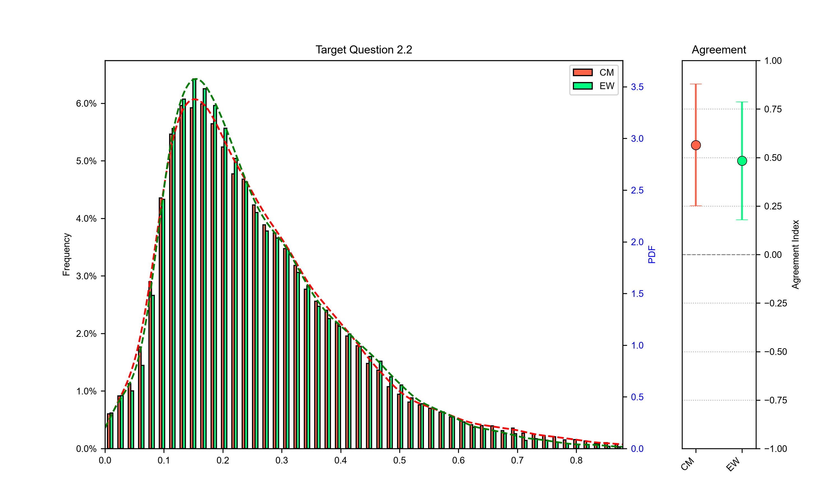
Uplift mechanisms in SW Hokkaido – Magma intrusion < 15 km from the area of uplift
Expert elicitation 02-Nov-2026
Please ascribe your median weights for the relative contributions of each mechanism and your 5th and 95th percentiles for each weight, all values must be within the relative weight interval [0..1]. Notes: Please note that your three median fractional weights should sum to 1.0 (strictly, the means sum to 1.0). Your marginal 5th and 95th percentiles are not simultaneous realizations of the process but a way of expressing your uncertainty around your median weight; these marginal percentile weights will not sum to 1.0, but each value must lie within interval [0..1].
 | Q05 | Q50 | Q95 | Qmean
Cooke | 7.49E-02 | 2.26E-01 | 5.73E-01 | 2.61E-01
EW | 7.79E-02 | 2.22E-01 | 5.42E-01 | 2.56E-01

Slide 26
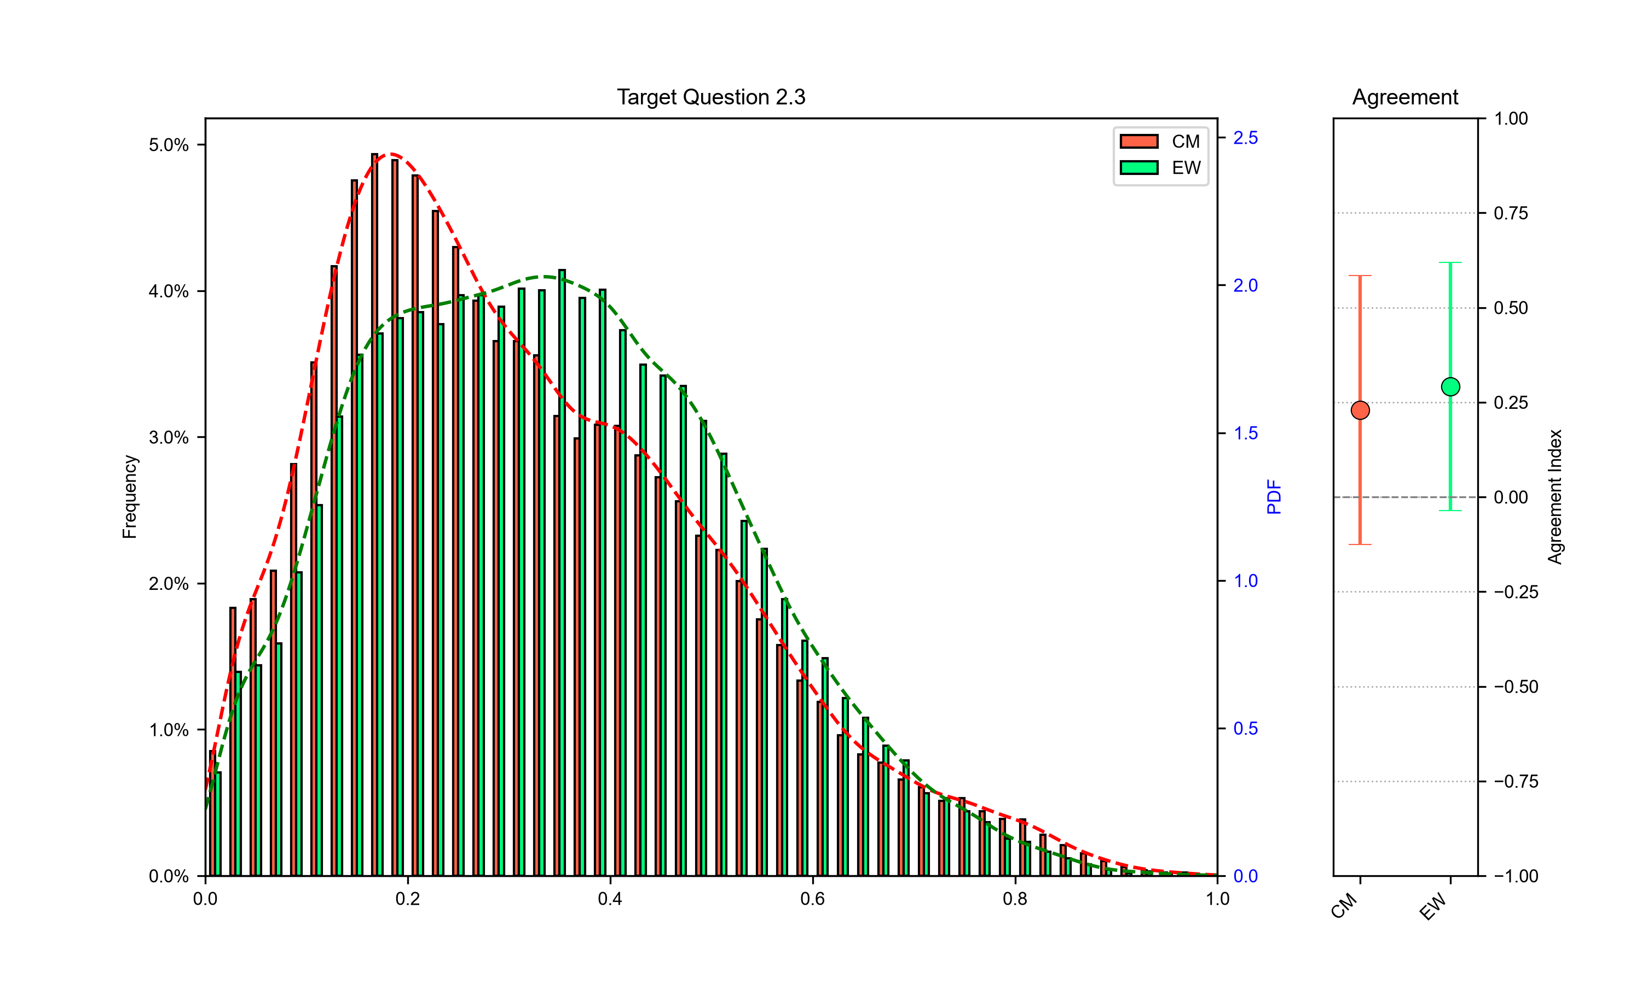
Uplift mechanisms in SW Hokkaido – Local isostatic response to sediment loading offshore
Expert elicitation 02-Nov-2026
Please ascribe your median weights for the relative contributions of each mechanism and your 5th and 95th percentiles for each weight, all values must be within the relative weight interval [0..1]. Notes: Please note that your three median fractional weights should sum to 1.0 (strictly, the means sum to 1.0). Your marginal 5th and 95th percentiles are not simultaneous realizations of the process but a way of expressing your uncertainty around your median weight; these marginal percentile weights will not sum to 1.0, but each value must lie within interval [0..1].
 | Q05 | Q50 | Q95 | Qmean
Cooke | 6.46E-02 | 2.84E-01 | 6.64E-01 | 3.16E-01
EW | 7.87E-02 | 3.32E-01 | 6.51E-01 | 3.43E-01

