Slide 1
Lab1
Data Structure

Slide 2
What is Git
Server
Repository
Push
Push
Push
Pull
Pull
Pull
Repository
Repository
…
Repository
update
update
update
commit
commit
commit
Working copy
Working copy
Working copy
…
Workstation/PC #1
Workstation/PC #2
Workstation/PC #n

Slide 3
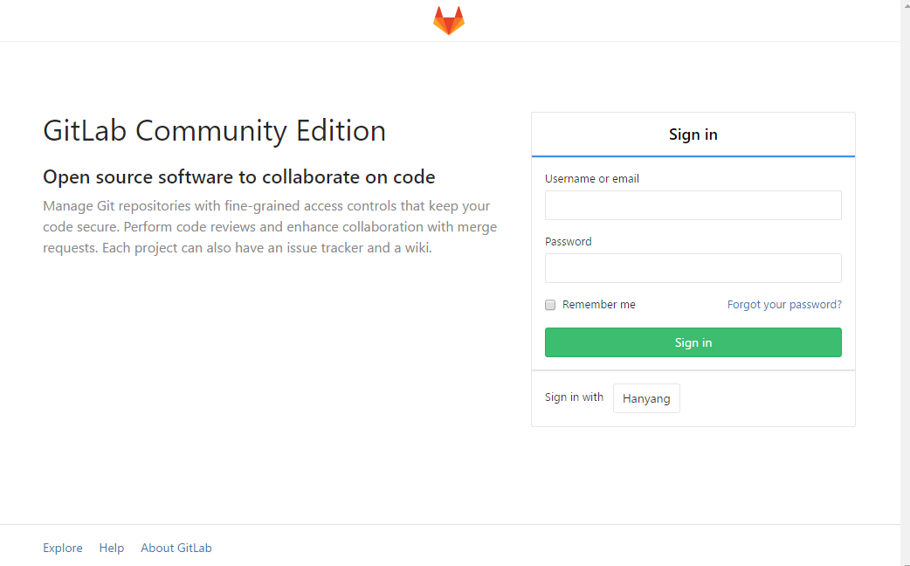
How to sign in GitLab
Go to http://hconnect.hanyang.ac.kr, and click [ Sign in with Hanyang ] button

Slide 4
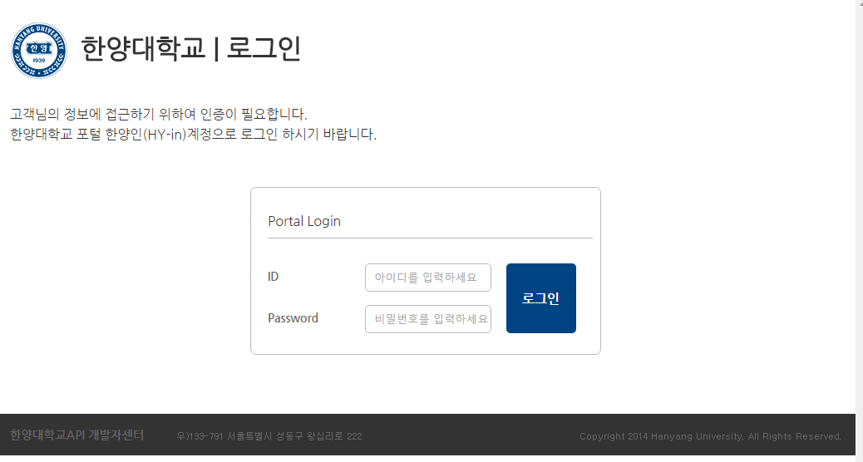
How to sign in GitLab
Login with Hanyang’s account
20XXXXXXXX
*******

Slide 5
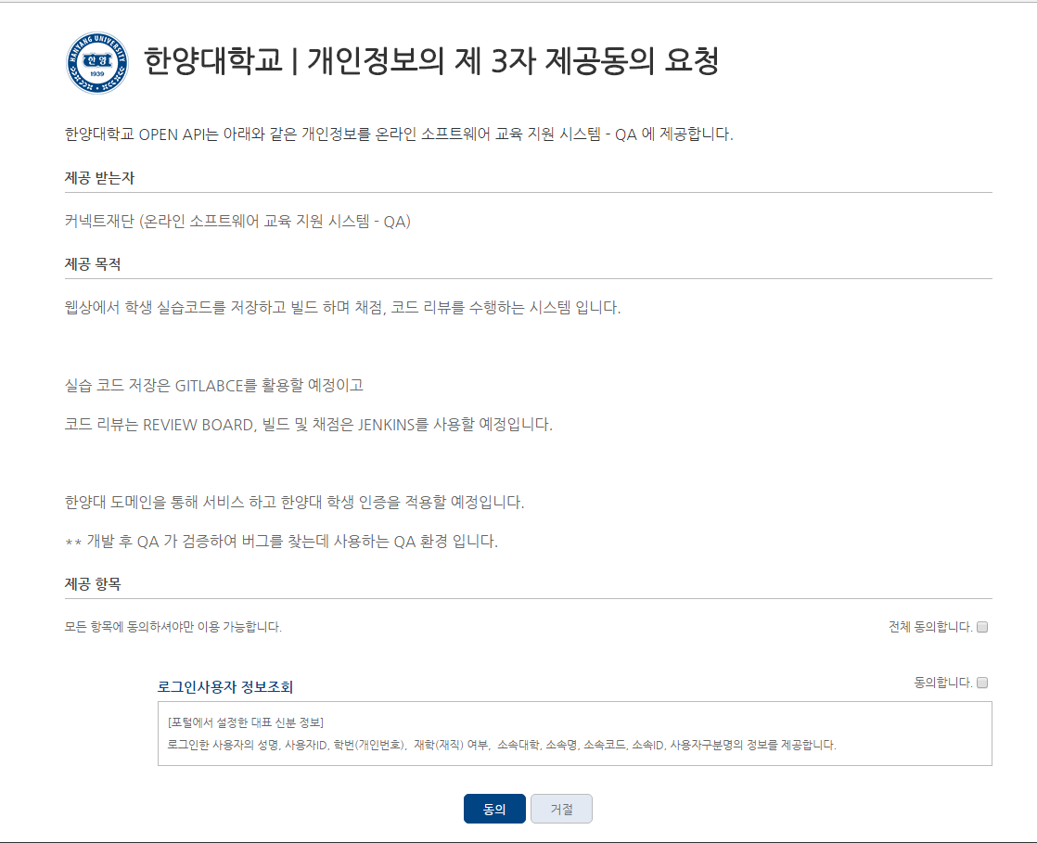
How to sign in GitLab
Check agreement
①
②

Slide 6
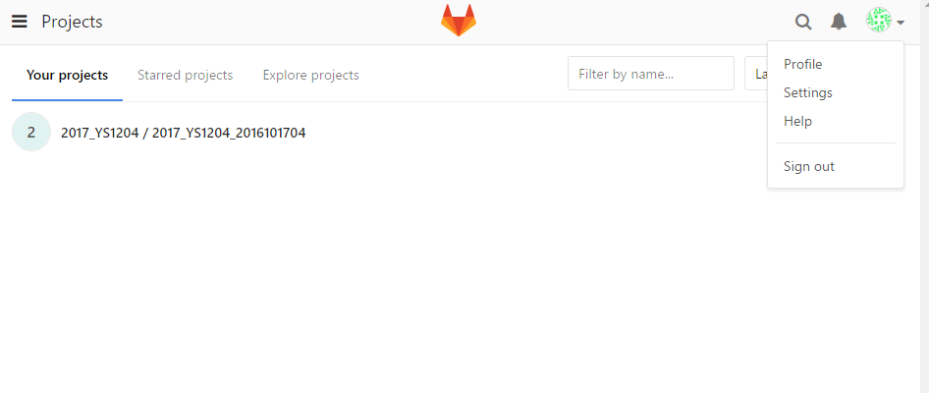
GitLab Initial Setting
Set password
①
②

Slide 7
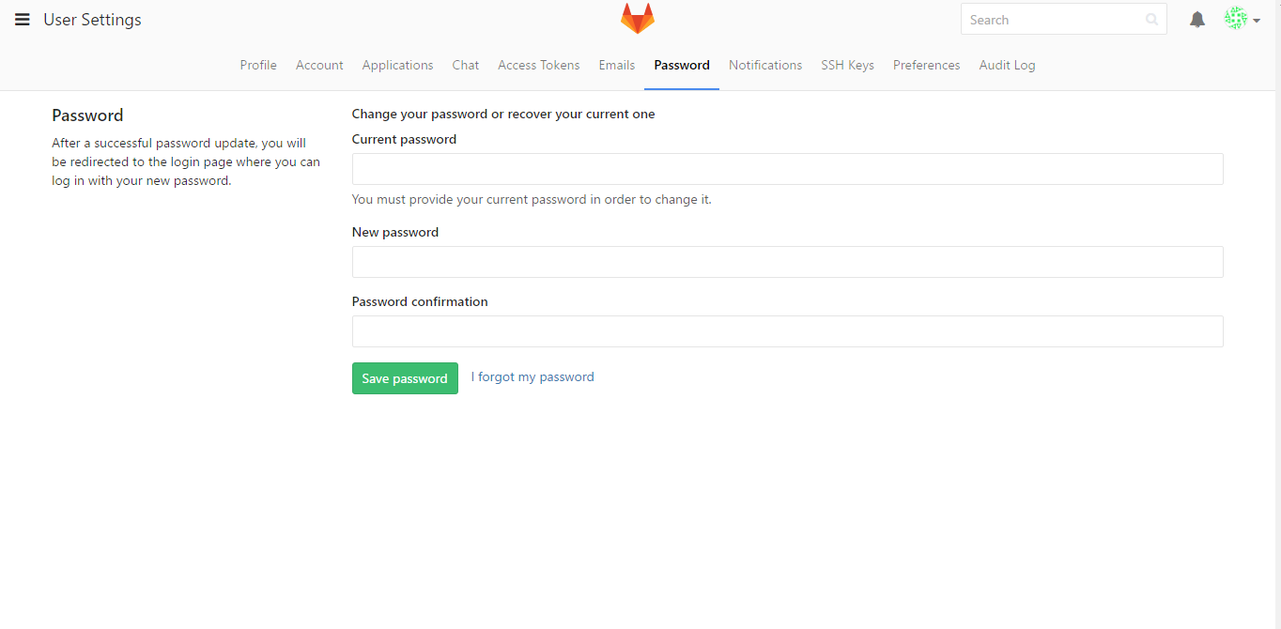
GitLab Initial Setting
Set password
③
④
default password same as HY-IN password
기본 비밀번호는 한양인과 같음
⑤

Slide 8
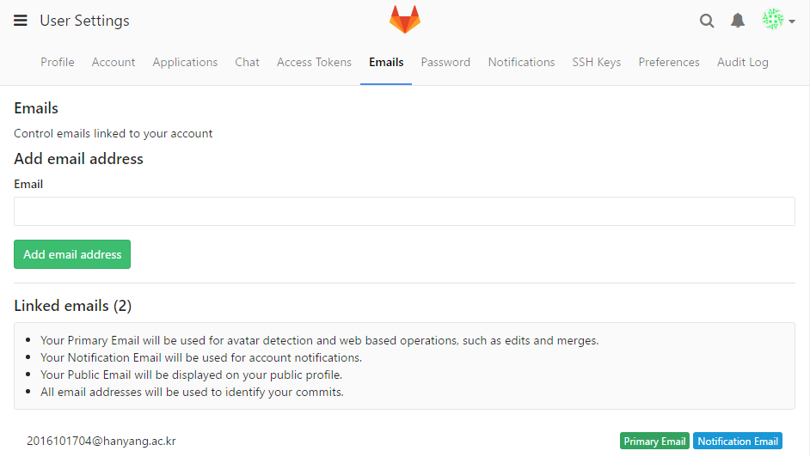
GitLab Initial Setting
2. Set Eamil
①
②
③

Slide 9
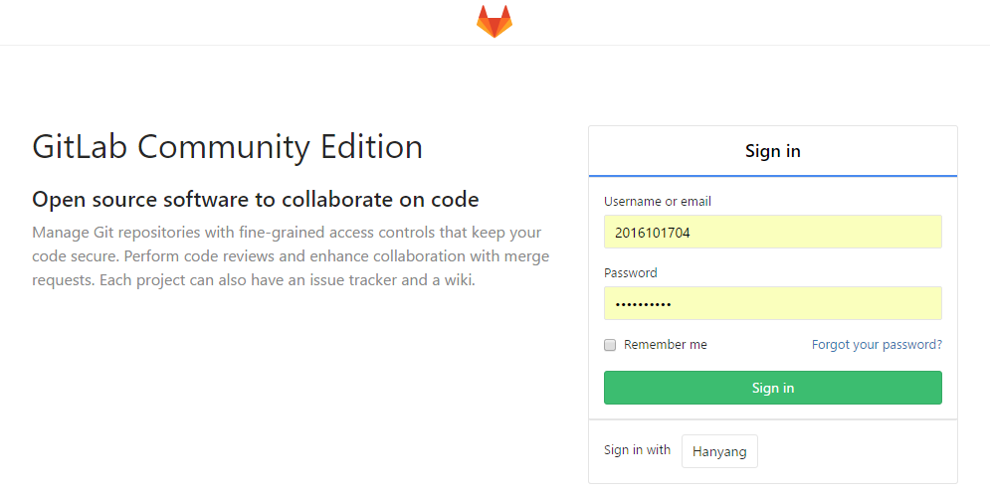
GitLab Initial Setting
3. Login

Slide 10
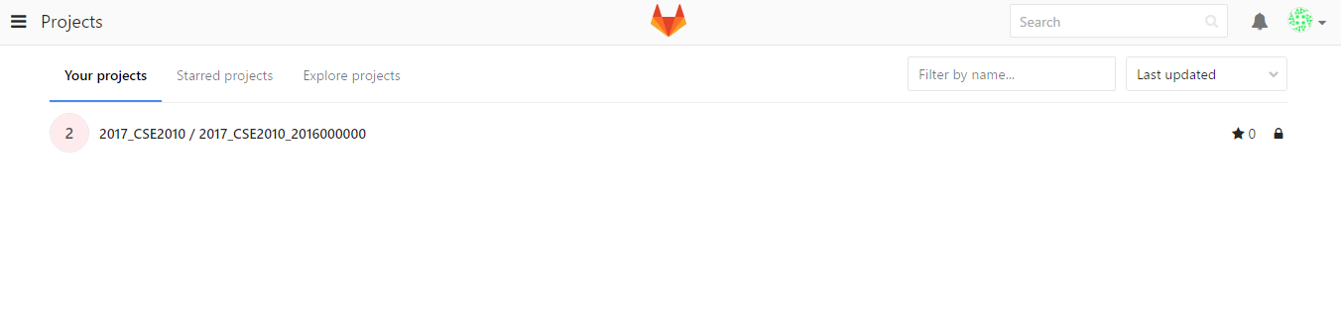
GitLab Initial Setting
4. Check if project exist
Project name : 2017_[Course no.]_[Student ID]

Slide 11
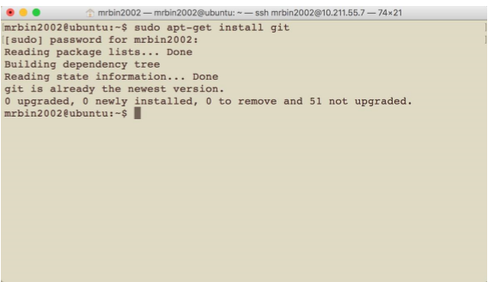
Install Git(Linux)
Ubuntu $ sudo apt-get install git
Fedora $ sudo yum install git

Slide 12
Git Usage
Set user info
$ git config --global user.name “2016000000”
$ git config --global user.email “2016000000@hanyang.ac.kr”

Slide 13
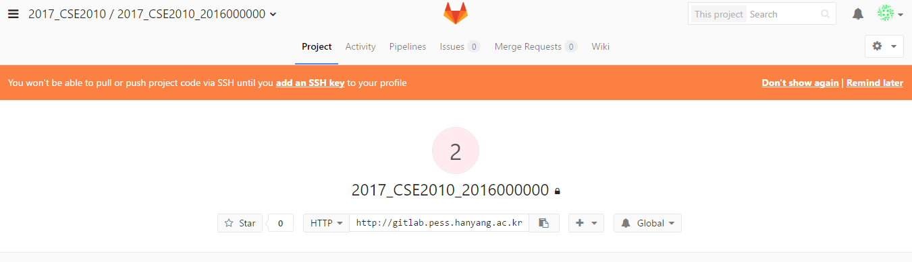
Git Usage
2. Clone project
$ git clone http://hconnect.hanyang.ac.kr/2017_[Course no.]_20XXXXXXXX.git
You can check the address of your git at GitLab webpage. GitLab 사이트에서 주소 확인 가능

Slide 14

Git Usage
2. Clone project
And type your username and password

Slide 15
Git Usage
3. Move to project directory
$ cd 2017_[student id]_20XXXXXXXX
4. Create a directory
$ mkdir [directory name]

Slide 16
Git Usage
5. Move to project directory
$ cd [directory name]
6-1. Create a file
$ vi [file name]

Slide 17
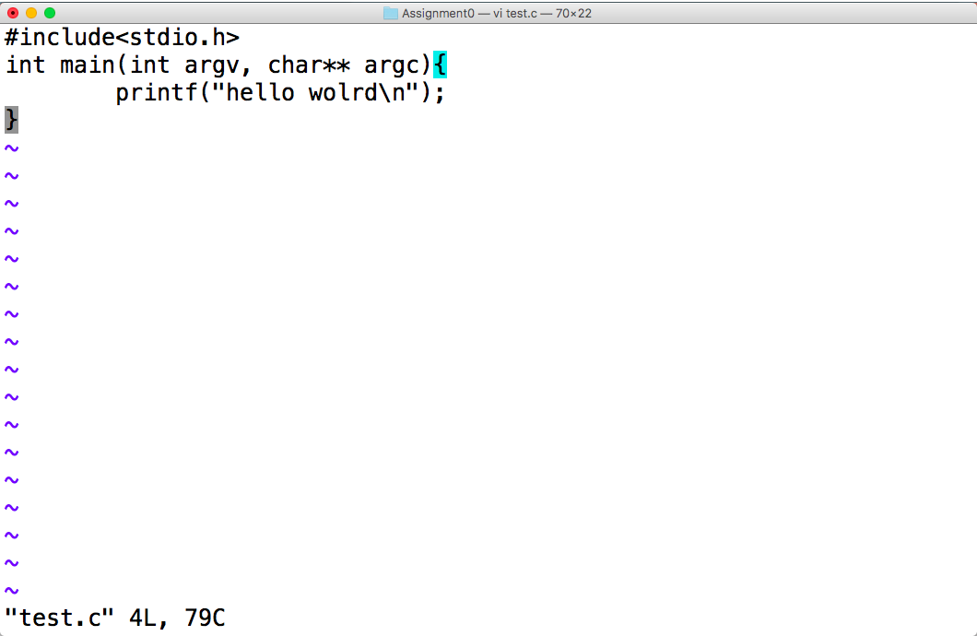
Git Usage
6-2. Type your code

Slide 18
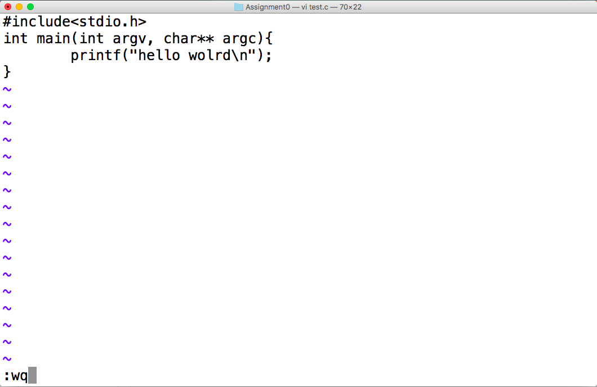
Git Usage
6-3. Save the file
press [ESC] ► type “:wq”

Slide 19
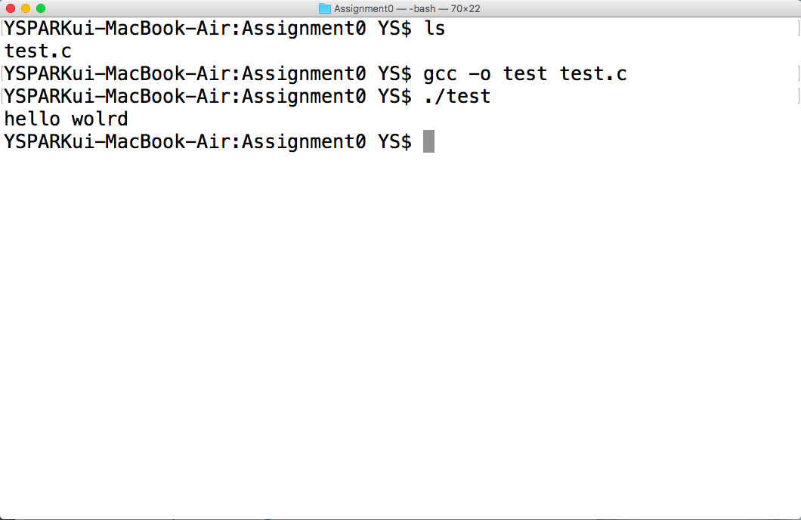
Git Usage
6-4. Compile and execute
$ gcc –o [object file name] [code file name]

Slide 20
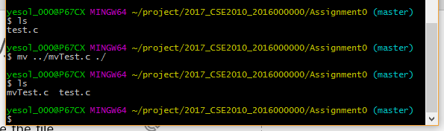
Git Usage
7. Move the file
$ mv [old location] [new location]
../ : Parent directory
./ : Current directory

Slide 21
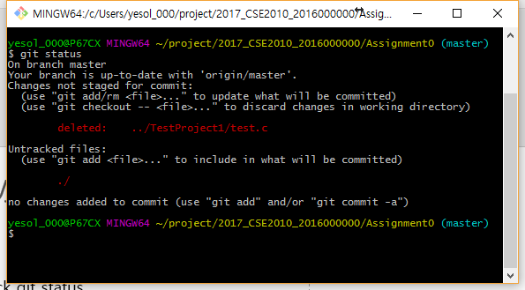
Git Usage
8. Print the status of git
$ git status

Slide 22
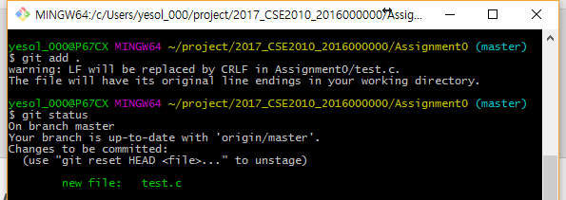
Git Usage
9. Add all files in the directory to git
$ git add .
$ git status

Slide 23
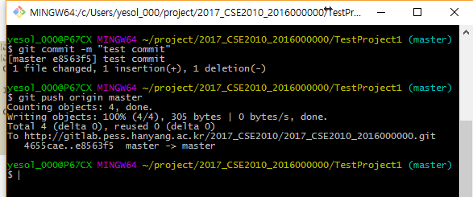
Git Usage
10. Commit file (Save to local repository 지역 저장소에 저장)
$ git commit –m “[commit log message]”
$ git push origin master
Commit log message should be write in detail 로그 메시지는 최대한 자세히 작성할 것. ex ) This is a program that prints a message “hello world”

Slide 24
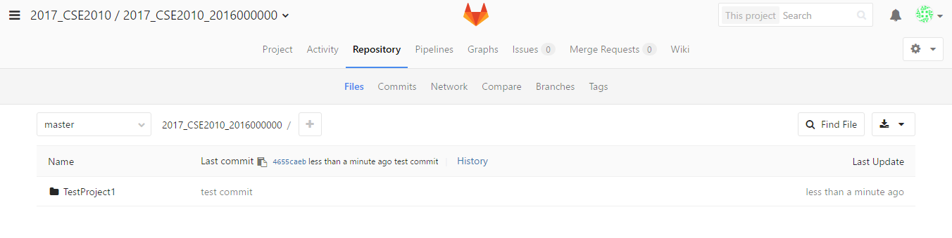
Git Usage
11. You can check the files pushed at GitLab.

Slide 25
Git Usage
12. Comment

Slide 26
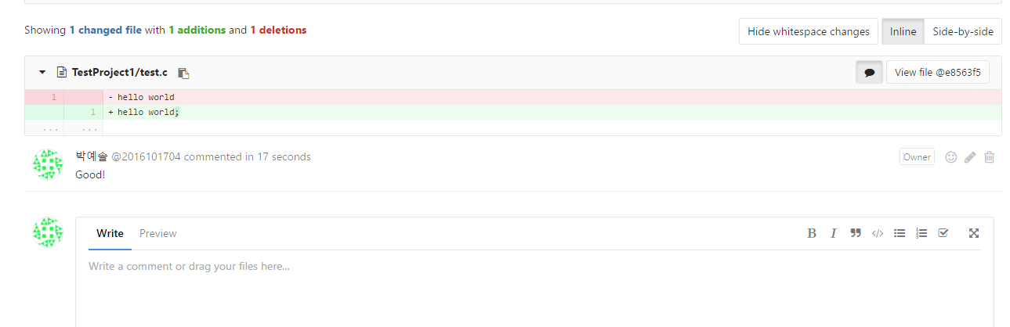
Git Usage
12. Comment

