Slide 1

GUIMAP
Date: April 20, 2022
Student: Hayden Ackerman
Major: Cybersecurity
Course: CSCI 499 Defense
Advisor: Dr. Hayes

Slide 2
Introduction
You’ll have to scan a port sooner or later in Cyber
All it takes is that one vulnerable service
Sometimes even you don’t know what ports are open on your system
It’s a waste of time and resources to manually verify all outward-facing services and open ports

Slide 3
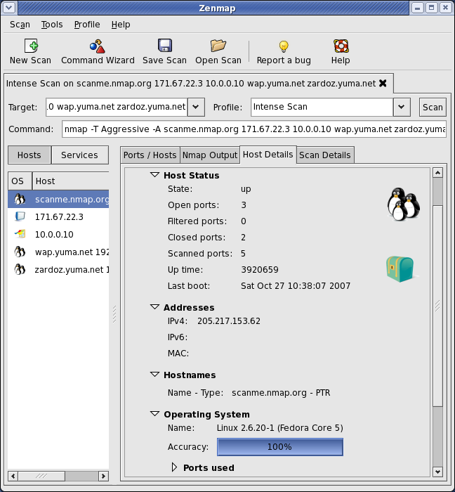
Problem
Nmap possesses no direct database output functionality
Cross-platform GUI Zenmap isn’t too user-friendly…
Bombards the user with options
Can be a heavy suite to run
https://nmap.org/zenmap/images/zenmap-hd-648x700.png

Slide 4

Motivation
I enjoy programming, and have really wanted to explore the depths of the Python language
Nmap is an important tool in the Cyber world, and I want to learn its capabilities
The desire to put together the knowledge gained from my college career
https://logos-download.com/wp-content/uploads/2016/10/Python_logo_icon.png

Slide 5
Research & Background
Deciding a language: C++, Java, or Python?
The easy implementation of a GUI in a language
The libraries that make my work and life easier
Numerous examples that I can easily understand
More user-friendly documentation

Slide 6
Hardware & Software Requirements
Hardware
Any CPU within the last 6 or more years
At least 1 GB of RAM
Storage space
Keyboard to input values
Display to view the GUI
Software
A Linux-based OS
Python3.8
SQLite and SQLAlchemy
Pandas
Xsltproc
PySimpleGUI

Slide 7
Program Demo

Slide 8
Functional Requirements
Allows the scanning of IP addresses, URLs, and network services
Allows for the creation of files, including .xml files, .db files, and .html files
Allows for the upload of existing files to a database
Allows for the viewing of scan data

Slide 9
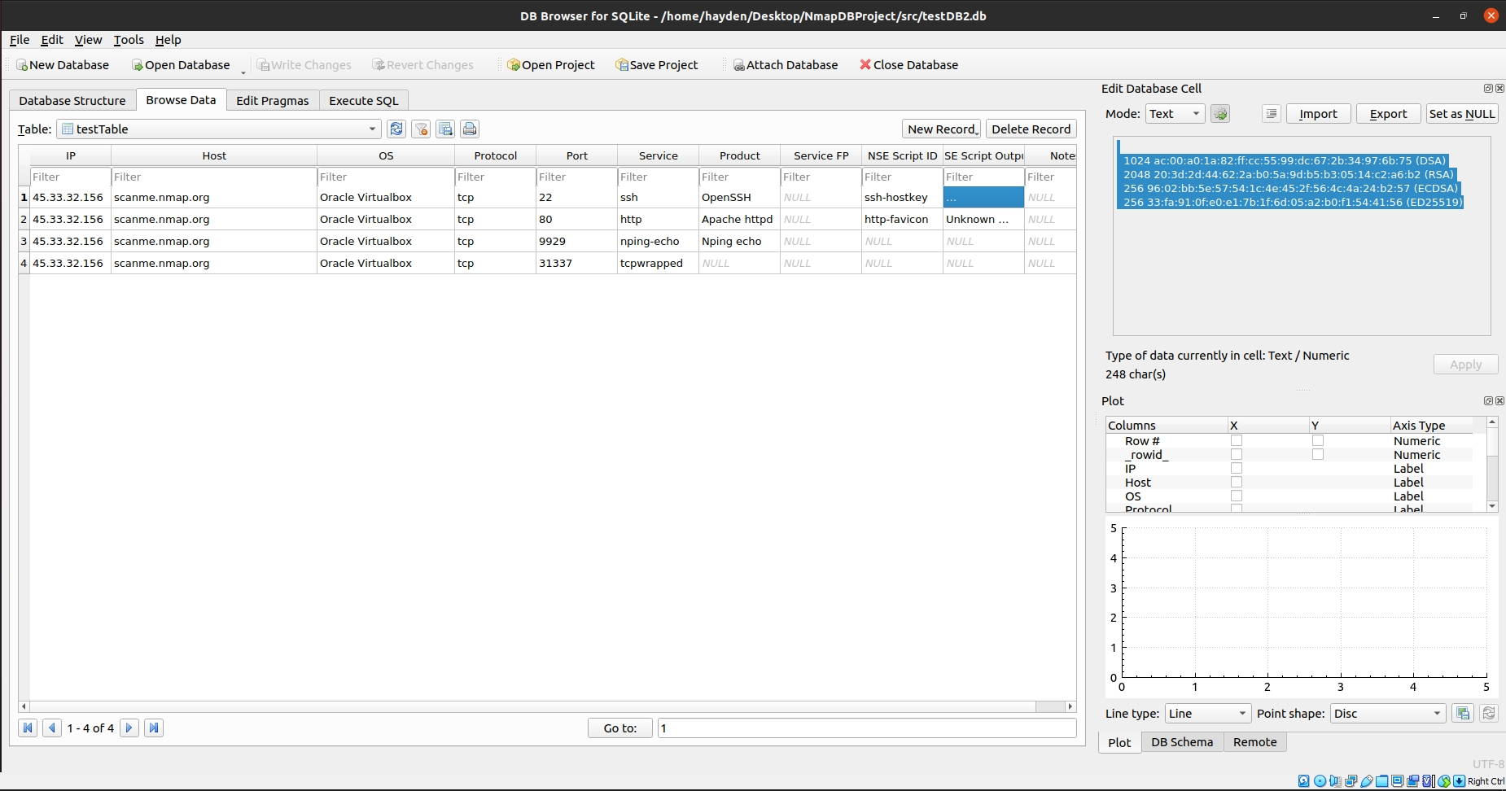
Database
This showcases the results transformed into a human-readable format, stored in a database.

Slide 10
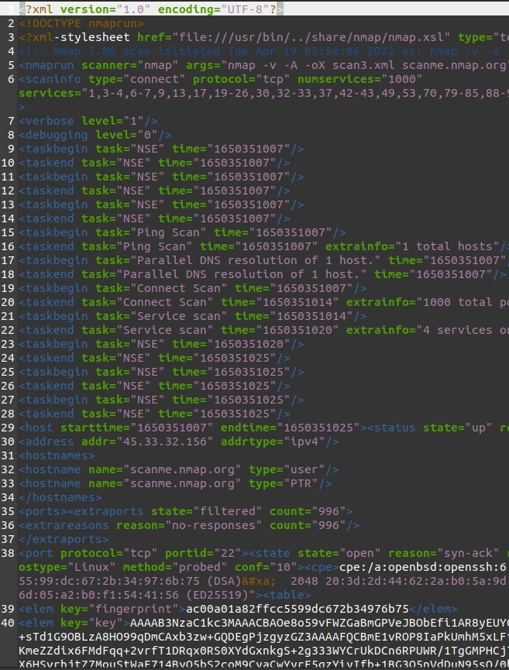
Scanning Results
This is (in my honest opinion) a non-human readable format of the scan results in an XML file.

Slide 11
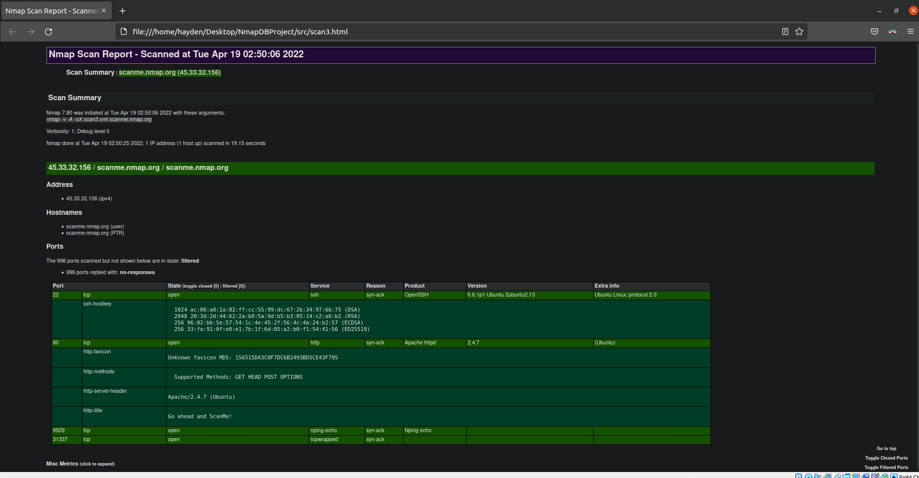
XSLTProc Transformation
The XSLTProc processing engine takes the XML file and transforms it into a clean HTML table.

Slide 12
Test Plan
Aim to make product run on specified hardware with minimal run-time issues
Ensure (or at least guarantee) that a large chunk of the functional requirements are met
Audit the code to prevent shell injection
Ensure that the database is scalable depending on scan size

Slide 13
Test Results
In terms of performance with minimal scan options, no performance issues were thread. However, depending on the scan option, performance might degrade.
Functional Requirements: All scans can be completed if a network connection is active, and results can be saved to a preferred file format. The user can easily view their results.

Slide 14
Challenges
Overcome
Not Overcome
Shell injection – using the shlex library to break up all commands into a list, this prevents shell injection.
Learning niche libraries of the Python language.
Learning a GUI library.
Some threading not locking properly.
Time constraints – always difficult for a full-time student.
Not all scan options were tested (too many to test in a single semester).

Slide 15
Future Enhancements
Optimize the code to run more efficiently with more scanning options
Fix threading issues
Extend the GUI to add more functionality
Learn more Python, so I can apply what I learn to this project

Slide 16
Any questions?

