Slide 1
Interim Report
BrentChoi -
https://github.com/HMCBSJ

Slide 2
Preface
Thanks to Jacky and Rex very much, I will keep up myself and do my best!

Slide 3
What brent is doing
Seoul Business Trip
Learning FAE task, which is 20% of job for a year (80% as an engineer a year)
Engineer ACS Recsys
Already having developed the baseline Recsys for ACS
Dataset : TBC EPG
Method: Cosine similarity [Done]
More advancement will coming
Deep reinforce learning [on the progress]

Slide 4
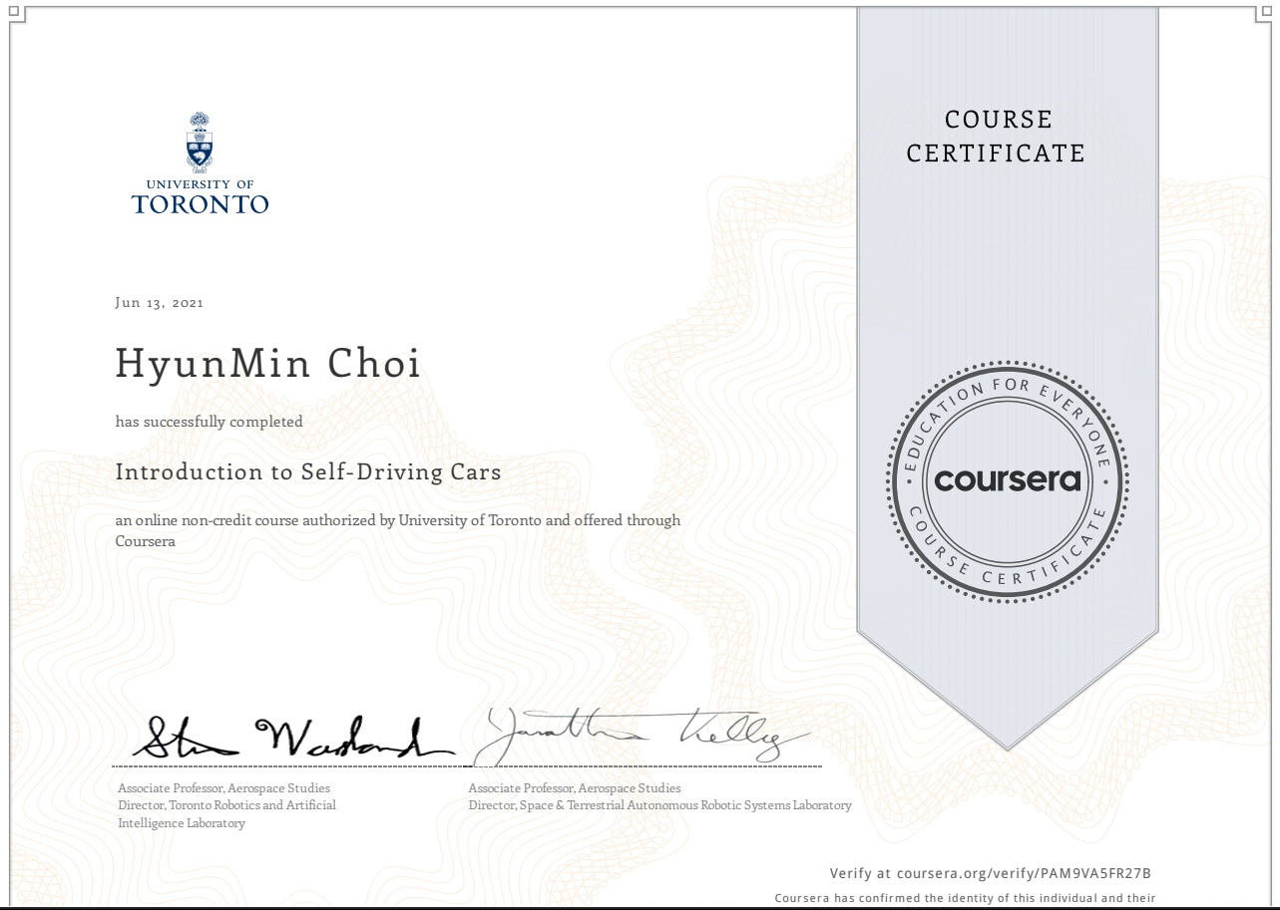
What brent is learning while resting
Self-Driving Cars （3 more courses to go more such as）

Slide 5

What brent is learning while resting
AI for Trading

Slide 6
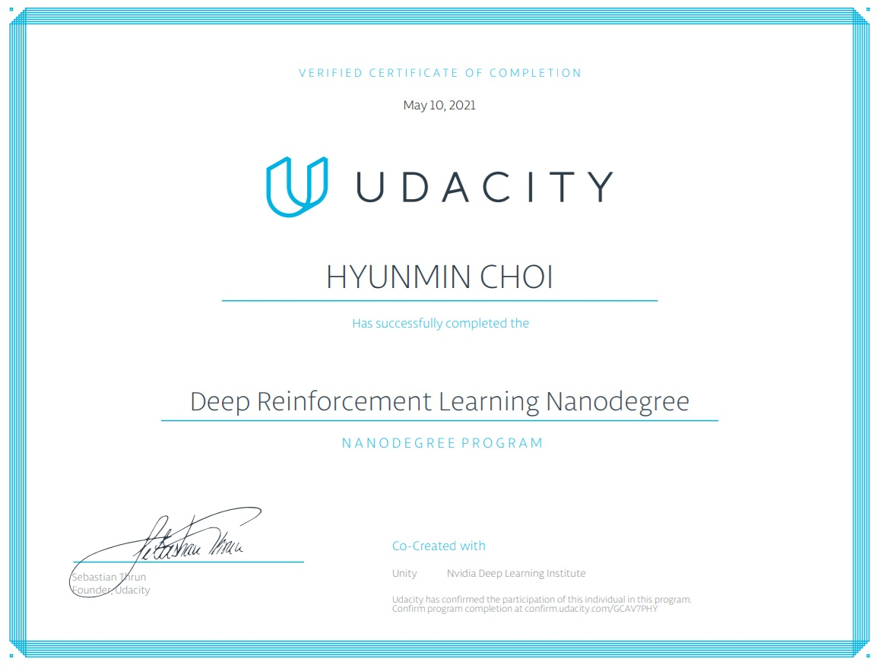
What brent is learning while resting
Deep Reinforcement Learning

Slide 7
On going
Recommendation System
Factorization model -> Wide & Deep learning model -> AutoRec & CF model -> LSTM model
Data Engineer nanodegree
Data modeling and creating pipelines with Postgres/Cassandra /Spark/AWS
Self-Driving Cars
State Estimation and Localization for Self-Driving Cars
Visual Perception for Self-Driving Cars
Motion planning for Self-Driving Cars
→ Feedback from Jacky
Keep developing the AI Recsys after the business trip
Understand code of Audio/HDMI/RCU structure when available

