Slide 1
RES2DMOD

Slide 2
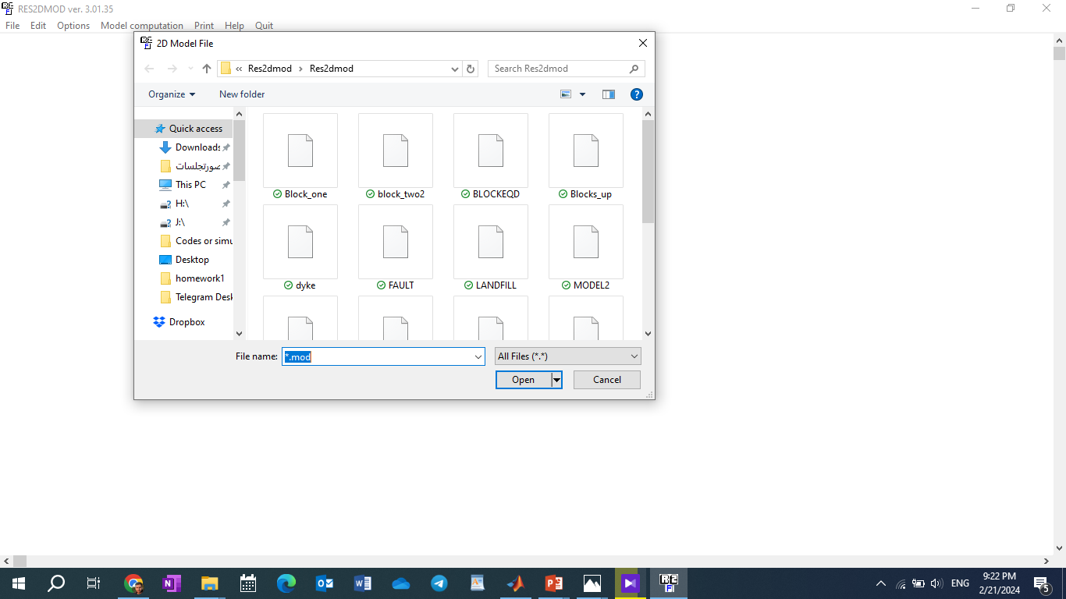

Slide 3
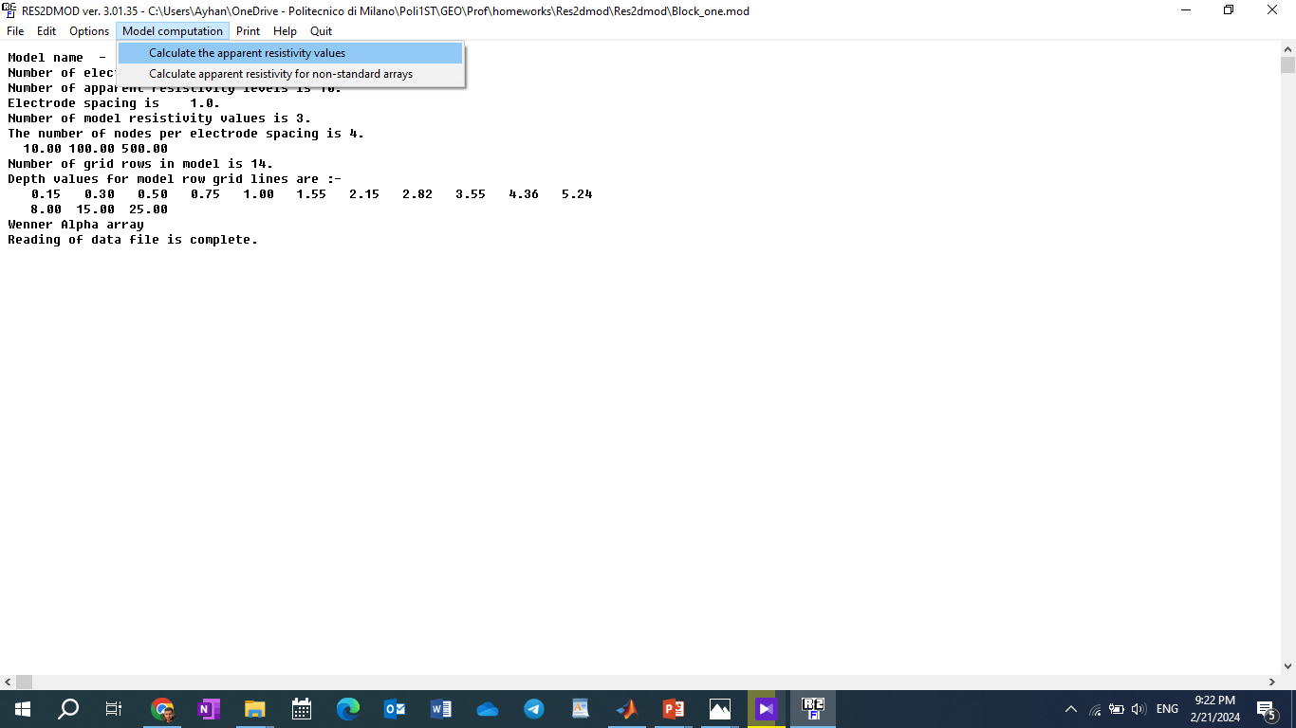

Slide 4
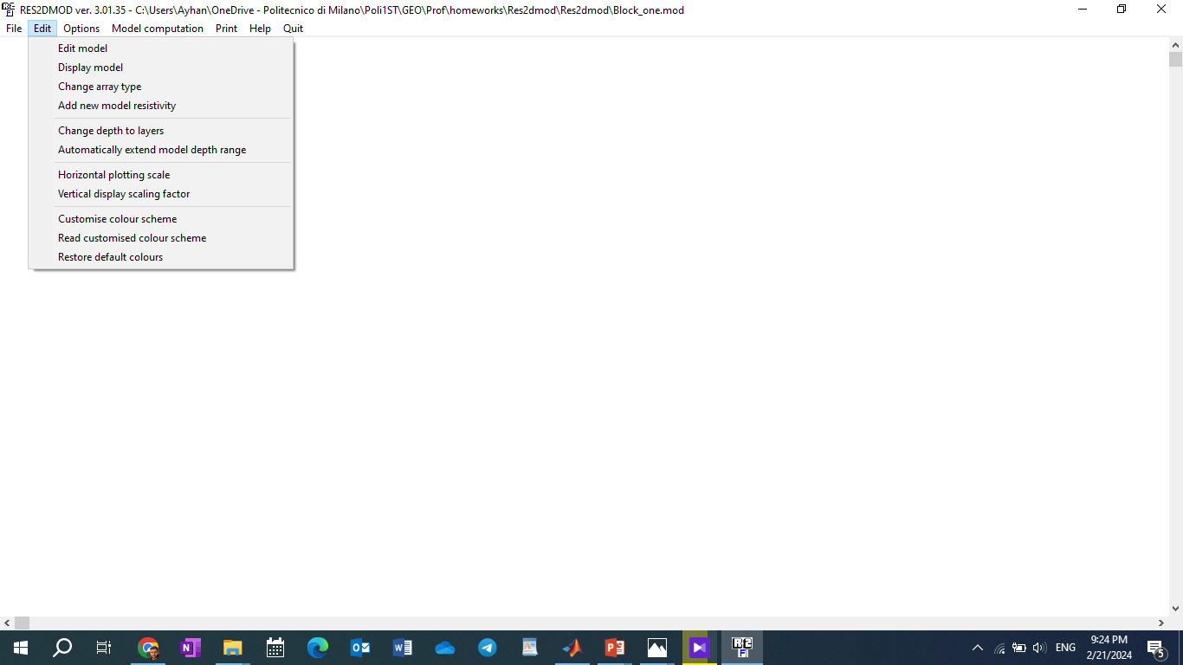

Slide 5
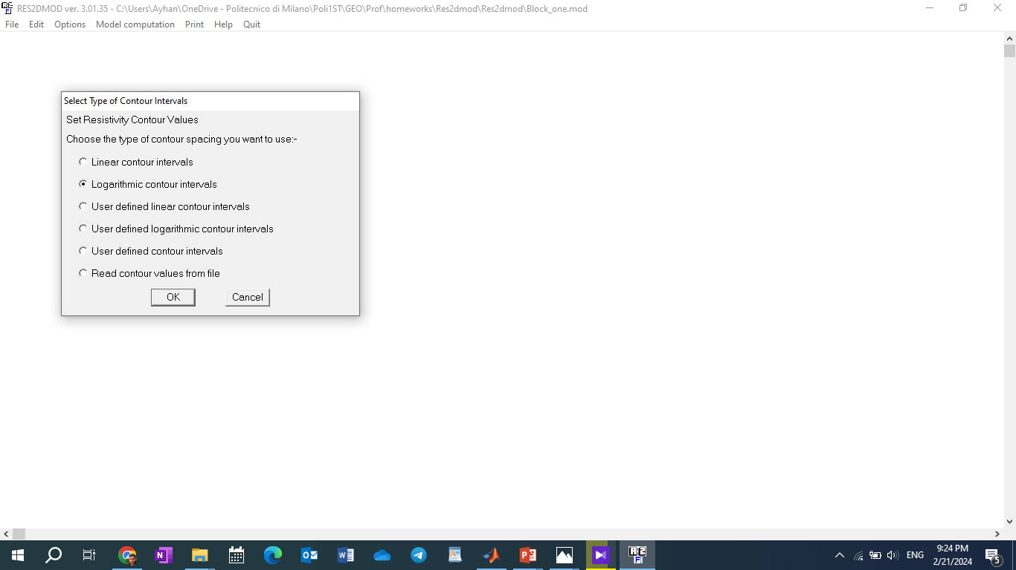

Slide 6
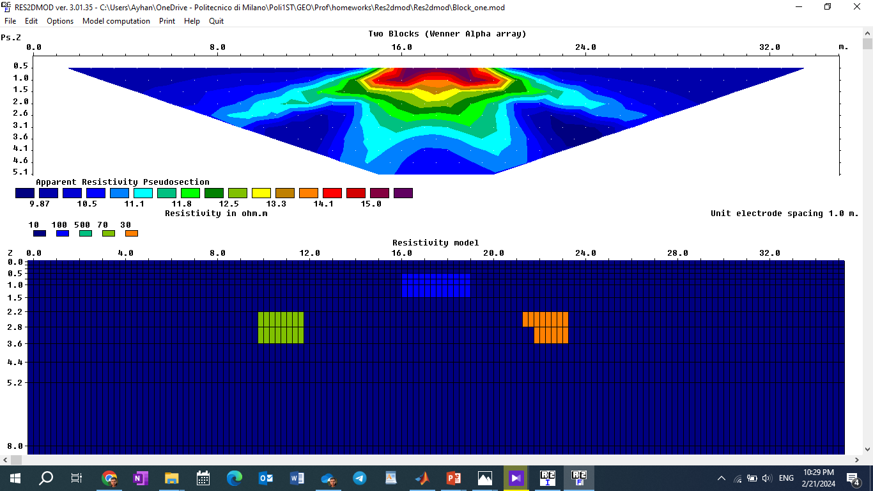
Parameters: Apparent Resistivity Pseudosection / Werner Alpha Array / 36 electrodes on the Surface / Separation between electrodes: 1m
This figure shows the model with three anomalies.
3 different resistivities materials close to the surface.
Higher resistivity causes less current to be flown.

Slide 7
RES2DINV

Slide 8
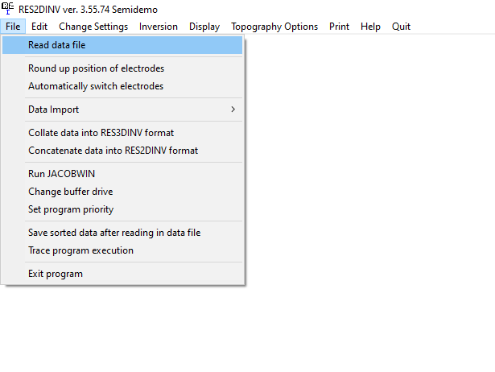

Slide 9
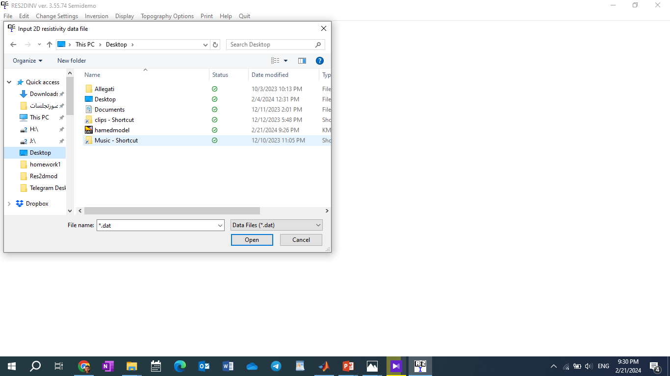

Slide 10
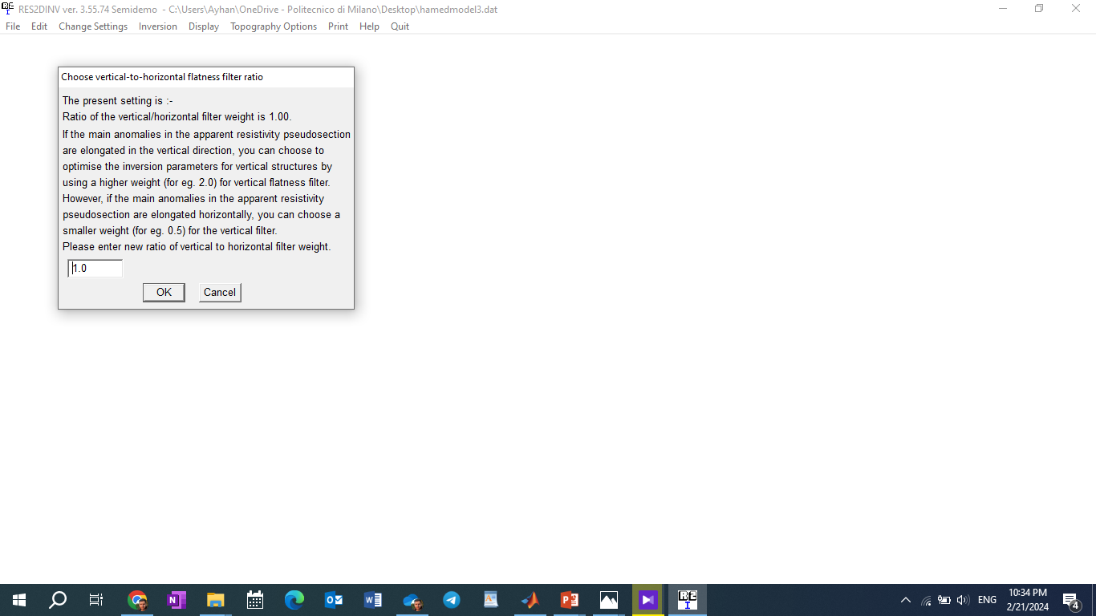
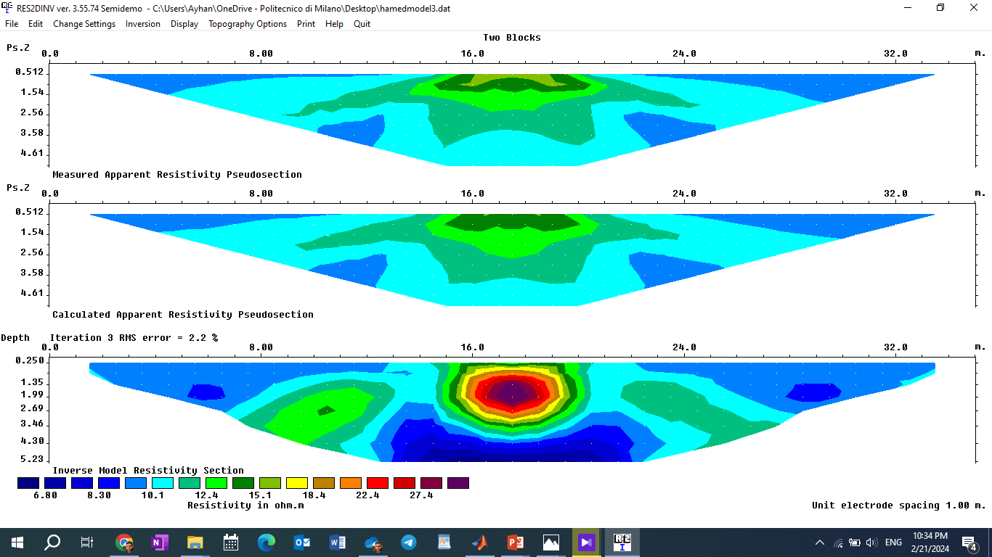
Measured Apparent Resistivity:
Data imported it by RES2MOD.
Calculated Apparent Resistivity:
computation of every iteration for this model (Picture above)
Inverse Model Resistivity Section:
The estimated model that we created based on apparent resistivity.
A comparison between picture 1 and picture 2 gives us the error value: of 1.59% if that error is below that our threshold so it is the main model.

Slide 11
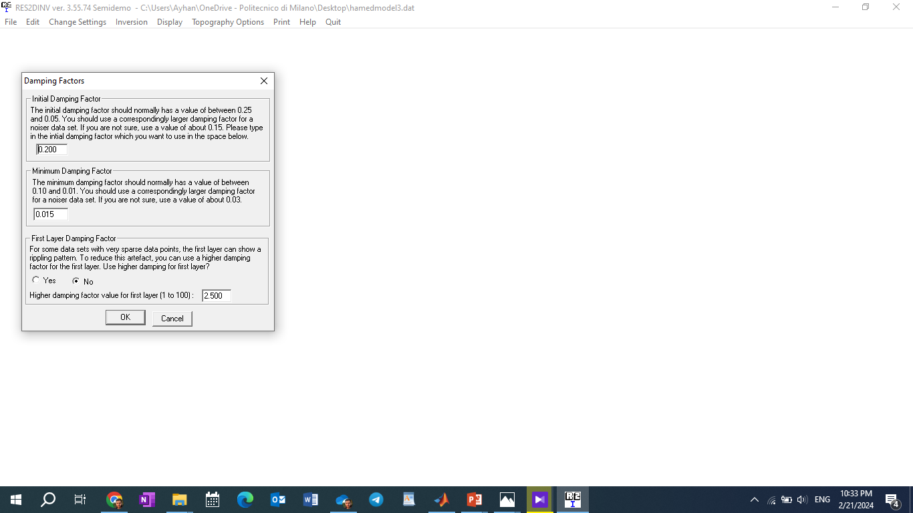
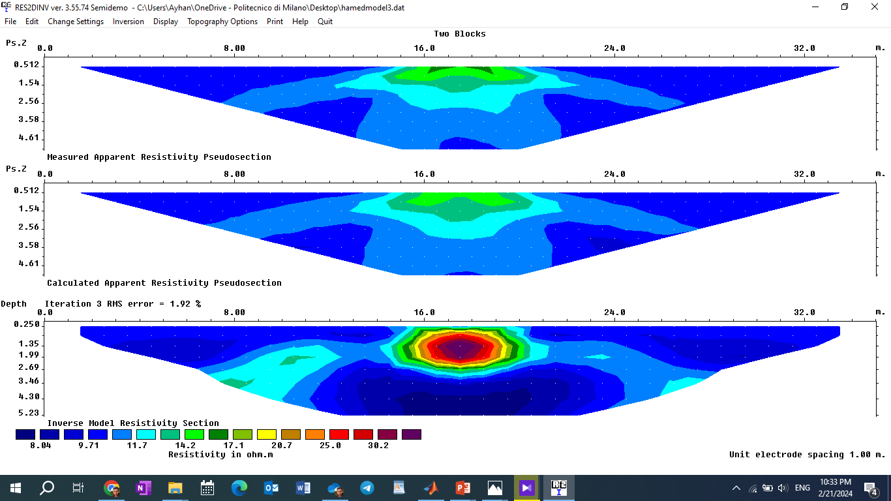

Slide 12
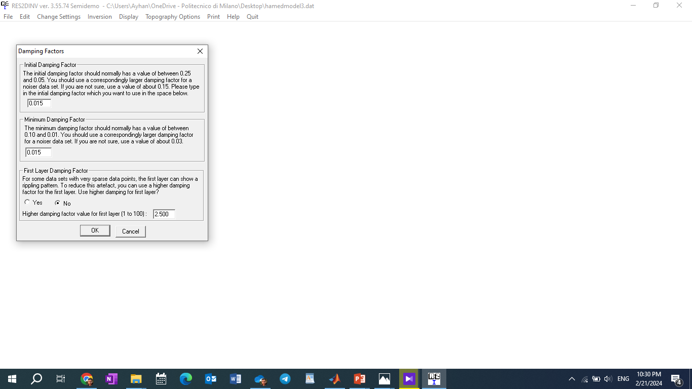
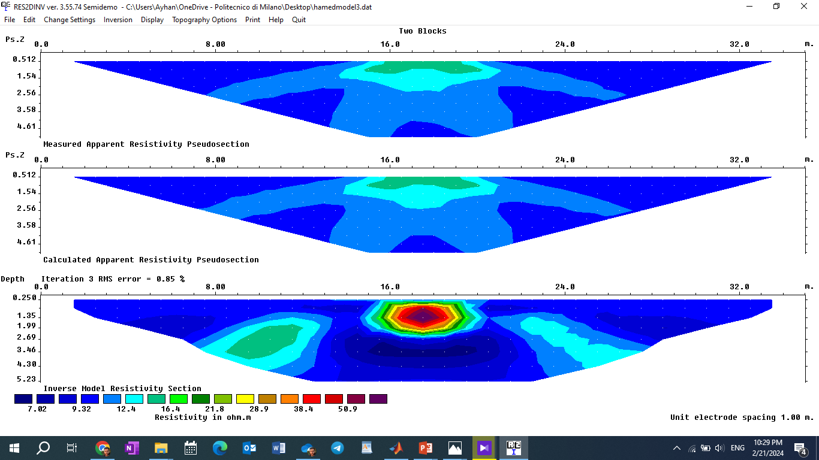
Normal value: 0.05
Increasing this value improves the measurements on the Deep levels but affects the measurements on the levels above changing the shape horizontally, so changing this value is more useful when we have bodies on the Deep side)

