Slide 1
T5 Exploring the Limits of Transfer Learning with a Unified Text-to-Text Transformer

Slide 2
Background
Pre-train → Fine-tune
Goal:
explore how different factor will affect the performance.
pre-training objectives
architectures
unlabeled datasets
transfer approaches

Slide 3
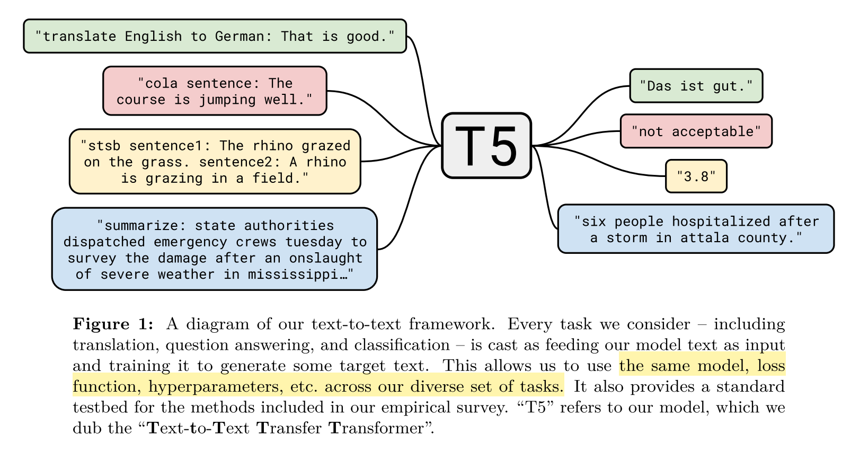
Unified Text-to-Text View

Slide 4
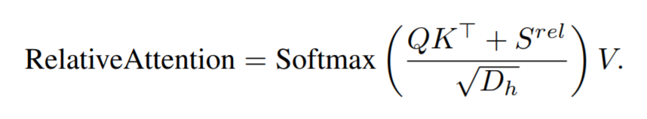
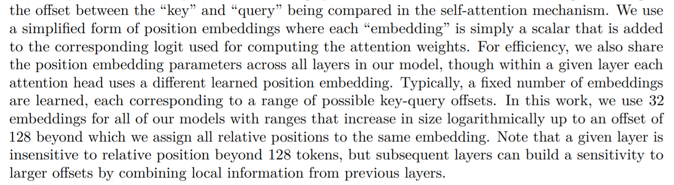

Model details
Encoder-decoder Transformer
Relative Positional Self-Attention
$S^{rel}$ is the simplified positional embedding

Slide 5
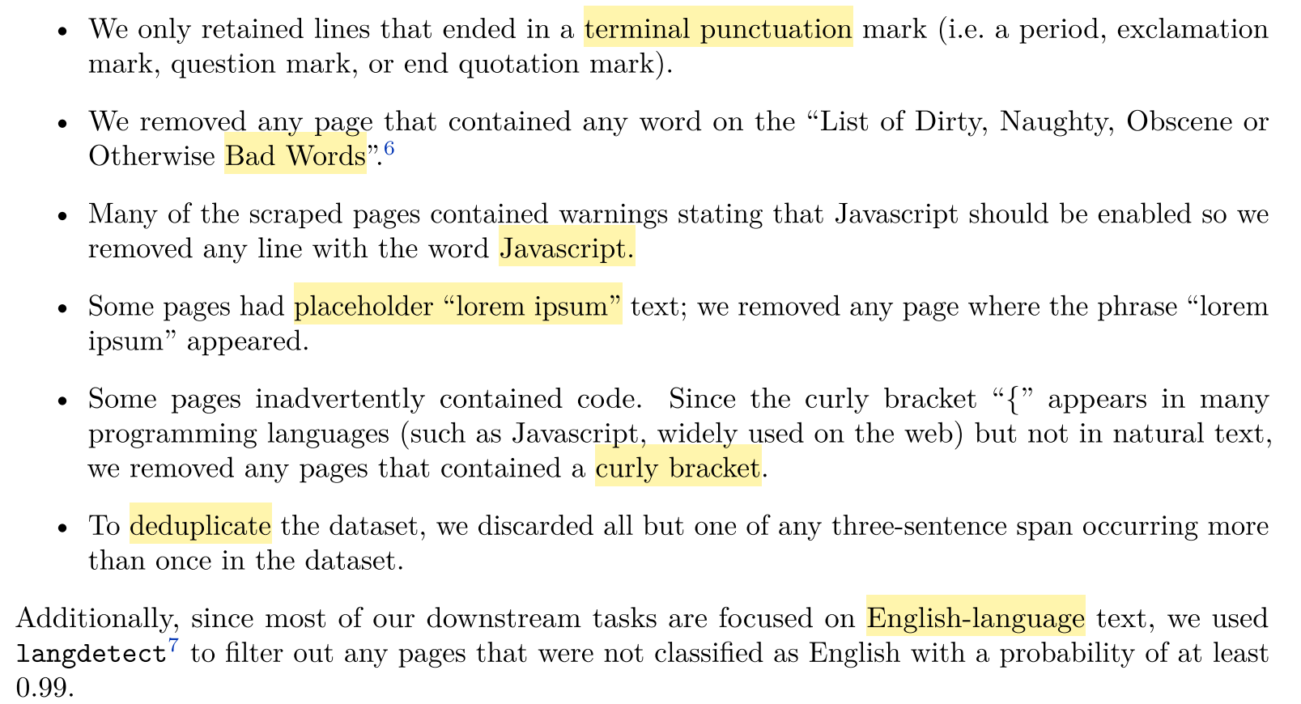
Dataset: Colossal Clean Crawled Corpus
Goal: the effect of the quality, characteristics, and size of unlabeled data
Source: Common Crawl (20TB/month, noisy)
Data Cleaning:
(Heuristics)
750G

Slide 6
Downstream Tasks
Text classification: GLUE and SuperGLUE
Abstractive summarization: CNN/Daily Mail
QA: SQuAD
Translation: WMT English to German, French, and Romanian

Slide 7
Input & Output
“text-to-text” format
consistent training objective: maximum likelihood
task-specific (text) prefix
Mismatch label Issue

Slide 8
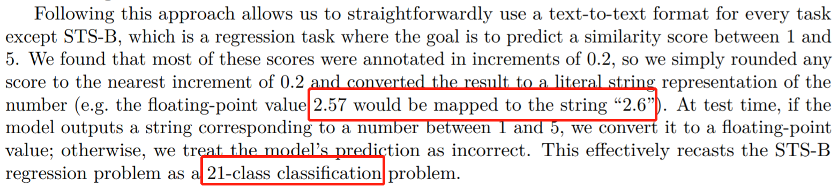
Input & Output
Regression Task:
Convert to 21-class classification

Slide 9
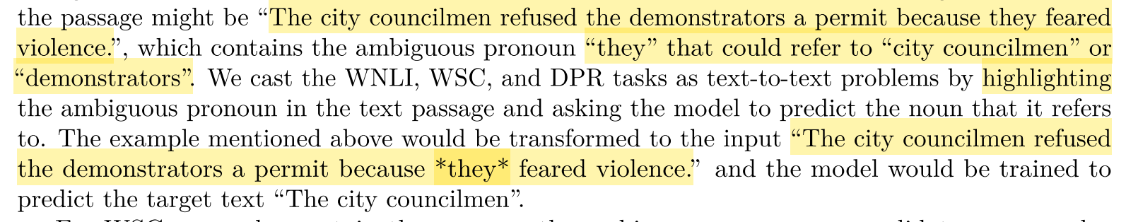
Input & Output
Winograd Task (ambiguation):
highlighting

Slide 10
Empirical Survey
Methodology “coordinate descent”
Baseline → Architecture → Objective → Dataset
→ Transfer Approach → Scaling

Slide 11
Baseline
Encoder-Decoder Transformer
Denoising objective
BERT-base Size Encoder and Decoder (2x larger)
Multilingual Vocabulary
32,000 word pieces
SentencePiece

Slide 12
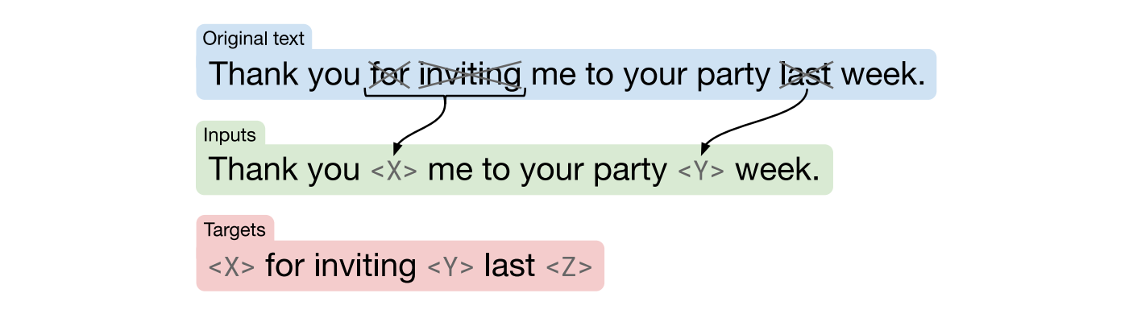
Baseline
Denoising objective
Drop 15% tokens

Slide 13
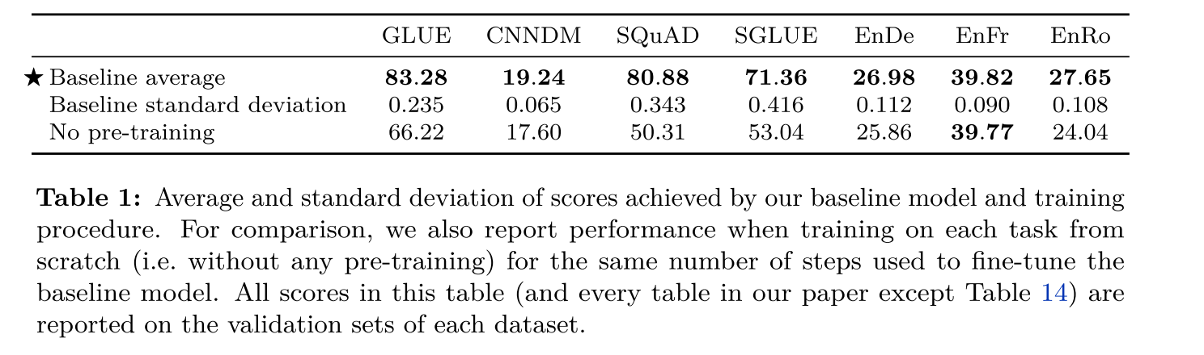
Baseline Results
Comparable to BERT-base

Slide 14
Baseline Details (Pre-train)
AdaFactor
Dropout: 0.1
Max length: 512
Batch Size: 128
pack multiple sentence into one sample: [1 1 1 1 1 1 0 0 2 2 2 0 0 3 3 3 3 3 0 0 4 4 4]
34B tokens << BERT (137B) <<RoBERTa (2.2T)
“inverse square root” Learning Rate
triangular is better but not comparable
10000 warmup

Slide 15
Baseline Details (Fine-tune)
2¹⁸ steps
constant learning rate: 0.001
Batch Size: 128
Length: 512
5,000 steps/checkpoint

Slide 16
Empirical Survey
Methodology “coordinate descent”
Baseline → Architecture → Objective → Dataset
→ Transfer Approach → Scaling

Slide 17
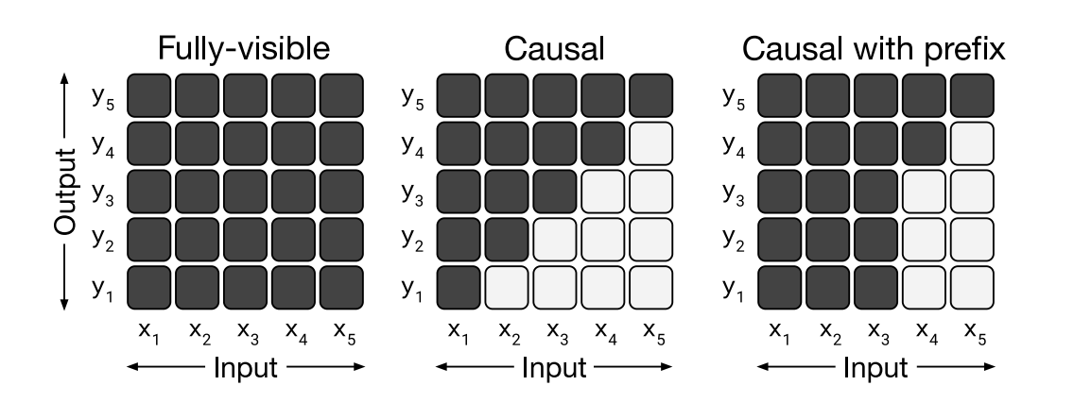
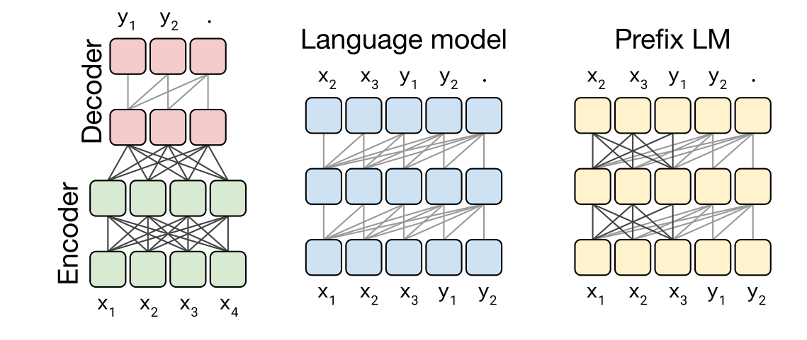
Model Architectures
Variants:
Encoder-decoder
Language model
Prefix LM: BERT, ULM
Encoder (BERT) Decoder ULM

Slide 18
Model Architectures
L + L Layer Encoder-decoder vs. L Layer Language model
2x parameters
Same computation cost
Ablation Study:
Share parameter across Encoder and Decoder
L/2 + L/2 Layer Encoder-decoder

Slide 19
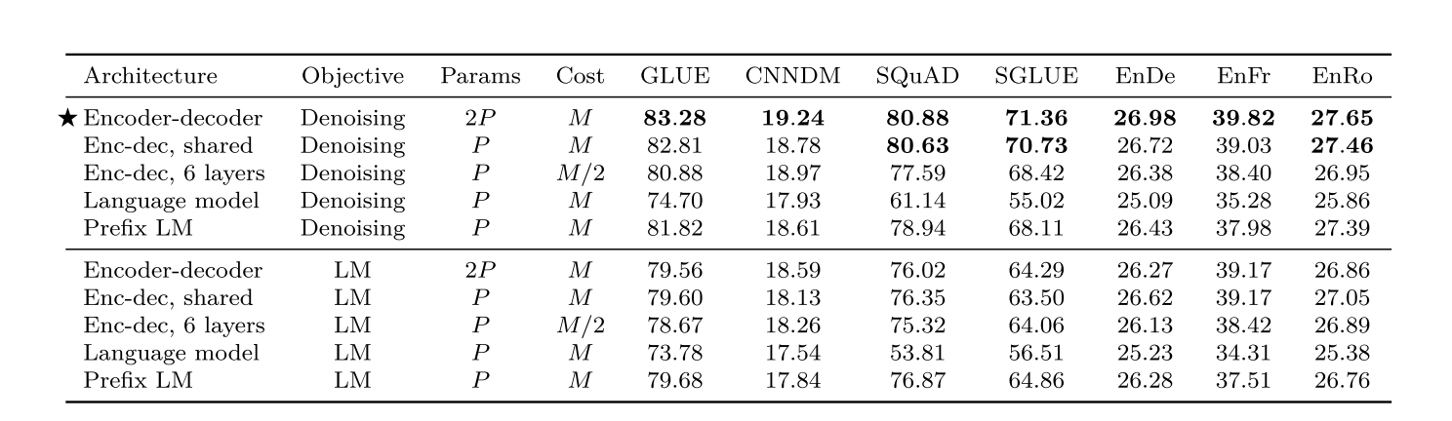
Model Architectures: Results
Surprisingly, sharing parameters across the encoder and decoder performed nearly as well. (ALBERT)
and better than prefix LM. Explicit encoder-decoder structure is useful.
Denoising objective > LM objective

Slide 20
Empirical Survey
Methodology “coordinate descent”
Baseline → Architecture → Objective → Dataset
→ Transfer Approach → Scaling

Slide 21
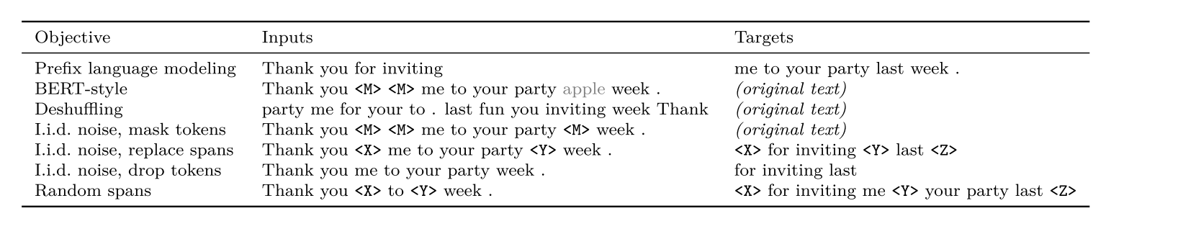
Unsupervised Objectives

Slide 22
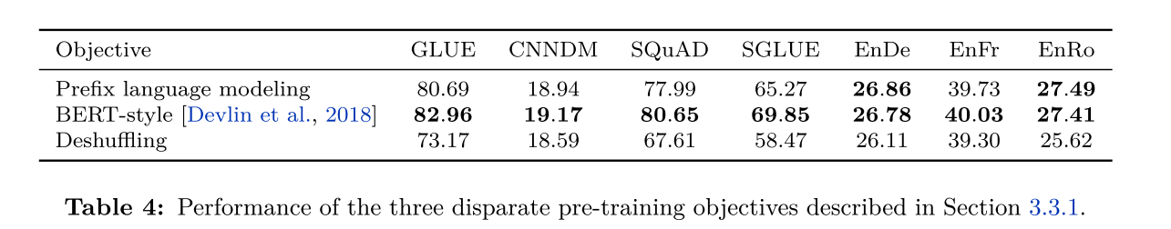
Unsupervised Objectives
LM vs. Masked LM vs. Deshuffling

Slide 23
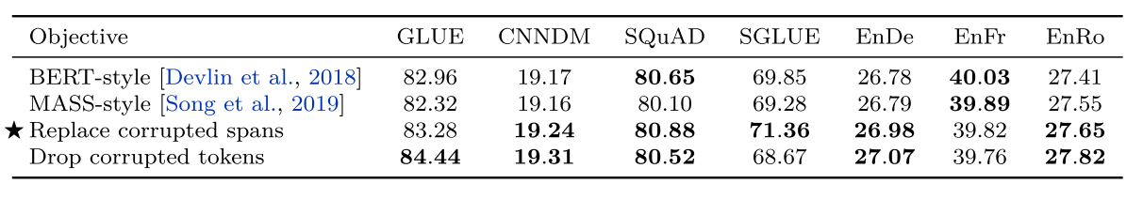
Unsupervised Objectives
Masked LM
BERT-style: 15% → (90% [MASK], 10% [Random Token])
MASS-style: 15% → [MASK]
Short Target & Fast Training
Due to CoLA

Slide 24
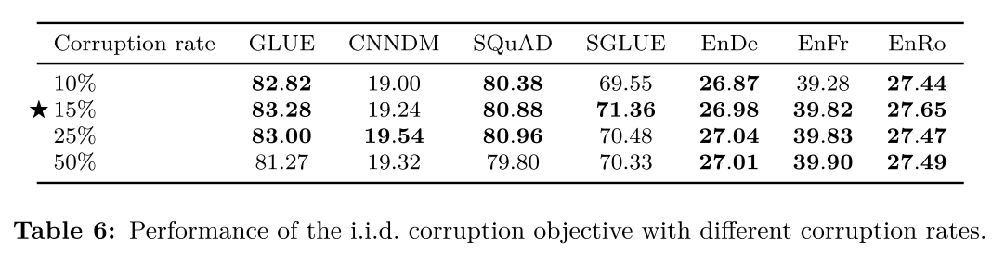
Unsupervised Objectives
Corruption rate
Not Sensitive

Slide 25
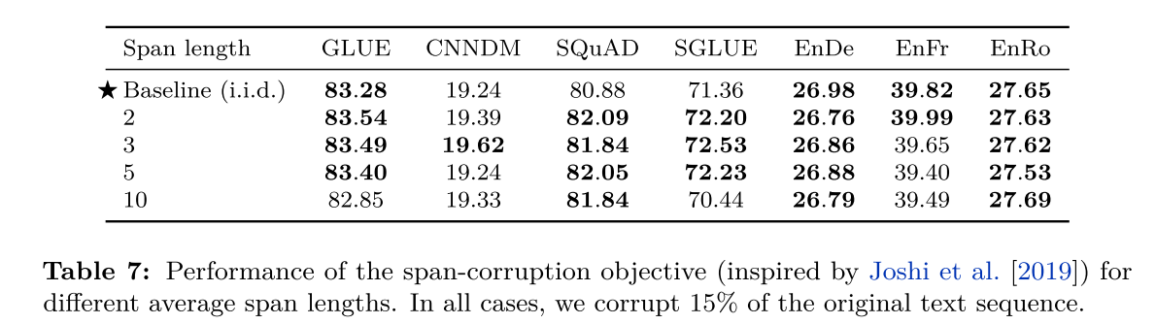
Unsupervised Objectives
i.i.d corruption vs. span corruption (SpanBERT)
Many small spans vs. Little large spans
Long target vs. Short target (No. of spans + No. of masked tokens)
Slow vs. Fast
Slightly but significantly improvement

Slide 26
Unsupervised Objectives
Message:
Small modification to the masked language model objective may not leads to significant improvement.
Try something different!

Slide 27
Empirical Survey
Methodology “coordinate descent”
Baseline → Architecture → Objective → Dataset
→ Transfer Approach → Scaling

Slide 28
Pre-training Datasets
C4: Common Crawl with heuristic filterin
Unfiltered C4: Common Crawl only use use langdetect to extract English text
RealNews-like: omitted any non-news content in C4
WebText-like (GPT2-like): high Reddit score webpages in C4
Wikipedia
Wikipedia + Toronto Books Corpus (BERT)

Slide 29
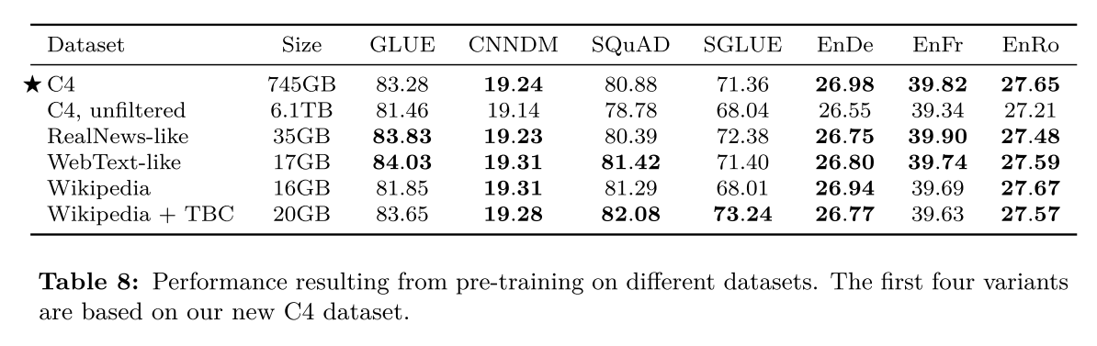
Pre-training Datasets
Pre-training on in-domain unlabeled data can improve performance on downstream tasks.
Due to ReCoRD,
News domain
Due to MultiRC,
the same domain as TBC
SQuAD, from Wikipedia

Slide 30
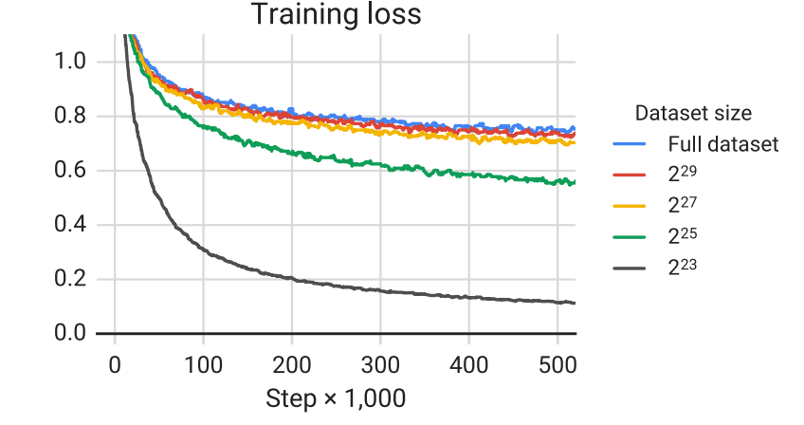
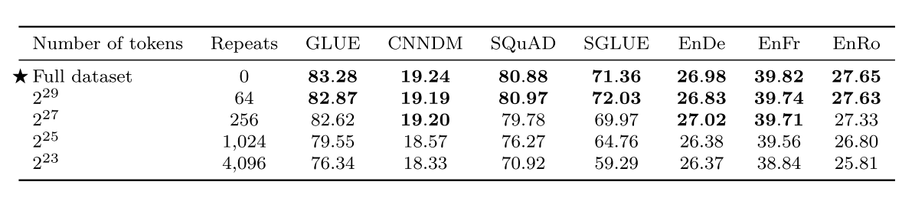
Pre-training Datasets
Size
The larger the better
2³⁵
2³⁵

Slide 31
Empirical Survey
Methodology “coordinate descent”
Baseline → Architecture → Objective → Dataset
→ Transfer Approach → Scaling

Slide 32
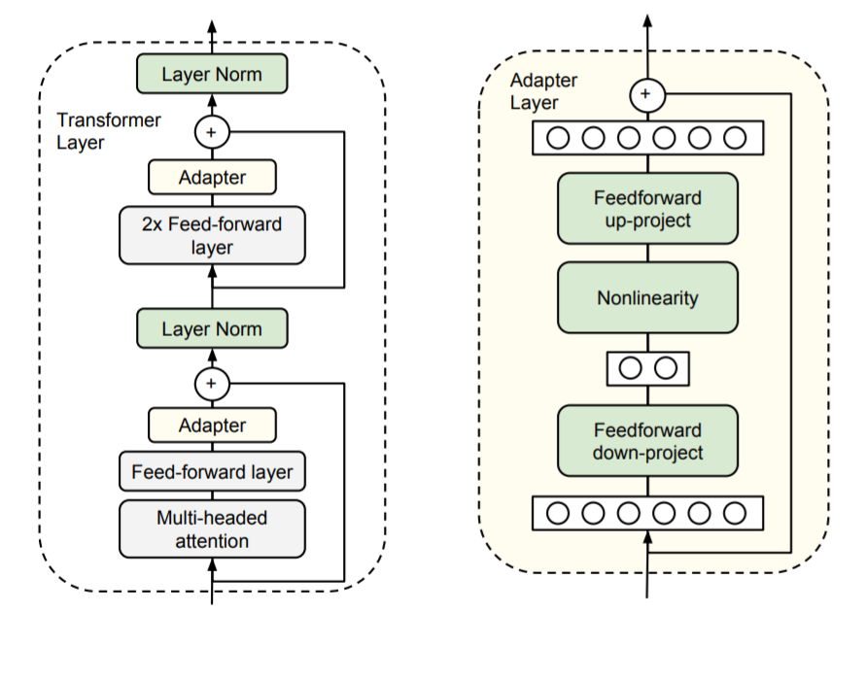
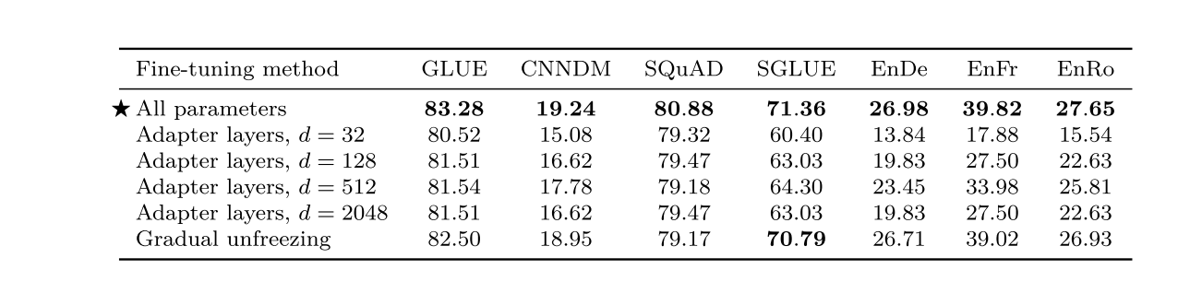
Transfer Approaches
Adaptive Layers (Houlsby 2019):
Only adaptive layers are updated

Slide 33
Transfer Approaches
Gradual Unfreezing (ULMFiT):
First unfreeze the last layer → the next lower layer

Slide 34
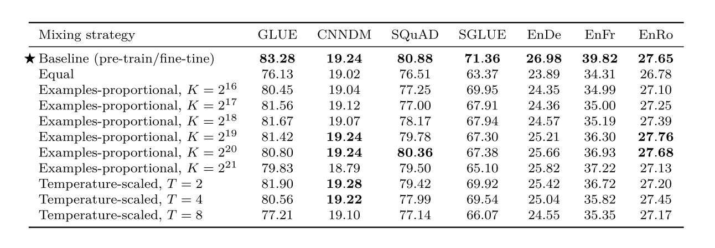

Transfer Approaches
Multi-task learning:
Examples-proportional mixing: $r_{m}∝s_{m}$
Temperature-scaled mixing (Multilingual BERT): $r_{m}∝s_{m}^{1/T}$
Equal mixing: $r_{m}∝1$ worst

Slide 35
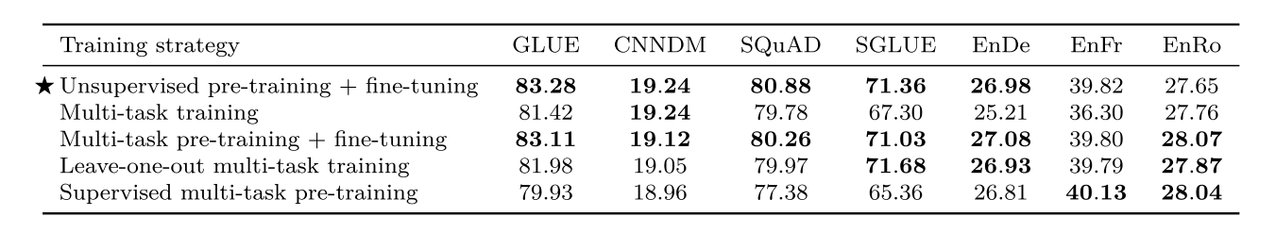
Transfer Approaches
Pretrain → Multi-task learning → Single-task fine tune (MTDNN)

Slide 36
Empirical Survey
Methodology “coordinate descent”
Baseline → Architecture → Objective → Dataset
→ Transfer Approach → Scaling

Slide 37
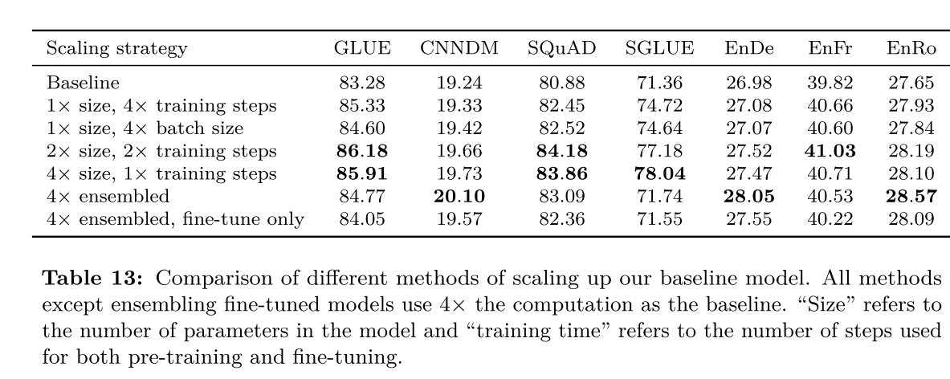
Scaling
With similar computation cost
increasing the training time and increasing the model size can be complementary

Slide 38
State-of-the-Art
Baseline + Architecture + Objective + Dataset
+ Transfer Approach + Scaling

Slide 39
SOA model
Objective: span-corruption (SpanBERT)
Longer training: 1M steps + 2048 batch size → 1T tokens
8x BERT, 2x XLNet, ½ x RoBERTa
Model sizes:
Small: 60M Base: 220M Large: 770M XLarge: 3B XXLarge: 11B
Multi-task pre-training: √
Finetune on GLUE and SuperGLUE: 8 batch size

Slide 40
