Slide 1
DEFENSIVE SECURITY PORTFOLIO
SentinelForge
A Docker-first lab for controlled ATT&CK simulation,
explainable detections, and graph investigation.
Notes:
Open with the engineering claim: this is one inspectable system spanning endpoint behavior, telemetry, detection, investigation, and regression.
[Sources]
- X:\dev\GitHub\SentinelForge\README.md:3-5
[/Sources]

Slide 2
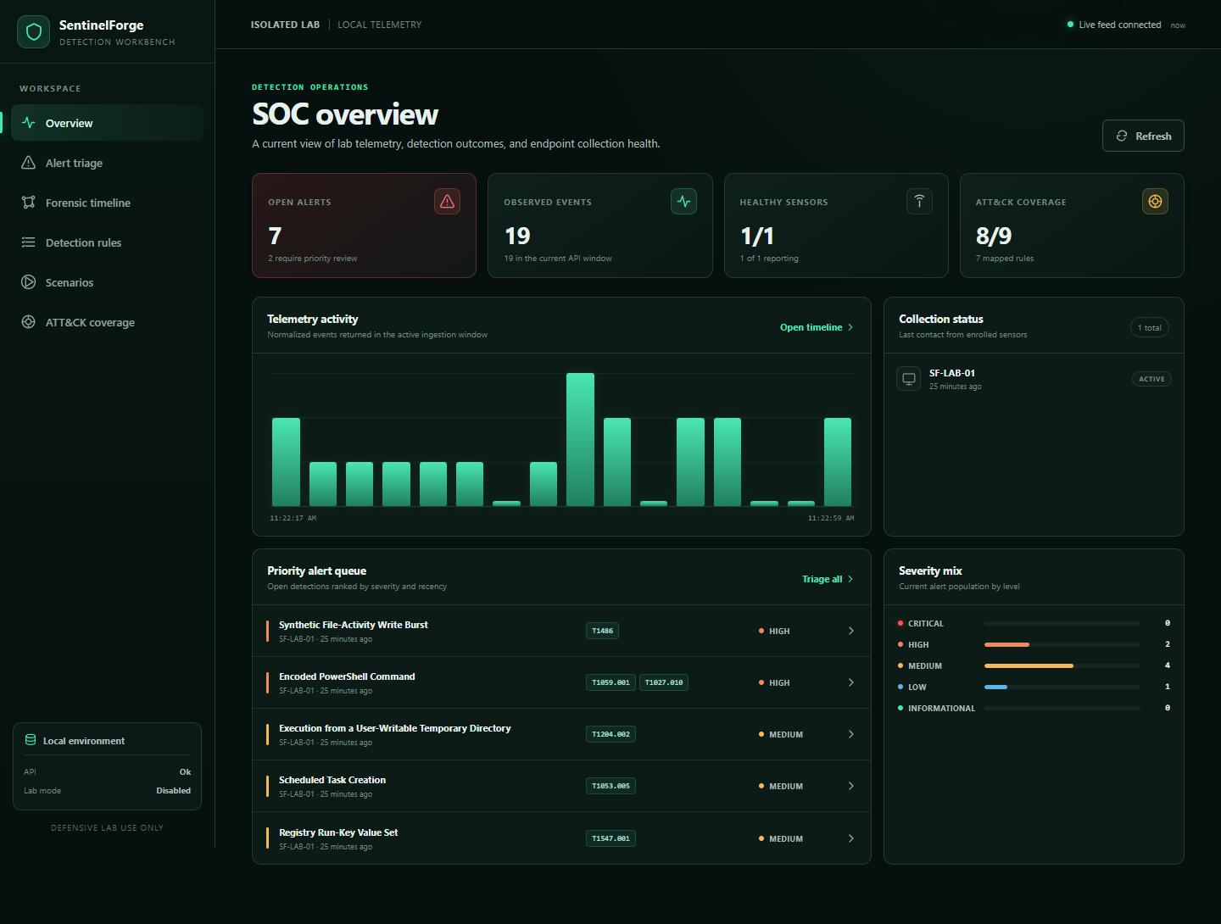
A working lab—not a mockup
Real seed-1337 Compose capture
19 normalized events · 7 alerts
27 graph nodes · 39 typed edges
8 of 9 cataloged techniques covered by rules
Repeat seeding remained idempotent
2
Notes:
Treat the numbers as regression evidence for the deterministic demo—not as throughput, scale, or detection-effectiveness claims. The screenshot is a real capture from the running Compose stack.
[Sources]
- X:\dev\GitHub\SentinelForge\docs\assets\sentinelforge-overview.png
- X:\dev\GitHub\SentinelForge\docs\validation-report.md:65-71
[/Sources]

Slide 3
I built the complete detection loop
01 · GENERATE
02 · INTERPRET
03 · INVESTIGATE
Controlled behavior
Eight allowlisted scenarios—or deterministic synthetic telemetry—create known-positive and near-miss activity.
Telemetry to decisions
Sysmon XML is normalized, stored, evaluated by a strict Sigma subset, and correlated across time windows.
Evidence to regression
Alerts expose why they fired; the timeline links evidence; cleanup and replay prove stability.
3
Notes:
The key differentiator is the closed loop. Each stage produces evidence the next stage can inspect, and the final regression path returns to the beginning.
[Sources]
- X:\dev\GitHub\SentinelForge\README.md:30-50
- X:\dev\GitHub\SentinelForge\docs\architecture.md:3-46
[/Sources]

Slide 4
Trust boundaries shape the stack
Isolated Windows lab
Safe scenarios + Sysmon event channel
.NET 8 sensor
A bounded modular monolith
Windows stays outside Compose because Event Log and DPAPI are host boundaries.
The API owns ordering-sensitive ingestion and correlation.
PostgreSQL is internal-only; the dashboard and CLI use the API boundary.
Normalize · durable spool · authenticated batches
Authenticated JSON
DOCKER NETWORK
FastAPI modular monolith
Enroll · ingest · validate · detect · correlate · live feed
read / write
API views
PostgreSQL
Investigation
Events, rules, alerts, scenarios, correlation state
React/Nginx dashboard + sentinelctl
4
Notes:
Explain the tradeoff: one API process keeps event ordering and correlation state explicit for a small lab. The project documents multi-instance processing as future work rather than pretending a broker fleet is already justified.
[Sources]
- X:\dev\GitHub\SentinelForge\docs\architecture.md:38-58
- X:\dev\GitHub\SentinelForge\docs\adr\0001-modular-monolith.md
- X:\dev\GitHub\SentinelForge\docs\adr\0003-windows-sensor-outside-compose.md
[/Sources]

Slide 5
Safe simulation is part of the security model
Behavior-shaped, deliberately benign
Eight fixed scenarios create telemetry patterns without accepting arbitrary scripts, destinations, registry targets, task names, or source files.
Run-key behavior uses a non-autostart key; scheduled tasks are disabled/no-op; ransomware behavior touches only generated marked files.
GATE
Lab mode + explicit live flag
SCOPE
SentinelForge sandbox only
REVERSAL
Manifest before mutation
VERIFY
Cleanup rechecks every artifact
5
Notes:
Safety is enforced at multiple independent layers: environment gate, catalog allowlist, fixed implementations, containment checks, manifest creation, and cleanup verification. Portable tests did not prove live registry or Task Scheduler integration.
[Sources]
- X:\dev\GitHub\SentinelForge\simulations\README.md:3-27
- X:\dev\GitHub\SentinelForge\simulations\catalog.json:3-68
- X:\dev\GitHub\SentinelForge\docs\threat-model.md
[/Sources]

Slide 6
Telemetry is durable before it is delivered
Abstract the event source
The Worker Service reads Sysmon through a testable source interface rather than coupling the pipeline to one channel implementation.
Normalize explicitly
Known XML fields map into normalized-event v1; unsupported event IDs are rejected instead of becoming invented generic data.
Spool before advancing
A batch is persisted locally before the cursor moves; disk use is bounded and the oldest complete batch is dropped at the limit.
Deliver with bounded failure
Sensor identity is DPAPI-protected; authenticated batches retry with bounded backoff and report health state.
6
Notes:
Avoid calling the spool lossless: its explicit safety bound trades oldest-batch retention for predictable disk use. Real Sysmon collection, Windows service installation, and DPAPI under the final service identity were not verified here.
[Sources]
- X:\dev\GitHub\SentinelForge\agent\README.md:3-15
- X:\dev\GitHub\SentinelForge\agent\README.md:55-61
- X:\dev\GitHub\SentinelForge\schemas\normalized-event-v1.schema.json
[/Sources]

Slide 7
Detection semantics are explicit and testable
Validated Sigma subset
A documented YAML subset is deterministic. Unsupported conditions and modifiers fail validation instead of degrading silently.
Stateful correlation
Time windows, grouping keys, ordered sequences, thresholds, and deduplication cover behavior a single event cannot express.
Explainable alerts
Every result retains the rule version, reason, matched events, ATT&CK tags, severity, confidence, false positives, and guidance.
7
Notes:
This is intentionally not arbitrary Sigma compatibility. The narrow subset is valuable because validation, evaluation, and evidence formatting share one deterministic contract.
[Sources]
- X:\dev\GitHub\SentinelForge\detections\README.md:3-5
- X:\dev\GitHub\SentinelForge\detections\rules\suspicious_process_sequence.yml:28-39
- X:\dev\GitHub\SentinelForge\detections\rules\ransomware_file_burst.yml:23-33
- X:\dev\GitHub\SentinelForge\backend\sentinelforge\services.py:384-407
[/Sources]

Slide 8
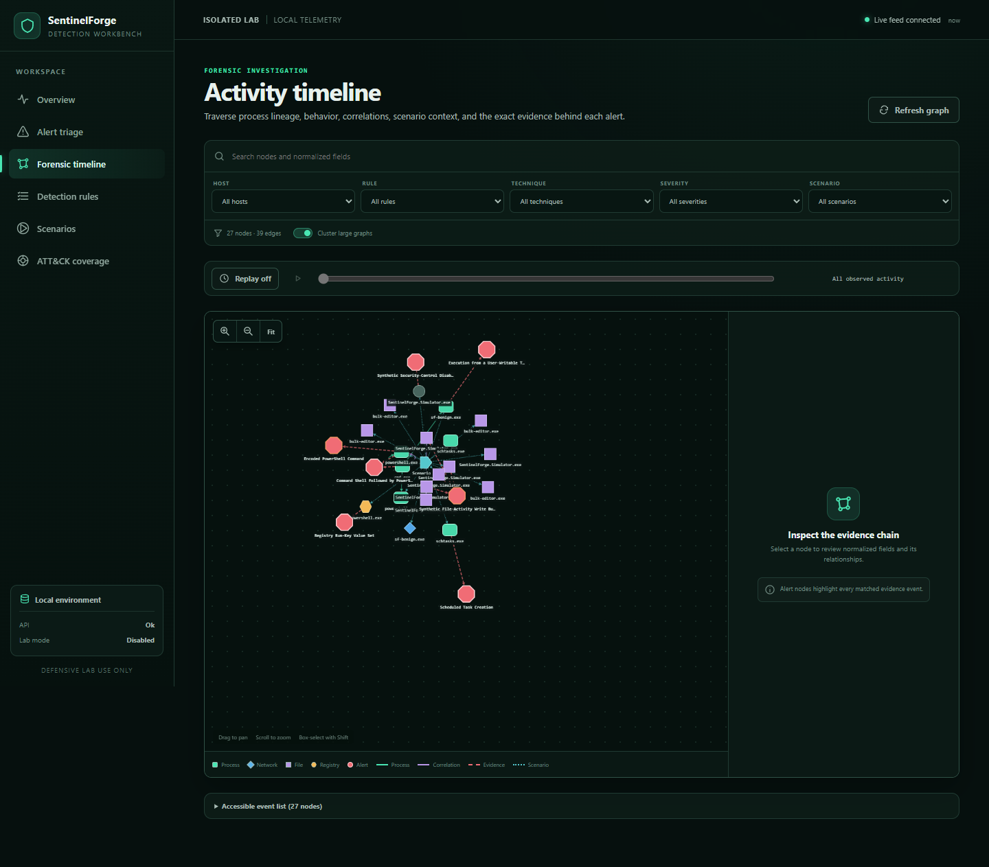
A timeline built for investigation
Evidence stays connected
Typed edges separate process lineage, activity, alert evidence, correlation, and scenario membership.
Filters, replay, clustering, and evidence highlighting preserve investigative context.
A bounded query and accessible event list keep the graph usable and reviewable.
8
Notes:
The graph is a projection of normalized data, not kernel-attested truth. The implementation deliberately bounds results and clusters large graphs to protect the browser.
[Sources]
- X:\dev\GitHub\SentinelForge\docs\assets\sentinelforge-timeline.png
- X:\dev\GitHub\SentinelForge\docs\timeline.md:3-17
- X:\dev\GitHub\SentinelForge\frontend\src\timeline\TimelineCanvas.tsx:123-204
- X:\dev\GitHub\SentinelForge\frontend\src\timeline\graph.ts:126-194
[/Sources]

Slide 9
Secure defaults make the safe path the easy path
Layered controls
Network exposure, identity, request bounds, process privileges, and lab execution are constrained independently.
A single misconfiguration should not silently turn a local research stack into an internet-facing control plane.
Constrained external edge
Contained internal plane
UI and API bind to loopback
Enrollment, admin, and sensor credentials are separate
Schemas, batches, bodies, and spools are bounded
PostgreSQL is never published
Token digests + pepper; parameterized queries
Non-root containers, cap drop, no-new-privileges
9
Notes:
These controls are appropriate for an isolated lab. They do not replace TLS termination, enterprise identity, multi-user RBAC, or internet-facing hardening.
[Sources]
- X:\dev\GitHub\SentinelForge\compose.yaml:3-118
- X:\dev\GitHub\SentinelForge\docs\security-model.md:3-26
- X:\dev\GitHub\SentinelForge\backend\sentinelforge\security.py:14-52
[/Sources]

Slide 10
Validation crosses every implementation boundary
Executed for the repository state recorded 2026-07-27 · these are regression counts, not effectiveness or scale metrics
29
backend pytest
14
frontend tests
4
CLI tests
22
.NET xUnit tests
46
simulation safety assertions
5
Playwright flows
7
rules validated
✓
idempotent demo replay
10
Notes:
The validation report records host and container tests, live Compose flows, migration state, security headers, dependency audits, and deterministic replay. Hosted CodeQL, dependency review, and SBOM jobs are defined but were not independently executed locally.
[Sources]
- X:\dev\GitHub\SentinelForge\docs\validation-report.md:3
- X:\dev\GitHub\SentinelForge\docs\validation-report.md:35-78
[/Sources]

Slide 11
I connect security logic to shipped software
Security architecture
Translate threat models into trust boundaries, privilege constraints, authenticated interfaces, and failure-safe defaults.
Endpoint engineering
Work across Sysmon semantics, Windows service constraints, C# durability, identity protection, and bounded retry behavior.
Detection engineering
Map ATT&CK behaviors into validated Sigma-like rules, stateful correlation, evidence, and false-positive guidance.
Product delivery
Ship FastAPI, PostgreSQL, React, Cytoscape, PowerShell, Docker, tests, CI, ADRs, and operational documentation as one system.
11
Notes:
This is the abilities synthesis: the project is strongest as evidence of cross-boundary engineering judgment, not as a claim that any single component equals a commercial platform.
[Sources]
- X:\dev\GitHub\SentinelForge\README.md:251-253
- X:\dev\GitHub\SentinelForge\docs\validation-report.md:19-30
[/Sources]

Slide 12
The strongest claim includes its boundary
Engineering judgment is part of the deliverable
SentinelForge proves a reproducible, inspectable defensive lab and the discipline to state exactly what its evidence supports.
It does not turn synthetic validation into a claim of enterprise EDR or SIEM equivalence.
Proven here
Not proven here
Deterministic, reversible lab behavior
Authenticated ingestion + explainable alerts
Compose reproducibility + regression evidence
EDR/SIEM equivalence or full ATT&CK/Sigma
Real Sysmon service and non-dry Windows runs
Internet-facing, distributed, or performance scale
12
Notes:
Close on credibility: the documented boundary is a feature. It shows the ability to distinguish implementation evidence from product equivalence, platform scale, and adversary-resistant validation.
[Sources]
- X:\dev\GitHub\SentinelForge\README.md:255-270
- X:\dev\GitHub\SentinelForge\docs\validation-report.md:80-90
[/Sources]

