Slide 1
Input:
proteins
Input:
genome assembly
Input:
transcripts
optional
fasta
fasta
fasta
fasta
Phase I:
spliced alignment
Miniprot
Minimap2
gtf
gtf
gtf
Input:
transcript gtf
optional
Phase II:
model merging
Taco
Stringtie
gtf
Stringtie
gtf
Busco
Input:
proteins for functional annotation
optional
Phase III:
CDS and functional annotation
TransDecoder
gtf
protein fasta
eggNog
Output:
Bed12-like gene model structure and function DB
Lastal -P
txt
Output:
mRNA
Phase IV:
DB formatting and sequence output
fasta
Output:
bedDB of best gene models
bed12-like
fasta
Output:
CDS
fasta
Output:
Protein

Slide 2
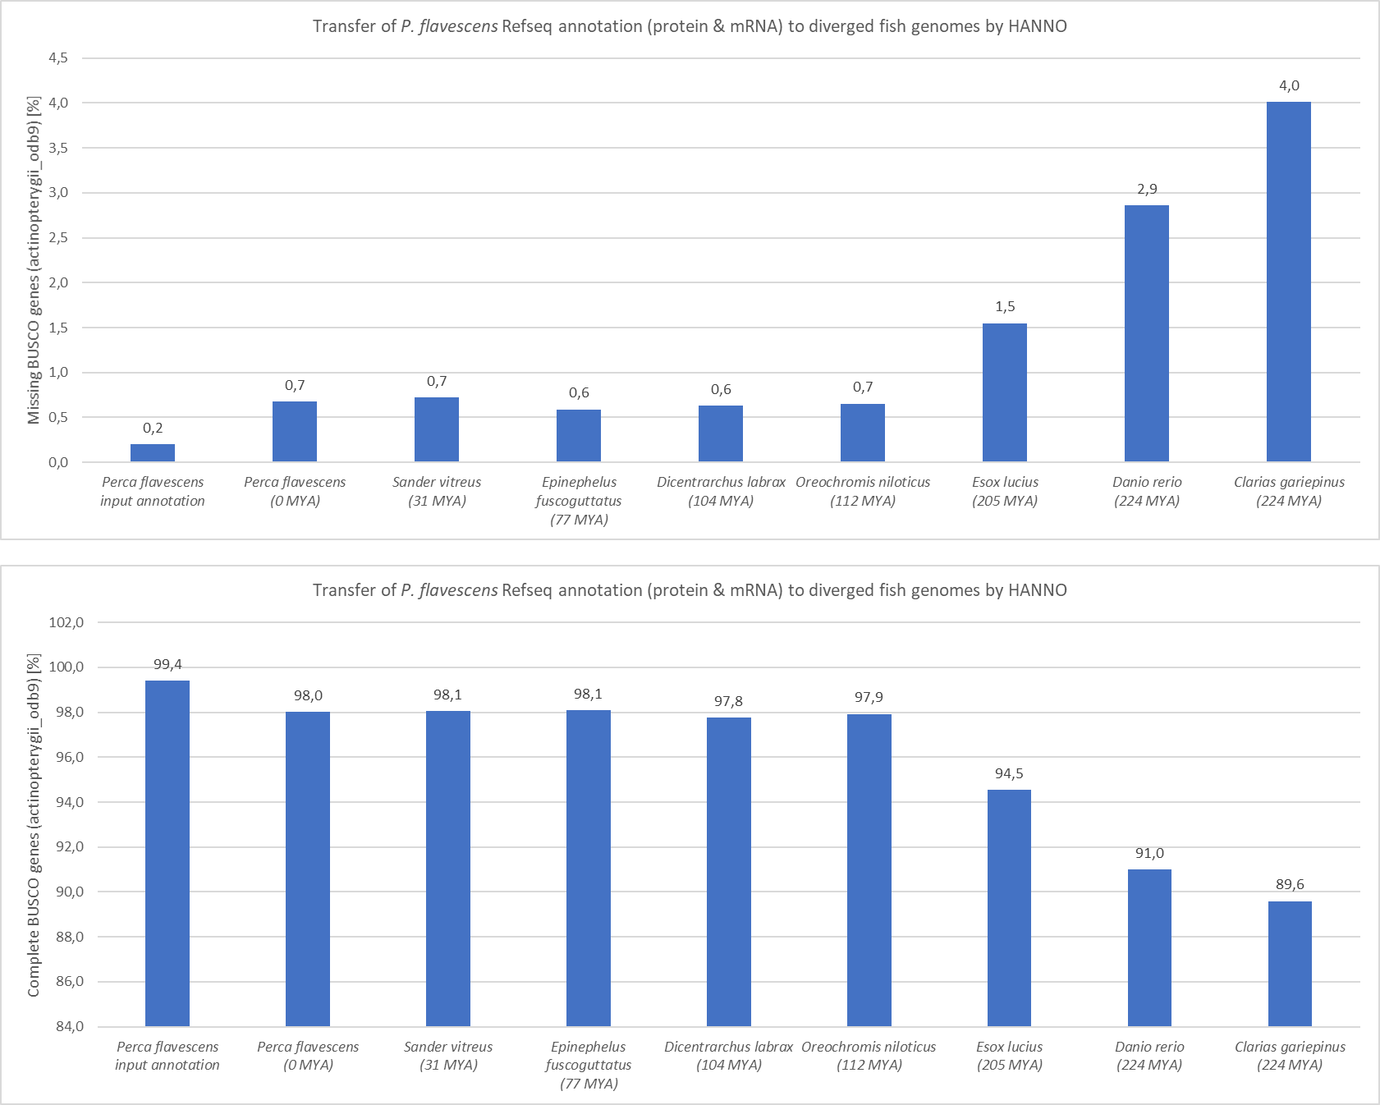
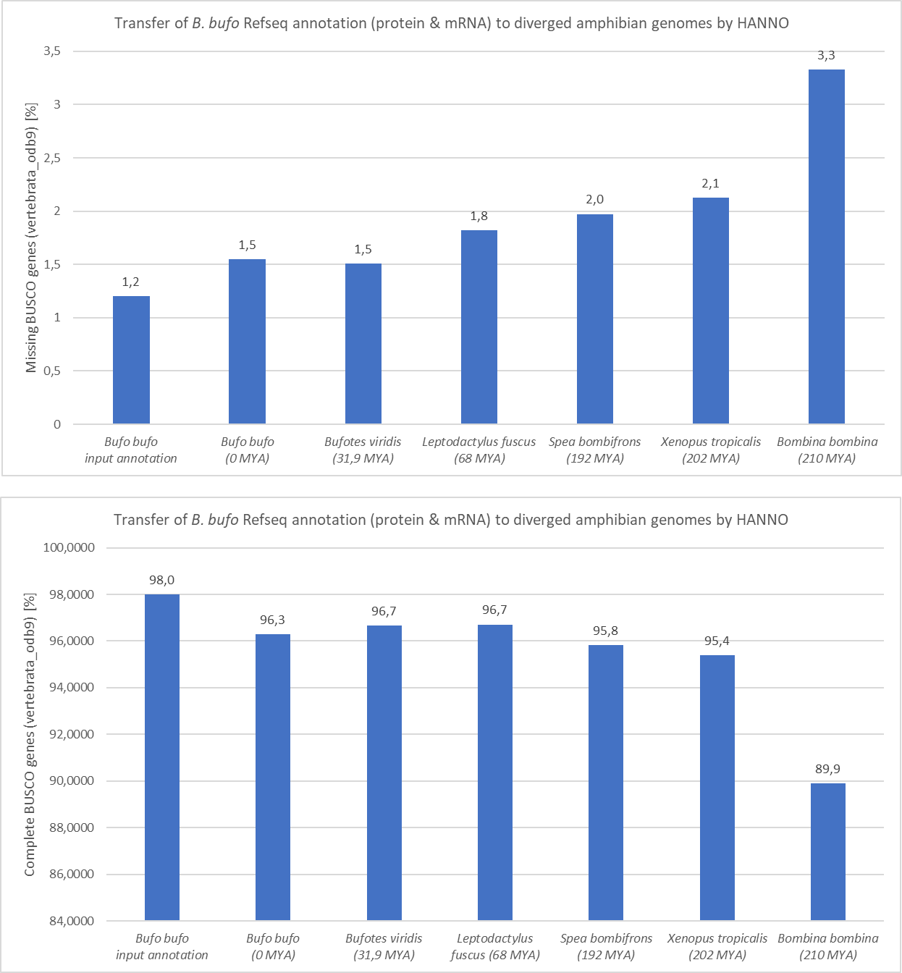
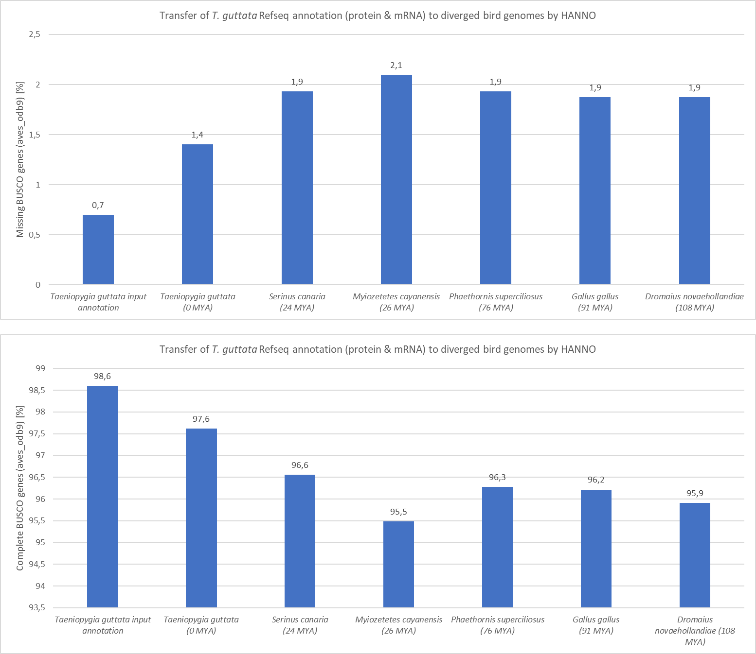
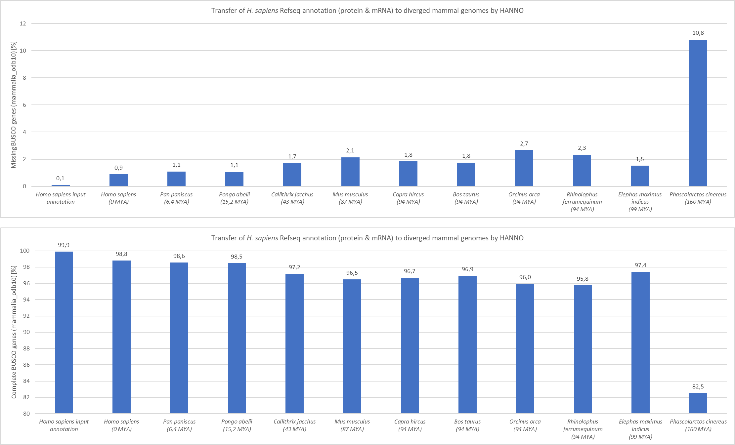
Fish
Amphibians
Mammals
Birds

