Slide 1
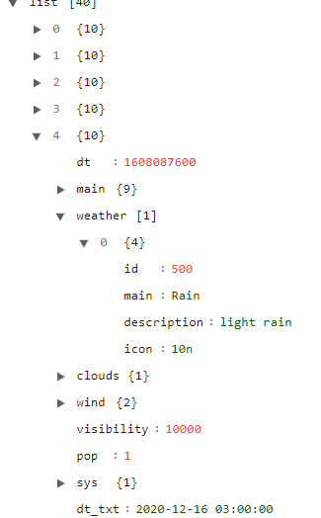
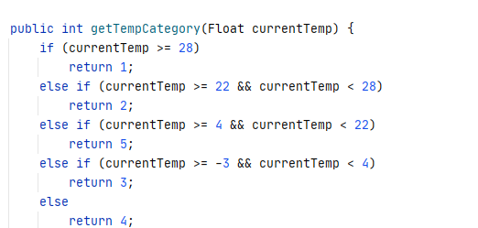
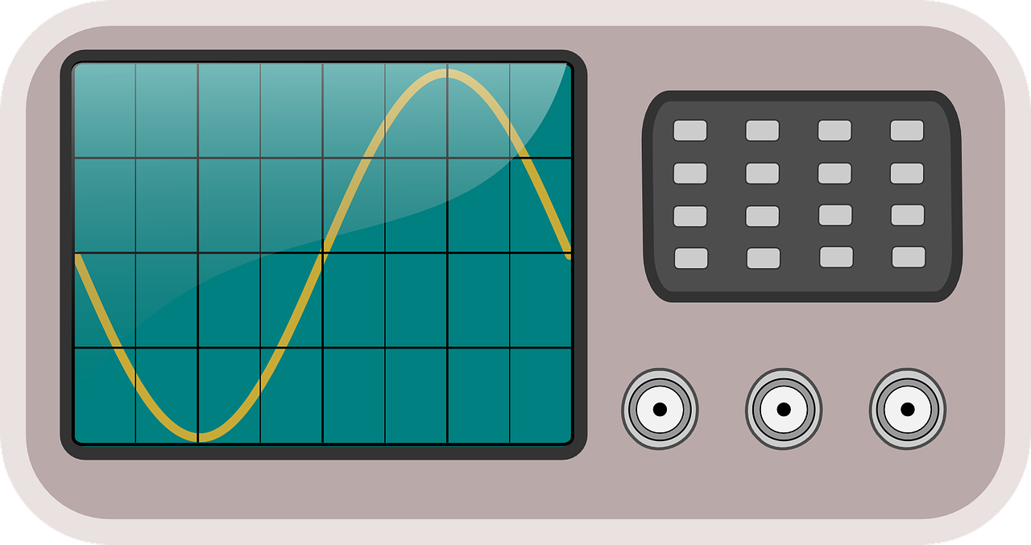
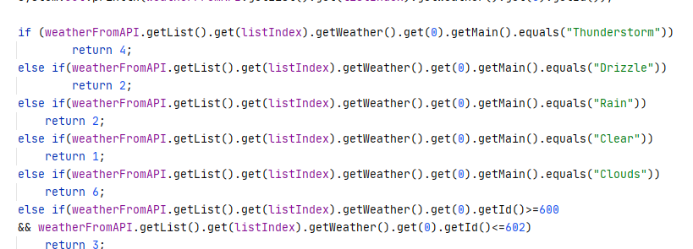
Temperature
Wind
Image
Weather
Category
Weather
Temperature
Category
Forecast Day
Forecast day
Correct data
Weather Analyzer
Weather description
Country

