Slide 1
FPU
By:
Abdulrahman Ragab hashim
Hussain Mustafa saied
Abdullah Khaled Kamal
Abdallah Mohammad Abo-elmagd
Mahmoud hassan Mohammad

Slide 2
Adder
Algorithm
Critical parts in code
Special cases

Slide 3
Multiplier
Algorithm
Critical parts in code
Special cases
Rounding algorithm

Slide 4
algorithm
1. exponent
Exponent 1
127
Exponent 1
127
Exponent 1 + Exponent 2
127+127
-127

Slide 5
algorithm
exponent
Exponent 1
127
Exponent 1
127
Exponent 1 + Exponent 2
127
∞
If overflow

Slide 6
algorithm
2. Concatenating the one and multiply the two fractions
1
Fraction 1
1
Fraction 2
c
Ofraction HI
Ofraction LO

Slide 7
algorithm
3. normalization
1
Fraction 1
1
Fraction 2
c
2
c
Ofraction HI
Ofraction LO

Slide 8
algorithm
exponent
exponent
1
∞
If overflow

Slide 9
output
4.sigen
Signe1
Sigen 2
sigen
Out exponent
Ofraction HI

Slide 10
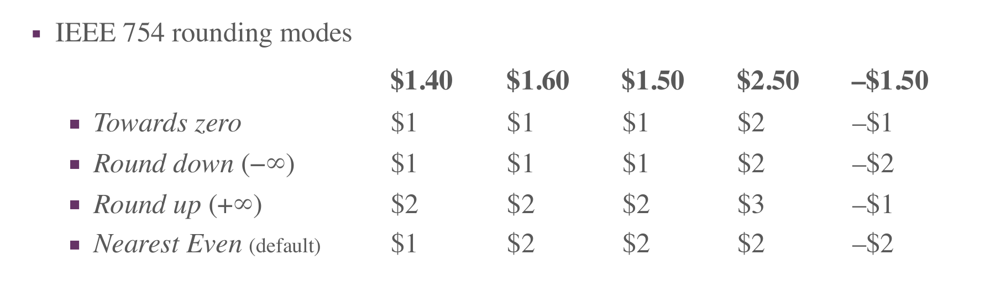
Rounding modes

Slide 11
Nearest even
c
Ofraction HI
Ofraction LO
>100
<100
3 bit
=100
odd
=100
even

Slide 12
Special cases
exponent
Ofraction HI
and
or
and
or
EX Ones flag
EX zero flag
frac Ones flag
zero Ones flag

Slide 13
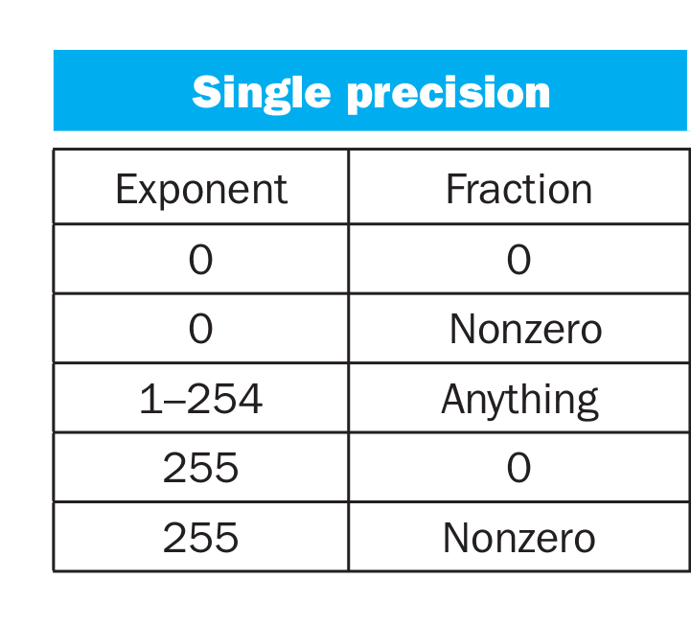
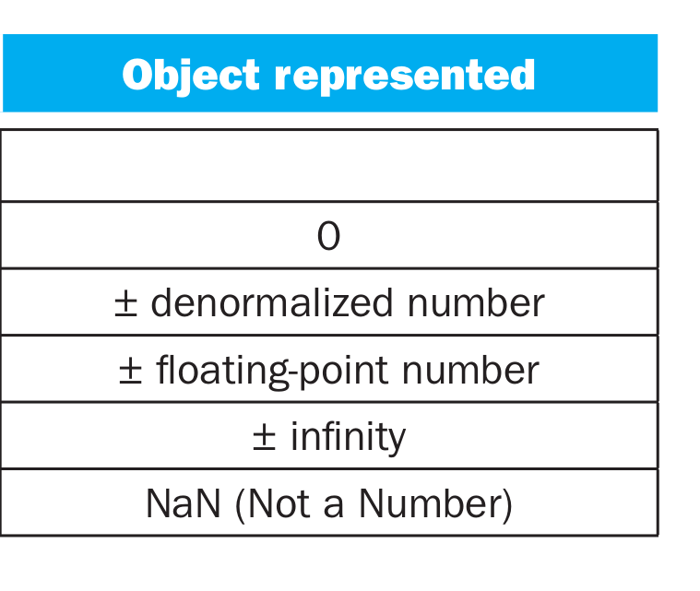
Special cases

Slide 14
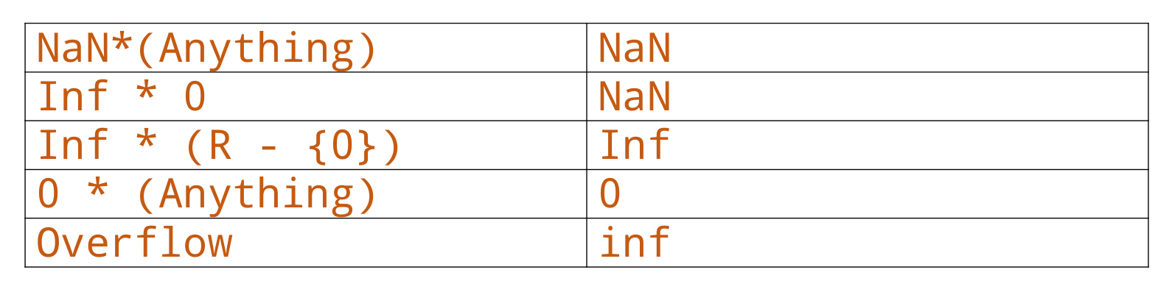
Special cases

Slide 15
testing
special
special
16
special
random
4*10(+/-)
random
random
20*2(+/-)

Slide 16
Divider
Algorithm
Critical parts in code
Special cases
Rounding algorithm

Slide 17
FPU

Slide 18
Funct | Output
00 | A + B
01 | A – B
10 | A / B
11 | A X B
XX | ZZ

Slide 19
One more thing.

Slide 20
FpuGUI
A friendly interactive testing software using our hardware implementation as a back-end logic

Slide 21
System Requirements
Unix based system
ModelSim interpreter
Python3

Slide 22
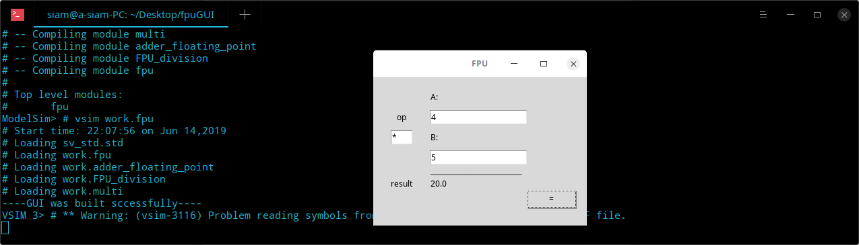
Screenshots

Slide 23
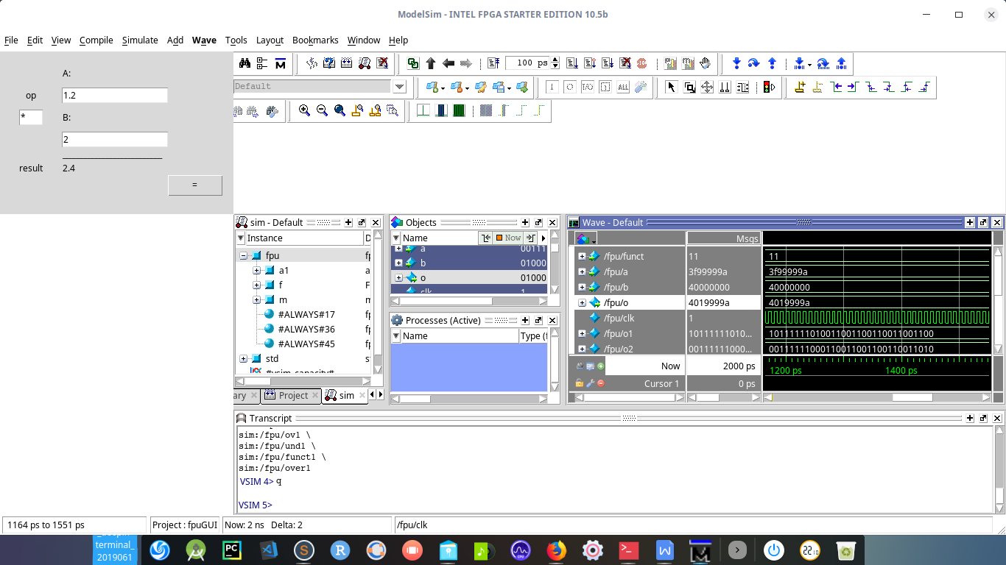
Screenshots

