Slide 1







SRA
Smart Recruitment
Assistant
Machine Learning Decision-Support System for Job-Change Intention
Presented By:
Hassan Muhammed

Slide 2


SRA
Recruitment Screening Challenge
Goal: estimate job-change intention, not hiring eligibility.
Candidate
Profiles
  HR teams review large volumes of candidate profiles.
  Manual screening takes time and may delay outreach.
  Recruiters need a data-driven signal to prioritize follow-up.
Manual
Review
Bottleneck
Delayed Recruiter Outreach

Slide 3
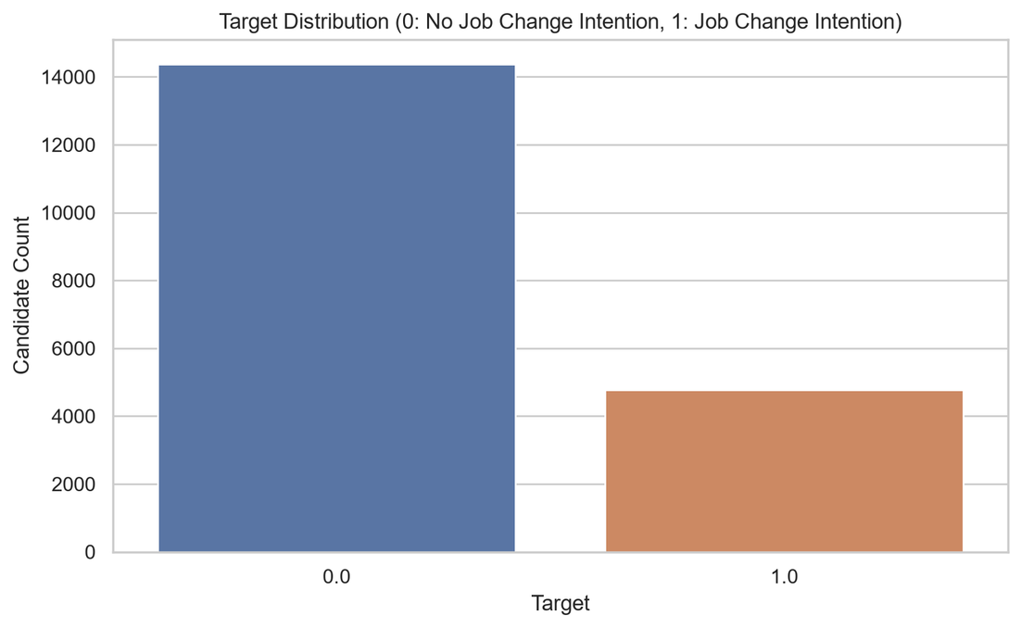

SRA
HR Analytics: Job Change of Data Scientists
Target = 0
Not looking for a job change
75.07%
Target = 1
Looking for a job change
24.93%
Examples: education level, experience, company type,
training hours, employment history, city development index.
19,158 Candidate Profiles
14 Data Columns

Slide 4
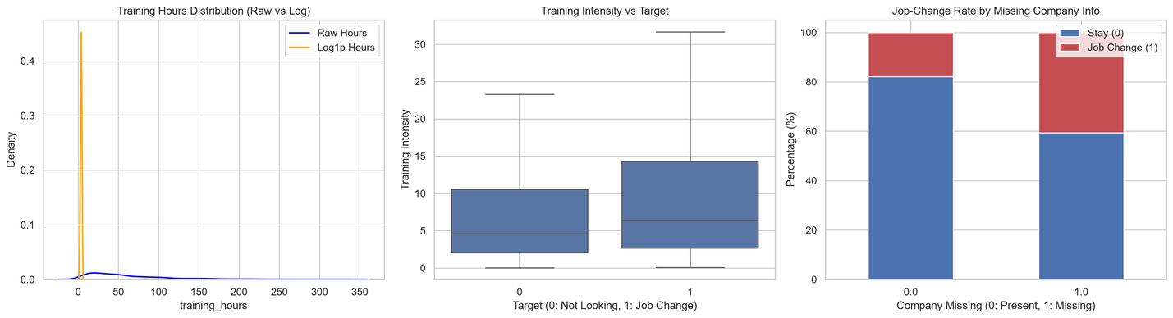
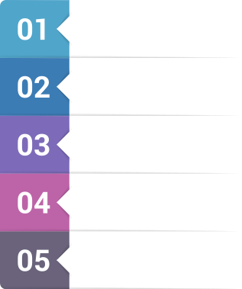
SRA
Data Preparation and Feature Engineering
Data quality
  No duplicate rows found
  Missing values handled inside the pipeline
  Sensitive feature excluded: gender
Engineered features
  experience_years
  training_hours_log
  training_intensity
  missing-value indicators
  city-development × experience interaction
Raw Data
Data Quality Checks
Train/Test Split
Pipeline-based Preprocessing
All imputers and encoders learn from training data only.
Model-ready Features

Slide 5



SRA
Modeling Approach
Training Data
Preprocessing Pipeline
  Numeric: Median Imputation
  Ordinal: Ordinal Encoding
  Nominal: One-Hot Encoding
Why F1 Score?
Classification Models
  Logistic Regression
  Random Forest
  XGBoost
The target classes are imbalanced,
so accuracy alone can be misleading.
F1-based Model Selection

Slide 6
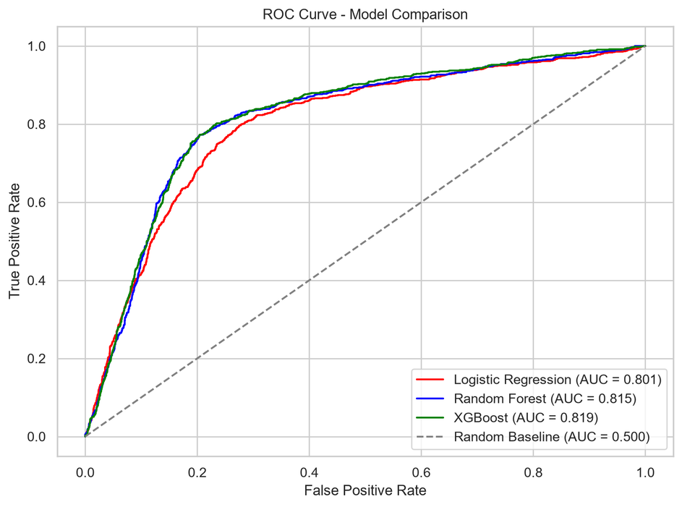
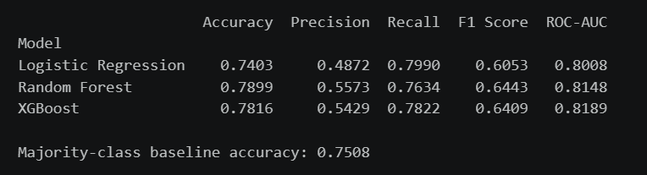
SRA
Model Evaluation Results
Selected model: Random Forest
Selection metric: F1 Score = 0.6383

Slide 7
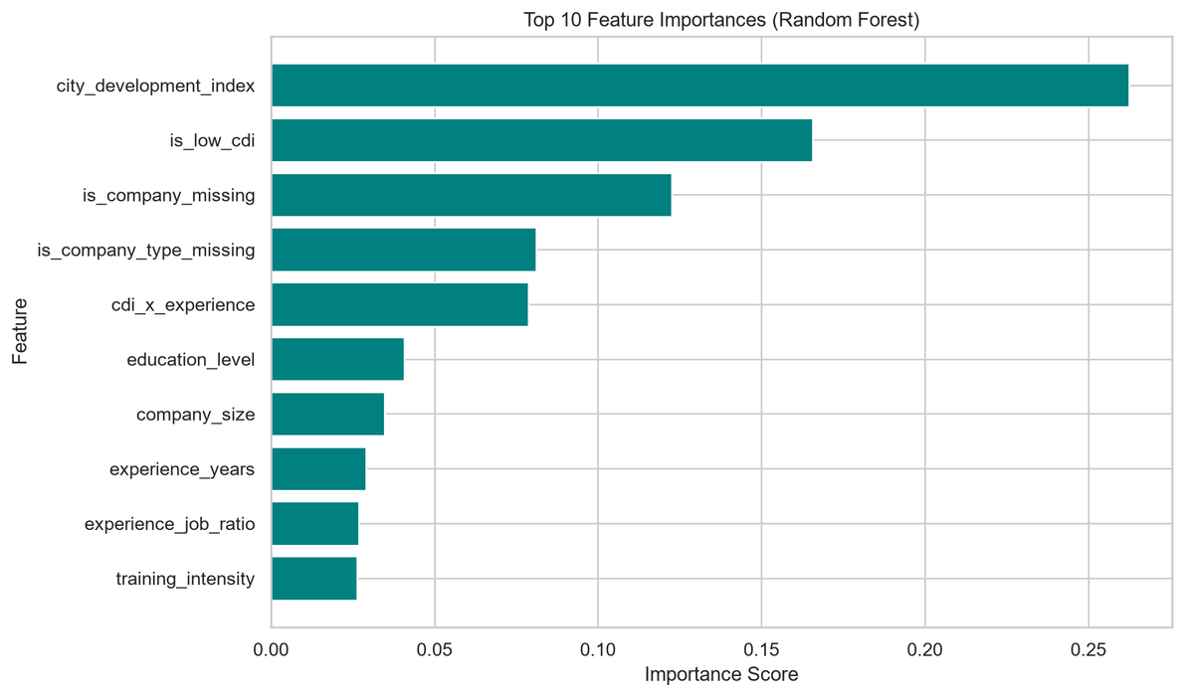
SRA
Insights and Interactive Application
Top predictive signals
  city_development_index
  is_low_cdi
  company information missingness
  • city-development × experience
  education level
  training intensity
The app supports:
  Single candidate analysis
  Batch CSV analysis
  Intent-based ranking
  CSV export
Production Architecture: FastAPI Backend (Pydantic validation) + Streamlit Web UI + Docker containerization.
Feature importance is predictive, not causal.

Slide 8
SRA
Business Impact and Responsible Use
Business value
Limitations
  Target measures job-change intention only
  No hire/reject outcome in the dataset
  No CV or job-description matching
  Requires fairness testing before real use
  Faster first-level candidate analysis
  Better prioritization for recruiter follow-up
  Consistent scoring through a saved ML pipeline
Next step: train on real hiring-outcome data
and add CV-to-job matching with fairness monitoring.

Slide 9
SRA
Thank
You

