Slide 1
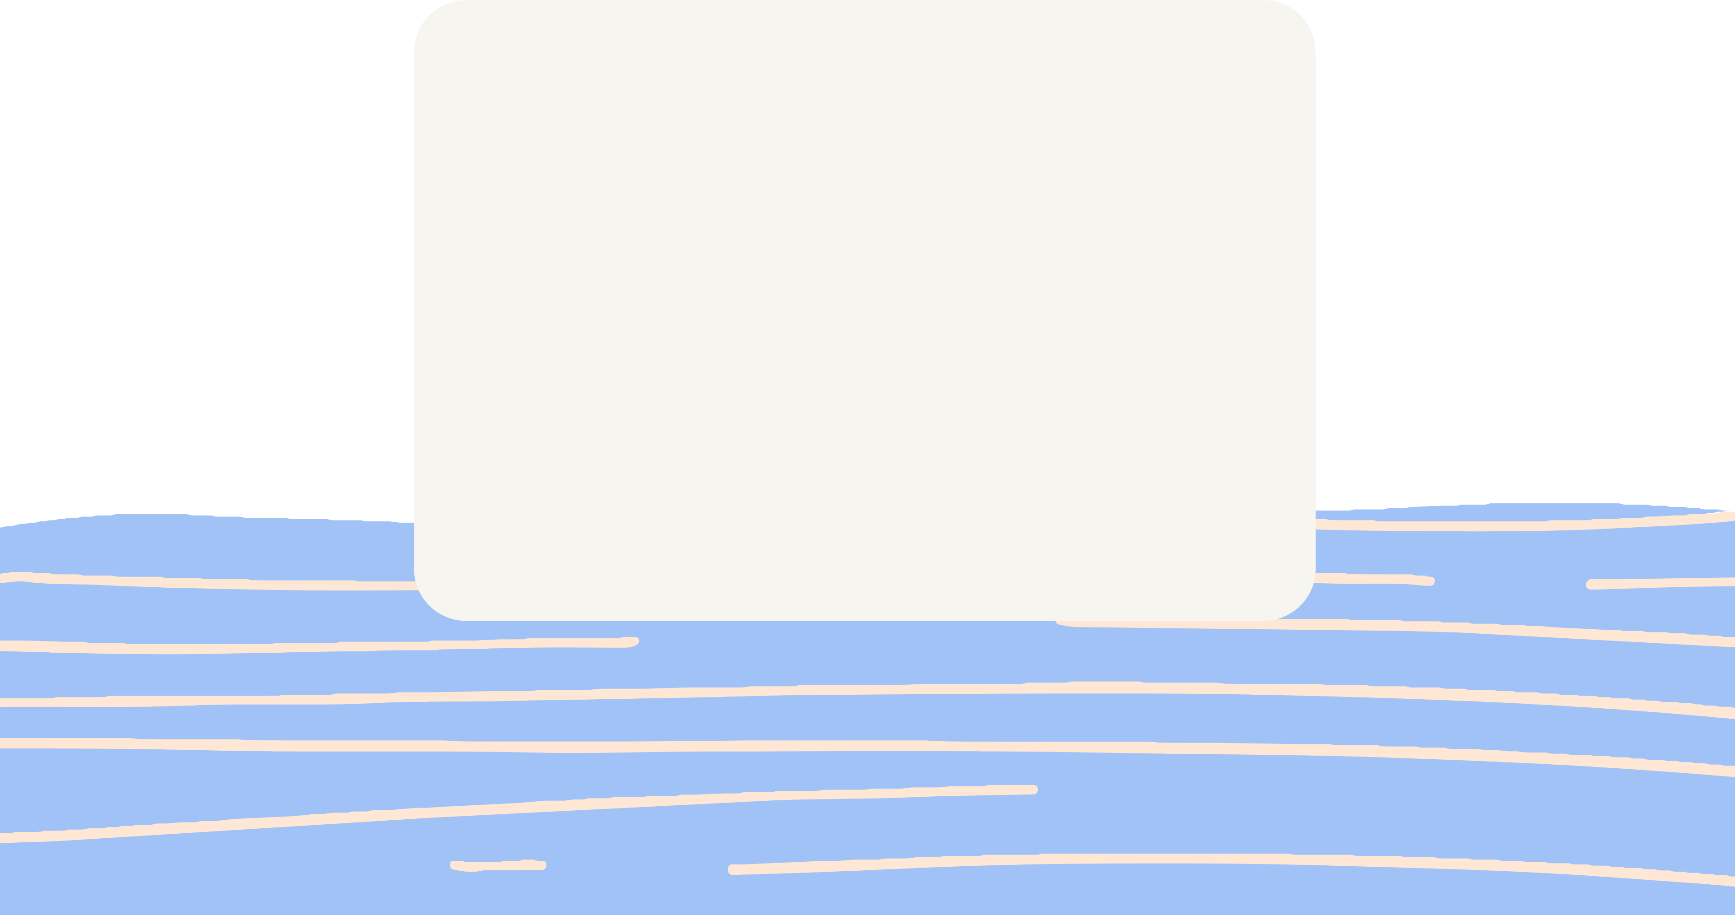



A* Algorithm
UNIVERSITY OF SCIENCE, VNU-HCM
Group 14 - CSC10004

Slide 2

SINCERELY, THANKS!!
Teacher Đinh Bá Tiến
Teacher Hồ Tuấn Thanh
Teacher Nguyễn Lê Hoàng Dũng Teacher Trương Phước Lộc
Team Member
19127216 - Đặng Hoàn Mỹ
19127544 - Nguyễn Hoàn Hoài Tâm
19127609 - Đinh Quang Tú

Slide 3


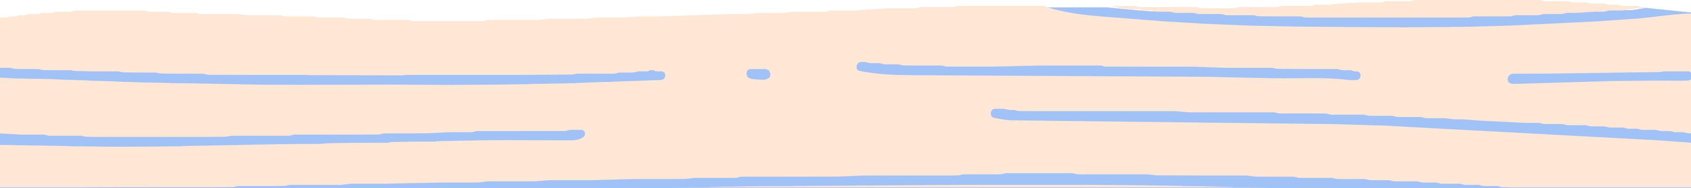
“WHAT??.”
Introduction
History
Terms & Data Structure
Implement
Complexity
Graph Example
Application
QUIZ!!!

Slide 4


What is
A* Algorithm?
19127609 – Đinh Quang Tú

Slide 5
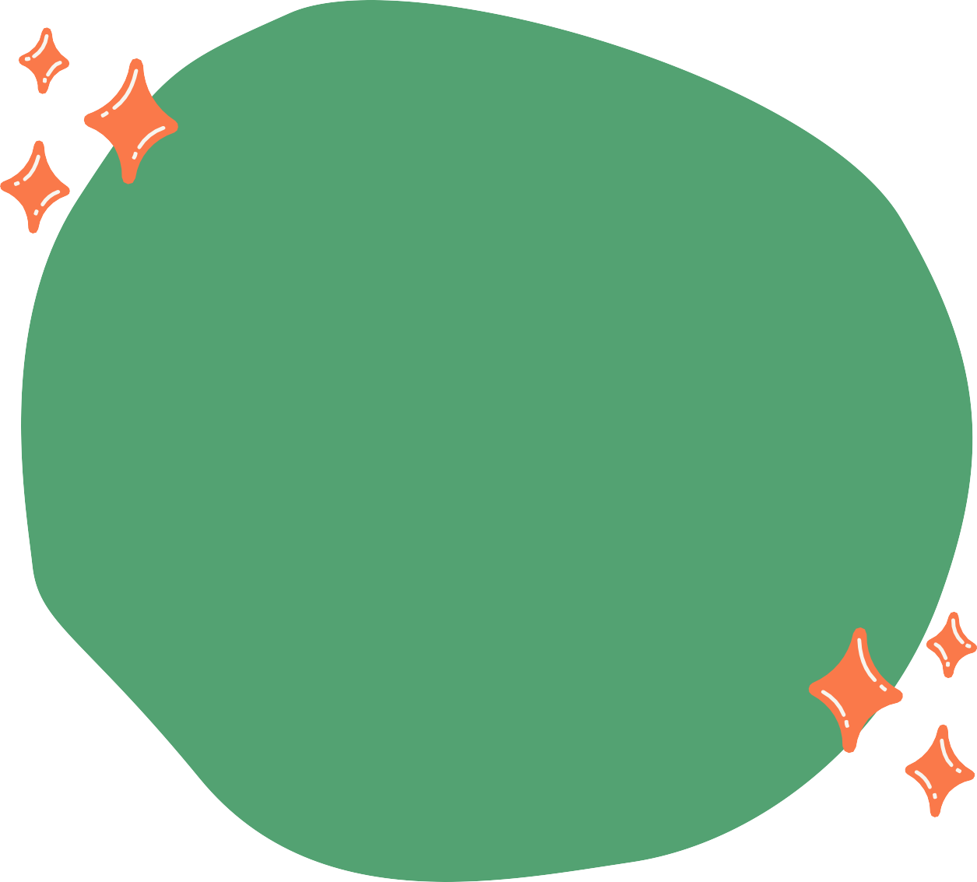
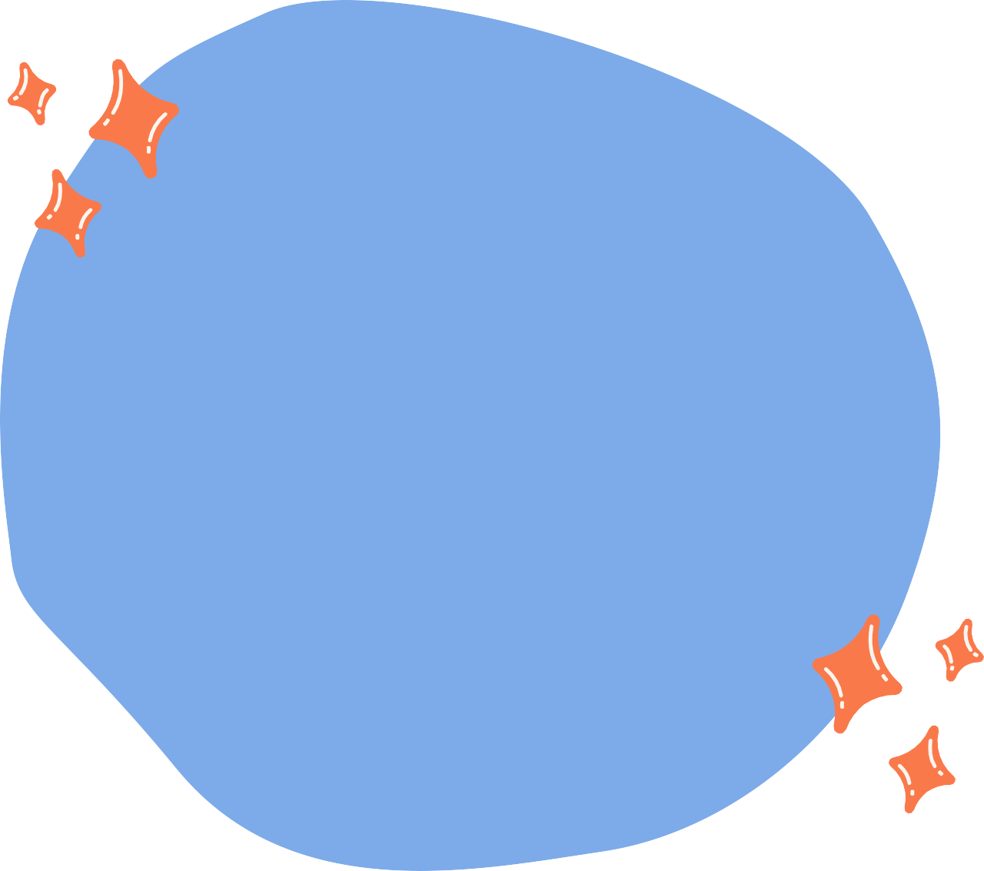
A* Algorithm is one of the most successful search algorithms to find the shortest path between nodes or graphs.
HOW CAN WE GO TO THE GOAL?
fast?
less consuming? many obstacles?
A* ALGORITHM
find the shortest distance; we also want save as much time as possible

Slide 6

HISTORY
1968
the Shakey project aimed to build a mobile robot that has artificial intelligence to plan its actions
combine heuristic approaches like Greedy Best- First-Search and formal approaches like Dijkstra's Algorithm.

Slide 7

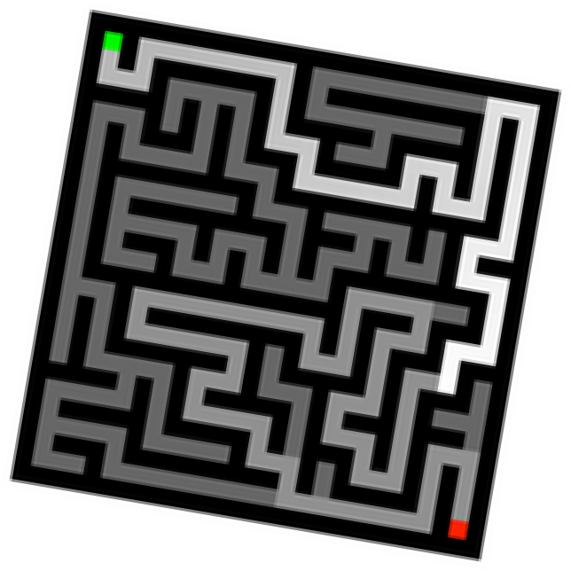
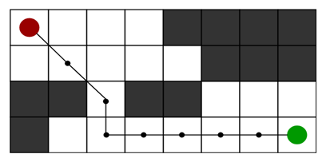
APPLICATION
Have everything you need within reach.
Graph Traversal & Path-findings
Games & Web-based maps
Warcarft III
2D Grid having several obstacles and we start from the source red cell to reach towards a goal green cell

Slide 8
What is
A* Algorithm?
19127216 – Đặng Hoàn Mỹ

Slide 9


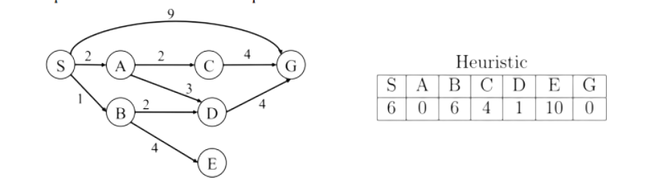


Terms
Heuristics? Cost? Admissible? Consistent?
Heuristics the estimated cost of moving from the current state to the goal state.
Cost the cost that we arrange on the graph (weight).

Slide 10
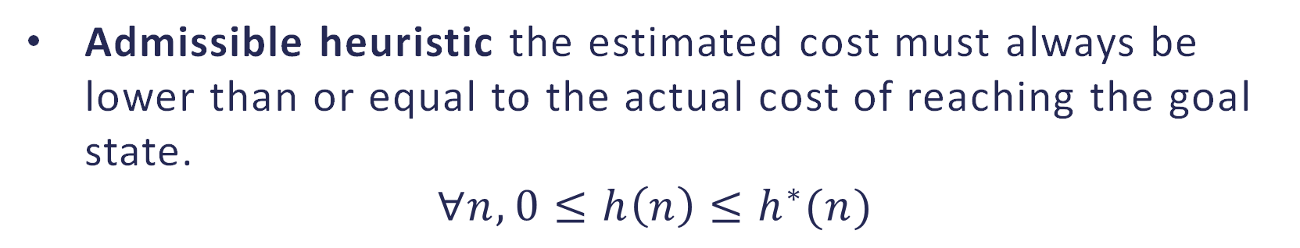
Terms
Heuristics? Cost? Admissible? Consistent?
Admissible heuristic the estimated cost must always be lower than or equal to the actual cost of reaching the goal state.
$$∀n, 0≤h\left(n\right)≤h^{∗}(n)$$

Slide 11
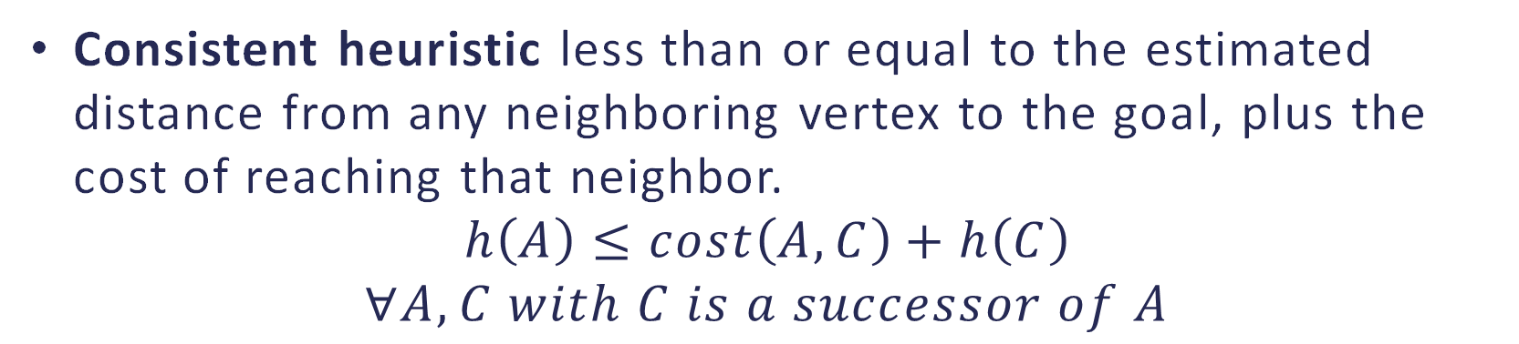
Terms
Heuristics? Cost? Admissible? Consistent?
Consistent heuristic less than or equal to the estimated distance from any neighboring vertex to the goal, plus the cost of reaching that neighbor.
$$h\left(A\right)≤cost\left(A, C\right)+h\left(C\right)$$
$$∀A, C with C is a successor of A$$

Slide 12

DATA STRUCTURE
This plays important role in A*.
frontier is a priority queue
-> keep track of the node
-> rearrange that to get the best node
frontier
?
?
?

Slide 13
DATA STRUCTURE
This plays important role in A*.
frontier is a priority queue
-> keep track of the node
-> rearrange that to get the best node
frontier
f(n) = g(n) + (n) | V | P
f(n) = g(n) + (n) | V | P
f(n) = g(n) + (n) | V | P

Slide 14
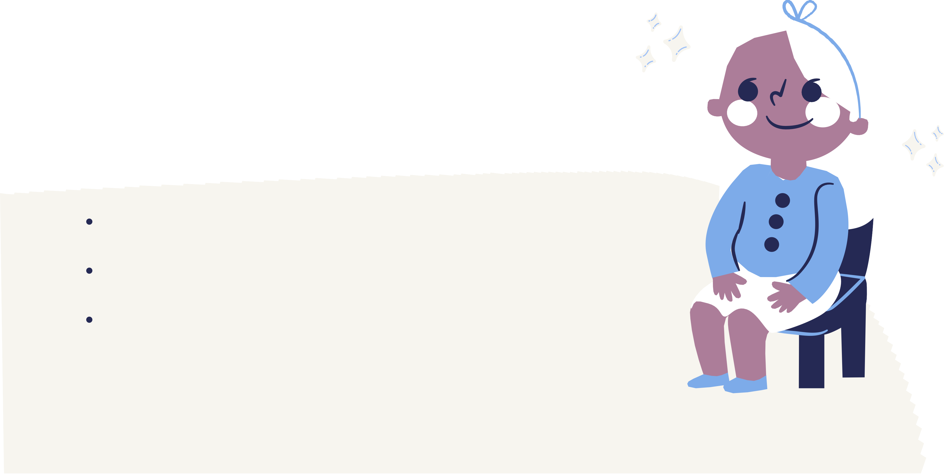
The main technique for this algorithm is using frontier as a priority queue to put the nodes while waiting.
IMPLEMENT
get the smallest cost of a path from that and put in the visited to mark up what has been visited
catch the goal, we start to reverse the path (the parents of visited nodes) that we saved in the expanded
there is no goal, we traverse all the children of that node and put it in the frontier with the formula
f(n) = g(n) + h(h)

Slide 15
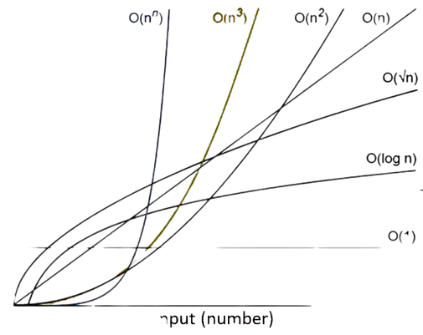
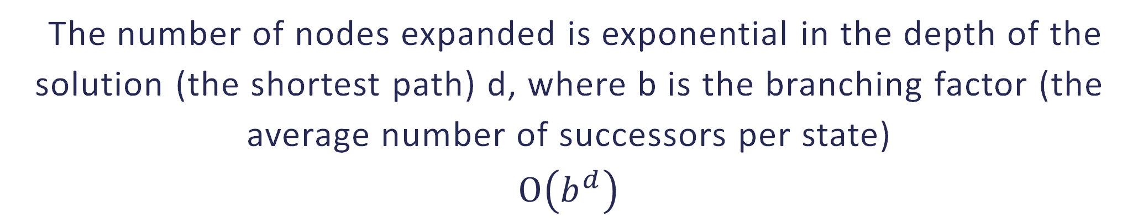
COMPLEXITY
The number of nodes expanded is exponential in the depth of the solution (the shortest path) d, where b is the branching factor (the average number of successors per state)
$$Ο\left(b^{d}\right)$$

Slide 16

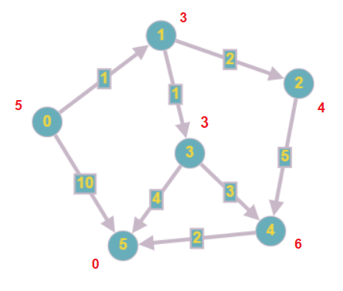
GRAPH EXAMPLE

Slide 17
Frontier
Expanded
f(n) = g(n) + h(n)
V
P
V
P
4 = 1 + 3
1
0
5 = 0 + 5
0
-1
7 = 3 + 4
2
1
10 = 10 + 0
5
0
11 = 5 + 6
4
3
5 = 2 + 3
3
1
5 = 6 + 0
5
3
Path
0
1
3
5
Is it better than any algorithm?

Slide 18

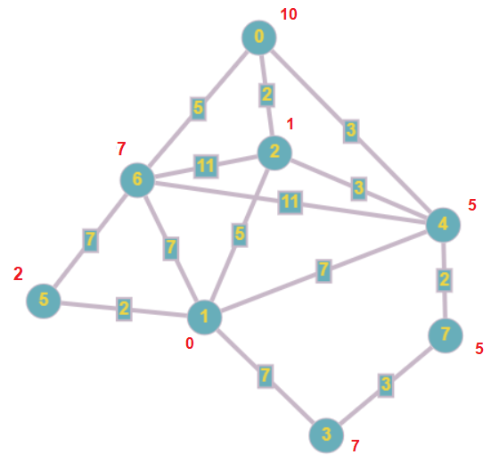
BETTER?
Dijkstra's Algorithm expands double number of nodes to find the same path. (0, 2, 4, 7, 6, 1)
A* Algorithm just expands only 3 nodes which is exact the same path. (0, 2, 1)

Slide 19
QUIZ!!!

Slide 20
Quang Tú – 25%
Find out the introduction and history
Some terminologies (heuristic, f(n) = g(n) + h(n))
Application
Hoàn Mỹ - 50%
Notes for implementation, time/ space complexity
Some terminologies (consistency and admissibility, completeness and optimality)
Comparison
Write source code (Graph)
Graph demo (draw -> result)
Report composer and PowerPoint arranger
Hoài Tâm – 25%
Find the questions for Quiz and put the questions on Kahoot
Template for PowerPoint and report

Slide 21
THANK YOU FOR LISTENING

