Slide 1

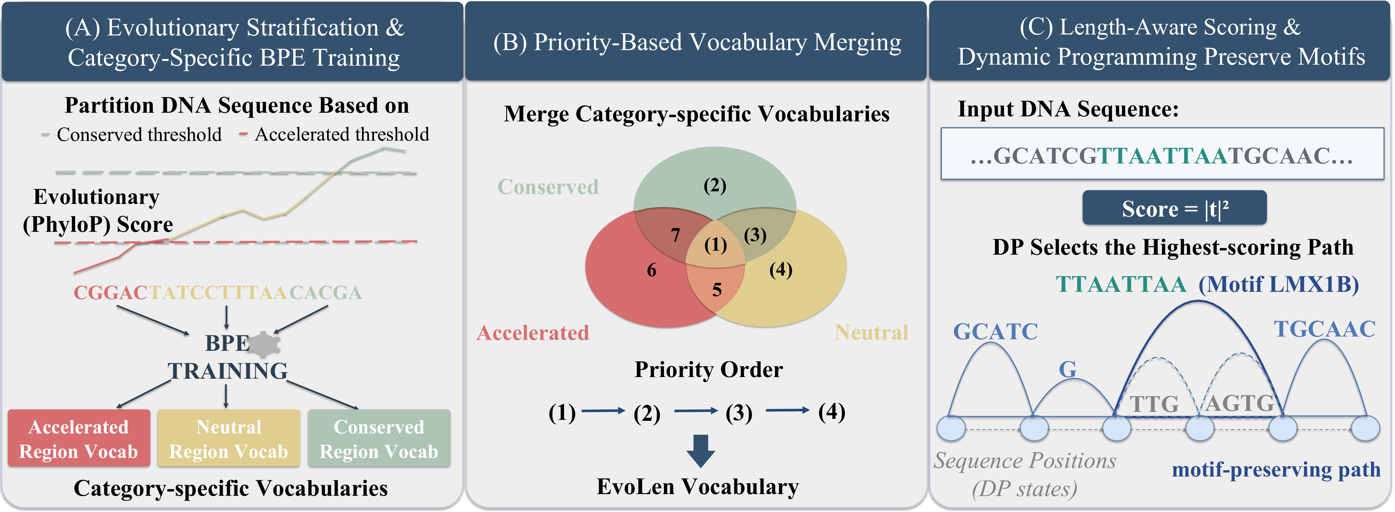
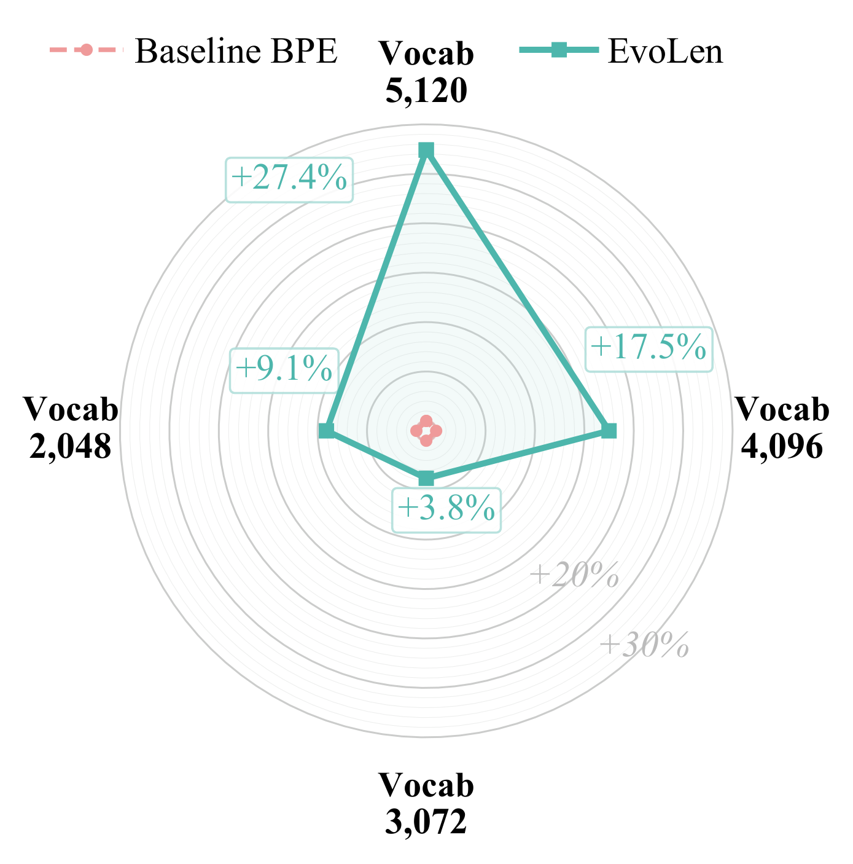
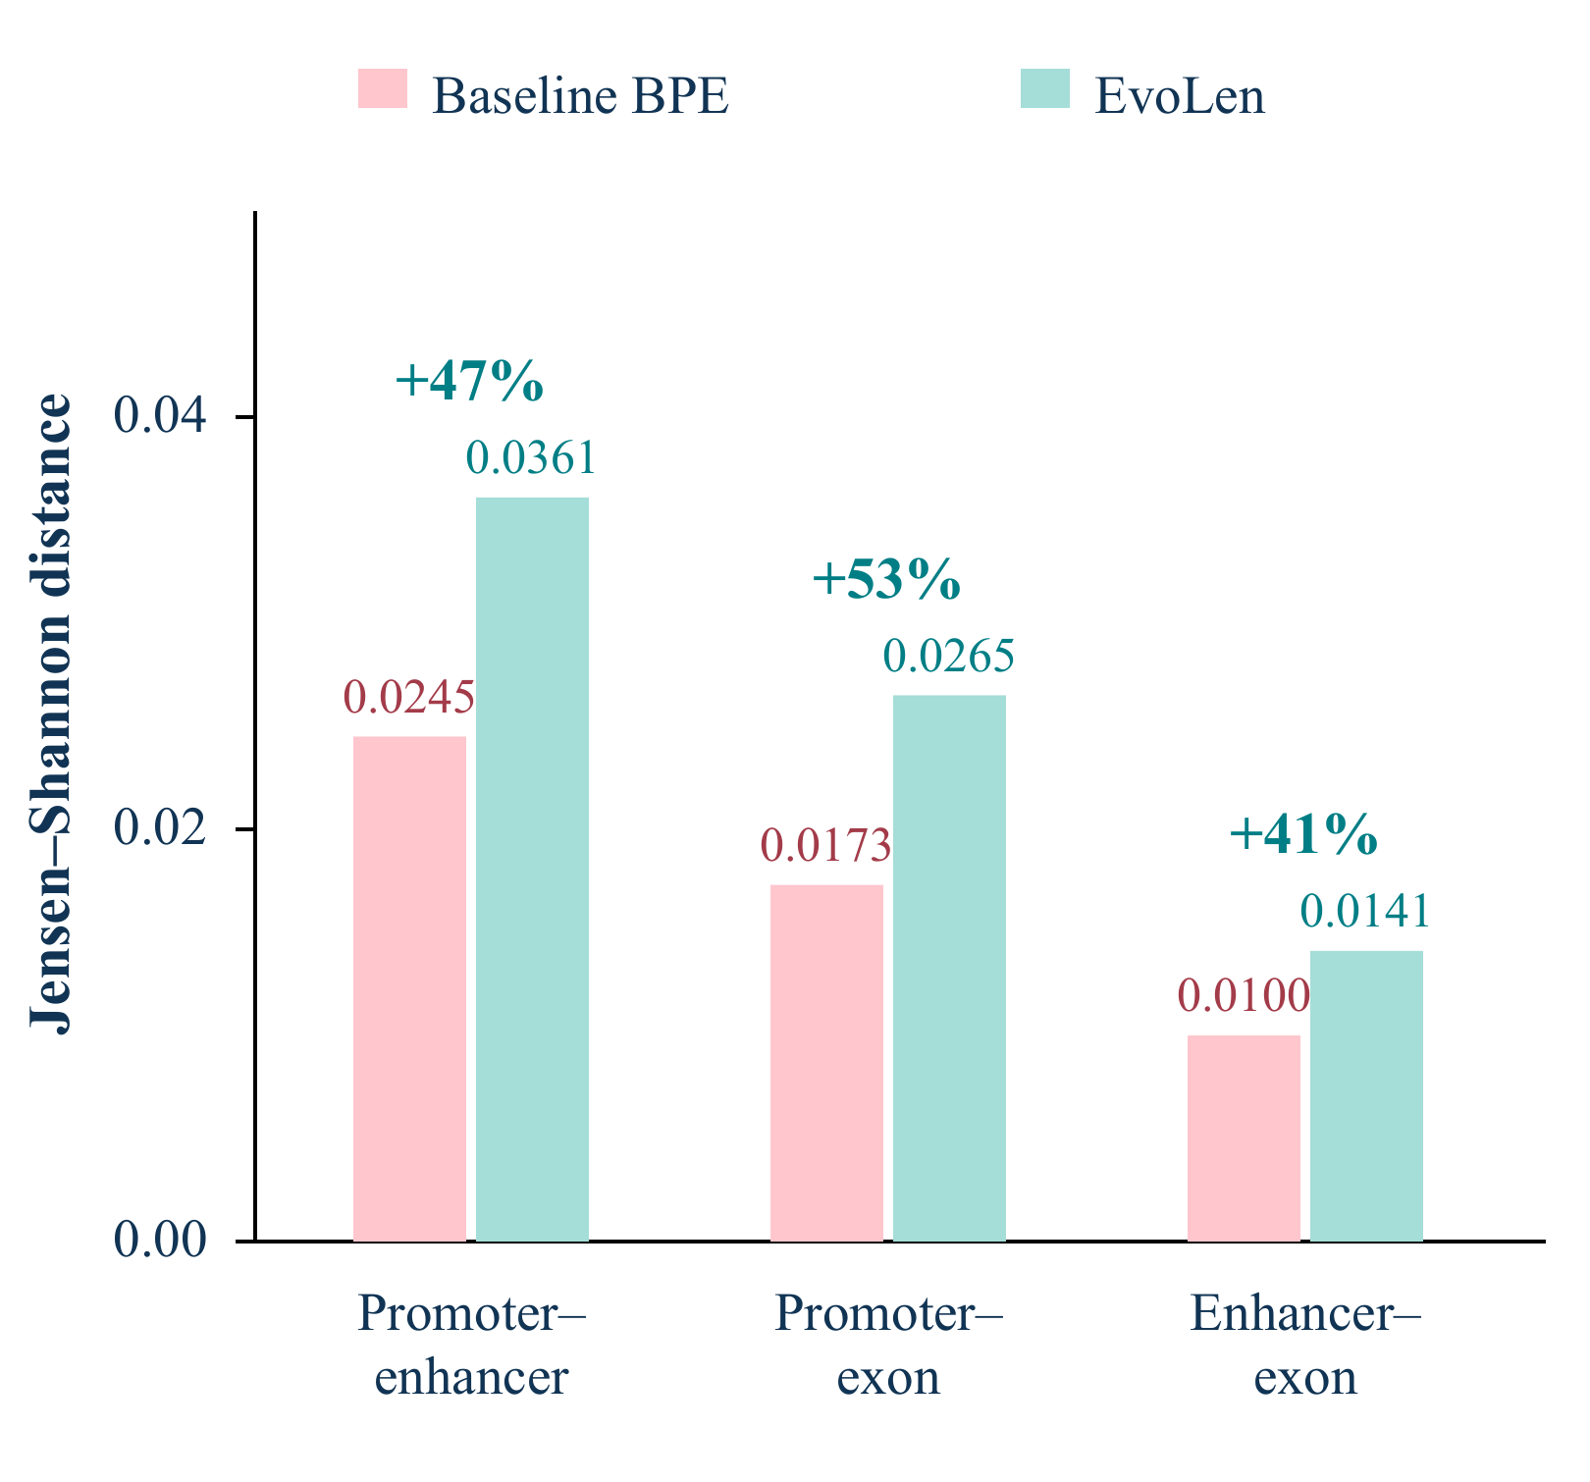
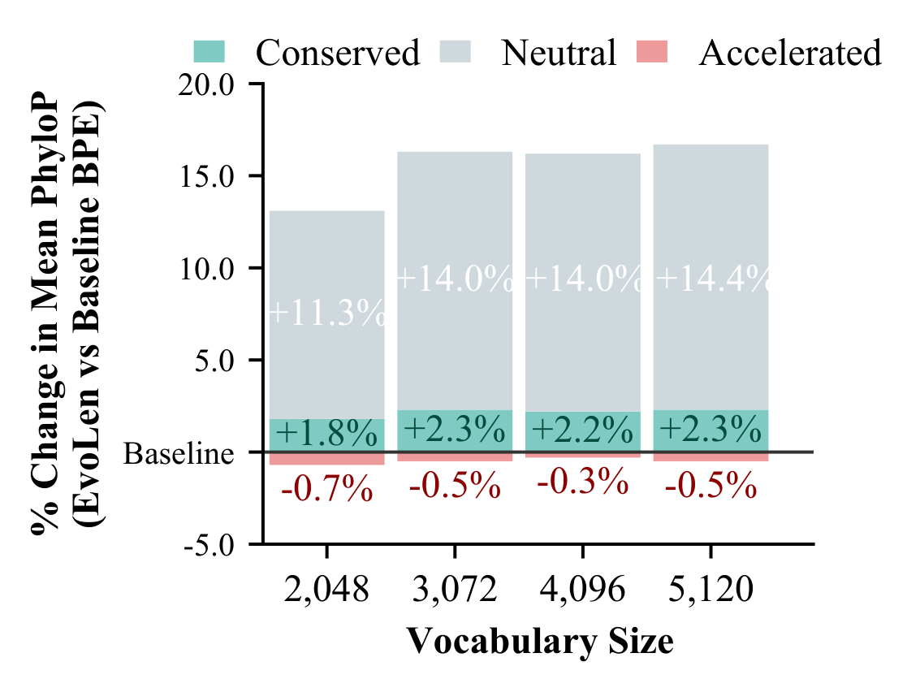
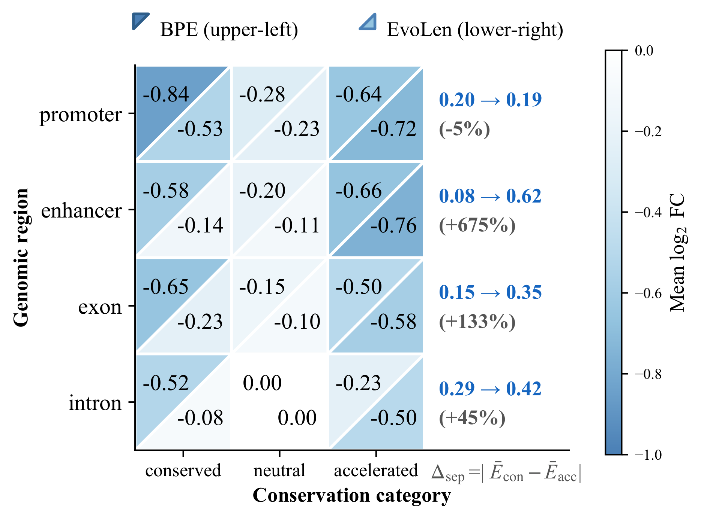

EvoLen: Evolution-Guided Tokenization for DNA Language Model
Nan Huang¹, Xiaoxiao Zhou², Junxia Cui¹, Mario Tapia-Pacheco¹, Tiffany Amariuta¹, Yang E. Li²*, Jingbo Shang¹*
¹ University of California, San Diego · ² Washington University in St. Louis · * Co-corresponding authors
MOTIVATION
EVOLEN TOKENIZER
BIOLOGICAL VALIDATION
DNA has no natural
token boundaries.
Evolution-guided vocabulary · Length-aware decoding
Are the tokens more biologically meaningful?
P1 · Motif preservation
P2 · Region separation
P3 · Evolutionary alignment
BPE prioritizes sequence frequency. [2]
Can evolutionary constraint
guide better tokens?
WHAT SHOULD A
GENOMIC TOKEN PRESERVE?
P1
Functional integrity
P2
Regulatory specificity
+27.4%
+41–53%
Up to +14.4%
P3
Evolutionary consistency
P4
Pattern recurrence
Evolutionary signal: phyloP [3] · Pipeline: EvoLen [1]
JASPAR motifs [4]; vocab 5,120
Jensen–Shannon distance
Mean token phyloP
FUNCTIONAL PATTERN ANALYSIS
DOWNSTREAM PERFORMANCE
Does better tokenization improve DNA language models?
MCC (%) [1]
GUE [5]
Genomic Benchmarks
Nucleotide Transformer
Regulatory
Yeast
Mouse
Prom-300
Prom-core
Splice
TF bind
Human reg
Mouse enh
Invert.
Histone
Enhancer
Promoter
Splice
cCRE
ATAC
BPE · 100K
46.8
56.5
76.5
64.2
78.5
57.8
69.9
58.1
76.4
53.7
48.7
74.7
69.3
21.9
12.2
EvoLen · 100K
46.8
58.8
78.5
63.6
75.2
61.0
70.3
63.8
76.1
55.0
49.6
76.5
67.8
22.1
13.3
Relative gain (%)
+0.1
+4.1
+2.7
-1.0
-4.2
+5.7
+0.5
+9.8
-0.4
+2.3
+1.9
+2.5
-2.2
+1.0
+9.5
BPE · 200K
46.9
54.5
77.6
64.8
75.5
58.6
69.9
53.8
76.2
53.5
49.7
74.9
69.0
22.7
10.3
EvoLen · 200K
47.9
58.9
78.1
64.4
75.6
61.2
70.8
64.2
77.0
55.4
50.0
76.3
68.4
22.5
13.7
Relative gain (%)
+2.1
+8.1
+0.6
-0.6
+0.1
+4.4
+1.3
+19.3
+1.0
+3.6
+0.6
+1.9
-0.9
-0.9
+33.0
40 / 56 tasks improved
Mean ΔMCC +0.93 pp
95% CI [+0.34, +1.54]
p = 0.0018
P4 · Stronger context-specific functional enrichment
Aggregate: 100K vs. BPE · Same architecture and objective · Relative gains transcribed from Table 1 [1]
REFERENCES
[1] Huang et al. EvoLen: Evolution-Guided Tokenization for DNA Language Model. COLM, 2026.
[4] Rauluseviciute et al. JASPAR 2024: 20th Anniversary of the Open-access Database
[2] Sennrich et al. Neural Machine Translation of Rare Words with Subword Units. ACL, 2016.
of Transcription Factor Binding Profiles. Nucleic Acids Res., 2024.
[3] Pollard et al. Detection of Nonneutral Substitution Rates on Mammalian Phylogenies. Genome Res., 2010.
[5] Zhou et al. DNABERT-2: Efficient Foundation Model and Benchmark for Multi-Species Genome. 2023.
PAPER arXiv:2604.08698 · CODE github.com/HN020719/EvoLen
TOKENIZATION IS A BIOLOGICAL INDUCTIVE BIAS
MODELS huggingface.co/EvoLenTokenizer · n5huang@ucsd.edu
Evolution-guided tokens → better genomic modeling
Notes:
Final print size: 72 x 36 inches. This slide is half scale (36 x 18 inches): print at 200%.
Figures: supplied figures/fig1_combiend_final.pdf, fig3_pmr_radar.pdf, fig4_bar.pdf, fig5.pdf, fig6_split.pdf. Text replaced with Times New Roman in derivative assets; source files unchanged. Figure geometry and numbers preserved. Institutional logo artwork retained unchanged.
Downstream: editable transcription of the baseline and compute-matched sections of Table 1, arXiv:2604.08698v2 page 9. Relative improvements copied from the paper rather than recomputed from rounded MCC values. No downstream figure was found in figures/.
Aggregate 40/56, +0.93 pp and CI refer to 100K comparisons (section 5.1). P3 evaluates alignment with phyloP, which also informs tokenizer construction.
References transcribed from the supplied paper. The full bibliography is available in the paper.

