Slide 1

Work
master
injection

Slide 2
Finish style
injection

Slide 3
H-
Calc

Slide 4



Elements
Filtering

Slide 5
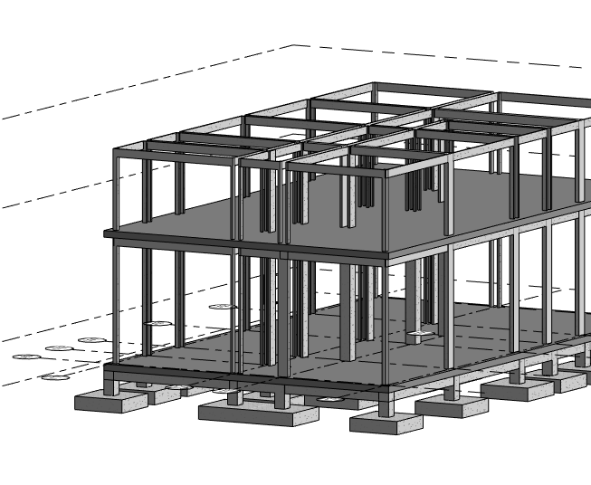
Draft
bidding model
automation

Slide 6
Draft
bidding Room Schedule
automation

Slide 7
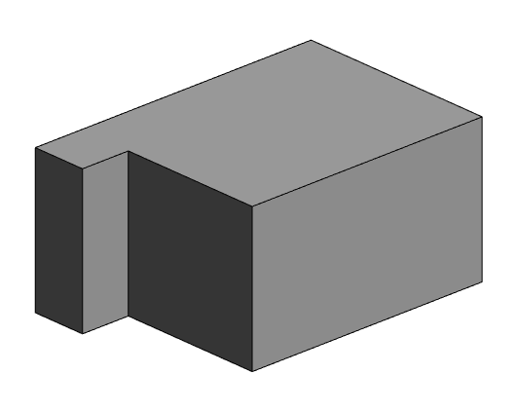
bidding Room Size
l
w
injection

Slide 8
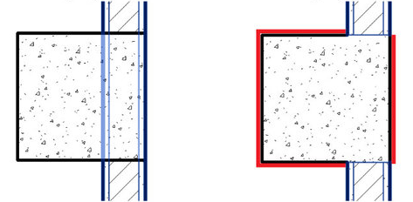
Element join order
organizer

Slide 9
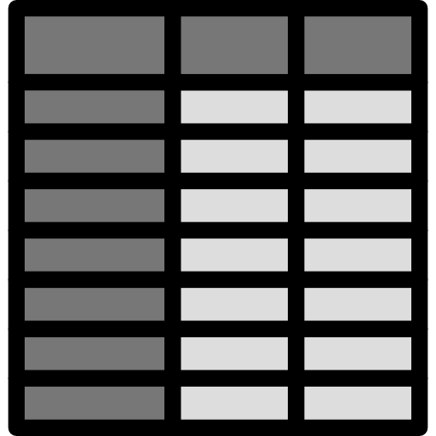
Familytype
‘
Revit
only
Revit
& Excel
‘
A type
D type
B type
E type
C type
F type
G type
CHECKER

Slide 10
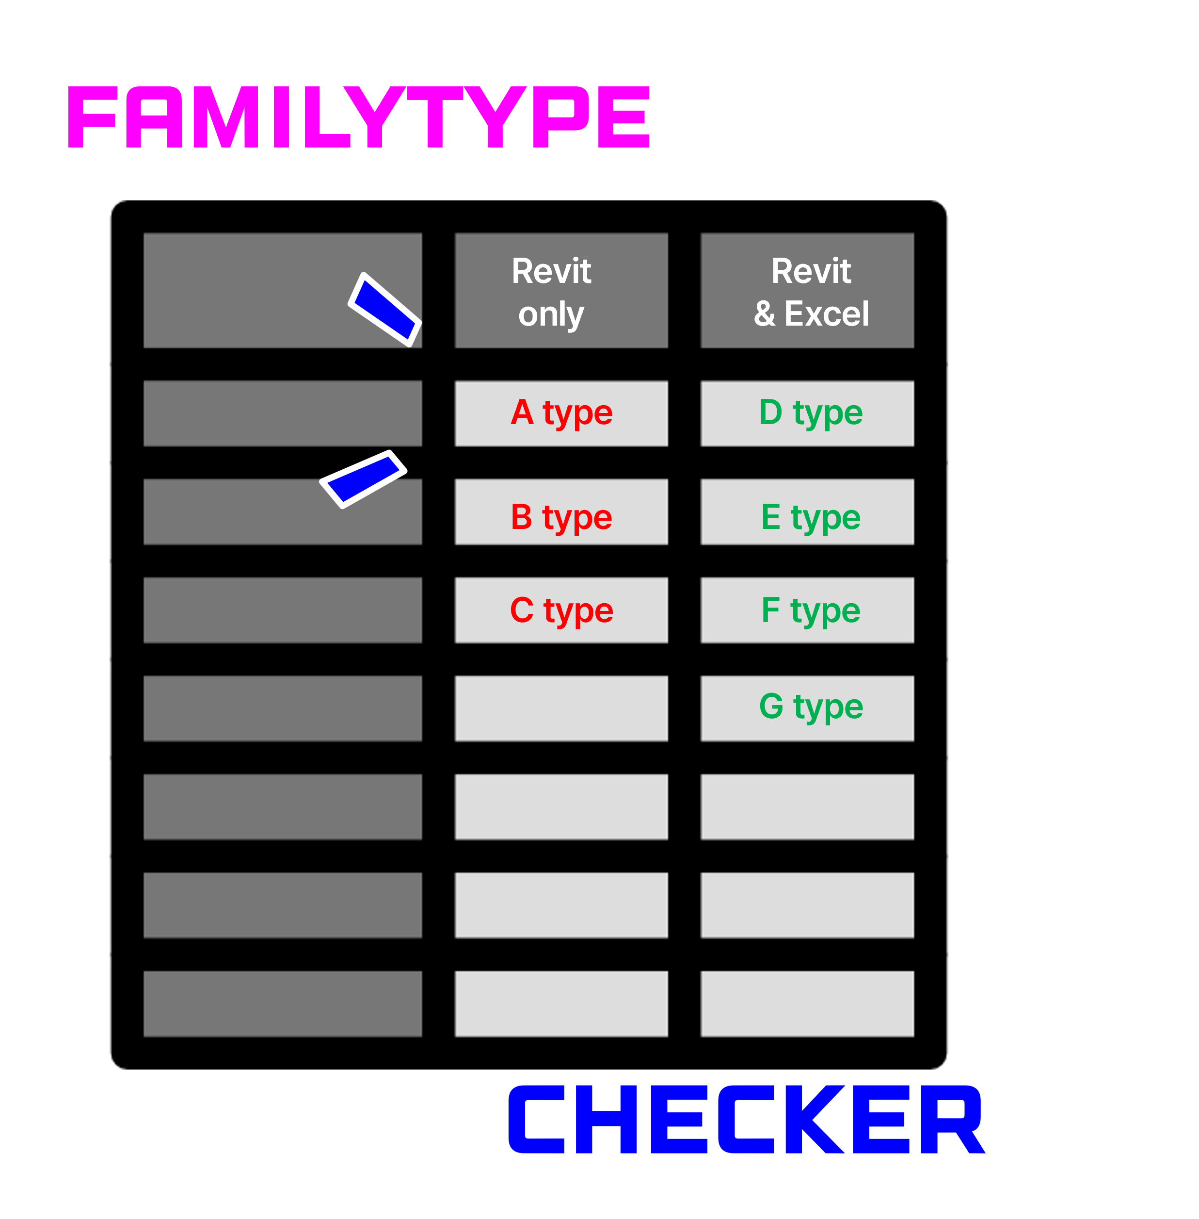

Slide 11


