Slide 1
What is BIM?
Building Information Modeling (BIM) is the holistic process of creating and managing information for a built asset. Based on an intelligent model and enabled by a cloud platform, BIM integrates structured, multi-disciplinary data to produce a digital representation of an asset across its lifecycle, from planning and design to construction and operations.

Slide 3
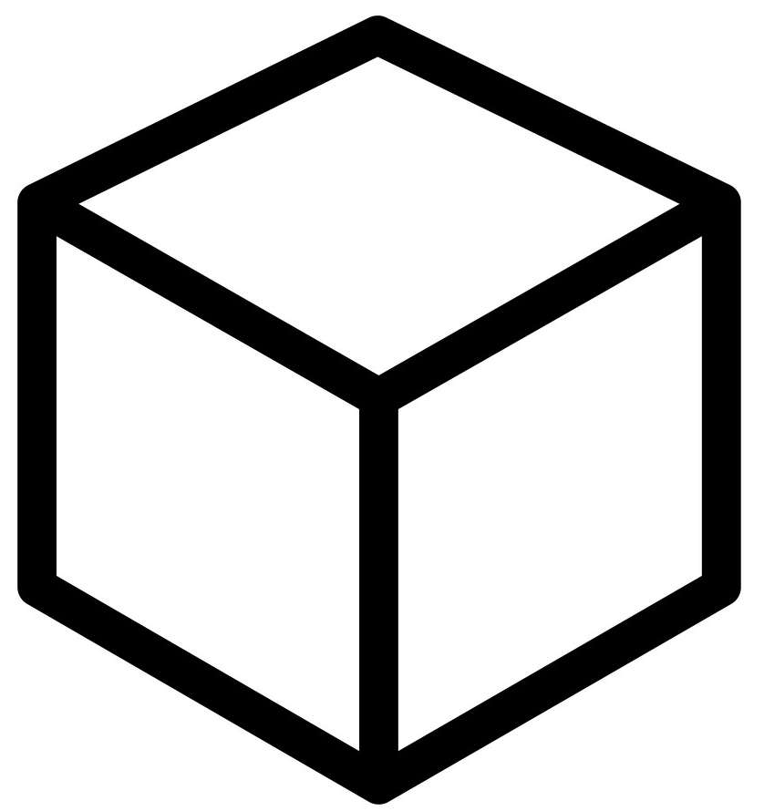
3-DIMENSIONAL MODELING
VERTEX
EDGE
FACE
LOCATION

Slide 4
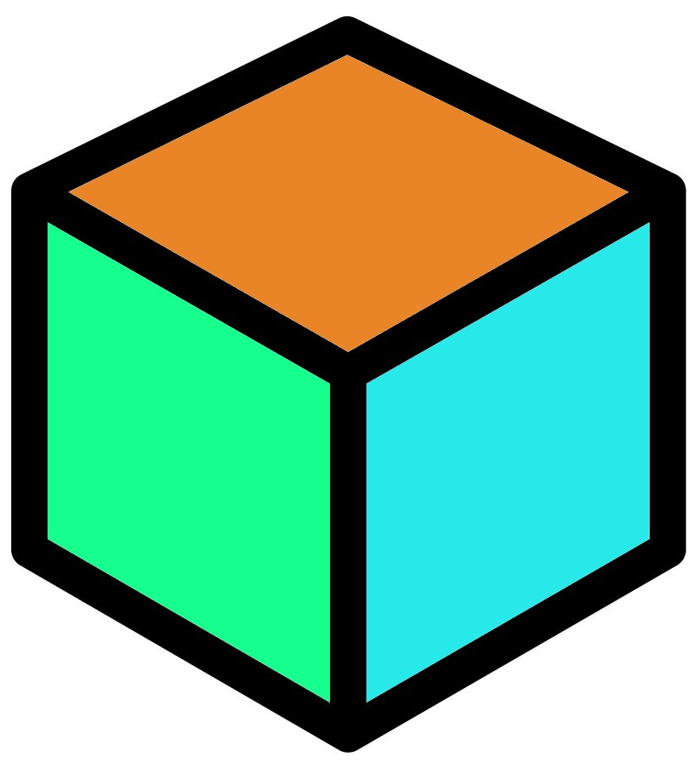
INFORMATION MODELING
BINDED INFORMATION
VERTEX
EDGE
FACE
LOCATION
WBS, CBS
CONSTRAINT CONDITION
BASE LEVEL
BASE OFFSET
SIZE
DIMENSION
COVER DEPTH
…
+

Slide 5

<in ENTIRE PROJECT>
TOTAL WBS =
BINDED WBS INFO
+
UNBINDED WBS INFO
WBS 1
WBS 4
WBS 7
WBS 2
WBS 5
WBS 8
WBS 3
WBS 6
WBS 9

Slide 6
<in ENTIRE PROJECT>
TOTAL WBS =
BINDED WBS INFO
+
UNBINDED WBS INFO
WBS 1
WBS 4
WBS 7
WBS 4
WBS 7
WBS 2
WBS 4
WBS 8
WBS 5
WBS 8
WBS 3
WBS 5
WBS 6
WBS 9
WBS 6
WBS 9

Slide 7
We have to do this.
TOTAL WBS =
BINDED WBS INFO
+
UNBINDED WBS INFO
But, How ?

Slide 8
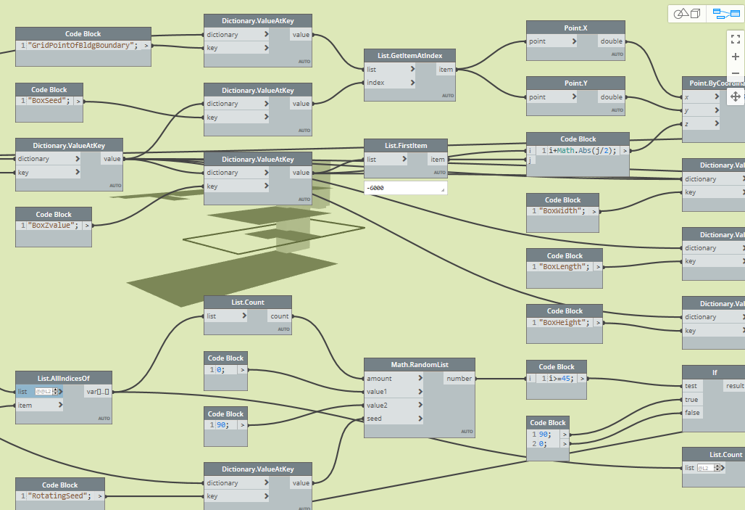
By Dynamo in Revit

