Slide 1
Plant Design Process by BIM

Slide 2
B
I
M
uilding
nformation
odeling

Slide 3


I
M
The meaning of
nformation
odeling
3-DIMENSIONAL MODELING
INFORMATION MODELING
VERTEX
EDGE
FACE
LOCATION
VERTEX
EDGE
FACE
LOCATION
+

Slide 4










Receive
Requirements
Create
Layout
Do Review
& Revise Layout
Detail Engineering
Create
Official Drawing
Calculate
Quantities
Do Review for Internal coherence

Slide 5





Receive
Requirements
Create
Layout
Do Review
& Revise Layout
Detail Engineering
Create
Official Drawing
Calculate
Quantities

Slide 6



Slide 7
For Auto Quantities Calculation

Slide 8
3-DIMENSIONAL MODELING
VERTEX
EDGE
FACE
LOCATION

Slide 9
INFORMATION MODELING
BINDED INFORMATION
VERTEX
EDGE
FACE
LOCATION
WBS, CBS
CONSTRAINT CONDITION
BASE LEVEL
BASE OFFSET
SIZE
DIMENSION
COVER DEPTH
…
+

Slide 10

<in ENTIRE PROJECT>
TOTAL WBS =
BINDED WBS INFO
+
UNBINDED WBS INFO
WBS 1
WBS 4
WBS 7
WBS 2
WBS 5
WBS 8
WBS 3
WBS 6
WBS 9

Slide 11
<in ENTIRE PROJECT>
TOTAL WBS =
BINDED WBS INFO
+
UNBINDED WBS INFO
WBS 1
WBS 4
WBS 7
WBS 4
WBS 7
WBS 2
WBS 4
WBS 8
WBS 5
WBS 8
WBS 3
WBS 5
WBS 6
WBS 9
WBS 6
WBS 9

Slide 12
We have to do this.
TOTAL WBS =
BINDED WBS INFO
+
UNBINDED WBS INFO
But, How ?

Slide 13
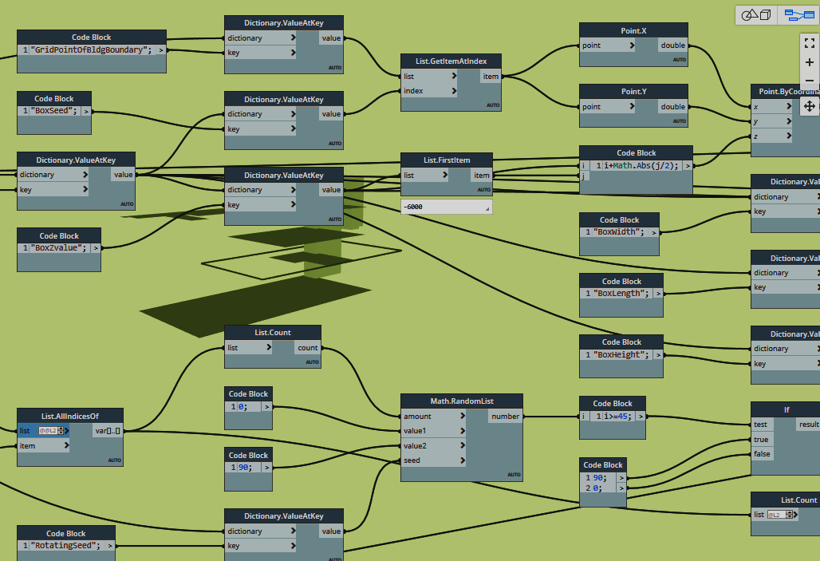
But, How ?
By Dynamo in Revit

