Slide 3
BIM
BIM
BIM
Note
Note
Note
HEC’s Plant Architecture Department
BIM Info Management Docs

Slide 4
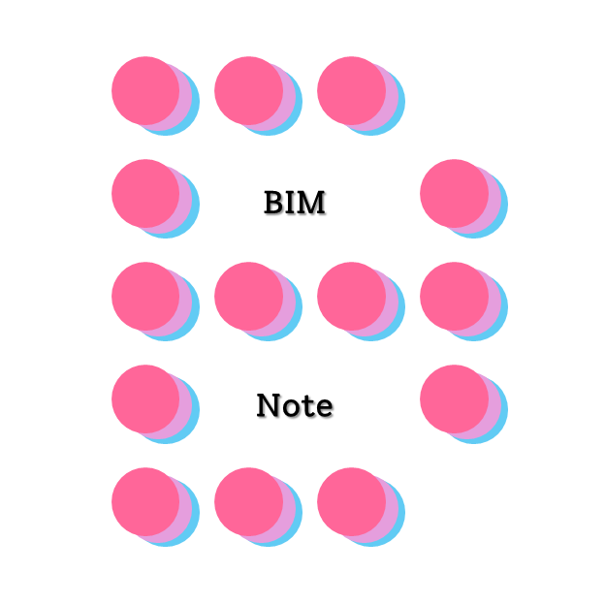

Slide 5


