Slide 1
Plant Design Process by BIM

Slide 2
B
I
M
uilding
nformation
odeling

Slide 3


I
M
The meaning of
nformation
odeling
3-DIMENSIONAL MODELING
INFORMATION MODELING
α
VERTEX
EDGE
FACE
LOCATION
VERTEX
EDGE
FACE
LOCATION
+

Slide 4










/w other dept.
Receive
Requirements
Create
Layout
Do Review
& Revise Layout
Detail Engineering
Create
Official Drawing
Calculate
Quantities
Do Review for Internal coherence
Feed Back

Slide 5





/w other dept.
Receive
Requirements
Create
Layout
Do Review
& Revise Layout
Detail Engineering
Feed Back
Create
Official Drawing
Calculate
Quantities

Slide 6
For Auto Quantities Calculation

Slide 7
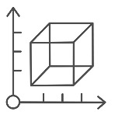
3-DIMENSIONAL MODELING
VERTEX
EDGE
FACE
LOCATION

Slide 8
INFORMATION MODELING
α = BINDED INFORMATION
VERTEX
EDGE
FACE
LOCATION
WBS, CBS
CONSTRAINT CONDITION
BASE LEVEL
BASE OFFSET
SIZE
DIMENSION
COVER DEPTH
…
+

Slide 9

<in ENTIRE PROJECT>
TOTAL WBS =
BINDED WBS INFO
+
UNBINDED WBS INFO
WBS 1
WBS 4
WBS 7
WBS 2
WBS 5
WBS 8
WBS 3
WBS 6
WBS 9

Slide 10
<in ENTIRE PROJECT>
TOTAL WBS =
BINDED WBS INFO
+
UNBINDED WBS INFO
WBS 1
WBS 4
WBS 7
WBS 4
WBS 7
WBS 2
WBS 4
WBS 8
WBS 5
WBS 8
WBS 3
WBS 5
WBS 6
WBS 9
WBS 6
WBS 9

Slide 11
We have to do this.
TOTAL WBS =
BINDED WBS INFO
+
UNBINDED WBS INFO
But, How ?

Slide 12
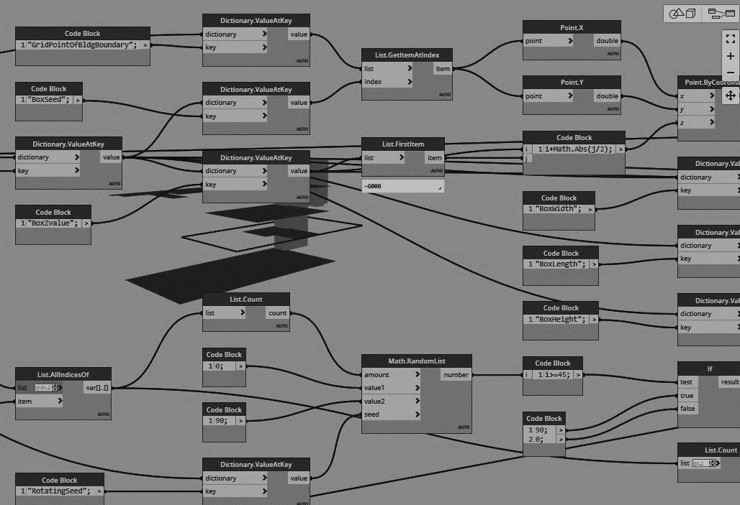
But, How ?
By Dynamo in Revit

Slide 13



Slide 14
프로그래밍에 대한 기본 지식
당연히 있으면 좋다
하지만 없어도 바로 덤벼볼 수 있다

