Slide 1
Vicksburg Campaign
30 April-4 July 1863

Slide 2
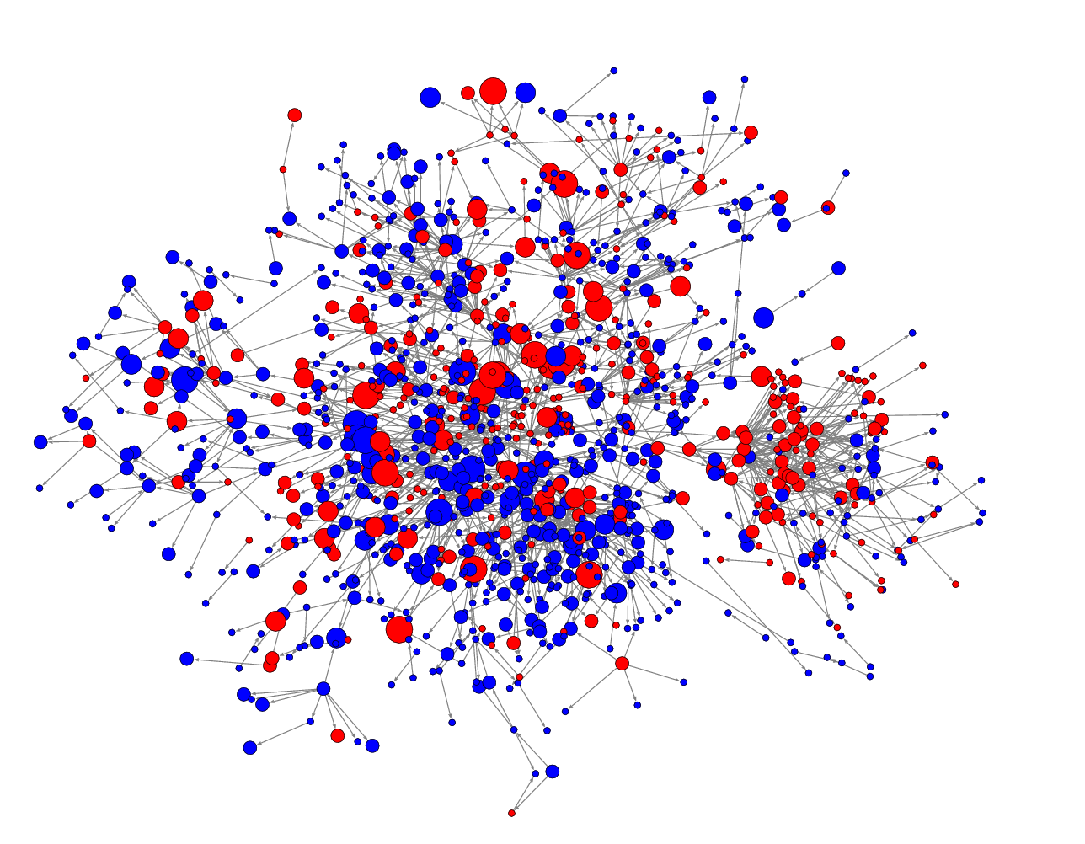
Challenge: Distill This Number of Points

Slide 3
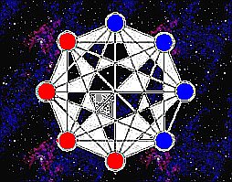
To a Manageable Number of Points

Slide 4
Command Structure

